Slide 1
Hurdle rates X: Financing weights & cost of capital
The minimum acceptable hurdle rate, at last..
Notes:
Sets the agenda for the class. This is a class that will be focused on the big picture of corporate finance rather than details, theories or models on a piecemeal basis.

Slide 2
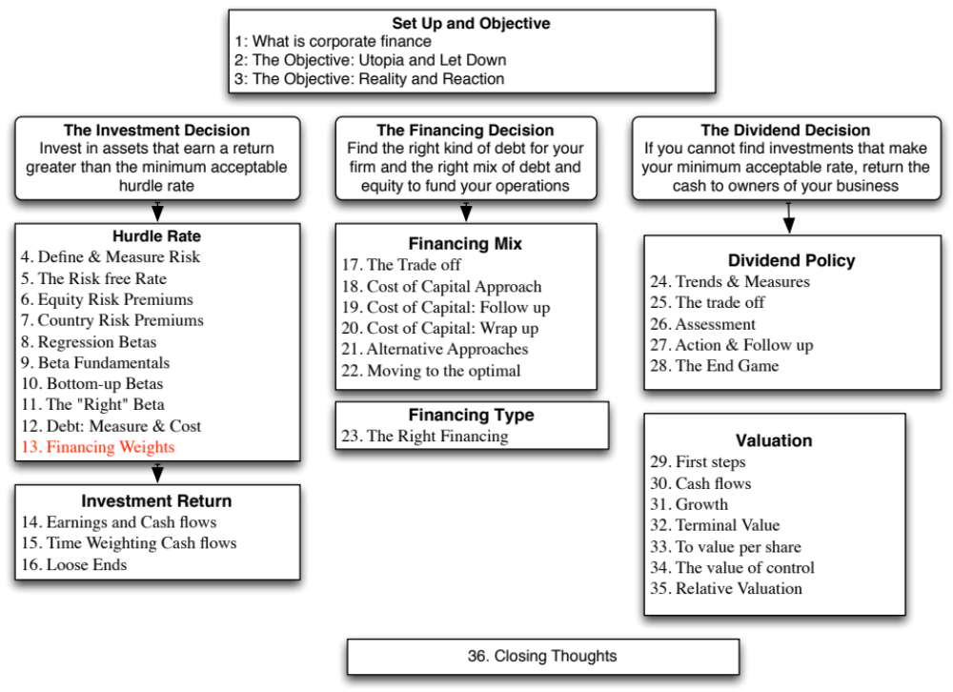

Slide 3
Weights for Cost of Capital Calculation
The weights used in the cost of capital computation should be market values.
There are three specious arguments used against market value
  Book value is more reliable than market value because it is not as volatile.
  Using book value rather than market value is a more conservative approach to estimating debt ratios.
  Since accounting returns are computed based upon book value, consistency requires the use of book value in computing cost of capital.
In practical terms, estimating the market value of equity should be easy for a publicly traded firm, but some or all of the debt at most companies is not traded. As a consequence, most practitioners use the book value of debt as a proxy for the market value of debt.
Notes:
Assume that the market value debt ratio is 10%, while the book value debt ratio is 30%, for a firm with a cost of equity of 15% and an after-tax cost of debt of 5%. The cost of capital can be calculated as follows –
With market value debt ratios: 15% (.9) + 5% (.1) = 14%
With book value debt ratios: 15% (.7) + 5% (.3) = 12%
Which is the more conservative estimate?

Slide 4
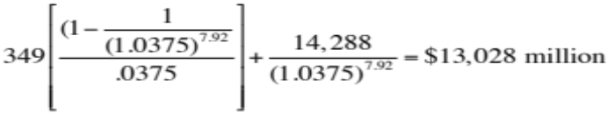
Disney: From book value to market value for interest bearing debt…
In Disney’s 2013 financial statements, the debt due over time was footnoted.
Disney’s total debt due, in book value terms, on the balance sheet is $14,288 million and the total interest expense for the year was $349 million. Using 3.75% as the pre-tax cost of debt:
Estimated MV of Disney Debt =
Time due | Amount due | Weight | Weight *Maturity
0.5 | $1,452 | 11.96% | 0.06
2 | $1,300 | 10.71% | 0.21
3 | $1,500 | 12.36% | 0.37
4 | $2,650 | 21.83% | 0.87
6 | $500 | 4.12% | 0.25
8 | $1,362 | 11.22% | 0.9
9 | $1,400 | 11.53% | 1.04
19 | $500 | 4.12% | 0.78
26 | $25 | 0.21% | 0.05
28 | $950 | 7.83% | 2.19
29 | $500 | 4.12% | 1.19
 | $12,139 |  | 7.92
Notes:
We first consolidate all of the debt outstanding and obtain an face value weighted average maturity for the debt of 7.92 years.
We then compute the market value of debt, setting the book value = face value, the interest expense = coupon, the average maturity = debt maturity and the pre-tax cost of debt based on the synthetic rating as the cost of debt.
Alternatively, we can compute the market value of each debt item separately and add up the values.

Slide 5
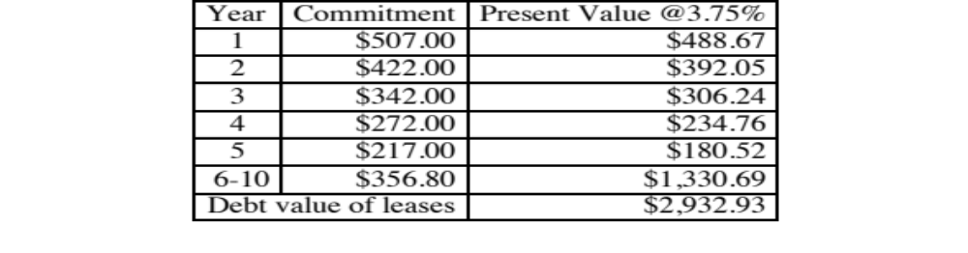
Operating Leases at Disney
The “debt value” of operating leases is the present value of the lease payments, at a rate that reflects their risk, usually the pre-tax cost of debt.
The pre-tax cost of debt at Disney is 3.75%.
Debt outstanding at Disney = $13,028 + $ 2,933= $15,961 million
Disney reported $1,784 million in commitments after year 5. Given that their average commitment over the first 5 years, we assumed 5 years @ $356.8 million each.
Notes:
The pre-tax cost of debt was based upon Disney’s current rating.
Disney reports a lump sum as the amount due after year 6…. We break it up into annual payments based upon the average lease payments over the first 5 years…You could also use the year 5 payment as the basis for making this adjustment (Putting it all in year 6 will overstate the present value).
To get to the total market value of debt, we add the estimated market value of interest bearing debt to the present value of operating leases (already a market value number since you used the current pre-tax cost of borrowing to arrive at the value).

Slide 6
6 Application Test: Estimating Market Value
Estimate the
  Market value of equity at your firm and Book Value of equity
  Market value of debt and book value of debt (If you cannot find the average maturity of your debt, use 3 years): Remember to capitalize the value of operating leases and add them on to both the book value and the market value of debt.
Estimate the
  Weights for equity and debt based upon market value
  Weights for equity and debt based upon book value
Notes:
For most firms, the book debt ratio will be much higher than the market debt ratio. Using the book debt ratio will therefore yield a lower cost of capital (which undercuts the conservatism argument used by defenders of book value weights)

Slide 7
Current Cost of Capital: Disney
Equity
  Cost of Equity = Riskfree rate + Beta * Risk Premium = 2.75% + 1.0013 (5.76%) = 8.52%
  Market Value of Equity = $121,878 million
  Equity/(Debt+Equity ) = 88.42%
Debt
  After-tax Cost of debt =(Riskfree rate + Default Spread) (1-t)
  = (2.75%+1%) (1-.361) = 2.40%
  Market Value of Debt = $13,028+ $2933 = $ 15,961 million
  Debt/(Debt +Equity) = 11.58%
Cost of Capital = 8.52%(.8842)+ 2.40%(.1158) = 7.81%
121,878/ (121,878+15,961)
Notes:
This reproduces the current cost of capital computation for Disney, using market value weights for both debt and equity, the cost of equity (based upon the bottom-up beta) and the cost of debt (based upon the bond rating)
The market value of debt is estimated by estimating the present value of total interest payments and face value at the current cost of debt.
One way to frame the capital structure question: Is there a mix of debt and equity at which Disney’s cost of capital will be lower than 7.81%?

Slide 8
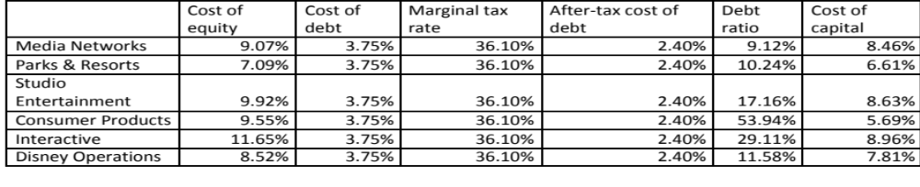
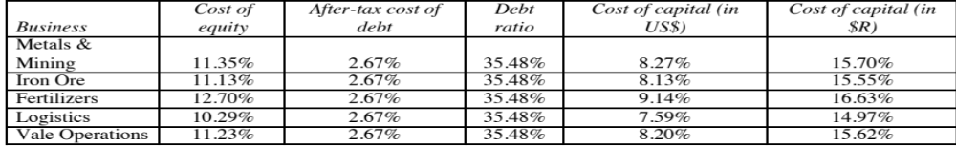
Divisional Costs of Capital: Disney and Vale
Disney
Vale
Notes:
For Disney, we used the division specific debt ratio weights we estimated earlier (when estimating the levered beta). We did assume that all divisions borrow at Disney’s pre-tax cost of debt. If the divisions issued debt independently, we would have considered using division-specific costs of debt.
For Vale, we used the same debt ratio and cost of debt for both divisions.
The cost of capital for Vale will be higher in $R, because we expect inflation to be 9% in $R and only 2% in US dollars.

Slide 9
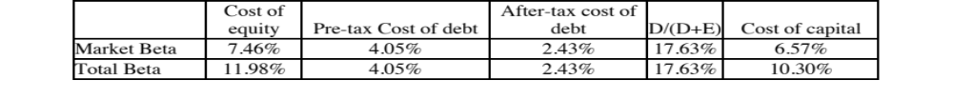
Costs of Capital: Tata Motors, Baidu and Bookscape
To estimate the costs of capital for Tata Motors in Indian rupees:
  Cost of capital= 14.49% (1-.2928) + 6.50% (.2928) = 12.15%
For Baidu, we follow the same path to estimate a cost of equity in Chinese RMB:
  Cost of capital = 12.91% (1-.0523) + 3.45% (.0523) = 12.42%
For Bookscape, the cost of capital is different depending on whether you look at market or total beta:
Notes:
For Bookscape, the cost of capital is much higher for the undiversified owner than it is for a diversified investor in a similar company.

Slide 10
6 Application Test: Estimating Cost of Capital
Using the bottom-up unlevered beta that you computed for your firm, and the values of debt and equity you have estimated for your firm, estimate a bottom-up levered beta and cost of equity for your firm.
Based upon the costs of equity and debt that you have estimated, and the weights for each, estimate the cost of capital for your firm.
How different would your cost of capital have been, if you used book value weights?
Notes:
To go from unlevered to levered betas and then to the cost of capital, you have to
Define debt and compute market value
Compute the present value of operating leases
Compute the levered beta, using the market value of equity and the consolidated market value of debt (including lease commitmetns)
Compute the cost of capital, using the debt and equity weights.

Slide 11
Choosing a Hurdle Rate
Either the cost of equity or the cost of capital can be used as a hurdle rate, depending upon whether the returns measured are to equity investors or to all claimholders on the firm (capital)
  If returns are measured to equity investors, the appropriate hurdle rate is the cost of equity.
  If returns are measured to capital (or the firm), the appropriate hurdle rate is the cost of capital.
Notes:
While the cost of equity and capital can be very different numbers, they can both be used as hurdle rates, as long as the returns and cash flows are defined consistently.
If returns and cash flows are equity based (return on equity or cash flow to equity), the appropriate hurdle rate is the cost of equity.
If returns and cash flows are firm or operating asset based (return on capital or cashflows to firm), the appropriate hurdle rate is the cost of capital.

Slide 12
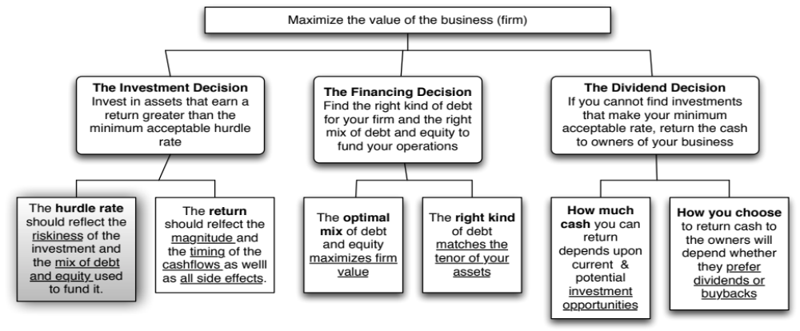
Back to First Principles
Notes:
Took us a while but we have the mechanics of the hurdle rate down..

Slide 13

Task
Estimate a cost of capital for your company (and its businesses)
Read
Chapter 4

