Slide 1
Investment returns I: setting the table
Show me the money
Notes:
Sets the agenda for the class. This is a class that will be focused on the big picture of corporate finance rather than details, theories or models on a piecemeal basis.

Slide 2
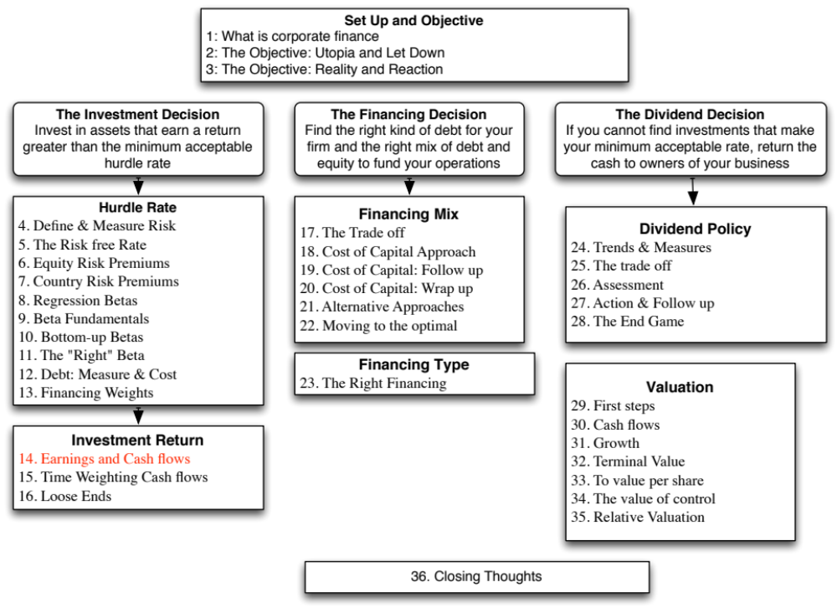

Slide 3
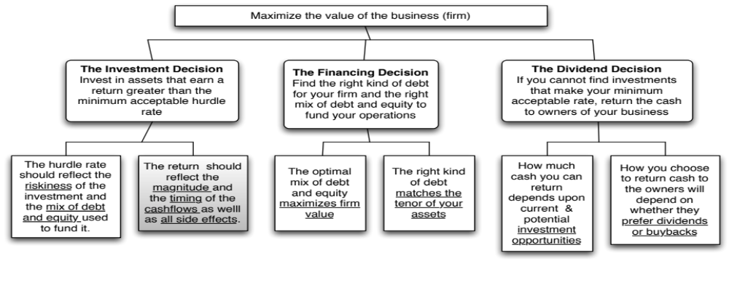
First Principles
Notes:
The next section of the notes will focus on measuring returns on investments, provide an argument for why cash flows make more sense than earnings and weighing those cash flows and discuss how best to bring in side benefits and costs into the returns.

Slide 4
Measures of return: earnings versus cash flows
Principles Governing Accounting Earnings Measurement
  Accrual Accounting: Show revenues when products and services are sold or provided, not when they are paid for.& expenses associated with these revenues
  Operating versus Capital Expenditures: Only expenses associated with creating revenues in the current period should be treated as operating expenses. Expenses that create benefits over several periods are written off over multiple periods (as depreciation or amortization)
To get from accounting earnings to cash flows:
  you add back non-cash expenses (like depreciation)
  you subtract out cash outflows which are not expensed (like capital expenditures)
  you have to make accrual revenues and expenses into cash revenues and expenses (by considering changes in working capital).
Notes:
Accrual accounting income is designed to measure the “income” made by an entity during a period, on sales made during the period. Thus, accrual accounting draws lines between operating expenses (that create income in the current period), financial expenses (expenses associated with the use of debt) and capital expenditures (which create income over multiple periods). It is not always consistent. R&D, for instance, is treated as an operating expense.
Accrual accounting also tries to allocate the cost of materials to current period revenues, leading to inventory, and give the company credit for sales made during the period, even if cash has not been received, giving rise to accounts receivable. In effect, adding in the change in working capital converts accrual earnings to cash earnings.

Slide 5
Measuring Returns Right: The Basic Principles
Use cash flows rather than earnings. You cannot spend earnings.
Use “incremental” cash flows relating to the investment decision, i.e., cashflows that occur as a consequence of the decision, rather than total cash flows.
Use “time weighted” returns, i.e., value cash flows that occur earlier more than cash flows that occur later.
The Return Mantra: “Time-weighted, Incremental Cash Flow Return”
Notes:
These are the basic financial principles underlying the measurement of investment returns.
We focus on cash flows, because when cash flows and earnings are different, cash flows provide a more reliable measure of what an investment generates.
We focus on “incremental” effects on the overall business, since we care about the overall health and value of the business, not just individual projects.
We use time-weighted returns, since returns made earlier are worth more than the same returns made later.

Slide 6
Earnings versus Cash Flows: A Disney Theme Park
The theme parks to be built near Rio, modeled on Euro Disney in Paris and Disney World in Orlando.
The complex will include a “Magic Kingdom” to be constructed, beginning immediately, and becoming operational at the beginning of the second year, and a second theme park modeled on Epcot Center at Orlando to be constructed in the second and third year and becoming operational at the beginning of the fourth year.
The earnings and cash flows are estimated in nominal U.S. Dollars.
Notes:
The earnings and cash flows will really be in Brazilian $R. We will consider later the effects of looking at all the cash flows in a different currency.
Note that this investment is not going to be fully operational until the fourth year.

Slide 7
Key Assumptions on Start Up and Construction
Disney has already spent $0.5 Billion researching the proposal and getting the necessary licenses for the park; none of this investment can be recovered. This expenditure has been capitalized and will be depreciated straight line over ten years to a salvage value of zero.
Disney will face substantial construction costs, if it chooses to build the theme parks.
  The cost of constructing Magic Kingdom will be $3 billion, with $ 2 billion to be spent right now, and $1 Billion to be spent one year from now.
  The cost of constructing Epcot II will be $ 1.5 billion, with $ 1 billion to be spent at the end of the second year and $0.5 billion at the end of the third year.
  These investments will be depreciated based upon a depreciation schedule in the tax code, where depreciation will be different each year.
Notes:
The emphasis in the second item should be on “already spent”.
While we often classify all these investments as “initial investments”, they occur over time. Companies seldom make large investments at an instant in time.
Also worth adding: Disney will fund this investment using the same mix of debt and equity that it uses for theme parks currently.

Slide 8
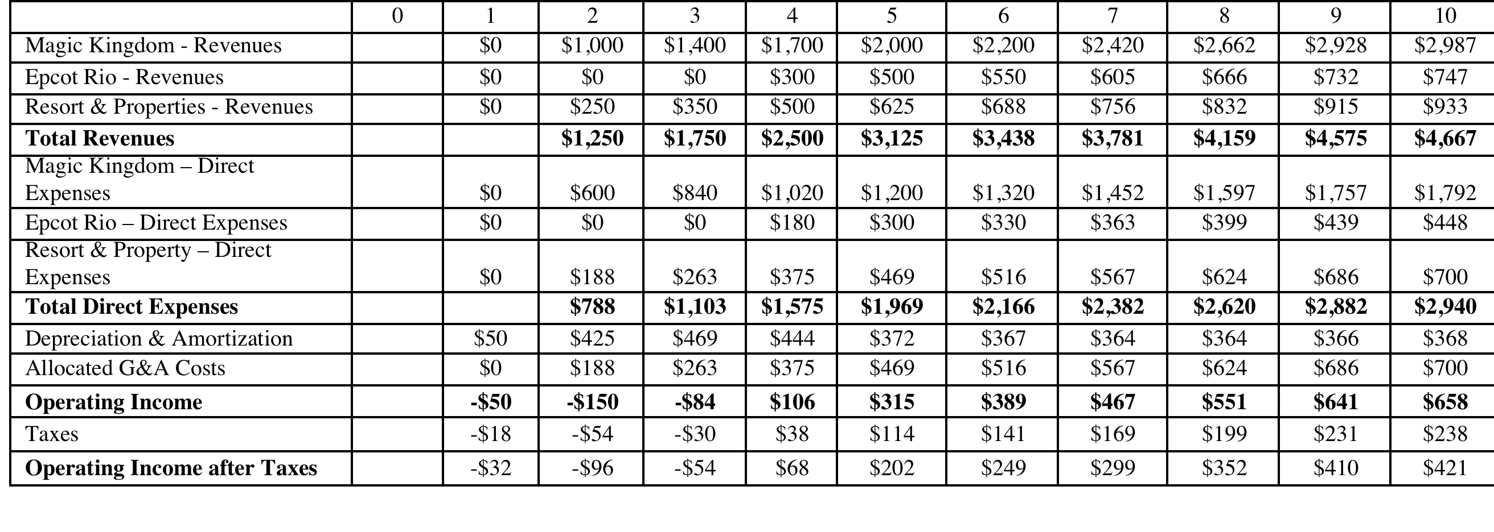
Step 1: Estimate Accounting Earnings on Project
Direct expenses: 60% of revenues for theme parks, 75% of revenues for resort properties
Allocated G&A: Company G&A allocated to project, based on projected revenues. Two thirds of expense is fixed, rest is variable.
Taxes: Based on marginal tax rate of 36.1%
Notes:
This shows the accounting earnings calculations for the next 10 years. Note the increasing after-tax operating income over time.
Note that loss in year 1. While this loss can be carried forward and offset against profits in future years, we have chosen to claim the losses against Disney’s profits from other projects in year 1. (You would rather save taxes now than the same taxes in the future…)
Where are the interest expenses? They do not show up because we are computing earnings to the firm - operating income - rather than earnings to equity - net income.

Slide 9
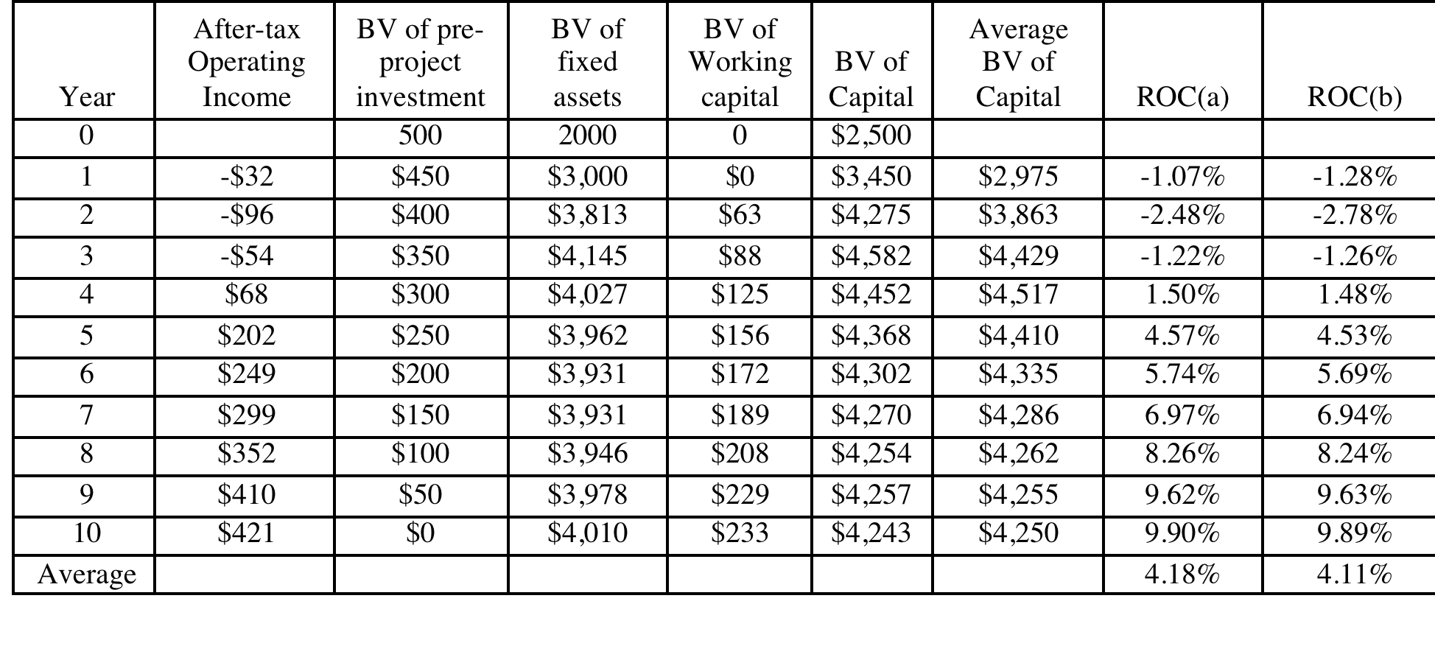
And the Accounting View of Return
Based upon book capital at the start of each year
Based upon average book capital over the year
Notes:
This converts the accounting income into a percentage return (to enable us to do the comparison to the hurdle rate, which is a percentage rate). We have computed a simple average return on capital over the next 10 years…
The average book value is computed each year using the beginning and ending book values. The book values themselves are computed as follows:
Ending BV = Beginning BV - Depreciation + Capital Expenditures

Slide 10
What should this return be compared to?
The computed return on capital on this investment is about 4%. To make a judgment on whether this is a sufficient return, we need to compare this return to a “hurdle rate”. Which of the following is the right hurdle rate? Why or why not?
  The riskfree rate of 2.75% (T. Bond rate)
  The cost of equity for Disney as a company (8.52%)
  The cost of equity for Disney theme parks (7.09%)
  The cost of capital for Disney as a company (7.81%)
  The cost of capital for Disney theme parks (6.61%)
  None of the above
Notes:
First, since we have computed return on capital, the comparison should be to the cost of capital.
Second, since it is a theme park investment, it should be the cost of capital for theme parks.
Here is the catch. This theme park is in Brazil, an emerging market. Thus, the cost of capital of 6.62% that we estimated for existing theme parks, which are in developed markets, may be too low.

Slide 11
Should there be a risk premium for foreign projects?
The exchange rate risk should be diversifiable risk (and hence should not command a premium) if the investors in the company are globally diversified.
The same diversification argument can also be applied against some political risk, which would mean that it too should not affect the discount rate. However, there are aspects of political risk especially in emerging markets that will be difficult to diversify and may affect the cash flows, by reducing the expected life or cash flows on the project.
For Disney, with globally diversified investors, exchange rate risk should not affect discount rates but political risk should.
Notes:
This will depend upon the company. Smaller companies, with higher insider holdings, should be more likely to assess higher discount rates for expanding overseas. Larger companies, with more diverse stockholdings, should be more inclined to use the same discount rates they use in the domestic market.

Slide 12
Estimating a hurdle rate for Rio Disney
We did estimate a cost of capital of 6.61% for the Disney theme park business, using a bottom-up levered beta of 0.7537 for the business. This cost of equity may not adequately reflect the additional risk associated with the theme park being in an emerging market.
We first computed the Brazil country risk premium (by multiplying the default spread for Brazil by the relative equity market volatility) and then re-estimated the cost of equity:
  Country risk premium for Brazil = 5.5%+ 3% = 8.5%
  Cost of Equity in US$= 2.75% + 0.7537 (8.5%) = 9.16%
Using this estimate of the cost of equity, Disney’s theme park debt ratio of 10.24% and its after-tax cost of debt of 2.40% (see chapter 4), we can estimate the cost of capital for the project:
  Cost of Capital in US$ = 9.16% (0.8976) + 2.40% (0.1024) = 8.46%
Notes:
Here is the other half of the equation:
The hurdle rate for an investment should reflect its risk. (That is why we use the bottom-up beta that we estimated for theme parks earlier rather than the bottom-up beta for Disney as a company). In addition, the exposure to country risk is incorporated into the investment.
We use Disney’s theme park debt ratio for this theme park, on the assumption that it is not a stand-alone investment with its own debt capacity. If it were, we would have considered using project specific financing weights. (It is usually not a good idea to compute the cost of capital for a project based on how it is financed, since firms can use disproportionate amounts of debt on some projects not because the projects can afford to carry debt but because they (the firms) have excess debt capacity.

Slide 13
Would lead us to conclude that...
Do not invest in this park. The return on capital of 4.18% is lower than the cost of capital for theme parks of 8.46%; This would suggest that the project should not be taken.
Given that we have computed the average over an arbitrary period of 10 years, while the theme park itself would have a life greater than 10 years, would you feel comfortable with this conclusion?
  Yes
  No
Notes:
I would not. I think the accounting return, which cuts off the analysis arbitrarily after 10 years, understates the true return on projects like this one, which have longer expected lives.
In general, while firms claim that using the same life for all projects is not discriminatory, it clearly creates a bias against longer term projects.

Slide 14
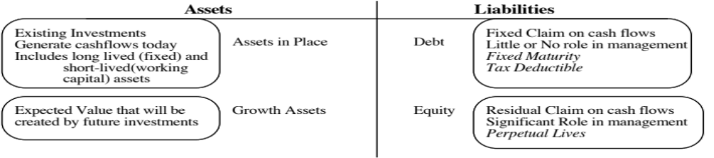
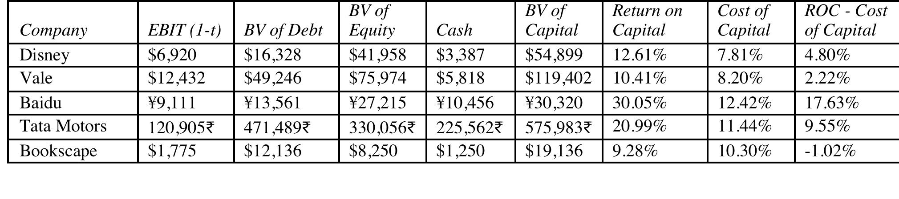
A Tangent: From New to Existing Investments: ROC for the entire firm
How “good” are the existing investments of the firm?
Measuring ROC for existing investments..
Notes:
A firm can be viewed as having a portfolio of existing projects. This approach allows you to assess whether that portfolio is earning more than the hurdle rate, but it is based upon the following assumptions:
Accounting earnings are a good measure of the earnings from current projects (They might not be, if items like R&D, which are really investments for the future, extraordinary profits or losses, or accounting changes affect the reported income.)
The book value of capital is a good measure of what is invested in current projects.
Some computational details:
Why do we use book value of debt and equity?
Because we want to focus on capital invested in assets in place. Market value has two problems. It includes growth assets and it updates the value to reflect returns earned. In fact, if you computed market value of just assets in place correctly, you should always earn your cost of capital.
Why end of last year?
To stay consistent with end-of-the-year cash flows and earnings that we use in the rest of the analysis. If we used mid-year conventions, we could use average values instead.

Slide 15
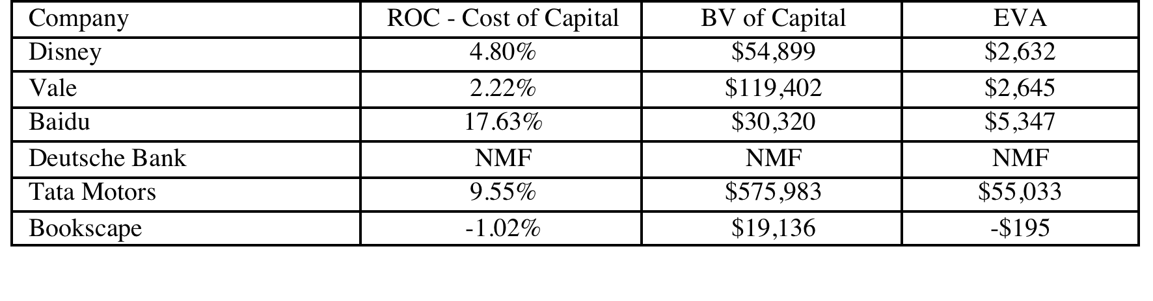
Old wine in a new bottle.. Another way of presenting the same results…
The key to value is earning excess returns. Over time, there have been attempts to restate this obvious fact in new and different ways. For instance, Economic Value Added (EVA) developed a wide following in the the 1990s:
EVA = (ROC – Cost of Capital ) (Book Value of Capital Invested)
The excess returns for the four firms can be restated as follows:
Notes:
The EVA is a measure of dollar value created in a single time period. Thus, it will be affected by how capital is measured and the ups and downs of year-to-year operating income.
EVA just restates the excess returns (ROC – Cost of capital) in dollar value terms. Thus, it will always have the same sign as the excess return, but it will be larger for larger companies. Thus, you cannot compare the EVA across companies but you can compare the EVA for the same company from year to year.

Slide 16
6 Application Test: Assessing Investment Quality
For the most recent period for which you have data, compute the after-tax return on capital earned by your firm, where after-tax return on capital is computed to be
After-tax ROC = EBIT (1-tax rate)/ (BV of debt + BV of Equity-Cash)_{previous year}
For the most recent period for which you have data, compute the return spread earned by your firm:
Return Spread = After-tax ROC - Cost of Capital
For the most recent period, compute the EVA earned by your firm
EVA = Return Spread * ((BV of debt + BV of Equity-Cash)_{previous year}
Notes:
This measure of investment quality is only as good as the measures of operating income and book value that go into it.
Note also that:
A negative EVA in a single period should not be taken as an indicator that the company is a bad or poorly managed company. It may reflect the fact that the firm had a bad year or that macro economic variables conspired to reduce operating income in that period (a recession for a cyclical firm, a downturn in commodity prices for a commodity company).
Even a string of negative EVAs may not be an indicator of a poorly run firm or business. Young businesses and infrastructure companies often have negative EVAs for extended periods (while they are building up infrastructure) before they turn positive.

Slide 17

Task
Estimate the return differential (ROIC-WACC) earned by your company
Read
Chapter 5,6

