Slide 1
Investment returns III: Loose ends
No garnishing allowed in investment analysis.
Notes:
Sets the agenda for the class. This is a class that will be focused on the big picture of corporate finance rather than details, theories or models on a piecemeal basis.

Slide 2
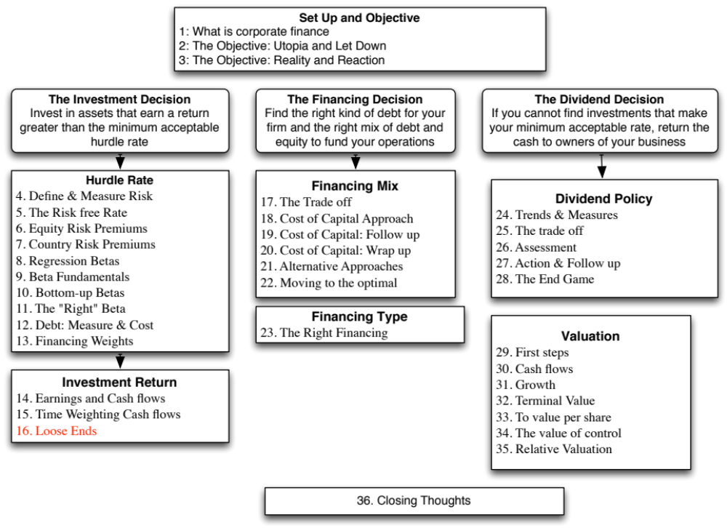

Slide 3
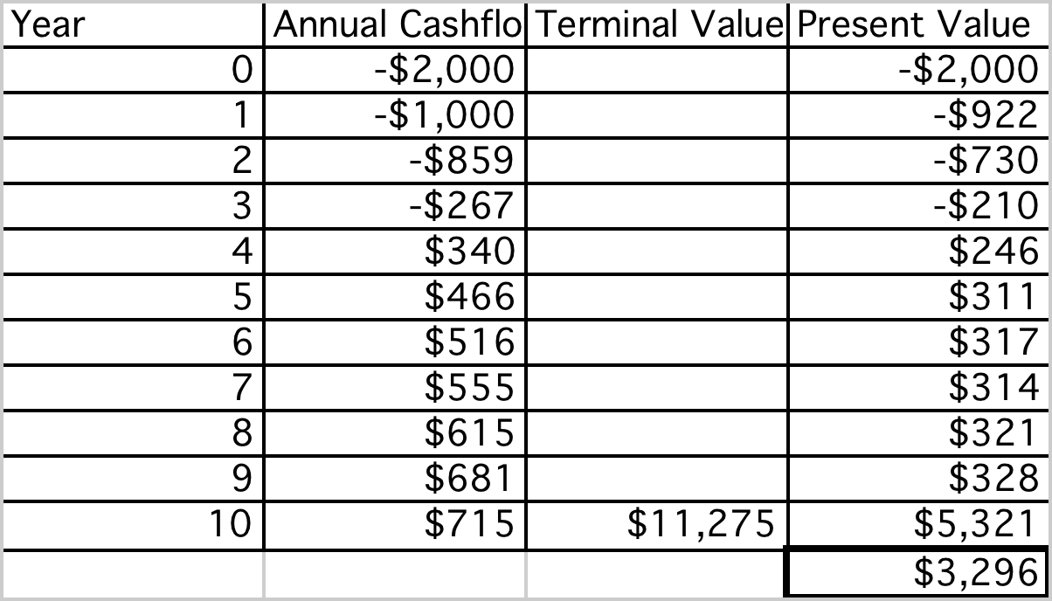
Rio Disney: The US Dollar Assessment
Discounted at Rio Disney cost of capital of 8.46%
Notes:
This is the net present value calculation using the cost of capital of 8.62%, the theme park cost of capital adjusted for emerging market risk in Brazil.

Slide 4
Does the currency matter?
The analysis was done in dollars. Would the conclusions have been any different if we had done the analysis in Brazilian Reais?
  Yes
  No
Notes:
No. It should not. A good project should be good in any currency. But showing this in practice requires us to make some key assumptions about how exchange rates will evolve over time.

Slide 5
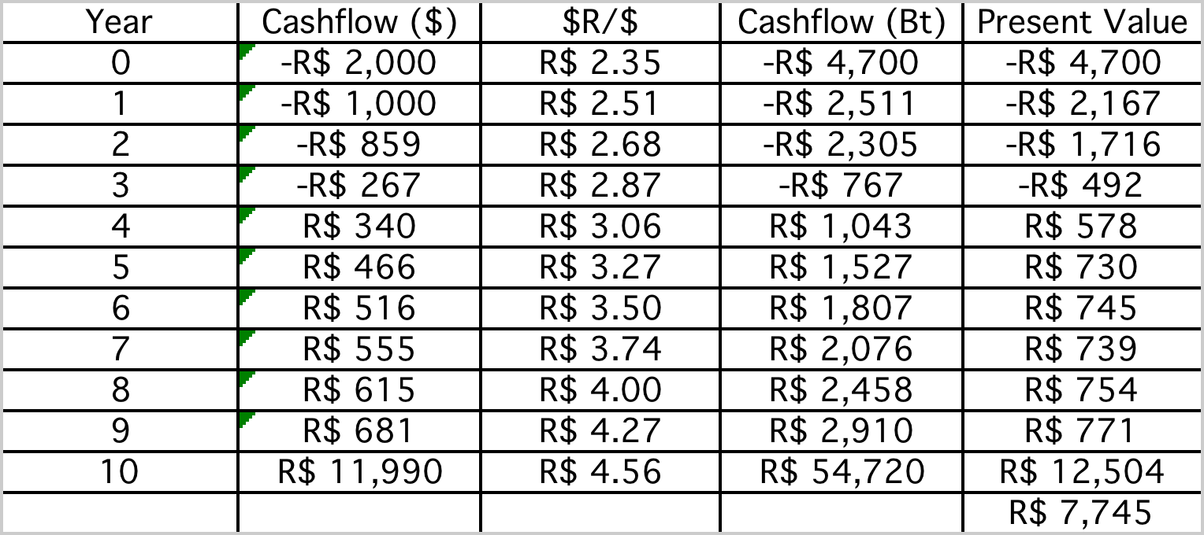
Disney Theme Park: $R NPV
  Expected Exchange Rate_{t}
  = Exchange Rate today * (1.09/1.02)^{t}
Discount at $R cost of capital
= (1.0846) (1.09/1.02) – 1 = 15.91%
NPV = R$ 7,745/2.35= $ 3,296 Million
NPV is equal to NPV in dollar terms
Notes:
The NPV is identical because what we lose by using a higher discount rate is exactly offset by what we gain in growth in the cash flows.
If you are not consistent about estimating the cash flows and the discount rates, the net present values may deviate but only because you have brought your point of view on the currency into the analysis.

Slide 6
Uncertainty in Project Analysis: What can we do?
Based on our expected cash flows and the estimated cost of capital, the proposed theme park looks like a very good investment for Disney. Which of the following may affect your assessment of value?
  Revenues may be over estimated (crowds may be smaller and spend less)
  Actual costs may be higher than estimated costs
  Tax rates may go up
  Interest rates may rise
  Risk premiums and default spreads may increase
  All of the above
How would you respond to this uncertainty?
  Will wait for the uncertainty to be resolved
  Will not take the investment
  Ignore it.
  Other
Notes:
All of the above will affect the actual value of the project. However, note that if your estimates are unbiased, there should be almost a good a chance that the outcome will be better than expected rather than worse than expected.
The uncertainty will never be resolved (new uncertainties will creep up) and if you do wait, you will never invest. The only two choices are to ignore it, arguing that the discount rate already reflects your uncertainty or to try to at least get a better handle on uncertainty before you make your final decision.

Slide 7
One simplistic solution: See how quickly you can get your money back…
Look at the payback, i.e., how quickly you make your initial investment back.
Year | Cash Flow | Cumulated CF | PV of Cash Flow | Cumulated DCF
0 | -$2,000 | -$2,000 | -$2,000 | -$2,000
1 | -$1,000 | -$3,000 | -$922 | -$2,922
2 | -$859 | -$3,859 | -$730 | -$3,652
3 | -$267 | -$4,126 | -$210 | -$3,862
4 | $340 | -$3,786 | $246 | -$3,616
5 | $466 | -$3,320 | $311 | -$3,305
6 | $516 | -$2,803 | $317 | -$2,988
7 | $555 | -$2,248 | $314 | -$2,674
8 | $615 | -$1,633 | $321 | -$2,353
9 | $681 | -$952 | $328 | -$2,025
10 | $715 | -$237 | $317 | -$1,708
11 | $729 | $491 | $298 | -$1,409
12 | $743 | $1,235 | $280 | -$1,129
13 | $758 | $1,993 | $264 | -$865
14 | $773 | $2,766 | $248 | -$617
15 | $789 | $3,555 | $233 | -$384
16 | $805 | $4,360 | $219 | -$165
17 | $821 | $5,181 | $206 | $41
Payback = 10.3 years
Discounted Payback = 16.8 years
Notes:
There are some decision makers who use payback as a decision rule. In other words, any investment that pays off in less than X years is a good investment. That strikes us as dangerous for many reasons. Payback asks and answers a very narrow question, which is when you make your initial investment back. Once that happens, we lose interest in the project, no matter how large or small the cash flows are after that.
Payback does offer more promise as a risk measure, especially in long term projects where you are concerned about whether the project will last as long as you thought and the cash flows in the later years. In more practical terms, you may accept only those investments that have positive NPV and pay off in less than X years.

Slide 8
A slightly more sophisticated approach: Sensitivity Analysis & What-if Questions…
The NPV, IRR and accounting returns for an investment will change as we change the values that we use for different variables.
One way of analyzing uncertainty is to check to see how sensitive the decision measure (NPV, IRR..) is to changes in key assumptions. While this has become easier and easier to do over time, there are caveats that we would offer.
Caveat 1: When analyzing the effects of changing a variable, we often hold all else constant. In the real world, variables move together.
Caveat 2: The objective in sensitivity analysis is that we make better decisions, not churn out more tables and numbers.
  Corollary 1: Less is more. Not everything is worth varying…
  Corollary 2: A picture is worth a thousand numbers (and tables).
Notes:
It is natural to ask what-if questions about a project once an analysis is complete.
Given how easy it is today to do sensitivity analysis, it is important that we focus only on the most important variables. Doing sensitivity analysis on too many minor variables may draw attention away from the key factors underlying the conclusion.
It is probably a good idea to also focus on variables where you have some effect over the outcome. Thus, asking what will happen if competition increases and margins shrink is useful, since you may be able to increase advertising and fight off the competition but working out what will happen if the economy goes into a recession will yield little of value (unless it affects how much you borrow to fund the investment.)

Slide 9
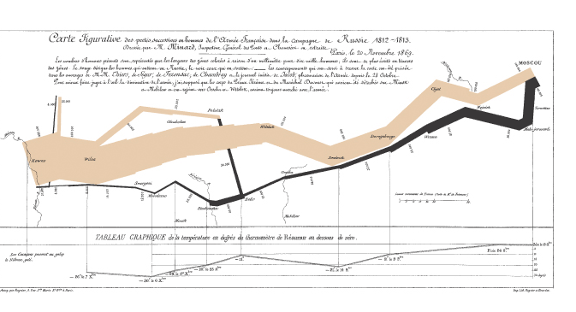
And here is a really good picture…
Notes:
A good way to show the effects of sensitivity analysis is with a graph and a good graph tells a story. This is one of my all-time favorites, from a book on charting by Edward Tufte (The Visual Display of Information)…
This graph shows the size of Napoleon’s army on his ill-fated attempt to invade Russia on one axis and the temperature on the other. It tells the story without any text… Note that the army shrinks on its way back from Moscow as temperatures drop below freezing.

Slide 10
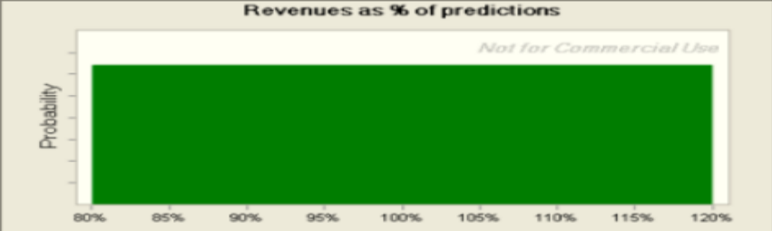
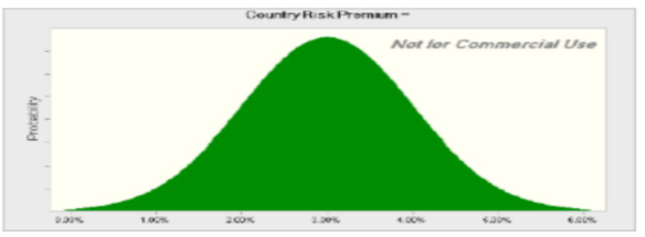
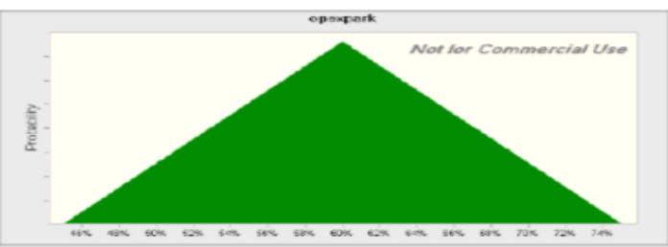
The final step up: Incorporate probabilistic estimates.. Rather than expected values..
Actual Revenues as % of Forecasted Revenues (Base case = 100%)
Country Risk Premium (Base Case = 3% (Brazil))
Operating Expenses at Parks as % of Revenues (Base Case = 60%)
Notes:
The key to doing simulations is
Picking the variables that you want to use probability distributions for (Hint: Don’t pick every input. Choose only the key inputs)
Choosing the type of distribution to use for each input (Review your probability distributions... And the paper I have on my site on how to pick the right one)
Estimating the parameters of the distribution (Use both historical and industry wide data…)

Slide 11
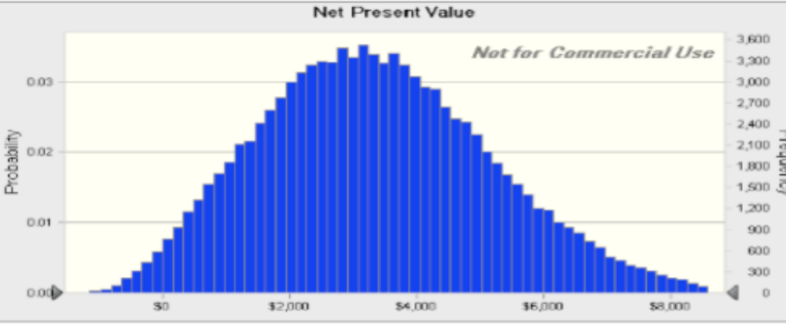
The resulting simulation…
Average = $3.40 billion
Median = $3.28 billion
NPV ranges from -$1 billion to +$8.5 billion. NPV is negative 12% of the time.
Notes:
This is the output from 100,000 simulations. I used Crystal Ball.
The average should be close to your base case value, though it will not be identical because of the distributional assumptions. The key issues are the spread in the distribution and the probability that the number is a negative value…. You also have the best and worst case scenarios embedded in the distribution.
Here are some questions that you can answer:
What is the likelihood that this is a bad investment? (A little less than 10%)
What are your best case and worst case scenarios? (About $8.5 billion and - $1 billion)
If you are planning on using risk hedging, you can see the effect on the distribution.

Slide 12
A side bar: Should you hedge risks?
Disney can reduce the risk in this project by hedging against exchange rate risk. Should it?
Yes
No
Maybe
Notes:
If it hedges exchange rate risk, the distribution of NPV will get tighter but the NPV will decrease by the cost of hedging. If the investors in Disney could have done the hedging themselves (either in the course of diversification or by hedging using derivatives), this will reduce value.

Slide 13
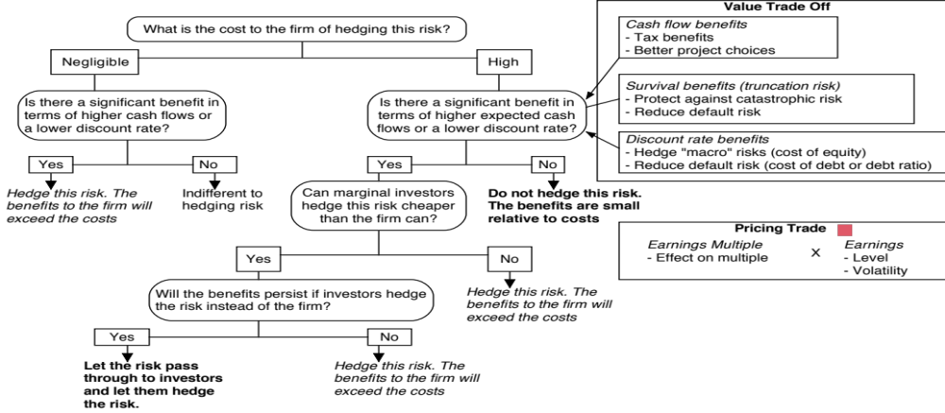
Notes:
You should hedge only after you have checked not just your options on the issue but your investors’ options.

Slide 14
A final thought: Side Costs and Benefits
Most projects considered by any business create side costs and benefits for that business.
  The side costs include the costs created by the use of resources that the business already owns (opportunity costs) and lost revenues for other projects that the firm may have.
  The benefits that may not be captured in the traditional capital budgeting analysis include project synergies (where cash flow benefits may accrue to other projects) and options embedded in projects (including the options to delay, expand or abandon a project).
The returns on a project should incorporate these costs and benefits.
Notes:
These costs and benefits should be incorporated, but that is easier said than done.
Some projects deliver most of their benefits indirectly…For instance, a Disney animated movie will often make four times as much revenue for Disney from merchandise sales and theme park revenues as it does in gate receipts. Thus, this is not a minor issue.

Slide 15
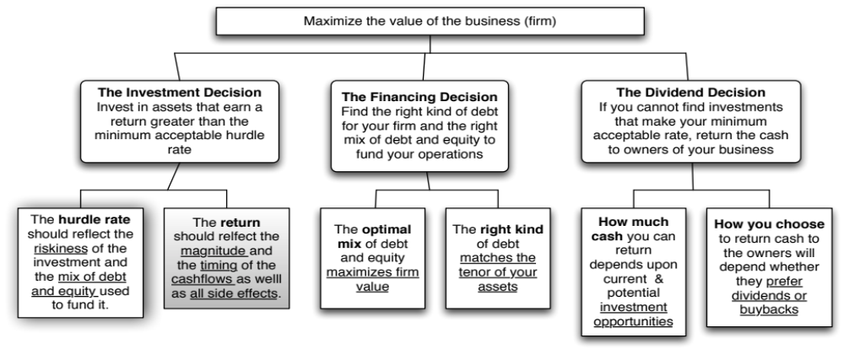
First Principles
Notes:
Reviewing the big picture…

Slide 16

Task
Draw up a risk profile for your company & make a judgment on which risks, if any, you would hedge.
Read
Chapter 6

