Slide 1
Optimal financing mix II: The cost of capital approach
It is better to have a lower hurdle rate than a higher one.
Notes:
Sets the agenda for the class. This is a class that will be focused on the big picture of corporate finance rather than details, theories or models on a piecemeal basis.

Slide 2
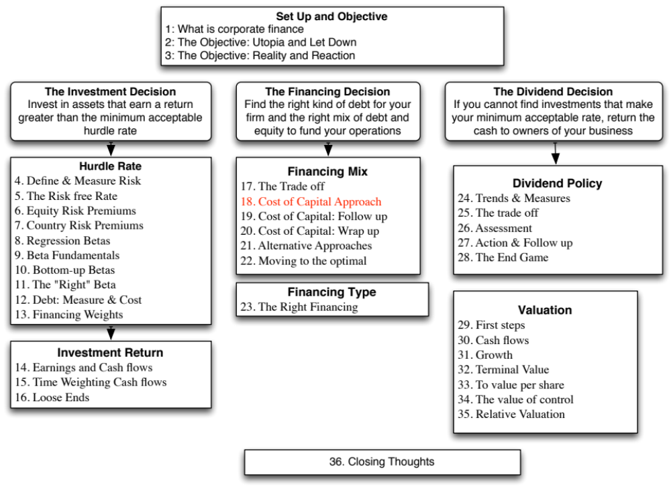

Slide 3
The Cost of Capital Approach
Value of a Firm = Present Value of Cash Flows to the Firm, discounted back at the cost of capital.
If the cash flows to the firm are held constant, and the cost of capital is minimized, the value of the firm will be maximized.
Notes:
This is the conventional valuation model for a firm.
If the cash flows are the same, and the discount rate is lowered, the present value has to go up. (The key is that cash flows have to remain the same. If this is not true, then minimizing cost of capital may not maximize firm value)

Slide 4
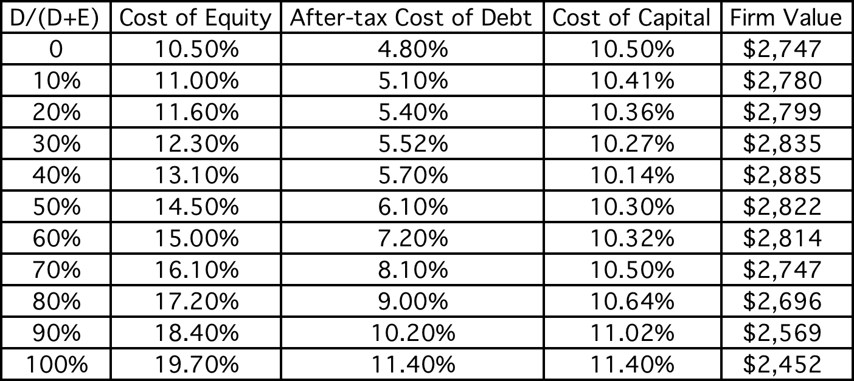
Applying Cost of Capital Approach: The Textbook Example
Notes:
This is a simple example, where both the costs of debt and equity are given. The firm has cash flows, before debt and after taxes and reinvestment, of $200 million and is in stable growth (growing 3% a year). Note that both increase as the debt ratio goes up, but the cost of capital becomes lower at least initially as you take on more debt ( because you are substituting in cheaper debt for more expensive equity)
At 40%, the cost of capital is minimized. It is the optimal debt ratio.
To get firm value, we used the same cash flow ($200 million) and same growth rate and changed the cost of capital.

Slide 5
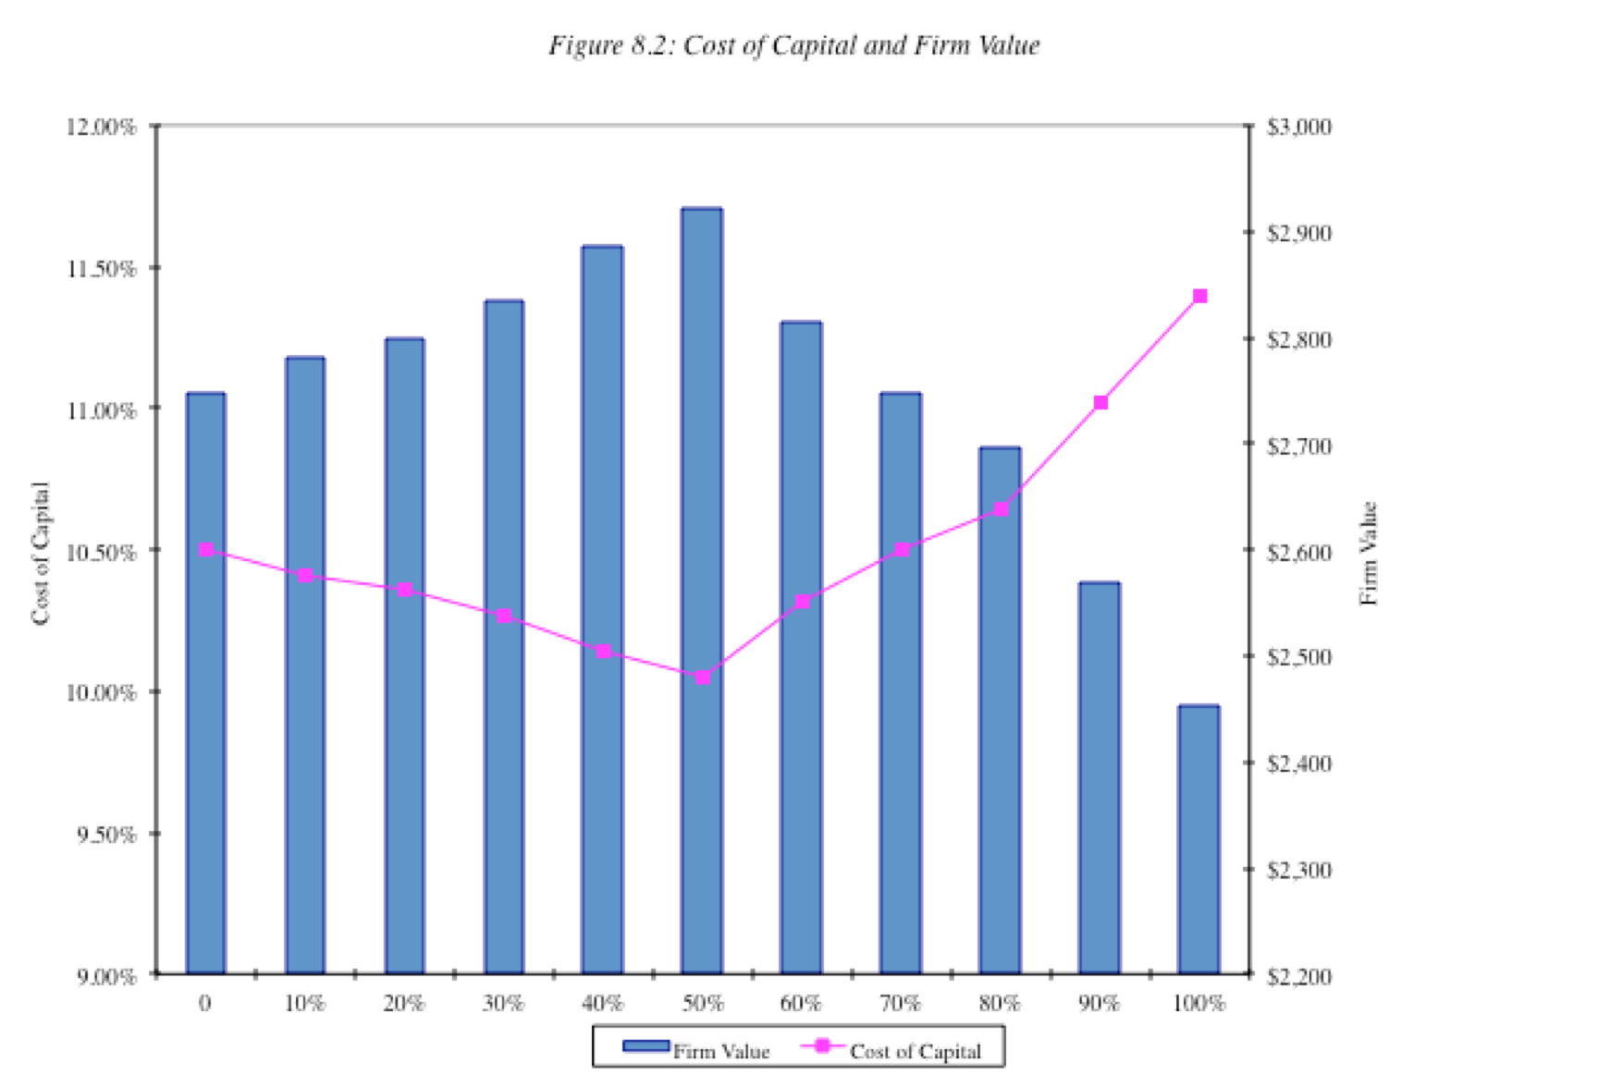
The U-shaped Cost of Capital Graph…
Notes:
Really adds nothing to the previous page.. But it is in every text book… the famous U-shaped cost of capital graph..
If you had this graph available to you, the optimal capital structure would be obvious. In most firms, all we know at the time we begin the analysis is one point on the graph - the current cost of capital. Our challenge is fleshing out the rest of the graph.

Slide 6
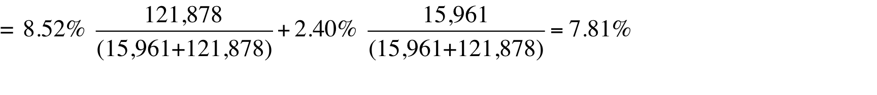
Current Cost of Capital: Disney
The beta for Disney’s stock in November 2013 was 1.0013. The T. bond rate at that time was 2.75%. Using an estimated equity risk premium of 5.76%, we estimated the cost of equity for Disney to be 8.52%:
Cost of Equity = 2.75% + 1.0013(5.76%) = 8.52%
Disney’s bond rating in May 2009 was A, and based on this rating, the estimated pretax cost of debt for Disney is 3.75%. Using a marginal tax rate of 36.1, the after-tax cost of debt for Disney is 2.40%.
After-Tax Cost of Debt = 3.75% (1 – 0.361) = 2.40%
The cost of capital was calculated using these costs and the weights based on market values of equity (121,878) and debt (15.961):
Cost of capital =
Notes:
The one point we do know for Disney…
This reproduces the current cost of capital computation for Disney, using market value weights for both debt and equity, the cost of equity (based upon the bottom-up beta) and the cost of debt (based upon the bond rating)
The market value of debt is estimated by estimating the present value of total interest payments and face value at the current cost of debt.
One way to frame the capital structure question: Is there a mix of debt and equity at which Disney’s cost of capital will be lower than 7.81%?

Slide 7
Mechanics of Cost of Capital Estimation
1. Estimate the Cost of Equity at different levels of debt:
  Equity will become riskier -> Beta will increase -> Cost of Equity will increase.
  Estimation will use levered beta calculation
2. Estimate the Cost of Debt at different levels of debt:
  Default risk will go up and bond ratings will go down as debt goes up -> Cost of Debt will increase.
  To estimating bond ratings, we will use the interest coverage ratio (EBIT/Interest expense)
3. Estimate the Cost of Capital at different levels of debt
4. Calculate the effect on Firm Value and Stock Price.
Notes:
The basic inputs for computing cost of capital are cost of equity and cost of debt. This summarizes the basic approach we will use to estimate each.

Slide 8
Laying the groundwork:
1. Estimate the unlevered beta for the firm
One approach is to use the regression beta (1.25) and then unlever, using the average debt to equity ratio (19.44%) during the period of the.
  Unlevered beta = = 1.25 / (1 + (1 - 0.361)(0.1944))= 1.1119
Alternatively, we can back to the source and estimate it from the betas of the businesses.
Business | Revenues | EV/Sales | Value of Business | Proportion of Disney | Unlevered beta | Value | Proportion
Media Networks | $20,356 | 3.27 | $66,580 | 49.27% | 1.03 | $66,579.81 | 49.27%
Parks & Resorts | $14,087 | 3.24 | $45,683 | 33.81% | 0.70 | $45,682.80 | 33.81%
Studio Entertainment | $5,979 | 3.05 | $18,234 | 13.49% | 1.10 | $18,234.27 | 13.49%
Consumer Products | $3,555 | 0.83 | $2,952 | 2.18% | 0.68 | $2,951.50 | 2.18%
Interactive | $1,064 | 1.58 | $1,684 | 1.25% | 1.22 | $1,683.72 | 1.25%
Disney Operations | $45,041 |  | $135,132 | 100.00% | 0.9239 | $135,132.11 | 100.00%
Notes:
Since we will be changing the debt ratio, we need to estimate the beta of Disney’s businesses… We can then use this unlevered beta to get to the beta at every debt ratio.

Slide 9
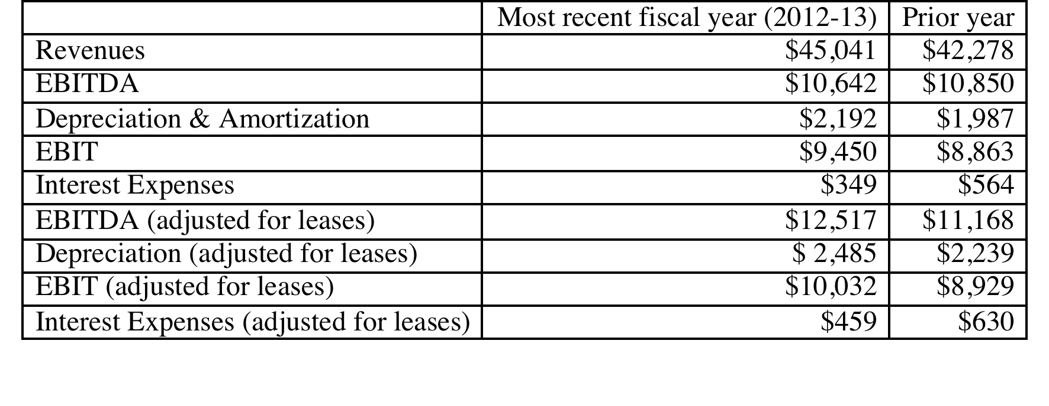
2. Get Disney’s current financials…
Notes:
This is a key step, Since you are determining your firm’s capacity to borrow long term, this is the stage at which you can modify these numbers to reflect the firm’s long term earning capacity rather than the vagaries of a single year of operations. With commodity companies, you may choose to use an average income across a commodity price cycle.
These numbers also reflect our efforts to bring leases into the financial expense column and to treat lease commitments as debt.

Slide 10
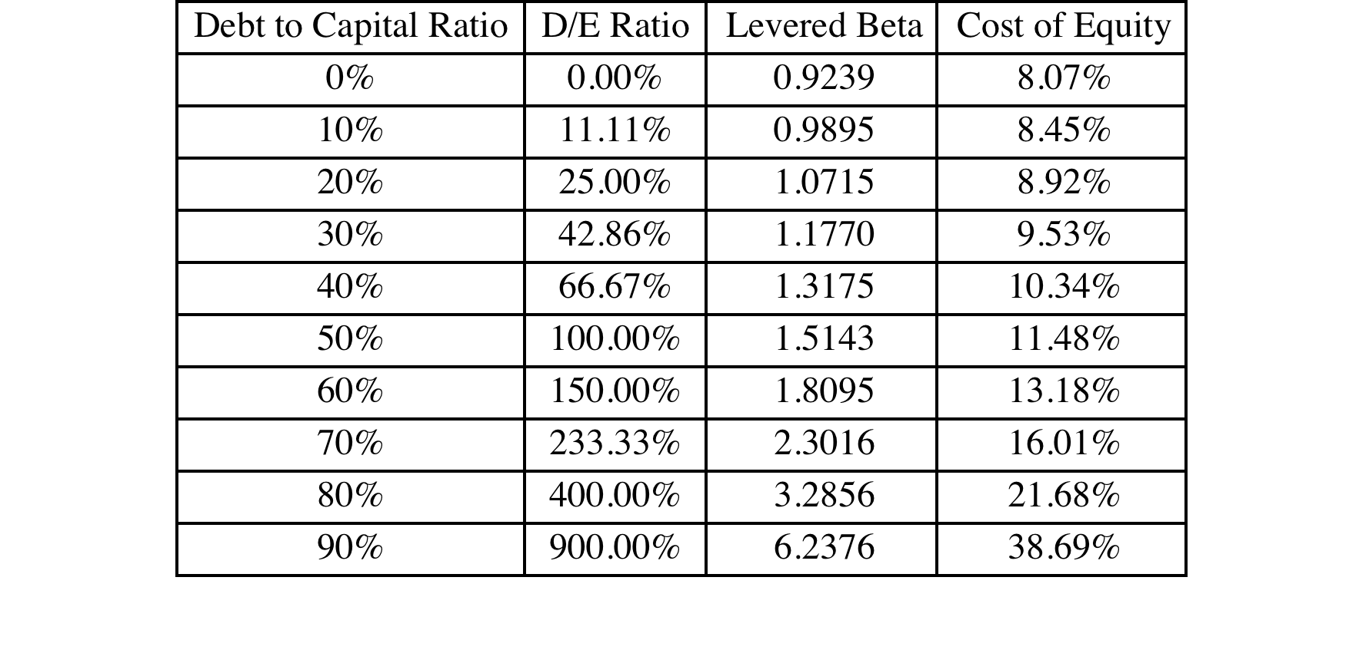
I. Cost of Equity
Levered Beta = 0.9239 (1 + (1- .361) (D/E))
Cost of equity = 2.75% + Levered beta * 5.76%
Notes:
This reproduces the levered beta, using the formula developed during the risk and return section. The unlevered beta of 1.0674 is the bottom-up unlevered beta.
Beta_{Levered} = Unlevered Beta (1 + (1-t) (Debt/Equity Ratio)) In calculating the levered beta in this table, we assumed that all market risk is borne by the equity investors; this may be unrealistic especially at higher levels of debt. We will also consider an alternative estimate of levered betas that apportions some of the market risk to the debt:
β_{levered} = β_{u} [1+(1-t)D/E] - β_{debt} (1-t) D/E
The beta of debt is based upon the rating of the bond and is estimated by regressing past returns on bonds in each rating class against returns on a market index. The levered betas estimated using this approach will generally be lower than those estimated with the conventional model

Slide 11
Estimating Cost of Debt
Start with the market value of the firm = = 121,878 + $15,961 = $137,839 million
D/(D+E) 0.00% 10.00% Debt to capital
D/E 0.00% 11.11% D/E = 10/90 = .1111
$ Debt $0 $13,784 10% of $137,839
EBITDA $12,517 $12,517 Same as 0% debt
Depreciation $ 2,485 $ 2,485 Same as 0% debt
EBIT $10,032 $10,032 Same as 0% debt
Interest $0 $434 Pre-tax cost of debt * $ Debt
Pre-tax Int. cov ∞ 23.10 EBIT/ Interest Expenses
Likely Rating AAA AAA From Ratings table
Pre-tax cost of debt 3.15% 3.15% Riskless Rate + Spread
Notes:
This is a manual computation of the cost of debt. Note the circularity in the argument, since the interest expense is needed to compute the rating, and the rating is needed to compute the cost of debt.
To get around the circularity, I start the 10% debt ratio calculation assuming that my cost of debt is the same as it was at 0% (which is 4.75%) and that my starting firm value (market value of equity + debt) remains my firm value. While neither assumption is realistic, we can revisit these numbers in subsequent iterations, if necessary.
We assume that whatever is borrowed is used to buy back equity, and that the operating assets of the firm remain unchanged (EBITDA and EBIT don’t change…). This allows us to isolate the effect of the recapitalization.

Slide 12
The Ratings Table
Interest coverage ratio is | Rating is | Spread is | Interest rate
> 8.50 | Aaa/AAA | 0.40% | 3.15%
6.5 – 8.5 | Aa2/AA | 0.70% | 3.45%
5.5 – 6.5 | A1/A+ | 0.85% | 3.60%
4.25 – 5.5 | A2/A | 1.00% | 3.75%
3 – 4.25 | A3/A- | 1.30% | 4.05%
2.5 -3 | Baa2/BBB | 2.00% | 4.75%
2.25 –2.5 | Ba1/BB+ | 3.00% | 5.75%
2 – 2.25 | Ba2/BB | 4.00% | 6.75%
1.75 -2 | B1/B+ | 5.50% | 8.25%
1.5 – 1.75 | B2/B | 6.50% | 9.25%
1.25 -1.5 | B3/B- | 7.25% | 10.00%
0.8 -1.25 | Caa/CCC | 8.75% | 11.50%
0.65 – 0.8 | Ca2/CC | 9.50% | 12.25%
0.2 – 0.65 | C2/C | 10.50% | 13.25%
<0.2 | D2/D | 12.00% | 14.75%
T.Bond rate =2.75%
Notes:
These are interest coverage ratio/ratings classes for large manufacturing firms (Market cap > $ 5 billion) and the default spreads at the time of the analysis. This is the default spread over and above the long term (10 year) treasury bond rate at the time of this analysis.
These default spreads can be obtained in one of two ways:
Getting a sampling of liquid bonds within each ratings class and averaging out their yields to maturity.
Finding a source that provides default spreads by ratings class (bondsonline.com used to provide these for free but now requires a fee)
The interest coverage ratio needs to be much higher for smaller firms to get similar ratings. (See ratings.xls spreadsheet)
Special cases:
If you have no interest expenses, your interest coverage ratio will be infinite: AAA rating (does not matter anyway, since you probably have no debt)
2. If you have negative operating income, interest coverage ratio is negative: D rating. You may want to modify by using average operating income over last few years.

Slide 13
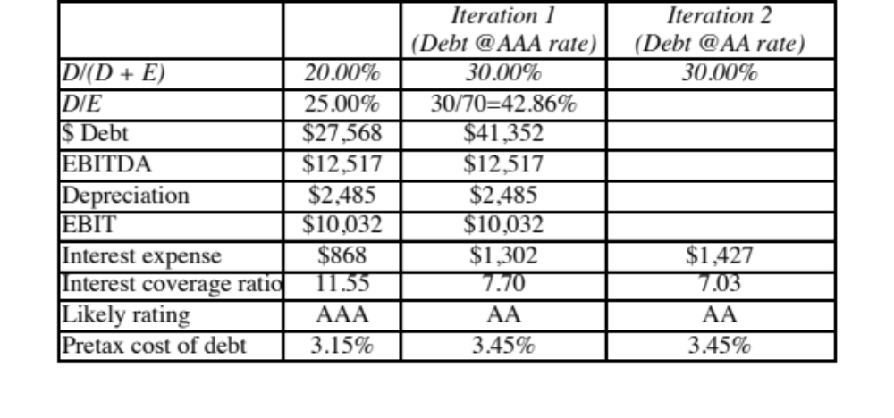
A Test: Can you do the 30% level?
Notes:
You have to start by assuming the AAA rate but you will end up with a rating that is different (AA)
You can redo the analysis using the AA rate and you can stop because you end up with the same rating at the end. (Sometimes you will need a third iteration).

Slide 14
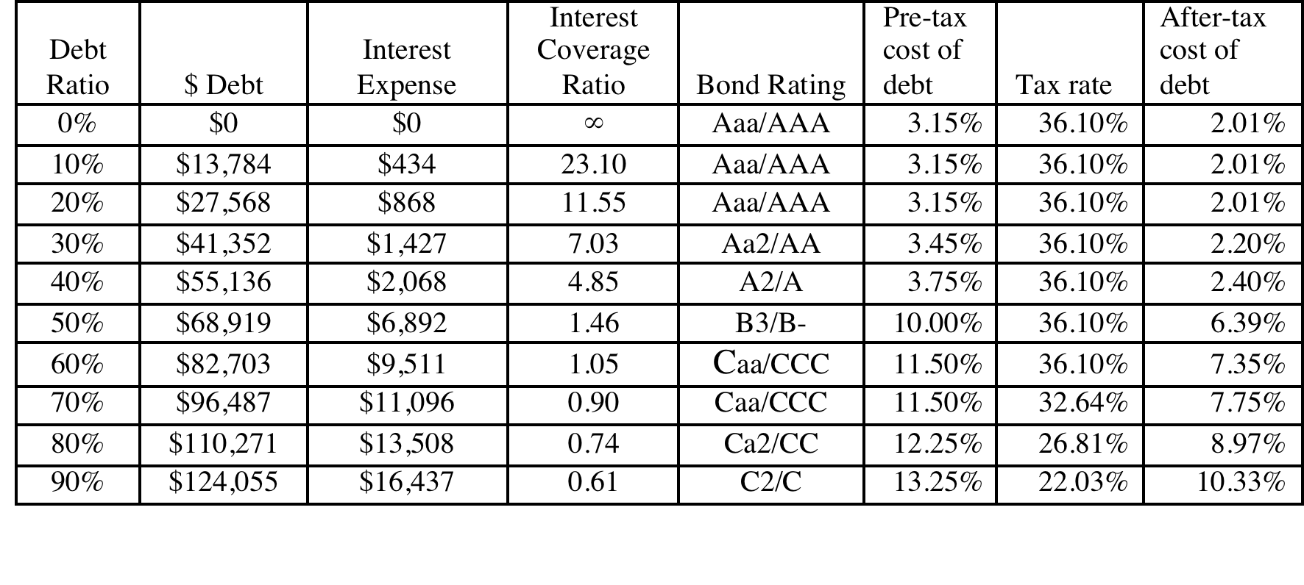
Bond Ratings, Cost of Debt and Debt Ratios
Notes:
This is the completed schedule of interest coverage ratios, ratings and costs of debt at different debt ratios ranging up to 90%.
It is significant that EBITDA not change as the debt ratio goes up. The reason is that the new debt is not used to make the firm larger by taking new projects, but to buy back equity. (This isolates the effect of the financing decision on the value of the firm)
We are being simplistic in assuming that the interest coverage ratio solely determines the ratings. We could use more than one ratio, create a consolidated score (like the Altman Z score) and make the rating a function of this score.
Note that the effective tax rate decreases after the 80% debt ratio. That is because we have insufficient income to cover the entire interest expense beyond that point. (EBIT < Interest Expenses) We therefore lose some of the tax advantage of borrowing.

Slide 15
Stated versus Effective Tax Rates
You need taxable income for interest to provide a tax savings. Note that the EBIT at Disney is $10,032 million. As long as interest expenses are less than $10,032 million, interest expenses remain fully tax-deductible and earn the 36.1% tax benefit. At an 60% debt ratio, the interest expenses are $9,511 million and the tax benefit is therefore 36.1% of this amount.
At a 70% debt ratio, however, the interest expenses balloon to $11,096 million, which is greater than the EBIT of $10,032 million. We consider the tax benefit on the interest expenses up to this amount:
  Maximum Tax Benefit = EBIT * Marginal Tax Rate = $10,032 million * 0.361 = $ 3,622 million
  Adjusted Marginal Tax Rate = Maximum Tax Benefit/Interest Expenses = $3,622/$11,096 = 32.64%
Notes:
We are being conservative. The interest that is not tax deductible can be carried forward and will probably earn some tax benefit in future periods.
Given that this is a permanent change in capital structure, however, it seems to be more conservative to just look at the interest expenses that provide a tax benefit in the current period.

Slide 16
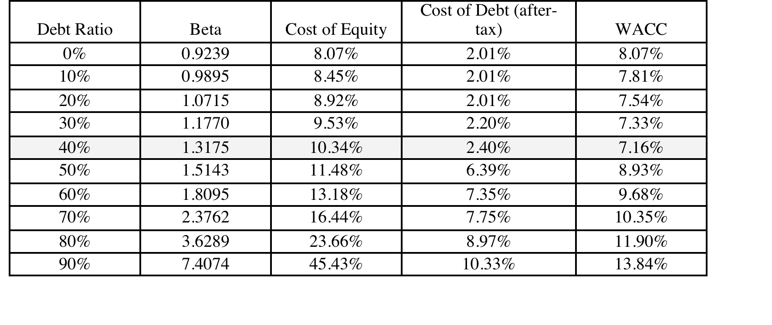
Disney’s cost of capital schedule…
Notes:
Summarizes the cost of equity and debt from prior pages, as well as the cost of capital at different debt ratios.
If the objective is to minimize cost of capital, it occurs at 30 and 40%... We did try for a more precise answer by working in 1% increments and arrived at an optimal of 43% with a cost of capital of 7.28%. (We moved in 1% increments from 30% top 50%)
This will maximize firm value, if operating cashflow (EBITDA) is unaffected by changes in leverage and the consequent changes in ratings. (In other words, we are assuming no indirect bankruptcy costs… If we did, the optimal might be affected, especially if it is at low rating).

Slide 17
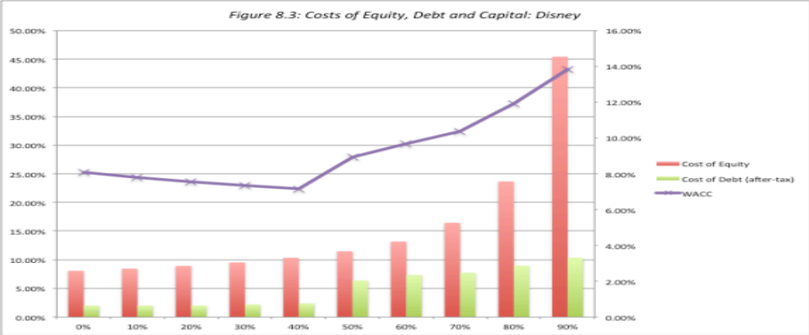
Disney: Cost of Capital Chart
Notes:
The cost of capital is minimized at 40% but notes that the cost of capital does not rise smoothly. Note that surge in cost of capital just beyond 40%. This is not unusual and represents a tipping point, where you go from being comfortable with your debt to pushing the limit…. Interest coverage ratios decrease, pushing up the cost of debt, pushing up interest expenses, pushing down interest coverage ratios, thus creating a spiral.
For those who may still be fixated on the assuming that we made that debt has a zero beta, when computing levered betas, we re-estimated the optimal allowing debt to have a beta (We backed into a beta for debt by taking the default spread at debt rating, assuming that 25% of that spread was due to market risk and estimating an imputed beta)

Slide 18
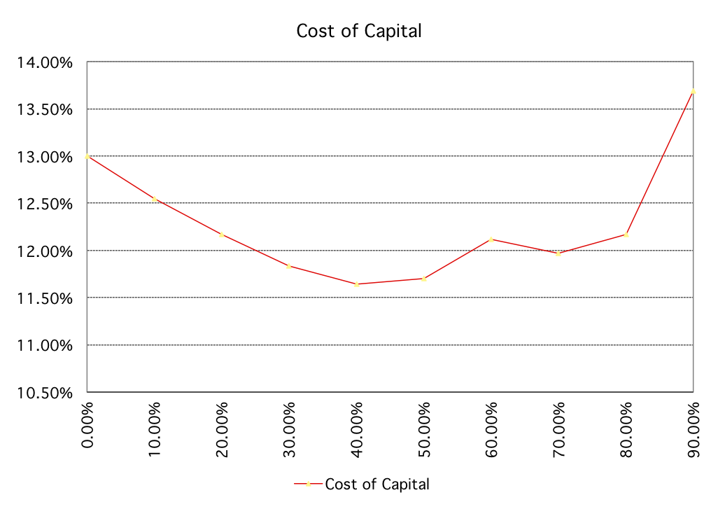
Disney: Cost of Capital Chart: 1997
Notes:
Note the kink in the cost of capital curve at 70%. This occurs largely because the cost of debt in this calculation is discontinuous. It changes only when the rating changes. In reality, the cost of debt, even within a ratings class, will vary depending upon where in the class the firm falls (low AA rated versus high AA rated).
We can make the cost of debt a continuous function of default risk or interest coverage ratios.

Slide 19

Task
Use the cost of capital approach to estimate the optimal financing mix for your company
Read
Chapter 8

