Slide 1
Optimal Financing Mix III: Following up the cost of capital approach
A GPS to your optimal financing mix.
Notes:
Sets the agenda for the class. This is a class that will be focused on the big picture of corporate finance rather than details, theories or models on a piecemeal basis.

Slide 2
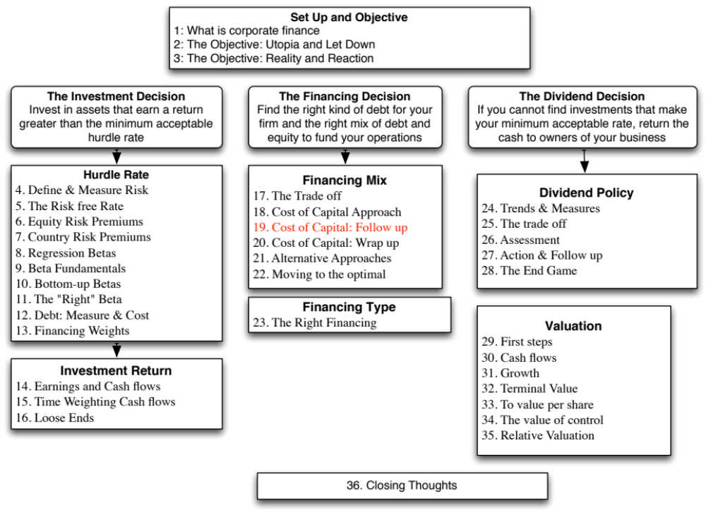

Slide 3

Disney’s cost of capital schedule…
Notes:
Summarizes the cost of equity and debt from prior pages, as well as the cost of capital at different debt ratios.
If the objective is to minimize cost of capital, it occurs at 30 and 40%... We did try for a more precise answer by working in 1% increments and arrived at an optimal of 43% with a cost of capital of 7.28%. (We moved in 1% increments from 30% top 50%)
This will maximize firm value, if operating cashflow (EBITDA) is unaffected by changes in leverage and the consequent changes in ratings. (In other words, we are assuming no indirect bankruptcy costs… If we did, the optimal might be affected, especially if it is at low rating).

Slide 4
The cost of capital approach suggests that Disney should do the following…
Disney currently has $15.96 billion in debt. The optimal dollar debt (at 40%) is roughly $55.1 billion. Disney has excess debt capacity of 39.14 billion.
To move to its optimal and gain the increase in value, Disney should borrow $ 39.14 billion and buy back stock.
Given the magnitude of this decision, you should expect to answer three questions:
  Why should we do it?
  What if something goes wrong?
  What if we don’t want to (or cannot ) buy back stock and want to make investments with the additional debt capacity?
Notes:
The cost of capital approach holds investments constant and changes the financial mix to see the effect on the cost of capital. Consequently, the recommendation that flows out of it is a recapitalization: borrow money and buy back stock to increase the debt ratio or issue stock and repay debt to lower the debt ratio.

Slide 5

Why should we do it?
Effect on Firm Value – Full Valuation
Step 1: Estimate the cash flows to Disney as a firm
  EBIT (1 – Tax Rate) = 10,032 (1 – 0.361) = $6,410
  + Depreciation and amortization = $2,485
  – Capital expenditures = $5,239
  – Change in noncash working capital $0
  Free cash flow to the firm = $3,657
Step 2: Back out the implied growth rate in the current market value
  Current enterprise value = $121,878 + 15,961 = 3,931 = 133,908
  Value of firm = $ 133,908 =
  Growth rate = (Firm Value * Cost of Capital – CF to Firm)/(Firm Value + CF to Firm)
  = (133,908* 0.0781 – 3,657)/(133,908+ 3,657) = 0.0494 or 4.94%
Step 3: Revalue the firm with the new cost of capital
  Firm value =
  The firm value increases by $39,028 million = $172,935 - $133,908
Notes:
We are assuming that the firm is correctly valued now, not because of any belief in market efficiency but to isolate the effect of changing the cost of capital. In other words, whatever the market’s expectations are now (realistic or unrealistic), those expectations stay unchanged as we move from the old to the new capital structure.
This approach will tend to break down with growth or money losing companies because the valuation models you will need for those are far more complicated.

Slide 6
Effect on Value: Incremental approach
In this approach, we start with the current market value and isolate the effect of changing the capital structure on the cash flow and the resulting value.
  Enterprise Value before the change = $133,908 million
  Cost of financing Disney at existing debt ratio = $ 133,908 * 0.0781 = $10,458 million
  Cost of financing Disney at optimal debt ratio = $ 133,908 * 0.0716 = $ 9,592 million
  Annual savings in cost of financing = $10,458 million – $9,592 million = $866 million
  Enterprise value after recapitalization
  = Existing enterprise value + PV of Savings = $133,908 + $19,623 = $153,531 million
Notes:
The reduction in the cost of capital translates into annual savings. Most of these savings are implicit, being savings in the cost of equity. Thus, the firm’s accounting earnings will not reflect these savings directly.
These savings can be converted into a present value by discounting back at the new cost of capital.
It is more realistic to assume growth in firm value. A simple way to estimate what the current growth attributed to the firm by the market is to estimate it using the firm value today, the free cash flow to the firm and the current cost of capital.
Note that the simple valuation formula used above assumes stable growth forever. For high growth firms, this formula will yield an implied growth rate that is too high (It will be very close to the cost of capital). In those cases, it is better to put a cap on the growth rate of around the risk free rate.
In this case, maximizing firm value also maximizes stock price, because we assume that
Debt is refinanced at current market rates, thus protecting bondholders
Markets are rational and efficient.

Slide 7
From firm value to value per share: The Rational Investor Solution
Because the increase in value accrues entirely to stockholders, we can estimate the increase in value per share by dividing by the total number of shares outstanding (1,800 million).
  Increase in Value per Share = $19,623/1800 = $ 10.90
  New Stock Price = $67.71 + $10.90= $78.61
Implicit in this computation is the assumption that the increase in firm value will be spread evenly across both the stockholders who sell their stock back to the firm and those who do not and that is why we term this the “rational” solution, since it leaves investors indifferent between selling back their shares and holding on to them.
Notes:
If investors are rational, the price on the buyback should be such that investors are indifferent between selling back their shares and holding on to them. At $78.61, that will happen.

Slide 8

The more general solution, given a buyback price
Start with the buyback price and compute the number of shares outstanding after the buyback:
  Increase in Debt = Debt at optimal – Current Debt
  # Shares after buyback = # Shares before –
Then compute the equity value after the recapitalization, starting with the enterprise value at the optimal, adding back cash and subtracting out the debt at the optimal:
  Equity value after buyback = Optimal Enterprise value + Cash – Debt
Divide the equity value after the buyback by the post-buyback number of shares.
  Value per share after buyback = Equity value after buyback/ Number of shares after buyback
Notes:
In the more general scenario, you are looking at the division of spoils between those who sell their shares back and those who stay on as stockholders.

Slide 9
Let’s try a price: What if can buy shares back at the old price ($67.71)?
Start with the buyback price and compute the number of shares outstanding after the buyback
  Debt issued = $ 55,136 - $15,961 = $39,175 million
  # Shares after buyback = 1800 - $39,175/$67.71 = 1221.43 m
Then compute the equity value after the recapitalization, starting with the enterprise value at the optimal, adding back cash and subtracting out the debt at the optimal:
  Optimal Enterprise Value = $153,531
  Equity value after buyback = $153,531 + $3,931– $55,136 = $102,326
Divide the equity value after the buyback by the post-buyback number of shares.
  Value per share after buyback = $102,326/1221.43 = $83.78
Notes:
This is the best case scenario for those who stay on as stockholders, since they claim the entire surplus.

Slide 10
Back to the rational price ($78.61): Here is the proof
Start with the buyback price and compute the number of shares outstanding after the buyback
  # Shares after buyback = 1800 - $39,175/$78.61 = 1301.65 m
Then compute the equity value after the recapitalization, starting with the enterprise value at the optimal, adding back cash and subtracting out the debt at the optimal:
  Optimal Enterprise Value = $153,531
  Equity value after buyback = $153,531 + $3,931– $55,136 = $102,326
Divide the equity value after the buyback by the post-buyback number of shares.
  Value per share after buyback = $102,326/1301.65 = $78.61
Notes:
Proof that the $78.61 leaves everyone equally well off.
Try different prices and see how the increase in value is apportioned between the groups.
In fact, try estimating the buyback price at which the entire value increase goes to those who sell their shares back.

Slide 11
2. What if something goes wrong?
The Downside Risk
Doing What-if analysis on Operating Income
  A. Statistical Approach
    Standard Deviation In Past Operating Income
    Reduce Base Case By One Standard Deviation (Or More)
  B. “Economic Scenario” Approach
    Look At What Happened To Operating Income During The Last Recession. (How Much Did It Drop In % Terms?)
    Reduce Current Operating Income By Same Magnitude
Constraint on Bond Ratings
Notes:
This analysis is based upon the firm continuing as a going concern. To the extent that more debt can put this survival at risk, it is important to do “what-if” analyses or build in survival constraints into the analysis.

Slide 12

Disney’s Operating Income: History
Recession Decline in Operating Income
2009 Drop of 23.06%
2002 Drop of 15.82%
1991 Drop of 22.00%
1981-82 Increased by 12%
Worst Year Drop of 29.47%
Standard deviation in % change in EBIT = 19.17%
Notes:
These are percentage changes in operating income at Disney.

Slide 13

Disney: Safety Buffers?
Notes:
Disney’s optimal debt ratio is robust and survives up to a 30% drop in EBIT, which is worse than their worst year in the last three decades.

Slide 14
Constraints on Ratings
Management often specifies a 'desired rating' below which they do not want to fall.
The rating constraint is driven by three factors
  it is one way of protecting against downside risk in operating income (so do not do both)
  a drop in ratings might affect operating income
  there is an ego factor associated with high ratings
Caveat: Every rating constraint has a cost.
  The cost of a rating constraint is the difference between the unconstrained value and the value of the firm with the constraint.
  Managers need to be made aware of the costs of the constraints they impose.
Notes:
Rating constraints are one way of buffering your analysis against the assumption that operating income will not change as leverage changes. If the operating income will suffer when ratings fall below a certain point (say BBB or investment grade), it makes sense to build in that constraint into the analysis.
When managers brag about their high ratings, the questions that should come up are whether the high rating is paying off in terms of higher operating income, and if not, how much stockholders are paying for managers’ bragging rights.

Slide 15
Ratings Constraints for Disney
At its optimal debt ratio of 40%, Disney has an estimated rating of A.
If managers insisted on a AA rating, the optimal debt ratio for Disney is then 30% and the cost of the ratings constraint is fairly small:
  Cost of AA Rating Constraint = Value at 40% Debt – Value at 30% Debt = $153,531 m – $147,835 m = $ 5,696 million
If managers insisted on a AAA rating, the optimal debt ratio would drop to 20% and the cost of the ratings constraint would rise:
  Cost of AAA rating constraint = Value at 40% Debt – Value at 20% Debt = $153,531 m – $141,406 m = $ 12,125 million
Notes:
This may be overstated, since it is based upon the assumption that operating income is unaffected by the change in ratings. To the degree that Disney’s operating income will drop if its rating drops below BBB, this will overstate the cost of the constraint.
This process can be modified to allow for other constraints. For instance, some firms do not want their book value debt ratios to rise above a certain level (say, industry averages). In other cases, existing bond covenants may restrict a financial ratio from exceeding a specified number.

Slide 16
3. What if you do not buy back stock..
The optimal debt ratio is ultimately a function of the underlying riskiness of the business in which you operate and your tax rate.
Will the optimal be different if you invested in projects instead of buying back stock?
  No. As long as the projects financed are in the same business mix that the company has always been in and your tax rate does not change significantly.
  Yes, if the projects are in entirely different types of businesses or if the tax rate is significantly different.
Notes:
The analysis is built on the assumption that debt is used to buy back stock. Many firms would rather use the debt to take projects, or might be barred from buying back stock (as is the case in markets like Germany)
If we assume that projects in the same line of business have the same cash flow generating capacity as the current firm (EBITDA/Firm Value), the optimal debt ratio will remain unchanged, but the optimal dollar debt will be a much higher number. (This analysis is impervious to changes in scale. If you double all the numbers, the optimal debt ratio will remain unchanged)
If the business you are expanding into has more risk and more negative cashflows, your optimal will decrease.

Slide 17

Task
Evaluate the value effects of moving to the optimal debt ratio for your firm and your room for error.
Read
Chapter 8

