Slide 1
Corporate Finance
What is it?
Aswath Damodaran

Slide 2
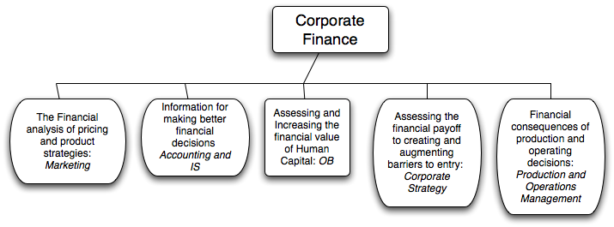
What is corporate finance?
Every decision that a business makes has financial implications, and any decision which affects the finances of a business is a corporate finance decision.
Defined broadly, everything that a business does fits under the rubric of corporate finance.
Notes:
Every decision is a corporate finance decision. Thus, marketing, accounting, operations and strategy can all be viewed as subsets of corporate finance (self serving, right?)

Slide 3
Objectives
To give you the capacity to understand the theory and apply, in real world situations, the techniques that have been developed in corporate finance.
  Motto for class: If it cannot be applied, who cares?.
To give you the big picture of corporate finance so that you can understand how things fit together.
  Motto for class: You can forget the details, but don’t miss the storyline.
To show you that corporate finance is fun.
  Motto for class: Are we having fun yet?
Notes:
We need “applied”: There are so many real world questions that need urgent answers. Why go looking for abstractions?
Big picture: Easy to get lost in the details & distractions. In fact, if you work in corporate finance, you get increasingly specialized and lose perspective. Knowing what the big picture looks like will let you figure out how what you do fits into the larger scheme of things but also lets you do it better.
Corporate finance is number crunching, with lots of room for your creative side to shine through. It provides discipline to creative people and imagination to “just show me the numbers” people. (Story: Steve Jobs was a great CEO at Apple in his second coming but not in his first one. What was different? He had someone who took his flights of imagination and made them operational in Tim Cook).
I am an evangelist when it comes to corporate finance. I will not try to make you bankers but I will try to sell you on the notion that no matter what you choose to do in life (entrepreneur, not-for-profit person, strategy guru, marketing superstar) that having an understanding of corporate finance will make you better at that.

Slide 4
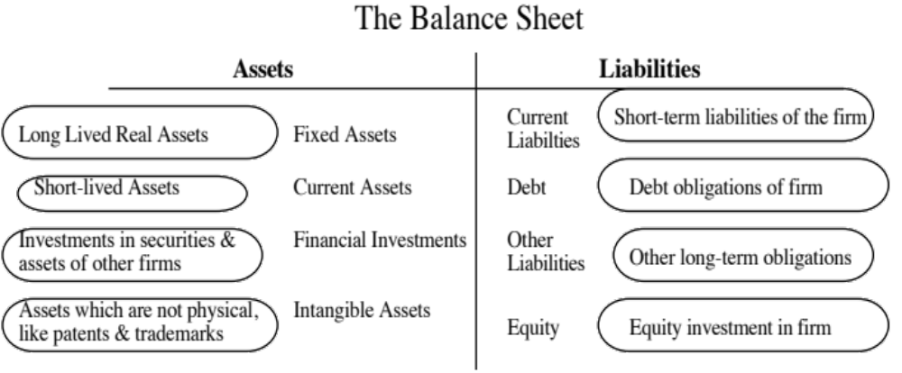
The Traditional Accounting Balance Sheet
Notes:
Before we embark on the corporate missions, let’s start by changing your mindset, especially if accounting is fresh in your mind. This is an accounting balance sheet and it is worth noting what it is and what it is not. It is backward looking and done right, it is a recording of what you have done as business. It is constrained by the accounting mindset which is conservative, risk averse and grounded in accounting history. Accounting was designed for the old economy, for the manufacturing firm that bought land, built a factory and produced tangible goods and it is stretched to breaking point by the new economy, not just technology firms but service firms.
Assets are categorized by how long they last and how tangible they are and liabilities reflect original capital raised. While fair value accounting is trying to change this, it is a hopeless venture, since accounting cannot abandon its moorings. It is like a person strapping on wings, while having lead boots.

Slide 5
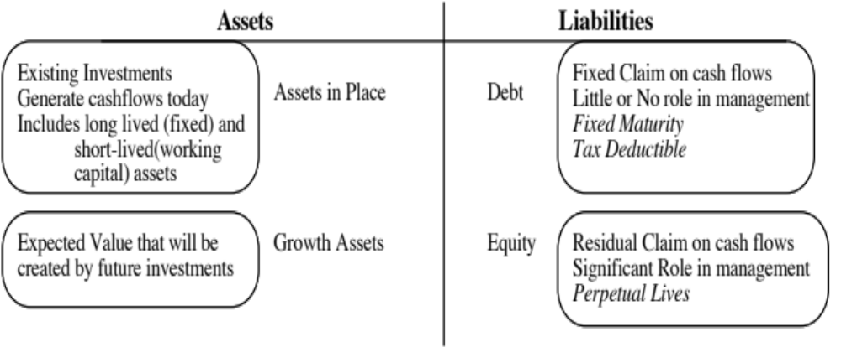
The Financial View of the Firm
Notes:
The financial perspective:
The past is irrelevant and only the future matters.
The value of an asset is determined by its capacity to generate cash flows in the future. It does not matter whether an asset is tangible or not. It does matter whether it exists right now (assets in place) or will be created in the future (growth assets)
There are two ways you can fund a business. You can borrow the money (debt) or use your own money (equity).

Slide 6
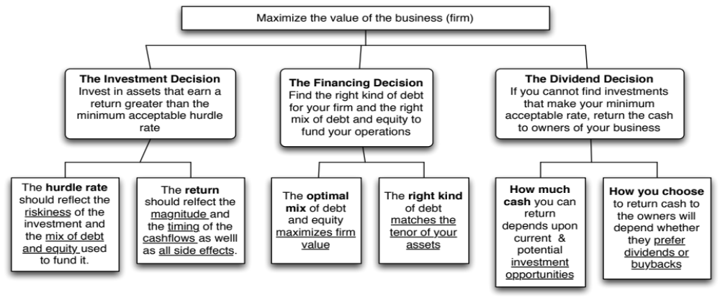
First Principles & The Big Picture
Notes:
This is the big picture that will animate how we approach corporate finance. We will use it to anchor the class, introducing each topic by noting its presence in the big picture. Ultimately, everything we do in corporate finance has to be somewhere in the picture.

Slide 7
Theme 1: Corporate finance is “common sense”
There is nothing earth shattering about any of the first principles that govern corporate finance.
Shrewd business people, notwithstanding their lack of exposure to corporate finance theory, have always recognized these fundamentals and put them into practice.
Notes:
Do you need a course in corporate finance to run a firm wisely? Obviously not, since shrewd business people through the ages have built up great businesses, without the benefits of corporate financial theory. They have been able to do so because the first principles of corporate finance are common sense ones: try to find the cheapest way to raise financing, make sure that you invest your funds in assets that earn you more than it costs you to raise them and take funds out of the business, if you cannot find these investments. Theories and models are often provided as justifications for actions that violate common sense. It is usually theories and models that are at fault, not common sense.

Slide 8
Theme 2: Corporate finance is focused…
It is the focus on maximizing the value of the business that gives corporate finance its focus. As a result of this singular objective, we can
  Choose the “right” investment decision rule to use, given a menu of such rules.
  Determine the “right” mix of debt and equity for a specific business
  Examine the “right” amount of cash that should be returned to the owners of a business and the “right” amount to hold back as a cash balance.
This certitude does come at a cost. To the extent that you accept the objective of maximizing firm value, everything in corporate finance makes complete sense. If you do not, nothing will.
Notes:
The presences of a singular objective – maximizing firm value – allows corporate finance to be able to hone in on best practices and focused models. To the extent that you agree with this objective, corporate finance makes complete sense. To the extent that you do not, nothing makes sense. That is why we will spend two sessions focusing on why we choose the objective and considering alternative objectives (and why we reject them).

Slide 9
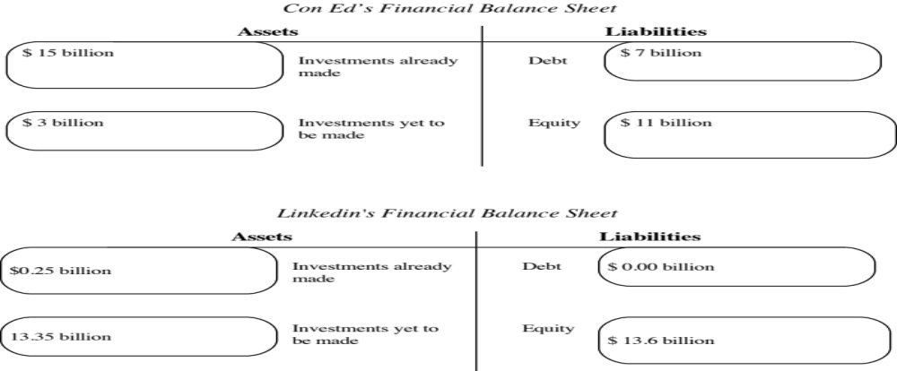
Theme 3: The focus changes across the life cycle…
Notes:
Drawing a contrast between the two companies:
Con Ed, a regulated utility, is a mature company with most of its value derived from investments that it has made in the past. Linkedin derives most of its value from expectations about what it will do in the future.
A very simple way to assess how firms should approach financing and dividend decisions in corporate finance is to look at where they derive value. Con Ed, as a mature company with significant assets in place and large cash flows from these assets, has relatively little need for new investments (since growth is limited) and can afford to both borrow more money and pay larger dividends. Linkedin has relatively little earnings capacity and high investment needs (to fund its growth). It cannot afford to borrow money (you cannot pay interest expenses with expectations) or pay dividends.

Slide 10
Theme 4: Corporate finance is universal…
Every business, small or large, public or private, US or emerging market, has to make investment, financing and dividend decisions.
The objective in corporate finance for all of these businesses remains the same: maximizing value.
While the constraints and challenges that firms face can vary dramatically across firms, the first principles do not change.
  Apply to both public and private companies, though they face different constraints.
  Apply to firms in both developed and emerging markets
Notes:
The first principles of corporate finance apply for all companies, small and large, public and private, developed market and emerging market. The estimation issues may vary and we may face greater uncertainty in some cases than others, but the first principles will be identical.

Slide 11
Theme 5: If you violate 1st principles, you will pay!
There are some investors/analysts/managers who convince themselves that the first principles don’t apply to them because of their superior education, standing or past successes, and then proceed to put into place strategies or schemes that violate first principles.
Sooner or later, these strategies will blow up and create huge costs.
Almost every corporate disaster or bubble has its origins in a violation of first principles.
Notes:
You can take your pick of bubbles. Here are a few:
Sub-prime crisis: At its core, the sub-prime crisis emanated from the fact that banks/bondholders lent money (or bought bonds) to entities with high credit risk and assumed that these entities would not default (because their models told them so). Reality proved otherwise.
Dot com bubble: We were told that internet companies in the late 1990s did not really have to worry about investing their money in good investments. The sector had so much promise (we were again told) that all investments would ultimately pay off, thus justifying the huge martket values of these firms.

Slide 12
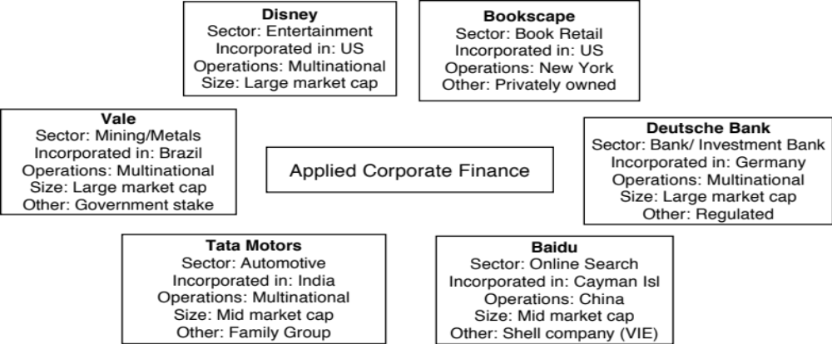
And it will be applied…
Notes:
My rationale for picking these companies was to get as diverse a group as possible: developed and emerging, small and large, old economy and new economy, mature and growth, to show that the principles of corporate finance are universal, while the estimation challenges are different. Everything I do in this class will be applied to these companies, with the real world problems that come with real companies. (New information will come out, the numbers will sometimes be murky and you may have to make leaps of faith). I would rather do that than create an artificial environment (either with a hypothetical company or with a company set back in time).

Slide 13
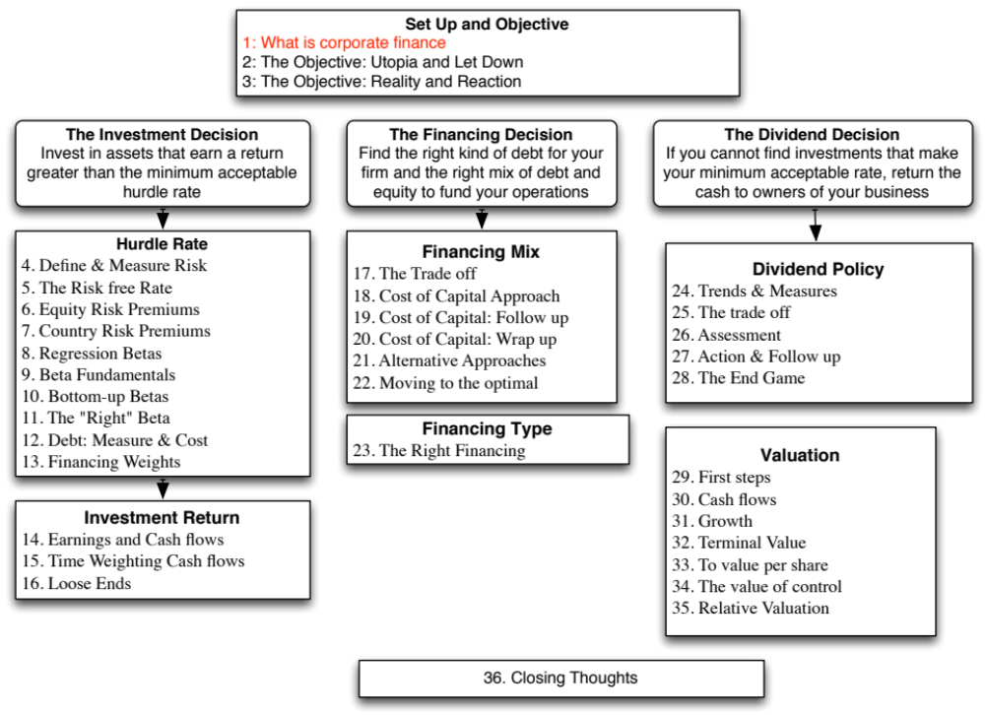

Slide 14

Chapter 1

