Slide 1
Optimal financing mix iV: Wrapping up the cost of capital approach
One size does not fit all.
Notes:
Sets the agenda for the class. This is a class that will be focused on the big picture of corporate finance rather than details, theories or models on a piecemeal basis.

Slide 2
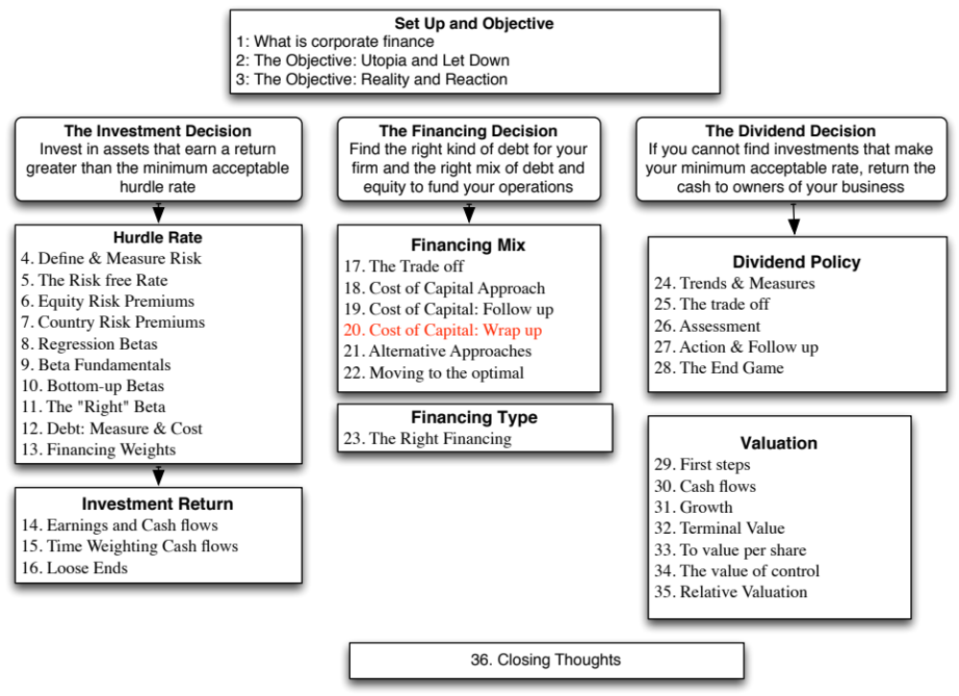

Slide 3
Enhanced Cost of Capital Approach
Distress cost affected operating income: In the enhanced cost of capital approach, the indirect costs of bankruptcy are built into the expected operating income. As the rating of the firm declines, the operating income is adjusted to reflect the loss in operating income that will occur when customers, suppliers and investors react.
Dynamic analysis: Rather than look at a single number for operating income, you can draw from a distribution of operating income (thus allowing for different outcomes).
Notes:
The most significant innovation is that the operating income is a function of the ratings. As he firm borrows more and its rating drops, its operating income will drop to reflect the indirect bankruptcy costs.

Slide 4
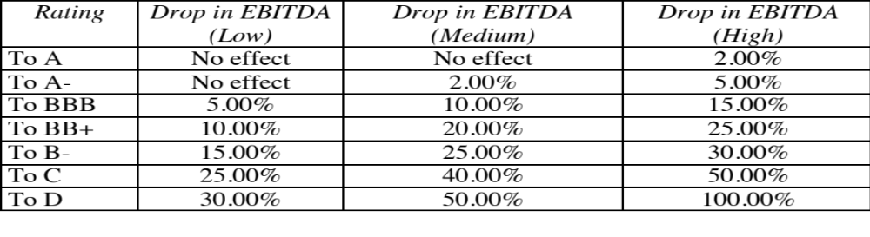
Estimating the Distress Effect- Disney
Notes:
To estimate these values, we looked at firms that had been downgraded and looked the change in operating income in the next year. There is a lot of estimation noise in these values…. And a lot of variation across firms.

Slide 5
The Optimal Debt Ratio with Indirect Bankruptcy Costs
Debt Ratio | Beta | Cost of Equity | Bond Rating | Interest rate on debt | Tax Rate | Cost of Debt (after-tax) | WACC | Enterprise Value
0% | 0.9239 | 8.07% | Aaa/AAA | 3.15% | 36.10% | 2.01% | 8.07% | $122,633
10% | 0.9895 | 8.45% | Aaa/AAA | 3.15% | 36.10% | 2.01% | 7.81% | $134,020
20% | 1.0715 | 8.92% | Aaa/AAA | 3.15% | 36.10% | 2.01% | 7.54% | $147,739
30% | 1.1769 | 9.53% | Aa2/AA | 3.45% | 36.10% | 2.20% | 7.33% | $160,625
40% | 1.3175 | 10.34% | A2/A | 3.75% | 36.10% | 2.40% | 7.16% | $172,933
50% | 1.5573 | 11.72% | C2/C | 11.50% | 31.44% | 7.88% | 9.80% | $35,782
60% | 1.9946 | 14.24% | Caa/CCC | 13.25% | 22.74% | 10.24% | 11.84% | $25,219
70% | 2.6594 | 18.07% | Caa/CCC | 13.25% | 19.49% | 10.67% | 12.89% | $21,886
80% | 3.9892 | 25.73% | Caa/CCC | 13.25% | 17.05% | 10.99% | 13.94% | $19,331
90% | 7.9783 | 48.72% | Caa/CCC | 13.25% | 15.16% | 11.24% | 14.99% | $17,311
The optimal debt ratio stays at 40% but the cliff becomes much steeper.
Notes:
When both operating income and cost of capital change, the optimal debt ratio may no longer be at the point where cost of capital is minimized. Firm value may be maximized at a different point, with higher operating income and a a higher cost of capital.

Slide 6
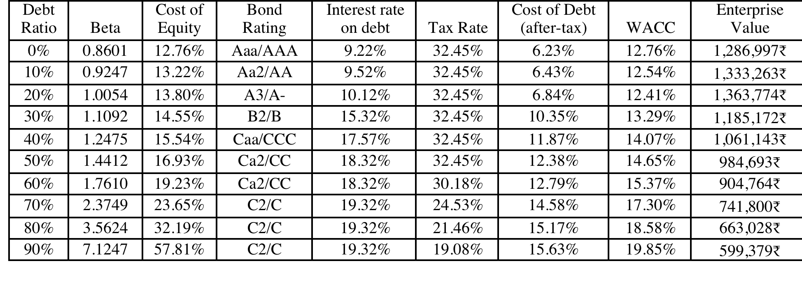
Extension to a family group company: Tata Motor’s Optimal Capital Structure
Tata Motors looks like it is over levered (29% actual versus 20% optimal), perhaps because it is drawing on the debt capacity of other companies in the Tata Group.
Notes:
While Tata Motors looks over levered, it is possible that the company is borrowing money on the basis of the Tata Group’s financial strength…. Thus, to assess whether there is too much or too little debt, we should be looking at the overall group’s optimal and actual debt ratio.

Slide 7
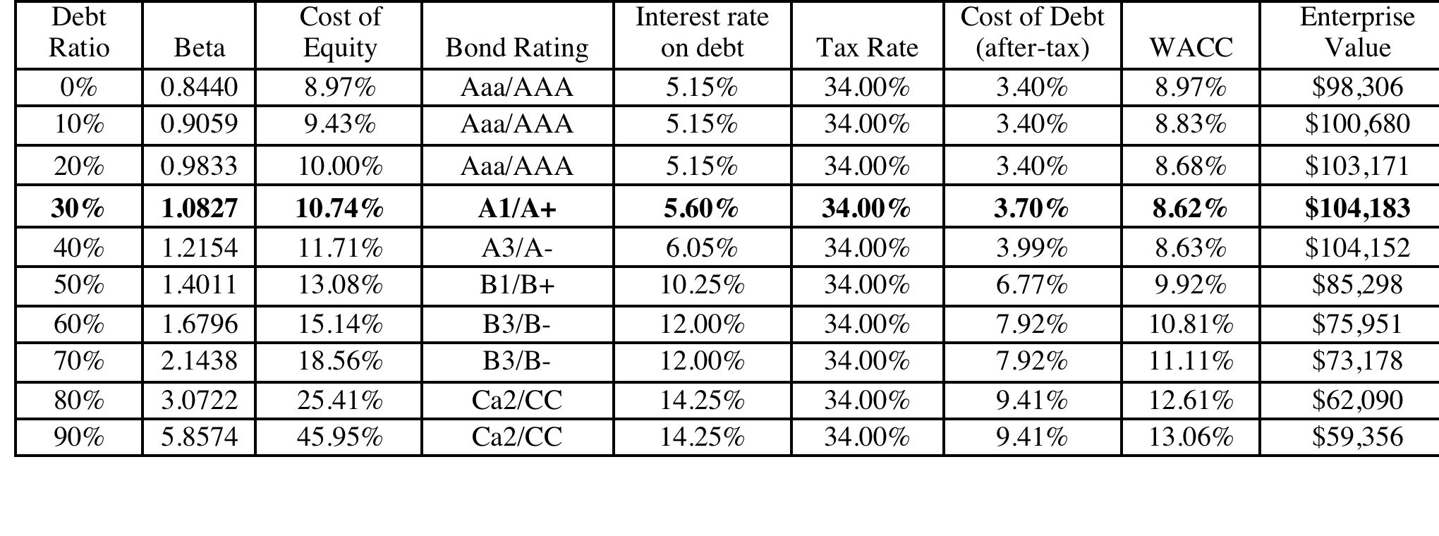
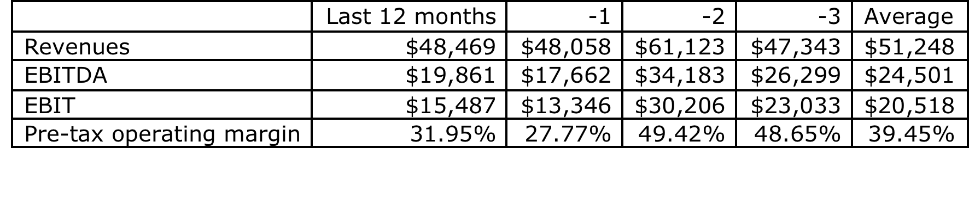
Extension to a firm with volatile earnings:
Vale’s Optimal Debt Ratio
Replacing Vale’s current operating income with the average over the last three years pushes up the optimal to 50%.
Notes:
Vale looks over levered at its current operating income, but since it is a mining company and its normalized income is higher, I think it is less worrisome.

Slide 8
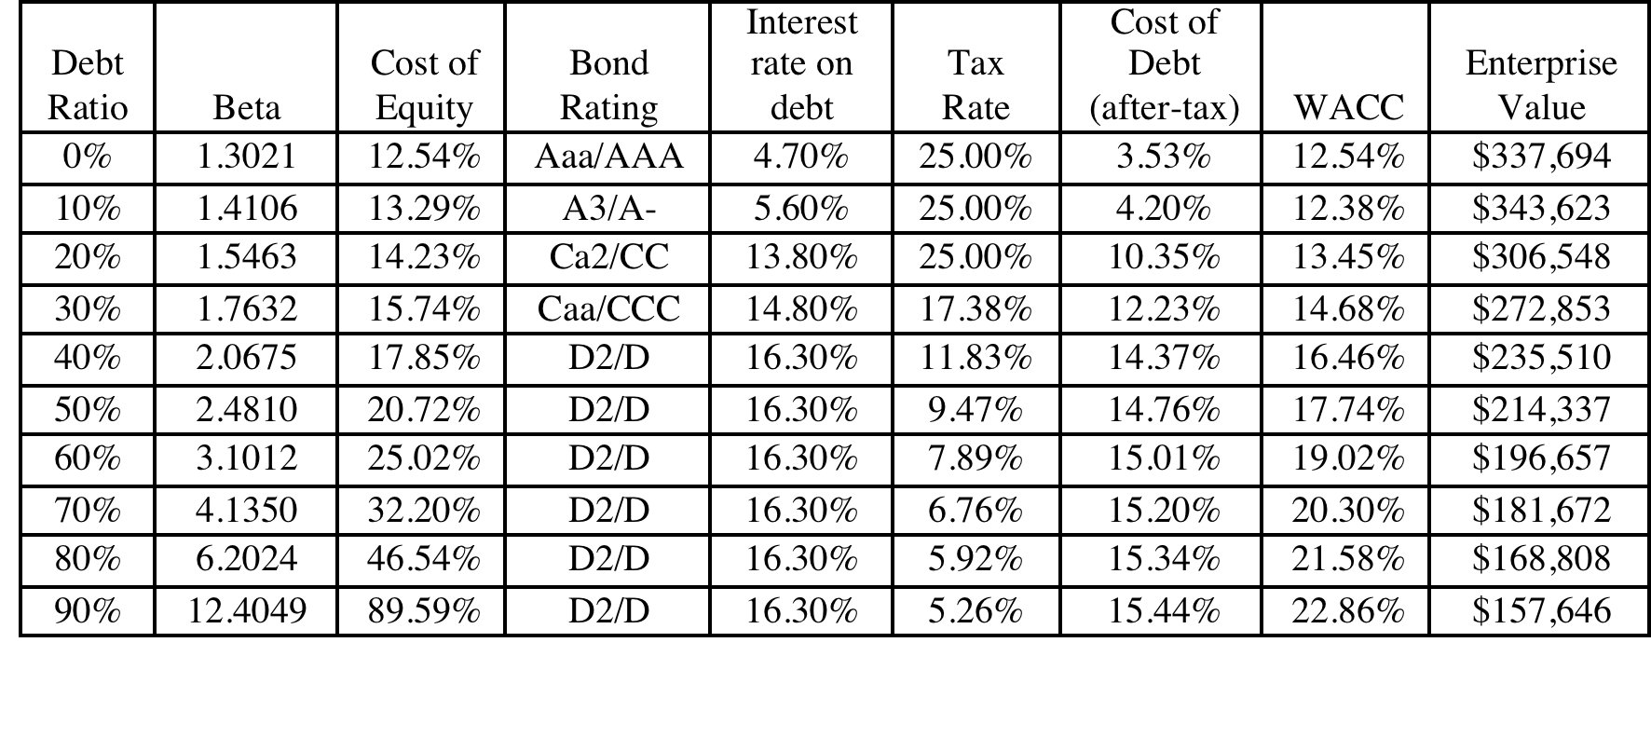
Optimal Debt Ratio for a young, growth firm: Baidu
The optimal debt ratio for Baidu is between 0 and 10%, close to its current debt ratio of 5.23%, and much lower than the optimal debt ratios computed for Disney, Vale and Tata Motors.
Notes:
May be a high flyer in terms of market cap, but cannot afford much debt, since its operating income is low, relative to its market value.

Slide 9
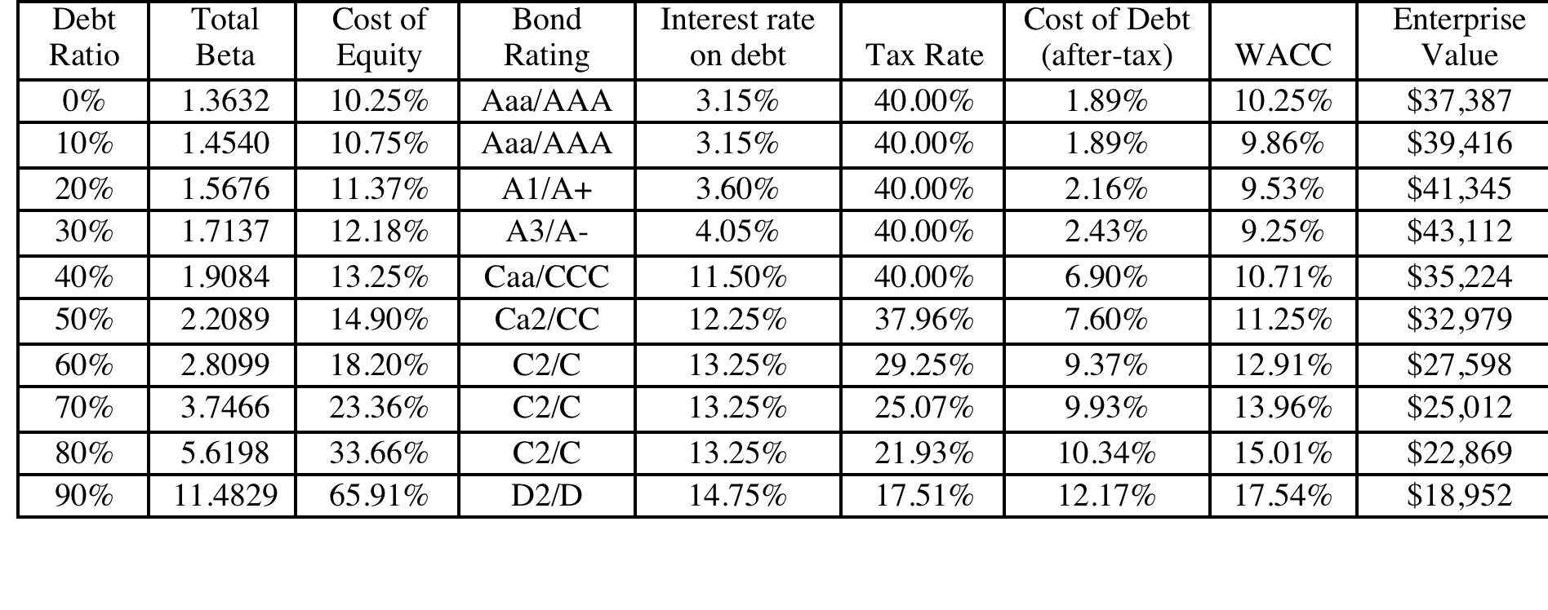
Extension to a private business
Optimal Debt Ratio for Bookscape
Debt value of leases = $12.136 million (only debt)
Estimated market value of equity = Net Income * Average PE for Publicly Traded Book Retailers = 1.575 * 20 = $31.5 million
Debt ratio = 12,136/(12,136+31,500) = 27.81%
The firm value is maximized (and the cost of capital is minimized) at a debt ratio of 30%. At its existing debt ratio of 27.81%, Bookscape is at its optimal.
Notes:
The optimal debt ratio for the private firm is 30% but the cost of capital is flat between 10% and 30%. The firm value is maximized at that point.
To the extent that private business owners view default risk more seriously than stockholders in a publicly traded firm, they will probably be more cautious about moving to the optimal.
We can extend the argument to closely held publicly traded firms. We would expect these firms to have lower debt ratios than publicly traded firms with diverse stockholdings.

Slide 10
Capital Structure for a bank:
An Alternative Approach
Consider a bank with $ 100 million in loans outstanding and a book value of equity of $ 6 million. Furthermore, assume that the regulatory requirement is that equity capital be maintained at 5% of loans outstanding. Finally, assume that this bank wants to increase its loan base by $ 50 million to $ 150 million and to augment its equity capital ratio to 7% of loans outstanding.
  Loans outstanding after Expansion = $ 150 million
  Equity after expansion = 7% of $150 = $10.5 million
  Existing Equity = $ 6.0 million
  New Equity needed = $ 4.5 million
Your need for “external” equity as a bank/financial service company will depend upon
  Your growth rate: Higher growth -> More external equity
  Existing capitalization vs Target capitalization: Under capitalized -> More external equity
  Current earnings: Less earnings -> More external equity
  Current dividends: More dividends -> More external equity
Notes:
As regulatory capital ratios increase, banks will have to raise more equity to grow.
Conservative banks will raise more equity than aggressive banks.
Assessing the financing mix for a bank or financial service firm boils down to equity. In effect, the firm can have too little or too much book equity, and that judgment is made based upon capital ratios (actual versus required). Unlike non-financial service firms, where debt can be reduced or increased to change the ratio, financial service firms generally have much less flexibility.
So, what can cause book equity to vary across time? Retained earnings obviously. Profits will increase book equity and losses will reduce them. Any dividends paid reduce book equity. For banks, loan losses can reduce book equity dramatically. In other words, a bank can go from being comfortably over funded to significantly under funded overnight.
The one issue in this approach is that it is framed by regulatory defintiions.of equity. Thus, preferred stock is usually counted as equity. After the crisis of 2008, there was a debate about whether wartrants should be counted in book equity.

Slide 11
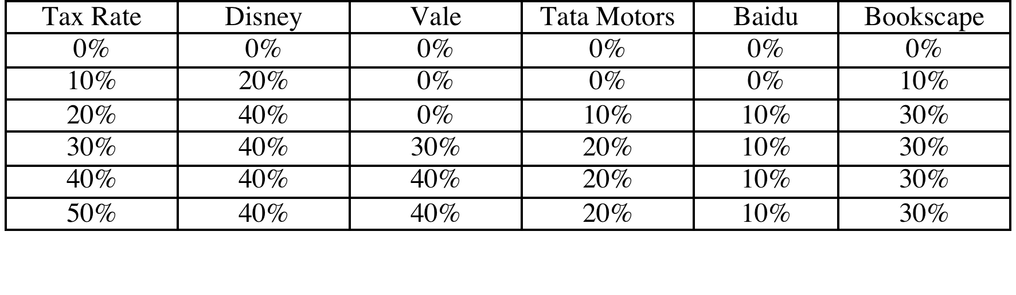
Determinants of the Optimal Debt Ratio:
1. The marginal tax rate
The primary benefit of debt is a tax benefit. The higher the marginal tax rate, the greater the benefit to borrowing:
Notes:
Note that with zero taxes, the optimal debt ratio goes to zero. Intuitively, if the costs of borrowing (higher bankruptcy cost, agency costs) and the primary benefit disappears, there will always by a net cost to borrowing.
If debt is cheaper than equity on a pre-tax basis (and it generally is), why do we not gain by borrowing?
Because the additional debt makes both debt and equity more expensive. (Ratings drop and betas increase…)

Slide 12
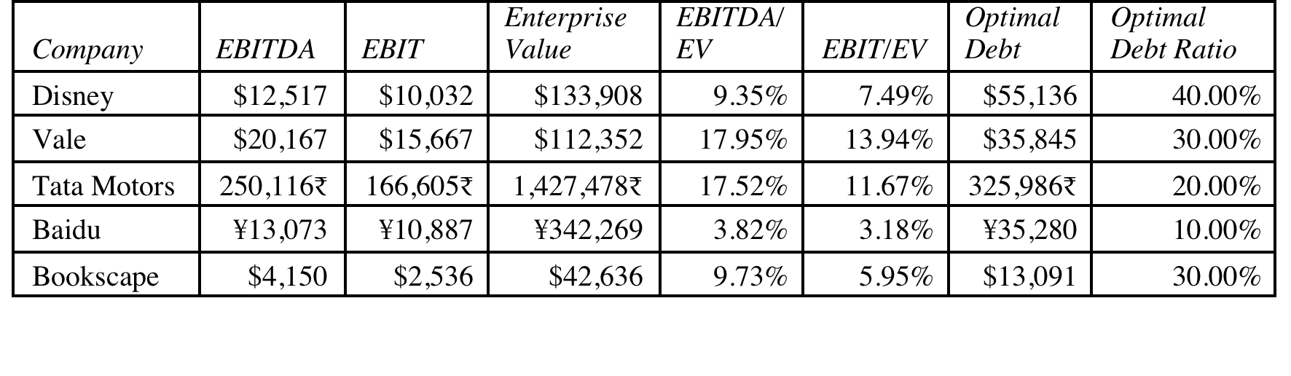
2. Pre-tax Cash flow Return
Notes:
This is the answer to the puzzle of why growth firms, even extremely profitable ones in the high growth space, tend to have low optimal debt ratios. While they may generate huge dollar profits, their market values are very high, relative to their income.

Slide 13
3. Operating Risk
Firms that face more risk or uncertainty in their operations (and more variable operating income as a consequence) will have lower optimal debt ratios than firms that have more predictable operations.
Operating risk enters the cost of capital approach in two places:
  Unlevered beta: Firms that face more operating risk will tend to have higher unlevered betas. As they borrow, debt will magnify this already large risk and push up costs of equity much more steeply.
  Bond ratings: For any given level of operating income, firms that face more risk in operations will have lower ratings. The ratings are based upon normalized income.
Notes:
A risky firm can be very profitable in a good year. However, it should be cautious about borrowing on the basis of that income, since earnings can drop quickly.

Slide 14
4. The only macro determinant:
Equity vs Debt Risk Premiums
Notes:
The cost of equity is determined by the equity risk premium and the cost of debt by the default spread. When ERP rise (fall) relative to default spreads, firms will borrow more (less).
This graph has the implied equity risk premium and the default spread on a Baa rated bond going back to 1960. While they generally move together, there have been periods of disconnect between the two.
In the late 1990s, equity risk premiums dropped relative to default spreads: Firms should have shifted to equity from debt and optimal debt ratios should have decreased.
Between 2004 and 2007, default spreads dropped while equity risk premiums remained unchanged. It was a golden age for leveraged transactions.
In 2008, risk premia climbed across the board but default spreads increased at a far faster pace than equity risk premium. On a relative basis, debt became more expensive relative to equity.

Slide 15
6Application Test: Your firm’s optimal financing mix
Using the optimal capital structure spreadsheet provided:
  Estimate the optimal debt ratio for your firm
  Estimate the new cost of capital at the optimal
  Estimate the effect of the change in the cost of capital on firm value
  Estimate the effect on the stock price
In terms of the mechanics, what would you need to do to get to the optimal immediately?
Notes:
The best way to see how capital structure is determined by fundamentals is to try it for a real firm and see how the optimal changes as you change the inputs.

Slide 16

Task
Examine the connection between your company’s fundamentals & its optimal debt ratio
Read
Chapter 8

