Slide 1
The right financing
The perfect financing for you. Yes, It exists!
Notes:
Sets the agenda for the class. This is a class that will be focused on the big picture of corporate finance rather than details, theories or models on a piecemeal basis.

Slide 2
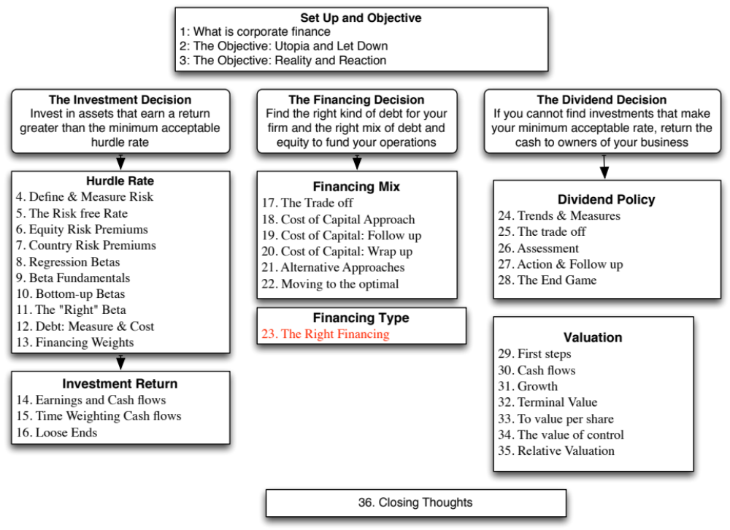

Slide 3
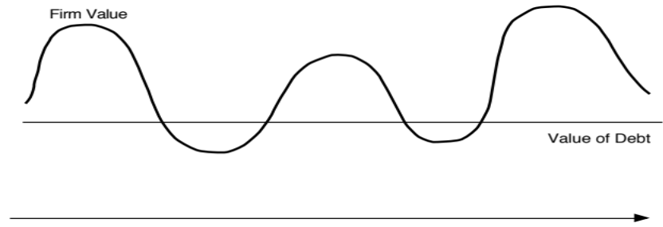

Designing Debt: The Fundamental Principle
The objective in designing debt is to make the cash flows on debt match up as closely as possible with the cash flows that the firm makes on its assets.
By doing so, we reduce our risk of default, increase debt capacity and increase firm value.
Unmatched Debt
Matched Debt
Notes:
Your objective is issue securities that bring you all of the tax benefits of debt while providing you with the flexibility of equity. It is not the reduction in risk but the increase in debt capacity that generates the value. A firm that does not use this debt capacity will not gain from matching debt to assets in the first place.

Slide 4
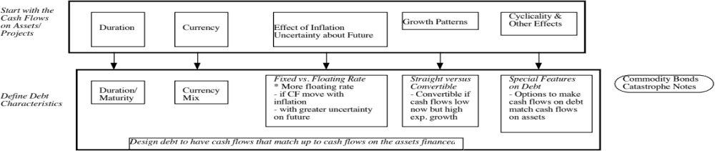
Design the perfect financing instrument
The perfect financing instrument will
  Have all of the tax advantages of debt
  While preserving the flexibility offered by equity
Notes:
There is ample scope for creativity in trying to design the perfect bond. The idea is to design debt that looks and acts like equity, in terms of the cash flows.
Consider each aspect;
Duration: Companies with long term projects (Boeing) should use long term debt. Companies with short term projects (Dell) should use short term debt.
Currency: Companies that get a high proportion of their revenues from non-domestic operations should use more foreign currency debt (especially if the currency mix is stable.
Inflation: Companies with pricing power can pass inflation through into their cash flows. These companies should be much better candidates for floating rate debt (because interest expenses on the debt will rise and fall with inflation).
Growth pattern: Mature companies with level , steady cash flows should be much better candidates for straight debt, whereas growth companies are much better candidates for convertible debt.

Slide 5
Ensuring that you have not crossed the line drawn by the tax code
All of this design work is lost, however, if the security that you have designed does not deliver the tax benefits.
In addition, there may be a trade off between mismatching debt and getting greater tax benefits.
Notes:
Note though that all is lost if the tax authorities do not allow you to subtract interest expenses for tax purposes.
It is also possible that you could increase your tax benefits by deviating from your perfect bond and issuing bonds in the wrong currency or the wrong maturity.

Slide 6
While keeping equity research analysts, ratings agencies and regulators applauding
Ratings agencies want companies to issue equity, since it makes them safer.
Equity research analysts want them not to issue equity because it dilutes earnings per share.
Regulatory authorities want to ensure that you meet their requirements in terms of capital ratios (usually book value). Financing that leaves all three groups happy is nirvana.
Notes:
This is a tough balancing act to pull off. You have to issue a security that looks like equity to the ratings agency, debt to the equity research analysts and equity again to your regulatory authorities (if you are a financial service firm).
While it may seem impossible, trust preferred and several other very profitable innovations (at least to investment bankers) have succeeded in doing this.

Slide 7
Debt or Equity: The Strange Case of Trust Preferred
Trust preferred stock has
  A fixed dividend payment, specified at the time of the issue
  That is tax deductible
  And failing to make the payment can give preferred stockholders voting rights.
When trust preferred was first created, ratings agencies treated it as equity. As they have become more savvy, ratings agencies have started giving firms only partial equity credit for trust preferred.
Assuming that trust preferred stock gets treated as equity by ratings agencies, which of the following firms is the most appropriate firm to be issuing it?
  A firm that is under levered, but has a rating constraint that would be violated if it moved to its optimal
  A firm that is over levered that is unable to issue debt because of the rating agency concerns.
Notes:
Ratings agencies have learnt over time, but slowly. As they have learnt, investment banks have come up with new securities that have the same objective.
I would expect under levered firms to gain, and over levered firms to lose by doing this. The latter might fool the ratings agencies but they lose because of the expected default cost that they create for themselves.

Slide 8
Soothe bondholder fears
There are some firms that face skepticism from bondholders when they go out to raise debt, because
  Of their past history of defaults or other actions
  They are small firms without any borrowing history
Bondholders tend to demand much higher interest rates from these firms to reflect these concerns.
Notes:
While adding these conditions to debt may make it less attractive to the firm, it may be only way they can borrow.

Slide 9
And do not lock in market mistakes that work against you
Ratings agencies can sometimes under rate a firm, and markets can underprice a firm’s stock or bonds. If this occurs, firms should not lock in these mistakes by issuing securities for the long term. In particular,
  Issuing equity or equity based products (including convertibles), when equity is under priced transfers wealth from existing stockholders to the new stockholders
  Issuing long term debt when a firm is under rated locks in rates at levels that are far too high, given the firm’s default risk.
What is the solution
  if you need to use equity?
  if you need to use debt?
Notes:
When you feel that your equity or debt is under valued, you do not want to lock in the under valuation. You should use short-term solutions (bridge financing) until they feel more comfortable with the valuations. Bridge financing includes short term debt and short term warrants.

Slide 10
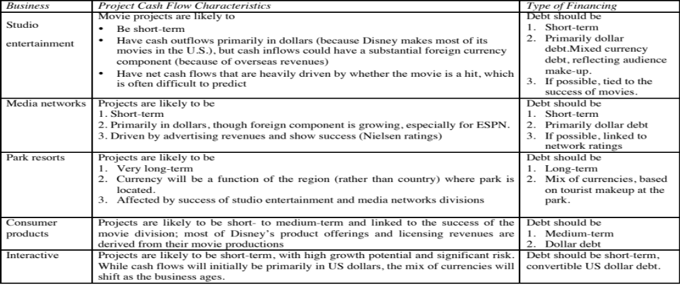
Designing Disney’s Debt
Notes:
There is plenty of room to be creative in this approach.
Look at firms which operate in each of these businesses and see what financing they use. That might be useful in designing the right kind of debt.

Slide 11
Recommendations for Disney
The debt issued should be long term and should have duration of about 4 to 5 years.
A significant portion of the debt should be floating rate debt, reflecting Disney’s pricing power.
Given Disney’s sensitivity to a stronger dollar, a portion of the debt should be in foreign currencies. Based upon 2013 numbers at least, this would indicate that about 18% of its debt should be foreign currency debt. As its broadcasting businesses expand into Latin America, it may want to consider using either Mexican Peso or Brazilian Real debt as well.
Notes:
Converts the numbers into tangible recommendations…

Slide 12
Analyzing Disney’s Current Debt
Disney has $14.3 billion in interest-bearing debt with a face-value weighted average maturity of 7.92 years. Allowing for the fact that the maturity of debt is higher than the duration, this would indicate that Disney’s debt may be a little longer than would be optimal, but not by much.
Of the debt, about 5.49% of the debt is in non-US dollar currencies (Indian rupees and Hong Kong dollars), but the rest is in US dollars and the company has no Euro debt. Based on our analysis, we would suggest that Disney increase its proportion of Euro debt to about 12% and tie the choice of currency on future debt issues to its expansion plans.
Disney has no convertible debt and about 5.67% of its debt is floating rate debt, which looks low, given the company’s pricing power. While the mix of debt in 2013 may be reflective of a desire to lock in low long-term interest rates on debt, as rates rise, the company should consider expanding its use of foreign currency debt.
Notes:
There may be good reasons for the mismatch but for most firms, the existing debt structure is more a result of history and inertia. Disney’s business mix has changed significantly over the last decade - more broadcasting, less theme park - and it is not surprising that the debt structure has not kept pace.
In some cases, market frictions and limitations may contribute to the mismatch. In fact, many emerging market companies were unable to borrow long term until recently because banks would not lend long term in those markets.

Slide 13
Adjusting Debt at Disney
It can swap some of its existing fixed rate, dollar debt for floating rate, foreign currency debt. Given Disney’s standing in financial markets and its large market capitalization, this should not be difficult to do.
If Disney is planning new debt issues, either to get to a higher debt ratio or to fund new investments, it can use primarily floating rate, foreign currency debt to fund these new investments. Although it may be mismatching the funding on these investments, its debt matching will become better at the company level.
Notes:
Disney’s large size and access to capital markets give it lots of options. Smaller firms and emerging market firms will have fewer options. In the extreme scenario, it may take more time to adjust the debt.

Slide 14
Debt Design for Bookscape & Vale
Bookscape: Given Bookscape’s dependence on revenues at its New York bookstore, we would design the debt to be
  Recommendation: Long-term, dollar denominated, fixed rate debt
  Actual: Long term operating lease on the store
Vale: Vale’s mines are spread around the world, and it generates a large portion of its revenues in China (37%). Its mines typically have very long lives and require large up-front investments, and the costs are usually in the local currencies but its revenues are in US dollars.
  Recommendation: Long term, dollar-denominated debt (with hedging of local currency risk exposure) and if possible, tied to commodity prices.
  Actual: The existing debt at Vale is primarily US dollar debt (65.48%), with an average maturity of 14.70 years. All of the debt, as far as we can assess, is fixed rate and there is no commodity-linked debt.
Notes:
We don’t even try to assess Deutsche’s right debt because its assets are constantly changing and debt plays a different role in a bank… it is more raw material than source of capital.

Slide 15
And for Tata Motors and Baidu
Tata Motors: As an manufacturing firm, with big chunks of its of its revenues coming from India and China (about 24% apiece) and the rest spread across developed markets.
  Recommendation: Medium to long term, fixed rate debt in a mix of currencies reflecting operations.
  Actual: The existing debt at Tata Motors is a mix of Indian rupee debt (about 71%) and Euro debt (about 29%), with an average maturity of 5.33 years and it is almost entirely fixed rate debt.
Baidu: Baidu has relatively little debt at the moment, reflecting its status as a young, technology company.
  Recommendation: Convertible, Chinese Yuan debt.
  Actual: About 82% of Baidu’s debt is in US dollars and Euros currently, with an average maturity of 5.80 years. A small portion is floating rate debt, but very little of the debt is convertible.
Notes:
As emerging market companies, they had few choices a decade or so ago. Now, their choices have increased as corporate bond markets have opened up domestically and both firms have access to foreign capital markets.

Slide 16
6 Application Test: Choosing your Financing Type
Based upon the business that your firm is in, and the typical investments that it makes, what kind of financing would you expect your firm to use in terms of
  Duration (long term or short term)
  Currency
  Fixed or Floating rate
  Straight or Convertible
Notes:
Based upon what a typical investment looks like, assess the right type of debt for your firm….

Slide 17

Task
Determine the right type of financing for your firm, given its characteristics
Read
Chapter 9

