Slide 1
Dividends: Just the facts!
Dividends are sticky.
Notes:
Sets the agenda for the class. This is a class that will be focused on the big picture of corporate finance rather than details, theories or models on a piecemeal basis.

Slide 2
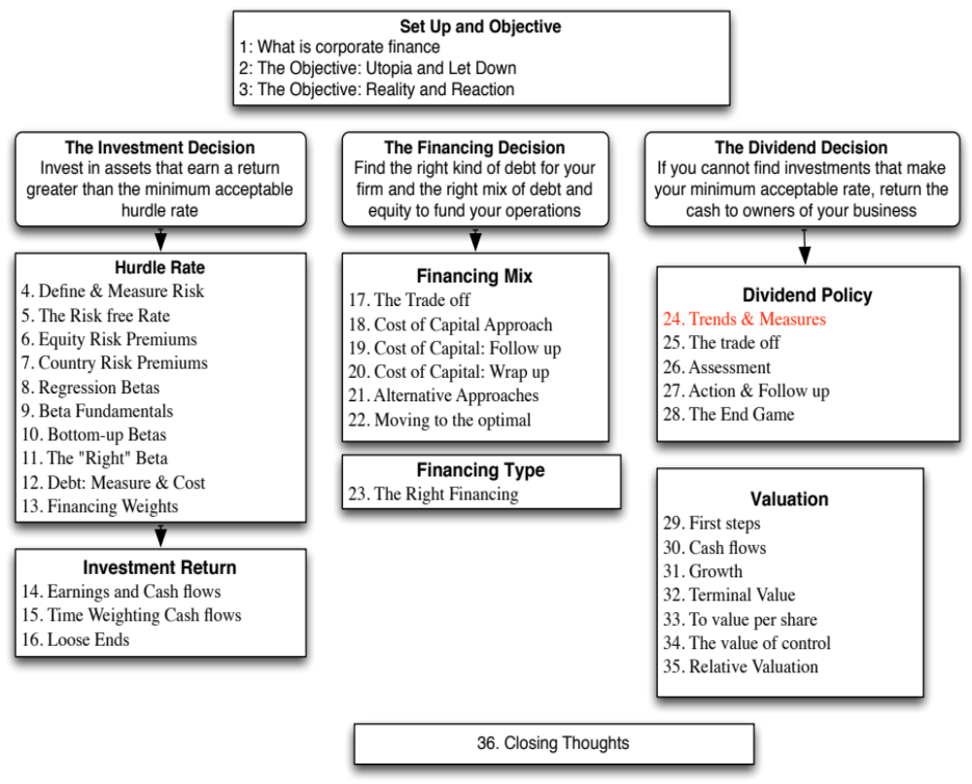

Slide 3
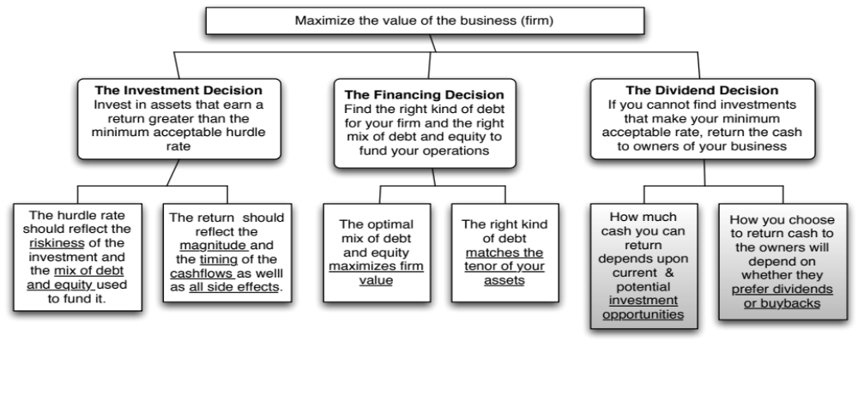
First Principles
Notes:
Third and final principle of corporate finance.

Slide 4
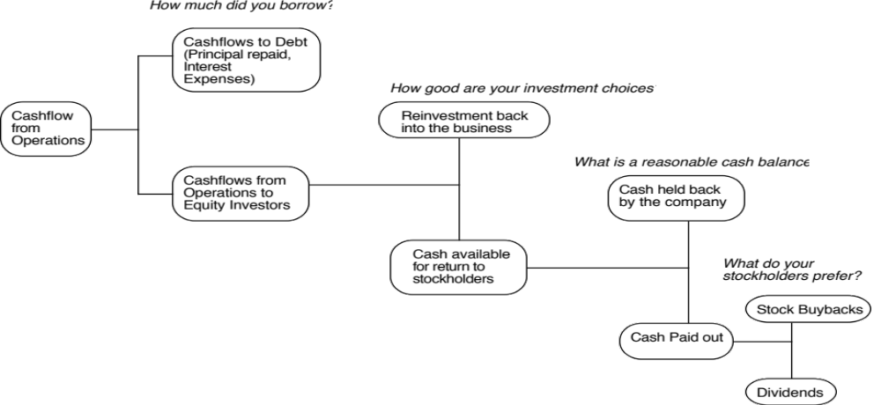
Steps to the Dividend Decision…
Notes:
Dividend policy is affected by investment and financing decisions…. And dividend decisions may affect investment and financing decisions. In other words, analyzing dividends has to be part and parcel of analyzing the whole company.

Slide 5
I. Dividends are sticky
Notes:
Most companies in most years pay out what they did last year as dividends. Among firms that change dividends, increases are more common than decreases.

Slide 6
II. Dividends tend to follow earnings
Notes:
Dividends tend to follow earnings. They don’t lead them and they are not contemporaneous. In other words, don’t expect a company to pay out more in dividends if their earnings go up… If earnings go up two years in a row, maybe.. Three years in a row and the odds increase.

Slide 7
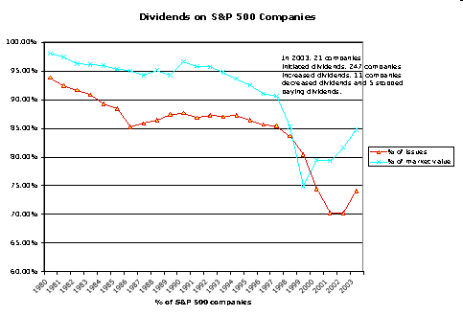
II. Are affected by tax laws…
In 2003
In the last quarter of 2012
As the possibility of tax rates reverting back to pre-2003 levels rose, 233 companies paid out $31 billion in dividends.
Of these companies, 101 had insider holdings in excess of 20% of the outstanding stock.
Notes:
I picked these years either because tax laws changed drastically (2003) or were expect to (2012).

Slide 8
IV. More and more firms are buying back stock, rather than pay dividends...
Notes:
This trend accelerated through the 1990s. It can be partially explained by
An increase in the volatility of earnings at all companies, making dividends much more difficult to maintain
An increasing proportion of investors who invested primarily for capital gains
Managers being compensated with options like stock buybacks more than dividends since the latter leads to lower stock prices.

Slide 9
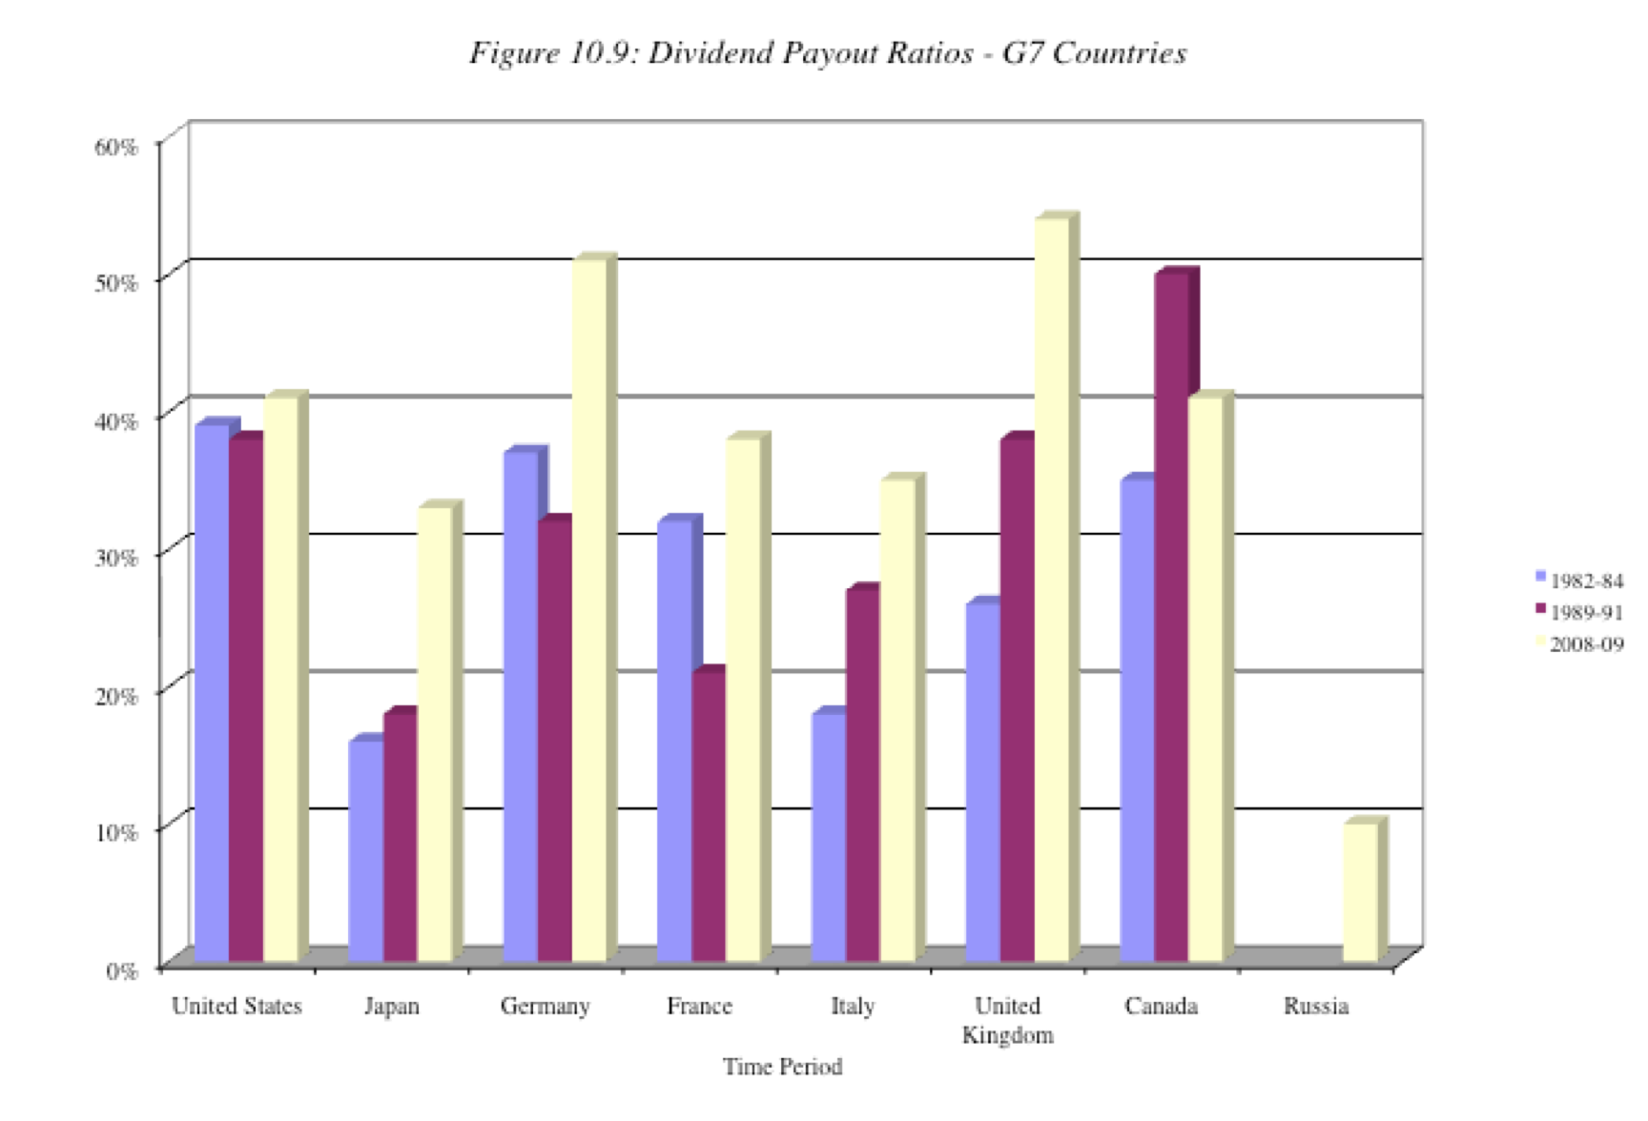
V. And there are differences across countries…
Notes:
Dividend policy vary across countries.
1. Differences in Stage of Growth: Just as higher-growth companies tend to pay out less of their earnings in dividends countries with higher growth pay out less in dividends. For instance, Japan had much higher expected growth in 1982–84 than the other G-7 countries and paid out a much smaller percentage of its earnings as dividends. As Japan’s growth declined, its payout ratio has risen.
2. Differences in Tax Treatment: Unlike the United States, where dividends are doubly taxed, some countries provide at least partial protection against the double taxation of dividends. For instance, Germany taxes corporate retained earnings at a higher rate than corporate dividends and the United Kingdom allows investors to offset corporate taxes against taxes due on dividends, thus reducing the effective tax rate on dividends.
3. Differences in Corporate Control: When there is a separation between ownership and management, as there is in many large publicly traded firms, and where stockholders have little control over managers, the dividends paid by firms will be lower. Managers, left to their own devices, have an incentive to accumulate cash. Russia, with its abysmal corporate governance system, has a dividend payout ratio of less than 10% in 2009.
4. Stock buyback restrictions: Especially in earlier perods, non_US companies faced restrictions on stock buybacks.
Not surprisingly, the dividend payout ratios of companies in most emerging markets are much lower than the dividend payout ratios in the G-7 countries. The higher growth and relative power of incumbent management in these countries contribute to keeping these payout ratios low.

Slide 10
Measures of Dividend Policy
Dividend Payout = Dividends/ Net Income
  Measures the percentage of earnings that the company pays in dividends
  If the net income is negative, the payout ratio cannot be computed.
Dividend Yield = Dividends per share/ Stock price
  Measures the return that an investor can make from dividends alone
  Becomes part of the expected return on the investment.
B DES Page 3
PB Page 41-43
Notes:
These are the two most common measures of dividend. They both focus on traditional dividends, and could be modified to include stock buybacks.

Slide 11
Dividend Payout Ratios
Notes:
The median payout ratio is between 20 and 30% for firms that pay dividends.
More firms (about 2/3rds of all US firms), however, do not pay dividends than do pay dividends. The trend in the number of non-dividend paying firms has been upwards over the last few decades.
Finally, a few interesting outliers.
The firms that have dividend payout ratios of more than 100% may seem irrational but there are three possible explanations:
Firms having a bad year in earnings, but expect earnings to bounce back.. They continue to pay dividends based upon their normalized earnings
Very stable firms that have little capital expenditures but large depreciation. Their cash flows (which they use for dividends) vastly exceed earnings. These firms are gradually liquidating themselves over time.
Firms that are under levered are paying more in dividends than earnings and funding the difference with new debt to increase debt ratios.

Slide 12
Dividend Yields
Notes:
Here again, there is a trend. Over the last two decades, the dividend yield for U.S. firms has decreased across the board.
In 2009, the dividend yields shot up, not because dividends increased but stock prices decreased.
Bottom line: Volatility in dividend yields is caused more by changes in the denominator (stock prices) than in the numerator (dividends)

Slide 13
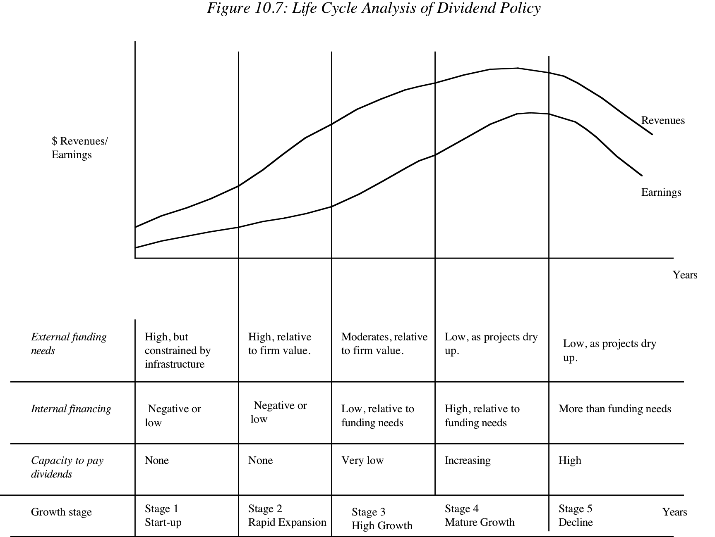
Notes:
One way of assessing dividend policy is to look at where a firm stands in the life cycle. As firms grow and mature, their capacity to generate excess cash flows and pay dividends should increase….

Slide 14
Dividend Yields and Payout Ratios: Growth Classes
Notes:
Some backing for the life cycle story.
These are US firms, categorized based upon expected growth in earnings. As earnings growth increases, both dividend yields and payout ratios decrease.

Slide 15
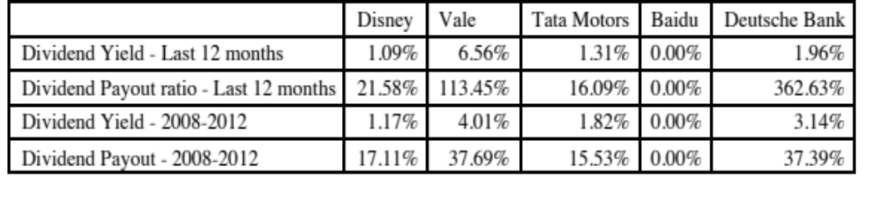
Dividend Policy: Disney et al.
Notes:
Baidu pays no dividends (Are you surprised?) Shows the life cycle effect.
Vale’s dividend yield and payout ratio look rich and part of it may be explained by Vale’s use of non-voting shares, which carry a heavy requirement on dividends (if you don’t pay them, you have to give up voting rights). Part of it also reflects the volatility of income over time, since the yield and payout ratio are lower if you use five-year averages.

Slide 16

Task
Evaluate how much your company has paid out in dividends, relative to earnings & market cap
Read
Chapter 10

