Slide 1
Dividend assessment: The cash-trust nexus
Dividend policy rests on management trust.
Notes:
Sets the agenda for the class. This is a class that will be focused on the big picture of corporate finance rather than details, theories or models on a piecemeal basis.

Slide 2
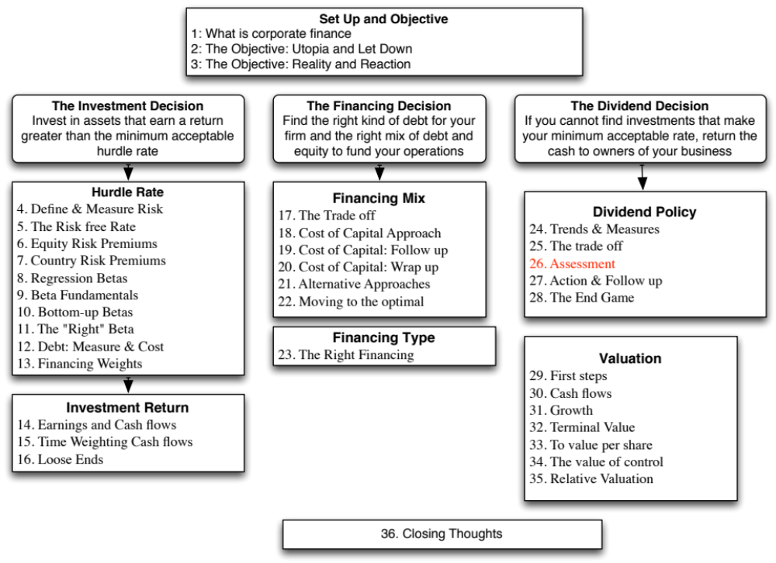

Slide 3
The Cash/Trust Assessment
Step 1: How much could the company have paid out during the period under question?
Step 2: How much did the the company actually pay out during the period in question?
Step 3: How much do I trust the management of this company with excess cash?
  How well did they make investments during the period in question?
  How well has my stock performed during the period in question?
Notes:
By paid out to stockholders in this phase of the analysis, we mean both dividends and stock buybacks.

Slide 4
How much has the company returned to stockholders?
As firms increasing use stock buybacks, we have to measure cash returned to stockholders as not only dividends but also buybacks.
For instance, for the companies we are analyzing the cash returned looked as follows.
 | Disney |  | Vale |  | Tata Motors |  | Baidu |  | Deutsche Bank
Year | Dividends | Buybacks | Dividends | Buybacks | Dividends | Buybacks | Dividends | Buybacks | Dividends | Buybacks
2008 | $648 | $648 | $2,993 | $741 | 7,595₹ | 0₹ | ¥0 | ¥0 | 2,274 € | 0 €
2009 | $653 | $2,669 | $2,771 | $9 | 3,496₹ | 0₹ | ¥0 | ¥0 | 309 € | 0 €
2010 | $756 | $4,993 | $3,037 | $1,930 | 10,195₹ | 0₹ | ¥0 | ¥0 | 465 € | 0 €
2011 | $1,076 | $3,015 | $9,062 | $3,051 | 15,031₹ | 0₹ | ¥0 | ¥0 | 691 € | 0 €
2012 | $1,324 | $4,087 | $6,006 | $0 | 15,088₹ | 970₹ | ¥0 | ¥0 | 689 € | 0 €
2008-12 | $4,457 | $15,412 | $23,869 | $5,731 | 51,405₹ | 970₹ | ¥0 | ¥0 | ¥4,428 | ¥0
Notes:
All four companies paid dividends over the five-year period, but there are interesting differences between the companies.
Disney uses buybacks more than the other firms to return cash to investors, though Vale seems to have caught on as wel.
Tata Motors seems intent on increasing dividends every year, even if by a fraction. It takes a really bad year for them to cut dividends (2009)
Deutsche cut dividends after the banking crisis but seems to be returning to the fray.

Slide 5
A Measure of How Much a Company Could have Afforded to Pay out: FCFE
The Free Cashflow to Equity (FCFE) is a measure of how much cash is left in the business after non-equity claimholders (debt and preferred stock) have been paid, and after any reinvestment needed to sustain the firm’s assets and future growth.
  Net Income
  + Depreciation & Amortization
  = Cash flows from Operations to Equity Investors
  - Preferred Dividends
  - Capital Expenditures
  - Working Capital Needs
  - Principal Repayments
  + Proceeds from New Debt Issues
  = Free Cash flow to Equity
Notes:
This cashflow is
Free: because it cashflow left over after debt payments and investment needs have been met
To Equity Investors: because it is after payments to all non-equity claimholders
In coming up with the numbers, we define
Capital expenditures as including all capital investments. We do not distinguish between discretionary and non-discretionary cap ex. Once we assume growth in earnings, all cap ex is non-discretionary.
Working capital needs refers to the increase in non-cash working capital.

Slide 6
Disney’s FCFE: 2008 – 2012
 | 2012 | 2011 | 2010 | 2009 | 2008 | Aggregate
Net Income | $6,136 | $5,682 | $4,807 | $3,963 | $3,307 | $23,895
- (Cap. Exp - Depr) | $604 | $1,797 | $1,718 | $397 | $122 | $4,638
- ∂ Working Capital | ($133) | $940 | $950 | $308 | ($109) | $1,956
Free CF to Equity (pre-debt) | $5,665 | $2,945 | $2,139 | $3,258 | $3,294 | $17,301
+ Net Debt Issued | $1,881 | $4,246 | $2,743 | $1,190 | ($235) | $9,825
= Free CF to Equity (actual debt) | $7,546 | $7,191 | $4,882 | $4,448 | $3,059 | $27,126
Free CF to Equity (target debt ratio) | $5,720 | $3,262 | $2,448 | $3,340 | $3,296 | $18,065
Dividends | $1,324 | $1,076 | $756 | $653 | $648 | $4,457
Dividends + Buybacks | $5,411 | $4,091 | $5,749 | $3,322 | $1,296 | $19,869
Disney returned about $1.5 billion more than the $18.1 billion it had available as FCFE with a normalized debt ratio of 11.58% (its current debt ratio).
Notes:
The depreciation numbers also include amortization and the capital expenditures include cash acquisitions. Increases in noncash working capital, shown as positive numbers, represent a drain on the cash, whereas decreases in noncash working capital, shown as negative numbers, represent positive cash flows. In 2008, for example, noncash working capital decreased by $109 million, increasing the cash available for stockholders in that year by the same amount. Finally, the net cash flow from debt is the cash generated by the issuance of new debt, netted out against the cash outflow from the repayment of old debt. Again, using 2008 as an example, Disney repaid $235 more in old debt than it raised in new debt, and this represents a negative cash flow in that year. We have computed three measures of FCFE, one before the net debt cash flow, one after the actual net debt cash flow and one computed assuming that they had stuck with a target debt ratio of 40%. Using 2008 as an illustration, we compute each as follows:
FCFE_{Before Debt CF}= Net Income + Depreciation – Capital Expenditures – Change in Noncash Working Capital = 3307 -122 –(-109) = 3294
FCFE_{After Debt CF}= FCFE_{Before Debt CF} + Net Debt CF = 3296 - 235 = 3059
FCFE target debt ratio = 3307 – (122-109) (1-.40) =3296

Slide 7
Estimating FCFE when Leverage is Stable
Net Income
- (1- DR) (Capital Expenditures - Depreciation)
- (1- DR) Working Capital Needs
= Free Cash flow to Equity
DR = Debt/Capital Ratio
For this firm,
  Proceeds from new debt issues = Principal Repayments + d (Capital Expenditures - Depreciation + Working Capital Needs)
  Thus, whatever debt has to be repaid gets paid off with new debt and additional debt is taken on to fund growth in the firm.
Notes:
When leverage is stable,
All principal repayments will come from new debt issues (since repaying them with equity will lower the debt ratio)
New external financing needs [Cap Ex - Depreciation + Change in non-cash working capital] have to be financed using the desired debt ratio
Adding the two together:
New Debt Issues = Principal Repayments + δ ( Cap Ex - Depreciation + Change in Non-cash Working Capital)
Substituting back into the FCFE equation on the previous page in the case where there is no preferred dividend, we arrive at this formula. If there are preferred dividends, they will be subtracted out to get to the FCFE.

Slide 8
An Example: FCFE Calculation
Consider the following inputs for Microsoft in 1996. In 1996, Microsoft’s FCFE was:
  Net Income = $2,176 Million
  Capital Expenditures = $494 Million
  Depreciation = $ 480 Million
  Increase in Non-Cash Working Capital = $ 35 Million
  Debt Ratio = 0%
FCFE = Net Income - (Cap ex - Depr) (1-DR) - Chg WC (!-DR)
  = $ 2,176 - (494 - 480) (1-0) - $ 35 (1-0)
  = $ 2,127 Million
By this estimation, Microsoft could have paid $ 2,127 Million in dividends/stock buybacks in 1996. They paid no dividends and bought back no stock. Where will the $2,127 million show up in Microsoft’s balance sheet?
Notes:
Note that Microsoft has almost no net cap ex. That is because their biggest reinvestment expenditure is R&D, which is expensed to arrive at net income.

Slide 9
FCFE for a Bank?
We redefine reinvestment as investment in regulatory capital.
FCFE_{Bank}= Net Income – Increase in Regulatory Capital (Book Equity)
Consider a bank with $ 10 billion in loans outstanding and book equity of $ 750 million. If it maintains its capital ratio of 7.5%, intends to grow its loan base by 10% to $11 billion and expects to generate $ 150 million in net income:
  FCFE = $150 million – (11,000-10,000)* (.075) = $75 million
Deutsche Bank: FCFE estimates (November 2013)
 | Current | 1 | 2 | 3 | 4 | 5
Asset Base | 439,851 € | 453,047 € | 466,638 € | 480,637 € | 495,056 € | 509,908 €
Capital ratio | 16.00% | 16.00% | 16.00% | 16.00% | 16.00% | 16.00%
Tier 1 Capital | 70,376 € | 72,487 € | 74,662 € | 76,902 € | 79,209 € | 81,585 €
Change in regulatory capital |  | 2,111 € | 2,175 € | 2,240 € | 2,307 € | 2,376 €
Book Equity | 76,829 € | 78,940 € | 81,115 € | 83,355 € | 85,662 € | 88,038 €
ROE | -1.08% | 0.74% | 2.55% | 4.37% | 6.18% | 8.00%
Net Income | -757 € | 584 € | 2,072 € | 3,642 € | 5,298 € | 7,043 €
- Investment in Regulatory Capital |  | 2,111 € | 2,175 € | 2,240 € | 2,307 € | 2,376 €
FCFE |  | -1,528 € | -102 € | 1,403 € | 2,991 € | 4,667 €
Notes:
We draw on the regulatory capital measure to estimate FCFE. Since it is difficult to estimate traditional cap ex and working capital for a bank, we look at additions to regulatory capital as the primary capital expenditure. Thus, conservative banks or banks that want to increase their capital ratio will tend to pay less dividends, as will growing banks.
See how much dividend you could pay, if you were willing to maintain a 6% capital ratio ($90 million) or if your growth were only 5% ($112.5 million).
For Deutsche Bank, we are assuming the following:
We begin with the current values for the asset base and regulatory capital at the end of 2012
2. We assume that the expected growth in the asset base will be 3% a year for the next 5 years and 2% thereafter.
3. We assume a target Tier 1 regulatory capital ratio of 16% in year 5..
4. We assume that the return on equity from the current value of -1.08% to 8% in year 5 and beyond.

Slide 10
Dividends versus FCFE: Across the globe
Dividend Class | US | Europe | Japan | Emerging Markets | Aus, NZ & Canada | Global
FCFE<0, No Dividends/Buybacks | 28.31% | 28.38% | 10.90% | 21.78% | 59.49% | 26.91%
FCFE >0, No Dividends/Buybacks | 29.86% | 19.56% | 13.26% | 23.01% | 15.76% | 22.05%
FCFE >0, FCFE>Dividends+Buybacks | 14.52% | 22.93% | 35.04% | 22.98% | 9.02% | 21.10%
CASH ACCUMULATORS | 44.38% | 42.49% | 48.30% | 45.98% | 24.77% | 43.16%
FCFE >0, FCFE<Dividends+Buybacks | 8.80% | 9.74% | 8.40% | 7.91% | 4.62% | 8.05%
FCFE<0, 've Dividends+Buybacks | 18.51% | 19.38% | 32.40% | 24.34% | 11.11% | 21.88%
OVER PAYERS | 27.31% | 29.12% | 40.80% | 32.24% | 15.73% | 29.93%
Notes:
Many firms in 2013 seemed to be paying out more than they could afford to in dividends.

Slide 11
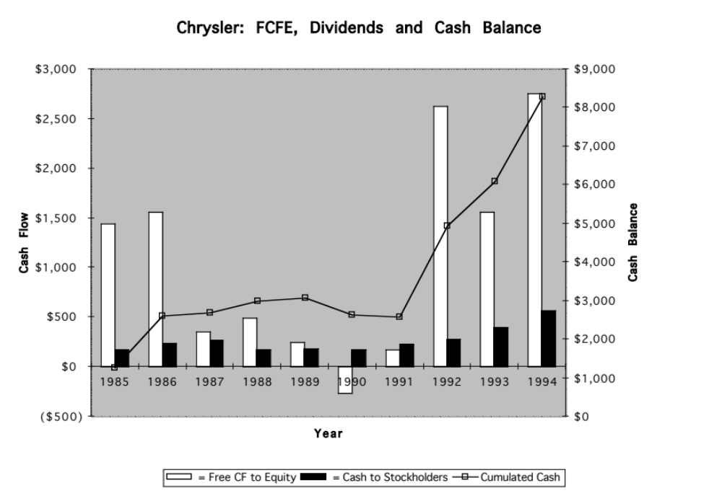
The Consequences of Failing to pay FCFE
Notes:
This shows the accumulation of a large cash balance at Chrysler. Starting with a zero cash balance in 1985, I added back the difference between FCFE and dividends each year to the cash balance. In the last few years, that difference has led to an accumulation in cash.
This large cash balance, of course, was what triggered the attempt by Kirk Kirkorian to take over Chrysler. While he failed, he did put sufficient pressure on Chrysler to force them to increase dividends and buy back stock.
Note that while Chrysler has argued that it needs a large cash balance as a buffer against the next recession, it used up only $ 0.5 billion during the 1990-91 recession.

Slide 12
6 Application Test: Estimating your firm’s FCFE
In General, If cash flow statement used
  Net Income Net Income
  + Depreciation & Amortization + Depreciation & Amortization
  - Capital Expenditures + Capital Expenditures
  - Change in Non-Cash Working Capital + Changes in Non-cash WC
  - Preferred Dividend + Preferred Dividend
  - Principal Repaid + Increase in LT Borrowing
  + New Debt Issued + Decrease in LT Borrowing
  + Change in ST Borrowing
  = FCFE = FCFE
Compare to
Dividends (Common)
+ Stock Buybacks
B FA page
PB Page 44
Notes:
Estimate the firm’s FCFE and compare to how much it returned to stockholders.

Slide 13

Task
Estimate the potential dividends for your company and it’s current cash balance.
Read
Chapter 11

