Slide 1
Dividends: Follow up
Changing dividend policy is hard to do, but not doing it can be worse.
Notes:
Sets the agenda for the class. This is a class that will be focused on the big picture of corporate finance rather than details, theories or models on a piecemeal basis.

Slide 2
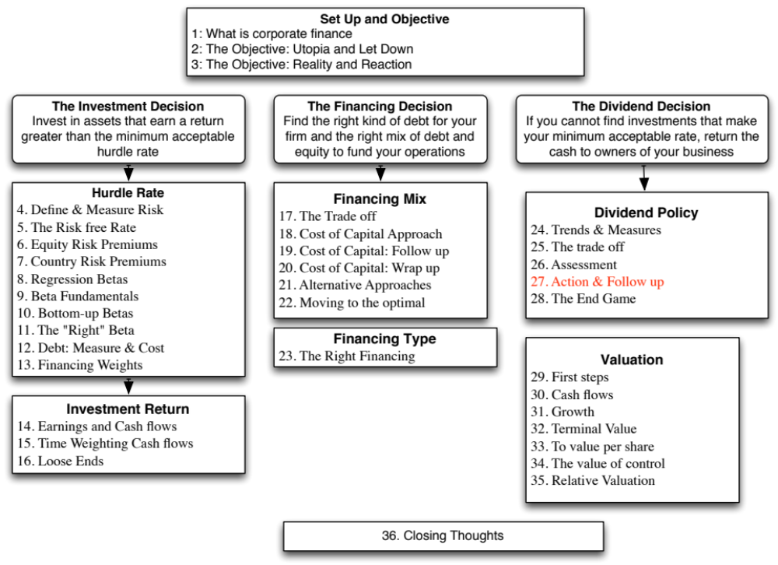

Slide 3
A Practical Framework for Analyzing Dividend Policy
How much did the firm pay out? How much could it have afforded to pay out?
What it could have paid out
What it actually paid out
Net Income
Dividends
- (Cap Ex - Depr’n) (1-DR)
+ Equity Repurchase
- Chg Working Capital (1-DR)
= FCFE
Firm pays out too little
Firm pays out too much
FCFE > Dividends
FCFE < Dividends
Do you trust managers in the company with
What investment opportunities does the
your cash?
firm have?
Look at past project choice:
Look at past project choice:
Compare
ROE to Cost of Equity
Compare
ROE to Cost of Equity
ROC to WACC
ROC to WACC
Firm has history of
Firm has history
Firm has good
Firm has poor
good project choice
of poor project
projects
projects
and good projects in
choice
the future
Give managers the
Force managers to
Firm should
Firm should deal
flexibility to keep
justify holding cash
cut dividends
with its investment
cash and set
or return cash to
and reinvest
problem first and
dividends
stockholders
more
then cut dividends
Notes:
Most firms return less in cash than they have available to return. Whether they will find themselves under pressure (like Chrysler) or relatively untouched (like Microsoft) will depend upon how much stockholders trust the managers of the firm to use the cash wisely.
Stockholders will tend to be less aggressive about demanding that the cash be returned to them for firms
With a good investment track record
In a sector with high returns
Where managers have substantial equity stakes in the firm
They will tend to be most aggressive when these conditions do not hold.

Slide 4
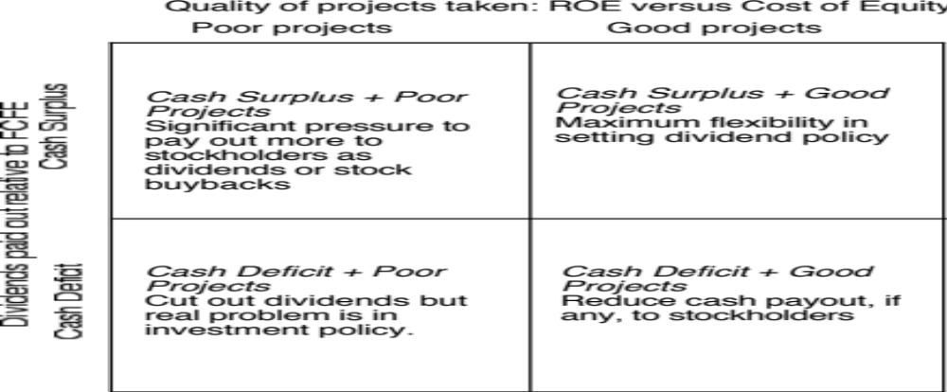
A Dividend Matrix
Notes:
The freedom that a company will have with dividend policy is directly proportional to its history in delivering high returns both on projects and to its stockholders.

Slide 5
Case 1: Disney in 2003
FCFE versus Dividends
  Between 1994 & 2003, Disney generated $969 million in FCFE each year.
  Between 1994 & 2003, Disney paid out $639 million in dividends and stock buybacks each year.
Cash Balance
  Disney had a cash balance in excess of $ 4 billion at the end of 2003.
Performance measures
  Between 1994 and 2003, Disney has generated a return on equity, on it’s projects, about 2% less than the cost of equity, on average each year.
  Between 1994 and 2003, Disney’s stock has delivered about 3% less than the cost of equity, on average each year.
  The underperformance has been primarily post 1996 (after the Capital Cities acquisition).
Notes:
In 2003, the company had been accumulating cash and had also had a poor track record in picking projects and delivering returns to its stockholders.

Slide 6
Can you trust Disney’s management?
Given Disney’s track record between 1994 and 2003, if you were a Disney stockholder, would you be comfortable with Disney’s dividend policy?
Yes
No
Does the fact that the company is run by Michael Eisner, the CEO for the last 10 years and the initiator of the Cap Cities acquisition have an effect on your decision.
Yes
No
Notes:
The fact that Disney has underperformed the market both in terms of stock price performance and return on equity suggests that stockholders are unlikely to have much patience with Disney accumulating cash (afraid of what they will do with the cash).
That conclusion is reinforced by the fact that the managers responsible for the damage are still at the helm of the firm.

Slide 7
Following up: Disney in 2009
Between 2004 and 2008, Disney made significant changes:
  It replaced its CEO, Michael Eisner, with a new CEO, Bob Iger, who at least on the surface seemed to be more receptive to stockholder concerns.
  Its stock price performance improved (positive Jensen’s alpha)
  Its project choice improved (ROC moved from being well below cost of capital to above)
The firm also shifted from cash returned < FCFE to cash returned > FCFE and avoided making large acquisitions.
If you were a stockholder in 2009 and Iger made a plea to retain cash in Disney to pursue investment opportunities, would you be more receptive?
  Yes
  No
Notes:
I would trust Disney’s management more in 2008 than I did in 2003. I would probably agree that they should retain more cash, especially in light of last year’s liquidity crisis, but it would not be a blank check. I would watch their new investments (say the acquisition of Marvel to see if they are continue to be deserving of my trust.

Slide 8
Final twist: Disney in 2013
Disney did return to holding cash between 2008 and 2013, with dividends and buybacks amounting to $2.6 billion less than the FCFE (with a target debt ratio) over this period.
Disney continues to earn a return on capital well in excess of the cost of capital and its stock has doubled over the last two years.
Now, assume that Bob Iger asks you for permission to withhold even more cash to cover future investment needs. Are you likely to go along?
Yes
No
Notes:
Disney continues to do well. That is the good news and will buy them some flexibility.
But Iger needs to mend fences and improve corporate governance.

Slide 9
Case 2: Vale – Dividends versus FCFE
 | Aggregate | Average
Net Income | $57,404 | $5,740
Dividends | $36,766 | $3,677
Dividend Payout Ratio | $1 | $1
Stock Buybacks | $6,032 | $603
Dividends + Buybacks | $42,798 | $4,280
Cash Payout Ratio | $1
Free CF to Equity (pre-debt) | ($1,903) | ($190)
Free CF to Equity (actual debt) | $1,036 | $104
Free CF to Equity (target debt ratio) | $19,138 | $1,914
Cash payout as % of pre-debt FCFE | FCFE negative
Cash payout as % of actual FCFE | 4131.08%
Cash payout as % of target FCFE | 223.63%
Notes:
Vale was clearly paying too much in dividends.

Slide 10
Vale: Its your call..
Vale’s managers have asked you for permission to cut dividends (to more manageable levels). Are you likely to go along?
  Yes
  No
The reasons for Vale’s dividend problem lie in it’s equity structure. Like most Brazilian companies, Vale has two classes of shares - common shares with voting rights and preferred shares without voting rights. However, Vale has committed to paying out 35% of its earnings as dividends to the preferred stockholders. If they fail to meet this threshold, the preferred shares get voting rights. If you own the preferred shares, would your answer to the question above change?
  Yes
  No
Notes:
Vale can make a reasonable case that they should be cutting dividends and reinvesting more back into the business… Whether their investors will accept this reasoning is a different issue. After all, preferred stockholders have not had voting rights and have received large dividends to compensate for the lack of control. At the minimum, I would demand voting rights in exchange for giving up dividends.
The broader lesson: Many emerging market companies have created multiple classes of shares, with different voting rights. The lower voting right shares are often compensated with a higher dividend. Sooner or later, these firms will be confronted by the conflict between their desire to maintain voting control and the need to have a sustainable dividend policy.

Slide 11
Case 3: BP: Summary of Dividend Policy: 1982-1991
Summary of calculations
Average
Standard Deviation
Maximum
Minimum
Free CF to Equity
$571.10
$1,382.29
$3,764.00
($612.50)
Dividends
$1,496.30
$448.77
$2,112.00
$831.00
Dividends+Repurchases
$1,496.30
$448.77
$2,112.00
$831.00
Dividend Payout Ratio
84.77%
Cash Paid as % of FCFE
262.00%
ROE - Required return
-1.67%
11.49%
20.90%
-21.59%
Notes:
BP clearly paid out more than it could have afforded to during this period. It financed the shortfall (in each year except 1987, when it issued stock) by borrowing money.

Slide 12
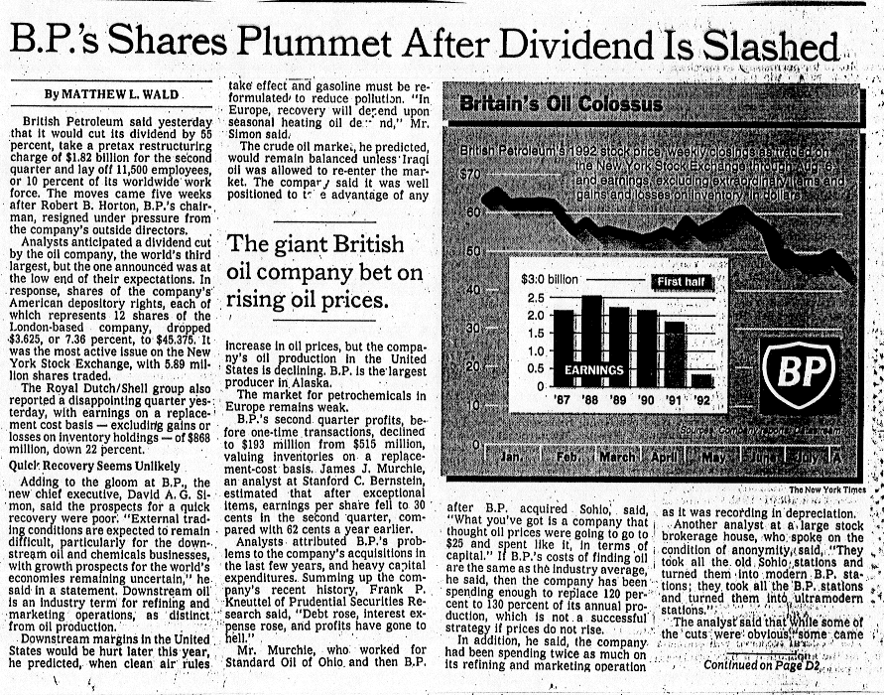
BP: Just Desserts!
Notes:
While it is pretty clear the BP should cut dividends, the stock price response was not positive when it did. This reflects the fact that investor clienteles cannot be changed overnight. In BP’s case, its history of high dividends had attracted investors who liked the high dividends. When they cut the dividends, these investors sold and a new clientele moved in, but not immediately. (It took a few months)
In hindsight, by cutting dividends, BP became a much healthier firm, with higher returns and lower leverage, after the dividend cut.

Slide 13
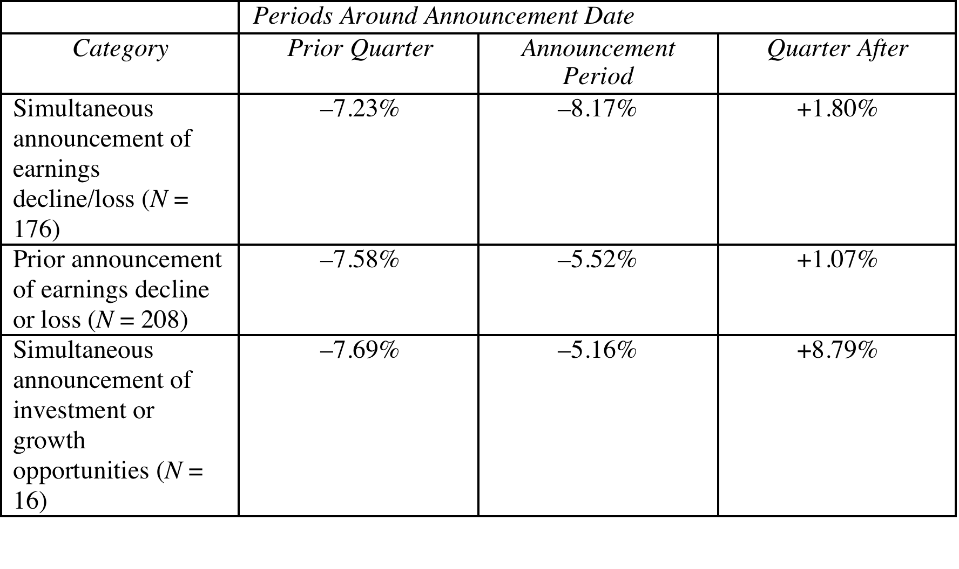
Managing changes in dividend policy
Notes:
There are several lessons for a firm that plans to change its dividend policy. First, no matter how good the rationale may be to cut dividends, it should expect markets to react negatively to the initial announcement for two reasons. The first reason is the well-founded skepticism with which markets greet any statement by the firm about dividend cuts. A second is that large dividend changes typically make the existing investor clientele unhappy. Although other stockholders may be happy with the new dividend policy, the transition will take time, during which stock prices fall. Second, if a firm has good reasons for cutting dividends, such as an increase in project availability, it will gain at least partial protection by providing information to markets about these projects.

Slide 14
Case 4: The Limited: Summary of Dividend Policy: 1983-1992
Summary of calculations
Average
Standard Deviation
Maximum
Minimum
Free CF to Equity
($34.20)
$109.74
$96.89
($242.17)
Dividends
$40.87
$32.79
$101.36
$5.97
Dividends+Repurchases
$40.87
$32.79
$101.36
$5.97
Dividend Payout Ratio
18.59%
Cash Paid as % of FCFE
-119.52%
ROE - Required return
1.69%
19.07%
29.26%
-19.84%
Notes:
A firm with negative FCFE should not pay dividends, especially when its projects earn excess returns.

Slide 15
Growth Firms and Dividends
High growth firms are sometimes advised to initiate dividends because its increases the potential stockholder base for the company (since there are some investors - like pension funds - that cannot buy stocks that do not pay dividends) and, by extension, the stock price. Do you agree with this argument?
  Yes
  No
Why?
Notes:
No. For every investor that these firms gain because they pay dividends, they lose more investors who will not buy the stock any more because the firm pays dividends.
Besides, firms which cannot afford to pay dividends should not be attracting a clientele that wants and likes dividends.

Slide 16
5. Tata Motors
 | Aggregate | Average
Net Income | $421,338.00 | $42,133.80
Dividends | $74,214.00 | $7,421.40
Dividend Payout Ratio | 17.61% | 15.09%
Stock Buybacks | $970.00 | $97.00
Dividends + Buybacks | $75,184.00 | $7,518.40
Cash Payout Ratio | 17.84%
Free CF to Equity (pre-debt) | ($106,871.00) | ($10,687.10)
Free CF to Equity (actual debt) | $825,262.00 | $82,526.20
Free CF to Equity (target debt ratio) | $47,796.36 | $4,779.64
Cash payout as % of pre-debt FCFE | FCFE negative
Cash payout as % of actual FCFE | 9.11%
Cash payout as % of target FCFE | 157.30%
Negative FCFE, largely because of acquisitions.
Notes:
Tata Motors is paying out too much, relative to its actual FCFE and the only reason that it is able to pay dividends is because of its access to debt. Looks like the Tata Group is subsidizing dividend payments to Tata Motors stockholders.

Slide 17
6 Application Test: Assessing your firm’s dividend policy
Compare your firm’s dividends to its FCFE, looking at the last 5 years of information.
Based upon your earlier analysis of your firm’s project choices, would you encourage the firm to return more cash or less cash to its owners?
If you would encourage it to return more cash, what form should it take (dividends versus stock buybacks)?
Notes:
Customize a solution for your firm’s dividend policy… but think about your earlier analysis of its capital structure as well.

Slide 18

Task
Compare the cash returned at your company to what is could have & make a judgment on whether its policies have to change.
Read
Chapter 11

