Slide 1
Valuation: First steps
Cynic: A person who knows the price of everything but the value of nothing..
Notes:
If corporate finance is all about maximizing value, you do have to know how to estimate value.

Slide 2
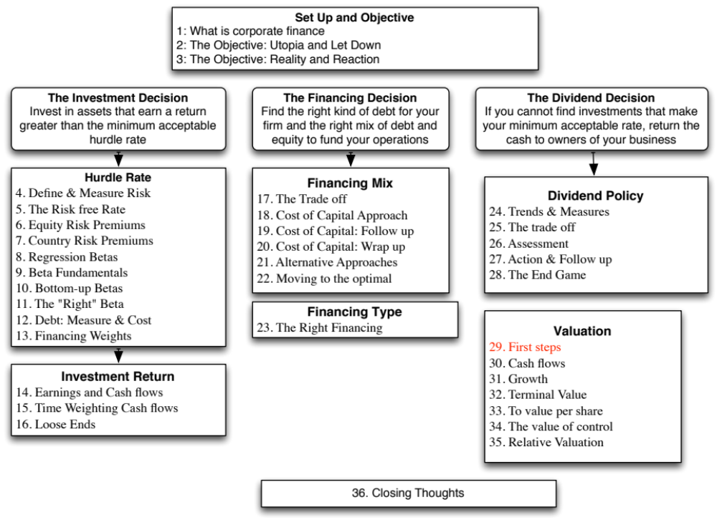

Slide 3
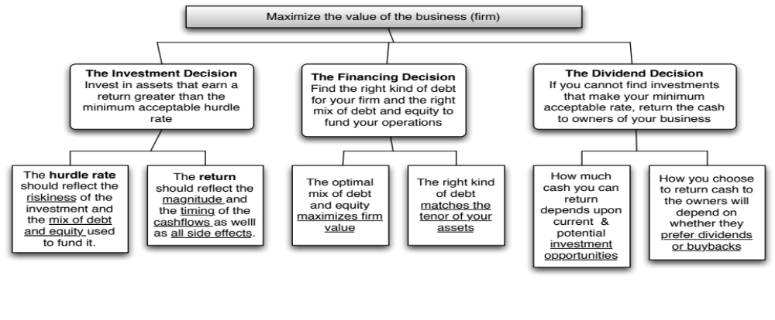
First Principles
Notes:
Back, full circle to the objective.

Slide 4
Three approaches to valuation
Intrinsic valuation: The value of an asset is a function of its fundamentals – cash flows, growth and risk. In general, discounted cash flow models are used to estimate intrinsic value.
Relative valuation: The value of an asset is estimated based upon what investors are paying for similar assets. In general, this takes the form of value or price multiples and comparing firms within the same business.
Contingent claim valuation: When the cash flows on an asset are contingent on an external event, the value can be estimated using option pricing models.
Notes:
While there are hundreds of valuation models in practice, they will all fall into one of these three categories. There are some who argue that liquidation value is a fourth approach, but we estimate the values of assets in liquidation using either discounted cash flow or relative valuation models.
Intrinsic value and relative value will converge in efficient markets, but can diverge in inefficient markets. One way to frame how companies approach corporate finance is in terms of whether they focus on maximizing intrinsic value or relative value.

Slide 5
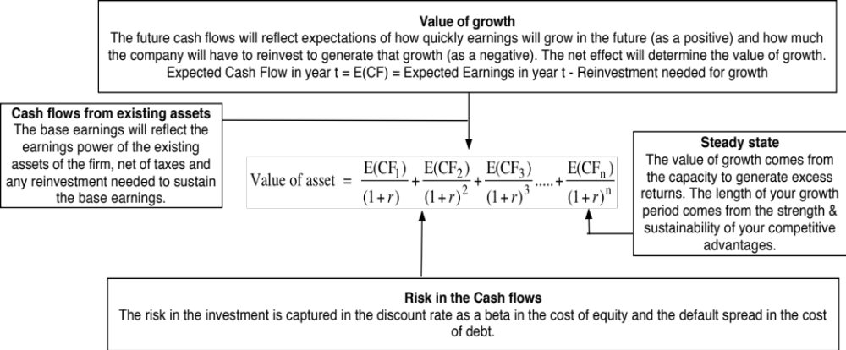
One tool for estimating intrinsic value: Discounted Cash Flow Valuation
Notes:
In discounted cash flow, the value of any asset is the present value of the expected cash flows on the assets. The discount rate becomes the vehicle for considering risks and the cash flow is an expectation across all possible outcomes.
Note: There is a misconception that computing the expected cash flow across multiple scenarios is somehow risk adjusting the cash flow. It is not.

Slide 6
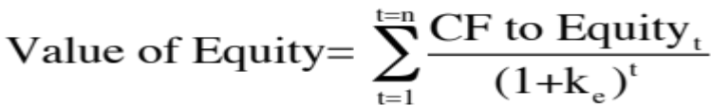
Equity Valuation
The value of equity is obtained by discounting expected cashflows to equity, i.e., the residual cashflows after meeting all expenses, tax obligations and interest and principal payments, at the cost of equity, i.e., the rate of return required by equity investors in the firm.
  where,
  CF to Equity _{t} = Expected Cashflow to Equity in period t
  ke = Cost of Equity
The dividend discount model is a specialized case of equity valuation, and the value of a stock is the present value of expected future dividends.
Notes:
The value of equity is the present value of cash flows to the equity investors discounted back at the rate of return that those equity investors need to make to break even (the cost of equity).
In the strictest sense of the word, the only cash flow stockholders in a publicly traded firm get from their investment is dividends, and the dividend discount model is the simplest and most direct version of an equity valuation model.

Slide 7
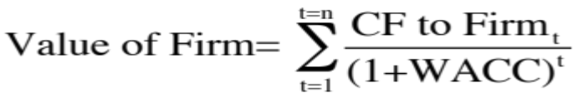
Firm Valuation
The value of the firm is obtained by discounting expected cashflows to the firm, i.e., the residual cashflows after meeting all operating expenses and taxes, but prior to debt payments, at the weighted average cost of capital, which is the cost of the different components of financing used by the firm, weighted by their market value proportions.
  where,
  CF to Firm _{t} = Expected Cashflow to Firm in period t
  WACC = Weighted Average Cost of Capital
Notes:
A firm includes not just the equity, but all claim holders. The cash flow to the firm is the collective cash flow that all claim holders make from the firm, and it is discounted at the weighted average of their different costs.

Slide 8
Choosing a Cash Flow to Discount
When you cannot estimate the free cash flows to equity or the firm, the only cash flow that you can discount is dividends. For financial service firms, it is difficult to estimate free cash flows. For Deutsche Bank, we will be discounting dividends.
If a firm’s debt ratio is not expected to change over time, the free cash flows to equity can be discounted to yield the value of equity. For Tata Motors, we will discount free cash flows to equity.
If a firm’s debt ratio might change over time, free cash flows to equity become cumbersome to estimate. Here, we would discount free cash flows to the firm. For Vale and Disney, we will discount the free cash flow to the firm.
Notes:
As a general rule, we should use a free cash flow (rather than a dividend) to discount, if we can estimate the free cash flow. It is difficult to estimate cap ex and working capital for a financial service firm.
When leverage is changing, we need to forecast debt repayments and new debt issues to estimate the free cash flow to equity. The free cash flow to the firm can be estimated much more directly.

Slide 9
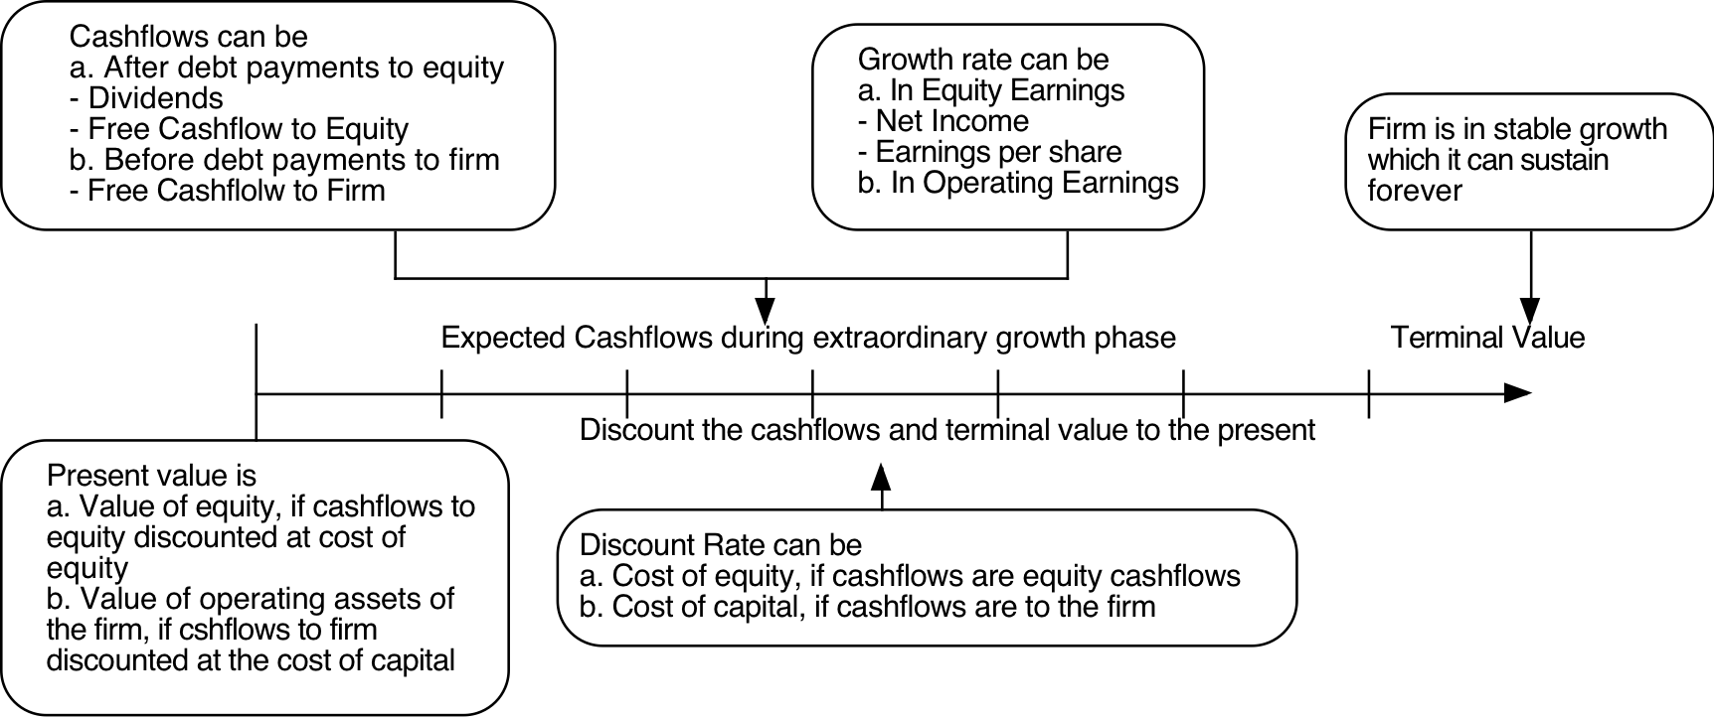
The Ingredients that determine value.
Notes:
Sets up the basic inputs:
1. Discount rates
2. Cash flows
3. Expected Growth
4. Length of the period that they can sustain a growth rate higher than the growth rate of the economy.
How we estimate each of these numbers depends on whether we are taking an equity perspective or a firm perspective.
The answer to the fourth question matters because we cannot estimate cash flows forever and a publicly traded company, at least in theory, can last forever. If cash flows grow at the same rate forever, we can short circuit the cash flow estimation and compute the present value of all cash flows beyond that point in time with one equation (CF/ (r-g)).

Slide 10
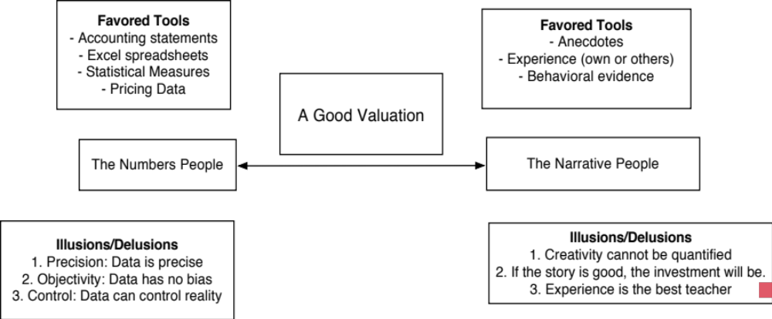
Narratives and Numbers

Slide 11

Task
Make a judgment on whether you want to value just the equity or the operating assets of your company.
Read
Chapter 12

