Slide 1
The objective in corporate finance
If you don’t know where you are going, it does not matter how you get there!
Notes:
Sets the agenda for the class. This is a class that will be focused on the big picture of corporate finance rather than details, theories or models on a piecemeal basis.

Slide 2
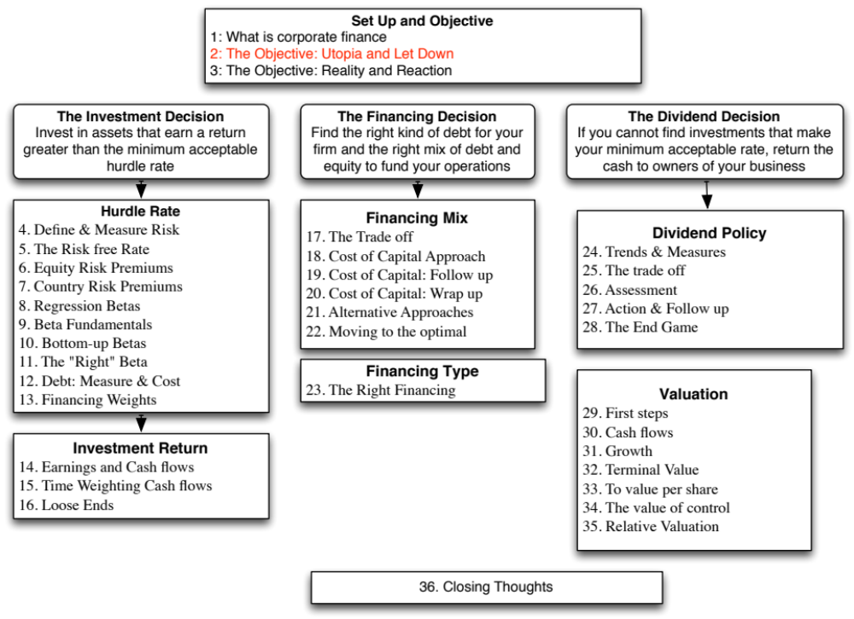

Slide 3
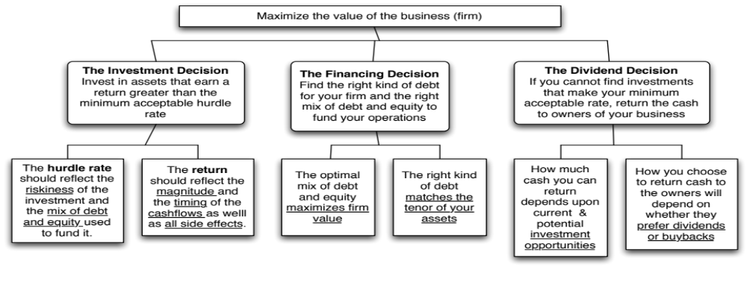
First Principles
Notes:
Our focus will be on the objective: Maximize firm value.
Since so much of corporate finance is built on this objective, it is important that we be clear about what it means and why we choose it. In addition, it is also worth exploring what the alternatives are and why this objective is preferable to the alternatives.

Slide 4
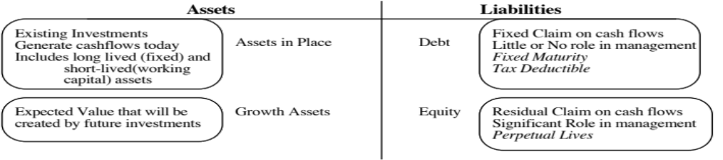
The Objective in Decision Making
In traditional corporate finance, the objective in decision making is to maximize the value of the firm.
A narrower objective is to maximize stockholder wealth. When the stock is traded and markets are viewed to be efficient, the objective is to maximize the stock price.
Maximize equity value
Maximize market estimate of equity value
Maximize firm value
Notes:
This is the answer to the question posed in the previous overhead.
Maximizing the value of the business is the most general objective function.
Managers answer to stockholders. Consequently, the objective gets narrowed down to “maximizing equity value”. (Implicit assumption: Bondholders/ Banks can protect themselves by writing in covenants and setting interest rates).
It is tough to assess equity value objectively. It would be nice to have a “third party” estimate that is objective. For publicly traded firms, the market (in spite of all its limitations) provides such an estimate. (Implicit assumption: Markets are rational and reasonably efficient).

Slide 5
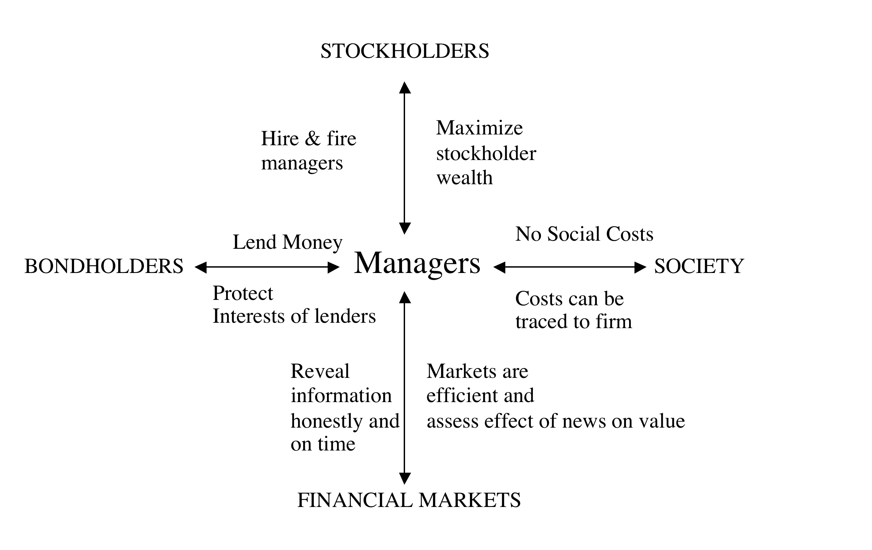
The Classical Objective

Slide 6
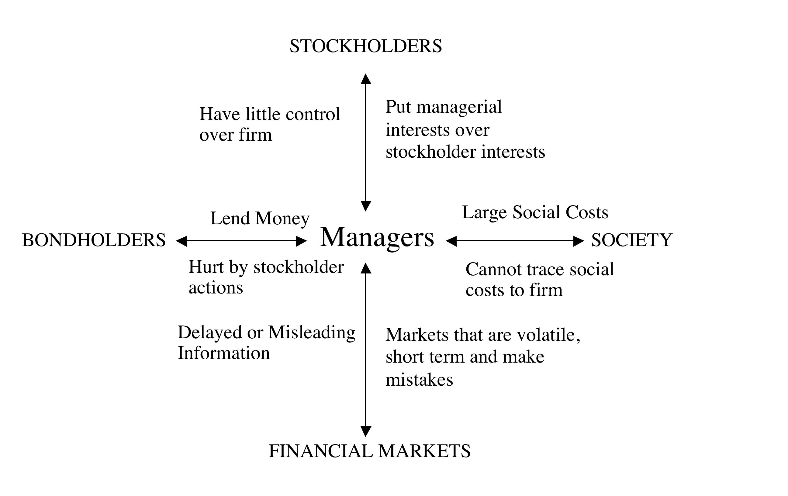
What can go wrong?

Slide 7
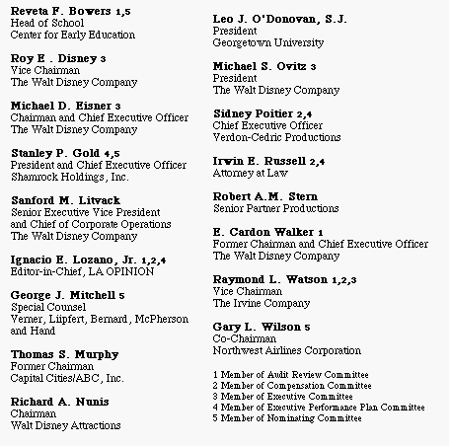
Who’s on Board? The Disney Experience - 1997
Notes:
This may be going back in time but it may help understanding Disney’s present standing. This was Disney’s board at the height of Michael Eisner’s powers. (Eisner became CEO of Disney in 1985 and consolidated power in the years after.)
Note the number of insiders on the board. (Seven out of 16; five current employees & two ex-employees)
Also note the presence of Mr. Eisner’s private attorney (Irwin Russell) and the principal of his childrens’ elementary school (Reveta Bowers) on the board.
How independent was this board likely to be of Mr. Eisner? This may explain some of the actions taken by Disney (and specifically Eisner) during the 1990s… (Read Disney War by James Stewart for the gory details)
When Eisner was hired in 1984, he insisted on bringing in his protégé Jeffrey Katzenberg, a brilliant show-biz exec lacking in social skills, into the firm with him. Katzenberg was largely responsible for the rebirth of Disney Animation (which Eisner had considered shutting down) with The Little Mermaid, Beauty and the Beast and The Lion King all proving to be mega-winners. As a reward for this success, Esiner fired him. His lucrative contract entitled him to 2% of the revenues from the movies he made in posterity but he would have settled for $100 million. Eisner refused to pay; Disney paid $ 250 million in 1999.
In 1995, Eisner hired Ovitz, the leading agent in Hollywood, and then told the board to okay the hire. He regretted it almost immediately and fired him 453 days later for “lying” and “incompetence”. However, rather than argue that this was just cause for firing, he paid Ovitz $ 100 million to leave.

Slide 8
So, what next? When the cat is idle, the mice will play ....
When managers do not fear stockholders, they will often put their interests over stockholder interests
  Greenmail: Managers of target buy out stake of hostile acquirer at a premium price.
  Golden Parachutes: Employment contract payments triggered by hostile acquisitions.
  Poison Pills: A security with rights which are triggered by an outside event.
  Shark Repellents: Anti-takeover amendments aimed at dissuading hostile takeovers, requiring shareholder assent.
  Overpaying on takeovers: Acquisitions often are driven by management interests rather than stockholder interests.
No stockholder approval needed….. Stockholder Approval needed
Notes:
These actions could all suggest that managerial interests are being put over stockholder interests. (Some of these actions, though, may also increase stockholder wealth. Managers will, of course, always claim that these actions are in stockholders’ best interests)
The reason that I have put overpaying on poison pills and shark repellants below greenmail and golden parachutes is not because they create less damage to stockholders but because stockholders at least get a chance to voice their view (they both require stockholder approval). Greenmail and golden parachutes just require board approval.

Slide 9
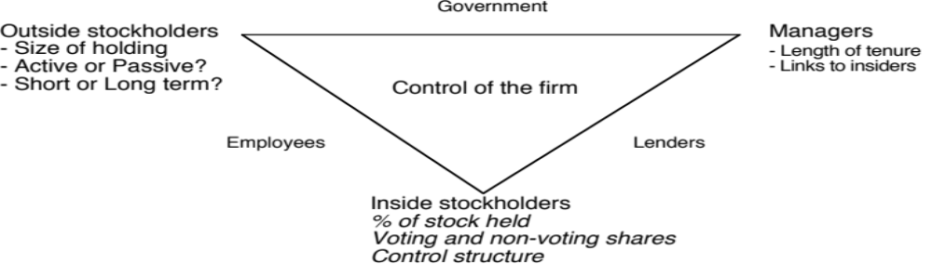
6Application Test: Who owns/runs your firm?
Look at: Bloomberg printout HDS for your firm
Who are the top stockholders in your firm?
What are the potential conflicts of interests that you see emerging from this stockholding structure?
B HDS Page
PB Page 3-12
Notes:
One of your first tasks when assessing a company is to see whether managers have a significant stake in the company. You can get this information in a variety of places. I use Bloomberg to get the data on the top 17 stockholders and go down the list to see if incumbent managers have a stake in the company. I also check to see if there are other investors on the list who may not be incumbent managers but are strong advocates for stockholders - Berkshire Hathaway at Coca Cola, KKR or Blackstone at many publicly traded firms…
You can also get this information from Yahoo! Finance by going into company profiles and clicking on institutional investors…
As you look at the list of top stockholders, you should be also considering the potential conflicts of interest created by the stockholder structure.
Inside stockholders (Founding family, controlling stockholder/manager) versus outside stockholders
Government as major stockholder (or holder of golden vote)
Employees as major stockholders

Slide 10
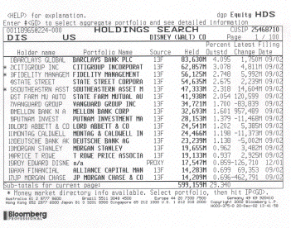
Case 1: Splintering of Stockholders
Disney’s top stockholders in 2003
Notes:
Not a single individual investor in the list other than Roy Disney who was the 15th largest stockholder… Managers are not significant stockholders in Disney (and the same can be said for most large publicly traded firms). Consider the following scenarios:
Managers are not significant stockholders in the firm: Significant potential for conflicts of interest between managers and stockholders.
Individuals are significant stockholders in the firm as well as part of top management. Usually, these are founder-owners of the firm and the firms tend to be younger firms or family run businesses that have recently made the transition to publicly traded firms. Smaller potential for conflict between managers and stockholders, but potential for conflict between inside stockholders and outside stockholders.
The government is a large stockholder (or a stockholder with veto power). This may keep managers in some check but it will create potential conflicts of interest between the other stockholders and the government (Consider what would happen if the company tried to minimize taxes paid)
Trusts or descendants of owners are significant stockholders in the firm but are not an active part of incumbent management. Power that these stockholders retain to replace managers reduces potential for conflict of interest but is reduced as holdings get diluted among lots of family members.
Another company is largest stockholder in firm. In this case, trace out who owns stock in the other company….

Slide 11
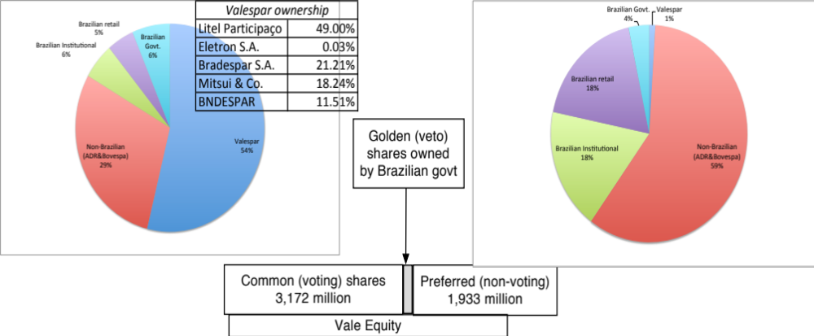
Case 2: Voting versus Non-voting Shares & Golden Shares: Vale
Vale has eleven members on its board of directors, ten of whom were nominated by Valepar and the board was chaired by Don Conrado, the CEO of Valepar.
Notes:
Voting right differences: When voting rights vary across shares, incumbent managers can consolidate their hold on a company with relatively small holdings. This reduces the power that stockholders have in these companies. Differences in voting rights are common outside the U.S. In Asia and Latin America, incumbent managers or family members can control companies with relatively small holdings with complete impunity.
Golden shares: When the government has veto power over major decisions, that also acts as a constraint on shareholders. Consequently, shareholders have to be realistic about what they can change and not change at these companies.

Slide 12
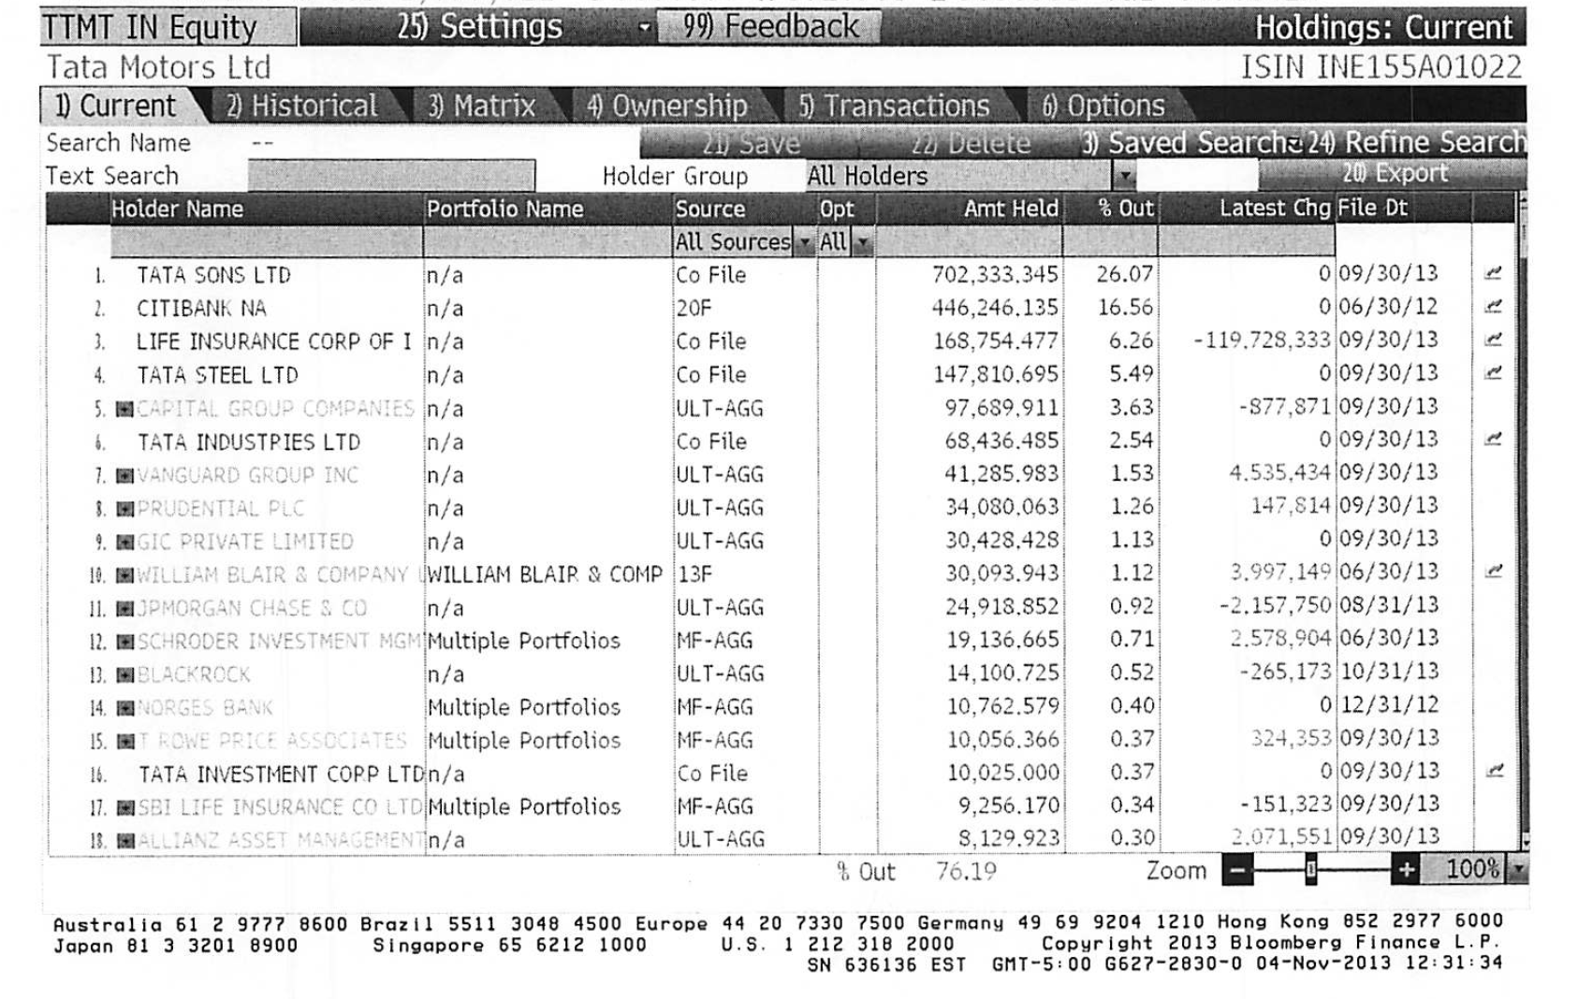
Case 3: Cross and Pyramid Holdings
Tata Motor’s top stockholders in 2013
Notes:
Cross holding structures are often designed with control in mind. In the case of Tata Motors, other Tata companies (which are part of the Tata family group) represent a large number of the top 15 stockholders in the company. (At least the Tatas are up front and open about their cross holding structures… In many Indian companies, the cross holdings are disguised with front companies holding the stock for families).
In Asia and Latin America, corporate holdings structures are designed to consolidate control.

Slide 13
Case 4: Legal rights and Corporate Structures: Baidu
The Board: The company has six directors, one of whom is Robin Li, who is the founder/CEO of Baidu. Mr. Li also owns a majority stake of Class B shares, which have ten times the voting rights of Class A shares.
The structure: Baidu’s primary stock listing is on the NASDAQ and the listed company is structured as a shell company, to get around Chinese government restrictions of foreign investors holding shares
The legal system: Baidu’s operating counterpart in China is structured as a Variable Interest Entity (VIE), and it is unclear how much legal power the shareholders in the shell company have to enforce changes at the VIE.
Notes:
When you invest in Baidu, you have to do so with the recognition that your rights to make changes in the company or have a say in how it is run are very limited. There have been cases in the last few years, where US investors in companies structured just like Baidu have found that the Chinese courts are not protective of their legal rights.

Slide 14
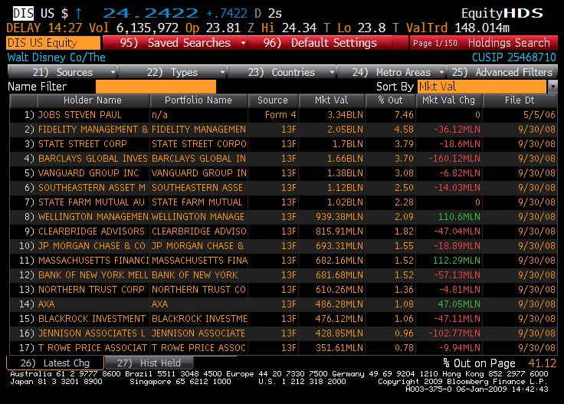
Things change.. Disney’s top stockholders in 2009
Notes:
Things can change… This is Disney in 2009. Note that there is now an individual at the top of the list – Steve Jobs, whose holdings come from his majority ownership at Pixar that was acquired by Disney.
As a stockholder in Disney, what are your thoughts about Jobs at the top of the list?
I think that it will shake the company up. Jobs has many shortcomings, but he is a visionary who will push Disney to take another look at its established business practices.

Slide 15

Task
Assess corporate governance at your company
Read
Chapter 2

