Slide 1
Valuation: future growth and cash flows
You will be wrong 100% of the time and it is okay.
Notes:
If corporate finance is all about maximizing value, you do have to know how to estimate value.

Slide 2
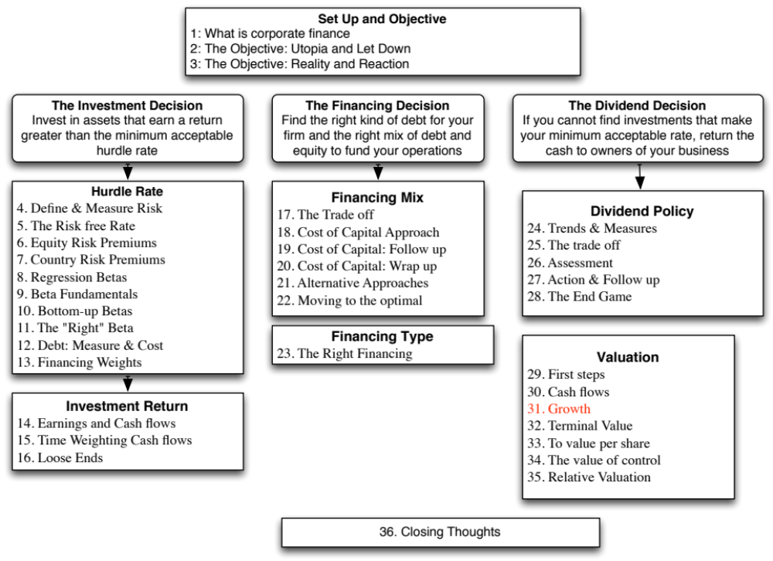

Slide 3
Historical Growth & Outside Estimates
Historical growth is a function of the time period you look at (starting and ending points), the measure of earnings you look at and a function of your averaging approach. It is also not a particularly good predictor of the future.
Outside estimates (from analysts or managers) is not only biased but tend not to be very good, especially for longer term forecasts.

Slide 4
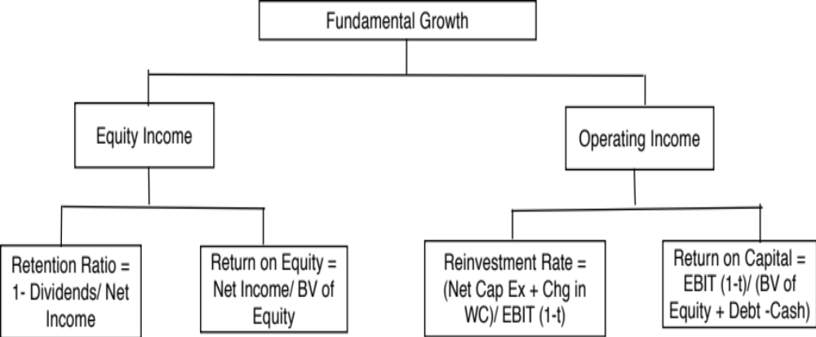
Expected Growth and Fundamentals
Notes:
Note that the approaches are similar, with the only difference being in how we define how much the firm reinvests and how well it reinvests.

Slide 5




Estimating growth in EPS: Deutsche Bank in January 2008
In 2007, Deutsche Bank reported net income of 6.51 billion Euros on a book value of equity of 33.475 billion Euros at the start of the year (end of 2006), and paid out 2.146 billion Euros as dividends.
Return on Equity =
Retention Ratio =
If Deutsche Bank maintains the return on equity (ROE) and retention ratio that it delivered in 2007 for the long run:
Expected Growth Rate _{Existing Fundamentals} = 0.6703 * 0.1945 = 13.04%
If we replace the net income in 2007 with average net income of $3,954 million, from 2003 to 2007:
Normalized Return on Equity =
Normalized Retention Ratio =
Expected Growth Rate _{Normalized Fundamentals} = 0.4572 * 0.1181 = 5.40%
Notes:
When forecasting future growth, we want estimates of the future retention ratio and future return on equity. While the current year’s numbers may be a good place to start, we should have no qualms about replacing those numbers with normalized values.

Slide 6
Estimating growth in Net Income: Tata Motors
Year | Net Income | Cap Ex | Depreciation | Change in WC | Change in Debt | Equity Reinvestment | Equity Reinvestment Rate
2008-09 | -25,053₹ | 99,708₹ | 25,072₹ | 13,441₹ | 25,789₹ | 62,288₹ | -248.63%
2009-10 | 29,151₹ | 84,754₹ | 39,602₹ | -26,009₹ | 5,605₹ | 13,538₹ | 46.44%
2010-11 | 92,736₹ | 81,240₹ | 46,510₹ | 50,484₹ | 24,951₹ | 60,263₹ | 64.98%
2011-12 | 135,165₹ | 138,756₹ | 56,209₹ | 22,801₹ | 30,846₹ | 74,502₹ | 55.12%
2012-13 | 98,926₹ | 187,570₹ | 75,648₹ | 680₹ | 32,970₹ | 79,632₹ | 80.50%
Aggregate | 330,925₹ | 592,028₹ | 243,041₹ | 61,397₹ | 120,160₹ | 290,224₹ | 87.70%
Year | Net Income | BV of Equity at start of the year | ROE
2008-09 | -25,053₹ | 91,658₹ | -27.33%
2009-10 | 29,151₹ | 63,437₹ | 45.95%
2010-11 | 92,736₹ | 84,200₹ | 110.14%
2011-12 | 135,165₹ | 194,181₹ | 69.61%
2012-13 | 98,926₹ | 330,056₹ | 29.97%
Aggregate | 330,925₹ | 763,532₹ | 43.34%
 | 2013 value | Average values: 2008-2013
Reinvestment rate | 80.50% | 87.70%
ROE | 29.97% | 43.34%
Expected growth | 24.13% | 38.01%
Notes:
We looked at both 2013 numbers and the aggregate values from 2008 to 2013. The acquisition of Landrover Jaguar has created accounting distortions in the return on equity in the years immediately after the acquisition.

Slide 7
ROE and Leverage
A high ROE, other things remaining equal, should yield a higher expected growth rate in equity earnings.
The ROE for a firm is a function of both the quality of its investments and how much debt it uses in funding these investments. In particular
ROE = ROC + D/E (ROC - i (1-t))
where,
ROC = (EBIT (1 - tax rate)) / (Book Value of Capital)
BV of Capital = BV of Debt + BV of Equity - Cash
D/E = Debt/ Equity ratio
i = Interest rate on debt
t = Tax rate on ordinary income.
Notes:
Leverage will have a positive effect on expected growth as long as the projects taken with the leverage earn more than the after-tax cost of debt.
Again, while we need to use book values if our objective is to explain past growth, looking forward, we need to make the best estimates we can for each of these inputs.

Slide 8
Decomposing ROE
Assume that you are analyzing a company with a 15% return on capital, an after-tax cost of debt of 5% and a book debt to equity ratio of 100%. Estimate the ROE for this company.
Now assume that another company in the same sector has the same ROE as the company that you have just analyzed but no debt. Will these two firms have the same growth rates in earnings per share if they have the same dividend payout ratio?
Will they have the same equity value?
Notes:
The return on equity for the first firm = 15% + 1 (15% -5%)= 25%
The two firms, if they have the same ROE and retention ratio, will have the same earnings per share growth rate.
However, the first firm will have a higher cost of equity, since it has the higher debt ratio, and thus a lower equity value.

Slide 9

Estimating Growth in EBIT: Disney
We started with the reinvestment rate that we computed from the 2013 financial statements:
Reinvestment rate =
  We computed the reinvestment rate in prior years to ensure that the 2013 values were not unusual or outliers.
We compute the return on capital, using operating income in 2013 and capital invested at the start of the year:
Return on Capital₂₀₁₃ =
  Disney’s return on capital has improved gradually over the last decade and has levelled off in the last two years.
If Disney maintains its 2013 reinvestment rate and return on capital for the next five years, its growth rate will be 6.80 percent.
  Expected Growth Rate from Existing Fundamentals = 53.93% * 12.61% = 6.8%
Notes:
The book value of debt is augmented by the present value of operating lease commitments. We checked both numbers (ROC and reinvestment rate) against prior years, to make sure that they looked reasonable. If not, we would have used average values over time.

Slide 10
When everything is in flux: Changing growth and margins
The elegant connection between reinvestment and growth in operating income breaks down, when you have a company in transition, where margins are changing over time.
If that is the case, you have to estimate cash flows in three steps:
  Forecast revenue growth and revenues in future years, taking into account market potential and competition.
  Forecast a “target” margin in the future and a pathway from current margins to the target.
  Estimate reinvestment from revenues, using a sales to capital ratio (measuring the dollars of revenues you get from each dollar of investment).
Notes:
Estimating the growth rate from the Reinvestment Rate and the Return on capital works only for firms with stable margins and ROC. When a company’s margins are expected to change over time, you have to start with revenues and work down the cash flow statement. In making your estimates, though, you still have to tie revenue growth to reinvestment, which I accomplish using the sales to capital ration.

Slide 11
Here is an example: Baidu’s Expected FCFF
Year | Revenue growth | Revenues | Operating Margin | EBIT | Tax rate | EBIT (1-t) | Chg in Revenues | Sales/Capital | Reinvestment | FCFF
Base year |  | $28,756 | 48.72% | $14,009 | 16.31% | $11,724 |  | 2.64
1 | 25.00% | $35,945 | 47.35% | $17,019 | 16.31% | $14,243 | $7,189 | 2.64 | $2,722 | $11,521
2 | 25.00% | $44,931 | 45.97% | $20,657 | 16.31% | $17,288 | $8,986 | 2.64 | $3,403 | $13,885
3 | 25.00% | $56,164 | 44.60% | $25,051 | 16.31% | $20,965 | $11,233 | 2.64 | $4,253 | $16,712
4 | 25.00% | $70,205 | 43.23% | $30,350 | 16.31% | $25,400 | $14,041 | 2.64 | $5,316 | $20,084
5 | 25.00% | $87,756 | 41.86% | $36,734 | 16.31% | $30,743 | $17,551 | 2.64 | $6,646 | $24,097
6 | 20.70% | $105,922 | 40.49% | $42,885 | 18.05% | $35,145 | $18,166 | 2.64 | $6,878 | $28,267
7 | 16.40% | $123,293 | 39.12% | $48,227 | 19.79% | $38,685 | $17,371 | 2.64 | $6,577 | $32,107
8 | 12.10% | $138,212 | 37.74% | $52,166 | 21.52% | $40,938 | $14,918 | 2.64 | $5,649 | $35,289
9 | 7.80% | $148,992 | 36.37% | $54,191 | 23.26% | $41,585 | $10,781 | 2.64 | $4,082 | $37,503
10 | 3.50% | $154,207 | 35.00% | $53,972 | 25.00% | $40,479 | $5,215 | 2.64 | $1,974 | $38,505
Notes:
Note that high revenue growth is accompanied by declining margins over time, as competition picks up and the revenues become larger. The reinvestment each year is computed by dividing the change in revenues by the sales to capital ratio to get the reinvestment each year (a composite value that includes net cap ex and change in working capital).

Slide 12

Task
Estimate the expected growth/future cash flows for your firm.
Read
Chapter 12

