Slide 1
Valuation: The value of control
Control is not always worth 20%.
Notes:
If corporate finance is all about maximizing value, you do have to know how to estimate value.

Slide 2
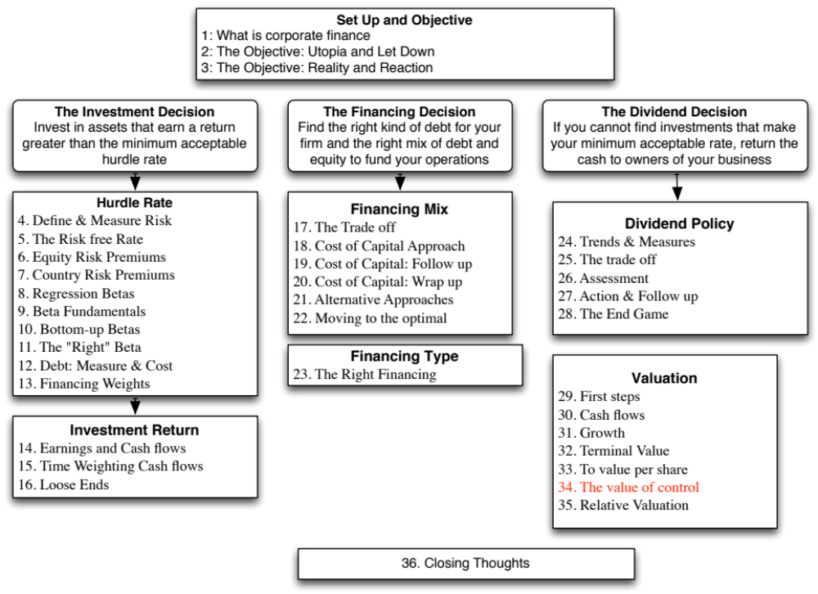

Slide 3
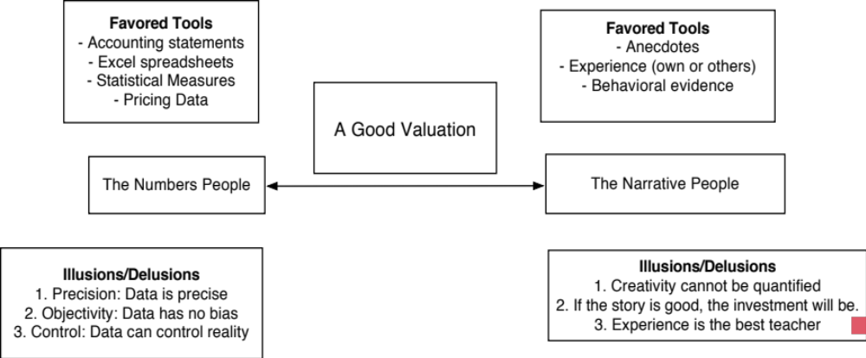
Narratives and Numbers

Slide 4

Disney: Inputs to Valuation
Notes:
The transition period is used as a phase where the inputs from the high growth period can be adjusted towards stable growth levels (which reflect industry or market averages).
Note that we estimate reinvestment needs using the expected growth rate and the return on capital.
We are making the assumption that Disney will continue to earn excess returns even in stable growth. (The return on capital is moved towards the cost of capital, but it is still higher than the cost of capital). If that assumption seems over optimistic, the return on capital in stable growth can be set equal to the cost of capital.
The leverage is pushed up to 20%, which is well below the optimal that we computed earlier, because current management seems intent on paying down debt.

Slide 5

Notes:
Brings it all together. Stock looks slightly over valued… or maybe the valuation is wrong…
Note that the non operating investment is the value of their minority holdings in other companies and that the minority interest reflects the value of others’ holdings in companies that Disney owns a majority stake in (and has consolidated). Both were taken at book value. Optimally, we would like to get both in market value terms.
The equity options is the value of management options, valued using an option pricing model, and adjusted for taxes.

Slide 6
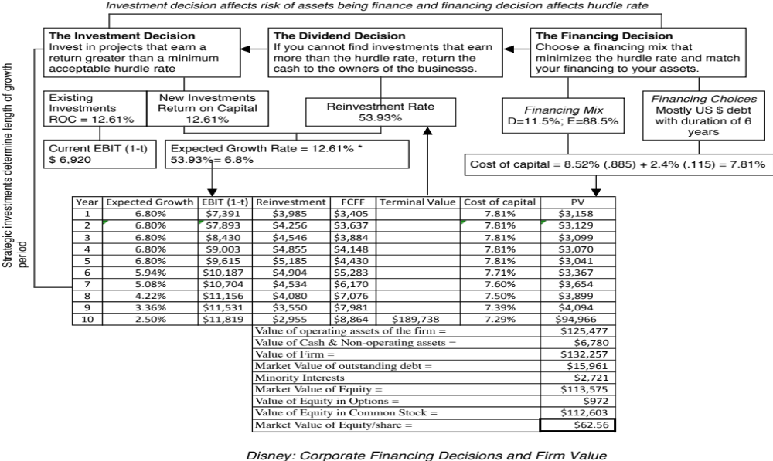
Notes:
Shows the link between our valuation and the earlier corporate financial analysis.

Slide 7

Ways of changing value…
Notes:
To change value, you have to take actions that affect one of four inputs:
Cash flows from existing assets
Expected growth
Cost of capital
Length of the growth period

Slide 8

Notes:
Note that with two changes, a higher return on capital on new investments over the high growth phase (from 12.61% to 14%, with a slight drop in reinvestment) and moving to the optimal debt ratio of 40%, we can raise the value per share from $62.56 to $74.91. The difference of $11.35 can be viewed as the value of control. In general, the better managed a firm is, the lower will be the value of control.

Slide 9
The value of control
We have two values for Disney.
  The status quo value per share, run by existing management with its current policies in place, is $62.56.
  The “optimal” value, with changes to investing, financing and dividend policy yields a value per share of $74.91
The difference between the two values can legitimately be called the value of control.
  Value of control = $74.91 - $62.56 = $ 12.35/share

Slide 10
Implications
The value of control should be greater at poorly managed firms than well run firms.
The market price of a company should reflect the expected value of control, which incorporates the probability that management will change.
  If corporate governance is so weak that there is no chance of management change, the expected value of control should go to zero and the stock price should converge on the status quo value.
  In the event of a control change (an acquisition or an activist investor waging a control battle), the likelihood of management change will increase and the stock should trade at close to its optimal value.

Slide 11

Task
Estimate the status quo & optimal values for your firm, and the value of control
Read
Chapter 12

