Slide 1
Estimating Hurdle Rates I: Defining & measuring risk
Risk = Danger + Opportunity
Notes:
Sets the agenda for the class. This is a class that will be focused on the big picture of corporate finance rather than details, theories or models on a piecemeal basis.

Slide 2
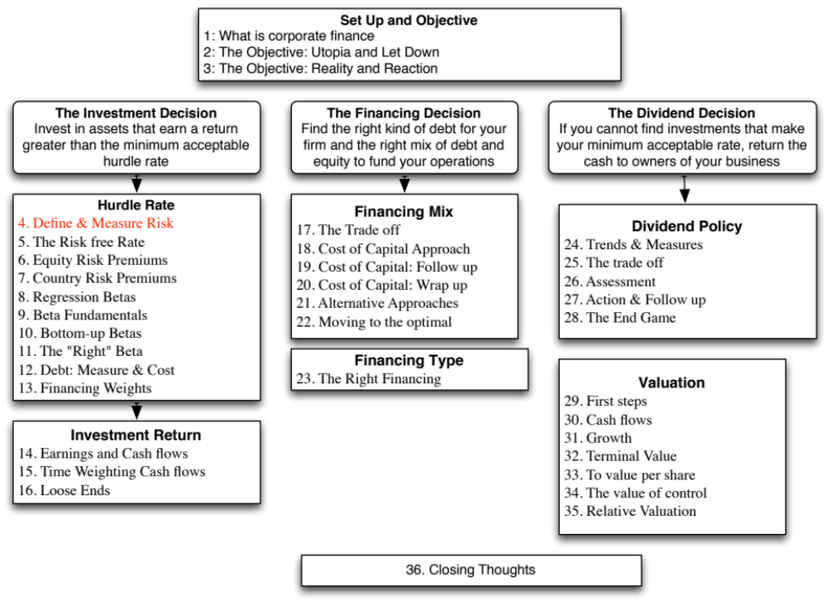

Slide 3
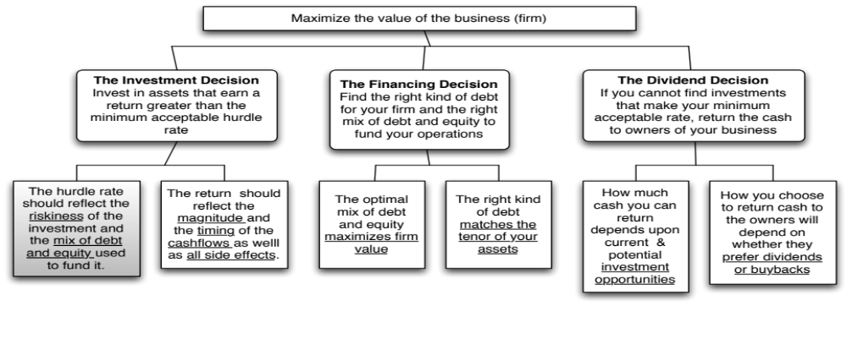
First Principles
Notes:
The focus of the first part of this investment analysis section is on coming up with a minimum acceptable hurdle rate. In the process, we have to grapple with the question of what risk is and how to bring risk into the hurdle rate.

Slide 4
The notion of a benchmark
Since financial resources are finite, there is a hurdle that projects have to cross before being deemed acceptable.
This hurdle will be higher for riskier projects than for safer projects.
A simple representation of the hurdle rate is as follows:
Hurdle rate = Riskless Rate + Risk Premium
The two basic questions that every risk and return model in finance tries to answer are:
  How do you measure risk?
  How do you translate this risk measure into a risk premium?
Notes:
Underlying the idea of a hurdle rate is the notion that projects have to earn a benchmark rate of return to be accepted, and that this benchmark should be higher for riskier projects than for safer ones.

Slide 5
What is Risk?
Risk, in traditional terms, is viewed as a ‘negative’. Webster’s dictionary, for instance, defines risk as “exposing to danger or hazard”. The Chinese symbols for risk, reproduced below, give a much better description of risk:
危机
The first symbol is the symbol for “danger”, while the second is the symbol for “opportunity”, making risk a mix of danger and opportunity. You cannot have one, without the other.
Risk is therefore neither good nor bad. It is just a fact of life. The question that businesses have to address is therefore not whether to avoid risk but how best to incorporate it into their decision making.
Notes:
Note that risk is neither good nor bad. It is a combination of danger and opportunity - you cannot have one without the other. Consequently, risk is neither something to be avoided nor sought out but carefully balanced. Good business avoid some risks, let others pass through to their investors and actively seek out still others.
When businesses want opportunity (higher returns), they have to live with the higher risk.
Any sales pitch that offers returns without risk is a pipe dream.
Bob Citron, treasurer of Orange County (CA), after he lost a chunk of the county’s pension fund money after investing in interest rate derivatives claimed that he was “not a finance person” and that Merrill’s market strategist (Charlie Clough) had told him he could make “15% with no risk”.
Many prominent (and intelligent) people invested with Bernie Madoff because he promised them (through third parties) that he could deliver 8% more than the treasury bill rate, guaranteed. (He was called the Jewish T.Bill). One investor, interviewed by the NY Times said, “I really did not understand what he was doing, but he said was going to do something with calls, something with puts and earn 12% every year. It sounded plausible (and all my friends were investing with him too).

Slide 6
A good risk and return model should…
It should come up with a measure of risk that applies to all assets and not be asset-specific.
It should clearly delineate what types of risk are rewarded and what are not, and provide a rationale for the delineation.
It should come up with standardized risk measures, i.e., an investor presented with a risk measure for an individual asset should be able to draw conclusions about whether the asset is above-average or below-average risk.
It should translate the measure of risk into a rate of return that the investor should demand as compensation for bearing the risk.
It should work well not only at explaining past returns, but also in predicting future expected returns.
Notes:
Before we embark on looking at risk and return models, it pays to specify what a good model will look like…
A risk measure that works only for US stocks or even for only publicly traded firms is inferior to one that applies across all stocks.

Slide 7
The Capital Asset Pricing Model
Uses variance of actual returns around an expected return as a measure of risk.
Specifies that a portion of variance can be diversified away, and that is only the non-diversifiable portion that is rewarded.
Measures the non-diversifiable risk with beta, which is standardized around one.
Translates beta into expected return -
  Expected Return = Riskfree rate + Beta * Risk Premium
Works as well as the next best alternative in most cases.
Notes:
This is a summary of the CAPM, before we get into the details.

Slide 8
1. The Mean-Variance Framework
The variance on any investment measures the disparity between actual and expected returns.
Low Variance Investment
High Variance Investment
Expected Return
Notes:
Note that the variance that the CAPM is built around is the variance of actual returns around an expected return.
If you were an investor with a 1-year time horizon, and you bought a 1-year T.Bill, your actual returns (at least in nominal terms) will be equal to your expected return. It is riskfree.
If you were the same investor, and you bought a stock (say Intel), your actual returns will almost certainly not be equal to your expected returns.
In practice, we often look at historical (past) returns to estimate variances. Implicitly, we are assuming that this variance is a good proxy for expected future variance.

Slide 9
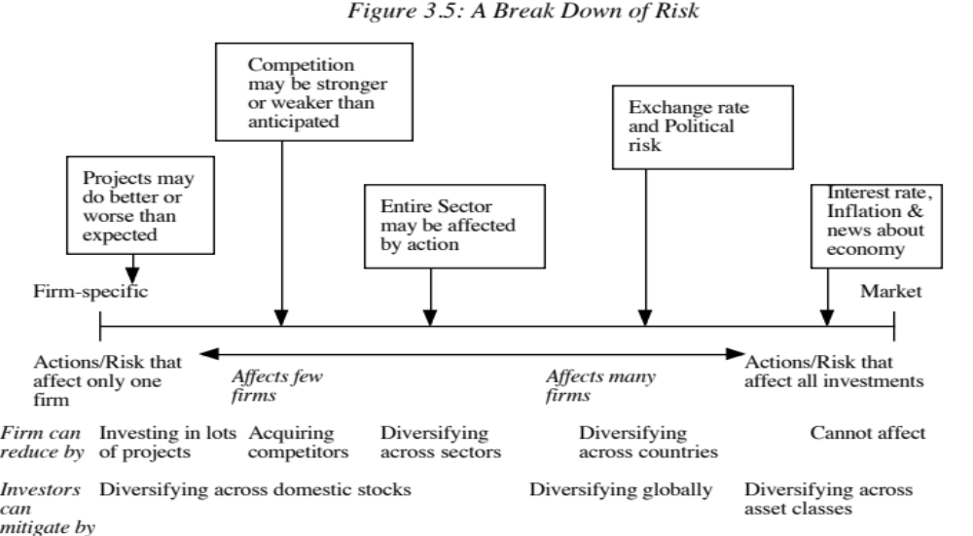
2. The Importance of Diversification: Risk Types
Notes:
This is the critical second step that all risk and return models in finance take.
As examples,
Project-specific Risk: Disney’s new Hong Kong theme park: To the degree that actual revenues at this park may be greater or less than expected. (Other examples: A big budget movie, ESPN Asia…)
Competitive Risk: The competition (Universal Studios, for instance) may take actions (like opening or closing a park) that affect Disney’s revenues at its theme parks.
Industry-specific risk: Congress may pass laws affecting cable and network television, and affect expected revenues at Disney and ABC, as well as all other firms in the sector, perhaps to varying degrees.
Exchange rate Risk: Disney owns NDTV, an Indian television group and has theme parks in Paris, Hong Kong and Tokyo. As the dollar strengthens or weakens, Disney will feel its effects. In fact, it may feel the effects of exchange rates even at its Orlando and Anaheim theme parks.
Market risk: If interest rates in the US go up or the economy weakens, Disney’s value as a firm will be affected.
From the perspective of an investor who holds only Disney, all risk is relevant.
From the perspective of a diversified investor, the first three risks can be diversified away, the fourth might be diversifiable (with a globally diversified portfolio) but the last risk I not.

Slide 10
The Role of the Marginal Investor
The marginal investor in a firm is the investor who is most likely to be the buyer or seller on the next trade and to influence the stock price.
Generally speaking, the marginal investor in a stock has to own a lot of stock and also trade that stock on a regular basis.
Since trading is required, the largest investor may not be the marginal investor, especially if he or she is a founder/manager of the firm (Larry Ellison at Oracle, Mark Zuckerberg at Facebook)
In all risk and return models in finance, we assume that the marginal investor is well diversified.
Notes:
We assume that the marginal investor, who sets prices, is well diversified. (Note that we do not need to assume that all investors are diversified)
An argument for the marginally diversified investor: Assume that a diversified investor and a non-diversified investor are both looking at Disney. The latter looks at the stock and sees all risk. The former looks at it and sees only the non-diversifiable risk. If they agree on the expected earnings and cash flows, the former will be willing to pay a higher price. Thus, the latter will get driven out of the market (perhaps into mutual funds).

Slide 11
3. The Limiting Case: The Market Portfolio
The big assumptions & the follow up: Assuming diversification costs nothing (in terms of transactions costs), and that all assets can be traded, the limit of diversification is to hold a portfolio of every single asset in the economy (in proportion to market value). This portfolio is called the market portfolio.
The consequence: Individual investors will adjust for risk, by adjusting their allocations to this market portfolio and a riskless asset (such as a T-Bill):
  Preferred risk level Allocation decision
  No risk 100% in T-Bills
  Some risk 50% in T-Bills; 50% in Market Portfolio;
  A little more risk 25% in T-Bills; 75% in Market Portfolio
  Even more risk 100% in Market Portfolio
  A risk hog.. Borrow money; Invest in market portfolio
Notes:
There are two reasons investors choose to stay undiversified:
They think that they can pick undervalued investments (private information)
There are transactions costs. Since the marginal benefits of diversification decrease as the number of investments increases, you will stop diversifying.
If we assume no costs to diversifying and no private information, we take away these reasons fro not diversifying. Consequently, you will keep adding traded assets to your portfolio until you have every single one. This portfolio is called the market portfolio. This portfolio should include all traded assets, held in proportion to their market value.
The only differences between investors then will be in not what is in the market portfolio but how much they allocate to the riskless asset and how much to the market portfolio.

Slide 12
4. The Risk of an Individual Asset
The essence: The risk of any asset is the risk that it adds to the market portfolio Statistically, this risk can be measured by how much an asset moves with the market (called the covariance)
The measure: Beta is a standardized measure of this covariance, obtained by dividing the covariance of any asset with the market by the variance of the market. It is a measure of the non-diversifiable risk for any asset can be measured by the covariance of its returns with returns on a market index, which is defined to be the asset's beta.
The result: The required return on an investment will be a linear function of its beta:
  Expected Return = Riskfree Rate+ Beta * (Expected Return on the Market Portfolio - Riskfree Rate)
Notes:
If an investor holds the market portfolio, the risk of any asset is the risk that it adds to the portfolio. That is what beta measures.
The cost of equity is a linear function of the beta of the portfolio.

Slide 13
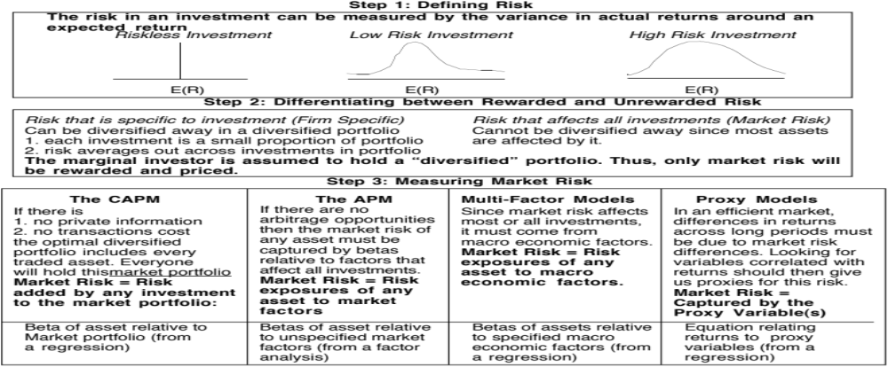
Alternatives to the CAPM
Notes:
Note that all of the models of risk and return in finance agree on the first two steps. They deviate at the last step in the way they measure market risk, with
The CAPM, capturing all of it in one beta, relative to the market portfolio
The APM, capturing the market risk in multiple betas against unspecified economic factors
The Multi-Factor model, capturing the market risk in multiple betas against specified macro economic factors
The Regression model, capturing the market risk in proxies such as market capitalization and price/book ratios

Slide 14
Limitations of the CAPM
1. The model makes unrealistic assumptions
2. The parameters of the model cannot be estimated precisely
3. The model does not work well
  - If the model is right, there should be
    a linear relationship between returns and betas
    the only variable that should explain returns is betas
  - The reality is that
    the relationship between betas and returns is weak
    Other variables (size, price/book value) seem to explain differences in returns better.
Notes:
The first two critiques can be lowered against any model in finance.
The last critique is the most damaging. Fama and French (1991) noted that
Betas explained little of the difference in returns across stocks between 1962 and 1991. (Over long time periods, it should, if the CAPM is right and betas are correctly estimated), explain almost all of the difference)
Market Capitalization and price to book value ratios explained a significant portion of the differences in returns.
This test, however, is a test of which model explains past returns best, and might not necessarily be a good indication of which one is the best model for predicting expected returns in the future.

Slide 15
Why the CAPM persists…
The CAPM, notwithstanding its many critics and limitations, has survived as the default model for risk in equity valuation and corporate finance.
This is because:
  The alternative models do a much better job than the CAPM in explaining past return, but not much better in estimating expected future returns.
  The alternative models are more complicated and require more information
  For most companies, the expected returns you get with the alternative models is not different enough to be worth the extra trouble.
Notes:
It takes a model to beat a model… The CAPM may not be a very good model at predicting expected returns but the alternative models don’t do much better. In fact, the tests of the CAPM are joint tests of both the effectiveness of the model and the quality of the parameters used in the testing (betas, for instance). We will argue that better beta estimates and a more careful use of the CAPM can yield far better estimates of expected return than switching to a different model.
Just as a side note, there are many who either dislike or distrust the CAPM. While we share some of their skepticism about its precision, we would not throw the basic principle that the discount rate has to be adjusted for risk out, just because we do not like the CAPM. In other words, find a different risk and return model, if so inclined, but adjust for risk.

Slide 16
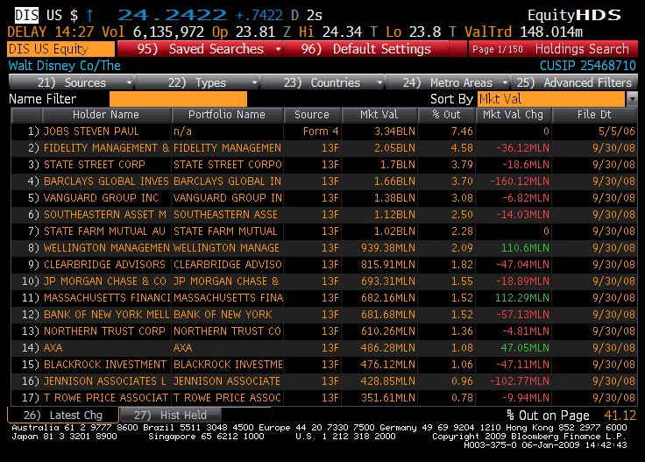
Gauging the marginal investor: Disney in 2009
Notes:
Of Disney’s top 17 investors, only 2 are individuals…. Laurene Jobs and George Lucas are big stockholders (getting those shares when their companies were sold to Disney) but neither is an active trader.

Slide 17
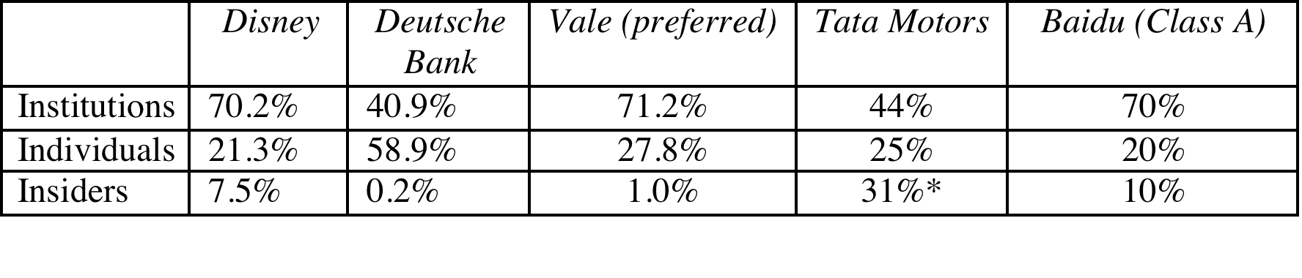
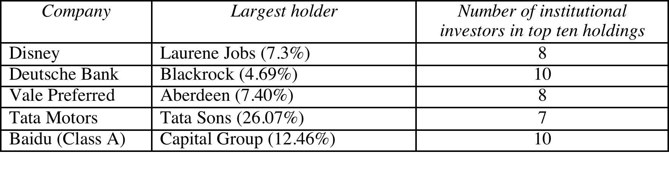
Extending the assessment of the investor base
In all five of the publicly traded companies that we are looking at, institutions are big holders of the company’s stock.
Notes:
It may also make sense to look at the proportion of trading at these companies that comes from institutions. Thus, if institutions own 20% of the shares but account for 80% of the trading, they may still be the marginal investors in the company.

Slide 18
6Application Test: Who is the marginal investor in your firm?
Looking at the breakdown of stockholders in your firm, consider whether the marginal investor is
  An institutional investor
  An individual investor
  An insider
B DES Page 3
PB Page 13
Notes:
For most publicly traded US firms, most, if not all, of the 15 largest investors are institutional investors. In addition, high proportions of both the stock owned and traded are by institutional investors. Thus, the assumption that the marginal investor is well diversified is quite justifiable.
For very small firms, the marginal investor may be an individual investor or even a day trader, who is not diversified. What implications does this have for the use of risk and return models?

Slide 19

Task
Who is the marginal investor in your firm?
Read
Chapter 3

