Slide 1
Hurdle rates IV: Implied ERP, country risk & company risk
Where there is opportunity, there is risk!
Notes:
Sets the agenda for the class. This is a class that will be focused on the big picture of corporate finance rather than details, theories or models on a piecemeal basis.

Slide 2
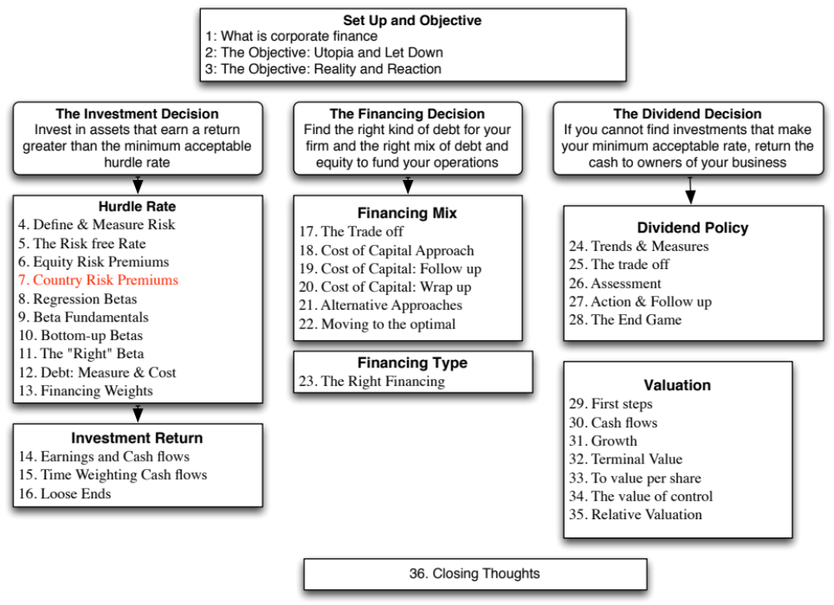

Slide 3
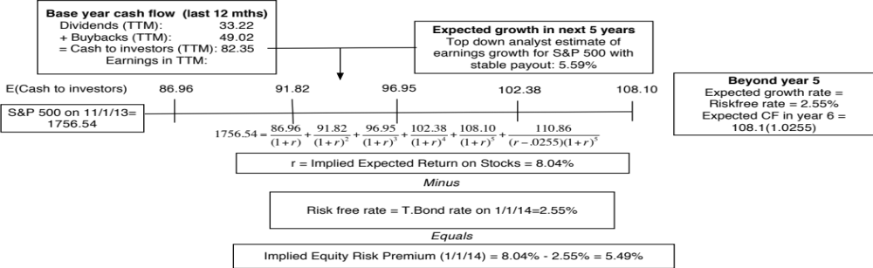
Implied ERP in November 2013: Watch what I pay, not what I say..
If you can observe what investors are willing to pay for stocks, you can back out an expected return from that price and an implied equity risk premium.
Notes:
View stocks like you would a bond. This is the analog to computing the YTM on a bond. The expected return is the IRR that makes the present value of expected cash flows on stocks = level of the index today. This implied equity risk premium will change over time, as the index and treasury bond rates change every minute of every day and the cash flows and growth numbers also change (though they get updated less frequently).

Slide 4

The bottom line on Equity Risk Premiums in November 2013
Mature Markets: In November 2013, the number that we chose to use as the equity risk premium for all mature markets was 5.5%. This was set equal to the implied premium at that point in time and it was much higher than the historical risk premium of 4.20% prevailing then (1928-2012 period).
For emerging markets, we will use the melded default spread approach (where default spreads are scaled up to reflect additional equity risk) to come up with the additional risk premium that we will add to the mature market premium. Thus, markets in countries with lower sovereign ratings will have higher risk premiums that 5.5%.
  Emerging Market ERP = 5.5% +
 | Arithmetic Average |  | Geometric Average
 | Stocks - T. Bills | Stocks - T. Bonds | Stocks - T. Bills | Stocks - T. Bonds
1928-2012 | 7.65% | 5.88% | 5.74% | 4.20%
 | 2.20% | 2.33%
1962-2012 | 5.93% | 3.91% | 4.60% | 2.93%
 | 2.38% | 2.66%
2002-2012 | 7.06% | 3.08% | 5.38% | 1.71%
 | 5.82% | 8.11%
Notes:
This is a judgment call and will depend upon your point of view in November 2013. If you believe in mean reversion and that history is the best guide to the future, you have a case for using the historical risk premium (4.20%). If you believe that the world is changing, that mean reversion may not be to historic norms and that risk premiums are dynamic, you will use an implied premium (5.5%).
If you thought that the crisis was just a bump in the road that markets would quickly forget and move on, you would use either the historical risk premium (3.88%) or the average implied premium over time (about 4%) as your mature market premium.
If you thought that the crisis would continue and perhaps even worsen, you would stick with 6.43%.
In hindsight, equity risk premiums dropped dramatically over the rest of 2009 to reach about 4.73% in December 2009.

Slide 5
A Composite way of estimating ERP for countries
Step 1: Estimate an equity risk premium for a mature market. If your preference is for a forward looking, updated number, you can estimate an implied equity risk premium for the US (assuming that you buy into the contention that it is a mature market)
  My estimate: In January 2014, my estimate for the implied premium in the US was 5%. That will also be my estimate for a mature market ERP.
Step 2: Come up with a generic and measurable definition of a mature market.
  My estimate: Any AAA rated country is mature.
Step 3: Estimate the additional risk premium that you will charge for markets that are not mature. You have two choices:
  The default spread for the country, estimated based either on sovereign ratings or the CDS market.
  A scaled up default spread, where you adjust the default spread upwards for the additional risk in equity markets.
Notes:
You could compute implied equity risk premiums for all markets and dispense with this three step process, but the inputs for implied ERP can be difficult to get in many emerging markets.
You may also take issue with my definition of a mature market (AAA) and my use of default spreads as measures of country risk. I share many of your concerns about whether these are adequate measures of country risk, but until we can come up with better measures, we are stuck with these.

Slide 6

ERP : Nov 2013
Andorra | 7.45% | 1.95% | Liechtenstein | 5.50% | 0.00%
Austria | 5.50% | 0.00% | Luxembourg | 5.50% | 0.00%
Belgium | 6.70% | 1.20% | Malta | 7.45% | 1.95%
Cyprus | 22.00% | 16.50% | Netherlands | 5.50% | 0.00%
Denmark | 5.50% | 0.00% | Norway | 5.50% | 0.00%
Finland | 5.50% | 0.00% | Portugal | 10.90% | 5.40%
France | 5.95% | 0.45% | Spain | 8.88% | 3.38%
Germany | 5.50% | 0.00% | Sweden | 5.50% | 0.00%
Greece | 15.63% | 10.13% | Switzerland | 5.50% | 0.00%
Iceland | 8.88% | 3.38% | Turkey | 8.88% | 3.38%
Ireland | 9.63% | 4.13% | United Kingdom | 5.95% | 0.45%
Italy | 8.50% | 3.00% | Western Europe | 6.72% | 1.22%
Albania | 12.25% | 6.75%
Armenia | 10.23% | 4.73%
Azerbaijan | 8.88% | 3.38%
Belarus | 15.63% | 10.13%
Bosnia | 15.63% | 10.13%
Bulgaria | 8.50% | 3.00%
Croatia | 9.63% | 4.13%
Czech Republic | 6.93% | 1.43%
Estonia | 6.93% | 1.43%
Georgia | 10.90% | 5.40%
Hungary | 9.63% | 4.13%
Kazakhstan | 8.50% | 3.00%
Latvia | 8.50% | 3.00%
Lithuania | 8.05% | 2.55%
Macedonia | 10.90% | 5.40%
Moldova | 15.63% | 10.13%
Montenegro | 10.90% | 5.40%
Poland | 7.15% | 1.65%
Romania | 8.88% | 3.38%
Russia | 8.05% | 2.55%
Serbia | 10.90% | 5.40%
Slovakia | 7.15% | 1.65%
Slovenia | 9.63% | 4.13%
Ukraine | 15.63% | 10.13%
E. Europe & Russia | 8.60% | 3.10%
Bangladesh | 10.90% | 5.40%
Cambodia | 13.75% | 8.25%
China | 6.94% | 1.44%
Fiji | 12.25% | 6.75%
Hong Kong | 5.95% | 0.45%
India | 9.10% | 3.60%
Indonesia | 8.88% | 3.38%
Japan | 6.70% | 1.20%
Korea | 6.70% | 1.20%
Macao | 6.70% | 1.20%
Malaysia | 7.45% | 1.95%
Mauritius | 8.05% | 2.55%
Mongolia | 12.25% | 6.75%
Pakistan | 17.50% | 12.00%
Papua NG | 12.25% | 6.75%
Philippines | 9.63% | 4.13%
Singapore | 5.50% | 0.00%
Sri Lanka | 12.25% | 6.75%
Taiwan | 6.70% | 1.20%
Thailand | 8.05% | 2.55%
Vietnam | 13.75% | 8.25%
Asia | 7.27% | 1.77%
Canada | 5.50% | 0.00%
United States of America | 5.50% | 0.00%
North America | 5.50% | 0.00%
Country | TRP | CRP
Angola | 10.90% | 5.40%
Benin | 13.75% | 8.25%
Botswana | 7.15% | 1.65%
Burkina Faso | 13.75% | 8.25%
Cameroon | 13.75% | 8.25%
Cape Verde | 12.25% | 6.75%
Egypt | 17.50% | 12.00%
Gabon | 10.90% | 5.40%
Ghana | 12.25% | 6.75%
Kenya | 12.25% | 6.75%
Morocco | 9.63% | 4.13%
Mozambique | 12.25% | 6.75%
Namibia | 8.88% | 3.38%
Nigeria | 10.90% | 5.40%
Rwanda | 13.75% | 8.25%
Senegal | 12.25% | 6.75%
South Africa | 8.05% | 2.55%
Tunisia | 10.23% | 4.73%
Uganda | 12.25% | 6.75%
Zambia | 12.25% | 6.75%
Africa | 11.22% | 5.82%
Argentina | 15.63% | 10.13%
Belize | 19.75% | 14.25%
Bolivia | 10.90% | 5.40%
Brazil | 8.50% | 3.00%
Chile | 6.70% | 1.20%
Colombia | 8.88% | 3.38%
Costa Rica | 8.88% | 3.38%
Ecuador | 17.50% | 12.00%
El Salvador | 10.90% | 5.40%
Guatemala | 9.63% | 4.13%
Honduras | 13.75% | 8.25%
Mexico | 8.05% | 2.55%
Nicaragua | 15.63% | 10.13%
Panama | 8.50% | 3.00%
Paraguay | 10.90% | 5.40%
Peru | 8.50% | 3.00%
Suriname | 10.90% | 5.40%
Uruguay | 8.88% | 3.38%
Venezuela | 12.25% | 6.75%
Latin America | 9.44% | 3.94%
Bahrain | 8.05% | 2.55%
Israel | 6.93% | 1.43%
Jordan | 12.25% | 6.75%
Kuwait | 6.40% | 0.90%
Lebanon | 12.25% | 6.75%
Oman | 6.93% | 1.43%
Qatar | 6.40% | 0.90%
Saudi Arabia | 6.70% | 1.20%
United Arab Emirates | 6.40% | 0.90%
Middle East | 6.88% | 1.38%
Australia | 5.50% | 0.00%
Cook Islands | 12.25% | 6.75%
New Zealand | 5.50% | 0.00%
Australia & NZ | 5.00% | 0.00%
Black #: Total ERP
Red #: Country risk premium
AVG: GDP weighted average
Notes:
Updated country risk premiums.

Slide 7
Estimating ERP for Disney: November 2013
Incorporation: The conventional practice on equity risk premiums is to estimate an ERP based upon where a company is incorporated. Thus, the cost of equity for Disney would be computed based on the US equity risk premium, because it is a US company.
Operations: The more sensible practice on equity risk premium is to estimate an ERP based upon where a company operates. For Disney in 2013:
Region/ Country | Proportion of Disney’s Revenues | ERP
US& Canada | 82.01% | 5.50%
Europe | 11.64% | 6.72%
Asia-Pacific | 6.02% | 7.27%
Latin America | 0.33% | 9.44%
Disney | 100.00% | 5.76%
Notes:
The ERP for a company should reflect where it does business rather than where it is incorporation. While I have used revenues as my basis for estimating the composite premium for Disney, you may chose an alternate variable (% of production, identifiable assets) to make the allocation. If you use the country of incorporation as your only basis, you will over estimated the costs of capital for emerging market companies and under estimate them for developed market companies.

Slide 8
ERP for Companies: November 2013
Company | Region/ Country | Weight | ERP
Bookscape | United States | 100% | 5.50%
Vale | US & Canada | 4.90% | 5.50%
 | Brazil | 16.90% | 8.50%
 | Rest of Latin America | 1.70% | 10.09%
 | China | 37.00% | 6.94%
 | Japan | 10.30% | 6.70%
 | Rest of Asia | 8.50% | 8.61%
 | Europe | 17.20% | 6.72%
 | Rest of World | 3.50% | 10.06%
 | Company | 100.00% | 7.38%
Tata Motors | India | 23.90% | 9.10%
 | China | 23.60% | 6.94%
 | UK | 11.90% | 5.95%
 | United States | 10.00% | 5.50%
 | Mainland Europe | 11.70% | 6.85%
 | Rest of World | 18.90% | 6.98%
 | Company | 100.00% | 7.19%
Baidu | China | 100% | 6.94%
Deutsche Bank | Germany | 35.93% | 5.50%
 | North America | 24.72% | 5.50%
 | Rest of Europe | 28.67% | 7.02%
 | Asia-Pacific | 10.68% | 7.27%
 | South America | 0.00% | 9.44%
 | Company | 100.00% | 6.12%
In November 2013, the mature market premium used was 5.5%
Notes:
Bookscape and Baidu are easy, since they get all of their revenues in one market. Baidu, though, may look different in future years if its plans to expand come to fruition. Deutshe, Tata Motors and Vale are multinationals.

Slide 9
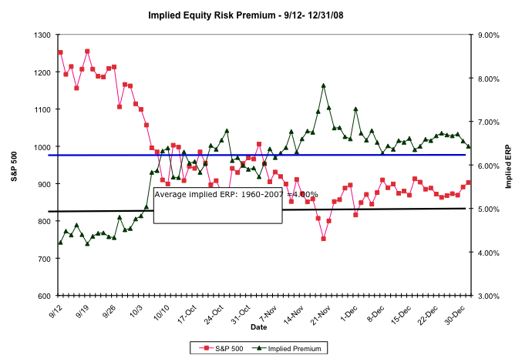
The Anatomy of a Crisis: Implied ERP from September 12, 2008 to January 1, 2009
Notes:
Equity risk premiums changed more in three months than they had in the previous 20 years put together. A wake-up call for those who stick with fixed premiums? That depends on whether we assume that this is an aberration or a break with the past.

Slide 10
An Updated Equity Risk Premium: January 2017
Notes:
The key lesson I would take away is that equity risk premiums are unstable and that globalization has made them more unstable. The other is that there seems to be mean reversion in the process – implied premiums, when abnormally high or low, move back towards a longer term average.

Slide 11
Implied Premiums in the US: 1960-2016
Notes:
As the index changes (and it is the input most likely to change by large amounts in short periods), the implied premium will change. Note that as premiums rise, stock prices drop. Notice two historical phenomena: (1) Equity risk premiums spiked in the 1970s as inflation increased in the US (2) Equity risk premiums bottomed out at 2% at the end of 1999 at the peak of the dot-com boom.
Would you settle for a 2% premium? If your answer is no, you believe that stocks are overvalued.

Slide 12
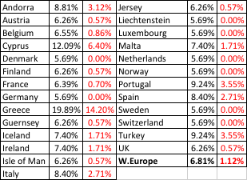
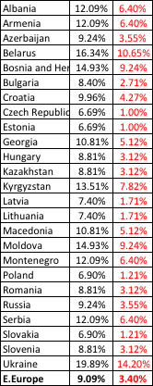
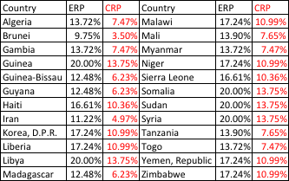
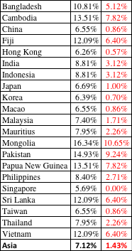

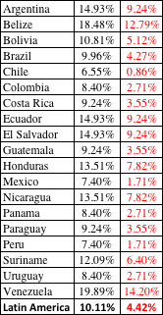
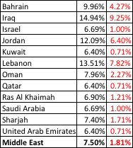

ERP : Jan 2017
Black #: Total ERP
Red #: Country risk premium
AVG: GDP weighted average
Notes:
Updated country risk premiums.

Slide 13
6 Application Test: Estimating a Market Risk Premium
For your company, get the geographical breakdown of revenues in the most recent year. Based upon this revenue breakdown and the most recent country risk premiums, estimate the equity risk premium that you would use for your company.
This computation was based entirely on revenues. With your company, what concerns would you have about your estimate being too high or too low?
Notes:
While revenues are a convenient and accessible measure of operating risk exposure, they are only a piece of the puzzle. A company’s production facilities will also come into play. A Nigerian company that has all of its factories or mines in Nigeria will be heavily exposed to Nigerian country risk, even if its revenues are entirely in Europe. If you have a breakdown of production facilities by region, you can bring those into the weights as well.

Slide 14

Task
Estimate the ERP for your company (based on exposure)
Read
Chapter 4

