Slide 1
Hurdle rates V: Betas – the regression approach
A regression beta is just a statistical number
Notes:
Sets the agenda for the class. This is a class that will be focused on the big picture of corporate finance rather than details, theories or models on a piecemeal basis.

Slide 2
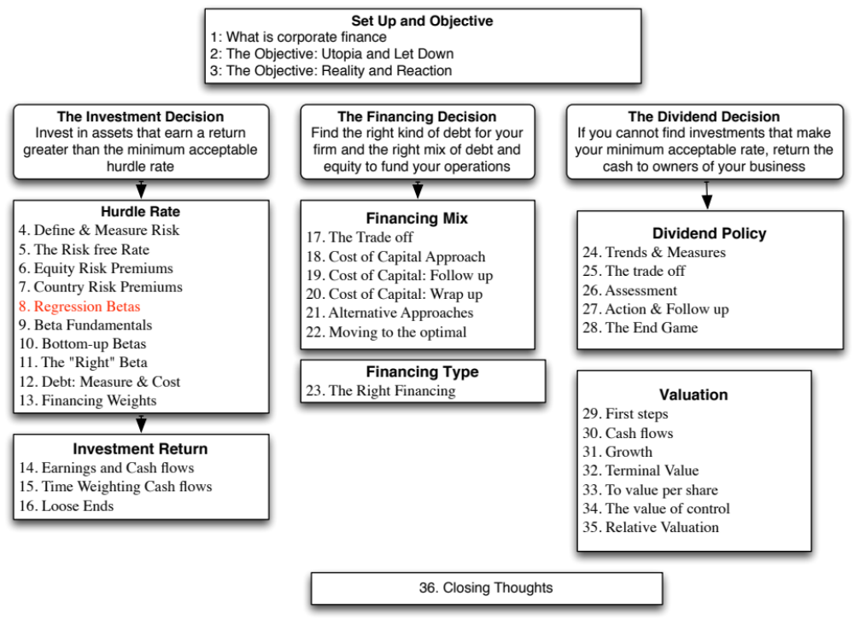

Slide 3
Estimating Beta
The standard procedure for estimating betas is to regress stock returns (Rj) against market returns (Rm) -
  R_{j} = a + b R_{m}
    where a is the intercept and b is the slope of the regression.
The slope of the regression corresponds to the beta of the stock, and measures the riskiness of the stock.
The R squared (R²) of the regression provides an estimate of the proportion of the risk (variance) of a firm that can be attributed to market risk.
Notes:
Betas reflect not just the volatility of the underlying investment but also how it moves with the market:
Beta (Slope) = Correlation_{jm} (σ_{j /} σ_{m})
Note that σ_{j} can be high but beta can be low (because the asset is not very highly correlated with the market)
Key point: Betas may be estimated from regressions but they should never be considered purely statistical numbers. They convey economic weight - they measure the risk added on by an asset to a diversified portfolio.

Slide 4
Estimating Performance
The intercept of the regression provides a simple measure of performance during the period of the regression, relative to the capital asset pricing model.
  Rj = Rf + b (Rm - Rf)
  = Rf (1-b) + b Rm ...........Capital Asset Pricing Model
  Rj = a + b Rm ...........Regression Equation
If
  a > Rf (1-b) .... Stock did better than expected during regression period
  a = Rf (1-b) .... Stock did as well as expected during regression period
  a < Rf (1-b) .... Stock did worse than expected during regression period
The difference between the intercept and Rf (1-b) is Jensen's alpha. If it is positive, your stock did perform better than expected during the period of the regression.
Notes:
Economic intuition:
Think of Riskfree rate (1- Beta) as the return your stock should make in a period when the market is flat (market return is zero)
The interpcet is what your stock actually made in a month in which the market was flat.
The difference measures whether your stock under or over performed the market index over the period. It is called Jensen’s alpha (Michael Jensen used the measure to evaluate mutual fund performance in 1968).
Jensen’s alpha can also be computed by estimating the expected return during the period of the regression, using the actual return on the market during the period, the riskfree rate during the period and the estimated beta, and then comparing it to the actual return over the period.
Algebraically, you should get the same answer.
In some cases, the regression is run using excess returns over the risk free rate on both sides - excess return for the stock on the left hand side and excess returns for the market on the right hand side. In that case, the intercept is itself Jensen’s alpha.

Slide 5
Setting up for the Estimation
Decide on an estimation period
  Services use periods ranging from 2 to 5 years for the regression
  Longer estimation period provides more data, but firms change.
  Shorter periods can be affected more easily by significant firm-specific event that occurred during the period.
Decide on a return interval - daily, weekly, monthly
  Shorter intervals yield more observations, but suffer from more noise.
  Noise is created by stocks not trading and biases all betas towards one.
Estimate returns (including dividends) on stock
  Return = (Price_{End} - Price_{Beginning} + Dividends_{Period})/ Price_{Beginning}
  Included dividends only in ex-dividend month
Choose a market index, and estimate returns (inclusive of dividends) on the index for each interval for the period.
Notes:
Note the number of subjective judgments that have to be made. The estimated beta is going to be affected by all these judgments. On each one, there are trade offs to be made, which may explain why different services make different choices.
My personal biases are to
Use five years of data (because I use monthly data)
Use monthly returns (to avoid non-trading problems)
Use returns with dividends
Use an index that is broad, market weighted and with a long history (I use the S&P 500. The NYSE composite is not market weighted, and the Wilshire 5000 has both non-trading and measurement issues that have not been resolved.) You want to get as close the mythical market portfolio as you can get…

Slide 6
Choosing the Parameters: Disney
Period used: 5 years
Return Interval = Monthly
Market Index: S&P 500 Index.
For instance, to calculate returns on Disney in December 2009,
  Price for Disney at end of November 2009 = $ 30.22
  Price for Disney at end of December 2009 = $ 32.25
  Dividends during month = $0.35 (It was an ex-dividend month)
  Return =($32.25 - $30.22 + $ 0.35)/$30.22= 7.88%
To estimate returns on the index in the same month
  Index level at end of November 2009 = 1095.63
  Index level at end of December 2009 = 1115.10
  Dividends on index in December 2009 = 1.683
  Return =(1115.1 – 1095.63+1.683)/ 1095.63 = 1.78%
Notes:
Reports parameters used. Returns in each month include dividends, if any, in that month. For most dividend paying U.S. stocks, there will be four months in the year where there are dividends and eight months without dividends. (Will the returns in those months be better? Not if you factor in what happens to stock prices on ex dividend days)

Slide 7
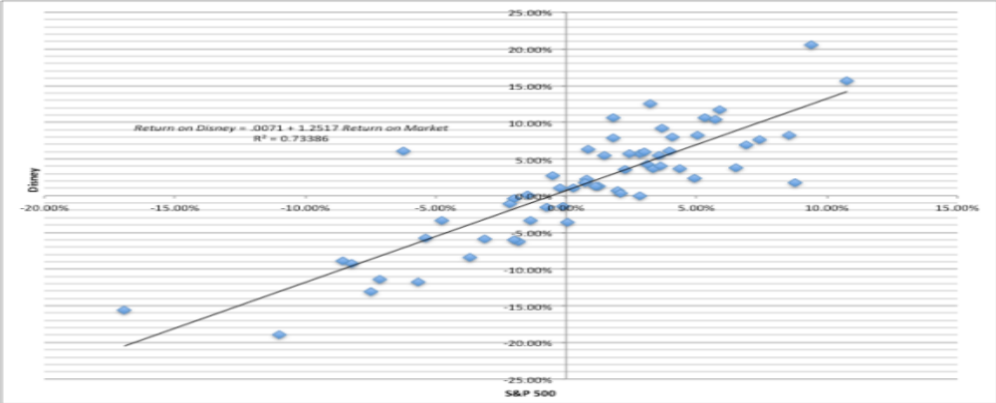
Disney’s Historical Beta
Return on Disney = .0071 + 1.2517 Return on Market R² = 0.73386
(0.10)
Notes:
This has both the scatter plot and the regression line. Note the there is substantial error in the regression. A statistician looking at this regression would view this as evidence that it was not a good regression. A financial economist looking the same regression sees it as a reflection of the reality that most of the risk in a given investment or stock is firm-specific.

Slide 8
Analyzing Disney’s Performance
Intercept = 0.712%
  This is an intercept based on monthly returns. Thus, it has to be compared to a monthly riskfree rate.
    Average Annualized T.Bill rate = 0.50%
    Monthly Riskfree Rate = 0.5%/12 = 0.042%
    Riskfree Rate (1-Beta) = 0.042% (1-1.252) = -.0105%
The Comparison is then between
  Intercept versus Riskfree Rate (1 - Beta)
  0.712% versus 0.0105%
  Jensen’s Alpha (monthly) = 0.7122% - (-0.0105)% = 0.723%
  Annualized, Disney’s annual excess return = (1.00723)¹² -1= 9.02%
On an annualized basis, Disney did 9.02% better than expected between 2008 and 2013. This Is not necessarily a sign that Diney is well managed.
Notes:
The intercept measures what your stock actually did in a month when the market was flat (zero return) during the time period of the regression. Rf(1- beta) measures what a stock should have done (given its beta) during the same period in a month in which the market did nothing.
Disney did 9.02% better than expected on an annual basis between 2004 and 2008. The Jensen’s alpha is a risk adjusted, market adjusted measure of performance. (Consider a simple example. Assume that the market was up 20% a year during the period of your regression and that you have a stock with a beta of 1.5. If you ignore the riskfree rate, this stock should have earned a return of 30% each year for the regression period. With a Jensen’s alpha of 9.02%, it earned 30% + 9.02% = 39.02%.)
If the regression is run using excess returns on the stock and market (over an above the riskfree rate), the intercept is already Jensen’s alpha:
Return on stock - Rf = a + b (Rm - Rf)
b. An alternate approach to estimating Jensen’s alpha is to use the average monthly return on the stock and subtract out the expected return using the risk free rate during the period, the beta and the average monthly return on the market. You should get an identical answer:

Slide 9
Estimating Disney’s Beta
Slope of the Regression of 1.25 is the beta
Regression parameters are always estimated with error. The error is captured in the standard error of the beta estimate, which in the case of Disney is 0.10.
Assume that I asked you what Disney’s true beta is, after this regression.
  What is your best point estimate?
  What range would you give me, with 67% confidence?
  What range would you give me, with 95% confidence?
Notes:
Best point estimate: 1.25
Range with 67% confidence: 1.15-1.35
Range with 95% confidence: 1.05-1.45

Slide 10
The Dirty Secret of “Standard Error”
Distribution of Standard Errors: Beta Estimates for U.S. stocks
1600
1400
1200
1000
800
Number of Firms
600
400
200
0
<.10
.10 - .20
.20 - .30
.30 - .40
.40 -.50
.50 - .75
> .75
Standard Error in Beta Estimate
Notes:
The standard errors of betas estimated in the US tend to be fairly high (the median is 0.20-0.25), with many beta estimates having standard errors of 0.40 or greater. These betas should come with warnings.

Slide 11
Breaking down Disney’s Risk
R Squared = 73%
This implies that
  73% of the risk at Disney comes from market sources
  27%, therefore, comes from firm-specific sources
The firm-specific risk is diversifiable and will not be rewarded.
The R-squared for companies, globally, has increased significantly since 2008. Why might this be happening?
What are the implications for investors?
Notes:
This suggests that Disney is exposed to more macro risk than the typical firm in the US. The typical firm has an R squared of between 40-45%. Hence, the allure of diversification.
(Why might this be? Size and having a more diversified business mix may explain Disney’s high R-squared.)
About 20% of firms have R-squared of less than 10%…
About 20% of firms have R-squared exceeding 50%…
If you were undiversified, which group would you like to hold? (Answer: The latter)
If you are diversified, which group would you like to hold? (Does not matter, since you get rid of the firm-specific risk anyway)

Slide 12
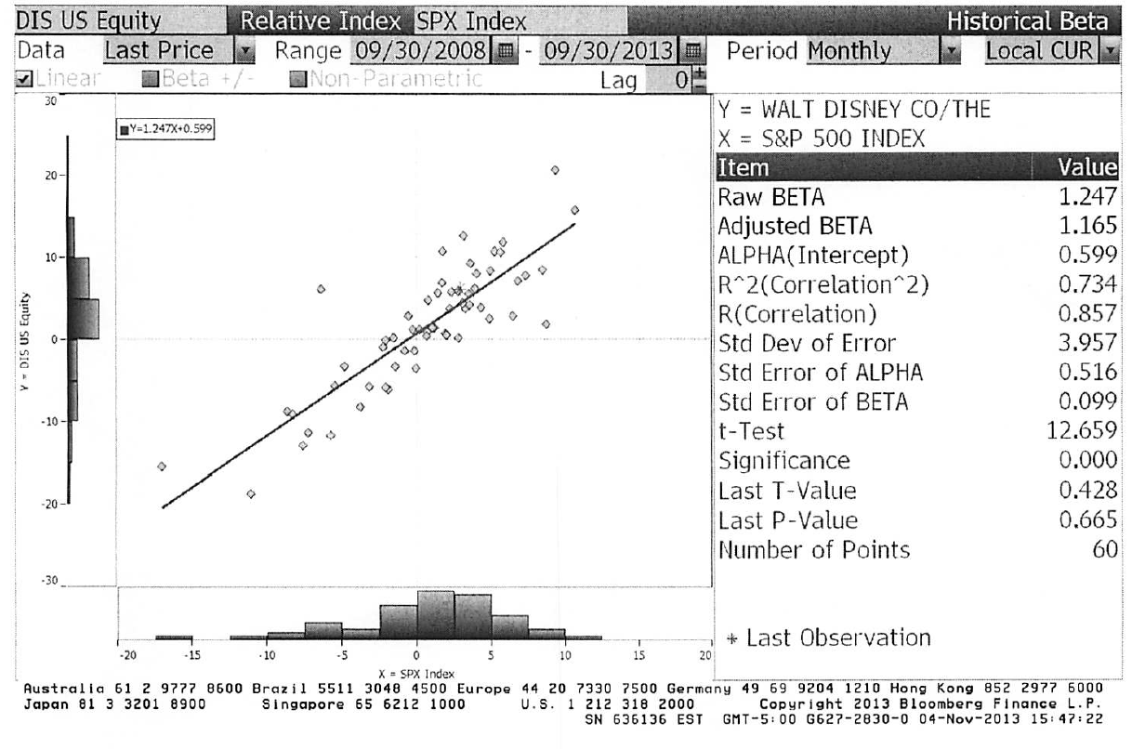
Beta Estimation: Using a Service (Bloomberg)
Notes:
This is the page for Disney’s beta, using the same period as the regression run earlier, from Bloomberg.
Bloomberg, however, uses only price returns (it ignores dividends both in the stock and the index). Hence the intercept is different.
The adjusted beta is just the regression beta moves towards one, reflecting the empirical realities that for most firms, betas tend to drift towards one as they get larger and more diversified.

Slide 13
Estimating Expected Returns for Disney in November 2013
Inputs to the expected return calculation
  Disney’s Beta = 1.25
  Riskfree Rate = 2.75% (U.S. ten-year T.Bond rate in November 2013)
  Risk Premium = 5.76% (Based on Disney’s operating exposure)
Expected Return = Riskfree Rate + Beta (Risk Premium)
= 2.75% + 1.25 (5.76%) = 9.95%
Notes:
Note that this expected return would have been different if we had decided to use a different equity risk premium. The potential error in the beta will translate into a forecast error on the expected return as well.

Slide 14
Use to a Potential Investor in Disney
As a potential investor in Disney, what does this expected return of 9.95% tell you?
  This is the return that I can expect to make in the long term on Disney, if the stock is correctly priced and the CAPM is the right model for risk,
  This is the return that I need to make on Disney in the long term to break even on my investment in the stock
  Both
Assume now that you are an active investor and that your research suggests that an investment in Disney will yield 12.5% a year for the next 5 years. Based upon the expected return of 9.95%, you would
  Buy the stock
  Sell the stock
Notes:
Both. If the stock is correctly priced, the beta is correctly estimated and the CAPM is the right model, this is what you would expect to make on Disney in the long term. As an investor, this is what you would need to make to break even on the investment. You are not being greedy, just prudent. After all, if you don’t make higher returns when the market is going up, you will find yourself falling behind when the market is going down.
Buy the stock, since you think you can make more than the hurdle rate.

Slide 15
How managers use this expected return
Managers at Disney
  need to make at least 9.95% as a return for their equity investors to break even.
  this is the hurdle rate for projects, when the investment is analyzed from an equity standpoint
In other words, Disney’s cost of equity is 9.95%.
What is the cost of not delivering this cost of equity?
Notes:
The cost of equity is what equity investors in your company view as their required return.
The cost of not delivering this return is more unhappy stockholders, a lower stock price, and if you are a manager, maybe your job.
Going back to the corporate governance section, if stockholders have little or no control over managers, managers are less likely to view this as the cost of equity.

Slide 16
6 Application Test: Analyzing the Risk Regression
If you can get a beta regression page (or output) for your company against a market index, answer the following questions:
  How well or badly did your stock do, relative to the market, during the period of the regression?
  Intercept - (Riskfree Rate/n) (1- Beta) = Jensen’s Alpha
    where n is the number of return periods in a year (12 if monthly; 52 if weekly)
  What proportion of the risk in your stock is attributable to the market? What proportion is firm-specific?
  What is the historical estimate of beta for your stock? What is the range on this estimate with 67% probability? With 95% probability?
  Based upon this beta, what is your estimate of the required return on this stock?
  Riskless Rate + Beta * Risk Premium
Notes:
Try this on your company.

Slide 17

Task
Break down the beta regression for your company
Read
Chapter 4

