Slide 1
Corporate Finance
B40.2302
Lecture Notes: Packet 1
Aswath Damodaran

Slide 2
The Objective in Corporate Finance
“If you don’t know where you are going, it does’nt matter how you get there”
Notes:
Since the objective in corporate finance (to maximize firm value) is central to everything we do, we need to look at both its strengths and weaknesses. In fact, many disagreements that people have with corporate finance theory stems from the fact that they have a different objective for the business in mind. Thus, if you view a firm’s objective as maximizing the number of jobs created, choosing projects based upon the highest NPV (which is the corporate finance prescription) will make little sense.

Slide 3
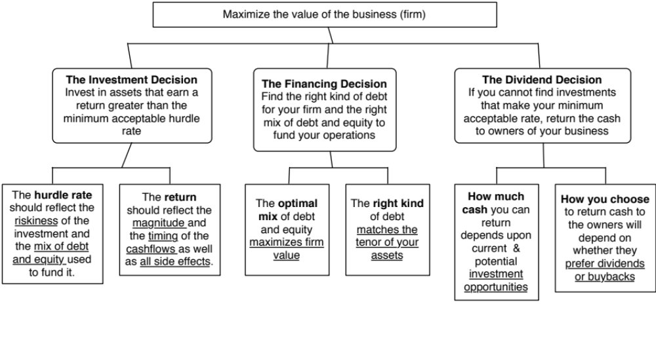
First Principles
Notes:
Our focus will be on the objective: Maximize firm value.
Since so much of corporate finance is built on this objective, it is important that we be clear about what it means and why we choose it. In addition, it is also worth exploring what the alternatives are and why this objective is preferable to the alternatives.

Slide 4
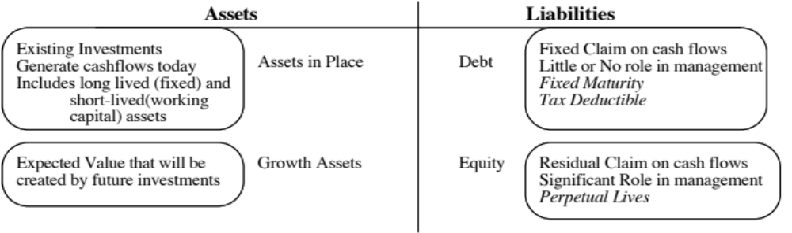
The Objective in Decision Making
In traditional corporate finance, the objective in decision making is to maximize the value of the firm.
A narrower objective is to maximize stockholder wealth. When the stock is traded and markets are viewed to be efficient, the objective is to maximize the stock price.
Maximize equity value
Maximize market estimate of equity value
Maximize firm value
Notes:
This is the answer to the question posed in the previous overhead.
Maximizing the value of the business is the most general objective function. Remember that value of the business includes assets in place and growth assets. If you are managing a growth company,, increasing earnings may not necessarily increase firm value. The other problem is that firm value itself is a difficult number to estimate. While there are models available, they all need inputs, most of which allow for subjective judgments.
Managers answer to stockholders. Consequently, the objective gets narrowed down to “maximizing equity value”. (Implicit assumption: Bondholders/ Banks can protect themselves by writing in covenants and setting interest rates).
It is tough to assess equity value objectively. It would be nice to have a “third party” estimate that is objective. For publicly traded firms, the market (in spite of all its limitations) provides such an estimate. (Implicit assumption: Markets are rational and reasonably efficient).

Slide 5
Maximizing Stock Prices is too “narrow” an objective: A preliminary response
Maximizing stock price is not incompatible with meeting employee needs/objectives. In particular:
  Employees are often stockholders in many firms
  Firms that maximize stock price generally are profitable firms that can afford to treat employees well.
Maximizing stock price does not mean that customers are not critical to success. In most businesses, keeping customers happy is the route to stock price maximization.
Maximizing stock price does not imply that a company has to be a social outlaw.
Notes:
Critique: Stock price maximization implies not caring for your employees.
Response: Use a recent story of layoffs to illustrate this criticism (XYZ Co. announced it was laying of 15,000 employees and stock price jumped $3.50). Then note that this is the exception rather than the rule. A Conference Board study from 1994 found that companies whose stock prices have gone up are more likely to hire people than one whose stock prices have gone down. Also note that employees, especially in high tech companies, have a large stake in how well their company does because they have stock options or stock in the company.
Critique: If you maximize value, you don’t care about customers.
Response: Note that customer satisfaction is important but only in the context that satisfied customers buy more from you. What would happen to a firm that defined its objective as maximizing customer satisfaction? You would give away your products for free…
Critique: Firms that maximize firm value are bad social citizens.
Response: A healthy company whose stock price has done well is much more likely to do social good than a company which is financially healthy. Again, note that there are social outlaws who might create social costs in the pursuit of stock price maximization (Those nasty corporate raiders..) but they are the exception rather than the rule.
To those who would like to have it all (they take different forms, but they talk about stakeholder wealth maximization or balanced scorecards or running a great company): It never works:
You cannot be all things to all people; keeping everyone happy leaves no one happy. You need a central objective. Otherwise, how do you choose between competing objectives?
You cannot mix up means with ends. You want satisfied and motivated employees and happy customers, but only as a means to an end: making money off them.
It gives poor performing managers an excuse for not performing because they can always pass the buck.
The Super Bowl in February 2013 was a showcase of means/ends at play. The two teams were coached by brothers: Jim (SF 49ers) and John (Ravens). During the season, Jim replaced his starting quarterback, Alex Smith, (making him, quite a few of his players, many fans and some in the press) unhappy. John fired his offensive coordinator (making his coaching staff unhappy and uncomfortable). Both coaches, though, had a singular objective which was to win the Super Bowl. They did not come into the season with fuzzy objectives (having a great season), misplaced objectives (win the most games in the regular season, win by the most points, gain the most yards) or mistaking means for ends (coaching a happy team, keeping fans happy, keeping the press happy).

Slide 6
Why traditional corporate financial theory focuses on maximizing stockholder wealth.
Stock price is easily observable and constantly updated (unlike other measures of performance, which may not be as easily observable, and certainly not updated as frequently).
If investors are rational (are they?), stock prices reflect the wisdom of decisions, short term and long term, instantaneously.
The objective of stock price performance provides some very elegant theory on:
  Allocating resources across scarce uses (which investments to take and which ones to reject)
  how to finance these investments
  how much to pay in dividends
Notes:
It is important it is to have an objective function that is observable and measurable. Fuzzy or multiple objectives are disastrous for several reasons:
Different decision makers define it to mean different things and can work at cross purposes with each other.
If your objective is fuzzy, it becomes very difficult to measure performance and how close you are to accomplishing your objective.
Note that stock prices provide almost instantaneous feedback (some of which is unwelcome) on every decision you make as a firm. Markets may not be perfect (they are far from it) but they are quick and unbiased.
Consider the example of an acquisition announcement and the market reaction to it. Stock prices of the acquiring firm tend to drop in a significant proportion of acquisitions. Why might markets be more pessimistic than managers about the expected success of an acquisition? Because the track record of firms on acquisitions is not very good.
There is also a legal basis for this focus. Courts (especially in Delaware, where most US corporations are incorporated) have long held that managers and board members have a primary fiduciary responsibility to the owners (stockholders). All other players in the game are secondary…

Slide 7
The Classical Objective Function
STOCKHOLDERS
Hire & fire
managers
- Board
- Annual Meeting
Maximize
stockholder wealth
Lend Money
No Social Costs
BONDHOLDERS/
LENDERS
Managers
SOCIETY
Protect
bondholder
Interests
All costs can be
traced to firm
Reveal
information
honestly and
on time
Markets are
efficient and
assess effect on
value
FINANCIAL MARKETS
Notes:
This is the utopian world. None of the assumptions are really defensible as written, and skepticism is clearly justified:
Why do we need these assumptions?
Since, in many large firms, there is a separation of ownership from management, managers have to be fearful of losing their jobs and go out and maximize stockholder wealth. If they do not have this fear, they will focus on their own interests.
If bondholders are not protected, stockholders can steal from them and make themselves better off, even as they make the firm less valuable.
If markets are not efficient, maximizing stock prices may not have anything to do with maximizing stockholder wealth or firm value.
If substantial social costs are created, maximizing stock prices may create large side costs for society (of which stockholders are members).
Note that corporate finance, done right, is not about expropriating or transferring wealth from other groups (bondholders, other stockholders or society) but about making the firm more productive and valuable. In this utopian world, the only way to increase value is to go out and take good investments. In the process, you contribute positively to the overall economy.

Slide 8
What can go wrong?
STOCKHOLDERS
Have little control
over managers
Managers put
their interests
above stockholders
Lend Money
Significant Social Costs
BONDHOLDERS
Managers
SOCIETY
Bondholders can
get ripped off
Some costs cannot be
traced to firm
Delay bad
news or
provide
misleading
information
Markets make
mistakes and
can over react
FINANCIAL MARKETS
Notes:
This is my worst case scenario:
Stockholders have little or no control over managers. Managers, consequently, put their interests above stockholder interests.
Bondholders who do not protect themselves find stockholders expropriating their wealth.
Information conveyed to markets is noisy, biases and sometimes misleading. Markets do not do a very good job of assimilating this information and market price changes have little to do with true value.
Firms in the process of maximizing stockholder wealth create large social costs.
In this environment, stockholder wealth maximization is not a good objective function.

Slide 9
I. Stockholder Interests vs. Management Interests
In theory: The stockholders have significant control over management. The two mechanisms for disciplining management are the annual meeting and the board of directors. Specifically, we assume that
  Stockholders who are dissatisfied with managers can not only express their disapproval at the annual meeting, but can use their voting power at the meeting to keep managers in check.
  The board of directors plays its true role of representing stockholders and acting as a check on management.
In Practice: Neither mechanism is as effective in disciplining management as theory posits.
Notes:
In theory, stockholders are supposed to come to the annual meeting, and make informed judgments about whether they want to keep incumbent management in place. Large stockholders act like private business owners and are vigilant about protecting their interests.
The board of directors is supposed to protect the stockholders and keep an eye on top managers.
So why don’t they work?

Slide 10
The Annual Meeting as a disciplinary venue
The power of stockholders to act at annual meetings is diluted by three factors
  Most small stockholders do not go to meetings because the cost of going to the meeting exceeds the value of their holdings.
  Incumbent management starts off with a clear advantage when it comes to the exercise of proxies. Proxies that are not voted becomes votes for incumbent management.
  For large stockholders, the path of least resistance, when confronted by managers that they do not like, is to vote with their feet.
Annual meetings are also tightly scripted and controlled events, making it difficult for outsiders and rebels to bring up issues that are not to the management’s liking.
Notes:
It is not irrational for small stockholders to not actively involve themselves in the management of firms, because it is not economical for them to do so.
A significant percentage of proxies do not get turned in. In many firms, the managers of the firm get the votes commanded by these proxies. That would be the equivalent of having an election and allowing the incumbent to get the votes of anyone who does not vote.
For a large stockholder like Fidelity Magellan, with its hundreds of holdings, it just might not be feasible to be an active investor. There are also potential conflicts of interest, since Fidelity is also in the business of managing corporate pension funds… Even activist investment funds (such as the California Pension Fund), have pulled back in recent years. (Putnam exception? See WSJ article on Putnam: Putnam is one of the few mutual fund companies to contest management)
The annual meeting is tightly scripted and run, making it difficult for dissident stockholders to be heard. (In Japan, in the 1980s, trouble makers were hired to heckle stockholders who tried to ask managers tough questions. In Europe, until very recently, annual meetings were exquisitely well mannered affairs where elite managers told plebian stockholders what was good for them - shades of Marie Antoinette and “let them eat cake”…. (At Tattingers, the French luxury good company, Claudia Tattinger said that she felt ashamed for the stockholders who would ask “such rude questions” after Asher Edelman demanded to know whether the company owned chateaus and who lived in them…)

Slide 11
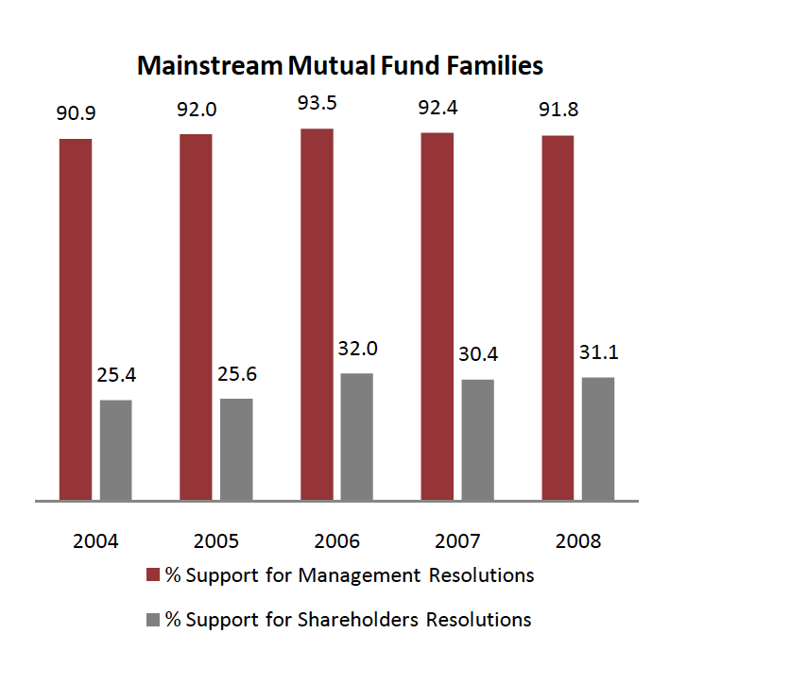
And institutional investors go along with incumbent managers…
Notes:
You would expect mutual funds and other institutional investors to take a more activist role and act as a check on the incumbent managers at annual meetings. For the most part, though, they seem to be supporters of the status quo, seldom challenging managers (even when they are wrong). This can be attributed to two factors:
Cost: It is costly to challenge incumbent managers. For institutional investors spread over multiple firms, this cost may be too high to bear.
Conflicts of interest: Many mutual fund families also look to companies for business. To the extent that challenging managers may cost them this business, they may hold back.

Slide 12
Board of Directors as a disciplinary mechanism
Directors are paid well: In 2010, the median board member at a Fortune 500 company was paid $212,512, with 54% coming in stock and the remaining 46% in cash. If a board member was a non-executive chair, he or she received about $150,000 more in compensation.
Spend more time on their directorial duties than they used to: A board member worked, on average, about 227.5 hours a year (and that is being generous), or 4.4 hours a week, according to the National Associate of Corporate Directors. Of this, about 24 hours a year are for board meetings. Those numbers are up from what they were a decade ago.
Even those hours are not very productive: While the time spent on being a director has gone up, a significant portion of that time was spent on making sure that they are legally protected (regulations & lawsuits).
And they have many loyalties: Many directors serve on three or more boards, and some are full time chief executives of other companies.
Notes:
This sounds judgmental and it is meant to be. Directors do not spend a great deal of time overseeing managers, and they are well paid.
The pay shown here understates the true compensation that directors make from other perks and benefits that they get (pensions, for instance).
As a postscript, the pay of directors has kept rising. While the number of hours spent has also increased somewhat though how much of this additional time is spent on getting legal protection (against stockholder lawsuits) is debatable.
Post Sarbanes-Oxley, directors seem to spend more time with lawyers, making sure that they don’t get sued than they do with managers, trying to figure out whether the company is well run. This may be the unintended consequence when you try to get good corporate governance by law.

Slide 13
The CEO often hand-picks directors..
CEOs pick directors: A 1992 survey by Korn/Ferry revealed that 74% of companies relied on recommendations from the CEO to come up with new directors and only 16% used an outside search firm. While that number has changed in recent years, CEOs still determine who sits on their boards. While more companies have outsiders involved in picking directors now, CEOs exercise significant influence over the process.
Directors don’t have big equity stakes: Directors often hold only token stakes in their companies. Most directors in companies today still receive more compensation as directors than they gain from their stockholdings. While share ownership is up among directors today, they usually get these shares from the firm (rather than buy them).
And some directors are CEOs of other firms: Many directors are themselves CEOs of other firms. Worse still, there are cases where CEOs sit on each other’s boards.
Notes:
When John Mack became CEO of Morgan Stanley, the fist two directors he picked to sit on the board were members of his golf club in Purchase, NY…
This adds to why directors spend so little time on oversight. CEOs, left to themselves, will seldom pick adversarial directors. Directors also make far more money from directorships than they do from owning stock in the firm. Not surprisingly, they do not take the side of stockholders.
A Wall Street Journal article, a few years ago, looked at the phenomenon of CEOs sitting on each other’s boards. It is very difficult to see how they can be objective in those cases.

Slide 14
Directors lack the expertise (and the willingness) to ask the necessary tough questions..
Robert’s Rules of Order? In most boards, the CEO continues to be the chair. Not surprisingly, the CEO sets the agenda, chairs the meeting and controls the information provided to directors.
Be a team player? The search for consensus overwhelms any attempts at confrontation.
The CEO as authority figure: Studies of social psychology have noted that loyalty is hardwired into human behavior. While this loyalty is an important tool in building up organizations, it can also lead people to suppress internal ethical standards if they conflict with loyalty to an authority figure. In a board meeting, the CEO generally becomes the authority figure.
Notes:
Harold Geneen who ruled ITT with an iron fist during the sixties when ITT built itself up through acquisitions, mentions in his memoirs that almost all decisions, during his tenure, that were made by the board, were unanimous.
CEOs often chair the board, and establish the agenda for what the board discusses.

Slide 15
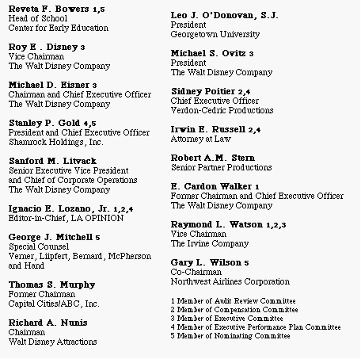
The worst board ever? The Disney Experience - 1997
Notes:
This may be going back in time but it may help understanding Disney’s present standing. This was Disney’s board at the height of Michael Eisner’s powers. (Eisner became CEO of Disney in 1985 and consolidated power in the years after.)
Note the number of insiders on the board. (Seven out of 16; five current employees & two ex-employees) Also note the presence of Mr. Eisner’s private attorney (Irwin Russell) and the principal of his childrens’ elementary school (Reveta Bowers) on the board.
How independent was this board likely to be of Mr. Eisner? This may explain some of the actions taken by Disney (and specifically Eisner) during the 1990s… (Read Disney War by James Stewart for the gory details)
When Eisner was hired in 1984, he insisted on bringing in his protégé Jeffrey Katzenberg, his young assistant, into the firm with him. He put Katzenberg in charge of Disney Animation, which was not doing well. Katzenberg was largely responsible for the rebirth of that division (which Eisner had considered shutting down) with The Little Mermaid, Beauty and the Beast and The Lion King all proving to be mega-winners. As a reward for this success, Eisner fired him. His lucrative contract entitled him to 2% of the revenues from the movies he made in posterity but he would have settled for $100 million. Eisner refused to pay; Disney paid $ 250 million in 1999.
In 1995, Eisner hired Ovitz, a leading agent in Hollywood, and then told the board to okay the hire. He regretted it almost immediately and fired him 453 days later for “lying” and “incompetence”. However, rather than argue that this was just cause for firing, he paid Ovitz $ 100 million to leave.

Slide 16
The Calpers Tests for Independent Boards
Calpers, the California Employees Pension fund, suggested three tests in 1997 of an independent board:
  Are a majority of the directors outside directors?
  Is the chairman of the board independent of the company (and not the CEO of the company)?
  Are the compensation and audit committees composed entirely of outsiders?
Disney was the only S&P 500 company to fail all three tests.
Notes:
Calpers was one of the first institutional investors to pay attention to corporate governance. Every year, Calpers lists the 10 companies that were the worst culprits when it came to putting managerial interests over stockholder interests.
In the last twenty years, investors have become more aware of how important corporate governance is and there are an increasing number of services that focus on measuring and reporting on corporate governance.

Slide 17
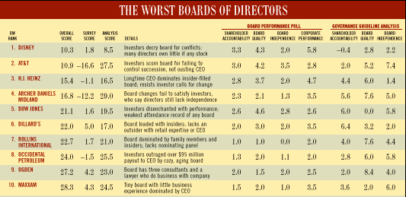
Business Week piles on… The Worst Boards in 1997..
Notes:
A poor board does not necessarily translate into a poorly managed firm. However, a poor board give CEOs carte blanche to do what they want to do… At some point in time, even good managers need restraint and good counsel. A rubber-stamp board will not provide that. (The best analogy is to a dictator… the line between a benevolent dictator and a malevolent one is a very fine one…)
As a stockholder, however, the fact that returns are good might not compensate for the fact that you do not believe that managers are responsive to your interests. (At the Disney stockholder meetings in both 1996 and 1997, there was substantial stockholder dissension in spite of the fact that the stock had performed reasonably in both periods.)

Slide 18
Application Test: Who’s on board?
Look at the board of directors for your firm.
  How many of the directors are inside directors (Employees of the firm, ex-managers)?
  Is there any information on how independent the directors in the firm are from the managers?
Are there any external measures of the quality of corporate governance of your firm?
  Yahoo! Finance now reports on a corporate governance score for firms, where it ranks firms against the rest of the market and against their sectors.
Is there tangible evidence that your board acts independently of management?
  Check news stories to see if there are actions that the CEO has wanted to take that the board has stopped him or her from taking or at least slowed him or her down.
Notes:
You can usually find this information for your firm in the 14-DEF filing that all firms in the US have to make with the SEC. If you have a non-US firm, this becomes more difficult to do. While you can usually find the names of the directors from the annual report, you may have a difficult time finding out the linkages (and potential conflicts) these directors may have with the managers of the firm.
You may also be able to find a corporate governance score for your company, especially if it is a large market cap company. Even if you cannot, you can make your own judgments on whether you (as a stockholder) are likely to have much influence on how this company is run.

Slide 19
So, what next? When the cat is idle, the mice will play ....
When managers do not fear stockholders, they will often put their interests over stockholder interests
  Greenmail: The (managers of ) target of a hostile takeover buy out the potential acquirer's existing stake, at a price much greater than the price paid by the raider, in return for the signing of a 'standstill' agreement.
  Golden Parachutes: Provisions in employment contracts, that allows for the payment of a lump-sum or cash flows over a period, if managers covered by these contracts lose their jobs in a takeover.
  Poison Pills: A security, the rights or cashflows on which are triggered by an outside event, generally a hostile takeover, is called a poison pill.
  Shark Repellents: Anti-takeover amendments are also aimed at dissuading hostile takeovers, but differ on one very important count. They require the assent of stockholders to be instituted.
  Overpaying on takeovers: Acquisitions often are driven by management interests rather than stockholder interests.
No stockholder approval needed….. Stockholder Approval needed
Notes:
These actions could all suggest that managerial interests are being put over stockholder interests. (Some of these actions, though, may also increase stockholder wealth. Managers will, of course, always claim that these actions are in stockholders’ best interests)
The reason that I have put overpaying on poison pills and shark repellants below greenmail and golden parachutes is not because they create less damage to stockholders but because stockholders at least get a chance to voice their view (they both require stockholder approval). Greenmail and golden parachutes just require board approval.

Slide 20
Overpaying on takeovers
The quickest and perhaps the most decisive way to impoverish stockholders is to overpay on a takeover.
The stockholders in acquiring firms do not seem to share the enthusiasm of the managers in these firms. Stock prices of bidding firms decline on the takeover announcements a significant proportion of the time.
Many mergers do not work, as evidenced by a number of measures.
  The profitability of merged firms relative to their peer groups, does not increase significantly after mergers.
  An even more damning indictment is that a large number of mergers are reversed within a few years, which is a clear admission that the acquisitions did not work.
Notes:
Managers of acquiring firms almost always make every acquisition sound like a good idea. Stockholders are more skeptical (as is evidenced by the behavior of acquiring firm stock prices on the announcement of acquisitions).
Stockholders must be right, on average, since many takeovers do not seem to work in terms of increasing stockholder wealth or delivering higher profitability.
(Good references:
The Synergy Trap, Mark Sirower)

Slide 21
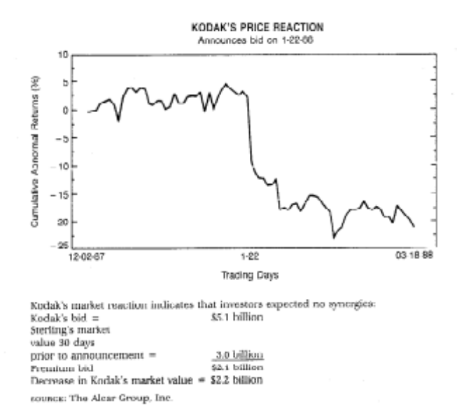
A case study in value destruction:
Eastman Kodak & Sterling Drugs
Kodak enters bidding war
Kodak wins!!!!
In late 1987, Eastman Kodak entered into a bidding war with Hoffman La Roche for Sterling Drugs, a pharmaceutical company.
The bidding war started with Sterling Drugs trading at about $40/share.
At $72/share, Hoffman dropped out of the bidding war, but Kodak kept bidding.
At $89.50/share, Kodak won and claimed potential synergies explained the premium.
Notes:
Note the difference in stock price behavior of the target and bidding firms.
Note also the symmetry between premium paid over the market price at Sterling Drugs ($ 2.1 billion) and value lost at Kodak ($2.2 billion). Kodak argued that this merger would create synergy and that was why they were paying the premium. The market did not seem to see any synergy.

Slide 22
Earnings and Revenues at Sterling Drugs
Sterling Drug under Eastman Kodak: Where is the synergy?
5,000
4,500
4,000
3,500
3,000
2,500
2,000
1,500
1,000
500
0
1988
1989
1990
1991
1992
Revenue
Operating Earnings
Notes:
Where is the synergy?
Profits essentially stagnated at Sterling after the Kodak acquisition. The rest of the drug industry reported an annual growth in earnings of 15% a year during this period.
Why is synergy so hard to deliver?
Firms do not plan for it at the time of the acquisitions
Culture shock
Unrealistic assumptions

Slide 23
Kodak Says Drug Unit Is Not for Sale … but…
An article in the NY Times in August of 1993 suggested that Kodak was eager to shed its drug unit.
  In response, Eastman Kodak officials say they have no plans to sell Kodak’s Sterling Winthrop drug unit.
  Louis Mattis, Chairman of Sterling Winthrop, dismissed the rumors as “massive speculation, which flies in the face of the stated intent of Kodak that it is committed to be in the health business.”
A few months later…Taking a stride out of the drug business, Eastman Kodak said that the Sanofi Group, a French pharmaceutical company, agreed to buy the prescription drug business of Sterling Winthrop for $1.68 billion.
  Shares of Eastman Kodak rose 75 cents yesterday, closing at $47.50 on the New York Stock Exchange.
  Samuel D. Isaly an analyst , said the announcement was “very good for Sanofi and very good for Kodak.”
  “When the divestitures are complete, Kodak will be entirely focused on imaging,” said George M. C. Fisher, the company's chief executive.
  The rest of the Sterling Winthrop was sold to Smithkline for $2.9 billion.
Notes:
As in the old Soviet Union, nothing is true until it is officially denied.
It is also worth noting that analysts sometimes say the most inane things in response to corporate actions and strategic buzzwords will often be offered by corporate chieftains (focus, diversification, synergy, strategic considerations..)

Slide 24

The connection to corporate governance: HP buys Autonomy… and explains the premium
Notes:
HP acquired Autonomy, a UK-based business software company, for $11.1 billion in 2011. At the time, almost everyone except for HP’s management thought that they were paying too much. Leo Apotheker, HP’s CEO at the time, claimed that they had done their homework and that the investment bankers had done a DCF and found the deal to be an accretive, good deal. The board of HP went along with the deal… and Meg Whitman was on the board. This is the same board that a year earlier had been caught sleeping on the job as the previous CEO, Mark Hurd, was found to have been involved in personal misconduct… And guess what…. This board met all of the Sarbanes Oxley requirements for independence.

Slide 25

A year later… HP admits a mistake…and explains it…
Notes:
About a year later, HP announced that it was writing off almost $8.9 billion off its original deal value and claimed that Autonomy had cooked the books. This was my attempt to break down the write off, even with the presumption of accounting impropriety. The CEO of HP, Meg Whitman, claimed no responsibility…

Slide 26
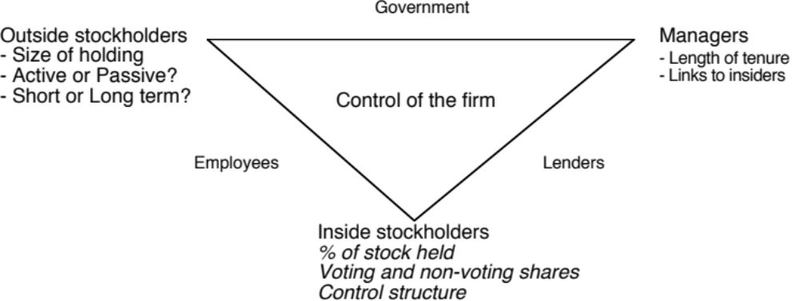
Application Test: Who owns/runs your firm?
Look at: Bloomberg printout HDS for your firm
Who are the top stockholders in your firm?
What are the potential conflicts of interests that you see emerging from this stockholding structure?
Notes:
One of your first tasks when assessing a company is to see whether managers have a significant stake in the company. You can get this information in a variety of places. I use Bloomberg to get the data on the top 17 stockholders and go down the list to see if incumbent managers have a stake in the company. I also check to see if there are other investors on the list who may not be incumbent managers but are strong advocates for stockholders - Berkshire Hathaway at Coca Cola, KKR or Blackstone at many publicly traded firms…
You can also get this information from Yahoo! Finance by going into company profiles and clicking on institutional investors…
As you look at the list of top stockholders, you should be also considering the potential conflicts of interest created by the stockholder structure.
Inside stockholders (Founding family, controlling stockholder/manager) versus outside stockholders
Government as major stockholder (or holder of golden vote)
Employees as major stockholders

Slide 27
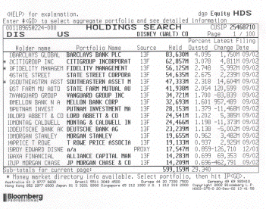
Case 1: Splintering of Stockholders
Disney’s top stockholders in 2003
Notes:
Not a single individual investor in the list other than Roy Disney who was the 15th largest stockholder… Managers are not significant stockholders in Disney (and the same can be said for most large publicly traded firms). Consider the following scenarios:
Managers are not significant stockholders in the firm: Significant potential for conflicts of interest between managers and stockholders.
Individuals are significant stockholders in the firm as well as part of top management. Usually, these are founder-owners of the firm and the firms tend to be younger firms or family run businesses that have recently made the transition to publicly traded firms. Smaller potential for conflict between managers and stockholders, but potential for conflict between inside stockholders and outside stockholders.
The government is a large stockholder (or a stockholder with veto power). This may keep managers in some check but it will create potential conflicts of interest between the other stockholders and the government (Consider what would happen if the company tried to minimize taxes paid)
Trusts or descendants of owners are significant stockholders in the firm but are not an active part of incumbent management. Power that these stockholders retain to replace managers reduces potential for conflict of interest but is reduced as holdings get diluted among lots of family members.
Another company is largest stockholder in firm. In this case, trace out who owns stock in the other company….

Slide 28
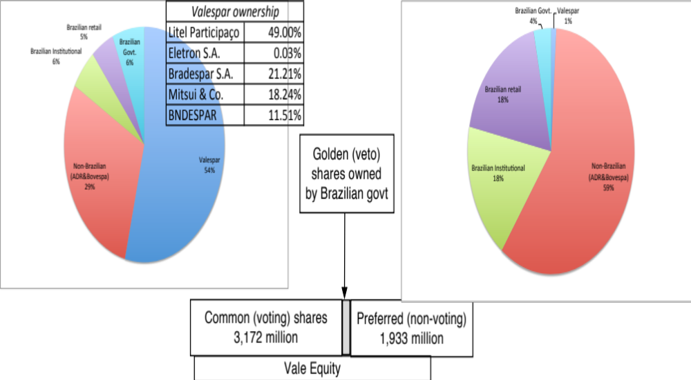
Case 2: Voting versus Non-voting Shares & Golden Shares: Vale
Vale has eleven members on its board of directors, ten of whom were nominated by Valepar and the board was chaired by Don Conrado, the CEO of Valepar.
Notes:
Voting right differences: When voting rights vary across shares, incumbent managers can consolidate their hold on a company with relatively small holdings. This reduces the power that stockholders have in these companies. Differences in voting rights are common outside the U.S. In Asia and Latin America, incumbent managers or family members can control companies with relatively small holdings with complete impunity.
Golden shares: When the government has veto power over major decisions, that also acts as a constraint on shareholders. Consequently, shareholders have to be realistic about what they can change and not change at these companies.

Slide 29
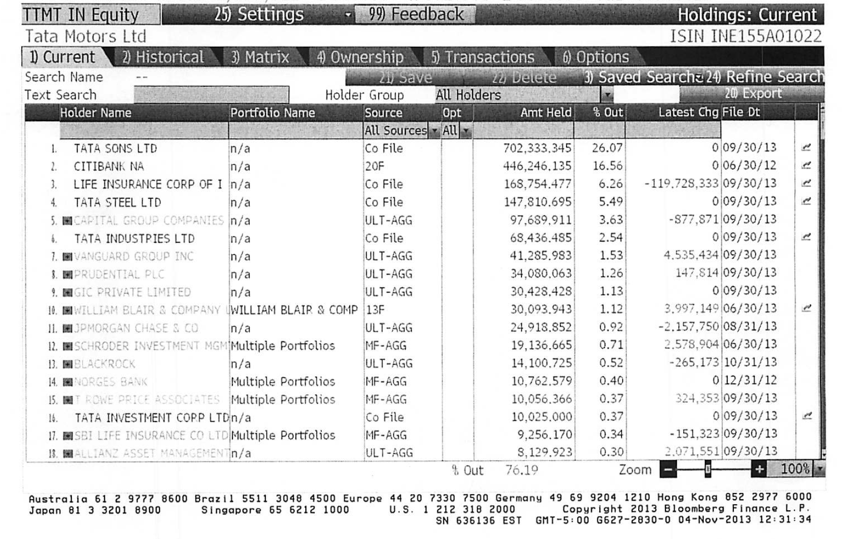
Case 3: Cross and Pyramid Holdings
Tata Motor’s top stockholders in 2013
Notes:
Cross holding structures are often designed with control in mind. In the case of Tata Motors, other Tata companies (which are part of the Tata family group) represent a large number of the top 15 stockholders in the company. (At least the Tatas are up front and open about their cross holding structures… In many Indian companies, the cross holdings are disguised with front companies holding the stock for families).
In Asia and Latin America, corporate holdings structures are designed to consolidate control.

Slide 30
Case 4: Legal rights and Corporate Structures: Baidu
The Board: The company has six directors, one of whom is Robin Li, who is the founder/CEO of Baidu. Mr. Li also owns a majority stake of Class B shares, which have ten times the voting rights of Class A shares, granting him effective control of the company.
The structure: Baidu is a Chinese company, but it is incorporated in the Cayman Islands, its primary stock listing is on the NASDAQ and the listed company is structured as a shell company, to get around Chinese government restrictions of foreign investors holding shares in Chinese corporations.
The legal system: Baidu’s operating counterpart in China is structured as a Variable Interest Entity (VIE), and it is unclear how much legal power the shareholders in the shell company have to enforce changes at the VIE.
Notes:
When you invest in Baidu, you have to do so with the recognition that your rights to make changes in the company or have a say in how it is run are very limited. There have been cases in the last few years, where US investors in companies structured just like Baidu have found that the Chinese courts are not protective of their legal rights.

Slide 31
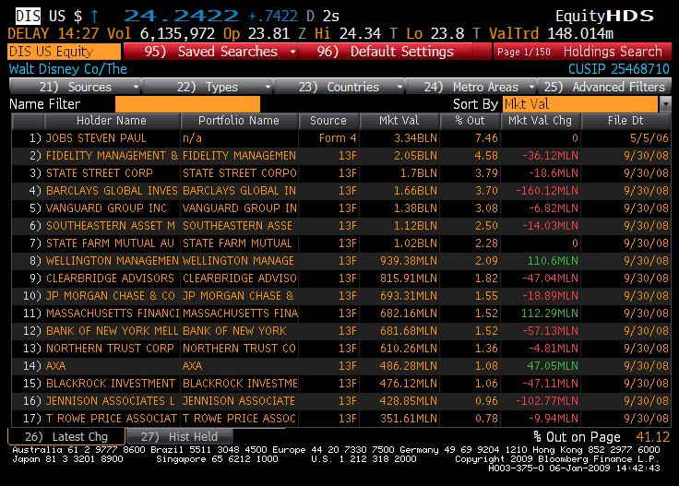
Things change.. Disney’s top stockholders in 2009
Notes:
Things can change… This is Disney in 2009. Note that there is now an individual at the top of the list – Steve Jobs, whose holdings came from his majority ownership at Pixar that was acquired by Disney.
As a stockholder in Disney, what would have been your thoughts about Jobs at the top of the list?
Jobs had many shortcomings, but he was a visionary who would have pushed Disney to take another look at its established business practices.

Slide 32
II. Stockholders' objectives vs. Bondholders' objectives
In theory: there is no conflict of interests between stockholders and bondholders.
In practice: Stockholder and bondholders have different objectives. Bondholders are concerned most about safety and ensuring that they get paid their claims. Stockholders are more likely to think about upside potential
Notes:
Bondholders include all lenders (including banks). What is good for stockholders is not necessarily good for lenders….

Slide 33
Examples of the conflict..
A dividend/buyback surge: When firms pay cash out as dividends, lenders to the firm are hurt and stockholders may be helped. This is because the firm becomes riskier without the cash.
Risk shifting: When a firm takes riskier projects than those agreed to at the outset, lenders are hurt. Lenders base interest rates on their perceptions of how risky a firm’s investments are. If stockholders then take on riskier investments, lenders will be hurt.
Borrowing more on the same assets: If lenders do not protect themselves, a firm can borrow more money and make all existing lenders worse off.
Notes:
In each of these cases, you are likely to see stock prices go up on the action and bond prices go down. Lenders value stability and security. Equity investors share in upside and may prefer to cash out…

Slide 34
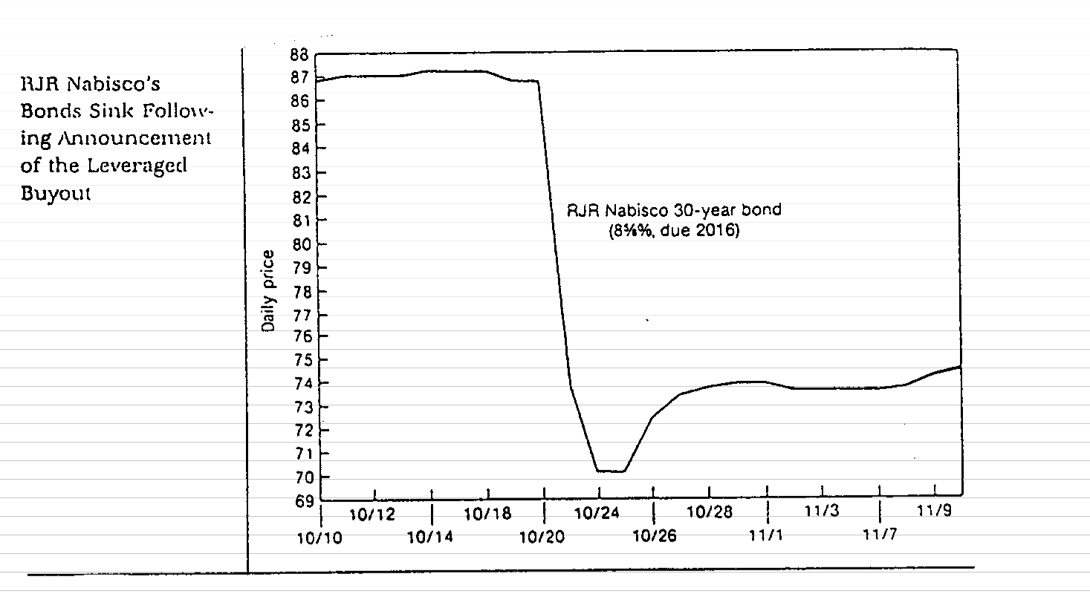
An Extreme Example: Unprotected Lenders?
Notes:
The fact that a company is well known and has a good reputation (as Nabisco did in the early 1980s, when you bought the bond) will not protect you as a lender. Nabisco’s bond price plummeted on the day of the LBO, while the stock price soared.
Is this just a paper loss? (You still get the same coupons. Only the price has changed)
Not really. There is now a greater chance of default in Nabisco, for which you as a lender are not compensated.
How could Nabisco’s bondholders have protected themselves?
Put in a covenant that allowed them to turn the bonds into the firm in the event of an event like an LBO and receive the face value of the bond. (Puttable bonds)
Make the coupon payments on the bond a function of the company’s rating (Rating sensitive bonds)

Slide 35
III. Firms and Financial Markets
In theory: Financial markets are efficient. Managers convey information honestly and and in a timely manner to financial markets, and financial markets make reasoned judgments of the effects of this information on 'true value'. As a consequence-
  A company that invests in good long term projects will be rewarded.
  Short term accounting gimmicks will not lead to increases in market value.
  Stock price performance is a good measure of company performance.
In practice: There are some holes in the 'Efficient Markets' assumption.
Notes:
An efficient market is one where the market price reflects the true value of the equity in the firm (and any changes in it). It does not imply perfection on the part of markets, but it does imply a link between what happens to the stock price and what happens to true value.
Note:
Efficient markets can and often should be volatile. True values change on a minute by minute basis, and so should the price.
Information should still affect prices in an efficient market.

Slide 36
Managers control the release of information to the general public
Information management (timing and spin): Information (especially negative) is sometimes suppressed or delayed by managers seeking a better time to release it. When the information is released, firms find ways to “spin” or “frame” it to put themselves in the best possible light.
Outright fraud: In some cases, firms release intentionally misleading information about their current conditions and future prospects to financial markets.
Notes:
Consider an example of Bre-X, which told markets that it had found one of the largest gold reserves in the world in Indonesia in the early 1990s. In 1997, it was revealed that there was no gold, and that the firm had salted the mine with gold to fool investors. When the news eventually came out, the stock price dropped to zero. Bre-X was followed by 9 analysts, all of whom professed to be shocked by the revelation.
Or Satyam Computer (a CFO who could not find the cash)….Or Mercury Finance (a company that could not find its CFO..) … Or Comverse, the Israeli company that could not find its CEO (until someone spotted him in Sri Lanka… and later in Namibia)
For a non-US example, consider Parmalat, the Italian dairy company. The managers and promoters of the firm went to jail because billions in debt raised by the firm could not be traced.
And there is Enron… and WorldCom… and Tyco…
Notwithstanding these examples, outright fraud remains the exception rather than the rule… What is more common is for firms to fudge the truth or to try to control the release of bad news to the market.

Slide 37
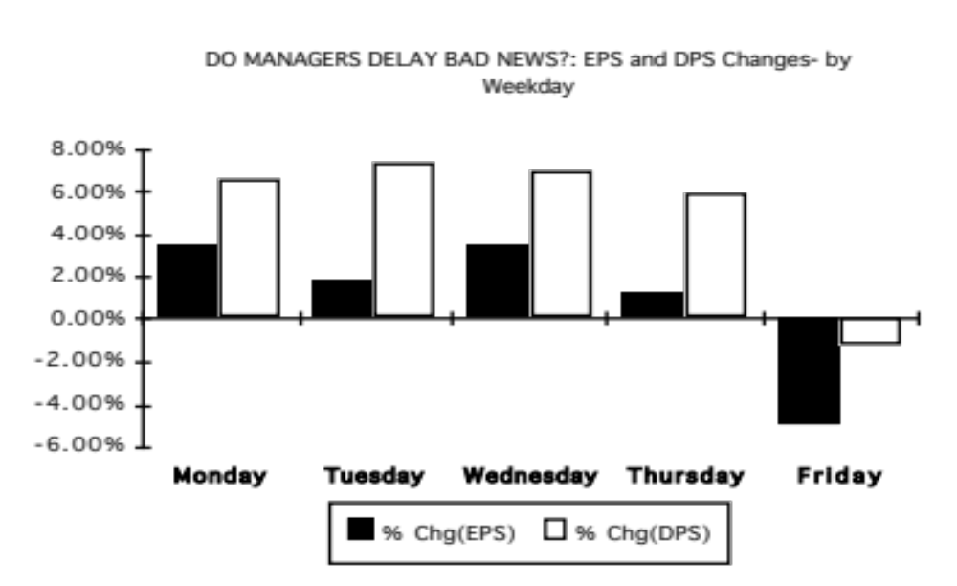
Evidence that managers delay bad news?
Notes:
This study looked at thousands of earnings and dividend announcements, categorized by day of the week in the 1980s. Either bad things tend to happen on Fridays, or managers are trying to hold on to bad news until Friday. In fact, most of the bad news on Friday comes out after 4 pm, and markets have closed.
Managers do not trust markets to not panic on bad news.
This may explain a portion of the weekend effect - stock prices tend to go down on Mondays.

Slide 38
Some critiques of market efficiency..
Investor irrationality: The base argument is that investors are irrational and prices often move for no reason at all. As a consequence, prices are much more volatile than justified by the underlying fundamentals. Earnings and dividends are much less volatile than stock prices.
Manifestations of irrationality
  Reaction to news: Some believe that investors overreact to news, both good and bad. Others believe that investors sometimes under react to big news stories.
  An insider conspiracy: Financial markets are manipulated by insiders; Prices do not have any relationship to value.
  Short termism: Investors are short-sighted, and do not consider the long-term implications of actions taken by the firm
Notes:
The Shiller effect - stock prices are much volatile than justified by looking at the underlying dividends and other fundamentals - is debatable. While people often present anecdotal evidence on the phenomenon, they under estimate the volatility of the underlying fundamentals.
For every researcher who claims to find evidence that markets overreact, there seems to be another researcher who finds evidence that they under react. And few investors seems to be able to systematically make real money (as opposed to hypothetical money) on these supposed over or under reactions.
Corporate strategists, like Michael Porter, argue that market prices are based upon short term forecasts of earnings and do not factor in the long term.
In some emerging markets outside the US, the argument is that prices are moved by insiders and that they have no relationship to value.

Slide 39
Are markets short sighted and too focused on the near term? What do you think?
Focusing on market prices will lead companies towards short term decisions at the expense of long term value.
  a. I agree with the statement
  b. I do not agree with this statement
Allowing managers to make decisions without having to worry about the effect on market prices will lead to better long term decisions.
  I agree with this statement
  I do not agree with this statement
Neither managers nor markets are trustworthy. Regulations/laws should be written that force firms to make long term decisions.
  I agree with this statement
  I do not agree with this statement
Notes:
This again has no right answers. Most participants, given the barrage of criticism that they hear about markets on the outside, come in with the perception that prices are short term.
However, most people are also unwilling to trust managers to make good long-term decisions, which brings the real problem to the forefront. The question should not be whether you trust the market to be long term, but whether you trust markets more than managers…
The point is that markets are imperfect, but someone has to make the judgments. Managers argue that they do it better. Governments argued (especially in the socialist heyday) that they have a long term focus. The Ministry of Finance in Japan thought it had the monopoly on long term perspective.

Slide 40
Are markets short term? Some evidence that they are not..
Value of young firms: There are hundreds of start-up and small firms, with no earnings expected in the near future, that raise money on financial markets. Why would a myopic market that cares only about short term earnings attach high prices to these firms?
Current earnings vs Future growth: If the evidence suggests anything, it is that markets do not value current earnings and cashflows enough and value future earnings and cashflows too much. After all, studies suggest that low PE stocks are under priced relative to high PE stocks
Market reaction to investments: The market response to research and development and investment expenditures is generally positive.
Notes:
None of these pieces of evidence is conclusive proof that markets are long term, but the evidence does add up to markets being much more long term than they are given credit for. There is little evidence, outside of anecdotal evidence, that markets are short term.
The best support for markets comes from looking at how well they do relative to expert prognosticators:
Forward currency rates are better predictors of expected currency rates in the future than economic forecasters.
Orange juice futures markets seem to predict the weather in Florida better than weather forecasters.
The Iowa Election Market has predicted election results better than political pundits.
It is true that there are many short term investors and analysts in the market, but the real question is whether the market price is able to get past their short term considerations and focus on the long term. Sometimes, it does not, but surprisingly often, it does.

Slide 41
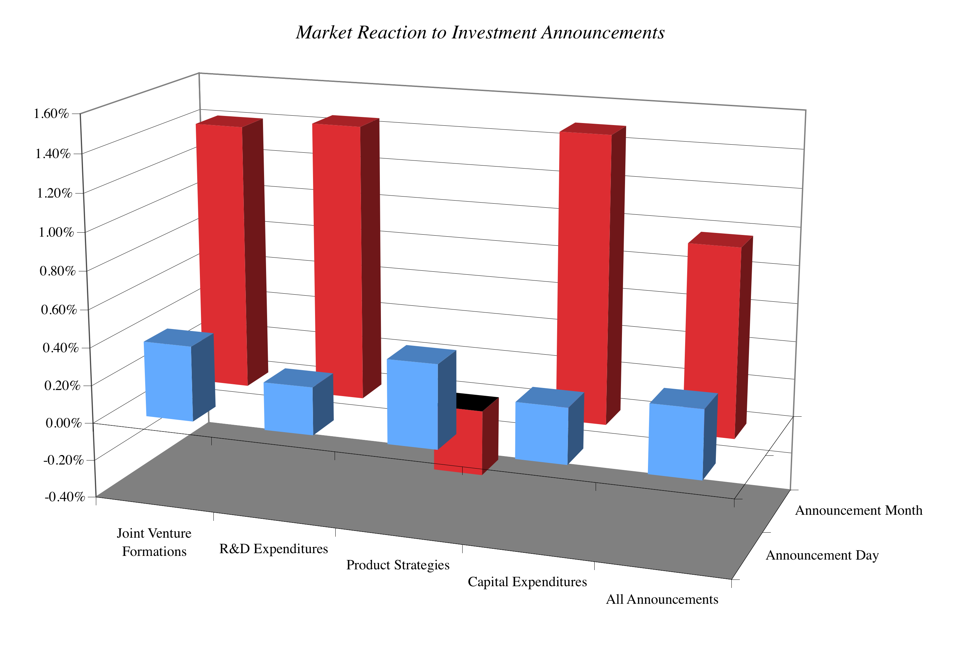
If markets are so short term, why do they react to big investments (that potentially lower short term earnings) so positively?
Notes:
Note that the price increases tend to be small, since these announcements tend to affect value by only small amounts. The effect seems to correlate with the weightiness of each announcement, being lower for product strategy announcements (which might signify little or no real investment) and being higher for the other three.
Markets also tend to be discriminating and look at both the type of business where the R&D is being spent (Intel versus Kellogg) and the track record of the managers spending the money.
You may argue that investors may be reacting this way because they want to make short term profits and that could be true, but so what? As long as the end-result is a price that reflects long term value, does it matter that what allowed that to happen was greedy, short term investors.

Slide 42
But what about market crises?
Markets are the problem: Many critics of markets point to market bubbles and crises as evidence that markets do not work. For instance, the market turmoil between September and December 2008 is pointed to as backing for the statement that free markets are the source of the problem and not the solution.
The counter: There are two counter arguments that can be offered:
  The events of the last quarter of 2008 illustrate that we are more dependent on functioning, liquid markets, with risk taking investors, than ever before in history. As we saw, no government or other entity (bank, Buffett) is big enough to step in and save the day.
  The firms that caused the market collapse (banks, investment banks) were among the most regulated businesses in the market place. If anything, their failures can be traced to their attempts to take advantage of regulatory loopholes (badly designed insurance programs… capital measurements that miss risky assets, especially derivatives)
Notes:
Note that only down markets are viewed as failures.. But not up markets! In other words, we are selective about our outrage. We feed off the positives of markets, attributing success to everything but the presence of markets but when markets fail, we blame their existence.
Here is a follow up. If it is market volatility that is the culprit, note that the they reflected some real uncertainty – about economic growth, bank failures and government actions.
As a thought experiment, consider a world without financial markets and ask yourself whether the gains would exceed the losses. (This does not have to be an experiment.. After all, Asia prior to the 1990s was a world without functioning financial markets for millennia… What was the real growth rate in India and China prior to 1995 and pos-1995? )
Do I have less trust in markets now than I did a few years ago? Perhaps. But I have even less trust in the other (alternate) institutions that I would have used instead – managers, governments, central banks, experts… This may sound weird. But, on a relative basis, I trust markets more now than I did in September 2008.

Slide 43
IV. Firms and Society
In theory: All costs and benefits associated with a firm’s decisions can be traced back to the firm.
In practice: Financial decisions can create social costs and benefits.
  A social cost or benefit is a cost or benefit that accrues to society as a whole and not to the firm making the decision.
    Environmental costs (pollution, health costs, etc..)
    Quality of Life' costs (traffic, housing, safety, etc.)
  Examples of social benefits include:
    creating employment in areas with high unemployment
    supporting development in inner cities
    creating access to goods in areas where such access does not exist
Notes:
Social costs and benefits exist in almost every financial decision.

Slide 44
Social Costs and Benefits are difficult to quantify because ..
Cannot know the unknown: They might not be known at the time of the decision. In other words, a firm may think that it is delivering a product that enhances society, at the time it delivers the product but discover afterwards that there are very large costs. (Asbestos was a wonderful product, when it was devised, light and easy to work with… It is only after decades that the health consequences came to light)
Eyes of the beholder: They are ‘person-specific’, since different decision makers can look at the same social cost and weight them very differently.
Decision paralysis: They can be paralyzing if carried to extremes.
Notes:
Economists measure social benefits in “utils”. Few, if any, businesses have figured out a way of actually putting this into practice.

Slide 45
A test of your social consciousness:
Put your money where you mouth is…
Assume that you work for Disney and that you have an opportunity to open a store in an inner-city neighborhood. The store is expected to lose about a million dollars a year, but it will create much-needed employment in the area, and may help revitalize it.
Would you open the store?
  Yes
  No
If yes, would you tell your stockholders and let them vote on the issue?
  Yes
  No
If no, how would you respond to a stockholder query on why you were not living up to your social responsibilities?
Notes:
I do this survey in three parts.
First, I allow people to make the choice of whether they would open the store. I then pick someone who would open the store and press them on whether they would reveal this to their stockholders. If the answer is No, I point out that it is after all the stockholders’ wealth. If the answer is Yes, I then ask them whether they would let stockholders vote (if not on individual store openings, on the money that the firm will spend collectively on being socially responsible)
I also ask people why they would open the store. If the answer is that they would do it for the publicity, I counter that it is advertising and not social responsibility that is driving the decision. There is nothing wrong with being socially responsible and getting economically rewarded for it. In fact, if societies want to make firms socially responsible they have to make it in their economic best interests to do so.
The bottom line is the following. If you own a private business, you can do whatever you want with your money. If you are a managers of a publicly traded firm, you are being charitable with other people’s money. You have an obligation to be open and up-front with your stockholders about how much you are spending to be socially conscious and give them a chance to decide whether you should continue on your path.

Slide 46
So this is what can go wrong...
STOCKHOLDERS
Managers put
their interests
above stockholders
Have little control
over managers
Lend Money
Significant Social Costs
BONDHOLDERS
Managers
SOCIETY
Bondholders can
get ripped off
Some costs cannot be
traced to firm
Delay bad
news or
provide
misleading
information
Markets make
mistakes and
can over react
FINANCIAL MARKETS
Notes:
This is my worst case scenario:
Stockholders have little or no control over managers. Managers, consequently, put their interests above stockholder interests.
Bondholders who do not protect themselves find stockholders expropriating their wealth.
Information conveyed to markets is noisy, biases and sometimes misleading. Markets do not do a very good job of assimilating this information and market price changes have little to do with true value.
Firms in the process of maximizing stockholder wealth create large social costs.
In this environment, stockholder wealth maximization is not a good objective function.

Slide 47
Traditional corporate financial theory breaks down when ...
Managerial self-interest: The interests/objectives of the decision makers in the firm conflict with the interests of stockholders.
Unprotected debt holders: Bondholders (Lenders) are not protected against expropriation by stockholders.
Inefficient markets: Financial markets do not operate efficiently, and stock prices do not reflect the underlying value of the firm.
Large social side costs: Significant social costs can be created as a by-product of stock price maximization.
Notes:
This summarizes the break down in each of the linkages noted on the previous page.

Slide 48
When traditional corporate financial theory breaks down, the solution is:
A non-stockholder based governance system: To choose a different mechanism for corporate governance, i.e, assign the responsibility for monitoring managers to someone other than stockholders.
A better objective than maximizing stock prices? To choose a different objective for the firm.
Maximize stock prices but minimize side costs: To maximize stock price, but reduce the potential for conflict and breakdown:
  Making managers (decision makers) and employees into stockholders
  Protect lenders from expropriation
  By providing information honestly and promptly to financial markets
  Minimize social costs
Notes:
At this point, things look pretty bleak for stock price maximization. These are the three choices that we have, if we abandon pure stock price maximization as an objective function.

Slide 49
I. An Alternative Corporate Governance System
Germany and Japan developed a different mechanism for corporate governance, based upon corporate cross holdings.
  In Germany, the banks form the core of this system.
  In Japan, it is the keiretsus
  Other Asian countries have modeled their system after Japan, with family companies forming the core of the new corporate families
At their best, the most efficient firms in the group work at bringing the less efficient firms up to par. They provide a corporate welfare system that makes for a more stable corporate structure
At their worst, the least efficient and poorly run firms in the group pull down the most efficient and best run firms down. The nature of the cross holdings makes its very difficult for outsiders (including investors in these firms) to figure out how well or badly the group is doing.
Notes:
In the 1980s, Michael Porter argued that US companies should move towards the Japanese system. The Japanese and German systems tend to do well in stable environments, where failure tends to be unsystematic ( a firm here and a firm there). They can take care of their “failures” and nurse them back to health, rather than exposing themselves to the costs associated with failure.
These systems break down when problems are wide spread and systematic. Contrast the way US banks dealt with problem loans on their balance sheets (markets forced them to deal with these problems quickly ) and the way Japanese banks have dealt with them (by hiding them and hoping they go away).
In the last decade, the success of China as an economy has evoked interest in their corporate governance system, which is rooted neither in stockholders nor in cross holding structures. Instead, it has been largely directed by a government or central authority. The plus that the centralized power brings is the capacity to see the big picture and make companies bend to the larger public good. The minus is that centralized powers do make mistakes and when they do, they are reluctant to admit it. The test of a system comes not during periods of success but during periods of failure, and the Chinese system has not been tested yet. Let’s see how it holds up.

Slide 50
II. Choose a Different Objective Function
Firms can always focus on a different objective function. Examples would include
  maximizing earnings
  maximizing revenues
  maximizing firm size
  maximizing market share
  maximizing EVA
The key thing to remember is that these are intermediate objective functions.
  To the degree that they are correlated with the long term health and value of the company, they work well.
  To the degree that they do not, the firm can end up with a disaster
Notes:
Consider each of these objectives. If you put them through the same tests that we did stock price maximization, you come up with far more problems with each.
Note that firms might pick an intermediate objective (like market share) when it is correlated with firm value but continue to use it, even after it loses this link. Do you want a 100% market share of a losing business?
In the 1980s, American Airlines (under Robert Crandall) set itself the objective of becoming the number one domestic airline in the United States. It succeeded but by 1989, it was losing billions.

Slide 51
III. Maximize Stock Price, subject to ..
The strength of the stock price maximization objective function is its internal self correction mechanism. Excesses on any of the linkages lead, if unregulated, to counter actions which reduce or eliminate these excesses
In the context of our discussion,
  managers taking advantage of stockholders has led to a much more active market for corporate control.
  stockholders taking advantage of bondholders has led to bondholders protecting themselves at the time of the issue.
  firms revealing incorrect or delayed information to markets has led to markets becoming more “skeptical” and “punitive”
  firms creating social costs has led to more regulations, as well as investor and customer backlashes.
Notes:
The strength of market based systems is that they are both ruthless and quick in correcting errors, once they are spotted.
These constraints flow from the earlier framework, where we introduced what can go wrong with each linkage.

Slide 52
The Stockholder Backlash
Activist Institutional investors have become much more active in monitoring companies that they invest in and demanding changes in the way in which business is done. They have been joined by private equity funds like KKR and Blackstone.
Activist individuals like Carl Icahn specialize in taking large positions in companies which they feel need to change their ways (Blockbuster, Time Warner, Motorola & Apple) and push for change.
Vocal stockholders, armed with more information and new powers: At annual meetings, stockholders have taken to expressing their displeasure with incumbent management by voting against their compensation contracts or their board of directors
Notes:
All of these developments represent the backlash to managers putting their interests over stockholder interests.
In recent years, private equity investors have joined the fray as activist investors pushing managers to change the way they run their firms.

Slide 53
The Hostile Acquisition Threat
The typical target firm in a hostile takeover has
  a return on equity almost 5% lower than its peer group
  had a stock that has significantly under performed the peer group over the previous 2 years
  has managers who hold little or no stock in the firm
In other words, the best defense against a hostile takeover is to run your firm well and earn good returns for your stockholders
Conversely, when you do not allow hostile takeovers, this is the firm that you are most likely protecting (and not a well run or well managed firm)
Notes:
This is the ultimate threat. Managers often have deathbed conversions to become advocates for stockholder wealth maximization, when faced with the threat of a hostile takeover.
For Disney, this wake-up call came in 2004, when Comcast announced a hostile acquisition bid for Disney. Though the bid failed, it shook up the company and led to Eisner’s decision to step down in 2006.

Slide 54
In response, boards are becoming more independent…
Boards have become smaller over time. The median size of a board of directors has decreased from 16 to 20 in the 1970s to between 9 and 11 in 1998. The smaller boards are less unwieldy and more effective than the larger boards.
There are fewer insiders on the board. In contrast to the 6 or more insiders that many boards had in the 1970s, only two directors in most boards in 1998 were insiders.
Directors are increasingly compensated with stock and options in the company, instead of cash. In 1973, only 4% of directors received compensation in the form of stock or options, whereas 78% did so in 1998.
More directors are identified and selected by a nominating committee rather than being chosen by the CEO of the firm. In 1998, 75% of boards had nominating committees; the comparable statistic in 1973 was 2%.
Notes:
While these trends are positive, note that many of these better boards (at least as seen from the vantage point of 1998) were responsible for the scandals of the bull market (Enron, Worldcom, Tyco…) In bull markets and strong economies, boards tend to get lazy.
The scandals at Enron and Tyco created the impetus for Sarbanes-Oxley, which in turn created a legal mandate for more independent boards..
The annual reports of more and more companies include corporate governance rules that they have adopted.

Slide 55
Disney: Eisner’s rise & fall from grace
In his early years at Disney, Michael Eisner brought about long-delayed changes in the company and put it on the path to being an entertainment giant that it is today. His success allowed him to consolidate power and the boards that he created were increasingly captive ones (see the 1997 board).
In 1996, Eisner spearheaded the push to buy ABC and the board rubberstamped his decision, as they had with other major decisions. In the years following, the company ran into problems both on its ABC acquisition and on its other operations and stockholders started to get restive, especially as the stock price halved between 1998 and 2002.
In 2003, Roy Disney and Stanley Gold resigned from the Disney board, arguing against Eisner’s autocratic style.
In early 2004, Comcast made a hostile bid for Disney and later in the year, 43% of Disney shareholders withheld their votes for Eisner’s reelection to the board of directors. Following that vote, the board of directors at Disney voted unanimously to elect George Mitchell as the Chair of the board, replacing Eisner, who vowed to stay on as CEO.
Notes:
Eisner was a good CEO when he came into Disney, partly because it was a company badly in need of change and partly because he had a solid COO in Frank Wells, who acted as a counterweight. Two things changed in the 1990s. The first was that Eisner was successful, and the ego boost that he received was the basis for acquiring more power (a compliant board). The second was that Frank Wells dies in an air accident, leaving Eisner as the imperial CEO. Power corrupts and absolute power does so absolutely.
As long as Disney was doing well, though, shareholders were willing to cut Eisner slack. However a bad acquisition followed by under performance (share prices and earnings) gradually ate away that support, until you get to the tipping point which in this case were the resignations and the hostile acquisition bid.

Slide 56
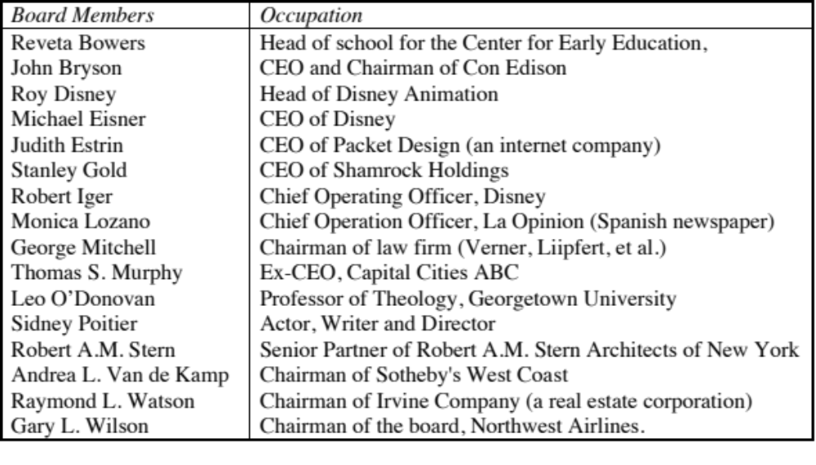
Eisner’s concession: Disney’s Board in 2003
Notes:
By 2003, stockholders were in open revolt at Disney. A hostile bid by Comcast for Disney was rebuffed by the board, with little discussion of its merits. In the 2004 meeting, 45% of the stockholders voted against Eisner’s compensation contract and 23% voted against George Mitchell for Chairman. Some improvement over 1997 but most of the directors are still there…
The most obvious conflict (Irwin Russell) has been removed. Still, there are far too many directors on this board (16), too many of them are still insiders (4) and there are too many CEOs of other firms. The jobs of CEO and Chairman were separated. Nevertheless, this board is a better one than the 1997 board. What precipitated the changes?
Poor financial and stock price performance
Pressure from major stockholders (like Stanley Gold)
Stockholder distrust of management
Big deals (like the Cap Cities acquisition) that have gone bad…
Enronitis…
Shortly after this filing, Stanley Gold and Roy Disney resigned from the board in protest over its ineffectiveness.

Slide 57
Changes in corporate governance at Disney
Required at least two executive sessions of the board, without the CEO or other members of management present, each year.
Created the position of non-management presiding director, and appointed Senator George Mitchell to lead those executive sessions and assist in setting the work agenda of the board.
Adopted a new and more rigorous definition of director independence.
Required that a substantial majority of the board be comprised of directors meeting the new independence standards.
Provided for a reduction in committee size and the rotation of committee and chairmanship assignments among independent directors.
Added new provisions for management succession planning and evaluations of both management and board performance
Provided for enhanced continuing education and training for board members.
Notes:
These changes were all welcome but they were being made in response to widespread stockholder anger. They would have been more effective and credible if they had been adopted at the height of Eisner’s powers (say, in 1994)….

Slide 58
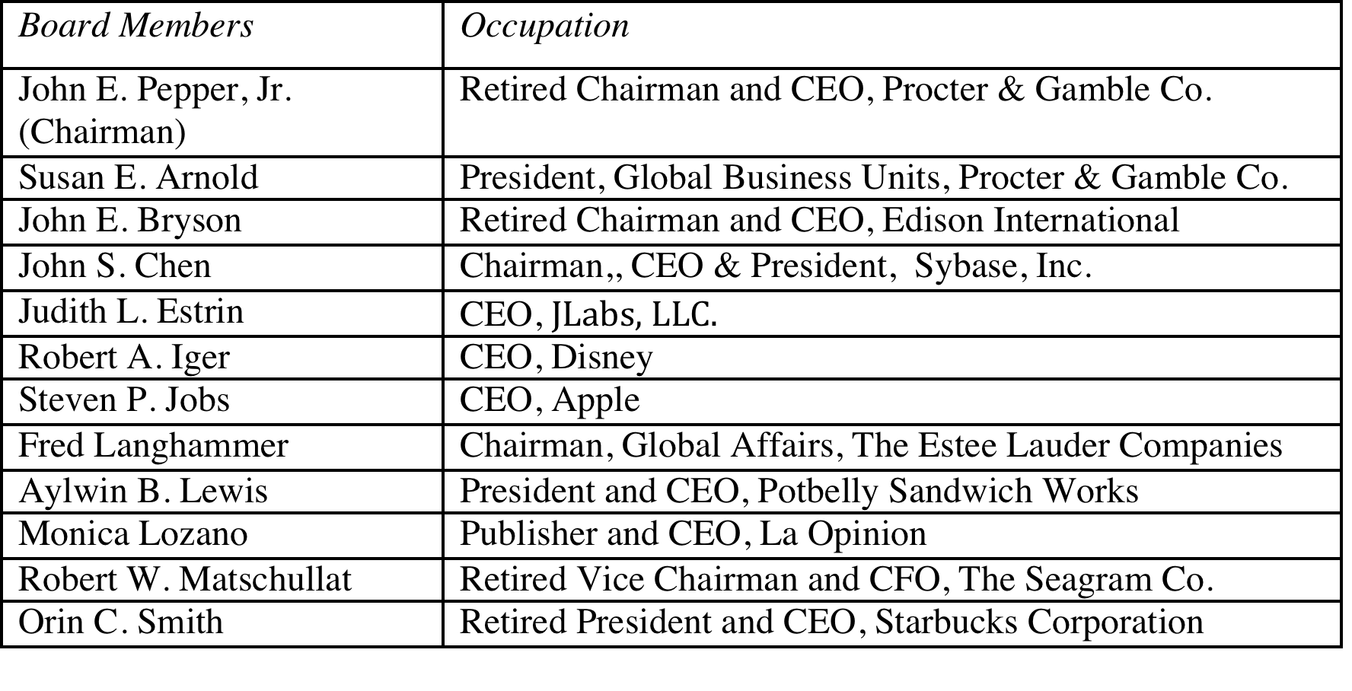
Eisner’s exit… and a new age dawns? Disney’s board in 2008
Notes:
The changes made by Eisner were too little.. Too late,,, and he was forced to leave in 2005, His successor, Bob Iger, has made a break from the past. Note the differences between the board in 2008 and the one in 2004:
It is smaller, 12 members instead of 18.
There is little overlap between this board and the 2003 board, reflecting the fact that this is now Iger’s board and not Eisner’s board.
The directors with the most obvious conflicts of interests are gone.
The question, though, is an open one. As Iger becomes entrenched as CEO, will be find directors who are beholden to him?
In 2011, Iger announced his intention to step down as CEO. It will be interesting to see what the new CEO brings to the table.

Slide 59
But as a CEO’s tenure lengthens, does corporate governance suffer?
While the board size has stayed compact (at twelve members), there has been only one change since 2008, with Sheryl Sandberg, COO of Facebook, replacing the deceased Steve Jobs.
The board voted reinstate Iger as chair of the board in 2011, reversing a decision made to separate the CEO and Chair positions after the Eisner years.
In 2011, Iger announced his intent to step down as CEO in 2015 but Disney’s board convinced Iger to stay on as CEO for an extra year, for the “the good of the company”.
There were signs of restiveness among Disney’s stockholders, especially those interested in corporate governance. Activist investors (CalSTRS) starting making noise and Institutional Shareholder Services (ISS), which gauges corporate governance at companies, raised red flags about compensation and board monitoring at Disney.
Notes:
The longer the tenure of a CEO, the more power he or she accumulates. Perhaps, we need term limits for CEOs.

Slide 60
What about legislation?
Every corporate scandal creates impetus for a legislative response. The scandals at Enron and WorldCom laid the groundwork for Sarbanes-Oxley.
You cannot legislate good corporate governance.
  The costs of meeting legal requirements often exceed the benefits
  Laws always have unintended consequences
  In general, laws tend to be blunderbusses that penalize good companies more than they punish the bad companies.
Notes:
While the motives for passing these laws may be good, there are significant costs. Sarbanes-Oxley has created new business for consultants, corporate governance experts and lawyers but it is debatable whether it has made boards more effective. In fact, while laws can require that directors be independent, it cannot force them to be competent.
You can try suing managers and directors who do not do their job but it is difficult to win. Disney’s stockholders sued in a Delaware court over the Ovitz fiasco, arguing that directors had not done their jobs. The court largely agreed with them on the failures of directors but ruled against the stockholders because the directors acted in good faith.
Ultimately, the best antidote to poor corporate governance is a stockholder base that takes its responsibilities seriously. Mutual funds need to think like stockholders and take a role in overseeing management (or at least demanding accountability).

Slide 61
Is there a payoff to better corporate governance?
In the most comprehensive study of the effect of corporate governance on value, a governance index was created for each of 1500 firms based upon 24 distinct corporate governance provisions.
  Buying stocks that had the strongest investor protections while simultaneously selling shares with the weakest protections generated an annual excess return of 8.5%.
  Every one point increase in the index towards fewer investor protections decreased market value by 8.9% in 1999
  Firms that scored high in investor protections also had higher profits, higher sales growth and made fewer acquisitions.
The link between the composition of the board of directors and firm value is weak. Smaller boards do tend to be more effective.
On a purely anecdotal basis, a common theme at problem companies and is an ineffective board that fails to ask tough questions of an imperial CEO.
Notes:
The bottom line is this. Changing the way boards of directors are chosen cannot change the way companies are governed. You need informed and active stockholders and a responsive management to make corporate governance work. When it does, stockholders are better off.
Think of companies that have been destroyed or severely damaged by fraud and scandal over the last decade - Enron, Tyco, Cendant and Worldcom come to mind. In each of these firms, the board was largely ineffective and the top management ran the company.
Perhaps the best indicator that corporate governance matters is that independent services have come into being to measure the strength of corporate governance at companies. (You can get the Corporate Governance Score for many US companies on Yahoo! Finance)

Slide 62
The Bondholders’ Defense Against Stockholder Excesses
More restrictive covenants on investment, financing and dividend policy have been incorporated into both private lending agreements and into bond issues, to prevent future “Nabiscos”.
New types of bonds have been created to explicitly protect bondholders against sudden increases in leverage or other actions that increase lender risk substantially. Two examples of such bonds
  Puttable Bonds, where the bondholder can put the bond back to the firm and get face value, if the firm takes actions that hurt bondholders
  Ratings Sensitive Notes, where the interest rate on the notes adjusts to that appropriate for the rating of the firm
More hybrid bonds (with an equity component, usually in the form of a conversion option or warrant) have been used. This allows bondholders to become equity investors, if they feel it is in their best interests to do so.
Notes:
Bondholders, responding to the Nabisco fiasco and other cases where stockholders expropriated their wealth, have become much more savvy about protecting themselves (using covenants or special features added to bonds) or getting an equity stake in the business (as is the case with convertibles).
The process never ends, though. A new set of lessons seem to be in order after the banking and loan crisis of 2008: that accounting statements are deceptive, that credit risk can change quickly and that macro problems can very quickly make even safe firms into risky ones. It will be interesting to see how bonds change to reflect these lessons.

Slide 63
The Financial Market Response
While analysts are more likely still to issue buy rather than sell recommendations, the payoff to uncovering negative news about a firm is large enough that such news is eagerly sought and quickly revealed (at least to a limited group of investors).
As investor access to information improves, it is becoming much more difficult for firms to control when and how information gets out to markets.
As option trading has become more common, it has become much easier to trade on bad news. In the process, it is revealed to the rest of the market.
When firms mislead markets, the punishment is not only quick but it is savage.
Notes:
The distinction between the US and many foreign markets is the existence of a private market for information. In many countries, firms are the only source of information about themselves, leading to very biased information.
The more avenues there are for investors to trade on information (including option markets), the more likely it is that prices will contain that information. The development of hedge funds (which can go short) and long term put options is good from this perspective. Short term solutions that prevent trading (restrictions on short selling, increased transactions costs) will only make this response less effective.
It is also important that investors be allowed to trade on both under and over valuation. In other words, there is nothing bad inherently about short selling and virtuous about being long on a stock.

Slide 64
The Societal Response
If firms consistently flout societal norms and create large social costs, the governmental response (especially in a democracy) is for laws and regulations to be passed against such behavior.
For firms catering to a more socially conscious clientele, the failure to meet societal norms (even if it is legal) can lead to loss of business and value.
Finally, investors may choose not to invest in stocks of firms that they view as socially irresponsible.
Notes:
None of these measures is perfect or complete, but they reflect the tug-of-war between private and public interests. Ultimately, if you want companies to be socially conscious, you have to make it in their economic interests to behave as such.
Here are some good examples for each:
After the Exxon-Valdez oil spill in the alter 1980s, many states and the federal government tightened regulations on oil tankers… The same is true for tobacco firms, where laws were tightened both on smoking in general and tobacco company advertising in particular.
After public interest groups claimed that specialty retailers were using under-age labor to run their factories, many retailers saw sales decline.
Many pension funds (and university endowment funds) are restricted from investing in sin stocks.

Slide 65
The Counter Reaction
STOCKHOLDERS
1. More activist
investors
2. Hostile takeovers
Managers of poorly
run firms are put
on notice.
Protect themselves
Corporate Good Citizen Constraints
BONDHOLDERS
Managers
SOCIETY
1. Covenants
2. New Types
1. More laws
2. Investor/Customer Backlash
Firms are
punished
for misleading
markets
Investors and
analysts become
more skeptical
FINANCIAL MARKETS
Notes:
This summarizes the objective function of maximizing stockholder wealth, with the fixes noted on the last few pages.

Slide 66
So what do you think?
At this point in time, the following statement best describes where I stand in terms of the right objective function for decision making in a business
  Maximize stock price, with no constraints
  Maximize stock price, with constraints on being a good social citizen.
  Maximize stockholder wealth, with good citizen constraints, and hope/pray that the market catches up with you.
  Maximize profits or profitability
  Maximize earnings growth
  Maximize market share
  Maximize revenues
  Maximize social good
  None of the above
Notes:
If the sales pitch has worked, and you believe in financial markets, you would choose to maximize stock price, subject to constraint.
If the sales pitch has worked but you remain skeptical about the short term efficiency of markets, you would maximize stockholder wealth.
If it has not, you have a long semester ahead of you.
In reasonably efficient markets, where bondholders and lenders are protected, stock prices are maximized where firm value is maximized. Thus, these objective functions become equivalent.

Slide 67
The Modified Objective Function
For publicly traded firms in reasonably efficient markets, where bondholders (lenders) are protected:
  Maximize Stock Price: This will also maximize firm value
For publicly traded firms in inefficient markets, where bondholders are protected:
  Maximize stockholder wealth: This will also maximize firm value, but might not maximize the stock price
For publicly traded firms in inefficient markets, where bondholders are not fully protected
  Maximize firm value, though stockholder wealth and stock prices may not be maximized at the same point.
For private firms, maximize stockholder wealth (if lenders are protected) or firm value (if they are not)
Notes:
These are the guiding objectives that we will use. For the publicly traded firms in our analysis, we will view maximizing stock prices as our objective function (but in the context of efficient markets and protected lenders). For the private firm, we will focus on maximizing stockholder wealth.
My bottom line. Companies should focus on making decisions that increase long term value but remain cognizant of what the market thinks (and the market price). They should consider market reactions to their actions and consider the possibility that the market is right (and that they are wrong). If they believe that the market reaction is wrong and that it is based upon incomplete or erroneous information, they should try to set the record straight.
As for social obligations, companies have to recognize that it is in their best long term interests to not violate social norms (even if such violations are legal). They should be open about their social consciousness (but not holier than thou) and be willing to expend real resources (not just words) and be open about their social investments.

Slide 68
The Investment Principle: Risk and Return Models
“You cannot swing upon a rope that is attached only to your own belt.”
Notes:
While the general presumption is that risk is a bad thing and some seek to avoid it at any cost, the reality is that businesses will not only always be exposed to risk but success may sometimes ride on seeking out and taking specific risks.

Slide 69
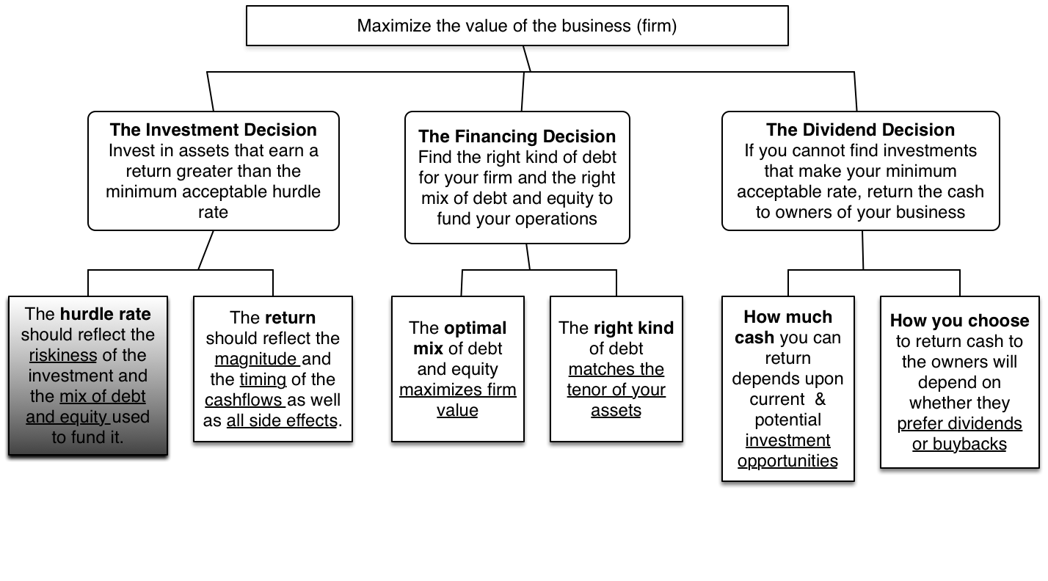
First Principles
Notes:
The focus of the first part of this investment analysis section is on coming up with a minimum acceptable hurdle rate. In the process, we have to grapple with the question of what risk is and how to bring risk into the hurdle rate.

Slide 70
The notion of a benchmark
Since financial resources are finite, there is a hurdle that projects have to cross before being deemed acceptable. This hurdle should be higher for riskier projects than for safer projects.
A simple representation of the hurdle rate is as follows:
  Hurdle rate = Riskless Rate + Risk Premium
The two basic questions that every risk and return model in finance tries to answer are:
  How do you measure risk?
  How do you translate this risk measure into a risk premium?
Notes:
Underlying the idea of a hurdle rate is the notion that projects have to earn a benchmark rate of return to be accepted, and that this benchmark should be higher for riskier projects than for safer ones.

Slide 71
What is Risk?
Risk, in traditional terms, is viewed as a ‘negative’. Webster’s dictionary, for instance, defines risk as “exposing to danger or hazard”. The Chinese symbols for risk, reproduced below, give a much better description of risk
  危机
The first symbol is the symbol for “danger”, while the second is the symbol for “opportunity”, making risk a mix of danger and opportunity. You cannot have one, without the other.
Risk is therefore neither good nor bad. It is just a fact of life. The question that businesses have to address is therefore not whether to avoid risk but how best to incorporate it into their decision making.
Notes:
Note that risk is neither good nor bad. It is a combination of danger and opportunity - you cannot have one without the other. Consequently, risk is neither something to be avoided nor sought out but carefully balanced. Good business avoid some risks, let others pass through to their investors and actively seek out still others.
When businesses want opportunity (higher returns), they have to live with the higher risk.
Any sales pitch that offers returns without risk is a pipe dream.
Bob Citron, treasurer of Orange County (CA), after he lost a chunk of the county’s pension fund money after investing in interest rate derivatives claimed that he was “not a finance person” and that Merrill’s market strategist (Charlie Clough) had told him he could make “15% with no risk”.
Many prominent (and intelligent) people invested with Bernie Madoff because he promised them (through third parties) that he could deliver 8% more than the treasury bill rate, guaranteed. (He was called the Jewish T.Bill). One investor, interviewed by the NY Times said, “I really did not understand what he was doing, but he said was going to do something with calls, something with puts and earn 12% every year. It sounded plausible (and all my friends were investing with him too).

Slide 72
A good risk and return model should…
It should come up with a measure of risk that applies to all assets and not be asset-specific.
It should clearly delineate what types of risk are rewarded and what are not, and provide a rationale for the delineation.
It should come up with standardized risk measures, i.e., an investor presented with a risk measure for an individual asset should be able to draw conclusions about whether the asset is above-average or below-average risk.
It should translate the measure of risk into a rate of return that the investor should demand as compensation for bearing the risk.
It should work well not only at explaining past returns, but also in predicting future expected returns.
Notes:
Before we embark on looking at risk and return models, it pays to specify what a good model will look like…
A risk measure that works only for US stocks or even for only publicly traded firms is inferior to one that applies across all stocks.

Slide 73
The Capital Asset Pricing Model
Uses variance of actual returns around an expected return as a measure of risk.
Specifies that a portion of variance can be diversified away, and that is only the non-diversifiable portion that is rewarded.
Measures the non-diversifiable risk with beta, which is standardized around one.
Translates beta into expected return -
  Expected Return = Riskfree rate + Beta * Risk Premium
Works as well as the next best alternative in most cases.
Notes:
This is a summary of the CAPM, before we get into the details.

Slide 74
1. The Mean-Variance Framework
The variance on any investment measures the disparity between actual and expected returns.
Low Variance Investment
High Variance Investment
Expected Return
Notes:
Note that the variance that the CAPM is built around is the variance of actual returns around an expected return.
If you were an investor with a 1-year time horizon, and you bought a 1-year T.Bill, your actual returns (at least in nominal terms) will be equal to your expected return. It is riskfree.
If you were the same investor, and you bought a stock (say Intel), your actual returns will almost certainly not be equal to your expected returns.
In practice, we often look at historical (past) returns to estimate variances. Implicitly, we are assuming that this variance is a good proxy for expected future variance.

Slide 75
How risky is Disney? A look at the past…
Notes:
Disney’s stock price has been volatile, yielding a standard deviation of 26.47% (on an annualized basis) between 2008 and 2013. If you were an investor looking at Disney in 2014, what concerns (if any) would you have in using this as your measure of the forward looking risk in Disney stock?
Disney as a company changed over this period. The standard deviation from the past may not be a good indicator or future risk.
If historical standard deviations are your only way of estimating risk, it makes it impossible to measure risk in non-traded assets.

Slide 76
Do you live in a mean-variance world?
Assume that you had to pick between two investments. They have the same expected return of 15% and the same standard deviation of 25%; however, investment A offers a very small possibility that you could quadruple your money, while investment B’s highest possible payoff is a 60% return. Would you
  be indifferent between the two investments, since they have the same expected return and standard deviation?
  prefer investment A, because of the possibility of a high payoff?
  prefer investment B, because it is safer?
Would your answer change if you were not told that there is a small possibility that you could lose 100% of your money on investment A but that your worst case scenario with investment B is -50%?
Notes:
While some people may be indifferent, most pick investment A. The possibility of a high payoff, even though it is captured in the expected value, seems to tilt investors. In statistical terms, this can be viewed as evidence that investors prefer positive skewness (high positive payoffs) and value it. It is a direct contradiction to the mean-variance framework that underlies so much of conventional risk theory.
Once you add the possibility that the big positive jumps are matched by the possibility of big negative jumps, the game changes again. This propensity, called kurtosis, is not desirable to most investors.
In the real world, investments reveal far too much skewness and kurtosis than would be expected in the standard normal distribution. In fact, there are some (Mandelbrot decades ago to Taleb in the Black Swan today) who have argued that the dependence on the normal distribution is what causes risk management systems like Value at Risk (VAR) to fail.

Slide 77
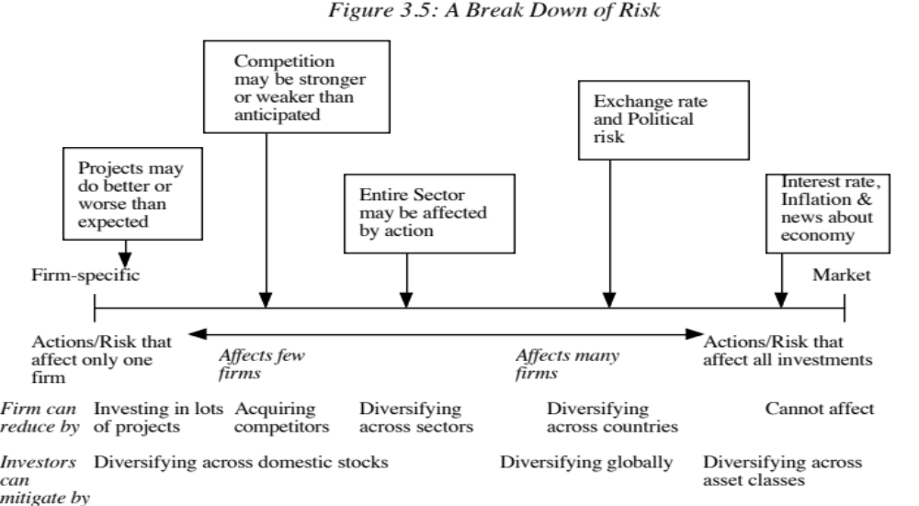
The Importance of Diversification: Risk Types
Notes:
This is the critical second step that all risk and return models in finance take.
As examples,
Project-specific Risk: Disney’s new Hong Kong theme park: To the degree that actual revenues at this park may be greater or less than expected. (Other examples: A big budget movie, ESPN Asia…)
Competitive Risk: The competition (Universal Studios, for instance) may take actions (like opening or closing a park) that affect Disney’s revenues at its theme parks.
Industry-specific risk: Congress may pass laws affecting cable and network television, and affect expected revenues at Disney and ABC, as well as all other firms in the sector, perhaps to varying degrees.
Exchange rate Risk: Disney owns NDTV, an Indian television group and has theme parks in Paris, Hong Kong and Tokyo. As the dollar strengthens or weakens, Disney will feel its effects. In fact, it may feel the effects of exchange rates even at its Orlando and Anaheim theme parks.
Market risk: If interest rates in the US go up or the economy weakens, Disney’s value as a firm will be affected.
From the perspective of an investor who holds only Disney, all risk is relevant.
From the perspective of a diversified investor, the first three risks can be diversified away, the fourth might be diversifiable (with a globally diversified portfolio) but the last risk I not.

Slide 78
Why diversification reduces/eliminates firm specific risk
Firm-specific risk can be reduced, if not eliminated, by increasing the number of investments in your portfolio (i.e., by being diversified). Market-wide risk cannot. This can be justified on either economic or statistical grounds.
On economic grounds, diversifying and holding a larger portfolio eliminates firm-specific risk for two reasons-
  Each investment is a much smaller percentage of the portfolio, muting the effect (positive or negative) on the overall portfolio.
  Firm-specific actions can be either positive or negative. In a large portfolio, it is argued, these effects will average out to zero. (For every firm, where something bad happens, there will be some other firm, where something good happens.)
Notes:
The first argument (that each investment is a small percent of your portfolio) is a pretty weak one. The second one (that things average out over investments and time) is a much stronger one.
Consider the news stories in the WSJ on any given day. About 85% to 90% of the stories are on individual firms (rather than affecting the entire market or about macro economic occurrences) and they cut both ways - some stories are good news (with the stock price rising) and some are bad news (with stock prices falling)

Slide 79
The Role of the Marginal Investor
The marginal investor in a firm is the investor who is most likely to be the buyer or seller on the next trade and to influence the stock price.
Generally speaking, the marginal investor in a stock has to own a lot of stock and also trade that stock on a regular basis.
Since trading is required, the largest investor may not be the marginal investor, especially if he or she is a founder/manager of the firm (Larry Ellison at Oracle, Mark Zuckerberg at Facebook)
In all risk and return models in finance, we assume that the marginal investor is well diversified.
Notes:
We assume that the marginal investor, who sets prices, is well diversified. (Note that we do not need to assume that all investors are diversified)
An argument for the marginally diversified investor: Assume that a diversified investor and a non-diversified investor are both looking at Disney. The latter looks at the stock and sees all risk. The former looks at it and sees only the non-diversifiable risk. If they agree on the expected earnings and cash flows, the former will be willing to pay a higher price. Thus, the latter will get driven out of the market (perhaps into mutual funds).

Slide 80
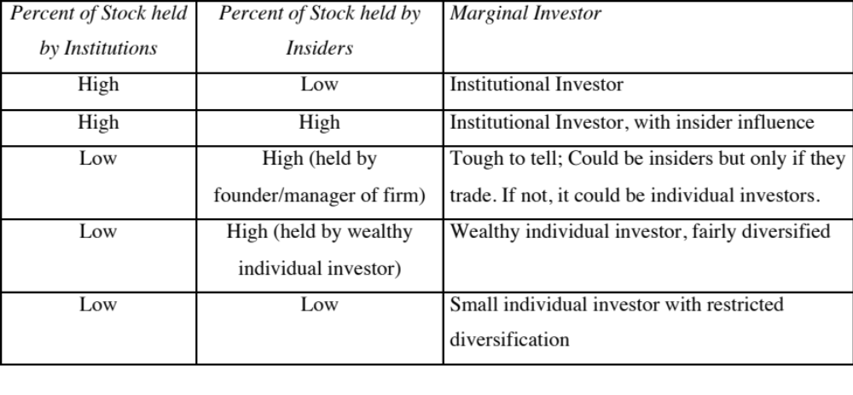
Identifying the Marginal Investor in your firm…
Notes:
This is meant to be a rough guide to identifying the marginal investor. The key is to recognize that you are not identifying a particular investor but a type of investor and considering whether that investor is likely to be diversified.

Slide 81
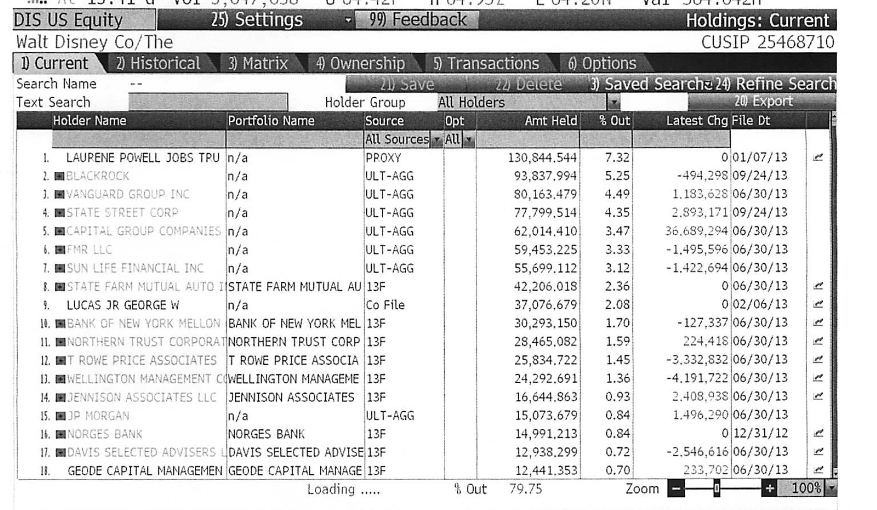
Gauging the marginal investor: Disney in 2013
Notes:
Of Disney’s top 17 investors, only 2 are individuals…. Laurene Jobs and George Lucas are big stockholders (getting those shares when their companies were sold to Disney) but neither is an active trader.

Slide 82
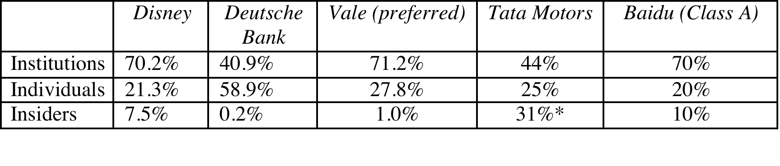
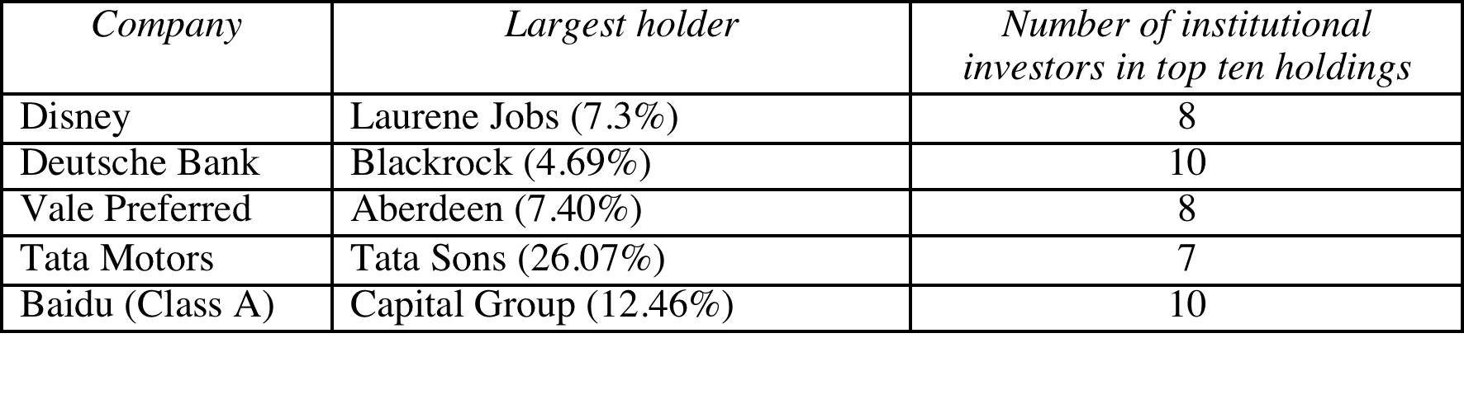
Extending the assessment of the investor base
In all five of the publicly traded companies that we are looking at, institutions are big holders of the company’s stock.
Notes:
It may also make sense to look at the proportion of trading at these companies that comes from institutions. Thus, if institutions own 20% of the shares but account for 80% of the trading, they may still be the marginal investors in the company.

Slide 83
The Limiting Case: The Market Portfolio
The big assumptions & the follow up: Assuming diversification costs nothing (in terms of transactions costs), and that all assets can be traded, the limit of diversification is to hold a portfolio of every single asset in the economy (in proportion to market value). This portfolio is called the market portfolio.
The consequence: Individual investors will adjust for risk, by adjusting their allocations to this market portfolio and a riskless asset (such as a T-Bill):
  Preferred risk level Allocation decision
  No risk 100% in T-Bills
  Some risk 50% in T-Bills; 50% in Market Portfolio;
  A little more risk 25% in T-Bills; 75% in Market Portfolio
  Even more risk 100% in Market Portfolio
  A risk hog.. Borrow money; Invest in market portfolio
Notes:
There are two reasons investors choose to stay undiversified:
They think that they can pick undervalued investments (private information)
There are transactions costs. Since the marginal benefits of diversification decrease as the number of investments increases, you will stop diversifying.
If we assume no costs to diversifying and no private information, we take away these reasons fro not diversifying. Consequently, you will keep adding traded assets to your portfolio until you have every single one. This portfolio is called the market portfolio. This portfolio should include all traded assets, held in proportion to their market value.
The only differences between investors then will be in not what is in the market portfolio but how much they allocate to the riskless asset and how much to the market portfolio.

Slide 84
The Risk of an Individual Asset
The essence: The risk of any asset is the risk that it adds to the market portfolio Statistically, this risk can be measured by how much an asset moves with the market (called the covariance)
The measure: Beta is a standardized measure of this covariance, obtained by dividing the covariance of any asset with the market by the variance of the market. It is a measure of the non-diversifiable risk for any asset can be measured by the covariance of its returns with returns on a market index, which is defined to be the asset's beta.
The result: The required return on an investment will be a linear function of its beta:
  Expected Return = Riskfree Rate+ Beta * (Expected Return on the Market Portfolio - Riskfree Rate)
Notes:
If an investor holds the market portfolio, the risk of any asset is the risk that it adds to the portfolio. That is what beta measures.
The cost of equity is a linear function of the beta of the portfolio.

Slide 85
Limitations of the CAPM
1. The model makes unrealistic assumptions
2. The parameters of the model cannot be estimated precisely
  The market index used can be wrong.
  The firm may have changed during the 'estimation' period'
3. The model does not work well
  - If the model is right, there should be:
    A linear relationship between returns and betas
    The only variable that should explain returns is betas
  - The reality is that
    The relationship between betas and returns is weak
    Other variables (size, price/book value) seem to explain differences in returns better.
Notes:
The first two critiques can be lowered against any model in finance.
The last critique is the most damaging. Fama and French (1991) noted that
Betas explained little of the difference in returns across stocks between 1962 and 1991. (Over long time periods, it should, if the CAPM is right and betas are correctly estimated), explain almost all of the difference)
Market Capitalization and price to book value ratios explained a significant portion of the differences in returns.
This test, however, is a test of which model explains past returns best, and might not necessarily be a good indication of which one is the best model for predicting expected returns in the future.

Slide 86
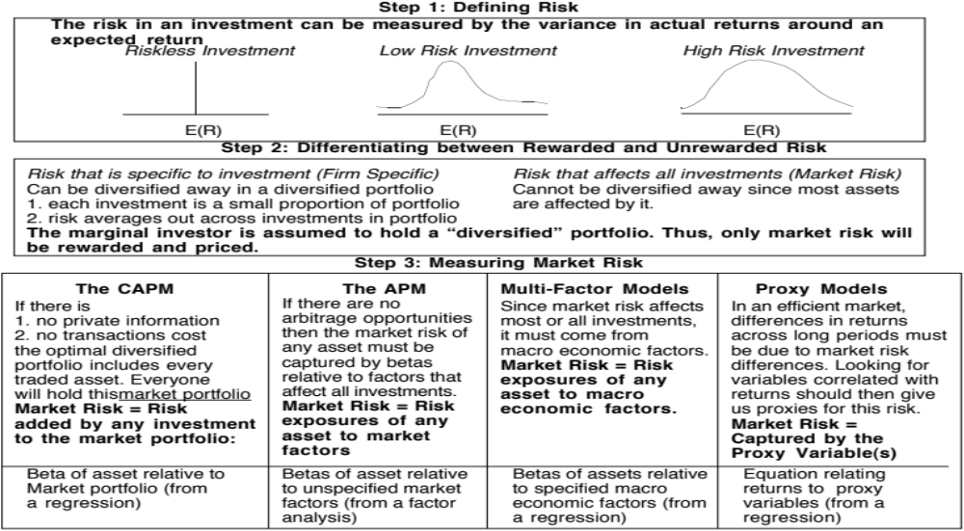
Alternatives to the CAPM
Notes:
Note that all of the models of risk and return in finance agree on the first two steps. They deviate at the last step in the way they measure market risk, with
The CAPM, capturing all of it in one beta, relative to the market portfolio
The APM, capturing the market risk in multiple betas against unspecified economic factors
The Multi-Factor model, capturing the market risk in multiple betas against specified macro economic factors
The Regression model, capturing the market risk in proxies such as market capitalization and price/book ratios

Slide 87
Why the CAPM persists…
The CAPM, notwithstanding its many critics and limitations, has survived as the default model for risk in equity valuation and corporate finance. The alternative models that have been presented as better models (APM, Multifactor model..) have made inroads in performance evaluation but not in prospective analysis because:
  The alternative models (which are richer) do a much better job than the CAPM in explaining past return, but their effectiveness drops off when it comes to estimating expected future returns (because the models tend to shift and change).
  The alternative models are more complicated and require more information than the CAPM.
  For most companies, the expected returns you get with the the alternative models is not different enough to be worth the extra trouble of estimating four additional betas.
Notes:
It takes a model to beat a model… The CAPM may not be a very good model at predicting expected returns but the alternative models don’t do much better. In fact, the tests of the CAPM are joint tests of both the effectiveness of the model and the quality of the parameters used in the testing (betas, for instance). We will argue that better beta estimates and a more careful use of the CAPM can yield far better estimates of expected return than switching to a different model.
Just as a side note, there are many who either dislike or distrust the CAPM. While we share some of their skepticism about its precision, we would not throw the basic principle that the discount rate has to be adjusted for risk out, just because we do not like the CAPM. In other words, find a different risk and return model, if so inclined, but adjust for risk.

Slide 88
Application Test: Who is the marginal investor in your firm?
You can get information on insider and institutional holdings in your firm from:
  http://finance.yahoo.com/
  Enter your company’s symbol and choose profile.
Looking at the breakdown of stockholders in your firm, consider whether the marginal investor is
  An institutional investor
  An individual investor
  An insider
Notes:
For most publicly traded US firms, most, if not all, of the 15 largest investors are institutional investors. In addition, high proportions of both the stock owned and traded are by institutional investors. Thus, the assumption that the marginal investor is well diversified is quite justifiable.
For very small firms, the marginal investor may be an individual investor or even a day trader, who is not diversified. What implications does this have for the use of risk and return models?

Slide 89
From Risk & Return Models to Hurdle Rates:
Estimation Challenges
“The price of purity is purists…”
Anonymous
Notes:
As we struggle to take the theory and models of risk and return and try to use them to estimate discount rates, we will be faced with the fact that the real world is a messy place and that data is not always clear and clean. We have to be pragmatic and make compromises along the way to get to usable discount rates.

Slide 90
Inputs required to use the CAPM -
The capital asset pricing model yields the following expected return:
  Expected Return = Riskfree Rate+ Beta * (Expected Return on the Market Portfolio - Riskfree Rate)
To use the model we need three inputs:
  The current risk-free rate
  The expected market risk premium, the premium expected for investing in risky assets, i.e. the market portfolio, over the riskless asset.
  The beta of the asset being analyzed.
Notes:
Summarizes the inputs. Note that we are replacing the last component (E(Rm)-Rf) with the expected equity risk premium..

Slide 91
The Riskfree Rate and Time Horizon
On a riskfree asset, the actual return is equal to the expected return. Therefore, there is no variance around the expected return.
For an investment to be riskfree, i.e., to have an actual return be equal to the expected return, two conditions have to be met –
  There has to be no default risk, which generally implies that the security has to be issued by the government. Note, however, that not all governments can be viewed as default free.
  There can be no uncertainty about reinvestment rates, which implies that it is a zero coupon security with the same maturity as the cash flow being analyzed.
Notes:
Reemphasize that you need to know the expected returns with certainty for something to be riskless.
No default risk and no reinvestment risk. Most people understand the first point, but don’t get the second.
If you need an investment where you will know the expected returns with certainty over a 5-year time horizon, what would that investment be?
A T.Bill would not work - there is reinvestment risk.
Even a 5-year T.Bond would not work, because the coupons will cause the actual return to deviate from the expected return.
Thus, you need a 5-year zero coupon T.Bond

Slide 92
Riskfree Rate in Practice
The riskfree rate is the rate on a zero coupon default-free bond matching the time horizon of the cash flow being analyzed.
Theoretically, this translates into using different riskfree rates for each cash flow - the 1 year zero coupon rate for the cash flow in year 1, the 2-year zero coupon rate for the cash flow in year 2 ...
Practically speaking, if there is substantial uncertainty about expected cash flows, the present value effect of using time varying riskfree rates is small enough that it may not be worth it.
Notes:
From a present value standpoint, using different riskfree rates for each cash flow may be overkill, except in those cases where your interest rates are very different for different time horizons (a very upward sloping or downward sloping yield curve)

Slide 93
The Bottom Line on Riskfree Rates
If the government is default-free, using a long term government rate (even on a coupon bond) as the risk free rate on all of the cash flows in a long term analysis will yield a close approximation of the true value. For short term analysis, it is entirely appropriate to use a short term government security rate as the riskfree rate.
The riskfree rate that you use in an analysis should be in the same currency that your cashflows are estimated in.
  In other words, if your cashflows are in U.S. dollars, your riskfree rate has to be in U.S. dollars as well.
  If your cash flows are in Euros, your riskfree rate should be a Euro riskfree rate.
The conventional practice of estimating riskfree rates is to use the government bond rate, with the government being the one that is in control of issuing that currency. In November 2013, for instance, the rate on a ten-year US treasury bond (2.75%) is used as the risk free rate in US dollars.
Notes:
Since corporate finance generally looks at long term decisions, we will for the most part use the long term government bond rate.

Slide 94
What is the Euro riskfree rate? An exercise in November 2013
Notes:
Note that there are ten government that issue bonds denominated in Euros… with different rates on each of them. Since they are all in the same currency, the differences have to be attributed to perceptions of default risk. For a riskfree rate in Euros, I would go with the lowest of the rates in this table, which belongs to the German Euro bond; the ten-year rate is 1.75%.
A purist can argue that even the German Euro bond has some default risk embedded in it. The Euro riskfree rate would therefore have to be lower than 1.75%.

Slide 95
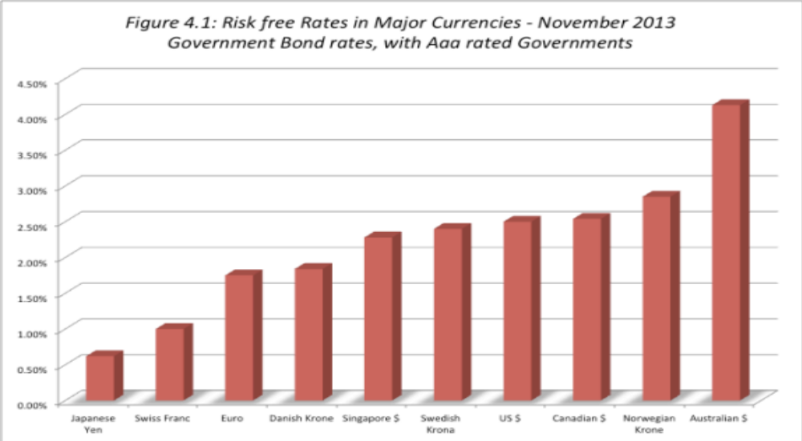
When the government is default free: Risk free rates – in November 2013
Notes:
These are currencies where there is at least one government issuing bonds in that currency that has a Aaa rating. Note, though, that the fact that a ratings agency claims that a rating is Aaa does not necessarily mean that the government is default free.

Slide 96
What if there is no default-free entity?
Risk free rates in November 2013
Adjust the local currency government borrowing rate for default risk to get a riskless local currency rate.
  In November 2013, the Indian government rupee bond rate was 8.82%. the local currency rating from Moody’s was Baa3 and the default spread for a Baa3 rated country bond was 2.25%.
  Riskfree rate in Rupees = 8.82% - 2.25% = 6.57%
  In November 2013, the Chinese Renmimbi government bond rate was 4.30% and the local currency rating was Aa3, with a default spread of 0.8%.
  Riskfree rate in Chinese Renmimbi = 4.30% - 0.8% = 3.5%
Do the analysis in an alternate currency, where getting the riskfree rate is easier. With Vale in 2013, we could chose to do the analysis in US dollars (rather than estimate a riskfree rate in R$). The riskfree rate is then the US treasury bond rate.
Do your analysis in real terms, in which case the riskfree rate has to be a real riskfree rate. The inflation-indexed treasury rate is a measure of a real riskfree rate.
Notes:
- Work with the local currency but you cannot use a long-term government bond rate as a riskfree rate if the government has default risk. You need to back into a riskfree rate. If you cannot do this, you have two choices:
Work with a currency where you can get a riskfree rate
Do everything in real terms
For a real riskfree rate, an expected real growth rate for the economy should provide a reasonable approximation.
To do your analysis in real terms, you need a real riskfree rate. In the U.S., you can obtain such a rate by looking at the inflation indexed treasury bond rate. Outside the U.S., you can assume as a rough approximation that the real riskfree rate is equal to your real growth rate. IIf the real growth rate is much lower than the real interest rate, you will have significant deficits - trade or budget - to make up the shortfall. If the real growth rate is much higher than the real interest rate, you will the exact opposite - surpluses. A long term equilibrium can be reached only when the two are equal.

Slide 97
Three paths to estimating sovereign default spreads
Sovereign dollar or euro denominated bonds: The difference between the interest rate on a sovereign US $ bond, issued by the country, and the US treasury bond rate can be used as the default spread. For example, in November 2013, the 10-year Brazil US $ bond, denominated in US dollars had a yield of 4.25% and the US 10-year T.Bond rate traded at 2.75%.
Default spread = 4.25% - 2.75% = 1.50%
CDS spreads: Obtain the default spreads for sovereigns in the CDS market. The CDS spread for Brazil in November 2013 was 2.50%.
Average spread: If you know the sovereign rating for a country, you can estimate the default spread based on the rating. In November 2013, Brazil’s rating was Baa2, yielding a default spread of 2%.
Notes:
The default spread is a key input into estimating a risk free rate in a currency where the government has default risk. All three of these approaches yield dollar-based measure of default risk.

Slide 98
Risk free rates in currencies: Sovereigns with default risk in November 2013
Notes:
Netting out the default spread from the government bond yields very different risk free rates for different currencies. The differences, though, are a result of different expected inflation rates in the currencies. As a consequence, there is no benefit to a company from switching currencies to compute hurdle rates. Using a lower inflation currency will result in a lower discount rate but the expected cash flows that you discount will have to be in the same currency and reflect the same lower inflation.

Slide 99
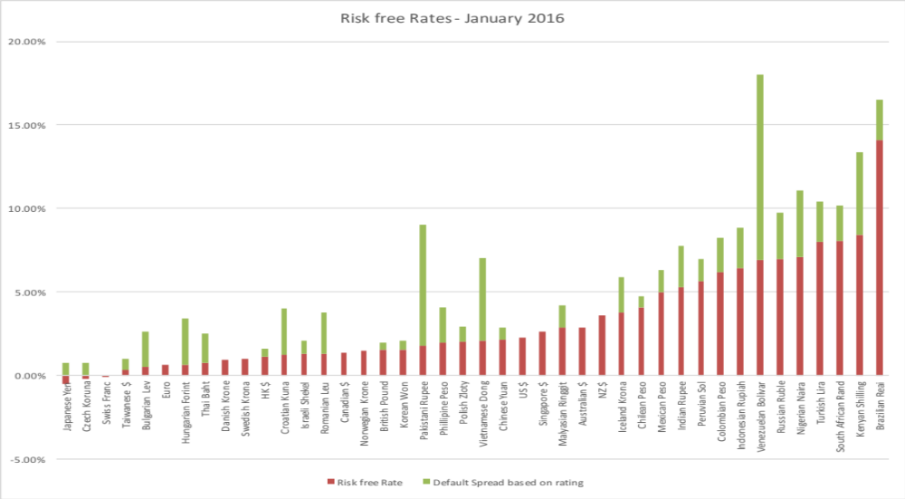
Risk free Rates in January 2016

Slide 100
Measurement of the risk premium
The risk premium is the premium that investors demand for investing in an average risk investment, relative to the riskfree rate.
As a general proposition, this premium should be
  greater than zero
  increase with the risk aversion of the investors in that market
  increase with the riskiness of the “average” risk investment
Notes:
Implicit here are two questions - Which investor’s risk premium? What is the average risk investment?
With this assumption it is quite clear that estimating equity risk premiums will be difficult to do because different investors have different degrees of risk aversion (and will demand different premiums) and risk aversion will change over time.
Studies show that there is a genetic component to risk aversion (some people are born more risk averse than others) and that there is an environmental component. Individuals who experience a severe recession when they are in their twenties are more risk averse for the rest of their lives.

Slide 101
What is your risk premium?
Assume that stocks are the only risky assets and that you are offered two investment options:
  a riskless investment (say a Government Security), on which you can make 3%
  a mutual fund of all stocks, on which the returns are uncertain
How much of an expected return would you demand to shift your money from the riskless asset to the mutual fund?
  Less than 3%
  Between 3% - 5%
  Between 5% - 7%
  Between 7% -9%
  Between 9%- 11%
  More than 11%
Notes:
I usually find that the median number that I get in the US is 7-9%, though the distribution is pretty spread out. This translates into a risk premium of 4-6%. (I have also run a survey on my web site for three years. With more than 30,000 responses, the median risk premium is about 4-6% as well.)
If this were the entire market, the risk premium would be a weighted average of the risk premiums demanded by each and every investor.
The weights will be determined by the wealth that each investor brings to the market. Thus, Warren Buffett’s risk aversion counts more towards determining the “equilibrium” premium than yours’ and mine.
As investors become more risk averse, you would expect the “equilibrium” premium to increase.

Slide 102
Risk Aversion and Risk Premiums
If this were the entire market, the risk premium would be a weighted average of the risk premiums demanded by each and every investor.
The weights will be determined by the wealth that each investor brings to the market. Thus, Warren Buffett’s risk aversion counts more towards determining the “equilibrium” premium than yours’ and mine.
As investors become more risk averse, you would expect the “equilibrium” premium to increase.
Notes:
The wealthier you are, the more your estimate of the risk premium will weight into the final market premium.

Slide 103
Risk Premiums do change..
Go back to the previous example. Assume now that you are making the same choice but that you are making it in the aftermath of a stock market crash (it has dropped 25% in the last month). Would you change your answer?
  I would demand a larger premium
  I would demand a smaller premium
  I would demand the same premium
Notes:
Quite a few will demand a larger premium, suggesting that this is a dynamic estimate, changing from period to period. Some will settle for a smaller premium, arguing that if stocks were a bargain before the drop, they should be even more so now. The broader point is that risk premiums change over time.
You can ask the same question about how a recession or losing your job will affect your risk premium.

Slide 104
Estimating Risk Premiums in Practice
Survey investors on their desired risk premiums and use the average premium from these surveys.
Assume that the actual premium delivered over long time periods is equal to the expected premium - i.e., use historical data
Estimate the implied premium in today’s asset prices.
Notes:
Lists the basic approaches. Not all of them are equally useful… So, let’s look at each one separately.

Slide 105
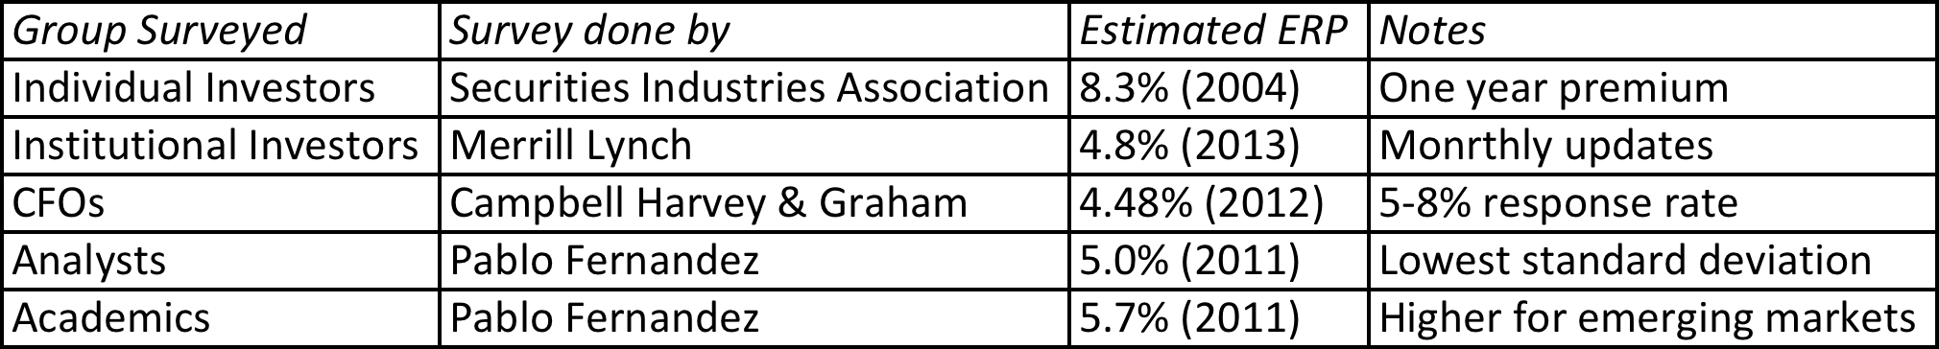
The Survey Approach
Surveying all investors in a market place is impractical.
However, you can survey a few individuals and use these results. In practice, this translates into surveys of the following:
The limitations of this approach are:
  There are no constraints on reasonability (the survey could produce negative risk premiums or risk premiums of 50%)
  The survey results are more reflective of the past than the future.
  They tend to be short term; even the longest surveys do not go beyond one year.
Notes:
Merrill Lynch does surveys of portfolio managers (who presumably have more wealth to invest and hence should be weighted more) asking investors what they think the market will do over the next year. They report the number but do not use it internally as a risk premium.
Morningstar does surveys of individual investors and reports absurdly high premiums. It is not clear whether these are wishes of expectations.
Campbell and Harvey have been doing surveys of CFOs for a decade and they report their results in detail every year. (The full surveys are well worth reading and are on ssrn.com)
Generally survey premiums seem to be more backward looking than forward looking. In other words, they seem to decrease in good times and jump after market crises (the key word is after… no predictive power here)

Slide 106
The Historical Premium Approach
This is the default approach used by most to arrive at the premium to use in the model
In most cases, this approach does the following
  Defines a time period for the estimation (1928-Present, last 50 years...)
  Calculates average returns on a stock index during the period
  Calculates average returns on a riskless security over the period
  Calculates the difference between the two averages and uses it as a premium looking forward.
The limitations of this approach are:
  it assumes that the risk aversion of investors has not changed in a systematic way across time. (The risk aversion may change from year to year, but it reverts back to historical averages)
  it assumes that the riskiness of the “risky” portfolio (stock index) has not changed in a systematic way across time.
Notes:
This is the basic approach used by almost every large investment bank and consulting firm.
The US has the longest and richest historical data base for stocks (going back as far as the 1800s) and many historical premiums are based upon that data…
We are trusting mean reversion, i.e., that numbers revert back to historical averages over time..

Slide 107
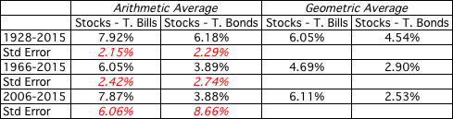
ERP: A Historical Snapshot
If you are going to use a historical risk premium, make it
  Long term (because of the standard error)
  Consistent with your risk free rate
  A “compounded” average
No matter which estimate you use, recognize that it is backward looking, is noisy and may reflect selection bias.
Historical premium for the US
Notes:
The US has the longest and richest historical data base for stocks (going back as far as the 1800s) and many historical premiums are based upon that data…
We are trusting mean reversion, i.e., that numbers revert back to historical averages over time..
This is based upon historical data available on the Federal Reserve site in St. Louis. There are three reasons for why the premium estimated may differ:
1. How far back you go (My personal bias is to go back as far as possible. Stock prices are so noisy that you need very long time periods to get reasonable estimates)
2. Whether you use T.Bill or T.Bond rates ( You have to be consistent. Since I will be using the T.Bond rate as my riskfree rate, I will use the premium over that rate)
3. Whether you use arithmetic or geometric means (If returns were uncorrelated over time, and you were asked to estimate a 1-year premium, the arithmetic mean would be used. Since returns are negatively correlated over time, and we are estimating premiums over longer holding periods, it makes more sense to use the compounded return, which gives us the geometric average)
Thus, I should be using the updated geometric average for stocks over bonds.

Slide 108
What about historical premiums for other markets?
Historical data for markets outside the United States is available for much shorter time periods. The problem is even greater in emerging markets.
The historical premiums that emerge from this data reflects this data problem and there is much greater error associated with the estimates of the premiums.
Notes:
Increasingly, the challenges we face are in estimating risk premiums outside the United States, not only because so many companies that we value are in younger, emerging markets but because so many US companies are looking at expanding into these markets.

Slide 109
One solution: Bond default spreads as CRP – November 2013
In November 2013, the historical risk premium for the US was 4.20% (geometric average, stocks over T.Bonds, 1928-2012)
Using the default spread on the sovereign bond or based upon the sovereign rating and adding that spread to the mature market premium (4.20% for the US) gives you a total ERP for a country.
If you prefer CDS spreads:
 | Arithmetic Average |  | Geometric Average
 | Stocks - T. Bills | Stocks - T. Bonds | Stocks - T. Bills | Stocks - T. Bonds
1928-2012 | 7.65% | 5.88% | 5.74% | 4.20%
 | 2.20% | 2.33%
Country | Rating | Default Spread (Country Risk Premium) | US ERP | Total ERP for country
India | Baa3 | 2.25% | 4.20% | 6.45%
China | Aa3 | 0.80% | 4.20% | 5.00%
Brazil | Baa2 | 2.00% | 4.20% | 6.20%
Country | Sovereign CDS Spread | US ERP | Total ERP for country
India | 4.20% | 4.20% | 8.40%
China | 1.20% | 4.20% | 5.40%
Brazil | 2.59% | 4.20% | 6.79%
Notes:
This approach is simple but it assumes that country default spreads are also good measures of additional country equity risk. The question thought is whether equities (which are riskier than bonds) should command a larger risk premium.

Slide 110
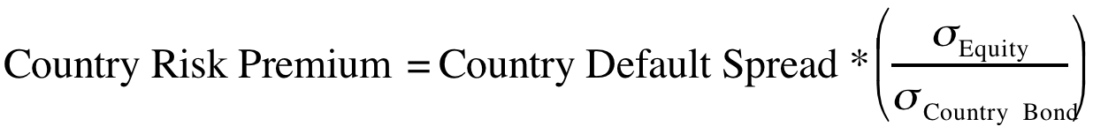

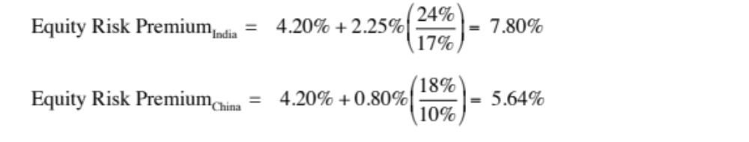
Beyond the default spread? Equities are riskier than bonds
While default risk spreads and equity risk premiums are highly correlated, one would expect equity spreads to be higher than debt spreads. One approach to scaling up the premium is to look at the relative volatility of equities to bonds and to scale up the default spread to reflect this:
Brazil: The annualized standard deviation in the Brazilian equity index over the previous year is 21 percent, whereas the annualized standard deviation in the Brazilian C-bond is 14 percent.
Using the same approach for China and India:
Notes:
In In this approach, we scale up the default spread to reflect the additional risk in stocks… This will result in larger equity risk premiums. We are assuming that investors, when pricing equities in an emerging market, look at what they can make on government bonds issued by that market and scale up premiums for additional risk.
There is a third approach which is closely related where you look at the standard deviation of the emerging equity market, relative to the standard deviation of the U.S. equity market, and multiply by the U.S. equity risk premium. Thus, the equity risk premium for an emerging market which is twice as volatile as the the US market should have an equity risk premium of 8.40% (twice 4.20%).

Slide 111
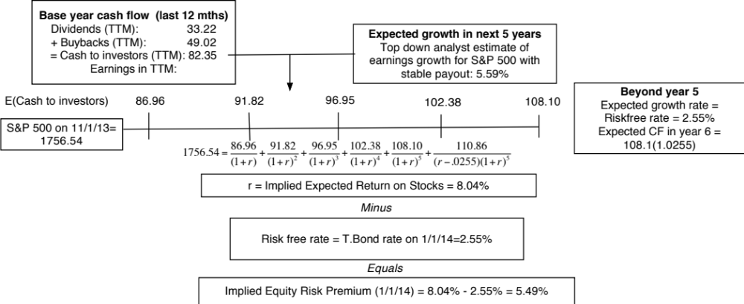
Implied ERP in November 2013: Watch what I pay, not what I say..
If you can observe what investors are willing to pay for stocks, you can back out an expected return from that price and an implied equity risk premium.
Notes:
View stocks like you would a bond. This is the analog to computing the YTM on a bond. The expected return is the IRR that makes the present value of expected cash flows on stocks = level of the index today. This implied equity risk premium will change over time, as the index and treasury bond rates change every minute of every day and the cash flows and growth numbers also change (though they get updated less frequently).

Slide 112
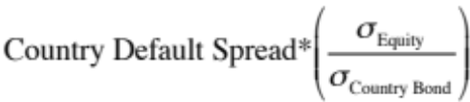
The bottom line on Equity Risk Premiums in November 2013
Mature Markets: In November 2013, the number that we chose to use as the equity risk premium for all mature markets was 5.5%. This was set equal to the implied premium at that point in time and it was much higher than the historical risk premium of 4.20% prevailing then (1928-2012 period).
For emerging markets, we will use the melded default spread approach (where default spreads are scaled up to reflect additional equity risk) to come up with the additional risk premium that we will add to the mature market premium. Thus, markets in countries with lower sovereign ratings will have higher risk premiums that 5.5%.
  Emerging Market ERP = 5.5% +
 | Arithmetic Average |  | Geometric Average
 | Stocks - T. Bills | Stocks - T. Bonds | Stocks - T. Bills | Stocks - T. Bonds
1928-2012 | 7.65% | 5.88% | 5.74% | 4.20%
 | 2.20% | 2.33%
1962-2012 | 5.93% | 3.91% | 4.60% | 2.93%
 | 2.38% | 2.66%
2002-2012 | 7.06% | 3.08% | 5.38% | 1.71%
 | 5.82% | 8.11%
Notes:
This is a judgment call and will depend upon your point of view in November 2013. If you believe in mean reversion and that history is the best guide to the future, you have a case for using the historical risk premium (4.20%). If you believe that the world is changing, that mean reversion may not be to historic norms and that risk premiums are dynamic, you will use an implied premium (5.5%).
If you thought that the crisis was just a bump in the road that markets would quickly forget and move on, you would use either the historical risk premium (3.88%) or the average implied premium over time (about 4%) as your mature market premium.
If you thought that the crisis would continue and perhaps even worsen, you would stick with 6.43%.
In hindsight, equity risk premiums dropped dramatically over the rest of 2009 to reach about 4.73% in December 2009.

Slide 113
A Composite way of estimating ERP for countries
Step 1: Estimate an equity risk premium for a mature market. If your preference is for a forward looking, updated number, you can estimate an implied equity risk premium for the US (assuming that you buy into the contention that it is a mature market)
  My estimate: In November 2013, my estimate for the implied premium in the US was 5.5%. That will also be my estimate for a mature market ERP.
Step 2: Come up with a generic and measurable definition of a mature market.
  My estimate: Any AAA rated country is mature.
Step 3: Estimate the additional risk premium that you will charge for markets that are not mature. You have two choices:
  The default spread for the country, estimated based either on sovereign ratings or the CDS market.
  A scaled up default spread, where you adjust the default spread upwards for the additional risk in equity markets.
Notes:
You could compute implied equity risk premiums for all markets and dispense with this three step process, but the inputs for implied ERP can be difficult to get in many emerging markets.
You may also take issue with my definition of a mature market (AAA) and my use of default spreads as measures of country risk. I share many of your concerns about whether these are adequate measures of country risk, but until we can come up with better measures, we are stuck with these.

Slide 114

ERP : Nov 2013
Andorra | 7.45% | 1.95% | Liechtenstein | 5.50% | 0.00%
Austria | 5.50% | 0.00% | Luxembourg | 5.50% | 0.00%
Belgium | 6.70% | 1.20% | Malta | 7.45% | 1.95%
Cyprus | 22.00% | 16.50% | Netherlands | 5.50% | 0.00%
Denmark | 5.50% | 0.00% | Norway | 5.50% | 0.00%
Finland | 5.50% | 0.00% | Portugal | 10.90% | 5.40%
France | 5.95% | 0.45% | Spain | 8.88% | 3.38%
Germany | 5.50% | 0.00% | Sweden | 5.50% | 0.00%
Greece | 15.63% | 10.13% | Switzerland | 5.50% | 0.00%
Iceland | 8.88% | 3.38% | Turkey | 8.88% | 3.38%
Ireland | 9.63% | 4.13% | United Kingdom | 5.95% | 0.45%
Italy | 8.50% | 3.00% | Western Europe | 6.72% | 1.22%
Albania | 12.25% | 6.75%
Armenia | 10.23% | 4.73%
Azerbaijan | 8.88% | 3.38%
Belarus | 15.63% | 10.13%
Bosnia | 15.63% | 10.13%
Bulgaria | 8.50% | 3.00%
Croatia | 9.63% | 4.13%
Czech Republic | 6.93% | 1.43%
Estonia | 6.93% | 1.43%
Georgia | 10.90% | 5.40%
Hungary | 9.63% | 4.13%
Kazakhstan | 8.50% | 3.00%
Latvia | 8.50% | 3.00%
Lithuania | 8.05% | 2.55%
Macedonia | 10.90% | 5.40%
Moldova | 15.63% | 10.13%
Montenegro | 10.90% | 5.40%
Poland | 7.15% | 1.65%
Romania | 8.88% | 3.38%
Russia | 8.05% | 2.55%
Serbia | 10.90% | 5.40%
Slovakia | 7.15% | 1.65%
Slovenia | 9.63% | 4.13%
Ukraine | 15.63% | 10.13%
E. Europe & Russia | 8.60% | 3.10%
Bangladesh | 10.90% | 5.40%
Cambodia | 13.75% | 8.25%
China | 6.94% | 1.44%
Fiji | 12.25% | 6.75%
Hong Kong | 5.95% | 0.45%
India | 9.10% | 3.60%
Indonesia | 8.88% | 3.38%
Japan | 6.70% | 1.20%
Korea | 6.70% | 1.20%
Macao | 6.70% | 1.20%
Malaysia | 7.45% | 1.95%
Mauritius | 8.05% | 2.55%
Mongolia | 12.25% | 6.75%
Pakistan | 17.50% | 12.00%
Papua NG | 12.25% | 6.75%
Philippines | 9.63% | 4.13%
Singapore | 5.50% | 0.00%
Sri Lanka | 12.25% | 6.75%
Taiwan | 6.70% | 1.20%
Thailand | 8.05% | 2.55%
Vietnam | 13.75% | 8.25%
Asia | 7.27% | 1.77%
Canada | 5.50% | 0.00%
United States of America | 5.50% | 0.00%
North America | 5.50% | 0.00%
Country | TRP | CRP
Angola | 10.90% | 5.40%
Benin | 13.75% | 8.25%
Botswana | 7.15% | 1.65%
Burkina Faso | 13.75% | 8.25%
Cameroon | 13.75% | 8.25%
Cape Verde | 12.25% | 6.75%
Egypt | 17.50% | 12.00%
Gabon | 10.90% | 5.40%
Ghana | 12.25% | 6.75%
Kenya | 12.25% | 6.75%
Morocco | 9.63% | 4.13%
Mozambique | 12.25% | 6.75%
Namibia | 8.88% | 3.38%
Nigeria | 10.90% | 5.40%
Rwanda | 13.75% | 8.25%
Senegal | 12.25% | 6.75%
South Africa | 8.05% | 2.55%
Tunisia | 10.23% | 4.73%
Uganda | 12.25% | 6.75%
Zambia | 12.25% | 6.75%
Africa | 11.22% | 5.82%
Argentina | 15.63% | 10.13%
Belize | 19.75% | 14.25%
Bolivia | 10.90% | 5.40%
Brazil | 8.50% | 3.00%
Chile | 6.70% | 1.20%
Colombia | 8.88% | 3.38%
Costa Rica | 8.88% | 3.38%
Ecuador | 17.50% | 12.00%
El Salvador | 10.90% | 5.40%
Guatemala | 9.63% | 4.13%
Honduras | 13.75% | 8.25%
Mexico | 8.05% | 2.55%
Nicaragua | 15.63% | 10.13%
Panama | 8.50% | 3.00%
Paraguay | 10.90% | 5.40%
Peru | 8.50% | 3.00%
Suriname | 10.90% | 5.40%
Uruguay | 8.88% | 3.38%
Venezuela | 12.25% | 6.75%
Latin America | 9.44% | 3.94%
Bahrain | 8.05% | 2.55%
Israel | 6.93% | 1.43%
Jordan | 12.25% | 6.75%
Kuwait | 6.40% | 0.90%
Lebanon | 12.25% | 6.75%
Oman | 6.93% | 1.43%
Qatar | 6.40% | 0.90%
Saudi Arabia | 6.70% | 1.20%
United Arab Emirates | 6.40% | 0.90%
Middle East | 6.88% | 1.38%
Australia | 5.50% | 0.00%
Cook Islands | 12.25% | 6.75%
New Zealand | 5.50% | 0.00%
Australia & NZ | 5.50% | 0.00%
Black #: Total ERP
Red #: Country risk premium
AVG: GDP weighted average
Notes:
Updated country risk premiums.

Slide 115
Estimating ERP for Disney: November 2013
Incorporation: The conventional practice on equity risk premiums is to estimate an ERP based upon where a company is incorporated. Thus, the cost of equity for Disney would be computed based on the US equity risk premium, because it is a US company, and the Brazilian ERP would be used for Vale, because it is a Brazilian company.
Operations: The more sensible practice on equity risk premium is to estimate an ERP based upon where a company operates. For Disney in 2013:
Region/ Country | Proportion of Disney’s Revenues | ERP
US& Canada | 82.01% | 5.50%
Europe | 11.64% | 6.72%
Asia-Pacific | 6.02% | 7.27%
Latin America | 0.33% | 9.44%
Disney | 100.00% | 5.76%
Notes:
The ERP for a company should reflect where it does business rather than where it is incorporation. While I have used revenues as my basis for estimating the composite premium for Disney, you may chose an alternate variable (% of production, identifiable assets) to make the allocation. If you use the country of incorporation as your only basis, you will over estimated the costs of capital for emerging market companies and under estimate them for developed market companies.

Slide 116
ERP for Companies: November 2013
Company | Region/ Country | Weight | ERP
Bookscape | United States | 100% | 5.50%
Vale | US & Canada | 4.90% | 5.50%
 | Brazil | 16.90% | 8.50%
 | Rest of Latin America | 1.70% | 10.09%
 | China | 37.00% | 6.94%
 | Japan | 10.30% | 6.70%
 | Rest of Asia | 8.50% | 8.61%
 | Europe | 17.20% | 6.72%
 | Rest of World | 3.50% | 10.06%
 | Company | 100.00% | 7.38%
Tata Motors | India | 23.90% | 9.10%
 | China | 23.60% | 6.94%
 | UK | 11.90% | 5.95%
 | United States | 10.00% | 5.50%
 | Mainland Europe | 11.70% | 6.85%
 | Rest of World | 18.90% | 6.98%
 | Company | 100.00% | 7.19%
Baidu | China | 100% | 6.94%
Deutsche Bank | Germany | 35.93% | 5.50%
 | North America | 24.72% | 5.50%
 | Rest of Europe | 28.67% | 7.02%
 | Asia-Pacific | 10.68% | 7.27%
 | South America | 0.00% | 9.44%
 | Company | 100.00% | 6.12%
In November 2013, the mature market premium used was 5.5%
Notes:
Bookscape and Baidu are easy, since they get all of their revenues in one market. Baidu, though, may look different in future years if its plans to expand come to fruition. Deutshe, Tata Motors and Vale are multinationals.

Slide 117
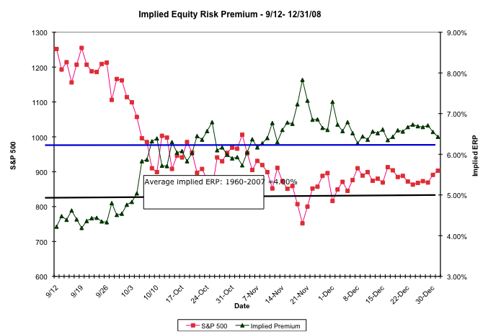
The Anatomy of a Crisis: Implied ERP from September 12, 2008 to January 1, 2009
Notes:
Equity risk premiums changed more in three months than they had in the previous 20 years put together. A wake-up call for those who stick with fixed premiums? That depends on whether we assume that this is an aberration or a break with the past.

Slide 118
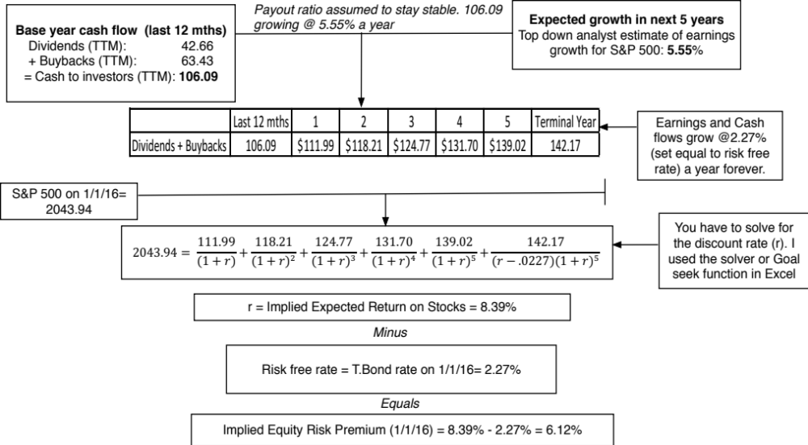
An Implied ERP
Notes:
This is the equivalent of a yield to maturity for stocks, where we compute the IRR (required return) based on the level of the index and expected cash flows. Beyond year 5, we assume that the growth rate will converge on the growth rate of the economy (proxied for by the risk free rate).

Slide 119
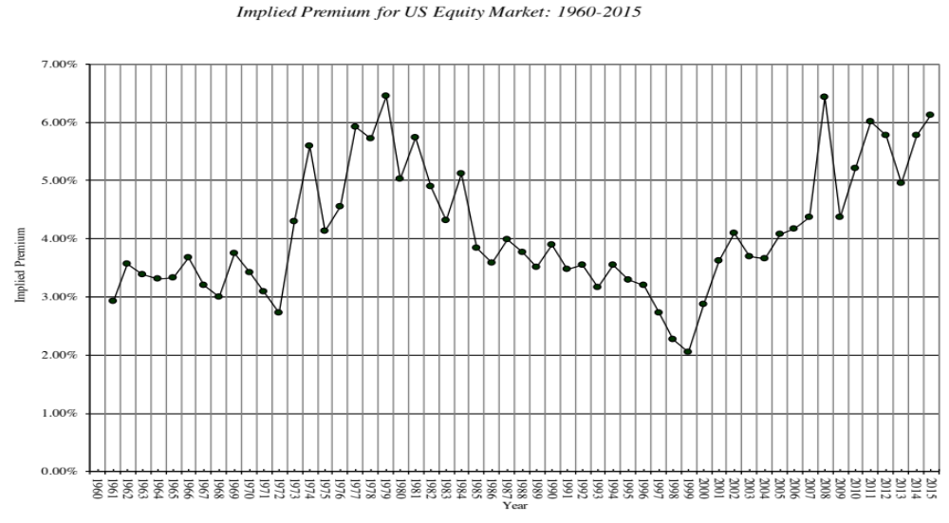
Implied Premiums in the US: 1960-2015
Notes:
As the index changes (and it is the input most likely to change by large amounts in short periods), the implied premium will change. Note that as premiums rise, stock prices drop. Notice two historical phenomena: (1) Equity risk premiums spiked in the 1970s as inflation increased in the US (2) Equity risk premiums bottomed out at 2% at the end of 1999 at the peak of the dot-com boom.
Would you settle for a 2% premium? If your answer is no, you believe that stocks are overvalued.

Slide 120
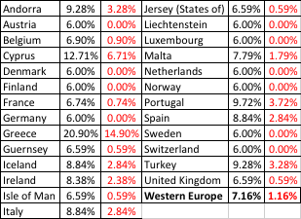
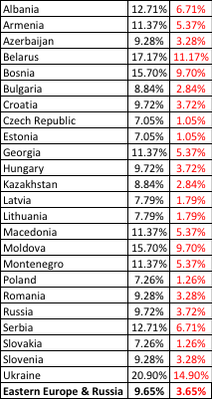
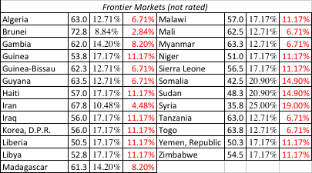
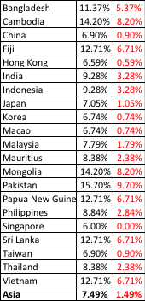

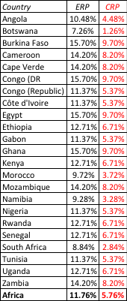
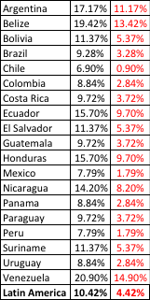
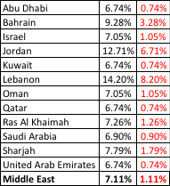

ERP : Jan 2016
Black #: Total ERP
Red #: Country risk premium
AVG: GDP weighted average
Notes:
Updated country risk premiums.

Slide 121
Application Test: Estimating a Market Risk Premium
For your company, get the geographical breakdown of revenues in the most recent year. Based upon this revenue breakdown and the most recent country risk premiums, estimate the equity risk premium that you would use for your company.
This computation was based entirely on revenues. With your company, what concerns would you have about your estimate being too high or too low?
Notes:
Companies often break down revenues into broad regions, rather than countries. Use the regional weighted averages. Some companies do provide more information than others. Use what you can and make your best estimates.

Slide 122
Estimating Beta
The standard procedure for estimating betas is to regress stock returns (R_{j}) against market returns (R_{m}):
R_{j} = a + b R _{m}
  where a is the intercept and b is the slope of the regression.
The slope of the regression corresponds to the beta of the stock, and measures the riskiness of the stock.
The R squared (R²) of the regression provides an estimate of the proportion of the risk (variance) of a firm that can be attributed to market risk. The balance (1 - R²) can be attributed to firm specific risk.
Notes:
Betas reflect not just the volatility of the underlying investment but also how it moves with the market:
Beta (Slope) = Correlation_{jm} (σ_{j /} σ_{m})
Note that σ_{j} can be high but beta can be low (because the asset is not very highly correlated with the market)
Key point: Betas may be estimated from regressions but they should never be considered purely statistical numbers. They convey economic weight - they measure the risk added on by an asset to a diversified portfolio.

Slide 123
Estimating Performance
The intercept of the regression provides a simple measure of performance during the period of the regression, relative to the capital asset pricing model.
  R_{j} = R_{f} + b (R_{m} - R_{f})
  = R_{f} (1-b) + b R_{m} ........... Capital Asset Pricing Model
  R_{j} = a + b R_{m} ........... Regression Equation
If
  a > R_{f} (1-b) .... Stock did better than expected during regression period
  a = R_{f} (1-b) .... Stock did as well as expected during regression period
  a < R_{f} (1-b) .... Stock did worse than expected during regression period
The difference between the intercept and Rf (1-b) is Jensen's alpha. If it is positive, your stock did perform better than expected during the period of the regression.
Notes:
Economic intuition:
Think of Riskfree rate (1- Beta) as the return your stock should make in a period when the market is flat (market return is zero). Note that it will be negative if the beta >1; a riskier stock will actually deliver negative returns in a month in which the market is flat.
The intercept is what your stock actually made in a month in which the market was flat.
The difference measures whether your stock under or over performed the market index over the period. It is called Jensen’s alpha (Michael Jensen used the measure to evaluate mutual fund performance in 1968).
Jensen’s alpha can also be computed by estimating the expected return during the period of the regression, using the actual return on the market during the period, the riskfree rate during the period and the estimated beta, and then comparing it to the actual return over the period.
Algebraically, you should get the same answer.
In some cases, the regression is run using excess returns over the risk free rate on both sides - excess return for the stock on the left hand side and excess returns for the market on the right hand side. In that case, the intercept is itself Jensen’s alpha.

Slide 124
Setting up for the Estimation
Decide on an estimation period
  Services use periods ranging from 2 to 5 years for the regression
  Longer estimation period provides more data, but firms change.
  Shorter periods can be affected more easily by significant firm-specific event that occurred during the period
Decide on a return interval - daily, weekly, monthly
  Shorter intervals yield more observations, but suffer from more noise.
  Noise is created by stocks not trading and biases all betas towards one.
Estimate returns (including dividends) on stock
  Return = (Price_{End} - Price_{Beginning} + Dividends_{Period})/ Price_{Beginning}
  Included dividends only in ex-dividend month
Choose a market index, and estimate returns (inclusive of dividends) on the index for each interval for the period.
Notes:
Note the number of subjective judgments that have to be made. The estimated beta is going to be affected by all these judgments. On each one, there are trade offs to be made, which may explain why different services make different choices.
My personal biases are to
Use five years of data (because I use monthly data)
Use monthly returns (to avoid non-trading problems)
Use returns with dividends
Use an index that is broad, market weighted and with a long history (I use the S&P 500. The NYSE composite is not market weighted, and the Wilshire 5000 has both non-trading and measurement issues that have not been resolved.) You want to get as close the mythical market portfolio as you can get…

Slide 125
Choosing the Parameters: Disney
Period used: 5 years
Return Interval = Monthly
Market Index: S&P 500 Index.
For instance, to calculate returns on Disney in December 2009,
  Price for Disney at end of November 2009 = $ 30.22
  Price for Disney at end of December 2009 = $ 32.25
  Dividends during month = $0.35 (It was an ex-dividend month)
  Return =($32.25 - $30.22 + $ 0.35)/$30.22= 7.88%
To estimate returns on the index in the same month
  Index level at end of November 2009 = 1095.63
  Index level at end of December 2009 = 1115.10
  Dividends on index in December 2009 = 1.683
  Return =(1115.1 – 1095.63+1.683)/ 1095.63 = 1.78%
Notes:
Reports parameters used. Returns in each month include dividends, if any, in that month. For most dividend paying U.S. stocks, there will be four months in the year where there are dividends and eight months without dividends. (Will the returns in those months be better? Not if you factor in what happens to stock prices on ex dividend days)

Slide 126
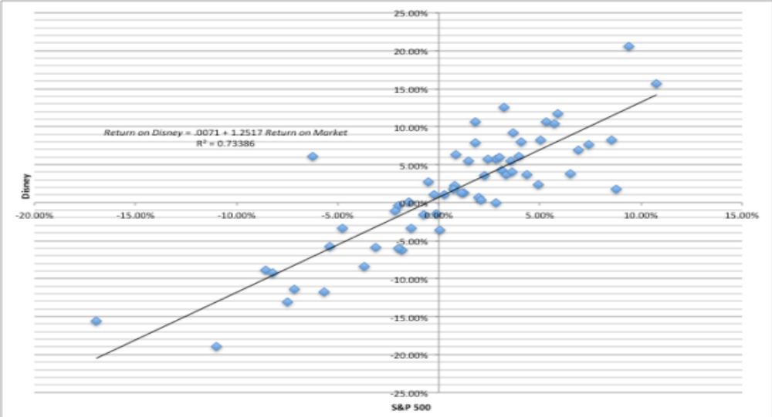
Disney’s Historical Beta
Return on Disney = .0071 + 1.2517 Return on Market R² = 0.73386
(0.10)
Notes:
This has both the scatter plot and the regression line. Note the there is substantial error in the regression. A statistician looking at this regression would view this as evidence that it was not a good regression. A financial economist looking the same regression sees it as a reflection of the reality that most of the risk in a given investment or stock is firm-specific.

Slide 127
Analyzing Disney’s Performance
Intercept = 0.712%
  This is an intercept based on monthly returns. Thus, it has to be compared to a monthly riskfree rate.
  Between 2008 and 2013
    Average Annualized T.Bill rate = 0.50%
    Monthly Riskfree Rate = 0.5%/12 = 0.042%
    Riskfree Rate (1-Beta) = 0.042% (1-1.252) = -.0105%
The Comparison is then between
  Intercept versus Riskfree Rate (1 - Beta)
  0.712% versus 0.0105%
  Jensen’s Alpha = 0.712% - (-0.0105)% = 0.723%
Disney did 0.723% better than expected, per month, between October 2008 and September 2013
  Annualized, Disney’s annual excess return = (1.00723)¹² -1= 9.02%
Notes:
The intercept measures what your stock actually did in a month when the market was flat (zero return) during the time period of the regression. Rf(1- beta) measures what a stock should have done (given its beta) during the same period in a month in which the market did nothing.
Disney did 9.02% better than expected on an annual basis between 2004 and 2008. The Jensen’s alpha is a risk adjusted, market adjusted measure of performance. (Consider a simple example. Assume that the market was up 20% a year during the period of your regression and that you have a stock with a beta of 1.5. If you ignore the riskfree rate, this stock should have earned a return of 30% each year for the regression period. With a Jensen’s alpha of 9.02%, it earned 30% + 9.02% = 39.02%.)
If the regression is run using excess returns on the stock and market (over an above the riskfree rate), the intercept is already Jensen’s alpha:
Return on stock - Rf = a + b (Rm - Rf)
b. An alternate approach to estimating Jensen’s alpha is to use the average monthly return on the stock and subtract out the expected return using the risk free rate during the period, the beta and the average monthly return on the market. You should get an identical answer:

Slide 128
More on Jensen’s Alpha
If you did this analysis on every stock listed on an exchange, what would the average Jensen’s alpha be across all stocks?
  Depend upon whether the market went up or down during the period
  Should be zero
  Should be greater than zero, because stocks tend to go up more often than down.
Disney has a positive Jensen’s alpha of 9.02% a year between 2008 and 2013. This can be viewed as a sign that management in the firm did a good job, managing the firm during the period.
  True
  False
Disney has had a positive Jensen’s alpha between 2008 and 2013. If you were an investor in early 2014, looking at the stock, you would view this as a sign that the stock will be a:
  Good investment for the future
  Bad investment for the future
  No information about the future
Notes:
Should be zero, if it is weighted by market value. The market cannot beat or lag itself.
What should the Jensen’s alpha of an index fund be?
- Should be zero
If I claim to be a successful stock picker and run a mutual fund, what should my Jensen’s alpha be?
- Should be positive for the entire portfolio (though not all stocks may have positive Jensen’s alphas)
If I pick a hundred stocks at random, what should my Jensen’s alpha be?
- Zero
What if I incur a 1.5% management fee and transactions costs in picking these stocks?
- Should be -1.5% (which is roughly what the Jensen’s alpha is across all actively managed mutual funds)

Slide 129
Estimating Disney’s Beta
Slope of the Regression of 1.25 is the beta
Regression parameters are always estimated with error. The error is captured in the standard error of the beta estimate, which in the case of Disney is 0.10.
Assume that I asked you what Disney’s true beta is, after this regression.
  What is your best point estimate?
  What range would you give me, with 67% confidence?
  What range would you give me, with 95% confidence?
Notes:
Best point estimate: 1.25
Range with 67% confidence: 1.15-1.35
Range with 95% confidence: 1.05-1.45

Slide 130
The Dirty Secret of “Standard Error”
Distribution of Standard Errors: Beta Estimates for U.S. stocks
1600
1400
1200
1000
800
Number of Firms
600
400
200
0
<.10
.10 - .20
.20 - .30
.30 - .40
.40 -.50
.50 - .75
> .75
Standard Error in Beta Estimate
Notes:
The standard errors of betas estimated in the US tend to be fairly high (the median is 0.20-0.25), with many beta estimates having standard errors of 0.40 or greater. These betas should come with warnings.

Slide 131
Breaking down Disney’s Risk
R Squared = 73%
This implies that
  73% of the risk at Disney comes from market sources
  27%, therefore, comes from firm-specific sources
The firm-specific risk is diversifiable and will not be rewarded.
The R-squared for companies, globally, has increased significantly since 2008. Why might this be happening?
What are the implications for investors?
Notes:
This suggests that Disney is exposed to more macro risk than the typical firm in the US. The typical firm has an R squared of between 40-45%. Hence, the allure of diversification.
(Why might this be? Size and having a more diversified business mix may explain Disney’s high R-squared.)
About 20% of firms have R-squared of less than 10%…
About 20% of firms have R-squared exceeding 50%…
If you were undiversified, which group would you like to hold? (Answer: The latter)
If you are diversified, which group would you like to hold? (Does not matter, since you get rid of the firm-specific risk anyway)

Slide 132
The Relevance of R Squared
You are a diversified investor trying to decide whether you should invest in Disney or Amgen. They both have betas of 1.25, but Disney has an R Squared of 73% while Amgen’s R squared is only 25%. Which one would you invest in?
  Amgen, because it has the lower R squared
  Disney, because it has the higher R squared
  You would be indifferent
Would your answer be different if you were an undiversified investor?
Notes:
If you were a diversified investor, you would not care, since you would diversify away all of the firm specific risk anyway. After you are done diversifying, what you will be left with on both stocks is the market risk which is best measured using the betas.
If you were undiversified, you would prefer Disney, which has less firm-specific risk.
How can two companies have the same betas but different R-squared?
The R-squared measures the proportion of the risk in a stock that is market risk.. The beta measures the units of market risk (in standardized terms). Amgen, in this case, has far more total risk than Disney (approximately three times as much). Thus, 25% of Amgen’s risk works out to the same number of units of market risk as 73% of Disney’s risk.

Slide 133
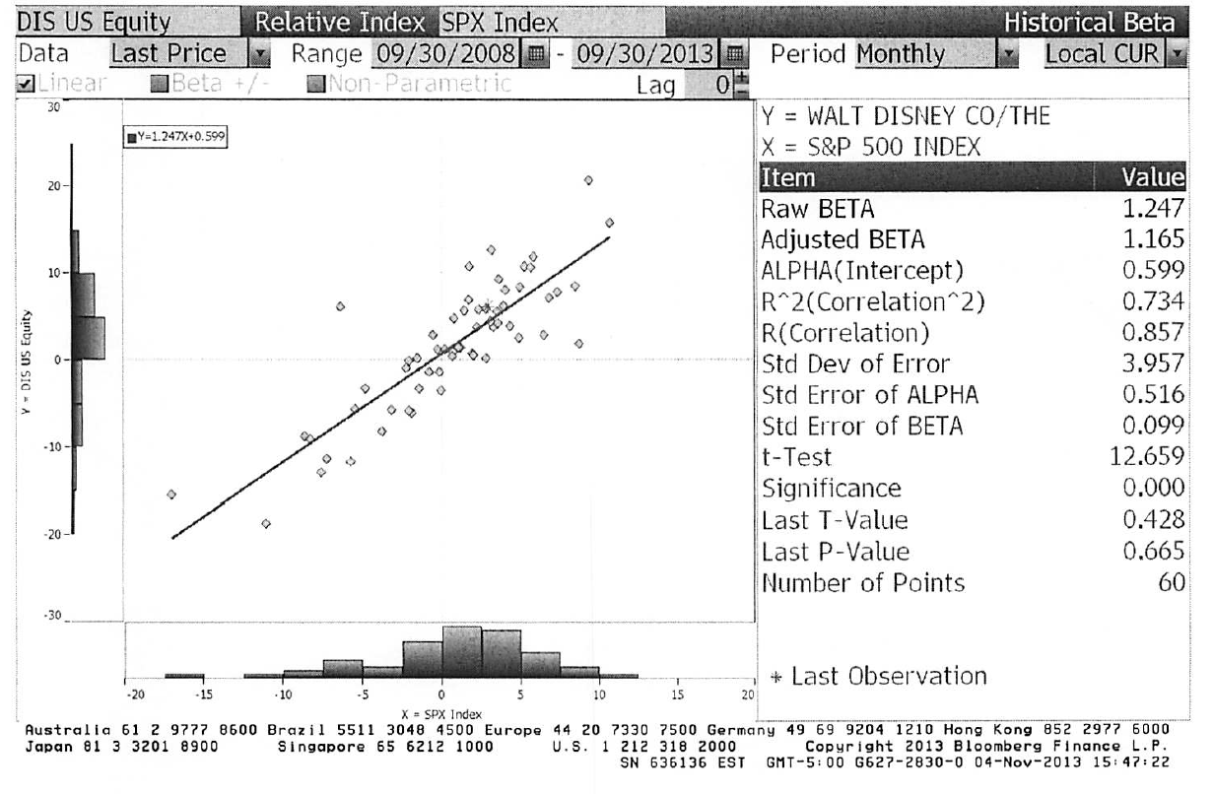
Beta Estimation: Using a Service (Bloomberg)
Notes:
This is the page for Disney’s beta, using the same period as the regression run earlier, from Bloomberg.
Bloomberg, however, uses only price returns (it ignores dividends both in the stock and the index). Hence the intercept is different.
The adjusted beta is just the regression beta moves towards one, reflecting the empirical realities that for most firms, betas tend to drift towards one as they get larger and more diversified.

Slide 134
Estimating Expected Returns for Disney in November 2013
Inputs to the expected return calculation
  Disney’s Beta = 1.25
  Riskfree Rate = 2.75% (U.S. ten-year T.Bond rate in November 2013)
  Risk Premium = 5.76% (Based on Disney’s operating exposure)
Expected Return = Riskfree Rate + Beta (Risk Premium)
= 2.75% + 1.25 (5.76%) = 9.95%
Notes:
Note that this expected return would have been different if we had decided to use a different equity risk premium. The potential error in the beta will translate into a forecast error on the expected return as well.

Slide 135
Use to a Potential Investor in Disney
As a potential investor in Disney, what does this expected return of 9.95% tell you?
  This is the return that I can expect to make in the long term on Disney, if the stock is correctly priced and the CAPM is the right model for risk,
  This is the return that I need to make on Disney in the long term to break even on my investment in the stock
  Both
Assume now that you are an active investor and that your research suggests that an investment in Disney will yield 12.5% a year for the next 5 years. Based upon the expected return of 9.95%, you would
  Buy the stock
  Sell the stock
Notes:
Both. If the stock is correctly priced, the beta is correctly estimated and the CAPM is the right model, this is what you would expect to make on Disney in the long term. As an investor, this is what you would need to make to break even on the investment. You are not being greedy, just prudent. After all, if you don’t make higher returns when the market is going up, you will find yourself falling behind when the market is going down.
Buy the stock, since you think you can make more than the hurdle rate.

Slide 136
How managers use this expected return
Managers at Disney
  need to make at least 9.95% as a return for their equity investors to break even.
  this is the hurdle rate for projects, when the investment is analyzed from an equity standpoint
In other words, Disney’s cost of equity is 9.95%.
What is the cost of not delivering this cost of equity?
Notes:
The cost of equity is what equity investors in your company view as their required return.
The cost of not delivering this return is more unhappy stockholders, a lower stock price, and if you are a manager, maybe your job.
Going back to the corporate governance section, if stockholders have little or no control over managers, managers are less likely to view this as the cost of equity.

Slide 137
Application Test: Analyzing the Risk Regression
Using your Bloomberg risk and return print out, answer the following questions:
  How well or badly did your stock do, relative to the market, during the period of the regression?
  Intercept - (Riskfree Rate/n) (1- Beta) = Jensen’s Alpha
    where n is the number of return periods in a year (12 if monthly; 52 if weekly)
  What proportion of the risk in your stock is attributable to the market? What proportion is firm-specific?
  What is the historical estimate of beta for your stock? What is the range on this estimate with 67% probability? With 95% probability?
  Based upon this beta, what is your estimate of the required return on this stock?
  Riskless Rate + Beta * Risk Premium
Notes:
Try this on your company.

Slide 138
A Quick Test
You are advising a very risky software firm on the right cost of equity to use in project analysis. You estimate a beta of 3.0 for the firm and come up with a cost of equity of 20%. The CFO of the firm is concerned about the high cost of equity and wants to know whether there is anything he can do to lower his beta.
How do you bring your beta down?
Should you focus your attention on bringing your beta down?
  Yes
  No
Notes:
There are three ways to bring your beta down:
Pay off debt, if you have any
Move into safer businesses
Sell off assets, and keep cash on your balance sheet
No. What matters is the difference between what you make on your projects (return on equity) and your cost of equity. If you lower your cost of equity, but lower your return on equity even more, you are not serving your stockholders.

Slide 139
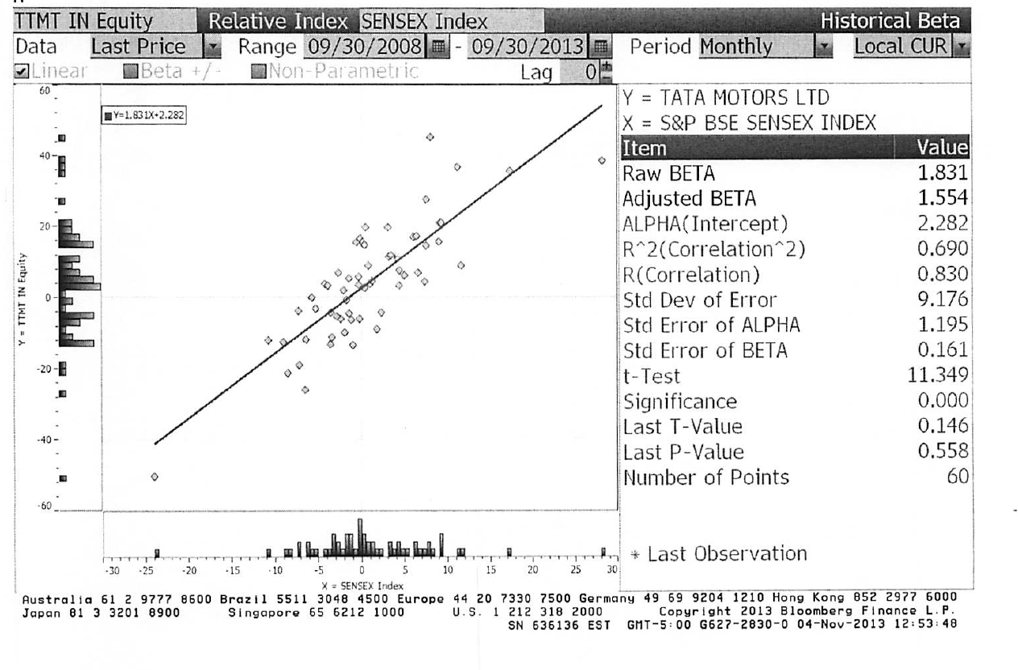
Regression Diagnostics for Tata Motors
Beta = 1.83
67% range
1.67-1.99
69% market risk
31% firm specific
Jensen’s α
= 2.28% - 4%/12 (1-1.83) = 2.56%
Annualized = (1+.0256)¹²-1= 35.42%
Average monthly riskfree rate (2008-13) = 4%
Expected Return (in Rupees)
= Riskfree Rate+ Beta*Risk premium
= 6.57%+ 1.83 (7.19%) = 19.73%
Notes:
Deconstructing Tata Motorl’s beta page, we find that
Tata Motors did better than expected over the period – by 35.42% in an annual basis.
Tata Motors is above average risk (1.83 times as risky as the typical Indian firm)
About 69% of the risk in Tata Motors is market risk

Slide 140
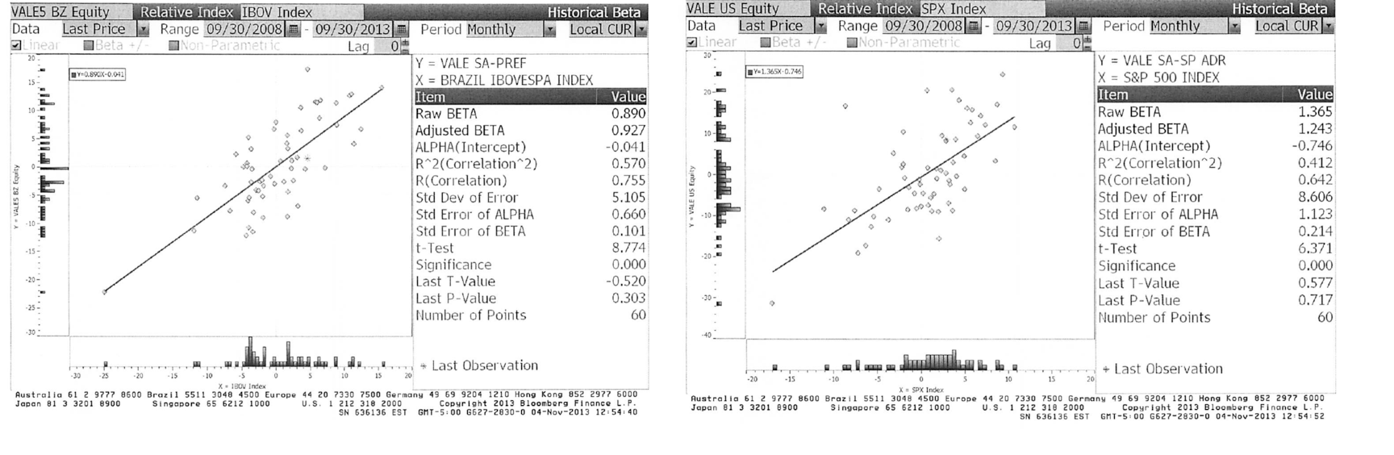
A better beta? Vale
Notes:
Shows how easy it is to get your betas to move, if you get to try different indices (and different time periods and different return intervals).

Slide 141
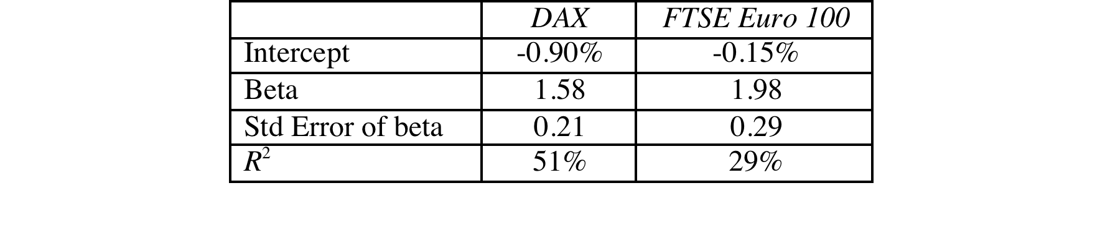
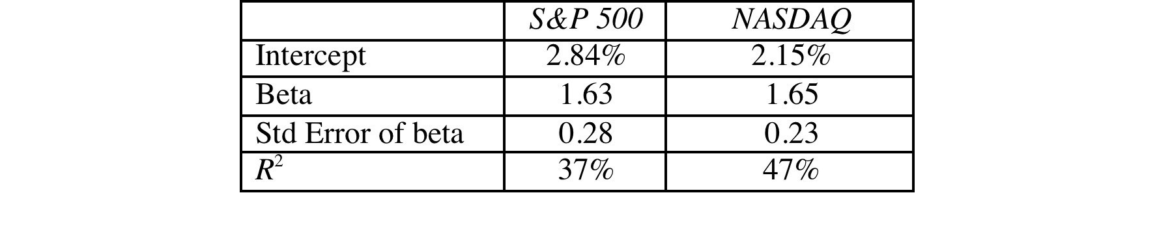
Deutsche Bank and Baidu: Index Effects on Risk Parameters
For Deutsche Bank, a widely held European stock, we tried both the DAX (German index) and the FTSE European index.
For Baidu, a NASDAQ listed stock, we ran regressions against both the S&P 500 and the NASDAQ.
Notes:
As the index used expands and becomes broader, the R-squared drops off and the standard error increases.
Which one would you use? It depends upon who your marginal investors are. If they are investors who are local and stay focused only on the local market, you may be able to get away with the DAX regression. As your marginal investors become more diversified, you should move from the local index to wider indices. The least precise beta estimate (with the highest standard error) may be the most meaningful.
As investors become globalized, there is an argument to be made that we should be abandoning the use of local indices and replacing them with global indices.
With Baidu, the best index is not the one that fits it best (which would be the NASDAQ) but the one that best captures what marginal investors are invested in.

Slide 142
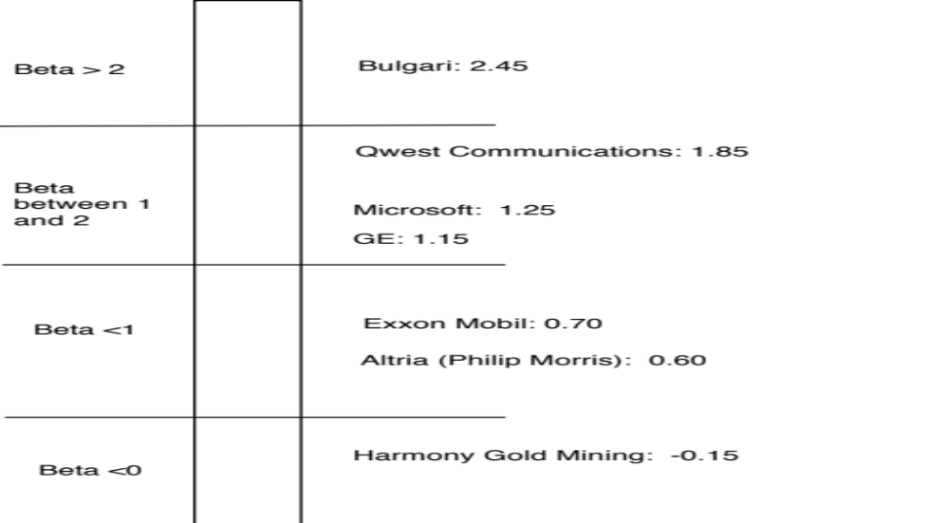
Beta: Exploring Fundamentals
Notes:
A cross selection of regression betas for companies… Lets try a story for each one:
Real Networks: Small, high growth company in risky business
Qwest: Some business risk but much more substantial overlay of financial risk created by borrowing billions.
Microsoft: Example of beta drift towards one as companies get larger and their product base (and customer base) becomes more diversified. Microsoft’s beta in the lat 1980s was much higher than 2.
GE: Most diversified US company you will find.. Beta will drift towards one for diversified companies. GE Capital’s debt acts as ballast on beta
Philip Morris: Main risk is oil price risk which cuts against the rest of the market (lower oil prices are good for many companies and the economy but not for oil companies). The litigation risk will not show up in the beta because it is firm-specific. (Changing the company name to Altria will not make a difference)
Harmony Gold Mining Company: A negative beta implies that adding this stock on to a diversified portfolio will actually reduce risk (acts as insurance). Gold has historically been an insurance against inflation.
(Consequences of a negative beta: Expected return < Riskfree rate)

Slide 143
Determinant 1: Product Type
Industry Effects: The beta value for a firm depends upon the sensitivity of the demand for its products and services and of its costs to macroeconomic factors that affect the overall market.
  Cyclical companies have higher betas than non-cyclical firms
  Firms which sell more discretionary products will have higher betas than firms that sell less discretionary products
Notes:
Betas measure risk relative to the market.
Firms which are cyclical or sell discretionary products tend to do much better when the economy is doing well (and the market is doing well) and much worse when the economy is doing badly than other firms in the market.
In terms of basic economics, companies that sell products/ services that have elastic demand should have higher betas than ones that sell products/services with inelastic demand.

Slide 144
A Simple Test
Phone service is close to being non-discretionary in the United States and Western Europe. However, in much of Asia and Latin America, there are large segments of the population for which phone service is a luxury.
Given our discussion of discretionary and non-discretionary products, which of the following conclusions would you be willing to draw:
  Emerging market telecom companies should have higher betas than developed market telecom companies.
  Developed market telecom companies should have higher betas than emerging market telecom companies
  The two groups of companies should have similar betas
Notes:
I would expect emerging market telecom company betas to be higher… A product or service that is more discretionary will translate into more volatile earnings and more sensitivity to overall macro economic conditions and a highr beta.

Slide 145
Determinant 2: Operating Leverage Effects
Operating leverage refers to the proportion of the total costs of the firm that are fixed.
Other things remaining equal, higher operating leverage results in greater earnings variability which in turn results in higher betas.
Notes:
Firms with high fixed costs tend to see much bigger swings in operating income (and stock prices) for a given change in revenues than firms with more flexible cost structures.
Consider the case of the airline sector, which tends to have cost structures which are almost entirely fixed (plane lease expenses, fuel costs …). Firms in the sector have high betas.
Are you destined to have a high beta, once you pick a sector?
To an extent, yes, but you can take action or make decisions to change your destiny. Consider Southwest. By using only one type of aircraft, hedging fuel costs, flying from no-name airports and having a flexible workforce, Southwest has been able to lower its fixed costs as a proportion of total costs. (Focusing less on business travel and high priced tickets has also helped them on the discretionary component).

Slide 146
Measures of Operating Leverage
Fixed Costs Measure = Fixed Costs / Variable Costs
  This measures the relationship between fixed and variable costs. The higher the proportion, the higher the operating leverage.
EBIT Variability Measure = % Change in EBIT / % Change in Revenues
  This measures how quickly the earnings before interest and taxes changes as revenue changes. The higher this number, the greater the operating leverage.
Notes:
The direct measures of fixed costs and variable costs are difficult to obtain. Hence we use the second.

Slide 147
Disney’s Operating Leverage: 1987- 2013
Year | Net Sales | % Change in Sales | EBIT | % Change in EBIT
1987 | $2,877 |  | $756
1988 | $3,438 | 19.50% | $848 | 12.17%
1989 | $4,594 | 33.62% | $1,177 | 38.80%
1990 | $5,844 | 27.21% | $1,368 | 16.23%
1991 | $6,182 | 5.78% | $1,124 | -17.84%
1992 | $7,504 | 21.38% | $1,287 | 14.50%
1993 | $8,529 | 13.66% | $1,560 | 21.21%
1994 | $10,055 | 17.89% | $1,804 | 15.64%
1995 | $12,112 | 20.46% | $2,262 | 25.39%
1996 | $18,739 | 54.71% | $3,024 | 33.69%
1997 | $22,473 | 19.93% | $3,945 | 30.46%
1998 | $22,976 | 2.24% | $3,843 | -2.59%
1999 | $23,435 | 2.00% | $3,580 | -6.84%
2000 | $25,418 | 8.46% | $2,525 | -29.47%
2001 | $25,172 | -0.97% | $2,832 | 12.16%
2002 | $25,329 | 0.62% | $2,384 | -15.82%
2003 | $27,061 | 6.84% | $2,713 | 13.80%
2004 | $30,752 | 13.64% | $4,048 | 49.21%
2005 | $31,944 | 3.88% | $4,107 | 1.46%
2006 | $33,747 | 5.64% | $5,355 | 30.39%
2007 | $35,510 | 5.22% | $6,829 | 27.53%
2008 | $37,843 | 6.57% | $7,404 | 8.42%
2009 | $36,149 | -4.48% | $5,697 | -23.06%
2010 | $38,063 | 5.29% | $6,726 | 18.06%
2011 | $40,893 | 7.44% | $7,781 | 15.69%
2012 | $42,278 | 3.39% | $8,863 | 13.91%
2013 | $45,041 | 6.54% | $9,450 | 6.62% | Operating Leverage
Average: 87-13 |  | 11.79% |  | 11.91% | 11.91/11.79 =1.01
Average: 96-13 |  | 8.16% |  | 10.20% | 10.20/8.16 =1.25
Average across entertainment companies = 1.35
Given Disney’s operating leverage measures (1.01 or 1.25), would you expect Disney to have a higher or a lower beta than other entertainment companies?
Higher
Lower
No effect
Notes:
This measures Disney’s operating leverage historically. You need a number of years of data before you can get reasonable estimates.

Slide 148
Determinant 3: Financial Leverage
As firms borrow, they create fixed costs (interest payments) that make their earnings to equity investors more volatile. This increased earnings volatility which increases the equity beta.
The beta of equity alone can be written as a function of the unlevered beta and the debt-equity ratio
_{L} = _{u} (1+ ((1-t)D/E))
  where
  _{L} = Levered or Equity Beta D/E = Market value Debt to equity ratio
  _{u} = Unlevered or Asset Beta t = Marginal tax rate
Earlier, we estimated the beta for Disney from a regression. Was that beta a levered or unlevered beta?
Levered
Unlevered
Notes:
Same rationale as operating leverage but the focus here is on equity earnings. Put another way, a firm with stable operating income can make its equity income much more volatile by borrowing large sums of money.
The levered beta equation on this page are built on two assumptions of convenience: that the beta for debt is zero and that the tax benefit from debt reduces its impact on debt. It is easy to modify the equation to allow for changes in both assumptions.
The regression beta is a levered beta.

Slide 149
Effects of leverage on betas: Disney
The regression beta for Disney is 1.25. This beta is a levered beta (because it is based on stock prices, which reflect leverage) and the leverage implicit in the beta estimate is the average market debt equity ratio during the period of the regression (2008 to 2013)
The average debt equity ratio during this period was 19.44%.
The unlevered beta for Disney can then be estimated (using a marginal tax rate of 36.1%)
  = Current Beta / (1 + (1 - tax rate) (Average Debt/Equity))
  = 1.25 / (1 + (1 - 0.361)(0.1944))= 1.1119
Notes:
Note that betas reflect the average leverage over the period and not the current leverage of the firms. Firms whose leverage has changed over the period will have regression betas that are different from their true betas.

Slide 150
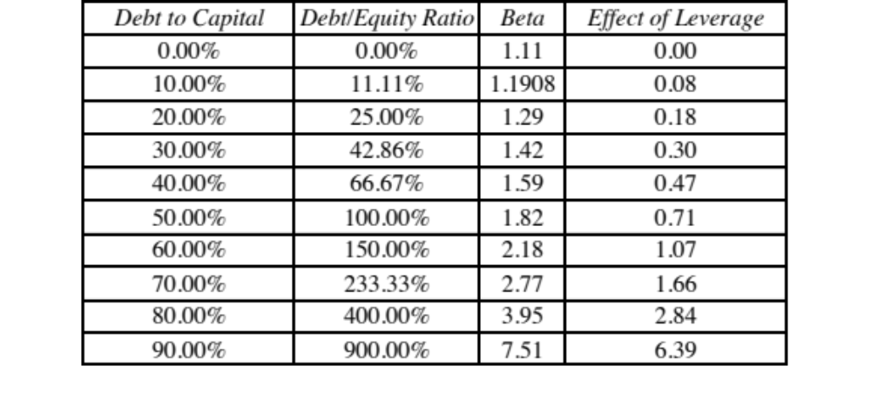
Disney : Beta and Financial Leverage
Notes:
Since equity investors bear all of the non-diversifiable risk, the beta of Disney’s equity will increase as the leverage increases.

Slide 151
Betas are weighted Averages
The beta of a portfolio is always the market-value weighted average of the betas of the individual investments in that portfolio.
Thus,
  the beta of a mutual fund is the weighted average of the betas of the stocks and other investment in that portfolio
  the beta of a firm after a merger is the market-value weighted average of the betas of the companies involved in the merger.
Notes:
Betas are always weighted averages - where the weights are based upon market value. This is because betas measure risk relative to a market index.

Slide 152
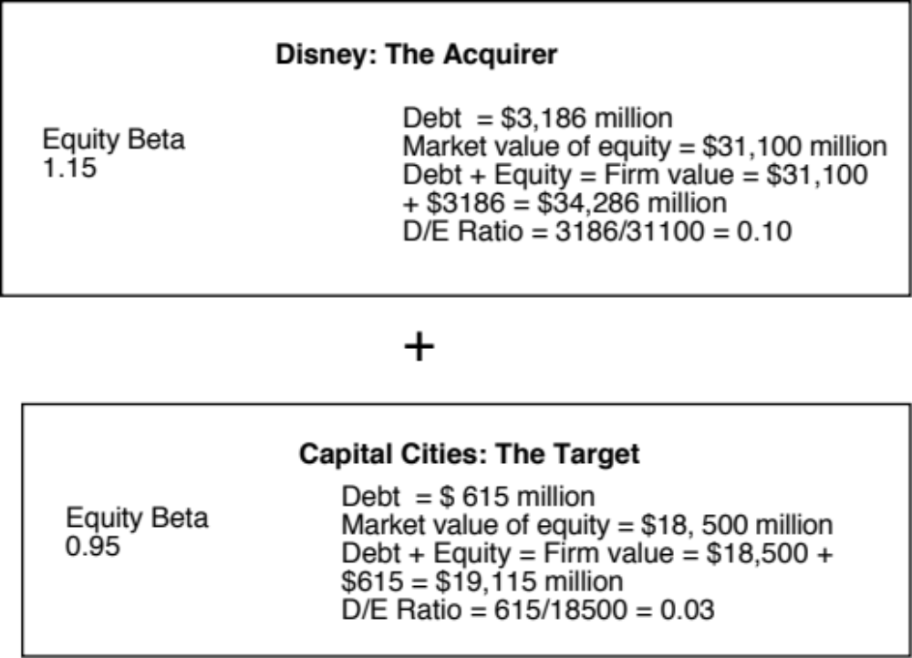
The Disney/Cap Cities Merger (1996): Pre-Merger
Notes:
These are the betas of the firms at the time of Disney’s acquisition. The tax rate used for both betas is 36%.
Equity betas are levered betas and we will assume that the leverage built into them is the current debt to equity ratio for the two firms.

Slide 153
Disney Cap Cities Beta Estimation: Step 1
Calculate the unlevered betas for both firms
  Disney’s unlevered beta = 1.15/(1+0.64*0.10) = 1.08
  Cap Cities unlevered beta = 0.95/(1+0.64*0.03) = 0.93
Calculate the unlevered beta for the combined firm
  Unlevered Beta for combined firm
  = 1.08 (34286/53401) + 0.93 (19115/53401)
  = 1.026
  The weights used are the firm values (and not just the equity values) of the two firms, since these are unlevered betas and thus reflects the risks of the entire businesses and not just the equity]
Notes:
The unlevered beta of the combined firm will always be the weighted average of the two firms’ unlevered betas. The firm values (rather than the equity values) are used for the weights because we are looking at the unlevered betas of the firms .

Slide 154
Disney Cap Cities Beta Estimation: Step 2
If Disney had used all equity to buy Cap Cities equity, while assuming Cap Cities debt, the consolidated numbers would have looked as follows:
  Debt = $ 3,186+ $615 = $ 3,801 million
  Equity = $ 31,100 + $18,500 = $ 49,600 m (Disney issues $18.5 billion in equity)
  D/E Ratio = 3,801/49600 = 7.66%
  New Beta = 1.026 (1 + 0.64 (.0766)) = 1.08
Since Disney borrowed $ 10 billion to buy Cap Cities/ABC, funded the rest with new equity and assumed Cap Cities debt:
  The market value of Cap Cities equity is $18.5 billion. If $ 10 billion comes from debt, the balance ($8.5 billion) has to come from new equity.
  Debt = $ 3,186 + $615 million + $ 10,000 = $ 13,801 million
  Equity = $ 31,100 + $8,500 = $39,600 million
  D/E Ratio = 13,801/39600 = 34.82%
  New Beta = 1.026 (1 + 0.64 (.3482)) = 1.25
Notes:
This reflects the effects of the financing of the acquisition. In the second scenario, note that $ 10 billion of the $ 18.5 billion is borrowed. The remaining $ 8.5 billion has to come from new equity issues.
Exercise: What would Disney’s beta be if it had borrowed the entire $ 18.5 billion?
Debt = $ 615 + $ 3,186 + $ 18,500 = $ 22,301 million
Equity = $ 31,100 million
D/E Ratio = 71.70%
New Beta = 1.026 ( 1 + 0.64 (.717)) = 1.50
What is the significance of assuming Cap Cities debt?
If the debt had not been assumed and had to be retired, Disney would have had to raise $19,115 million ($18,500 + $615) to fund the acquisition. You would not have added $615 million in debt to the consolidated company after the transaction.

Slide 155
Firm Betas versus divisional Betas
Firm Betas as weighted averages: The beta of a firm is the weighted average of the betas of its individual projects.
Firm Betas and Business betas: At a broader level of aggregation, the beta of a firm is the weighted average of the betas of its individual division.
Notes:
The same principle applies to a firm. To the degree that the firm is in multiple businesses, its beta reflects all of these businesses.

Slide 156
Bottom-up versus Top-down Beta
The top-down beta for a firm comes from a regression
The bottom up beta can be estimated by doing the following:
  Find out the businesses that a firm operates in
  Find the unlevered betas of other firms in these businesses
  Take a weighted (by sales or operating income) average of these unlevered betas
  Lever up using the firm’s debt/equity ratio
The bottom up beta is a better estimate than the top down beta for the following reasons
  The standard error of the beta estimate will be much lower
  The betas can reflect the current (and even expected future) mix of businesses that the firm is in rather than the historical mix
Notes:
Bottom-up betas build up to the beta from the fundamentals, rather than trusting the regression.
The standard error of an average beta for a sector, is smaller by a factor of √n, where n is the number of firms in the sector. Thus, if there are 25 firms in a sector, the standard error of the average is 1/5 the average standard error.

Slide 157

Disney’s businesses: The financial breakdown (from 2013 annual report)
Notes:
Disney does break down its divisions very well in its financial statements. Not all companies are this forthcoming and you may have to go on much coarser data, in some cases.

Slide 158

Unlevered Betas for businesses
Business | Comparable firms | Sample size | Median Beta | Median D/E | Median Tax rate | Company Unlevered Beta | Median Cash/ Firm Value | Business Unlevered Beta
Media Networks | US firms in broadcasting business | 26 | 1.43 | 71.09% | 40.00% | 1.0024 | 2.80% | 1.0313
Parks & Resorts | Global firms in amusement park business | 20 | 0.87 | 46.76% | 35.67% | 0.6677 | 4.95% | 0.7024
Studio Entertainment | US movie firms | 10 | 1.24 | 27.06% | 40.00% | 1.0668 | 2.96% | 1.0993
Consumer Products | Global firms in toys/games production & retail | 44 | 0.74 | 29.53% | 25.00% | 0.6034 | 10.64% | 0.6752
Interactive | Global computer gaming firms | 33 | 1.03 | 3.26% | 34.55% | 1.0085 | 17.25% | 1.2187
Notes:
Comes from the companies in each sector. Judgment calls had to be made and when the sample size was too small (as was the case with broadcasting and theme parks), I had to broaden my sample, by going up and down the food chain of revenues in the case of broadcasting (by including companies that make revenues from syndicating TV shows, for instance) or going global (with theme parks).

Slide 159

A closer look at the process…
Studio Entertainment Betas
Enterprise Value (EV) = Market Cap + Debt - Cash
Firm value = Market Cap + Total Debt
Gross D/E = Total Debt/ Market Cap
Notes:
This shows the raw numbers behind one of the line items on the previous page – studio entertainment. It lists the companies used, their market values of equity, total debt outstanding and cash.
We show three summary numbers – the average, the aggregate and the median. The average is skewed by outliers. While both the aggregate and median yield meaningful values, we have chosen to go with the median.
In the last three columns, I have computed the enterprise value = mkt cap + debt – cash, revenues and EV/Revenues. These will be used on the next page.

Slide 160

Backing into a pure play beta: Studio Entertainment
1. Start with the median regression beta (equity beta) of 1.24
2. Unlever the beta, using the median gross D/E ratio of 27.06%
Gross D/E ratio = 21.30/78.70 = 27.06%
Unlevered beta = 1.24/ (1+ (1-.4) (.2706)) = 1.0668
3. Take out the cash effect, using the median cash/value of 2.96%
(.0296) (0) + (1-.0296) (Beta of movie business) = 1.0668
Beta of movie business = 1.0668/(1-.0296) = 1.0993
Alternatively, you could have used the net debt to equity ratio
Net D/E ratio = (21.30-2.96)/78.70 = 23.30%
Unlevered beta for movies = 1.24/ (1+(1-.4)(.233)) = 1.0879
Notes:
Using the studio entertainment companies as the base, this page explains the process, step by step.
You always start with a regression or equity beta, then clean up for debt and then for cash. (I assumed a marginal tax rate of 40%, since these were all US firms)
An alternate approach is to net cash out against debt and use a net debt to equity ratio.
If you did that your net debt ratio would be (35.02- 8.93)/ 64.98 = 40.16%
The unlevered beta = 1.57/ (1+ (1-.4) (.4016)) = 1.2652
The answers are close but they will not be the same. With the net debt ratio, you are assuming that debt and cash not only cancel out in terms of risk but also in terms of tax advantages.

Slide 161

Disney’s unlevered beta: Operations & Entire Company
Business | Revenues | EV/Sales | Value of Business | Proportion of Disney | Unlevered beta | Value | Proportion
Media Networks | $20,356 | 3.27 | $66,580 | 49.27% | 1.03 | $66,579.81 | 49.27%
Parks & Resorts | $14,087 | 3.24 | $45,683 | 33.81% | 0.70 | $45,682.80 | 33.81%
Studio Entertainment | $5,979 | 3.05 | $18,234 | 13.49% | 1.10 | $18,234.27 | 13.49%
Consumer Products | $3,555 | 0.83 | $2,952 | 2.18% | 0.68 | $2,951.50 | 2.18%
Interactive | $1,064 | 1.58 | $1,684 | 1.25% | 1.22 | $1,683.72 | 1.25%
Disney Operations | $45,041 |  | $135,132 | 100.00% | 0.9239 | $135,132.11
Disney has $3.93 billion in cash, invested in close to riskless assets (with a beta of zero). You can compute an unlevered beta for Disney as a company (inclusive of cash):
Notes:
I used revenues and revenue multiples to estimate the values of each business. I could have also used EBIT or EBITDA, by business, and applied a multiple but the problem is with divisions that have negative values for either (as is the case with Interactive for Disney).
The reason that I compute two unlevered beta, one for just the operations and one that includes the cash (and is thus for the entire firm) is that each has its use somewhere along. When computing the cost of capital, which is a cost of funding your operating assets, I will use the former. If I needed a beta for a dividend discount model, where the dividends are paid out of composite earnings, I would use the latter.

Slide 162

The levered beta: Disney and its divisions
To estimate the debt ratios for division, we allocate Disney’s total debt ($15,961 million) to its divisions based on identifiable assets.
We use the allocated debt to compute D/E ratios and levered betas.
Business | Unlevered beta | Value of business | D/E ratio | Levered beta | Cost of Equity
Media Networks | 1.0313 | $66,580 | 10.03% | 1.0975 | 9.07%
Parks & Resorts | 0.7024 | $45,683 | 11.41% | 0.7537 | 7.09%
Studio Entertainment | 1.0993 | $18,234 | 20.71% | 1.2448 | 9.92%
Consumer Products | 0.6752 | $2,952 | 117.11% | 1.1805 | 9.55%
Interactive | 1.2187 | $1,684 | 41.07% | 1.5385 | 11.61%
Disney Operations | 0.9239 | $135,132 | 13.10% | 1.0012 | 8.52%
Notes:
I allocated the debt based upon the identifiable assets (since these tend to be large, fixed assets, as defined by accountants) and thus more likely to require the use of debt.

Slide 163
Discussion Issue
Assume now that you are the CFO of Disney. The head of the movie business has come to you with a new big budget movie that he would like you to fund. He claims that his analysis of the movie indicates that it will generate a return on equity of 9.5%. Would you fund it?
  Yes. It is higher than the cost of equity for Disney as a company
  No. It is lower than the cost of equity for the movie business.
  What are the broader implications of your choice?
Notes:
The cost of equity for each division should be used. Otherwise, the riskier divisions will over invest and the safest divisions will under invest.
Over time, the firm will become a riskier firm. Think of Bankers Trust from 1980, when it was a commercial bank, to 1992, when it had become primarily an investment bank.
It also means that any multi business company should have different hurdle rates for each business, with higher rates for riskier businesses and lower rates for safer businesses.

Slide 164


Estimating Bottom Up Betas & Costs of Equity: Vale
Notes:
Following the same script that I did for Disney, but I did not attempt to allocate the debt across businesses, partly because there was little information available on the allocation and partly because they businesses are more similar in terms of their debt capacity.

Slide 165


Vale: Cost of Equity Calculation – in nominal $R
To convert a discount rate in one currency to another, all you need are expected inflation rates in the two currencies.
From US $ to R$: If we use 2% as the inflation rate in US dollars and 9% as the inflation ratio in Brazil, we can convert Vale’s US dollar cost of equity of 11.23% to a $R cost of equity:
Alternatively, you can compute a cost of equity, starting with the $R riskfree rate of 10.18%.
  Cost of Equity in $R = = 10.18% + 1.15 (7.38%) = 18.67%
Notes:
The cost of equity can be stated in different currencies. When computing the nominal BR cost of equity, we scale up the risk premium to reflect the fact the the inflation rates (and risk free rates in BR) are much higher.
I prefer the first approach, which is to start with a dollar based cost of capital and scale up for inflation differentials, since all of the risk premiums that I am using come from dollar based markets and scaling up with inflation allows me to scale up the premiums as well..

Slide 166
Bottom up betas & Costs of Equity: Tata Motors & Baidu
Tata Motors: We estimated an unlevered beta of 0.8601 across 76 publicly traded automotive companies (globally) and estimated a levered beta based on Tata Motor’s D/E ratio of 41.41% and a marginal tax rate of 32.45% for India:
  Levered Beta for Tata Motors = 0.8601 (1 + (1-.3245) (.4141)) = 1.1007
  Cost of equity for Tata Motors (Rs) = 6.57% + 1.1007 (7.19%) = 14.49%
Baidu: To estimate its beta, we looked at 42 global companies that derive all or most of their revenues from online advertising and estimated an unlevered beta of 1.30 for the business. Incorporating Baidu’s current market debt to equity ratio of 5.23% and the marginal tax rate for China of 25%, we estimate Baidu’s current levered beta to be 1.3560.
  Levered Beta for Baidu = 1.30 (1 + (1-.25) (.0523)) = 1.356
  Cost of Equity for Baidu (Renmimbi) = 3.50% + 1.356 (6.94%) = 12.91%
Notes:
Both are single business companies and the beta estimation is made a little easier. I used the global averages for both, simply because there are very few companies in either the domestic markets or even across all emerging markets.

Slide 167


Bottom up Betas and Costs of Equity: Deutsche Bank
We break Deutsche Bank down into two businesses – commercial and investment banking.
We do not unlever or relever betas, because estimating debt and equity for banks is an exercise in futility. Using a riskfree rate of 1.75% (Euro risk free rate) and Deutsche’s ERP of 6.12%:
Notes:
Investment banking is riskier and should require a higher return. (In fact, if you could break investment banking down into its component parts, you could get very different costs of equity within that business).

Slide 168
Estimating Betas for Non-Traded Assets
The conventional approaches of estimating betas from regressions do not work for assets that are not traded. There are no stock prices or historical returns that can be used to compute regression betas.
There are two ways in which betas can be estimated for non-traded assets
  Using comparable firms
  Using accounting earnings
Notes:
Private firms are not traded. There are no historical price records to compute betas from.

Slide 169

Using comparable firms to estimate beta for Bookscape
Unlevered beta for book company = 0.8130/ (1+ (1-.4) (.2141)) = 0.7205
Unlevered beta for book business = 0.7205/(1-.05) = 0.7584
Notes:
To estimate the bottom up beta, we initially looked at publicly traded book retail firms but found only two firms. To add to the sample, we looked at publishing firms, arguing that their risk should be similar to that of book retailers (We are open to the critique that the operating leverage can be different in the two businesses).
To avoid outliers, we will use median values for the firms in the sample.

Slide 170
Estimating Bookscape Levered Beta and Cost of Equity
Because the debt/equity ratios used in computing levered betas are market debt equity ratios, and the only debt equity ratio we can compute for Bookscape is a book value debt equity ratio, we have assumed that Bookscape is close to the book industry median market debt to equity ratio of 21.41 percent.
Using a marginal tax rate of 40 percent for Bookscape, we get a levered beta of 0.8558.
  Levered beta for Bookscape = 0.7584[1 + (1 – 0.40) (0.2141)] = 0.8558
Using a riskfree rate of 2.75% (US treasury bond rate) and an equity risk premium of 5.5%:
  Cost of Equity = 2.75%+ 0.8558 (5.5%) = 7.46%
Notes:
If you cannot get a target debt to equity ratio for a private firm, use an industry -average debt to equity ratio to compute the levered beta. It will give you a more meaningful estimate than using book debt to equity ratios.

Slide 171
Is Beta an Adequate Measure of Risk for a Private Firm?
Beta measures the risk added on to a diversified portfolio. The owners of most private firms are not diversified. Therefore, using beta to arrive at a cost of equity for a private firm will
  Under estimate the cost of equity for the private firm
  Over estimate the cost of equity for the private firm
  Could under or over estimate the cost of equity for the private firm
Notes:
Using beta (that looks at only market risk) will tend to under estimate the cost of equity since private owners feel exposed to all risk, if they are not diversified.

Slide 172

Total Risk versus Market Risk
Adjust the beta to reflect total risk rather than market risk. This adjustment is a relatively simple one, since the R squared of the regression measures the proportion of the risk that is market risk.
  Total Beta = Market Beta / Correlation of the sector with the market
In the Bookscape example, where the market beta is 0.8558 and the median R-squared of the comparable publicly traded firms is 26.00%; the correlation with the market is 50.99%.
  Total Cost of Equity = 2.75 + 1.6783 (5.5%) = 11.98%
Notes:
This assumes that
The owner of the private business has all of his or her wealth invested in the business
The reality is that most individuals will fall somewhere between the two extremes. A private equity or VC investor may hold several positions in their portfolio, pushing up the R-squared of their portfolio with the market and pushing down the total beta.
If you were a private business looking at potential acquirers - one is a publicly traded firm and the other is an individual . Which one is likely to pay the higher price and why?
If both acquirers have the same cash flow expectations, the publicly traded firm will win out (Blockbuster Video, Browning-Ferris are good examples of publicly traded firms which bought small private businesses to grow to their current stature.)
This approach can be extended to cover investors who are partially diversified such as venture capitalists and private equity investors. Instead of using the correlation of firms in the business with the market, we would use the correlation of the investor’s portfolio with the market. As the investor gets more diversified, the correlation will rise and the total beta will fall towards the market beta.

Slide 173
Application Test: Estimating a Bottom-up Beta
Based upon the business or businesses that your firm is in right now, and its current financial leverage, estimate the bottom-up unlevered beta for your firm.
Data Source: You can get a listing of unlevered betas by industry on my web site by going to updated data.
Notes:
The breakdown of a firm into businesses is available in the 10-K. The unlevered betas are available on my web site.

Slide 174
From Cost of Equity to Cost of Capital
The cost of capital is a composite cost to the firm of raising financing to fund its projects.
In addition to equity, firms can raise capital from debt
Notes:
Capital is more than just equity. It also includes other financing sources, particularly debt.

Slide 175
What is debt?
General Rule: Debt generally has the following characteristics:
  Commitment to make fixed payments in the future
  The fixed payments are tax deductible
  Failure to make the payments can lead to either default or loss of control of the firm to the party to whom payments are due.
As a consequence, debt should include
  Any interest-bearing liability, whether short term or long term.
  Any lease obligation, whether operating or capital.
Notes:
Debt is not restricted to what gets called debt in the balance sheet. It includes any financing with these characteristics.
Applying this test to items on the liability side of the balance sheet, we would conclude that
All interest bearing debt, short term as well as long term, is debt
Accounts payable and suppliers should not be considered debt because they don’t carry explicit interest expenses; they should be considered as part of working capital. Alternatively, you can try to make the implicit interest expenses (the discount you could have received by paying early rather than late) explicit and treat it as debt.
Other liabilities such as under funded pension or health care obligations are best not considered as debt (though there may be exceptions) since the commitments are flexible.

Slide 176
Estimating the Cost of Debt
If the firm has bonds outstanding, and the bonds are traded, the yield to maturity on a long-term, straight (no special features) bond can be used as the interest rate.
If the firm is rated, use the rating and a typical default spread on bonds with that rating to estimate the cost of debt.
If the firm is not rated,
  and it has recently borrowed long term from a bank, use the interest rate on the borrowing or
  estimate a synthetic rating for the company, and use the synthetic rating to arrive at a default spread and a cost of debt
The cost of debt has to be estimated in the same currency as the cost of equity and the cash flows in the valuation.
Notes:
There are two key components to the cost of debt:
You want a long-term cost (I use a 10-year cost) of debt even if your debt is short term. You do not want to reward companies that play the term structure by giving them a lower cost of debt and capital. In effect, you are assuming that the rolled over cost of short term debt = cost of long term debt.
You want a current cost. In other words, you do not care about the debt and interest expenses on the books. The book interest rate (interest expense/book debt) is not a good measure of the cost of debt because it does not reflect the current cost of borrowing any may even be lower than the riskfree rate.
While the cost of debt can be estimated easily for some firms, by looking up traded bonds, it can be more difficult for non-rated firms. The default spreads can be obtained from
http://www.bondsonline.com

Slide 177


The easy route: Outsourcing the measurement of default risk
For those firms that have bond ratings from global ratings agencies, I used those ratings:
If you want to estimate Vale’s cost of debt in $R terms, we can again use the differential inflation approach we used for the cost of equity:
Notes:
You are trusting the ratings agencies to be right and to have incorporated all default risk (company as well as country) into the rating.

Slide 178

A more general route: Estimating Synthetic Ratings
The rating for a firm can be estimated using the financial characteristics of the firm. In its simplest form, we can use just the interest coverage ratio:
Interest Coverage Ratio = EBIT / Interest Expenses
For the non-financial service companies, we obtain the following:
Notes:
Basing the rating on just an interest coverage ratio will give you an approximation for the rating. A more realistic approach would use more than the interest coverage ratio. In fact, we could construct a score based upon multiple ratios (such as a Z-score) and use that score to estimate ratings.
The operating income used to compute the rating does not have to be last year’s number. It can be an average over time or a normalized value.

Slide 179

Interest Coverage Ratios, Ratings and Default Spreads- November 2013
Disney: Large cap, developed 22.57 → AAA
Vale: Large cap, emerging 11.67 → AA
Tata Motors: Large cap, Emerging 4.51 → A-
Baidu: Small cap, Emerging 23.72 → AAA
Bookscape: Small cap, private 5.16 → A-
Notes:
This table is constructed, using smaller non-financial service companies (<$5 billion market cap) that are rated, and their interest coverage ratios. The firms were sorted based upon their ratings, and the interest coverage range was estimated.
These ranges will change over time, especially as the economy strengthens or weakens. You can get the updated ranges on my web site.

Slide 180
Synthetic versus Actual Ratings: Rated Firms
Disney’s synthetic rating is AAA, whereas its actual rating is A. The difference can be attributed to any of the following:
  Synthetic ratings reflect only the interest coverage ratio whereas actual ratings incorporate all of the other ratios and qualitative factors
  Synthetic ratings do not allow for sector-wide biases in ratings
  Synthetic rating was based on 2013 operating income whereas actual rating reflects normalized earnings
Vale’s synthetic rating is AA, but the actual rating for dollar debt is A-. The biggest factor behind the difference is the presence of country risk, since Vale is probably being rated lower for being a Brazil-based corporation.
Deutsche Bank had an A rating. We will not try to estimate a synthetic rating for the bank. Defining interest expenses on debt for a bank is difficult…
Notes:
The synthetic ratings process will deliver reasonably close ratings for any firm with debt of substance. It will tend to overstate ratings for firms with little debt (technology firms often will get AAA ratings because their interest coverage ratios are so high). The fact that these ratings are too high is not an issue because these companies also have so little debt in their capital structure - the cost of capital is very close to the cost of equity.
Can we trust rating agencies? In general, ratings agencies do a reasonable job of assessing default risk and offer us these measures for free (at least to investors). They have two faults: (1) They adjust for changes in default risk too slowly. All too often ratings downgrades follow bond price declines and not the other way around (2) They sometimes get caught up in the mood of the moment and either overestimate default risk or underestimate default risk for an entire sector.
It is a good idea to estimate synthetic ratings even for firms that have actual ratings. If there is disagreement between ratings agencies or a firm has multiple bond ratings, the synthetic rating can operate as a tie-breaker. If there is a significant difference between actual and synthetic ratings and there is no fundamental reason that can be pinpointed for the difference, the synthetic rating may be providing an early signal of a ratings agency mistake.

Slide 181

Estimating Cost of Debt
For Bookscape, we will use the synthetic rating (A-) to estimate the cost of debt:
  Default Spread based upon A- rating = 1.30%
  Pre-tax cost of debt = Riskfree Rate + Default Spread = 2.75% + 1.30% = 4.05%
  After-tax cost of debt = Pre-tax cost of debt (1- tax rate) = 4.05% (1-.40) = 2.43%
For the three publicly traded firms that are rated in our sample, we will use the actual bond ratings to estimate the costs of debt.
For Tata Motors, we have a rating of AA- from CRISIL, an Indian bond-rating firm, that measures only company risk. Using that rating:
  Cost of debt_{TMT} = Risk free rate_{Rupees} + Default spread_{India} + Default spread_{TMT}
  = 6.57% + 2.25% + 0.70% = 9.62%
  After-tax cost of debt = 9.62% (1-.3245) = 6.50%
Notes:
The tax rate used is the marginal tax rate…. Interest saves you taxes on your marginal income, not the first or average dollar of income….
The marginal tax rate comes from the tax code and as relatively little to do with your company. For US companies, it should be 35%+. For non-US companies, it will reflect the tax rates in those countries (low in HK and Singapore, higher in Europe and Latin America…)
For Tata Motors, we added the country default spread on to the company default spread to reflect the fact that Tata has to bear the burden of country risk when it borrows. (We skipped this step with Vale because we used the actual rating, which already reflects Brazil country risk)
For Disney, Deutsche Bank and Vale, we chose to use the actual ratings rather than the synthetic rating, because it does contain more information.

Slide 182
Updated Default Spreads – January 2016
Notes:
This table should be updated frequently and should have current default spreads in it. These will be the spreads you use for your synthetic ratings today.

Slide 183

Default Spreads – January 2016
Notes:
This table should be updated frequently and should have current default spreads in it. These will be the spreads you use for your synthetic ratings today.

Slide 184
Application Test: Estimating a Cost of Debt
Based upon your firm’s current earnings before interest and taxes, its interest expenses, estimate
  An interest coverage ratio for your firm
  A synthetic rating for your firm (use the tables from prior pages)
  A pre-tax cost of debt for your firm
  An after-tax cost of debt for your firm
Notes:
To estimate the after-tax cost of debt, you need a marginal tax rate. Since the federal tax rate for corporations is 35%, I would expect the marginal tax rate to be 35% of higher for US companies. Thus, even if the effective tax rate reported in the financial statements are lower, I would use at least 35%. If the effective tax rate is higher than 35%, I would use the effective tax rate, with the assumption that it is capturing other taxes that the firm has to pay.

Slide 185
Costs of Hybrids
Preferred stock shares some of the characteristics of debt - the preferred dividend is pre-specified at the time of the issue and is paid out before common dividend -- and some of the characteristics of equity - the payments of preferred dividend are not tax deductible. If preferred stock is viewed as perpetual, the cost of preferred stock can be written as follows:
  kps = Preferred Dividend per share/ Market Price per preferred share
Convertible debt is part debt (the bond part) and part equity (the conversion option). It is best to break it up into its component parts and eliminate it from the mix altogether.
Notes:
The easiest way to break down a convertible bond is to value it as a straight bond and to then assign the remaining market value to the conversion option. In March 2004, Disney had convertible bonds outstanding with 19 years left to maturity and a coupon rate of 2.125%, trading at $1,064 a bond. Holders of this bond have the right to convert the bond into 33.9444 shares of stock anytime over the bond’s remaining life. To break the convertible bond into straight bond and conversion option components, we will value the bond using Disney’s pre-tax cost of debt of 5.25%:
At this conversion ratio, the price that investors would be paying for Disney shares would be $29.46, much higher than the stock price of $20.46 prevailing at the time of the analysis.
This rate was based upon a 10-year treasury bond rate. If the 5-year treasury bond rate had been substantially different, we would have recomputed a pre-tax cost of debt by adding the default spread to the 5-year rate.
Straight Bond component
= Value of a 2.125% coupon bond due in 19 years with a market interest rate of 5.25%
= PV of $21.25 in coupons each year for 19 years + PV of $1000 at end of year 19 = $629.91
Conversion Option= Market value of convertible – Value of straight bond
= 1064 - $629.91 = $434.09
The straight bond component of $630 is treated as debt, while the conversion option of $434 is treated as equity.

Slide 186
Weights for Cost of Capital Calculation
The weights used in the cost of capital computation should be market values.
There are three specious arguments used against market value
  Book value is more reliable than market value because it is not as volatile: While it is true that book value does not change as much as market value, this is more a reflection of weakness than strength
  Using book value rather than market value is a more conservative approach to estimating debt ratios: For most companies, using book values will yield a lower cost of capital than using market value weights.
  Since accounting returns are computed based upon book value, consistency requires the use of book value in computing cost of capital: While it may seem consistent to use book values for both accounting return and cost of capital calculations, it does not make economic sense.
Notes:
Assume that the market value debt ratio is 10%, while the book value debt ratio is 30%, for a firm with a cost of equity of 15% and an after-tax cost of debt of 5%. The cost of capital can be calculated as follows –
With market value debt ratios: 15% (.9) + 5% (.1) = 14%
With book value debt ratios: 15% (.7) + 5% (.3) = 12%
Which is the more conservative estimate?

Slide 187

Disney: From book value to market value for interest bearing debt…
In Disney’s 2013 financial statements, the debt due over time was footnoted.
Disney’s total debt due, in book value terms, on the balance sheet is $14,288 million and the total interest expense for the year was $349 million. Using 3.75% as the pre-tax cost of debt:
Estimated MV of Disney Debt =
Time due | Amount due | Weight | Weight *Maturity
0.5 | $1,452 | 11.96% | 0.06
2 | $1,300 | 10.71% | 0.21
3 | $1,500 | 12.36% | 0.37
4 | $2,650 | 21.83% | 0.87
6 | $500 | 4.12% | 0.25
8 | $1,362 | 11.22% | 0.9
9 | $1,400 | 11.53% | 1.04
19 | $500 | 4.12% | 0.78
26 | $25 | 0.21% | 0.05
28 | $950 | 7.83% | 2.19
29 | $500 | 4.12% | 1.19
 | $12,139 |  | 7.92
The debt in this table does not add up to the book value of debt, because Disney does not break down the maturity of all of its debt.
Notes:
We first consolidate all of the debt outstanding and obtain an face value weighted average maturity for the debt of 7.92 years.
We then compute the market value of debt, setting the book value = face value, the interest expense = coupon, the average maturity = debt maturity and the pre-tax cost of debt based on the synthetic rating as the cost of debt.
Alternatively, we can compute the market value of each debt item separately and add up the values.

Slide 188

Operating Leases at Disney
The “debt value” of operating leases is the present value of the lease payments, at a rate that reflects their risk, usually the pre-tax cost of debt.
The pre-tax cost of debt at Disney is 3.75%.
Debt outstanding at Disney = $13,028 + $ 2,933= $15,961 million
Disney reported $1,784 million in commitments after year 5. Given that their average commitment over the first 5 years, we assumed 5 years @ $356.8 million each.
Notes:
The pre-tax cost of debt was based upon Disney’s current rating.
Disney reports a lump sum as the amount due after year 6…. We break it up into annual payments based upon the average lease payments over the first 5 years…You could also use the year 5 payment as the basis for making this adjustment (Putting it all in year 6 will overstate the present value).
To get to the total market value of debt, we add the estimated market value of interest bearing debt to the present value of operating leases (already a market value number since you used the current pre-tax cost of borrowing to arrive at the value).

Slide 189
Application Test: Estimating Market Value
Estimate the
  Market value of equity at your firm and Book Value of equity
  Market value of debt and book value of debt (If you cannot find the average maturity of your debt, use 3 years): Remember to capitalize the value of operating leases and add them on to both the book value and the market value of debt.
Estimate the
  Weights for equity and debt based upon market value
  Weights for equity and debt based upon book value
Notes:
For most firms, the book debt ratio will be much higher than the market debt ratio. Using the book debt ratio will therefore yield a lower cost of capital (which undercuts the conservatism argument used by defenders of book value weights)

Slide 190
Current Cost of Capital: Disney
Equity
  Cost of Equity = Riskfree rate + Beta * Risk Premium = 2.75% + 1.0013 (5.76%) = 8.52%
  Market Value of Equity = $121,878 million
  Equity/(Debt+Equity ) = 88.42%
Debt
  After-tax Cost of debt =(Riskfree rate + Default Spread) (1-t)
  = (2.75%+1%) (1-.361) = 2.40%
  Market Value of Debt = $13,028+ $2933 = $ 15,961 million
  Debt/(Debt +Equity) = 11.58%
Cost of Capital = 8.52%(.8842)+ 2.40%(.1158) = 7.81%
121,878/ (121,878+15,961)
Notes:
This reproduces the current cost of capital computation for Disney, using market value weights for both debt and equity, the cost of equity (based upon the bottom-up beta) and the cost of debt (based upon the bond rating)
The market value of debt is estimated by estimating the present value of total interest payments and face value at the current cost of debt.
One way to frame the capital structure question: Is there a mix of debt and equity at which Disney’s cost of capital will be lower than 7.81%?

Slide 191


Divisional Costs of Capital: Disney and Vale
Disney
Vale
Notes:
For Disney, we used the division specific debt ratio weights we estimated earlier (when estimating the levered beta). We did assume that all divisions borrow at Disney’s pre-tax cost of debt. If the divisions issued debt independently, we would have considered using division-specific costs of debt.
For Vale, we used the same debt ratio and cost of debt for both divisions.
The cost of capital for Vale will be higher in $R, because we expect inflation to be 9% in $R and only 2% in US dollars.

Slide 192

Costs of Capital: Tata Motors, Baidu and Bookscape
To estimate the costs of capital for Tata Motors in Indian rupees:
  Cost of capital= 14.49% (1-.2928) + 6.50% (.2928) = 12.15%
For Baidu, we follow the same path to estimate a cost of equity in Chinese RMB:
  Cost of capital = 12.91% (1-.0523) + 3.45% (.0523) = 12.42%
For Bookscape, the cost of capital is different depending on whether you look at market or total beta:
Notes:
For Bookscape, the cost of capital is much higher for the undiversified owner than it is for a diversified investor in a similar company.

Slide 193
Application Test: Estimating Cost of Capital
Using the bottom-up unlevered beta that you computed for your firm, and the values of debt and equity you have estimated for your firm, estimate a bottom-up levered beta and cost of equity for your firm.
Based upon the costs of equity and debt that you have estimated, and the weights for each, estimate the cost of capital for your firm.
How different would your cost of capital have been, if you used book value weights?
Notes:
To go from unlevered to levered betas and then to the cost of capital, you have to
Define debt and compute market value
Compute the present value of operating leases
Compute the levered beta, using the market value of equity and the consolidated market value of debt (including lease commitmetns)
Compute the cost of capital, using the debt and equity weights.

Slide 194
Choosing a Hurdle Rate
Either the cost of equity or the cost of capital can be used as a hurdle rate, depending upon whether the returns measured are to equity investors or to all claimholders on the firm (capital)
If returns are measured to equity investors, the appropriate hurdle rate is the cost of equity.
If returns are measured to capital (or the firm), the appropriate hurdle rate is the cost of capital.
Notes:
While the cost of equity and capital can be very different numbers, they can both be used as hurdle rates, as long as the returns and cash flows are defined consistently.
If returns and cash flows are equity based (return on equity or cash flow to equity), the appropriate hurdle rate is the cost of equity.
If returns and cash flows are firm or operating asset based (return on capital or cashflows to firm), the appropriate hurdle rate is the cost of capital.

Slide 195
Back to First Principles
Notes:
Took us a while but we have the mechanics of the hurdle rate down..

Slide 196
Measuring Investment Returns
I: The Mechanics of Investment Analysis
“Show me the money”
from Jerry Maguire
Notes:
If there is a theme to how we think about returns in corporate finance, this line from Jerry Maguire brings it home. We trust the concrete over the vague and cash flows over earnings.

Slide 197

First Principles
Notes:
The next section of the notes will focus on measuring returns on investments, provide an argument for why cash flows make more sense than earnings and weighing those cash flows and discuss how best to bring in side benefits and costs into the returns.

Slide 198
Measures of return: earnings versus cash flows
Principles Governing Accounting Earnings Measurement
  Accrual Accounting: Show revenues when products and services are sold or provided, not when they are paid for. Show expenses associated with these revenues rather than cash expenses.
  Operating versus Capital Expenditures: Only expenses associated with creating revenues in the current period should be treated as operating expenses. Expenses that create benefits over several periods are written off over multiple periods (as depreciation or amortization)
To get from accounting earnings to cash flows:
  you have to add back non-cash expenses (like depreciation)
  you have to subtract out cash outflows which are not expensed (such as capital expenditures)
  you have to make accrual revenues and expenses into cash revenues and expenses (by considering changes in working capital).
Notes:
Accrual accounting income is designed to measure the “income” made by an entity during a period, on sales made during the period. Thus, accrual accounting draws lines between operating expenses (that create income in the current period), financial expenses (expenses associated with the use of debt) and capital expenditures (which create income over multiple periods). It is not always consistent. R&D, for instance, is treated as an operating expense.
Accrual accounting also tries to allocate the cost of materials to current period revenues, leading to inventory, and give the company credit for sales made during the period, even if cash has not been received, giving rise to accounts receivable. In effect, adding in the change in working capital converts accrual earnings to cash earnings.

Slide 199
Measuring Returns Right: The Basic Principles
Use cash flows rather than earnings. You cannot spend earnings.
Use “incremental” cash flows relating to the investment decision, i.e., cashflows that occur as a consequence of the decision, rather than total cash flows.
Use “time weighted” returns, i.e., value cash flows that occur earlier more than cash flows that occur later.
The Return Mantra: “Time-weighted, Incremental Cash Flow Return”
Notes:
These are the basic financial principles underlying the measurement of investment returns.
We focus on cash flows, because when cash flows and earnings are different, cash flows provide a more reliable measure of what an investment generates.
We focus on “incremental” effects on the overall business, since we care about the overall health and value of the business, not just individual projects.
We use time-weighted returns, since returns made earlier are worth more than the same returns made later.

Slide 200
Setting the table: What is an investment/project?
An investment/project can range the spectrum from big to small, money making to cost saving:
  Major strategic decisions to enter new areas of business or new markets.
  Acquisitions of other firms are projects as well, notwithstanding attempts to create separate sets of rules for them.
  Decisions on new ventures within existing businesses or markets.
  Decisions that may change the way existing ventures and projects are run.
  Decisions on how best to deliver a service that is necessary for the business to run smoothly.
Put in broader terms, every choice made by a firm can be framed as an investment.
Notes:
The discussion of what is a “good investment” that follows applies to pretty much everything that firms do… Put another way, the rules we develop are general ones and cannot be altered or modified just because a specific investment is too big or too small…

Slide 201
Here are four examples…
Rio Disney: We will consider whether Disney should invest in its first theme parks in South America. These parks, while similar to those that Disney has in other parts of the world, will require us to consider the effects of country risk and currency issues in project analysis.
New iron ore mine for Vale: This is an iron ore mine that Vale is considering in Western Labrador, Canada.
An Online Store for Bookscape: Bookscape is evaluating whether it should create an online store to sell books. While it is an extension of their basis business, it will require different investments (and potentially expose them to different types of risk).
Acquisition of Harman by Tata Motors: A cross-border bid by Tata for Harman International, a publicly traded US firm that manufactures high-end audio equipment, with the intent of upgrading the audio upgrades on Tata Motors’ automobiles. This investment will allow us to examine currency and risk issues in such a transaction.
Notes:
These investments range the spectrum, from small to large, extensions of existing businesses to acquisitions. The emphasis will be that the principles of investment analysis do not change, no matter what type of investment you are looking at.

Slide 202
Earnings versus Cash Flows: A Disney Theme Park
The theme parks to be built near Rio, modeled on Euro Disney in Paris and Disney World in Orlando.
The complex will include a “Magic Kingdom” to be constructed, beginning immediately, and becoming operational at the beginning of the second year, and a second theme park modeled on Epcot Center at Orlando to be constructed in the second and third year and becoming operational at the beginning of the fourth year.
The earnings and cash flows are estimated in nominal U.S. Dollars.
Notes:
The earnings and cash flows will really be in Brazilian $R. We will consider later the effects of looking at all the cash flows in a different currency.
Note that this investment is not going to be fully operational until the fourth year.

Slide 203
Key Assumptions on Start Up and Construction
Disney has already spent $0.5 Billion researching the proposal and getting the necessary licenses for the park; none of this investment can be recovered if the park is not built. This expenditure has been capitalized and will be depreciated straight line over ten years to a salvage value of zero.
Disney will face substantial construction costs, if it chooses to build the theme parks.
  The cost of constructing Magic Kingdom will be $3 billion, with $ 2 billion to be spent right now, and $1 Billion to be spent one year from now.
  The cost of constructing Epcot II will be $ 1.5 billion, with $ 1 billion to be spent at the end of the second year and $0.5 billion at the end of the third year.
  These investments will be depreciated based upon a depreciation schedule in the tax code, where depreciation will be different each year.
Notes:
The emphasis in the second item should be on “already spent”.
While we often classify all these investments as “initial investments”, they occur over time. Companies seldom make large investments at an instant in time.
Also worth adding: Disney will fund this investment using the same mix of debt and equity that it uses for theme parks currently.

Slide 204
Key Revenue Assumptions
Revenue estimates for the parks and resort properties (in millions)
Year Magic Kingdom Epcot II Resort Properties Total
1 $0 $0 $0 $0
2 $1,000 $0 $250 $1,250
3 $1,400 $0 $350 $1.750
4 $1,700 $300 $500 $2.500
5 $2,000 $500 $625 $3.125
6 $2,200 $550 $688 $3,438
7 $2,420 $605 $756 $3,781
8 $2,662 $666 $832 $4,159
9 $2,928 $732 $915 $4,575
10 $2,987 $747 $933 $4,667
Notes:
These are assumptions. Most real investments involve uncertainty about the future, but we have to make a judgment on what we “expect” to make. These expectations may be based upon past experience or market testing. (For instance, Disney would make these forecasts by looking at the history of Disneyland., EuroDisney and DisneyWorld).
Note that these are not conservative or low-ball estimates. Using lower numbers than expected (because a project is risky or because you are risk-averse) can lead to risk being double counted.
There is an alternative approach to capital budgeting where we can estimate what are called certainty equivalent cash flows, but the discount rate in that case would be the riskfree rate.
Finally, note that the project continues after year 10.

Slide 205
Key Expense Assumptions
The operating expenses are assumed to be 60% of the revenues at the parks, and 75% of revenues at the resort properties.
Disney will also allocate corporate general and administrative costs to this project, based upon revenues; the G&A allocation will be 15% of the revenues each year. It is worth noting that a recent analysis of these expenses found that only one-third of these expenses are variable (and a function of total revenue) and that two-thirds are fixed.
Notes:
Again, these numbers are easier to estimate in an investment like this one, where Disney can look at similar investments that it has made in the past.
Most large firms have significant expenses that cannot be traced to individual projects. These expenses are sometimes lumped under General and Administrative expenses (G&A) and get allocated to projects.

Slide 206

Depreciation and Capital Maintenance
The capital maintenance expenditures are low in the early years, when the parks are still new but increase as the parks age.
Notes:
This is accrual accounting at work. Some expenses such as regular maintenance expenses will be treated as operating, but some expenses (such as replacing a significant portion of an existing amusement park ride) will be treated as capital expenditures. The capital expenditures on this page are maintenance capital expenditures, designed to keep the parks in operational condition, generating revenues in the long term, and are on top of the initial capital expenditures.
The depreciation is the total depreciation on all fixed assets. Note that capital expenditures moves towards depreciation over time, reflecting the fact that on a long lived project, the cash inflow from depreciation will have to be reinvested back into the project to preserve the earning power of the assets.

Slide 207
Other Assumptions
Disney will have to maintain non-cash working capital (primarily consisting of inventory at the theme parks and the resort properties, netted against accounts payable) of 5% of revenues, with the investments being made at the end of each year.
The income from the investment will be taxed at Disney’s marginal tax rate of 36.1%.
Notes:
This will be a drain on the cash flows, since revenues are growing. This, in turn, will create larger inventory and working capital needs each year, which will tie up more cash in the project.
The tax rate used is the marginal tax rate (as opposed to the effective tax rate reported in income statements and annual reports) because projects create income at the margin and will be taxed at the margin.

Slide 208

Laying the groundwork:
Book Capital, Working Capital and Depreciation
12.5% of book value at end of prior year ($3,000)
Notes:
The depreciation each year is computed by multiplying the book value of fixed assets at the end of the previous year and multiplying by the depreciation percentage specified in the earlier table. IN year 2, for instance, the depreciation is 12.5% of the book value of fixed assets at the end of year 1 ($3,000), yielding $375 million.
The $ 500 million that has been spent already on the project was capitalized. It is depreciated straight line over the 10 years. (If it had been expensed, this would not be necessary)

Slide 209

Step 1: Estimate Accounting Earnings on Project
Notes:
This shows the accounting earnings calculations for the next 10 years. Note the increasing after-tax operating income over time.
Note that loss in year 1. While this loss can be carried forward and offset against profits in future years, we have chosen to claim the losses against Disney’s profits from other projects in year 1. (You would rather save taxes now than the same taxes in the future…)
Where are the interest expenses? They do not show up because we are computing earnings to the firm - operating income - rather than earnings to equity - net income.

Slide 210

And the Accounting View of Return
(a) Based upon average book capital over the year
(b) Based upon book capital at the start of each year
Notes:
This converts the accounting income into a percentage return (to enable us to do the comparison to the hurdle rate, which is a percentage rate). We have computed a simple average return on capital over the next 10 years…
The average book value is computed each year using the beginning and ending book values. The book values themselves are computed as follows:
Ending BV = Beginning BV - Depreciation + Capital Expenditures

Slide 211
What should this return be compared to?
The computed return on capital on this investment is about 4.18%. To make a judgment on whether this is a sufficient return, we need to compare this return to a “hurdle rate”. Which of the following is the right hurdle rate? Why or why not?
  The riskfree rate of 2.75% (T. Bond rate)
  The cost of equity for Disney as a company (8.52%)
  The cost of equity for Disney theme parks (7.09%)
  The cost of capital for Disney as a company (7.81%)
  The cost of capital for Disney theme parks (6.61%)
  None of the above
Notes:
First, since we have computed return on capital, the comparison should be to the cost of capital.
Second, since it is a theme park investment, it should be the cost of capital for theme parks.
Here is the catch. This theme park is in Brazil, an emerging market. Thus, the cost of capital of 6.62% that we estimated for existing theme parks, which are in developed markets, may be too low.

Slide 212
Should there be a risk premium for foreign projects?
The exchange rate risk should be diversifiable risk (and hence should not command a premium) if
  the company has projects is a large number of countries (or)
  the investors in the company are globally diversified.
  For Disney, this risk should not affect the cost of capital used. Consequently, we would not adjust the cost of capital for Disney’s investments in other mature markets (Germany, UK, France)
The same diversification argument can also be applied against some political risk, which would mean that it too should not affect the discount rate. However, there are aspects of political risk especially in emerging markets that will be difficult to diversify and may affect the cash flows, by reducing the expected life or cash flows on the project.
For Disney, this is the risk that we are incorporating into the cost of capital when it invests in Brazil (or any other emerging market)
Notes:
This will depend upon the company. Smaller companies, with higher insider holdings, should be more likely to assess higher discount rates for expanding overseas. Larger companies, with more diverse stockholdings, should be more inclined to use the same discount rates they use in the domestic market.

Slide 213
Should there be a risk premium for foreign projects?
The exchange rate risk should be diversifiable risk (and hence should not command a premium) if
  the company has projects is a large number of countries (or)
  the investors in the company are globally diversified.
  For Disney, this risk should not affect the cost of capital used. Consequently, we would not adjust the cost of capital for Disney’s investments in other mature markets (Germany, UK, France)
The same diversification argument can also be applied against some political risk, which would mean that it too should not affect the discount rate. However, there are aspects of political risk especially in emerging markets that will be difficult to diversify and may affect the cash flows, by reducing the expected life or cash flows on the project.
For Disney, this is the risk that we are incorporating into the cost of capital when it invests in Brazil (or any other emerging market)
Notes:
This will depend upon the company. Smaller companies, with higher insider holdings, should be more likely to assess higher discount rates for expanding overseas. Larger companies, with more diverse stockholdings, should be more inclined to use the same discount rates they use in the domestic market.

Slide 214
Estimating a hurdle rate for Rio Disney
We did estimate a cost of capital of 6.61% for the Disney theme park business, using a bottom-up levered beta of 0.7537 for the business.
This cost of equity may not adequately reflect the additional risk associated with the theme park being in an emerging market.
The only concern we would have with using this cost of equity for this project is that it may not adequately reflect the additional risk associated with the theme park being in an emerging market (Brazil). We first computed the Brazil country risk premium (by multiplying the default spread for Brazil by the relative equity market volatility) and then re-estimated the cost of equity:
  Country risk premium for Brazil = 5.5%+ 3% = 8.5%
  Cost of Equity in US$= 2.75% + 0.7537 (8.5%) = 9.16%
Using this estimate of the cost of equity, Disney’s theme park debt ratio of 10.24% and its after-tax cost of debt of 2.40% (see chapter 4), we can estimate the cost of capital for the project:
  Cost of Capital in US$ = 9.16% (0.8976) + 2.40% (0.1024) = 8.46%
Notes:
Here is the other half of the equation:
The hurdle rate for an investment should reflect its risk. (That is why we use the bottom-up beta that we estimated for theme parks earlier rather than the bottom-up beta for Disney as a company). In addition, the exposure to country risk is incorporated into the investment.
We use Disney’s theme park debt ratio for this theme park, on the assumption that it is not a stand-alone investment with its own debt capacity. If it were, we would have considered using project specific financing weights. (It is usually not a good idea to compute the cost of capital for a project based on how it is financed, since firms can use disproportionate amounts of debt on some projects not because the projects can afford to carry debt but because they (the firms) have excess debt capacity.

Slide 215
Would lead us to conclude that...
Do not invest in this park. The return on capital of 4.18% is lower than the cost of capital for theme parks of 8.46%; This would suggest that the project should not be taken.
Given that we have computed the average over an arbitrary period of 10 years, while the theme park itself would have a life greater than 10 years, would you feel comfortable with this conclusion?
  Yes
  No
Notes:
I would not. I think the accounting return, which cuts off the analysis arbitrarily after 10 years, understates the true return on projects like this one, which have longer expected lives.
In general, while firms claim that using the same life for all projects is not discriminatory, it clearly creates a bias against longer term projects.

Slide 216

A Tangent: From New to Existing Investments: ROC for the entire firm
How “good” are the existing investments of the firm?
Measuring ROC for existing investments..
Notes:
A firm can be viewed as having a portfolio of existing projects. This approach allows you to assess whether that portfolio is earning more than the hurdle rate, but it is based upon the following assumptions:
Accounting earnings are a good measure of the earnings from current projects (They might not be, if items like R&D, which are really investments for the future, extraordinary profits or losses, or accounting changes affect the reported income.)
The book value of capital is a good measure of what is invested in current projects.
Some computational details:
Why do we use book value of debt and equity?
Because we want to focus on capital invested in assets in place. Market value has two problems. It includes growth assets and it updates the value to reflect returns earned. In fact, if you computed market value of just assets in place correctly, you should always earn your cost of capital.
Why end of last year?
To stay consistent with end-of-the-year cash flows and earnings that we use in the rest of the analysis. If we used mid-year conventions, we could use average values instead.

Slide 217

The return on capital is an accounting number, though, and that should scare you.
Notes:
The return on capital is computed entirely from accounting numbers, which makes it susceptible to accounting game playing. This page captures some of the common biases created by accounting decisions and indecisions.

Slide 218

Return Spreads Globally….
Notes:
Looking across all firms, you can see that almost a third of all firms earn more than 5% less than their cost of capital. It is true that we are looking at one year’s returns, but many of these firms have been earning less than their cost of capital for years. Companies in every region of the world earn less than their cost of capital.

Slide 219
6 Application Test: Assessing Investment Quality
For the most recent period for which you have data, compute the after-tax return on capital earned by your firm, where after-tax return on capital is computed to be
After-tax ROC = EBIT (1-tax rate)/ (BV of debt + BV of Equity-Cash)previous year
For the most recent period for which you have data, compute the return spread earned by your firm:
Return Spread = After-tax ROC - Cost of Capital
For the most recent period, compute the EVA earned by your firm
EVA = Return Spread * ((BV of debt + BV of Equity-Cash)previous year
Notes:
This measure of investment quality is only as good as the measures of operating income and book value that go into it.
Note also that:
A negative EVA in a single period should not be taken as an indicator that the company is a bad or poorly managed company. It may reflect the fact that the firm had a bad year or that macro economic variables conspired to reduce operating income in that period (a recession for a cyclical firm, a downturn in commodity prices for a commodity company).
Even a string of negative EVAs may not be an indicator of a poorly run firm or business. Young businesses and infrastructure companies often have negative EVAs for extended periods (while they are building up infrastructure) before they turn positive.

Slide 220
The cash flow view of this project..
 | 0 | 1 | 2 | 3 | 4 | 5 | 6 | 7 | 8 | 9 | 10
After-tax Operating Income |  | -$32 | -$96 | -$54 | $68 | $202 | $249 | $299 | $352 | $410 | $421
+ Depreciation & Amortization | $0 | $50 | $425 | $469 | $444 | $372 | $367 | $364 | $364 | $366 | $368
- Capital Expenditures | $2,500 | $1,000 | $1,188 | $752 | $276 | $258 | $285 | $314 | $330 | $347 | $350
- Change in non-cash Work Capital |  | $0 | $63 | $25 | $38 | $31 | $16 | $17 | $19 | $21 | $5
Cashflow to firm | ($2,500) | ($982) | ($921) | ($361) | $198 | $285 | $314 | $332 | $367 | $407 | $434
To get from income to cash flow, we
added back all non-cash charges such as depreciation. Tax benefits:
subtracted out the capital expenditures
subtracted out the change in non-cash working capital
Notes:
This converts earnings to cash flows.
Depreciation and amortization are just two of the most common non-cash charges.
Any capital expenditures (whether initial or maintenance) need to be subtracted out.
It is only the change in non-cash working capital that needs to be subtracted out.

Slide 221
The Depreciation Tax Benefit
While depreciation reduces taxable income and taxes, it does not reduce the cash flows.
The benefit of depreciation is therefore the tax benefit. In general, the tax benefit from depreciation can be written as:
Tax Benefit = Depreciation * Tax Rate
Disney Theme Park: Depreciation tax savings (Tax rate = 36.1%)
Proposition 1: The tax benefit from depreciation and other non-cash charges is greater, the higher your tax rate.
Proposition 2: Non-cash charges that are not tax deductible (such as amortization of goodwill) and thus provide no tax benefits have no effect on cash flows.
 | 1 | 2 | 3 | 4 | 5 | 6 | 7 | 8 | 9 | 10
Depreciation | $50 | $425 | $469 | $444 | $372 | $367 | $364 | $364 | $366 | $368
Tax Bendfits from Depreciation | $18 | $153 | $169 | $160 | $134 | $132 | $132 | $132 | $132 | $133
Notes:
If a firm pays no taxes (it is a tax-exempt entity, for instance), there is no benefit to depreciation.
As your tax rates increase, the benefit to depreciation also increases. In the 1970s, when tax rates for wealthy individuals were much higher than tax rates for corporations, the former (who get much higher tax benefits from depreciation) would buy expensive assets (such as airplanes) and lease them back to the latter.
Non-cash charges that are not tax deductible do not create a benefit from a cash flow standpoint. They are subtracted out from after-tax income and then added back. Thus, the debate in acquisitions about whether to use purchase accounting (which leads to goodwill, the amortization of which reduces after-tax earnings in future periods) or pooling (which does not affect earnings) has no implications for cash flows) is really a debate that affects earnings but not cash flows.

Slide 222
Depreciation Methods
Broadly categorizing, depreciation methods can be classified as straight line or accelerated methods. In straight line depreciation, the capital expense is spread evenly over time, In accelerated depreciation, the capital expense is depreciated more in earlier years and less in later years. Assume that you made a large investment this year, and that you are choosing between straight line and accelerated depreciation methods. Which will result in higher net income this year?
  Straight Line Depreciation
  Accelerated Depreciation
Which will result in higher cash flows this year?
  Straight Line Depreciation
  Accelerated Depreciation
Notes:
Straight line depreciation will lead to higher income and accelerated depreciation to higher cash flows.
Most US firms use straight line depreciation for financial reporting (as in annual reports) and accelerated depreciation (for tax purposes). This is one reason why effective tax rates in annual reports look low. (Effective Tax Rate = Taxes Paid / Reported Pre-tax Income).

Slide 223
The Capital Expenditures Effect
Capital expenditures are not treated as accounting expenses but they do cause cash outflows.
Capital expenditures can generally be categorized into two groups
  New (or Growth) capital expenditures are capital expenditures designed to create new assets and future growth
  Maintenance capital expenditures refer to capital expenditures designed to keep existing assets.
Both initial and maintenance capital expenditures reduce cash flows
The need for maintenance capital expenditures will increase with the life of the project. In other words, a 25-year project will require more maintenance capital expenditures than a 2-year project.
Notes:
While most analysts who look at projects remember to consider the initial capital investment, many of them fail to consider the need for capital maintenance expenditure.
Depreciation and capital expenditures are highly interrelated assumptions. You cannot depreciate what you do not cap ex.

Slide 224
To cap ex or not to cap ex?
Assume that you run your own software business, and that you have an expense this year of $ 100 million from producing and distribution promotional CDs in software magazines. Your accountant tells you that you can expense this item or capitalize and depreciate it over three years. Which will have a more positive effect on income?
  Expense it
  Capitalize and Depreciate it
Which will have a more positive effect on cash flows?
  Expense it
  Capitalize and Depreciate it
Notes:
Capitalizing and amortizing the expense will have a more positive effect on income. Assuming you have the income to expense it, expensing it will have a more positive effect on cash flows.
Here are the two times when you may prefer to capitalize and depreciate, rather than expense:
When you are losing money and expect to make money in the future (and are worried about losing loss carry forwards)
When you expect your tax rates to go up over time.

Slide 225
The Working Capital Effect
Intuitively, money invested in inventory or in accounts receivable cannot be used elsewhere. It, thus, represents a drain on cash flows
To the degree that some of these investments can be financed using supplier credit (accounts payable), the cash flow drain is reduced.
Investments in working capital are thus cash outflows
  Any increase in working capital reduces cash flows in that year
  Any decrease in working capital increases cash flows in that year
To provide closure, working capital investments need to be salvaged at the end of the project life.
Proposition 1: The failure to consider working capital in a capital budgeting project will overstate cash flows on that project and make it look more attractive than it really is.
Proposition 2: Other things held equal, a reduction in working capital requirements will increase the cash flows on all projects for a firm.
Notes:
By working capital, we consider only non-cash working capital. Defined even more tightly,
Non-cash WC = Inventory + Accounts Receivable - Accounts Payable
Why do we not include cash? Because the investment in working capital is considered to be an investment on which you cannot make a return. To the extent that most US firms that have cash today invest that cash in treasury bills or commercial paper (where they earn a low but a fair rate of return), treating the cash as part of non-cash working capital may be requiring it to earn a return twice.
Some businesses do need to maintain wasting cash balances, i.e., cash in the form of currency but this requirement should be small. If that is the case, that cash can be counted into working capital.
Question to consider: Can non-cash working capital be a source of cash in some businesses?
Yes… There are businesses that have little need for inventory and take full advantage of supplier credit, thus making working capital a negative number and a source of cash.

Slide 226

The incremental cash flows on the project
$ 500 million has already been spent & $ 50 million in depreciation will exist anyway
2/3rd of allocated G&A is fixed.
Add back this amount (1-t)
Tax rate = 36.1%
Notes:
A sunk cost is any cost that has already been incurred and will not be recovered even if the project under consideration is rejected.
The tax savings on the depreciation on the sunk cost is also subtracted out, since that tax savings would accrue to the firm even if it did not take this investment.
Only the after-tax amount of the non-incremental allocated costs are added back because the cash flows are after-tax cash flows.
Alternatively, the cash flows can be estimated from scratch using only the incremental cash flows.

Slide 227
A more direct way of getting to incremental cash flows
 | 0 | 1 | 2 | 3 | 4 | 5 | 6 | 7 | 8 | 9 | 10
Revenues |  | $0 | $1,250 | $1,750 | $2,500 | $3,125 | $3,438 | $3,781 | $4,159 | $4,575 | $4,667
Direct Expenses |  | $0 | $788 | $1,103 | $1,575 | $1,969 | $2,166 | $2,382 | $2,620 | $2,882 | $2,940
Incremental Depreciation |  | $0 | $375 | $419 | $394 | $322 | $317 | $314 | $314 | $316 | $318
Incremental G&A |  | $0 | $63 | $88 | $125 | $156 | $172 | $189 | $208 | $229 | $233
Incremental Operating Income |  | $0 | $25 | $141 | $406 | $678 | $783 | $896 | $1,017 | $1,148 | $1,175
- Taxes |  | $0 | $9 | $51 | $147 | $245 | $283 | $323 | $367 | $415 | $424
Incremental after-tax Operating income |  | $0 | $16 | $90 | $260 | $433 | $500 | $572 | $650 | $734 | $751
+ Incremental Depreciation |  | $0 | $375 | $419 | $394 | $322 | $317 | $314 | $314 | $316 | $318
- Capital Expenditures | $2,000 | $1,000 | $1,188 | $752 | $276 | $258 | $285 | $314 | $330 | $347 | $350
- Change in non-cash Working Capital |  | $0 | $63 | $25 | $38 | $31 | $16 | $17 | $19 | $21 | $5
Cashflow to firm | ($2,000) | ($1,000) | ($859) | ($267) | $340 | $466 | $516 | $555 | $615 | $681 | $715

Slide 228
Sunk Costs
What is a sunk cost? Any expenditure that has already been incurred, and cannot be recovered (even if a project is rejected) is called a sunk cost. A test market for a consumer product and R&D expenses for a drug (for a pharmaceutical company) would be good examples.
The sunk cost rule: When analyzing a project, sunk costs should not be considered since they are not incremental.
A Behavioral Aside: It is a well established finding in psychological and behavioral research that managers find it almost impossible to ignore sunk costs.
Notes:
Sunk costs should not be considered an investment analysis. After all, rejecting an investment that adds value is self-defeating even if the value added < Sunk costs….
It is human nature, though, to try to make back what has already been lost. It is what keeps casinos going…
In what is known as the Concorde fallacy, managers were presented with a hypothetical scenario. Assume that you have spent $ 9 million, developing a new technology, and that you will need to spend an additional million to complete your development. Assume now that a competitor has just come up with a much better technology (that will make yours obsolete). The subjects of this experiment were asked to decide whether they would invest the extra million, in light of this new information.
When managers were just asked about investing an extra million in a technology that would be obsolete when it came out (and not told about the $ 9 million already spent) they all rejected the investment.
When made aware of what had already been spent, 40% chose to make the additional investment.

Slide 229
Test Marketing and R&D: The Quandary of Sunk Costs
A consumer product company has spent $ 100 million on test marketing. Looking at only the incremental cash flows (and ignoring the test marketing), the project looks like it will create $25 million in value for the company. Should it take the investment?
  Yes
  No
Now assume that every investment that this company has shares the same characteristics (Sunk costs > Value Added). The firm will clearly not be able to survive. What is the solution to this problem?
Notes:
Companies with substantial test marketing and R&D expenses have to put into place processes where these costs are assessed before they occur since it is too late to do it afterwards. These assessments will be based upon fairly primitive information but they are necessary. For instance, proposals for basic research will have to include probabilities that the research will lead to commercial products and the potential markets for such products.

Slide 230
Allocated Costs
Firms allocate costs to individual projects from a centralized pool (such as general and administrative expenses) based upon some characteristic of the project (sales is a common choice, as is earnings)
For large firms, these allocated costs can be significant and result in the rejection of projects
To the degree that these costs are not incremental (and would exist anyway), this makes the firm worse off. Thus, it is only the incremental component of allocated costs that should show up in project analysis.
Notes:
Allocation is the accountant’s mechanism for fairness.
If the allocation is of an expense that would be incurred anyway, whether the project is taken or not, it is not incremental.
It is difficult to figure out what allocated expenses are fixed and what are incremental. One approach that works reasonably well for firms with a history is to look at the expense (say, G&A) over time and compare it with some base variable (revenues or number of units). If the expense is fixed, it should not vary with the base variable. If it is variable, it will, and the nature of the variation will help define how much is fixed and how much is variable.

Slide 231

Breaking out G&A Costs into fixed and variable components: A simple example
Assume that you have a time series of revenues and G&A costs for a company.
  What percentage of the G&A cost is variable?
Notes:
If the pattern of this three year period tells the whole story,roughly 40% of the G&A cost is variable. Note that the incremental G&A/incremental revenues was 10% in both years 2 and 3. Using this 10% on total revenue in year 1 yields the variable G&A cost of $100 million in year 1 which is 40% of the total G&A costs.
In the real world, it is likely that this relationship will be far more jagged. You will need more data and your estimates will have more error. One way to estimate the variable G&A costs as a proportion of revenues, if you have a long time series of data, is to run a regression of G&A Costs against revenues:
G&A = a + b Revenues
The coefficient on revenue should provide a measure of how much G&A cots increase for every dollar increase in revenue.

Slide 232
To Time-Weighted Cash Flows
Incremental cash flows in the earlier years are worth more than incremental cash flows in later years.
In fact, cash flows across time cannot be added up. They have to be brought to the same point in time before aggregation.
This process of moving cash flows through time is
  discounting, when future cash flows are brought to the present
  compounding, when present cash flows are taken to the future
Notes:
Cash flows across time cannot be compared. Discounting brings cash flows back to the same point in time.
The present value factors are in a sense time-weighing factors. The riskier a cash flow and the further it is in the future, the lower the weight you attach to that cash flow.

Slide 233



Present Value Mechanics
Cash Flow Type Discounting Formula Compounding Formula
1. Simple CF CF_{n} / (1+r)^{n} CF₀ (1+r)^{n}
2. Annuity
3. Growing Annuity
4. Perpetuity A/r
5. Growing Perpetuity Expected Cashflow next year/(r-g)
Notes:
These are the basic present value formulae. All except the growing annuity, can be done using the PV key on any financial calculator.
These formulae are based upon the assumptions that cash flows occur at the end of each period. If cash flows occur at the end of each period, the equations can be modified by multiplying each one by (1+r) to get end-of-the-period equivalents.

Slide 234
Discounted cash flow measures of return
Net Present Value (NPV): The net present value is the sum of the present values of all cash flows from the project (including initial investment).
  NPV = Sum of the present values of all cash flows on the project, including the initial investment, with the cash flows being discounted at the appropriate hurdle rate (cost of capital, if cash flow is cash flow to the firm, and cost of equity, if cash flow is to equity investors)
  Decision Rule: Accept if NPV > 0
Internal Rate of Return (IRR): The internal rate of return is the discount rate that sets the net present value equal to zero. It is the percentage rate of return, based upon incremental time-weighted cash flows.
  Decision Rule: Accept if IRR > hurdle rate
Notes:
The key difference between these approaches is that Net Present Value is a dollar measure, and it measures surplus value created. Thus, even a small net present value is over and above your hurdle rate.
Internal rate of return is a percentage measure of total return (not excess return). It is only when it is compared to the hurdle rate that is provides a measure of excess return (in percentage terms)

Slide 235
Closure on Cash Flows
In a project with a finite and short life, you would need to compute a salvage value, which is the expected proceeds from selling all of the investment in the project at the end of the project life. It is usually set equal to book value of fixed assets and working capital
In a project with an infinite or very long life, we compute cash flows for a reasonable period, and then compute a terminal value for this project, which is the present value of all cash flows that occur after the estimation period ends..
Assuming the project lasts forever, and that cash flows after year 10 grow 2% (the inflation rate) forever, the present value at the end of year 10 of cash flows after that can be written as:
  Terminal Value in year 10= CF in year 11/(Cost of Capital - Growth Rate)
  =715 (1.02) /(.0846-.02) = $ 11,275 million
Notes:
When you stop estimating cash flows on a project, you have to either estimate salvage value or terminal value. For projects with finite lives (such as buying a plant or equipment), estimating salvage value is appropriate. For projects with very long lives, estimating a terminal value is more reasonable.
If you assume that the project is liquidated, any investments in working capital have to be salvaged. This does not necessarily mean that you will get 100% back.
A terminal value can also be thought off as the value that you would get by selling this project (as an on-going project) to someone else at the end of the analysis. In this case, we are estimating that the theme park in Bangkok will be worth $ 10,669 million at the end of year 10. (The perpetual growth model gives the value of the asset at the beginning of the year of the cash flow. We used year 11 cash flows in the numerator and have the terminal value as of the start of year 11, which is also the end of year 10)

Slide 236

Which yields a NPV of..
Discounted at Rio Disney cost of capital of 8.46%
Notes:
This is the net present value calculation using the cost of capital of 8.62%, the theme park cost of capital adjusted for emerging market risk in Brazil.

Slide 237
Which makes the argument that..
The project should be accepted. The positive net present value suggests that the project will add value to the firm, and earn a return in excess of the cost of capital.
By taking the project, Disney will increase its value as a firm by $3,296 million.
Notes:
The net present value calculation suggests that this project is a good one.
The increase in firm value will not necessarily translate into an increase in market value, since market values reflect expectations. If expectations were such that the market expected Disney to take large positive NPV projects, the $3,296 million will have to be measured against these expectations.
The additive nature of NPV is useful in a variety of contexts:
The value of a business that is composed of many projects can be written as the sum of the NPVs of the projects.
When a firm over pays on an acquisition, it is the equivalent of accepting a negative NPV investment, and the value of its equity should drop by the overpayment.

Slide 238
The IRR of this project
Notes:
This is a net present value profile, where NPV is plotted against discount rates. The IRR is that discount rate at which NPV is zero.
The steepness of the slope tells us something about how sensitive this investment is to changes in the discount rate. (It is the equivalent of the duration of a bond, which tells you how sensitive bond prices are to changes in interest rates).
Notice that the NPV is much more sensitive to changes in discount rates, when discount rates are low, than when they are high. (This may have consequences for how value will change in low interest rate scenarios as opposed to high interest rate ones).

Slide 239
The IRR suggests..
The project is a good one. Using time-weighted, incremental cash flows, this project provides a return of 12.60%. This is greater than the cost of capital of 8.46%.
The IRR and the NPV will yield similar results most of the time, though there are differences between the two approaches that may cause project rankings to vary depending upon the approach used. They can yield different results, especially why comparing across projects because
  A project can have only one NPV, whereas it can have more than one IRR.
  The NPV is a dollar surplus value, whereas the IRR is a percentage measure of return. The NPV is therefore likely to be larger for “large scale” projects, while the IRR is higher for “small-scale” projects.
  The NPV assumes that intermediate cash flows get reinvested at the “hurdle rate”, which is based upon what you can make on investments of comparable risk, while the IRR assumes that intermediate cash flows get reinvested at the “IRR”.
Notes:
The information needed to use IRR in investment analysis is the same as the information need to use NPV.
If the hurdle rate is changing over time, IRR becomes more complicated to use. It has to be compared to the geometric average of the hurdle rates over time.

Slide 240
Does the currency matter?
The analysis was done in dollars. Would the conclusions have been any different if we had done the analysis in Brazilian Reais?
  Yes
  No
Notes:
No. It should not. A good project should be good in any currency. But showing this in practice requires us to make some key assumptions about how exchange rates will evolve over time.

Slide 241
The ‘‘Consistency Rule” for Cash Flows
The cash flows on a project and the discount rate used should be defined in the same terms.
  If cash flows are in dollars ($R), the discount rate has to be a dollar ($R) discount rate
  If the cash flows are nominal (real), the discount rate has to be nominal (real).
If consistency is maintained, the project conclusions should be identical, no matter what cash flows are used.
Notes:
When working with higher inflation currencies, the discount rates will be higher but so will the expected growth (because of the inflation)
We are implicitly assuming that current exchange rates are correct and that expected changes in exchange rates over time will reflect differences in inflation. To the degree that this is not true, the project analysis might be affected by the currency in which the analysis is done.

Slide 242

Disney Theme Park: Project Analysis in $R
The inflation rates were assumed to be 9% in Brazil and 2% in the United States. The $R/dollar rate at the time of the analysis was 2.35 $R/dollar.
The expected exchange rate was derived assuming purchasing power parity.
  Expected Exchange Rate_{t} = Exchange Rate today * (1.09/1.02)^{t}
The expected growth rate after year 10 is still expected to be the inflation rate, but it is the 9% $R inflation rate.
The cost of capital in $R was derived from the cost of capital in dollars and the differences in inflation rates:
  $R Cost of Capital =
  = (1.0846) (1.09/1.02) – 1 = 15.91%
Notes:
Note that the expected exchange rate reflects purchasing power parity.
Many companies in Asia, during the early 1990s used the current exchange rate to forecast future cash flows, because governments in these markets had pegged their currencies to the dollar (essentially promising a fixed exchange rate). While this held up for a while, the differences in inflation eventually caused the local currency to collapse, taking many real projects down with it.

Slide 243

Disney Theme Park: $R NPV
  Expected Exchange Rate_{t}
  = Exchange Rate today * (1.09/1.02)^{t}
Discount at $R cost of capital
= (1.0846) (1.09/1.02) – 1 = 15.91%
NPV = R$ 7,745/2.35= $ 3,296 Million
NPV is equal to NPV in dollar terms
Notes:
The NPV is identical because what we lose by using a higher discount rate is exactly offset by what we gain in growth in the cash flows.
If you are not consistent about estimating the cash flows and the discount rates, the net present values may deviate but only because you have brought your point of view on the currency into the analysis.

Slide 244
Uncertainty in Project Analysis: What can we do?
Based on our expected cash flows and the estimated cost of capital, the proposed theme park looks like a very good investment for Disney. Which of the following may affect your assessment of value?
  Revenues may be over estimated (crowds may be smaller and spend less)
  Actual costs may be higher than estimated costs
  Tax rates may go up
  Interest rates may rise
  Risk premiums and default spreads may increase
  All of the above
How would you respond to this uncertainty?
  Will wait for the uncertainty to be resolved
  Will not take the investment
  Ask someone else (consultant, boss, colleague) to make the decision
  Ignore it.
  Other
Notes:
All of the above will affect the actual value of the project. However, note that if your estimates are unbiased, there should be almost a good a chance that the outcome will be better than expected rather than worse than expected.
The uncertainty will never be resolved (new uncertainties will creep up) and if you do wait, you will never invest. The only two choices are to ignore it, arguing that the discount rate already reflects your uncertainty or to try to at least get a better handle on uncertainty before you make your final decision.

Slide 245
One simplistic solution: See how quickly you can get your money back…
If your biggest fear is losing the billions that you invested in the project, one simple measure that you can compute is the number of years it will take you to get your money back.
Year | Cash Flow | Cumulated CF | PV of Cash Flow | Cumulated DCF
0 | -$2,000 | -$2,000 | -$2,000 | -$2,000
1 | -$1,000 | -$3,000 | -$922 | -$2,922
2 | -$859 | -$3,859 | -$730 | -$3,652
3 | -$267 | -$4,126 | -$210 | -$3,862
4 | $340 | -$3,786 | $246 | -$3,616
5 | $466 | -$3,320 | $311 | -$3,305
6 | $516 | -$2,803 | $317 | -$2,988
7 | $555 | -$2,248 | $314 | -$2,674
8 | $615 | -$1,633 | $321 | -$2,353
9 | $681 | -$952 | $328 | -$2,025
10 | $715 | -$237 | $317 | -$1,708
11 | $729 | $491 | $298 | -$1,409
12 | $743 | $1,235 | $280 | -$1,129
13 | $758 | $1,993 | $264 | -$865
14 | $773 | $2,766 | $248 | -$617
15 | $789 | $3,555 | $233 | -$384
16 | $805 | $4,360 | $219 | -$165
17 | $821 | $5,181 | $206 | $41
Payback = 10.3 years
Discounted Payback = 16.8 years
Notes:
There are some decision makers who use payback as a decision rule. In other words, any investment that pays off in less than X years is a good investment. That strikes us as dangerous for many reasons. Payback asks and answers a very narrow question, which is when you make your initial investment back. Once that happens, we lose interest in the project, no matter how large or small the cash flows are after that.
Payback does offer more promise as a risk measure, especially in long term projects where you are concerned about whether the project will last as long as you thought and the cash flows in the later years. In more practical terms, you may accept only those investments that have positive NPV and pay off in less than X years.

Slide 246
A slightly more sophisticated approach: Sensitivity Analysis & What-if Questions…
The NPV, IRR and accounting returns for an investment will change as we change the values that we use for different variables.
One way of analyzing uncertainty is to check to see how sensitive the decision measure (NPV, IRR..) is to changes in key assumptions. While this has become easier and easier to do over time, there are caveats that we would offer.
Caveat 1: When analyzing the effects of changing a variable, we often hold all else constant. In the real world, variables move together.
Caveat 2: The objective in sensitivity analysis is that we make better decisions, not churn out more tables and numbers.
  Corollary 1: Less is more. Not everything is worth varying…
  Corollary 2: A picture is worth a thousand numbers (and tables).
Notes:
It is natural to ask what-if questions about a project once an analysis is complete.
Given how easy it is today to do sensitivity analysis, it is important that we focus only on the most important variables. Doing sensitivity analysis on too many minor variables may draw attention away from the key factors underlying the conclusion.
It is probably a good idea to also focus on variables where you have some effect over the outcome. Thus, asking what will happen if competition increases and margins shrink is useful, since you may be able to increase advertising and fight off the competition but working out what will happen if the economy goes into a recession will yield little of value (unless it affects how much you borrow to fund the investment.)

Slide 247

And here is a really good picture…
Notes:
A good way to show the effects of sensitivity analysis is with a graph and a good graph tells a story. This is one of my all-time favorites, from a book on charting by Edward Tufte (The Visual Display of Information)…
This graph shows the size of Napoleon’s army on his ill-fated attempt to invade Russia on one axis and the temperature on the other. It tells the story without any text… Note that the army shrinks on its way back from Moscow as temperatures drop below freezing.

Slide 248



The final step up: Incorporate probabilistic estimates.. Rather than expected values..
Actual Revenues as % of Forecasted Revenues (Base case = 100%)
Country Risk Premium (Base Case = 3% (Brazil))
Operating Expenses at Parks as % of Revenues (Base Case = 60%)
Notes:
The key to doing simulations is
Picking the variables that you want to use probability distributions for (Hint: Don’t pick every input. Choose only the key inputs)
Choosing the type of distribution to use for each input (Review your probability distributions... And the paper I have on my site on how to pick the right one)
Estimating the parameters of the distribution (Use both historical and industry wide data…)

Slide 249

The resulting simulation…
Average = $3.40 billion
Median = $3.28 billion
NPV ranges from -$1 billion to +$8.5 billion. NPV is negative 12% of the time.
Notes:
This is the output from 100,000 simulations. I used Crystal Ball.
The average should be close to your base case value, though it will not be identical because of the distributional assumptions. The key issues are the spread in the distribution and the probability that the number is a negative value…. You also have the best and worst case scenarios embedded in the distribution.
Here are some questions that you can answer:
What is the likelihood that this is a bad investment? (A little less than 10%)
What are your best case and worst case scenarios? (About $8.5 billion and - $1 billion)
If you are planning on using risk hedging, you can see the effect on the distribution.

Slide 250
You are the decision maker…
Assume that you are the person at Disney who is given the results of the simulation. The average and median NPV are close to your base case values of $3.29 billion. However, there is a 10% probability that the project could have a negative NPV and that the NPV could be a large negative value? How would you use this information?
  I would accept the investment and print the results of this simulation and file them away to show that I exercised due diligence.
  I would reject the investment, because it is too risky (there is a 10% chance that it could be a bad project)
  Other
Notes:
Not a. If the purpose of the analysts is to provide cover to decision makers, it does not add any real value to the firm. (It does to the decision maker)
Not b. Seems to be double counting. After all, we have captured the risk in the discount rate already….. If a firm is not diversified or in danger of default, though, it may make sense to alter your decision to reflect the results from the simulation.
I would actually choose c. I would accept this investment, but use the results of the simulation to guide how I manage the project in the aftermath. Thus, if the variability in the NPV is coming primarily from a macro variable (say the cost of a commodity), I would consider hedging that risk. If it is coming from labor costs, I would try to negotiate a long term contract with my workers to stabilize costs.

Slide 251
Equity Analysis: The Parallels
The investment analysis can be done entirely in equity terms, as well. The returns, cashflows and hurdle rates will all be defined from the perspective of equity investors.
If using accounting returns,
  Return will be Return on Equity (ROE) = Net Income/BV of Equity
  ROE has to be greater than cost of equity
If using discounted cashflow models,
  Cashflows will be cashflows after debt payments to equity investors
  Hurdle rate will be cost of equity
Notes:
The Disney analysis was a firm analysis, looking at cost of capital and returns on capital. (Note that while we borrowed money, we did not consider any of the cash flows associated with borrowing. The earnings were before interest expenses and the cash flows were before debt repayments.
The analysis could have been done entirely in terms of cash flows and returns to equity investors in the business.

Slide 252
A Vale Iron Ore Mine in Canada Investment Operating Assumptions
The mine will require an initial investment of $1.25 billion and is expected to have a production capacity of 8 million tons of iron ore, once established. The initial investment of $1.25 billion will be depreciated over ten years, using double declining balance depreciation, down to a salvage value of $250 million at the end of ten years.
The mine will start production midway through the next year, producing 4 million tons of iron ore for year 1, with production increasing to 6 million tons in year 2 and leveling off at 8 million tons thereafter (until year 10). The price, in US dollars per ton of iron ore is currently $100 and is expected to keep pace with inflation for the life of the plant.
The variable cost of production, including labor, material and operating expenses, is expected to be $45/ton of iron ore produced and there is a fixed cost of $125 million in year 1. Both costs, which will grow at the inflation rate of 2% thereafter. The costs will be in Canadian dollars, but the expected values are converted into US dollars, assuming that the current parity between the currencies (1 Canadian $ = 1 US dollar) will continue, since interest and inflation rates are similar in the two currencies.
The working capital requirements are estimated to be 20% of total revenues, and the investments have to be made at the beginning of each year. At the end of the tenth year, it is anticipated that the entire working capital will be salvaged.
Vale’s corporate tax rate of 34% will apply to this project as well.
Notes:
This project differs from the Disney analysis on three dimensions:
The cash flows are in real terms.
The investment is a finite life investment
The analysis will be done in equity terms.

Slide 253

Financing Assumptions
Vale plans to borrow $0.5 billion at its current cost of debt of 4.05% (based upon its rating of A-), using a ten-year term loan (where the loan will be paid off in equal annual increments). The breakdown of the payments each year into interest and principal are provided below:
Notes:
The mine will be partly funded with debt, which will be paid off in equal annual installments. However, the composition of these payments will change over time.
Start by estimating the annual payment, using the loan amount of $50 million and the interest rate of 4.05%, with a ten-year maturity. Then, break the payment down by year into interest and principal. If you do it right, there should be no principal left at the end of the 10th year.

Slide 254

The Hurdle Rate
The analysis is done US dollar terms and to equity investors. Thus, the hurdle rate has to be a US $ cost of equity.
In the earlier section, we estimated costs of equity, debt and capital in US dollars and $R for Vale’s iron ore business.
Notes:
Everything is done in real, equity terms.
Note that we are using the levered beta for just the iron ore business and not Vale as a whole

Slide 255
Net Income: Vale Iron Ore Mine
 | 1 | 2 | 3 | 4 | 5 | 6 | 7 | 8 | 9 | 10
Production (millions of tons) | 4.00 | 6.00 | 8.00 | 8.00 | 8.00 | 8.00 | 8.00 | 8.00 | 8.00 | 8.00
* Price per ton | 102 | 104.04 | 106.12 | 108.24 | 110.41 | 112.62 | 114.87 | 117.17 | 119.51 | 121.9
= Revenues (millions US$) | $408.00 | $624.24 | $848.97 | $865.95 | $883.26 | $900.93 | $918.95 | $937.33 | $956.07 | $975.20
- Variable Costs | $180.00 | $275.40 | $374.54 | $382.03 | $389.68 | $397.47 | $405.42 | $413.53 | $421.80 | $430.23
- Fixed Costs | $125.00 | $127.50 | $130.05 | $132.65 | $135.30 | $138.01 | $140.77 | $143.59 | $146.46 | $149.39
- Depreciation | $200.00 | $160.00 | $128.00 | $102.40 | $81.92 | $65.54 | $65.54 | $65.54 | $65.54 | $65.54
EBIT | -$97.00 | $61.34 | $216.37 | $248.86 | $276.37 | $299.91 | $307.22 | $314.68 | $322.28 | $330.04
- Interest Expenses | $20.25 | $18.57 | $16.82 | $14.99 | $13.10 | $11.13 | $9.07 | $6.94 | $4.72 | $2.41
Taxable Income | -$117.25 | $42.77 | $199.56 | $233.87 | $263.27 | $288.79 | $298.15 | $307.74 | $317.57 | $327.63
- Taxes | ($39.87) | $14.54 | $67.85 | $79.51 | $89.51 | $98.19 | $101.37 | $104.63 | $107.97 | $111.40
= Net Income (millions US$) | -$77.39 | $28.23 | $131.71 | $154.35 | $173.76 | $190.60 | $196.78 | $203.11 | $209.59 | $216.24
Book Value and Depreciation
Beg. Book Value | $1,250.00 | $1,050.00 | $890.00 | $762.00 | $659.60 | $577.68 | $512.14 | $446.61 | $381.07 | $315.54
- Depreciation | $200.00 | $160.00 | $128.00 | $102.40 | $81.92 | $65.54 | $65.54 | $65.54 | $65.54 | $65.54
+ Capital Exp. | $0.00 | $0.00 | $0.00 | $0.00 | $0.00 | $0.00 | $0.00 | $0.00 | $0.00 | $0.00
End Book Value | $1,050.00 | $890.00 | $762.00 | $659.60 | $577.68 | $512.14 | $446.61 | $381.07 | $315.54 | $250.00
- Debt Outstanding | $458.45 | $415.22 | $370.24 | $323.43 | $274.73 | $224.06 | $171.34 | $116.48 | $59.39 | $0.00
End Book Value of Equity | $591.55 | $474.78 | $391.76 | $336.17 | $302.95 | $288.08 | $275.27 | $264.60 | $256.14 | $250.00
Notes:
The mine takes a little while to transition to full production and the price per ton rises at 2% (inflation rate) every year.
The depreciation is 20% of the remaining depreciable value until you get to year 6, when the straight line depreciation exceeds it and we switch to it.

Slide 256
A ROE Analysis
Year | Net Income | Beg. BV: Assets | Depreciation | Capital Expense | Ending BV: Assets | BV of Working Capital | Debt | BV: Equity | Average BV: Equity | ROE
0 |  | $0.00 | $0.00 | $1,250.00 | $1,250.00 | $81.60 | $500.00 | $831.60
1 | ($77.39) | $1,250.00 | $200.00 | $0.00 | $1,050.00 | $124.85 | $458.45 | $716.40 | $774.00 | -10.00%
2 | $28.23 | $1,050.00 | $160.00 | $0.00 | $890.00 | $169.79 | $415.22 | $644.57 | $680.49 | 4.15%
3 | $131.71 | $890.00 | $128.00 | $0.00 | $762.00 | $173.19 | $370.24 | $564.95 | $604.76 | 21.78%
4 | $154.35 | $762.00 | $102.40 | $0.00 | $659.60 | $176.65 | $323.43 | $512.82 | $538.89 | 28.64%
5 | $173.76 | $659.60 | $81.92 | $0.00 | $577.68 | $180.19 | $274.73 | $483.13 | $497.98 | 34.89%
6 | $190.60 | $577.68 | $65.54 | $0.00 | $512.14 | $183.79 | $224.06 | $471.87 | $477.50 | 39.92%
7 | $196.78 | $512.14 | $65.54 | $0.00 | $446.61 | $187.47 | $171.34 | $462.74 | $467.31 | 42.11%
8 | $203.11 | $446.61 | $65.54 | $0.00 | $381.07 | $191.21 | $116.48 | $455.81 | $459.27 | 44.22%
9 | $209.59 | $381.07 | $65.54 | $0.00 | $315.54 | $195.04 | $59.39 | $451.18 | $453.50 | 46.22%
10 | $216.24 | $315.54 | $65.54 | $0.00 | $250.00 | $0.00 | $0.00 | $250.00 | $350.59 | 61.68%
Average ROE over the ten-year period = |  |  |  |  |  |  |  |  |  | 31.36%
  US $ ROE of 31.36% is greater than
  Vale Iron Ore US$ Cost of Equity of 11.13%
Notes:
The return on equity is computed by dividing the net income by the average book value of equity. Note the increase in return on equity as you move through to the later years (income rises as depreciation falls, and the book value of the equity investment becomes smaller because of the depreciation)
The fact that this is a finite life project allows us to get away with no small capital maintenance expenditure.

Slide 257
From Project ROE to Firm ROE
As with the earlier analysis, where we used return on capital and cost of capital to measure the overall quality of projects at firms, we can compute return on equity and cost of equity to pass judgment on whether firms are creating value to its equity investors.
Specifically, we can compute the return on equity (net income as a percentage of book equity) and compare to the cost of equity. The return spread is then:
  Equity Return Spread = Return on Equity – Cost of equity
This measure is particularly useful for financial service firms, where capital, return on capital and cost of capital are difficult measures to nail down.
For non-financial service firms, it provides a secondary (albeit a more volatile measure of performance). While it usually provides the same general result that the excess return computed from return on capital, there can be cases where the two measures diverge.
Notes:
Equity return spreads diverge (in direction) from capital return spreads, when the book interest rate on debt diverges from the market interest rate (if the book interest rate is much lower than the market interest rate, the capital return spread can be be negative & the equity return spread can be positive) and or when there are other non-operating sources of income (that are not captured in operating income but become part of net income).

Slide 258
An Incremental CF Analysis
 | 0 | 1 | 2 | 3 | 4 | 5 | 6 | 7 | 8 | 9 | 10
Net Income |  | ($77.39) | $28.23 | $131.71 | $154.35 | $173.76 | $190.60 | $196.78 | $203.11 | $209.59 | $216.24
+ Depreciation & Amortization |  | $200.00 | $160.00 | $128.00 | $102.40 | $81.92 | $65.54 | $65.54 | $65.54 | $65.54 | $65.54
- Capital Expenditures | $750.00 | $0.00 | $0.00 | $0.00 | $0.00 | $0.00 | $0.00 | $0.00 | $0.00 | $0.00 | $0.00
- Change in Working Capital | $81.60 | $43.25 | $44.95 | $3.40 | $3.46 | $3.53 | $3.60 | $3.68 | $3.75 | $3.82 | ($195.04)
- Principal Repayments |  | $41.55 | $43.23 | $44.98 | $46.80 | $48.70 | $50.67 | $52.72 | $54.86 | $57.08 | $59.39
+ Salvage Value of mine |  |  |  |  |  |  |  |  |  |  | $250.00
Cashflow to Equity | ($831.60) | $37.82 | $100.05 | $211.33 | $206.48 | $203.44 | $201.86 | $205.91 | $210.04 | $214.22 | $667.42
Notes:
This converts the equity earnings on the previous page into cash flows to equity. Note that we reduce the initial investment by the new debt (since it reduces the equity investment needed). The salvage value is shown in the final year.
The real cash flows to equity are discounted at the real cost of equity to arrive at a NPV (which should be the same in real and nominal terms)
FCFE : Free Cash Flow to Equity. This measures the cash flow left over for equity investors after all needs on this project are met, including debt payments and capital expenditures.

Slide 259

An Equity NPV
Discounted at US$ cost of equity of 11.13% for Vale’s iron ore business
Notes:
The caswhflows to equity are US $ cashflows and are discounted back at the US $ cost of equity for the iron ore business.

Slide 260

An Equity IRR
Notes:
The IRR for this project, using US $ equity cashflows, is 17.17%, higher than the cost of equity of 11.13%….

Slide 261
Real versus Nominal Analysis
In computing the NPV of the plant, we estimated US $ cash flows and discounted them at the US $ cost of equity. We could have estimated the cash flows in real terms (with no inflation) and discounted them at a real cost of equity. Would the answer be different?
Yes
No
Explain
Notes:
If we remain consistent about using the same expected inflation to increase the cash flows and adjust the cost of equity, there should be no effect on value.

Slide 262
Dealing with Macro Uncertainty: The Effect of Iron Ore Price
Like the Disney Theme Park, the Vale Iron Ore Mine’s actual value will be buffeted as the variables change. The biggest source of variability is an external factor –the price of iron ore.
Notes:
The breakeven price is about $325. if pulp prices fall below that value, this plant will become value destructive.
A key difference between breakeven analysis and simulation is that you can change only on variable at a time in breakeven analysis, while holding all else constant…. To the extent that the other variables (other than revenues) are affected by pulp prices I may get a poor measure of the effect on NPV of changing pulp prices.

Slide 263
And Exchange Rates…
Notes:
The mine will be in Canada, with the costs in Canadian dollars, and the revenues will be in US $, creating an exchange rate risk exposure.

Slide 264
Should you hedge?
The value of this mine is very much a function iron ore prices. There are futures, forward and option markets iron ore that Vale can use to hedge against price movements. Should it?
  Yes
  No
Explain.
The value of the mine is also a function of exchange rates. There are forward, futures and options markets on currency. Should Vale hedge against exchange rate risk?
  Yes
  No
Explain.
On the last question, would your answer have been different if the mine were in Brazil.
  Yes
  No
Notes:
Vale is not unique in this respect. All commodity companies are exposed to commodity price risk. However, here is the catch. Many investors in these companies invest in them because they want to play the commodity price game. Thus, investors who believe that oil prices will go up often buy oil companies. If these companies then hedge against oil price variability, they are undercutting that rationale. On an empirical basis, there have been studies that have compared commodity prices that hedge against commodity price movements against companies that do not, as investments. The general consensus seems to be that companies that do not hedge are much better investments, even on a risk adjusted basis, than companies that do.
Here are the possible exceptions. A commodity company that prides itself on its operating prowess may choose to isolate that strength by hedging against commodity price risk. Thus, an oil company that is consistently more efficient about finding and exploiting new oil reserves may hedge against oil price to show the market its strength.
On exchange rates, the answer is more nuanced. Investors do not buy Vale to bet on exchange rates. To the extent that Vale’s managers feel that their competitive advantage is in the mining business and not in forecasting exchange rates, there is an argument to be made that hedging against exchange rate risk is not expensive and can allow managers to focus on what matters. (This may also explain why airlines like Southwest and Singapore Airlines hedge against oil price variability…) Here is the hidden danger. It is very easy to step across the line from hedging to speculation.

Slide 265

Notes:
Whether you should hedge a risk or not depends on who you are, who your investors are, what risk you are considering, how transparent that risk is and how costly it is to hedge.

Slide 266
Acquisitions and Projects
An acquisition is an investment/project like any other and all of the rules that apply to traditional investments should apply to acquisitions as well. In other words, for an acquisition to make sense:
  It should have positive NPV. The present value of the expected cash flows from the acquisition should exceed the price paid on the acquisition.
  The IRR of the cash flows to the firm (equity) from the acquisition > Cost of capital (equity) on the acquisition
In estimating the cash flows on the acquisition, we should count in any possible cash flows from synergy.
The discount rate to assess the present value should be based upon the risk of the investment (target company) and not the entity considering the investment (acquiring company).
Notes:
All too often, firms seem to use different and often far looser rules to assess acquisitions than they do traditional investments. In many cases, acquisitions are justified, even when the make no financial sense, using fuzzy words such as strategic considerations and synergy. We are not denying that these considerations exist but we would argue that we these words have to be converted into expected cash flows (uncertain though we might be) and assess these cash flows exactly the same way that we assess all other cash flows.

Slide 267
Tata Motors and Harman International
Harman International is a publicly traded US firm that manufactures high end audio equipment. Tata Motors is an automobile company, based in India.
Tata Motors is considering an acquisition of Harman, with an eye on using its audio equipment in its Indian automobiles, as optional upgrades on new cars.
Notes:
Harman is in a very different business, country and currency than Tata Motors

Slide 268

Estimating the Cost of Capital for the Acquisition (no synergy)
Currency: Estimated in US $, since cash flows will be estimated in US $.
Beta: Harman International is an electronic company and we use the unlevered beta (1.17) of electronics companies in the US.
Equity Risk Premium: Computed based on Harman’s operating exposure:
Debt ratio & cost of debt: Tata Motors plans to assume the existing debt of Harman International and to preserve Harman’s existing debt ratio. Harman currently has a debt (including lease commitments) to capital ratio of 7.39% (translating into a debt to equity ratio of 7.98%) and faces a pre-tax cost of debt of 4.75% (based on its BBB- rating).
Levered Beta = 1.17 (1+ (1-.40) (.0798)) = 1.226
Cost of Equity= 2.75% + 1.226 (6.13%) = 10.26%
Cost of Capital = 10.26% (1-.0739) + 4.75% (1-.40) (.0739) = 9.67%
Notes:
Note that the discount rate is assessed in dollars because all of the cash flows will be estimated in dollars.
To compute the cost of capital, we use Harman-specific numbers rather than the numbers from Tata Motors. The only inputs where there could have been some variation are in the debt ratio and cost of debt. If Tata Motors had been under levered (had too little debt) or over levered (too much debt), a case can be made for replacing the current debt ratio and cost of debt with the optimal. Again, this would have nothing to do with Tata Motors capacity to borrow money…

Slide 269
Estimating Cashflows- First Steps
Operating Income: The firm reported operating income of $201.25 million on revenues of $4.30 billion for the year. Adding back non-recurring expenses (restructuring charge of $83.2 million in 2013) and adjusting income for the conversion of operating lease commitments to debt, we estimated an adjusted operating income of $313.2 million. The firm paid 18.21% of its income as taxes in 2013 and we will use this as the effective tax rate for the cash flows.
Reinvestment: Depreciation in 2013 amounted to $128.2 million, whereas capital expenditures and acquisitions for the year were $206.4 million. Non-cash working capital increased by $272.6 million during 2013 but was 13.54% of revenues in 2013.
Notes:
Here is the lease conversion details. The present value of lease commitments over the next 7 years, discounted back at Harman’s pre-tax cost of debt of 4.75% is $143.95 million. We added back the operating lease expense from 2013 ($49.3 million) and subtracted out an estimated depreciation of $20.6 million to arrive at the adjusted value:
Adjusted Operating Income = 201.25+ 83.2 + (49.3-20.6) = $313.2

Slide 270

Bringing in growth
We will assume that Harman International is a mature firm, growing 2.75% in perpetuity.
We assume that revenues, operating income, capital expenditures and depreciation will all grow 2.75% for the year and that the non-cash working capital remain 13.54% of revenues in future periods.
Notes:
Normalizing working capital changes because they are so volatile.

Slide 271

Value of Harman International: Before Synergy
Earlier, we estimated the cost of capital of 9.67% as the right discount rate to apply in valuing Harman International and the cash flow to the firm of $166.85 million for 2014 (next year), assuming a 2.75% growth rate in revenues, operating income, depreciation, capital expenditures and total non-cash working capital. We also assumed that these cash flows would continue to grow 2.75% a year in perpetuity.
Adding the cash balance of the firm ($515 million) and subtracting out the existing debt ($313 million, including the debt value of leases) yields the value of equity in the firm:
Value of Equity = Value of Operating Assets + Cash – Debt
= $2,476 + $ 515 - $313 million = $2,678 million
The market value of equity in Harman in November 2013 was $5,428 million.
To the extent that Tata Motors pays the market price, it will have to generate benefits from synergy that exceed $2750 million.
Notes:
When we discount cash flows to the firm at the cost of capital, we are valuing the operating assets of the firm. We add cash and subtract out debt to get to the value of equity.
We will return to examine how best to value synergy later in the presentation.

Slide 272
Measuring Investment Returns
II. Investment Interactions, Options and Remorse…
Life is too short for regrets, right?
Notes:
Now that we have looked at how best to assess an investment that stands alone (independent investments), it is time to make life complicated.

Slide 273
Independent investments are the exception…
In all of the examples we have used so far, the investments that we have analyzed have stood alone. Thus, our job was a simple one. Assess the expected cash flows on the investment and discount them at the right discount rate.
In the real world, most investments are not independent. Taking an investment can often mean rejecting another investment at one extreme (mutually exclusive) to being locked in to take an investment in the future (pre-requisite).
More generally, accepting an investment can create side costs for a firm’s existing investments in some cases and benefits for others.
Notes:
At most firms, an investment cannot be assessed by itself since it affects not only other investments that the firm has on its books already but future investments.

Slide 274
I. Mutually Exclusive Investments
We have looked at how best to assess a stand-alone investment and concluded that a good investment will have positive NPV and generate accounting returns (ROC and ROE) and IRR that exceed your costs (capital and equity).
In some cases, though, firms may have to choose between investments because
  They are mutually exclusive: Taking one investment makes the other one redundant because they both serve the same purpose
  The firm has limited capital and cannot take every good investment (i.e., investments with positive NPV or high IRR).
Using the two standard discounted cash flow measures, NPV and IRR, can yield different choices when choosing between investments.
Notes:
In some cases, exclusivity will be thrust upon you because two investments serve the same purpose. This is the case, for instance, when you choose between different distribution or computer systems to serve your needs or between alternative marketing strategies.
In other cases, the exclusivity is created by the fact that you do not have the capital (or the access to it) to take every good investment that comes along. Thus, good investments compete against each other.

Slide 275
Comparing Projects with the same (or similar) lives..
When comparing and choosing between investments with the same lives, we can
  Compute the accounting returns (ROC, ROE) of the investments and pick the one with the higher returns
  Compute the NPV of the investments and pick the one with the higher NPV
  Compute the IRR of the investments and pick the one with the higher IRR
While it is easy to see why accounting return measures can give different rankings (and choices) than the discounted cash flow approaches, you would expect NPV and IRR to yield consistent results since they are both time-weighted, incremental cash flow return measures.
Notes:
Discounted cash flow measures (NPV and IRR) share the same DNA and yield the same conclusions when looking at independent investments. If an investment has a positive NPV, the IRR> Discount rate. However, this may no longer hold when you are comparing two or more investments, as we will see by looking at three cases where the choices vary.

Slide 276
Case 1: IRR versus NPV
Consider two projects with the following cash flows:
Year Project 1 CF Project 2 CF
0 -1000 -1000
1 800 200
2 1000 300
3 1300 400
4 -2200 500
Notes:
Provides cash flows on a single project. You could compute the net present value or compute the IRR.

Slide 277

Project’s NPV Profile
Notes:
Project 1 has two Internal Rates of Return (IRR) - one is around 7% and the other is over 36%…
Project 2 has one internal rate of return: about 12%

Slide 278
What do we do now?
Project 1 has two internal rates of return. The first is 6.60%, whereas the second is 36.55%. Project 2 has one internal rate of return, about 12.8%.
Why are there two internal rates of return on project 1?
If your cost of capital is 12%, which investment would you accept?
  Project 1
  Project 2
Explain.
Notes:
Because there are two sign changes fn the cash flows, one in year 1 and one in year 4.
I would accept project 2, if the discount rate is 12% because it has a higher NPV.

Slide 279
Case 2: NPV versus IRR
Project A
Cash Flow
$ 350,000
$ 450,000
$ 600,000
$ 750,000
Investment
$ 1,000,000
NPV = $467,937
IRR= 33.66%
Project B
Cash Flow
$ 3,000,000
$ 3,500,000
$ 4,500,000
$ 5,500,000
Investment
$ 10,000,000
NPV = $1,358,664
IRR=20.88%
Notes:
These investments are mutually exclusive. Note the difference in scale. IRR, as a percent measure, will be biased towards smaller investments whereas NPV as a dollar value, will be biased towards larger investments.

Slide 280
Which one would you pick?
Assume that you can pick only one of these two projects. Your choice will clearly vary depending upon whether you look at NPV or IRR. You have enough money currently on hand to take either. Which one would you pick?
  Project A. It gives me the bigger bang for the buck and more margin for error.
  Project B. It creates more dollar value in my business.
If you pick A, what would your biggest concern be?
If you pick B, what would your biggest concern be?
Notes:
Depends upon whether you face capital rationing. If you do not have capital rationing, you should use NPV (and pick project B). The more serious the capital rationing constraint, the more likely that IRR will be used (to pick project A)
If you pick project A, the biggest risk is that no other projects come along during the course of the period, and the funds stay uninvested (earning a NPV of zero).
If you pick project B, the biggest risk is that lots of very good projects earning higher returns than B come along and you do not have the funds to accept them.

Slide 281
Capital Rationing, Uncertainty and Choosing a Rule
If a business has limited access to capital, has a stream of surplus value projects and faces more uncertainty in its project cash flows, it is much more likely to use IRR as its decision rule.
  Small, high-growth companies and private businesses are much more likely to use IRR.
If a business has substantial funds on hand, access to capital, limited surplus value projects, and more certainty on its project cash flows, it is much more likely to use NPV as its decision rule.
As firms go public and grow, they are much more likely to gain from using NPV.
Notes:
Small firms that are successful become large firms, but some continue to act as if they have a capital rationing constraint and maintain unrealistically high hurdle rates. These firms will often accumulate cash while turning away projects that earn more than their cost of capital.

Slide 282

The sources of capital rationing…
Notes:
In a world where firms had free and complete access to capital markets and information could be conveyed credibly to financial markets, there would be no capital rationing constraints. Any firm with a good project (positive NPV) would be able to raise the funds to take the investment. In the real world, there are market frictions that can cause capital rationing. This table is the result of an old survey (1976) which tried to identify the reasons for capital rationing.
More often than not, the source of capital rationing s not external (lack of access to markets, inability to convey information, transactions costs) but by internal factors (management is conservative, restrictions on human capital…)
Many firms also create implicit capital constraints by setting their hurdle rates higher than their cost of capital.

Slide 283
An Alternative to IRR with Capital Rationing
The problem with the NPV rule, when there is capital rationing, is that it is a dollar value. It measures success in absolute terms.
The NPV can be converted into a relative measure by dividing by the initial investment. This is called the profitability index.
  Profitability Index (PI) = NPV/Initial Investment
In the example described, the PI of the two projects would have been:
  PI of Project A = $467,937/1,000,000 = 46.79%
  PI of Project B = $1,358,664/10,000,000 = 13.59%
  Project A would have scored higher.
Notes:
It is possible to convert NPV, which is dollar measure of value, into a percentage measure by dividing by the initial investment.
The rankings will be similar to IRR but the two approaches make different assumptions about what rate the intermediate cash flows get reinvested at. (This will be illustrated on the next two overheads)

Slide 284
Case 3: NPV versus IRR
Project A
Cash Flow
$ 5,000,000
$ 4,000,000
$ 3,200,000
$ 3,000,000
Investment
$ 10,000,000
NPV = $1,191,712
IRR=21.41%
Project B
Cash Flow
$ 3,000,000
$ 3,500,000
$ 4,500,000
$ 5,500,000
Investment
$ 10,000,000
NPV = $1,358,664
IRR=20.88%
Notes:
The projects have the same scale. Why are the two approaches yielding different rankings? (They are both discounted cash flow approaches, but they must be time-weighting the cash flows slightly differently to yield different rankings)

Slide 285
Why the difference?
These projects are of the same scale. Both the NPV and IRR use time-weighted cash flows. Yet, the rankings are different. Why?
Which one would you pick?
  Project A. It gives me the bigger bang for the buck and more margin for error.
  Project B. It creates more dollar value in my business.
Notes:
NPV assumes that intermediate cash flows get reinvested at the cost of capital, while IRR assumes that they get reinvested at the IRR.
I would pick project B. It is much more reasonable to assume that you can earn the cost of capital on the intermediate cash flows (since the cost of capital is based upon what investments of similar risk are making in the market place)

Slide 286
NPV, IRR and the Reinvestment Rate Assumption
The NPV rule assumes that intermediate cash flows on the project get reinvested at the hurdle rate (which is based upon what projects of comparable risk should earn).
The IRR rule assumes that intermediate cash flows on the project get reinvested at the IRR. Implicit is the assumption that the firm has an infinite stream of projects yielding similar IRRs.
Conclusion: When the IRR is high (the project is creating significant surplus value) and the project life is long, the IRR will overstate the true return on the project.
Notes:
The higher the IRR, the more dangerous this reinvestment assumption becomes. Note that this reinvestment assumption will never make a bad project into a good project. It just makes a good project look better than it really is.

Slide 287

Solution to Reinvestment Rate Problem
Notes:
This is the modified IRR. Its rankings are going to be very similar to those yielded by the PI approach.

Slide 288
Why NPV and IRR may differ.. Even if projects have the same lives
A project can have only one NPV, whereas it can have more than one IRR.
The NPV is a dollar surplus value, whereas the IRR is a percentage measure of return. The NPV is therefore likely to be larger for “large scale” projects, while the IRR is higher for “small-scale” projects.
The NPV assumes that intermediate cash flows get reinvested at the “hurdle rate”, which is based upon what you can make on investments of comparable risk, while the IRR assumes that intermediate cash flows get reinvested at the “IRR”.
Notes:
This summarizes the conclusions of the last 3 illustrations. Generally, the NPV approach is based upon sounder fundamental assumptions, but does assume that the firm has the capital to take positive NPV projects.

Slide 289
Comparing projects with different lives..
Project A
$400
$400
$400
$400
$400
-$1000
NPV of Project A = $ 442
IRR of Project A = 28.7%
Project B
$350
$350
$350
$350
$350
$350
$350
$350
$350
$350
-$1500
NPV of Project B = $ 478
IRR for Project B = 19.4%
Hurdle Rate for Both Projects = 12%
Notes:
The NPV of the shorter life project will generally be lower than the NPV of the longer-life project. This is an issue only if they are mutually exclusive, i.e. you can pick only one.

Slide 290
Why NPVs cannot be compared.. When projects have different lives.
The net present values of mutually exclusive projects with different lives cannot be compared, since there is a bias towards longer-life projects. To compare the NPV, we have to
  replicate the projects till they have the same life (or)
  convert the net present values into annuities
The IRR is unaffected by project life. We can choose the project with the higher IRR.
Notes:
If you pick projects based on NPV, you will tend to accept longer life projects over shorter life projects. In effect, you are assuming that you have no other excess return investments on the horizon after these projects run out.
You can use IRR, but it comes with its own baggage (reinvestment rate assumptions, scaling issues)

Slide 291
Solution 1: Project Replication
Project A: Replicated
$400
$400
$400
$400
$400
$400
$400
$400
$400
$400
-$1000
-$1000 (Replication)
NPV of Project A replicated = $ 693
Project B
$350
$350
$350
$350
$350
$350
$350
$350
$350
$350
-$1500
NPV of Project B= $ 478
Notes:
Here, we have done the replication assuming that the cash flows are identical for the second replication. (This does not have to be the case)
This process will become more complicated if you are comparing projects with 7 and 9 year lives, for instance.

Slide 292
Solution 2: Equivalent Annuities
Equivalent Annuity for 5-year project
  = $442 * PV(A,12%,5 years)
  = $ 122.62
Equivalent Annuity for 10-year project
  = $478 * PV(A,12%,10 years)
  = $ 84.60
Notes:
This is simpler than replication but it is actually based upon the principle of infinite replication. The conclusions will be the same as with replication with the same cash flows. (Implicitly, you are making the same assumptions).

Slide 293
What would you choose as your investment tool?
Given the advantages/disadvantages outlined for each of the different decision rules, which one would you choose to adopt?
  Return on Investment (ROE, ROC)
  Payback or Discounted Payback
  Net Present Value
  Internal Rate of Return
  Profitability Index
Do you think your choice has been affected by the events of the last quarter of 2008? If so, why? If not, why not?
Notes:
If you believe that access to capital markets is easy, you will tend to go with the NPV rule.
One effect of a market crisis like 2008 is that it makes us all more leery about assuming capital market access and may push people to go back to the IRR rule, with perhaps a reinvestment rate modification (MIRR) since we are also probably less likely to assume a constant stream of good projects coming our way.

Slide 294
What firms actually use ..
Decision Rule % of Firms using as primary decision rule in
1976 1986 1998
IRR 53.6% 49.0% 42.0%
Accounting Return 25.0% 8.0% 7.0%
NPV 9.8% 21.0% 34.0%
Payback Period 8.9% 19.0% 14.0%
Profitability Index 2.7% 3.0% 3.0%
Notes:
Why do so many firms pick IRR, if NPV is the superior approach?
Because many firms, whether it is true or not, perceive themselves to be operating with a capital rationing constraint.
Most decision-makers, for whatever reason, are more comfortable looking at percentage rates of return rather than dollar values.

Slide 295
II. Side Costs and Benefits
Most projects considered by any business create side costs and benefits for that business.
  The side costs include the costs created by the use of resources that the business already owns (opportunity costs) and lost revenues for other projects that the firm may have.
  The benefits that may not be captured in the traditional capital budgeting analysis include project synergies (where cash flow benefits may accrue to other projects) and options embedded in projects (including the options to delay, expand or abandon a project).
The returns on a project should incorporate these costs and benefits.
Notes:
These costs and benefits should be incorporated, but that is easier said than done.
Some projects deliver most of their benefits indirectly…For instance, a Disney animated movie will often make four times as much revenue for Disney from merchandise sales and theme park revenues as it does in gate receipts. Thus, this is not a minor issue.

Slide 296
A. Opportunity Cost
An opportunity cost arises when a project uses a resource that may already have been paid for by the firm.
When a resource that is already owned by a firm is being considered for use in a project, this resource has to be priced on its next best alternative use, which may be
  a sale of the asset, in which case the opportunity cost is the expected proceeds from the sale, net of any capital gains taxes
  renting or leasing the asset out, in which case the opportunity cost is the expected present value of the after-tax rental or lease revenues.
  use elsewhere in the business, in which case the opportunity cost is the cost of replacing it.
Notes:
In most established businesses, this occurs frequently. Companies constantly redeploy assets that they own to new investments rather than buy new assets. These assets do have alternate uses and have to be costed out.
This can involve
Real assets, like land, buildings or equipment
Individuals, who work for the firm already on other project or divisions
Excess capacity in computer systems, distribution systems etc.

Slide 297
Case 1: Foregone Sale?
Assume that Disney owns land in Rio already. This land is undeveloped and was acquired several years ago for $ 5 million for a hotel that was never built. It is anticipated, if this theme park is built, that this land will be used to build the offices for Disney Rio. The land currently can be sold for $ 40 million, though that would create a capital gain (which will be taxed at 20%). In assessing the theme park, which of the following would you do:
  Ignore the cost of the land, since Disney owns its already
  Use the book value of the land, which is $ 5 million
  Use the market value of the land, which is $ 40 million
  Other:
Notes:
Use the market value of the land, net of capital gains taxes.
$ 40 million - 0.2 (40 - 5) = $ 33 million
This is the cash flow you would have generated if the project was not taken.

Slide 298
Case 2: Incremental Cost?
An Online Retailing Venture for Bookscape
The initial investment needed to start the service, including the installation of additional phone lines and computer equipment, will be $1 million. These investments are expected to have a life of four years, at which point they will have no salvage value. The investments will be depreciated straight line over the four-year life.
The revenues in the first year are expected to be $1.5 million, growing 20% in year two, and 10% in the two years following. The cost of the books will be 60% of the revenues in each of the four years.
The salaries and other benefits for the employees are estimated to be $150,000 in year one, and grow 10% a year for the following three years.
The working capital, which includes the inventory of books needed for the service and the accounts receivable will be10% of the revenues; the investments in working capital have to be made at the beginning of each year. At the end of year 4, the entire working capital is assumed to be salvaged.
The tax rate on income is expected to be 40%.
Notes:
Bookscape is considering this expansion into online retailing.

Slide 299
Cost of capital for investment
We will re-estimate the beta for this online project by looking at publicly traded online retailers. The unlevered total beta of online retailers is 3.02, and we assume that this project will be funded with the same mix of debt and equity (D/E = 21.41%, Debt/Capital = 17.63%) that Bookscape uses in the rest of the business. We will assume that Bookscape’s tax rate (40%) and pretax cost of debt (4.05%) apply to this project.
  Levered Beta _{Online Service} = 3.02 [1 + (1 – 0.4) (0.2141)] = 3.41
  Cost of Equity _{Online Service} = 2.75% + 3.41 (5.5%) = 21.48%
  Cost of Capital_{Online Service}= 21.48% (0.8237) + 4.05% (1 – 0.4) (0.1763) = 18.12%
This is much higher than the cost of capital (10.30%) we computed for Bookscape earlier, but it reflects the higher risk of the online retail venture.
Notes:
The median unlevered market beta across 29 online retailers in the US is 1.45, and the average correlation of these stocks with the market is 0.48. The unlevered total beta is therefore 1.45/0.48 = 3.02.

Slide 300
Incremental Cash flows on Investment
 | 0 | 1 | 2 | 3 | 4
Revenues |  | $1,500,000 | $1,800,000 | $1,980,000 | $2,178,000
Operating Expenses
Labor |  | $150,000 | $165,000 | $181,500 | $199,650
Materials |  | $900,000 | $1,080,000 | $1,188,000 | $1,306,800
Depreciation |  | $250,000 | $250,000 | $250,000 | $250,000
Operating Income |  | $200,000 | $305,000 | $360,500 | $421,550
Taxes |  | $80,000 | $122,000 | $144,200 | $168,620
After-tax Operating Income |  | $120,000 | $183,000 | $216,300 | $252,930
+ Depreciation |  | $250,000 | $250,000 | $250,000 | $250,000
- Change in Working Capital | $150,000 | $30,000 | $18,000 | $19,800 | -$217,800
+ Salvage Value of Investment |  |  |  |  | $0
Cash flow after taxes | -$1,150,000 | $340,000 | $415,000 | $446,500 | $720,730
Present Value | -$1,150,000 | $287,836 | $297,428 | $270,908 | $370,203
NPV of investment = $76,375
Notes:
The NPV for this project is negative.

Slide 301
The side costs…
It is estimated that the additional business associated with online ordering and the administration of the service itself will add to the workload for the current general manager of the bookstore. As a consequence, the salary of the general manager will be increased from $100,000 to $120,000 next year; it is expected to grow 5 percent a year after that for the remaining three years of the online venture. After the online venture is ended in the fourth year, the manager’s salary will revert back to its old levels.
It is also estimated that Bookscape Online will utilize an office that is currently used to store financial records. The records will be moved to a bank vault, which will cost $1000 a year to rent.
Notes:
These are the side costs to the firm from taking the investment.

Slide 302

NPV with side costs…
Additional salary costs = PV of $34,352
Office Costs
  After-Tax Additional Storage Expenditure per Year = $1,000 (1 – 0.40) = $600
  PV of expenditures = $600 (PV of annuity, 18.12%,4 yrs) = $1,610
NPV with Opportunity Costs = $76,375 – $34,352 – $1,610= $ 40,413
Opportunity costs aggregated into cash flows
Year | Cashflows | Opportunity costs | Cashflow with opportunity costs | Present Value
0 | ($1,150,000) |  | ($1,150,000) | ($1,150,000)
1 | $340,000 | $12,600 | $327,400 | $277,170
2 | $415,000 | $13,200 | $401,800 | $287,968
3 | $446,500 | $13,830 | $432,670 | $262,517
4 | $720,730 | $14,492 | $706,238 | $362,759
Adjusted NPV |  |  |  | $40,413
Notes:
We can either consider the side costs separately and add them to the NPV or incorporate them into the cash flows/ The answer is the same using either.

Slide 303
Case 3: Excess Capacity
In the Vale example, assume that the firm will use its existing distribution system to service the production out of the new iron ore mine. The mine manager argues that there is no cost associated with using this system, since it has been paid for already and cannot be sold or leased to a competitor (and thus has no competing current use). Do you agree?
  Yes
  No
Notes:
No. Using that excess capacity will create a cost down the road for the firm.

Slide 304
A Framework for Assessing The Cost of Using Excess Capacity
If I do not add the new product, when will I run out of capacity?
If I add the new product, when will I run out of capacity?
When I run out of capacity, what will I do?
  Cut back on production: cost is PV of after-tax cash flows from lost sales
  Buy new capacity: cost is difference in PV between earlier & later investment
Notes:
Answering these three questions will help you map out the cost to the company of what will happen in the future.

Slide 305
Product and Project Cannibalization: A Real Cost?
Assume that in the Disney theme park example, 20% of the revenues at the Rio Disney park are expected to come from people who would have gone to Disney theme parks in the US. In doing the analysis of the park, you would
  Look at only incremental revenues (i.e. 80% of the total revenue)
  Look at total revenues at the park
  Choose an intermediate number
Would your answer be different if you were analyzing whether to introduce a new show on the Disney cable channel on Saturday mornings that is expected to attract 20% of its viewers from ABC (which is also owned by Disney)?
  Yes
  No
Notes:
The answer will depend upon whether the cannibalization would occur anyway (to a competitor, if Disney does not take the project). The greater the barriers to entry or the competitive advantage that Disney has over its competitors, the less likely it is that cannibalization would occur anyway. In that case, it should be treated as an incremental cost. If not, it should be treated as non-incremental and ignored.
I would argue that Disney has far greater competitive advantages at its theme parks, than it does in TV broadcasting. Therefore, I would look at only the incremental revenue for the theme park, and the total revenues for the TV show.

Slide 306
B. Project Synergies
A project may provide benefits for other projects within the firm. Consider, for instance, a typical Disney animated movie. Assume that it costs $ 50 million to produce and promote. This movie, in addition to theatrical revenues, also produces revenues from
  the sale of merchandise (stuffed toys, plastic figures, clothes ..)
  increased attendance at the theme parks
  stage shows (see “Beauty and the Beast” and the “Lion King”)
  television series based upon the movie
In investment analysis, however, these synergies are either left unquantified and used to justify overriding the results of investment analysis, i.e,, used as justification for investing in negative NPV projects.
If synergies exist and they often do, these benefits have to be valued and shown in the initial project analysis.
Notes:
Disney is a master at creating project synergies. In analyzing new investments, we have two choices in how we deal with synergies.
Assume that they exist and will be large enough to offset any negatives associated with the investment. (This is all too common in big investments, where companies fall back on the “strategic benefits” argument to overwhelm financial considerations).
Try to quantify the benefits and bring them into the cash flows and returns and make sure that the project meets its financial hurdles.

Slide 307
Case 1: Adding a Café to a bookstore: Bookscape
Assume that you are considering adding a café to the bookstore. Assume also that based upon the expected revenues and expenses, the café standing alone is expected to have a net present value of -$87,571.
The cafe will increase revenues at the book store by $500,000 in year 1, growing at 10% a year for the following 4 years. In addition, assume that the pre-tax operating margin on these sales is 10%.
The net present value of the added benefits is $135,268. Added to the NPV of the standalone Café of -$87,571 yields a net present value of $47,697.
 |  | 1 | 2 | 3 | 4 | 5
Increased Revenues |  | $500,000 | $550,000 | $605,000 | $665,500 | $732,050
Operating Margin |  | 10.00% | 10.00% | 10.00% | 10.00% | 10.00%
Operating Income |  | $50,000 | $55,000 | $60,500 | $66,550 | $73,205
Operating Income after Taxes |  | $30,000 | $33,000 | $36,300 | $39,930 | $43,923
PV of Additional Cash Flows |  | $27,199 | $27,126 | $27,053 | $26,981 | $26,908
PV of Synergy Benefits |  | $135,268
Notes:
This is a café being added on to an existing bookstore. The revenues shown here are the revenues at the café.
With the side benefits, the café looks like a good investment.
Interesting side questions;
Should we be using different discount rates for the café revenues and the bookstore revenues? (I don’t think so since the café is an extension of the bookstore)
If we had used different discount rates, whose discount rate should be used to discount the synergies?

Slide 308
Case 2: Synergy in a merger..
We valued Harman International for an acquisition by Tata Motors and estimated a value of $ 2,476 million for the operating assets and $ 2,678 million for the equity in the firm, concluding that it would not be a value-creating acquisition at its current market capitalization of $5,248 million. In estimating this value, though, we treated Harman International as a stand-alone firm.
Assume that Tata Motors foresees potential synergies in the combination of the two firms, primarily from using its using Harman’s high-end audio technology (speakers, tuners) as optional upgrades for customers buying new Tata Motors cars in India. To value this synergy, let us assume the following:
  It will take Tata Motors approximately 3 years to adapt Harman’s products to Tata Motors cars.
  Tata Motors will be able to generate Rs 10 billion in after-tax operating income in year 4 from selling Harman audio upgrades to its Indian customers, growing at a rate of 4% a year after that in perpetuity (but only in India).
Notes:
In most acquisitions, synergy is provided as a motive and used to justify large premiums. While synergy does exist, we believe that it is often not valued correctly (or at all) and that acquirers pay too much for it.
In our earlier assessment of the value of Sensient to Tata, we ignored synergy all together. Now we are considering what form the synergy will take.

Slide 309
Estimating the cost of capital to use in valuing synergy..
Business risk: The perceived synergies flow from optional add-ons in auto sales. We will begin with the levered beta of 1.10, that we estimated for Tata Motors in chapter 4, in estimating the cost of equity.
Geographic risk: The second is that the synergies are expected to come from India; consequently, we will add the country risk premium of 3.60% for India, estimated in chapter 4 (for Tata Motors) to the mature market premium of 5.5%.
Debt ratio: Finally, we will assume that the expansion will be entirely in India, with Tata Motors maintain its existing debt to capital ratio of 29.28% and its current rupee cost of debt of 9.6% and its marginal tax rate of 32.45%.
  Cost of equity in Rupees = 6.57% + 1.10 (5.5%+3.60%) = 16.59%
  Cost of debt in Rupees = 9.6% (1-.3245) = 6.50%
  Cost of capital in Rupees = 16.59% (1-.2928) + 6.50% (.2928) = 13.63%
Notes:
To estimate the right discount rate to use to value synergy, we have to assess where the cash flows are coming from,. The right discount rate to use for synergy will therefore vary from case to case.. While we used Sensient’s risk and debt characteristics to estimate the value of synergy in this case, we may use the combined firm’s cost of capital, if synergy takes a different form.

Slide 310


Estimating the value of synergy… and what Tata can pay for Harman
Value of synergy_{Year 3} =
Value of synergy today =
Converting the synergy value into dollar terms at the prevailing exchange rate of Rs 60/$, we can estimate a dollar value for the synergy from the potential acquisition:
  Value of synergy in US $ = Rs 70,753/60 = $ 1,179 million
Adding this value to the intrinsic value of $2,678 million that we estimated for Harman’s equity in chapter 5, we get a total value for the equity of $3,857 million.
  Value of Harman = $2,678 million + $1,179 million = $3,857 million
Since Harman’s equity trades at $5,248 million, the acquisition still does not make sense, even with the synergy incorporated into value.
Notes:
Note that we are not recommending that Tata pay $1,456 million for synergy. To create value, you have to pay less than what you derive in return. Thus, Tata should be looking for ways in which It can pay below $1,456 million on this acquisition.

Slide 311
III. Project Options
One of the limitations of traditional investment analysis is that it is static and does not do a good job of capturing the options embedded in investment.
  The first of these options is the option to delay taking a project, when a firm has exclusive rights to it, until a later date.
  The second of these options is taking one project may allow us to take advantage of other opportunities (projects) in the future
  The last option that is embedded in projects is the option to abandon a project, if the cash flows do not measure up.
These options all add value to projects and may make a “bad” project (from traditional analysis) into a good one.
Notes:
Most projects have one or more than one option embedded in them. These options can not only have significant economic value but can lead us to reverse the decisions that we would have made with conventional capital budgeting analysis.

Slide 312
The Option to Delay
When a firm has exclusive rights to a project or product for a specific period, it can delay taking this project or product until a later date. A traditional investment analysis just answers the question of whether the project is a “good” one if taken today. The rights to a “bad” project can still have value.
PV of Cash Flows
Initial Investment in
Project
NPV is positive in this section
Present Value of Expected
Cash Flows on Product
Notes:
Traditional investment analysis just looks at the question of whether a project is a good one, if taken today. It does not say the rights to this project are worthless.
Consequently, the rights to a bad project can be worth money, if viewed as an option.
This looks at the option to delay a project, to which you have exclusive rights.
The initial investment in the project is what you would need to invest to convert this project from a right to a real project.
The present value of the cash flows will change over time.
If the perceived present value of the cash flows stays below the investment needed, the project should never be taken.

Slide 313
Insights for Investment Analyses
Having the exclusive rights to a product or project is valuable, even if the product or project is not viable today.
The value of these rights increases with the volatility of the underlying business.
The cost of acquiring these rights (by buying them or spending money on development - R&D, for instance) has to be weighed off against these benefits.
Notes:
The value of an option will increase with the uncertainty associated with the cash flows and value of the project.
Thus, firms should be willing to pay large amounts for the rights to technology in areas where there is tremendous uncertainty about what the future will bring, and much less in sectors where there is more stability.
The expenses incurred on R&D can be viewed as the cost of acquiring these rights.

Slide 314
The Option to Expand/Take Other Projects
Taking a project today may allow a firm to consider and take other valuable projects in the future. Thus, even though a project may have a negative NPV, it may be a project worth taking if the option it provides the firm (to take other projects in the future) has a more-than-compensating value.
PV of Cash Flows
from Expansion
Additional Investment
to Expand
Cash Flows on Expansion
Expansion becomes
Firm will not expand in
attractive in this section
this section
Notes:
A project may be the first in a sequence and give you the right to far more lucrative investments in the future.

Slide 315
The Option to Abandon
A firm may sometimes have the option to abandon a project, if the cash flows do not measure up to expectations.
If abandoning the project allows the firm to save itself from further losses, this option can make a project more valuable.
PV of Cash Flows
from Project
Cost of Abandonment
Present Value of Expected
Cash Flows on Project
Notes:
You would like to abandon a project, once you know that it will create only negative cash flows for you. This is not always possible, because of contracts you might have entered into with employees or customers.

Slide 316
IV. Assessing Existing or Past investments…
While much of our discussion has been focused on analyzing new investments, the techniques and principles enunciated apply just as strongly to existing investments.
With existing investments, we can try to address one of two questions:
  Post –mortem: We can look back at existing investments and see if they have created value for the firm.
  What next? We can also use the tools of investment analysis to see whether we should keep, expand or abandon existing investments.
Notes:
While looking at new investments is a key part of investment analysis, we cannot ignore investments made in the past. Not only can they offer lessons for the future but they can also be used to improve our assessments of new investments.

Slide 317

Analyzing an Existing Investment
In a post-mortem, you look at the actual cash flows, relative to forecasts.
You can also reassess your expected cash flows, based upon what you have learned, and decide whether you should expand, continue or divest (abandon) an investment
Notes:
When looking at an existing investment, you can look back (in regret or celebration) and forward ( to make the best assessment of what to do next)

Slide 318
a. Post Mortem Analysis
The actual cash flows from an investment can be greater than or less than originally forecast for a number of reasons but all these reasons can be categorized into two groups:
  Chance: The nature of risk is that actual outcomes can be different from expectations. Even when forecasts are based upon the best of information, they will invariably be wrong in hindsight because of unexpected shifts in both macro (inflation, interest rates, economic growth) and micro (competitors, company) variables.
  Bias: If the original forecasts were biased, the actual numbers will be different from expectations. The evidence on capital budgeting is that managers tend to be over-optimistic about cash flows and the bias is worse with over-confident managers.
While it is impossible to tell on an individual project whether chance or bias is to blame, there is a way to tell across projects and across time. If chance is the culprit, there should be symmetry in the errors – actuals should be about as likely to beat forecasts as they are to come under forecasts. If bias is the reason, the errors will tend to be in one direction.
Notes:
When assessing risky investments, you will always be wrong (at least in hindsight). However, why you are wrong makes a difference, If is due to chance, you will be at least partially protected by having a portfolio of projects, The larger that portfolio, the more likely it is that your mistakes will average out over time. With bias, though, the law of averages will not work for you.
That is the part of the reason why the objective in designing an investment analysis process should be minimizing bias and not minimizing errors.
There are two beneifts to post-mortems. The first is that you can hold the project analysts responsible for their own forecasts. The second is that you can use the information from the actuals to reassess your forecasts for the rest of the project life.

Slide 319




b. What should we do next?
........ Liquidate the project
........ Terminate the project
........ Divest the project
........ Continue the project
Notes:
At first sight, whether to liquidate or continue a project seems like a no brainer. Projects that deliver cash flows that are less than expected should be terminated whereas those that deliver more than expected cash flows should be continued and even expanded. Unfortunately, it is not that simple. Terminating a project will not mean that you will get the capital your originally invested in it back. Thus, even a bad project may be worth continuing because divesting it now yields too low a value. Conversely, your best projects may be worth divesting if someone is willing to pay a much higher price for them than what you would make from continuing the investment.

Slide 320
Example: Disney California Adventure – The 2008 judgment call
Disney opened the Disney California Adventure (DCA) Park in 2001, at a cost of $1.5 billion, with a mix of roller coaster rides and movie nostalgia. Disney expected about 60% of its visitors to Disneyland to come across to DCA and generate about $ 100 million in annual after-cash flows for the firm.
By 2008, DCA had not performed up to expectations. Of the 15 million people who came to Disneyland in 2007, only 6 million visited California Adventure, and the cash flow averaged out to only $ 50 million between 2001 and 2007.
In early 2008, Disney faced three choices:
  Shut down California Adventure and try to recover whatever it can of its initial investment. It is estimated that the firm recover about $ 500 million of its investment.
  Continue with the status quo, recognizing that future cash flows will be closer to the actual values ($ 50 million) than the original projections.
  Invest about $ 600 million to expand and modify the park, with the intent of increasing the number of attractions for families with children, is expected to increase the percentage of Disneyland visitors who come to DCA from 40% to 60% and increase the annual after tax cash flow by 60% (from $ 50 million to $ 80 million) at the park.
Notes:
DCA has been a huge investment for Disney that has not paid off. Disney has to do something, but what?

Slide 321


DCA: Evaluating the alternatives…
Continuing Operation: Assuming the current after-tax cash flow of $ 50 million will continue in perpetuity, growing at the inflation rate of 2% and discounting back at the theme park cost of capital in 2008 of 6.62% yields a value for continuing with the status quo
Value of DCA =
Abandonment: Abandoning this investment currently would allow Disney to recover only $ 500 million of its original investment.
Abandonment value of DCA = $ 500 million
Expansion: The up-front cost of $ 600 million will lead to more visitors in the park and an increase in the existing cash flows from $ 50 to $ 80 million.
Value of CF from expansion =
Notes:
Abandonment makes no sense since the value of abandonment is less than the value from continuing. Since the NPV from expansion is positive, the optimal solution is to invest the additional $ 600 million into the park.

Slide 322

First Principles
Notes:
Reviewing the big picture…

