Slide 1
Corporate Finance
Lecture Note Packet 2
Capital Structure, Dividend Policy and Valuation
Aswath Damodaran Spring 2016

Slide 2
Capital Structure: The Choices and the Trade off
“Neither a borrower nor a lender be”
Someone who obviously hated this part of corporate finance
Notes:
There is a deep seated feeling, reinforced by centuries of religious edicts, that good people do not borrow and that only the craven and the weak borrow to fund their businesses. In corporate finance, we take a much more sanguine view of debt. It is just another way of raising capital to fund a business. It is no more or less sinful that using equity…

Slide 3
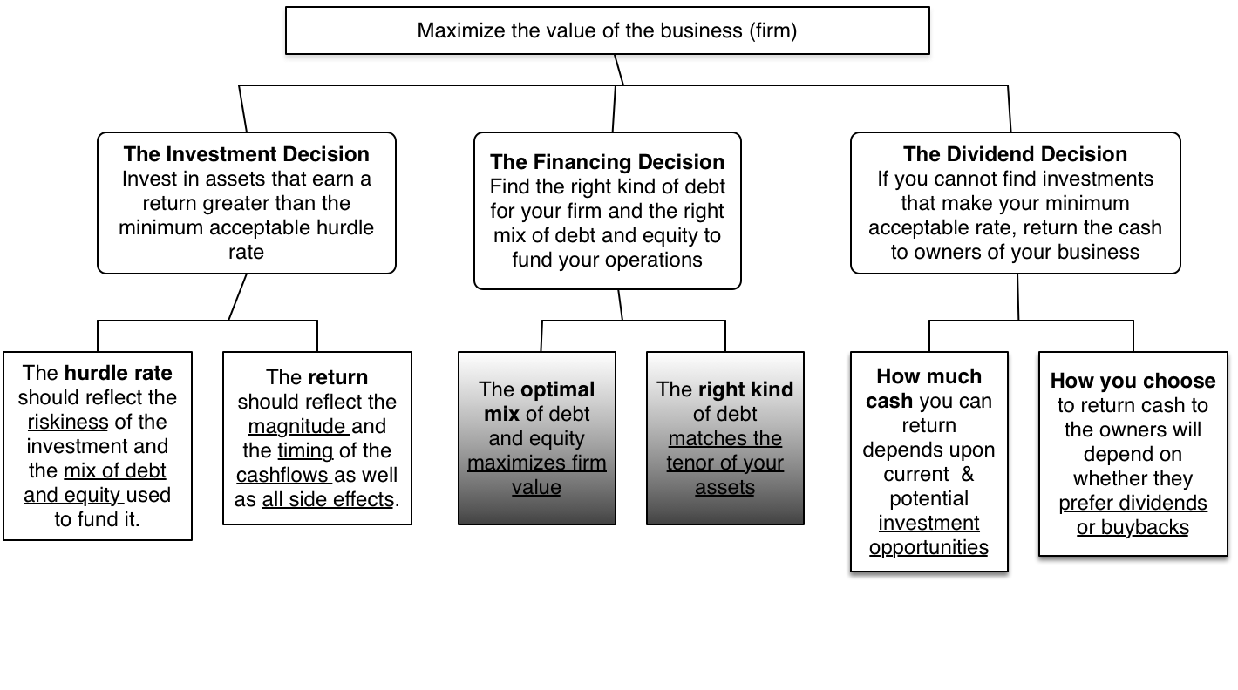
First principles
Notes:
We shift from the investment principle to the financing principle.

Slide 4
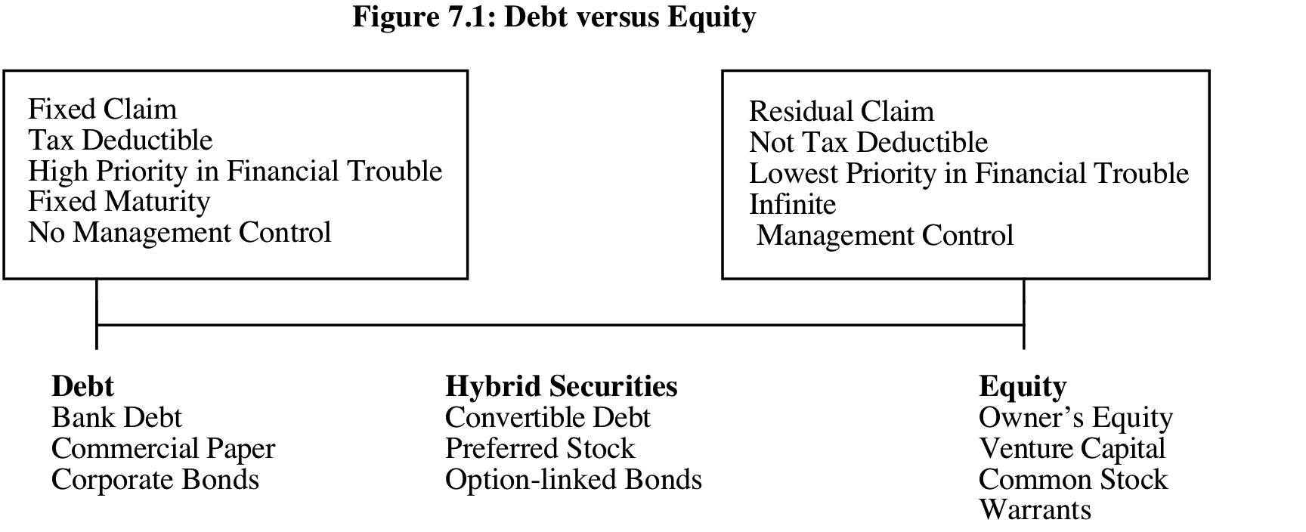
The Choices in Financing
There are only two ways in which a business can raise money.
  The first is debt. The essence of debt is that you promise to make fixed payments in the future (interest payments and repaying principal). If you fail to make those payments, you lose control of your business.
  The other is equity. With equity, you do get whatever cash flows are left over after you have made debt payments.
Notes:
Rather than categorizing financing based on what it is called or categorized as by accountants, we should be thinking whether financing is debt or equity by looking at the following questions:
1. Are the payments on the securities contractual or residual?
If contractually set, it is closer to debt.
If residual, it is closer to equity.
2. Are the payments tax-deductible?
If yes, it is closer to debt.
If no, if is closer to equity.
3. Do the cash flows on the security have a high priority or a low priority if the firm is in financial trouble?
If it has high priority, it is closer to debt.
If it has low priority, it is closer to equity.
4. Does the security have a fixed life?
If yes, it is closer to debt.
If no, it is closer to equity.
5. Does the owner of the security get a share of the control of management of the firm?
If no, it is closer to debt.
If yes, if is closer to equity

Slide 5
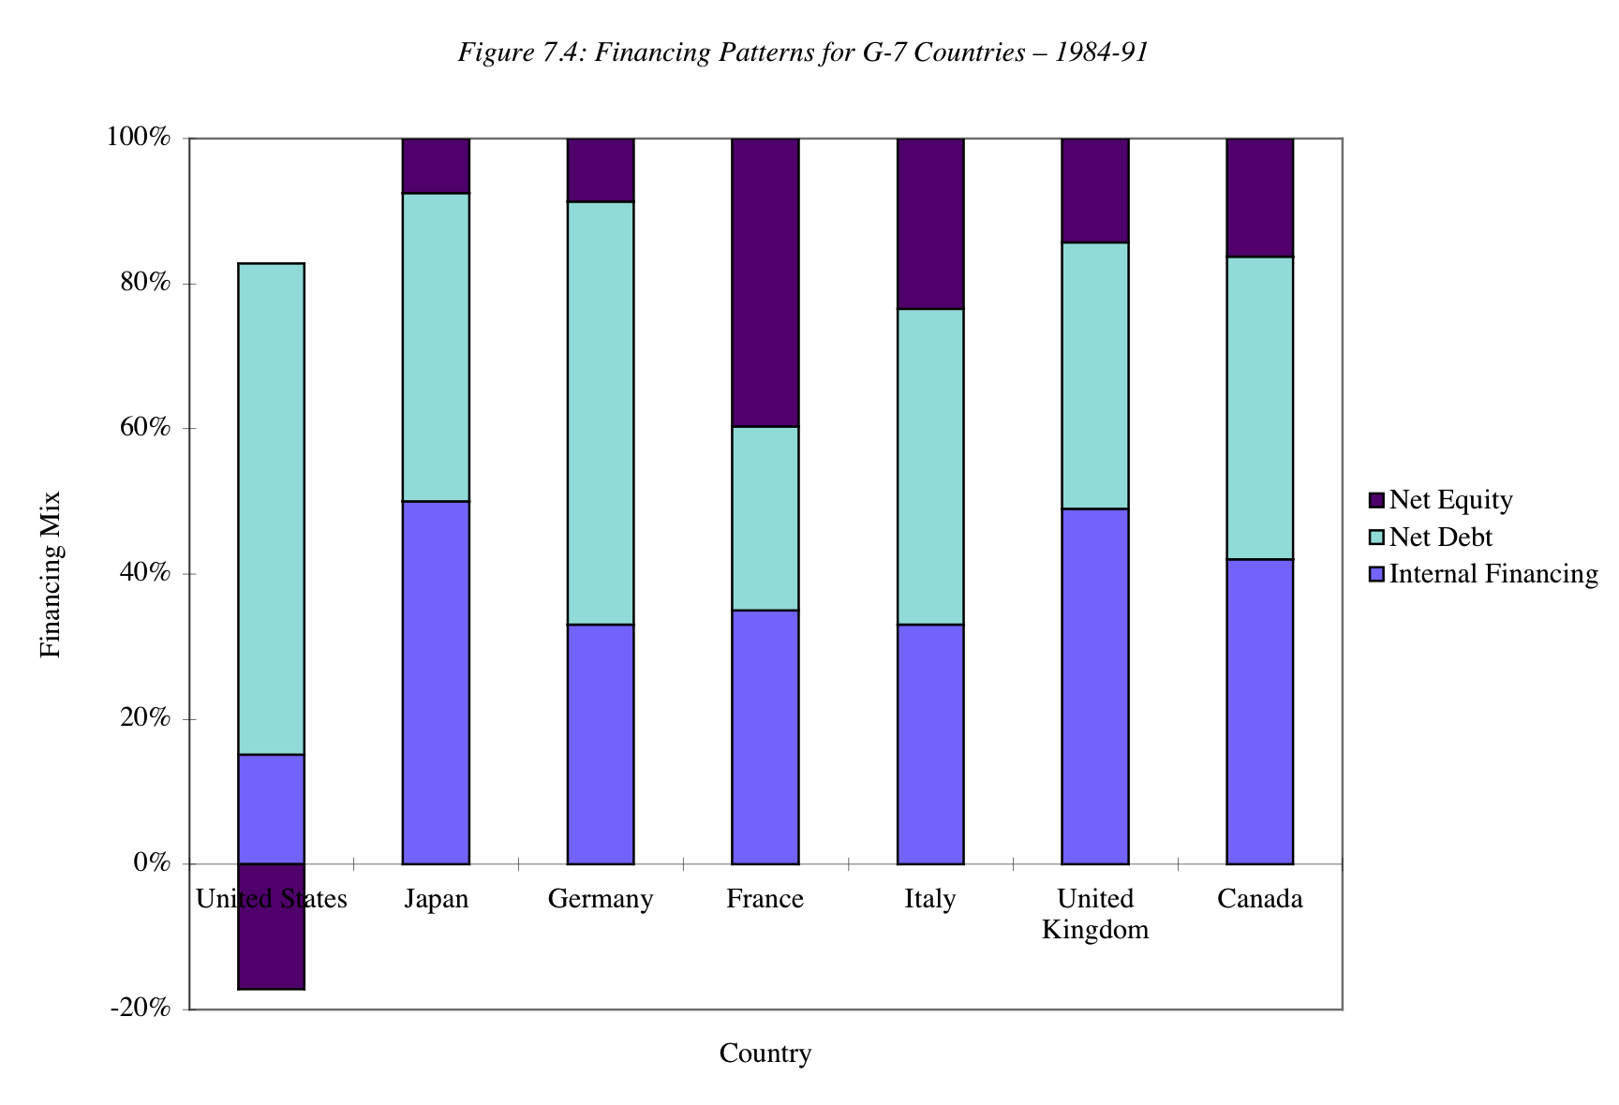
Global Patterns in Financing…
Notes:
Net equity refers to the difference between new equity issues and stock buybacks.
Firms in the United States, during the period of this comparison, bought back more stock than they issued, leading to negative net equity.
A comparison of financing patterns in the United States, Germany, and Japan reveals that German and Japanese firms were much more dependent on bank debt than firms in the United States, which are much likely to issue bonds.
Things are starting to change as corporate bond markets have expanded in Europe and even in some emerging markets.

Slide 6
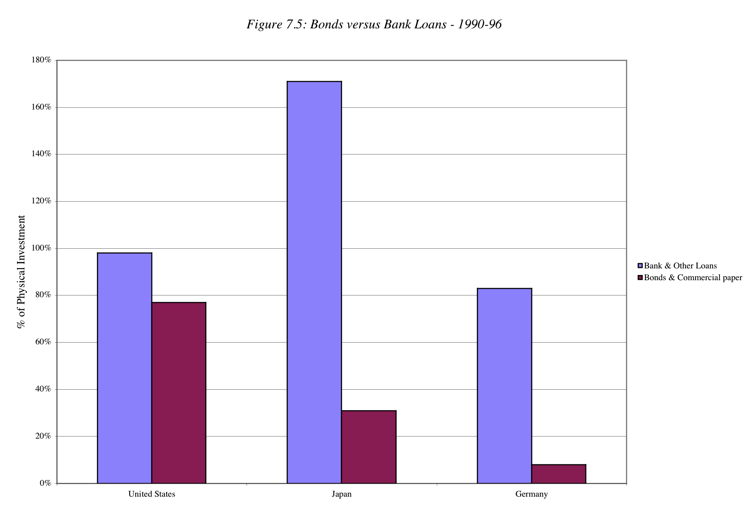
And a much greater dependence on bank loans outside the US…
Notes:
When borrowing money, US companies have historically had more access to bond markets than firms in other markets which are far more dependent on banks.
Interesting follow up questions:
If you can issue bonds, why would you use bank loans instead? (Answer: You may be able to supply proprietary information to a bank that you could not make public…. Special relationships with banks…)
In markets where there is no choice and you have to borrow from a bank, would you expect see lower debt ratios? Higher interest rates? (Answer: Not necessarily, but access to debt may be available only to well established firms that have long-standing relationships with banks. Smaller and younger firms may find themselves shut out of the process..)

Slide 7
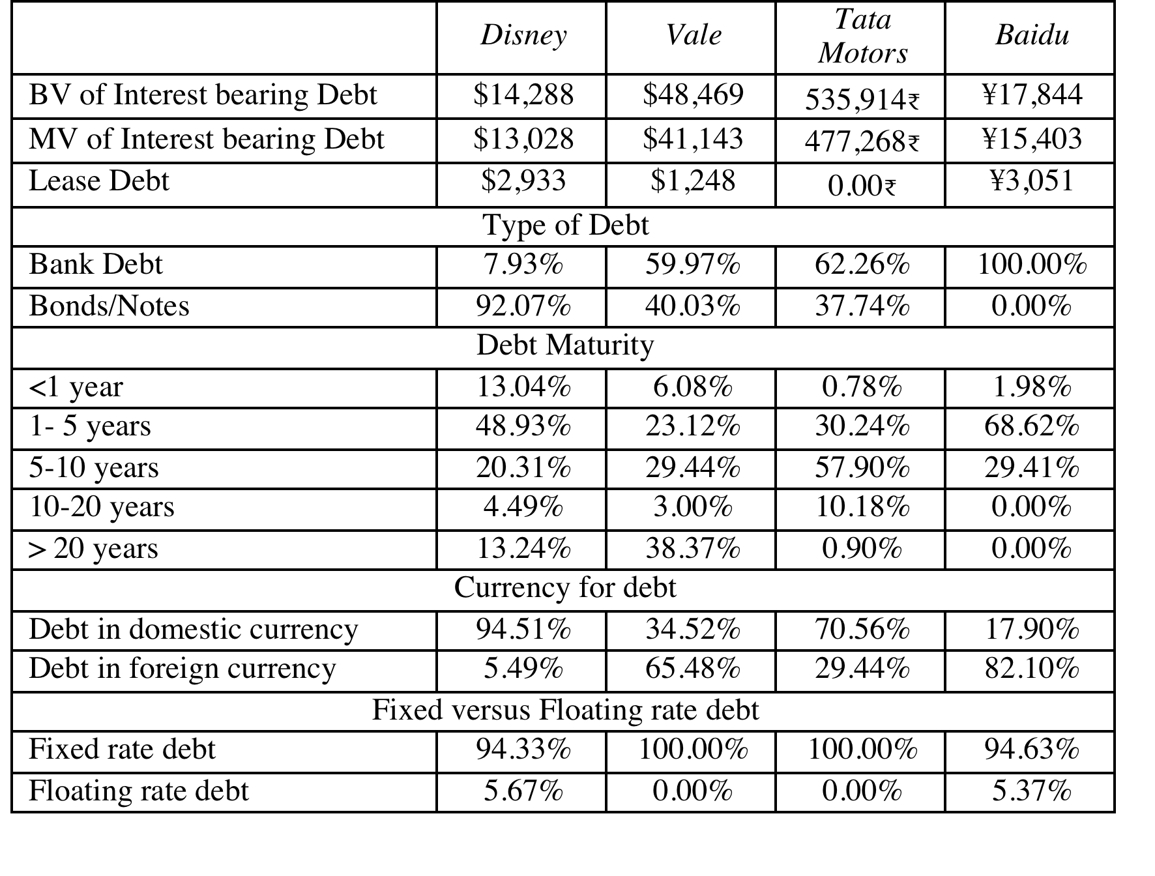
Assessing the existing financing choices: Disney, Vale, Tata Motors, Baidu & Bookscape
Notes:
Disney used the corporate bond market much more extensively than the other companies, with 92% of its debt taking the form of bonds, reflecting both its standing as a large market capitalization company and its access to capital markets as a US-based company.
While Disney has the higher proportion of short term debt of the three companies, it is the only one of the three companies with debt maturing in more than 10 years. That may also be a reflection of its use of the bond market, since banks, especially in emerging markets, may be unwilling to commit to long term loans.
Disney is the only one of the three companies any floating rate debt, where the interest will vary across time, as a function of index rates (LIBOR, in the case of Disney).

Slide 8
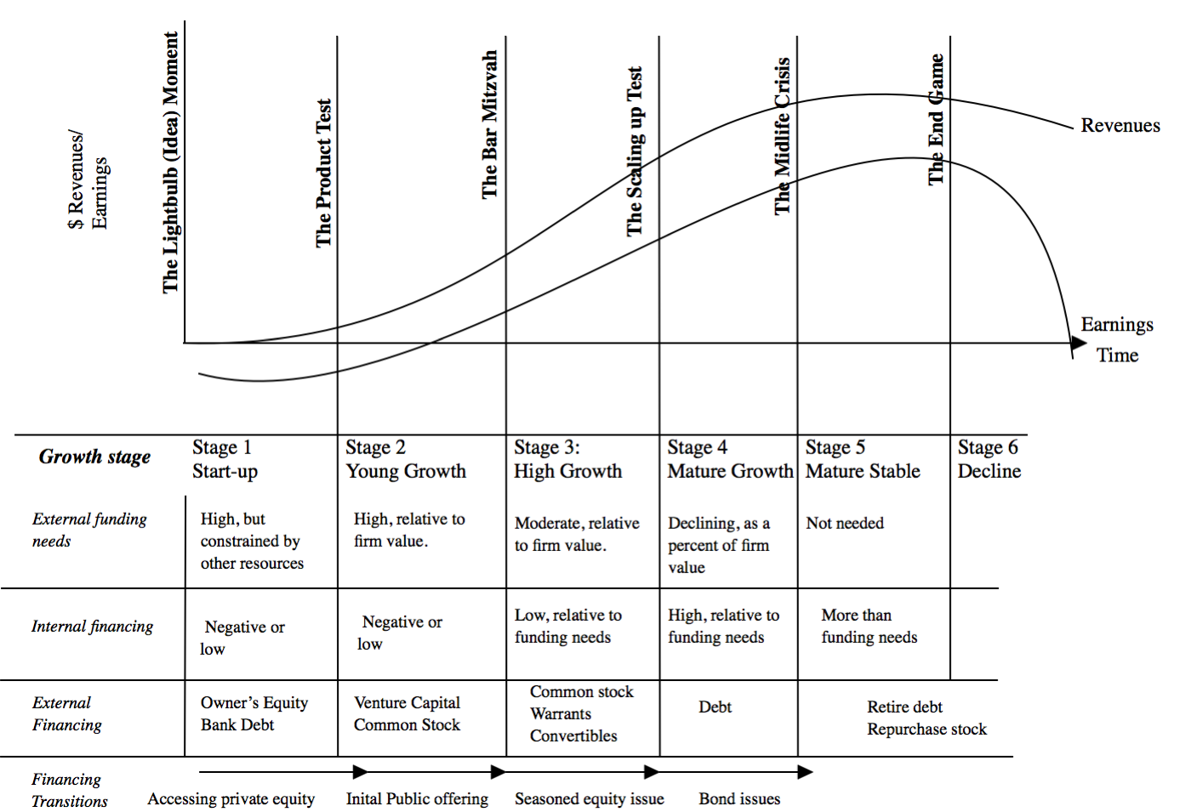
Notes:
The forms that debt and equity take will change as a firm moves through its lifecycle. Early in the process, equity will take the form of owner’s wealth or savings and debt will be bank debt. As the firm evolves, the equity choices will expand first to include venture capital and private equity. When the firm goes public, its choices expand further.
There are three transitional periods: (1) Going from being a private business entirely funded by the owner to accessing the private equity markets (venture capital) (2) Going from private to public with an initial public offering and (3) Public companies making seasoned offerings of debt and equity.

Slide 9
The Transitional Phases..
The transitions that we see at firms – from fully owned private businesses to venture capital, from private to public and subsequent seasoned offerings are all motivated primarily by the need for capital.
In each transition, though, there are costs incurred by the existing owners:
  When venture capitalists enter the firm, they will demand their fair share and more of the ownership of the firm to provide equity.
  When a firm decides to go public, it has to trade off the greater access to capital markets against the increased disclosure requirements (that emanate from being publicly lists), loss of control and the transactions costs of going public.
  When making seasoned offerings, firms have to consider issuance costs while managing their relations with equity research analysts and rat
Notes:
As a firm goes through the lifecycle, there are usually three transition points worth watching…
Note, though, that whether and when these transition points occur can vary widely across firms. For some firms like Google and Amazon, the transition from owner funded businesses to large publicly traded companies was speedy. Other firms, like Cargill and Koch, never make the transition and stay privately owned businesses as they grow, using internal funding to grow over time. Still others never make it to the transitional phases and fade away, go bankrupt or are acquired.

Slide 10
Measuring a firm’s financing mix …
The simplest measure of how much debt and equity a firm is using currently is to look at the proportion of debt in the total financing. This ratio is called the debt to capital ratio:
Debt to Capital Ratio = Debt / (Debt + Equity)
Debt includes all interest bearing liabilities, short term as well as long term. It should also include other commitments that meet the criteria for debt: contractually pre-set payments that have to be made, no matter what the firm’s financial standing.
Equity can be defined either in accounting terms (as book value of equity) or in market value terms (based upon the current price). The resulting debt ratios can be very different.
Notes:
The difference between book value and market value debt ratios can give rise to problems. For instance, most published debt ratios are book value debt ratios and many analysts talk about book debt ratios when talking about financial leverage. When firms raise financing, though, they do so in market value terms.
When “debt ratios” are used in analysis, it is best to define them up front. For the rest of this analysis, we will debt ratio to mean market value, total debt ratios, with debt including the present value of operating lease commitments.

Slide 11
The Financing Mix Question
In deciding to raise financing for a business, is there an optimal mix of debt and equity?
  If yes, what is the trade off that lets us determine this optimal mix?
      What are the benefits of using debt instead of equity?
      What are the costs of using debt instead of equity?
  If not, why not?
Notes:
This is the basic question that we will cover in the first part of the analysis.

Slide 12
The Illusory Benefits of Debt
At first sight, the benefit of debt seems obvious. The cost of debt is lower than the cost of equity.
That benefit is an illusion, though, because debt is cheaper than equity for a simple reason. The lender gets both first claim on the cash flows and a contractually pre-set cash flow. The equity investor is last in line and has to demand a higher rate of return than the lender does.
By borrowing money at a lower rate, you are not making a business more valuable, but just moving the risk around.
Notes:
The analogy offered by Miller and Modigliani is apt. In a world with no tax benefits to debt, a business that borrows money is akin to taking whole milk and separating it into butter and fat-free milk. The overall fat in the milk don’t change, but the apportionment does. In practical terms, the overall cost of capital for a firm will remain unchanged as you borrow money, as the cost of equity rises to offset the benefits of using cheaper debt. That, of course, is the Milller-Modigliani theorem, but more on that later.

Slide 13
Costs and Benefits of Debt
Benefits of Debt
  Tax Benefits: The tax code is tilted in favor of debt, with interest payments being tax deductible in most parts of the world, while cash flows to equity are not.
  Adds discipline to management: When managers are sloppy in their project choices, borrowing money may make them less so.
Costs of Debt
  Bankruptcy Costs: Borrowing money will increase your expected probability and cost of bankruptcy.
  Agency Costs: What’s good for stockholders is not always what’s good for lenders and that creates friction and costs.
  Loss of Future Flexibility: Using up debt capacity today will mean that you will not be able to draw on it in the future.
Notes:
This summarizes the trade off that we make when we choose between using debt and equity. If the benefits exceed the costs, you should borrow. If not, it is better to use equity.

Slide 14
Tax Benefits of Debt
When you borrow money, you are allowed to deduct interest expenses from your income to arrive at taxable income. This reduces your taxes. When you use equity, you are not allowed to deduct payments to equity (such as dividends) to arrive at taxable income.
The dollar tax benefit from the interest payment in any year is a function of your tax rate and the interest payment:
  Tax benefit each year = Tax Rate * Interest Payment
  The caveat is that you need to have the income to cover interest payments to get this tax benefit.
Proposition 1: Other things being equal, the higher the marginal tax rate of a business, the more debt it will have in its capital structure.
Notes:
The tax benefit of debt will be lower if the tax code allows some or all of the cash flows to equity to be tax deductible, as well. For instance, in Germany, dividends paid to stockholders are taxed at a lower rate than retained earnings. In these cases, the tax advantage of debt will be lower.
If you do not pay taxes, debt becomes a lot less attractive. Carnival Cruise Lines, which gets most of its business from the United States pays no taxes because it is domiciled in Liberia. We would expect it to have less debt in its capital structure than a competitor in the US which pays taxes.
Implications:
Debt ratios for firms should go up as corporate tax rates increase.
Debt ratios of firms incorporated in high-tax locales should be higher than debt ratios of firms in low-tax or tax exempt locales.

Slide 15

The Effects of Taxes
You are comparing the debt ratios of real estate corporations, which pay the corporate tax rate, and real estate investment trusts, which are not taxed, but are required to pay 95% of their earnings as dividends to their stockholders. Which of these two groups would you expect to have the higher debt ratios?
The real estate corporations
The real estate investment trusts
Cannot tell, without more information
Notes:
I would expect real estate corporations to have more debt. The forced payout of 95% of earnings as dividends by REITs to their stockholders may expose their investors to substantial personal taxes, but the absence of taxes at the entity level will make debt a less attractive option.
In practice, REITs do use debt. On reason might be that they can borrow at a lower rate at the REIT level than at the property level. Another might be that they have views on the market pricing of their stock. If they feel that they are being under priced, they may choose to borrow money as bridge financing (until they feel their equity is fairly priced again).

Slide 16
Debt adds discipline to management
If you are managers of a firm with no debt, and you generate high income and cash flows each year, you tend to become complacent. The complacency can lead to inefficiency and investing in poor projects. There is little or no cost borne by the managers
Forcing such a firm to borrow money can be an antidote to the complacency. The managers now have to ensure that the investments they make will earn at least enough return to cover the interest expenses. The cost of not doing so is bankruptcy and the loss of such a job.
Notes:
Managers of publicly traded firms with substantial cash flows and little debt are much more protected from the consequences of their mistakes (especially when stockholders are powerless and boards toothless).
Left to themselves, managers (especially lazy ones) would rather run all-equity financed firms with substantial cash reserves.
There are two pieces of evidence that you can point to in support of this proposition.
First, poorly managed, poorly run firms, where managers are not significant stockholders, are more likely to be targeted for leveraged buyouts.
Second, there is evidence of improvements in operating efficiency at firms that increase their debt ratio substantially.

Slide 17
Debt and Discipline
Assume that you buy into this argument that debt adds discipline to management. Which of the following types of companies will most benefit from debt adding this discipline?
Conservatively financed (very little debt), privately owned businesses
Conservatively financed, publicly traded companies, with stocks held by millions of investors, none of whom hold a large percent of the stock.
Conservatively financed, publicly traded companies, with an activist and primarily institutional holding.
Notes:
Conservatively financed (Equity financed), publicly traded firms with a wide and diverse stockholding should be the best candidates for debt (with discipline as the argument)
Private firms should have the incentive to be efficient without debt, because the owner/manager has his or her wealth at stake.
Publicly traded firms with activist stockholders (like Michael Price) might not need debt to be disciplined. Investors looking over managers’ shoulders will keep them honest.

Slide 18
Bankruptcy Cost
The expected bankruptcy cost is a function of two variables--
  the probability of bankruptcy, which will depend upon how uncertain you are about future cash flows
  the cost of going bankrupt
    direct costs: Legal and other Deadweight Costs
    indirect costs: Costs arising because people perceive you to be in financial trouble
Proposition 2: Firms with more volatile earnings and cash flows will have higher probabilities of bankruptcy at any given level of debt and for any given level of earnings.
Proposition 3: Other things being equal, the greater the indirect bankruptcy cost, the less debt the firm can afford to use for any given level of debt.
Notes:
Studies (see Warner) seem to indicate that the direct costs of bankruptcy are fairly small (10% or less or firm value)
The indirect cost of going bankrupt comes from the perception that you are in financial trouble, which in turn affects sales and the capacity to raise credit. We would expect indirect bankruptcy costs to vary across firms and be higher at
a. Firms that sell durable products with long lives that require replacement parts and service
b. Firms that provide goods or services for which quality is an important attribute but is difficult to determine in advance.
c. Firms producing products whose value to customers depends on the services and complementary products supplied by independent companies
As an example, when Apple Computer was perceived to be in financial trouble in early 1997, first-time buyers and businesses stopped buying Apple computers and software firms stopped coming up with upgrades for Mac products.
Similarly, Kmart found that suppliers started demanding payments in 30 days instead of 60 days, when it got into financial trouble.
The probability of bankruptcy should be a function of the predictability (or variability) of earnings.

Slide 19
Debt & Bankruptcy Cost
Rank the following companies on the magnitude of bankruptcy costs from most to least, taking into account both explicit and implicit costs:
A Grocery Store
An Airplane Manufacturer
High Technology company
Notes:
I would expect a grocery store to have the lowest bankruptcy costs. Customers generally do not consider the rating or default risk of grocery stores when they shop, but they definitely do consider both when placing an order for an airplane.
Technology companies can have high bankruptcy costs, but the costs will vary depending upon what type of product they produce. A PC manufacturer might be affected more than someone who manufacturers software; a company which serves businesses might be affected more than one which creates games for children.

Slide 20
Agency Cost
An agency cost arises whenever you hire someone else to do something for you. It arises because your interests(as the principal) may deviate from those of the person you hired (as the agent).
When you lend money to a business, you are allowing the stockholders to use that money in the course of running that business. Stockholders interests are different from your interests, because
  You (as lender) are interested in getting your money back
  Stockholders are interested in maximizing their wealth
In some cases, the clash of interests can lead to stockholders
  Investing in riskier projects than you would want them to
  Paying themselves large dividends when you would rather have them keep the cash in the business.
Proposition 4: Other things being equal, the greater the agency problems associated with lending to a firm, the less debt the firm can afford to use.
Notes:
What is good for equity investors might not be good for bondholders and lenders…. Equity investors describe the projects that they will be funding with debt as safe and secure. However…
A risky project, with substantial upside, may make equity investors happy, but they might cause bondholders, who do not share in the upside, much worse off.
Similarly, paying a large dividend may make stockholders happier but they make lenders less well off.
Lenders recognize this tendency and factor them into their lending by
charging a higher interest rate up front for the loan
Putting restrictive covenants on the loan
These create costs for the borrower.

Slide 21
Debt and Agency Costs
Assume that you are a bank. Which of the following businesses would you perceive the greatest agency costs?
A Technology firm
A Large Regulated Electric Utility
A Real Estate Corporation
Why?
Notes:
Lenders will probably perceive less agency costs in the regulated utility because:
The assets are tangible and easy to monitor (much easier to monitor a power plant than R&D)
The regulatory authorities will operate as brake on the investment activities of the utility and thus do the lender’s work for them.

Slide 22
Loss of future financing flexibility
When a firm borrows up to its capacity, it loses the flexibility of financing future projects with debt.
Thus, if the firm is faced with an unexpected investment opportunity or a business shortfall, it will not be able to draw on debt capacity, if it has alread used it up.
Proposition 5: Other things remaining equal, the more uncertain a firm is about its future financing requirements and projects, the less debt the firm will use for financing current projects.
Notes:
Firms like to preserve flexibility. The value of flexibility should be a function of how uncertain future investment requirements are, and the firm’s capacity to raise fresh capital quickly.
Firms with uncertain future needs and the inability to access markets quickly will tend to value flexibility the most, and borrow the least.

Slide 23
What managers consider important in deciding on how much debt to carry...
A survey of Chief Financial Officers of large U.S. companies provided the following ranking (from most important to least important) for the factors that they considered important in the financing decisions
  Factor Ranking (0-5)
  1. Maintain financial flexibility 4.55
  2. Ensure long-term survival 4.55
  3. Maintain Predictable Source of Funds 4.05
  4. Maximize Stock Price 3.99
  5. Maintain financial independence 3.88
  6. Maintain high debt rating 3.56
  7. Maintain comparability with peer group 2.47
Notes:
This survey suggests that financial flexibility (which is not explicitly allowed for in the trade off) is valued very highly. What implications does this have for whether firms will borrow as much as the trade off suggests they should?
What is financial flexibility? Flexibility to do what? What do we need to assume about access to capital markets for financial flexibility to have high value? What kinds of firms will value flexibility the most?
The flexibility that firms want to maintain is the flexibility to be able to fund that once in a lifetime investment that may come along or to protect themselves against that devastating downside risk…
If we assumed perfect capital markets, you would not need flexibility, which must imply that flexibility is valued most highly by firms with the least access to capital markets (private firms, small firms…)

Slide 24

Debt: Summarizing the trade off
Notes:
Brings together the costs and the benefits of debt, with the implications.

Slide 25
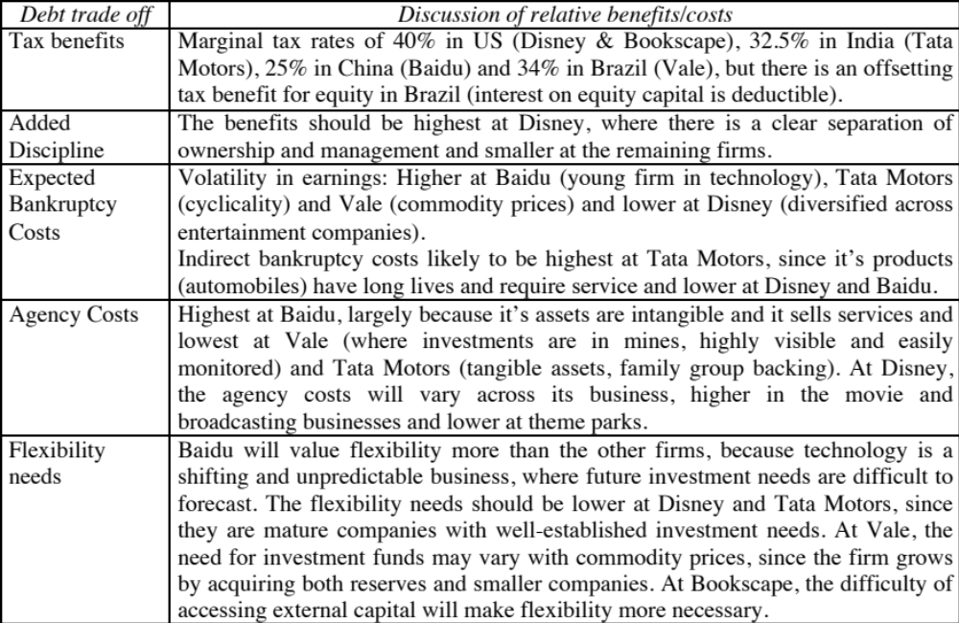
The Trade off for Disney, Vale, Tata Motors and Baidu
Notes:
None of these firms seems like a candidate for a really high debt ratio. With each firm, one or another cost gets in the way.
For Disney, the biggest impediments to borrowing more are the variability of its income and the fact that its assets are mostly “intangible” and difficult to monitor.
For Vale, it is the variability in commodity prices.
For Tata Motors, it is the cross holding structure and the fear that the debt will be channeled to other subsidiaries.
For Baidu, it is the fact that it is a young company with small cash flows (relative to market value).
Notwithstanding these issues, I would expect Disney to have more debt than other entertainment companies because it is larger and more diverse than its competitors. I would also expect to see significant debt on both Tata’s and Vale’s balance sheets, given the tax benefits.

Slide 26
6 Application Test: Would you expect your firm to gain or lose from using a lot of debt?
Considering, for your firm,
  The potential tax benefits of borrowing
  The benefits of using debt as a disciplinary mechanism
  The potential for expected bankruptcy costs
  The potential for agency costs
  The need for financial flexibility
Would you expect your firm to have a high debt ratio or a low debt ratio?
Does the firm’s current debt ratio meet your expectations?
Notes:
This is just a qualitative analysis. It will not give you a specific optimal debt ratio but provides insight into why the firm may be using the financing mix that it is today.

Slide 27
A Hypothetical Scenario
Assume that you live in a world where
  (a) There are no taxes
  (b) Managers have stockholder interests at heart and do what’s best for stockholders.
  (c) No firm ever goes bankrupt
  (d) Equity investors are honest with lenders; there is no subterfuge or attempt to find loopholes in loan agreements.
  (e) Firms know their future financing needs with certainty
What happens to the trade off between debt and equity? How much should a firm borrow?
Notes:
Assume that you super impose these assumptions on the balance sheet on the previous page. The advantages of debt go to zero, as do the disadvantages. Under such a scenario, firms should be indifferent to issuing debt.

Slide 28
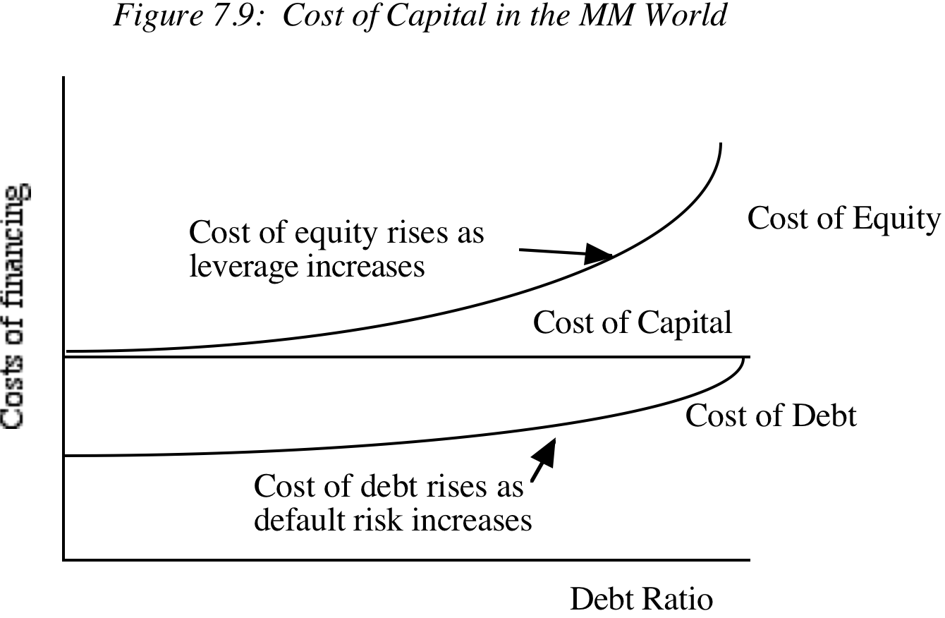
The Miller-Modigliani Theorem
In an environment, where there are no taxes, default risk or agency costs, capital structure is irrelevant.
If the Miller Modigliani theorem holds:
  A firm's value will be determined the quality of its investments and not by its financing mix.
  The cost of capital of the firm will not change with leverage. As a firm increases its leverage, the cost of equity will increase just enough to offset any gains to the leverage.
Notes:
With the assumptions on the previous page:
The cost of capital will remain unchanged as the debt ratio changes
The value of the firm will not be a function of leverage
Investment decisions can be made independently of financing decisions
Note that if we allow for tax benefits, and keep the other assumptions, the optimal debt ratio will go to 100%.

Slide 29
What do firms look at in financing?
There are some who argue that firms follow a financing hierarchy, with retained earnings being the most preferred choice for financing, followed by debt and that new equity is the least preferred choice. In particular,
  Managers value flexibility. Managers value being able to use capital (on new investments or assets) without restrictions on that use or having to explain its use to others.
  Managers value control. Managers like being able to maintain control of their businesses.
With flexibility and control being key factors:
  Would you rather use internal financing (retained earnings) or external financing?
  With external financing, would you rather use debt or equity?
Notes:
Firms have fairly strong preferences in terms of where they would like to raise capital. They seem to prefer internal over external sources of capital and new debt over new equity.
Managers make financing decisions, not stockholders. The survey results indicate that what they value will have consequences for what kind of financing gets used. And they seem to value flexibility and control…
What type of financing gives you the most flexibility and the least need to answer to anyone?
Internal financing or External financing (With internal financing, you do not have to file with the SEC or explain to investors what you plan to do with the money… you may, in hindsight, have to come up with a good story to tell your stockholders about why you retained earnings…)
New debt or new equity (If you do have to access external financing, it is a closer call. While new debt may come with covenants (which restrict your operating flexibility) and the need to explain your actions to ratings agencies or banks, issuing new equity requires filings with the SEC and the possible loss of control.

Slide 30
Preference rankings long-term finance: Results of a survey
Ranking
Source
Score
1
Retained Earnings
5.61
2
Straight Debt
4.88
3
Convertible Debt
3.02
4
External Common Equity
2.42
5
Straight Preferred Stock
2.22
6
Convertible Preferred
1.72
Notes:
Notice that
internal equity is vastly preferred to external equity.
straight debt over convertible debt,
debt over new common stock and
Any financing over preferred stock (Is that due to debt having a tax advantage?)

Slide 31
And the unsurprising consequences..
Notes:
At US companies, internal financing has comprised the bulk of financing over much of history. When raising external funds from markets, firms are far more likely to use debt than equity….

Slide 32
Financing Choices
You are reading the Wall Street Journal and notice a tombstone ad for a company, offering to sell convertible preferred stock. What would you hypothesize about the health of the company issuing these securities?
Nothing
Healthier than the average firm
In much more financial trouble than the average firm
Notes:
I would expect the firm to be in much more financial trouble than the average firm. Why else would it use convertible preferred stock when it could have used an alternate source of financing?
The stock price response to the issue of securities seems to mirror this financing hierarchy, with new bond issues eliciting more positive stock price responses than new stock issues.

Slide 33
Capital Structure:
Finding the Right Financing Mix
You can have too much debt… or too little..
Notes:
While we can talk about the trade off between debt and equity in qualitative terms, ultimately we have to get down to the details. In this section, we will look at approaches that can be used to estimate the right debt ratio for a firm.

Slide 34
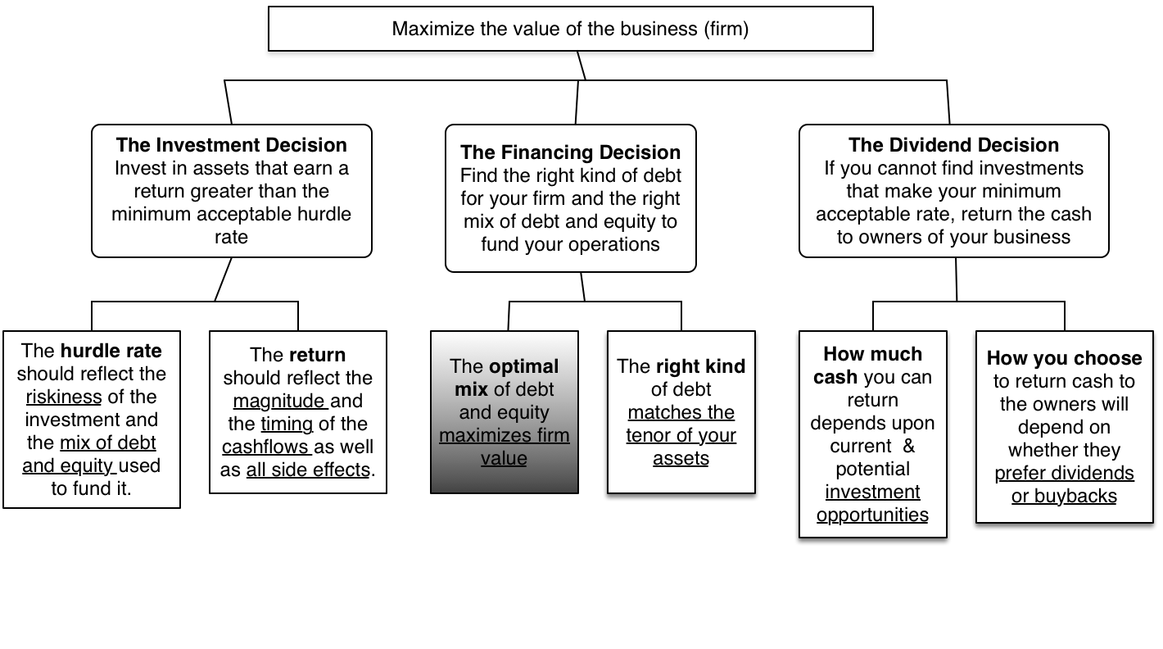
The Big Picture..
Notes:
Is there an optimal mix? And can we find it for a given firm? Time to get down to pragmatic questions.

Slide 35
Pathways to the Optimal
The Cost of Capital Approach: The optimal debt ratio is the one that minimizes the cost of capital for a firm.
The Enhanced Cost of Capital approach: The optimal debt ratio is the one that generates the best combination of (low) cost of capital and (high) operating income.
The Adjusted Present Value Approach: The optimal debt ratio is the one that maximizes the overall value of the firm.
The Sector Approach: The optimal debt ratio is the one that brings the firm closes to its peer group in terms of financing mix.
The Life Cycle Approach: The optimal debt ratio is the one that best suits where the firm is in its life cycle.
Notes:
We will look at all five approaches, though they may yield different results.

Slide 36
I. The Cost of Capital Approach
Value of a Firm = Present Value of Cash Flows to the Firm, discounted back at the cost of capital.
If the cash flows to the firm are held constant, and the cost of capital is minimized, the value of the firm will be maximized.
Notes:
This is the conventional valuation model for a firm.
If the cash flows are the same, and the discount rate is lowered, the present value has to go up. (The key is that cash flows have to remain the same. If this is not true, then minimizing cost of capital may not maximize firm value)

Slide 37
Measuring Cost of Capital
Recapping our discussion of cost of capital:
The cost of debt is the market interest rate that the firm has to pay on its long term borrowing today, net of tax benefits. It will be a function of:
  (a) The long-term riskfree rate
  (b) The default spread for the company, reflecting its credit risk
  (c) The firm’s marginal tax rate
The cost of equity reflects the expected return demanded by marginal equity investors. If they are diversified, only the portion of the equity risk that cannot be diversified away (beta or betas) will be priced into the cost of equity.
The cost of capital is the cost of each component weighted by its relative market value.
Cost of capital = Cost of equity (E/(D+E)) + After-tax cost of debt (D/(D+E))
Notes:
The cost of equity reflects the non-diversifiable risk in a business and the cost of debt is the rate at which a business can borrow today. In a sense, this is what it would cost you to refinance the entire firm from scratch today.
The cost of capital is the weighted average of the cost of all the different sources of financing.
Note that there are only two components in the computation – debt and equity. But what about hybrids?
a. Convertible debt: It is best to break convertible debt into its debt and equity components, with the bond portion being treated as debt and the conversion option as equity.
b. Preferred stock is messier. It is not debt (because preferred dividends are not tax deductible) and not equity (because preferred dividends are fixed). There are two ways of dealing with it:
Treat it as a third item on the cost of capital computation, with its own cost. The simplest measure of this cost is the preferred dividend yield. (Preferred dividend/Preferred stock price)
Treat it as debt but gross up the amount to reflect the absence of tax advantages on preferred dividends. Thus, $ 100 million in preferred stock, when the marginal tax rate is 40% can be grossed up as follows:
Grossed up value = 100/(1-.4) = 166.67 million

Slide 38
Costs of Debt & Equity
An article in an Asian business magazine argued that equity was cheaper than debt, because dividend yields are much lower than interest rates on debt. Do you agree with this statement?
Yes
No
Can equity ever be cheaper than debt?
Yes
No
Notes:
No. Dividend yields are only a portion of what you have to deliver to equity investors to keep them satisfied (To which, the Asian manager might well respond: What if they are not satisfied? What can the do to me? The more power stockholders have over managers, the more likely it is that they will subscribe to viewing cost of equity as including dividend yield and price appreciation)
Equity can never be cheaper than debt for any firm at any stage in its life cycle, since equity investors always stand behind debt holders in line when it comes to claims on cash flows (each year) and on assets (on liquidation). I know.. I know.. There is one exception. If you have a company with a negative or very low beta, its cost of equity may be so low that it is lower than the default-risk adjusted cost of debt. Such a company should never borrow money in the first place, making the exception moot.

Slide 39
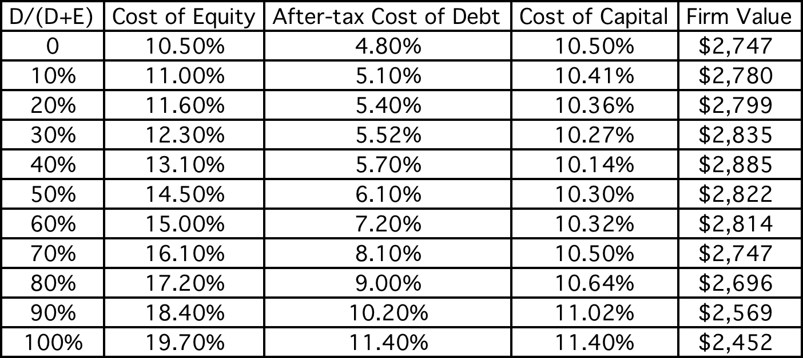
Applying Cost of Capital Approach: The Textbook Example
Assume the firm has $200 million in cash flows, expected to grow 3% a year forever.
Notes:
This is a simple example, where both the costs of debt and equity are given. The firm has cash flows, before debt and after taxes and reinvestment, of $200 million and is in stable growth (growing 3% a year). Note that both increase as the debt ratio goes up, but the cost of capital becomes lower at least initially as you take on more debt ( because you are substituting in cheaper debt for more expensive equity)
At 40%, the cost of capital is minimized. It is the optimal debt ratio.
To get firm value, we used the same cash flow ($200 million) and same growth rate and changed the cost of capital.

Slide 40
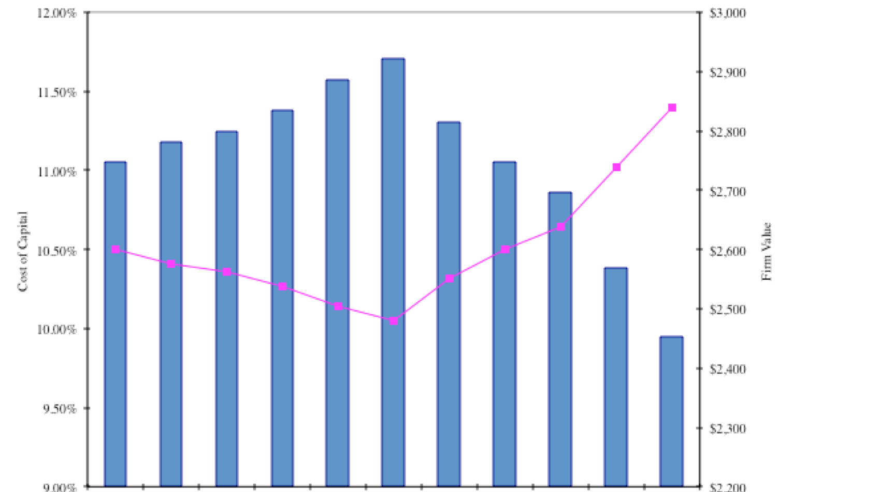
The U-shaped Cost of Capital Graph…
Notes:
Really adds nothing to the previous page.. But it is in every text book… the famous U-shaped cost of capital graph..
If you had this graph available to you, the optimal capital structure would be obvious. In most firms, all we know at the time we begin the analysis is one point on the graph - the current cost of capital. Our challenge is fleshing out the rest of the graph.

Slide 41
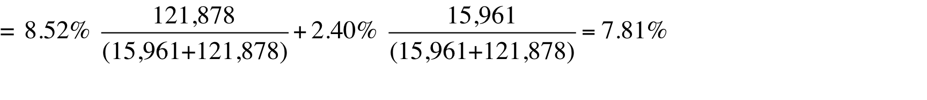
Current Cost of Capital: Disney
The beta for Disney’s stock in November 2013 was 1.0013. The T. bond rate at that time was 2.75%. Using an estimated equity risk premium of 5.76%, we estimated the cost of equity for Disney to be 8.52%:
Cost of Equity = 2.75% + 1.0013(5.76%) = 8.52%
Disney’s bond rating in May 2009 was A, and based on this rating, the estimated pretax cost of debt for Disney is 3.75%. Using a marginal tax rate of 36.1, the after-tax cost of debt for Disney is 2.40%.
After-Tax Cost of Debt = 3.75% (1 – 0.361) = 2.40%
The cost of capital was calculated using these costs and the weights based on market values of equity (121,878) and debt (15.961):
Cost of capital =
Notes:
The one point we do know for Disney…
This reproduces the current cost of capital computation for Disney, using market value weights for both debt and equity, the cost of equity (based upon the bottom-up beta) and the cost of debt (based upon the bond rating)
The market value of debt is estimated by estimating the present value of total interest payments and face value at the current cost of debt.
One way to frame the capital structure question: Is there a mix of debt and equity at which Disney’s cost of capital will be lower than 7.81%?

Slide 42
Mechanics of Cost of Capital Estimation
1. Estimate the Cost of Equity at different levels of debt:
  Equity will become riskier -> Beta will increase -> Cost of Equity will increase.
  Estimation will use levered beta calculation
2. Estimate the Cost of Debt at different levels of debt:
  Default risk will go up and bond ratings will go down as debt goes up -> Cost of Debt will increase.
  To estimating bond ratings, we will use the interest coverage ratio (EBIT/Interest expense)
3. Estimate the Cost of Capital at different levels of debt
4. Calculate the effect on Firm Value and Stock Price.
Notes:
The basic inputs for computing cost of capital are cost of equity and cost of debt. This summarizes the basic approach we will use to estimate each.

Slide 43
Laying the groundwork:
1. Estimate the unlevered beta for the firm
The Regression Beta: One approach is to use the regression beta (1.25) and then unlever, using the average debt to equity ratio (19.44%) during the period of the regression to arrive at an unlevered beta.
  Unlevered beta = = 1.25 / (1 + (1 - 0.361)(0.1944))= 1.1119
The Bottom up Beta: Alternatively, we can back to the source and estimate it from the betas of the businesses.
Business | Revenues | EV/Sales | Value of Business | Proportion of Disney | Unlevered beta | Value | Proportion
Media Networks | $20,356 | 3.27 | $66,580 | 49.27% | 1.03 | $66,579.81 | 49.27%
Parks & Resorts | $14,087 | 3.24 | $45,683 | 33.81% | 0.70 | $45,682.80 | 33.81%
Studio Entertainment | $5,979 | 3.05 | $18,234 | 13.49% | 1.10 | $18,234.27 | 13.49%
Consumer Products | $3,555 | 0.83 | $2,952 | 2.18% | 0.68 | $2,951.50 | 2.18%
Interactive | $1,064 | 1.58 | $1,684 | 1.25% | 1.22 | $1,683.72 | 1.25%
Disney Operations | $45,041 |  | $135,132 | 100.00% | 0.9239 | $135,132.11 | 100.00%
Notes:
Since we will be changing the debt ratio, we need to estimate the beta of Disney’s businesses… We can then use this unlevered beta to get to the beta at every debt ratio.

Slide 44
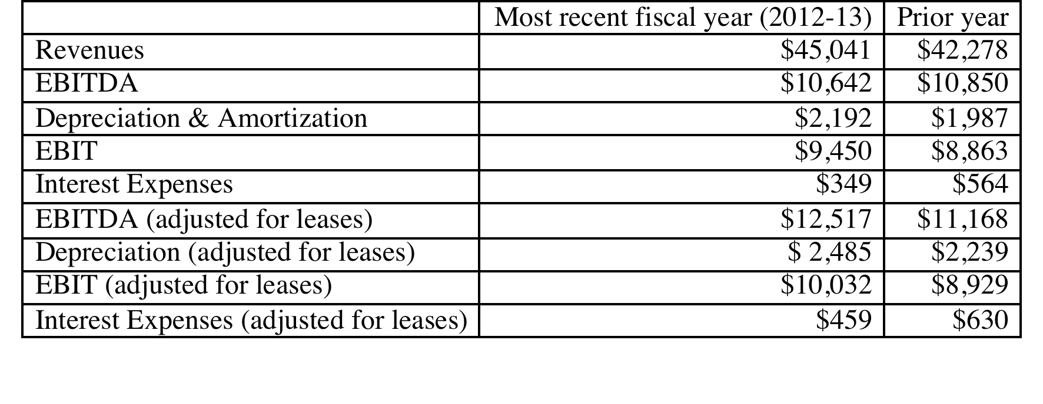
2. Get Disney’s current financials…
Notes:
This is a key step, Since you are determining your firm’s capacity to borrow long term, this is the stage at which you can modify these numbers to reflect the firm’s long term earning capacity rather than the vagaries of a single year of operations. With commodity companies, you may choose to use an average income across a commodity price cycle.
These numbers also reflect our efforts to bring leases into the financial expense column and to treat lease commitments as debt.

Slide 45
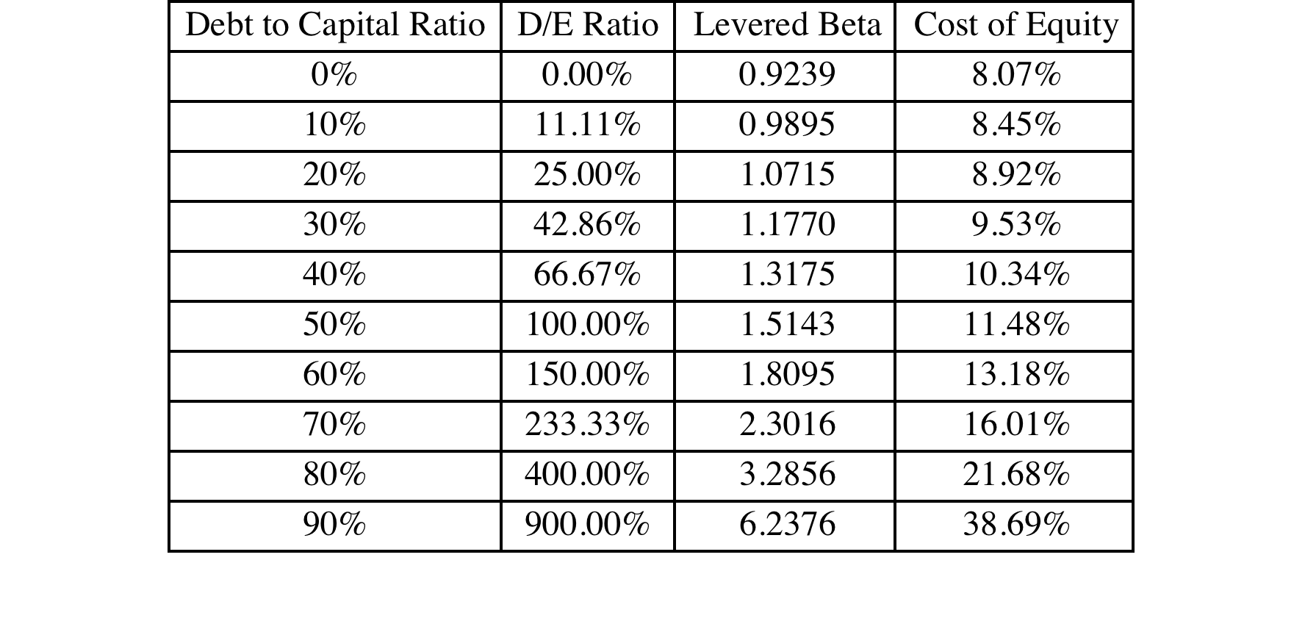
I. Cost of Equity
Levered Beta = 0.9239 (1 + (1- .361) (D/E))
Cost of equity = 2.75% + Levered beta * 5.76%
Notes:
This reproduces the levered beta, using the formula developed during the risk and return section. The unlevered beta of 1.0674 is the bottom-up unlevered beta.
Beta_{Levered} = Unlevered Beta (1 + (1-t) (Debt/Equity Ratio)) In calculating the levered beta in this table, we assumed that all market risk is borne by the equity investors; this may be unrealistic especially at higher levels of debt. We will also consider an alternative estimate of levered betas that apportions some of the market risk to the debt:
β_{levered} = β_{u} [1+(1-t)D/E] - β_{debt} (1-t) D/E
The beta of debt is based upon the rating of the bond and is estimated by regressing past returns on bonds in each rating class against returns on a market index. The levered betas estimated using this approach will generally be lower than those estimated with the conventional model

Slide 46
Estimating Cost of Debt
Start with the market value of the firm = = 121,878 + $15,961 = $137,839 million
D/(D+E) 0.00% 10.00% Debt to capital
D/E 0.00% 11.11% D/E = 10/90 = .1111
$ Debt $0 $13,784 10% of $137,839
EBITDA $12,517 $12,517 Same as 0% debt
Depreciation $ 2,485 $ 2,485 Same as 0% debt
EBIT $10,032 $10,032 Same as 0% debt
Interest $0 $434 Pre-tax cost of debt * $ Debt
Pre-tax Int. cov ∞ 23.10 EBIT/ Interest Expenses
Likely Rating AAA AAA From Ratings table
Pre-tax cost of debt 3.15% 3.15% Riskless Rate + Spread
Notes:
This is a manual computation of the cost of debt. Note the circularity in the argument, since the interest expense is needed to compute the rating, and the rating is needed to compute the cost of debt.
To get around the circularity, I start the 10% debt ratio calculation assuming that my cost of debt is the same as it was at 0% (which is 4.75%) and that my starting firm value (market value of equity + debt) remains my firm value. While neither assumption is realistic, we can revisit these numbers in subsequent iterations, if necessary.
We assume that whatever is borrowed is used to buy back equity, and that the operating assets of the firm remain unchanged (EBITDA and EBIT don’t change…). This allows us to isolate the effect of the recapitalization.

Slide 47
The Ratings Table
Interest coverage ratio is | Rating is | Spread is | Interest rate
> 8.50 | Aaa/AAA | 0.40% | 3.15%
6.5 – 8.5 | Aa2/AA | 0.70% | 3.45%
5.5 – 6.5 | A1/A+ | 0.85% | 3.60%
4.25 – 5.5 | A2/A | 1.00% | 3.75%
3 – 4.25 | A3/A- | 1.30% | 4.05%
2.5 -3 | Baa2/BBB | 2.00% | 4.75%
2.25 –2.5 | Ba1/BB+ | 3.00% | 5.75%
2 – 2.25 | Ba2/BB | 4.00% | 6.75%
1.75 -2 | B1/B+ | 5.50% | 8.25%
1.5 – 1.75 | B2/B | 6.50% | 9.25%
1.25 -1.5 | B3/B- | 7.25% | 10.00%
0.8 -1.25 | Caa/CCC | 8.75% | 11.50%
0.65 – 0.8 | Ca2/CC | 9.50% | 12.25%
0.2 – 0.65 | C2/C | 10.50% | 13.25%
<0.2 | D2/D | 12.00% | 14.75%
T.Bond rate =2.75%
Notes:
These are interest coverage ratio/ratings classes for large manufacturing firms (Market cap > $ 5 billion) and the default spreads at the time of the analysis. This is the default spread over and above the long term (10 year) treasury bond rate at the time of this analysis.
These default spreads can be obtained in one of two ways:
Getting a sampling of liquid bonds within each ratings class and averaging out their yields to maturity.
Finding a source that provides default spreads by ratings class (bondsonline.com used to provide these for free but now requires a fee)
The interest coverage ratio needs to be much higher for smaller firms to get similar ratings. (See ratings.xls spreadsheet)
Special cases:
If you have no interest expenses, your interest coverage ratio will be infinite: AAA rating (does not matter anyway, since you probably have no debt)
2. If you have negative operating income, interest coverage ratio is negative: D rating. You may want to modify by using average operating income over last few years.

Slide 48
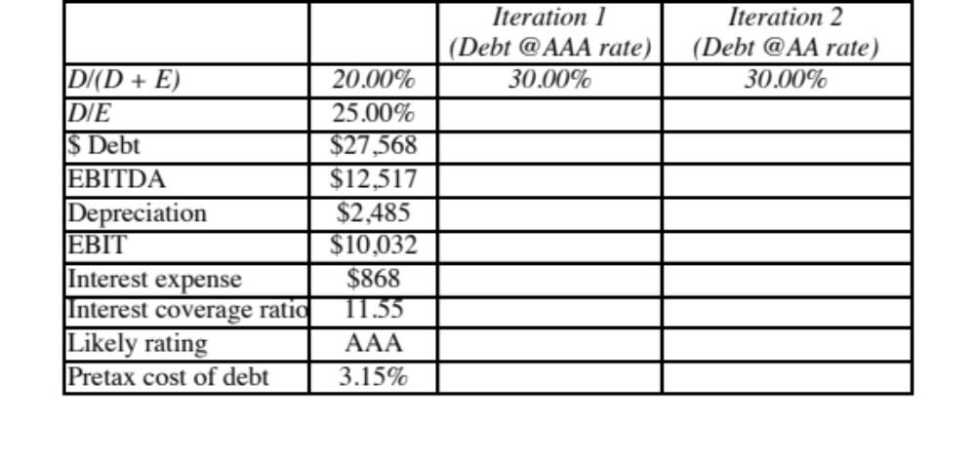
A Test: Can you do the 30% level?
Notes:
You have to start by assuming the AAA rate but you will end up with a rating that is different (AA)
You can redo the analysis using the AA rate and you can stop because you end up with the same rating at the end. (Sometimes you will need a third iteration).

Slide 49
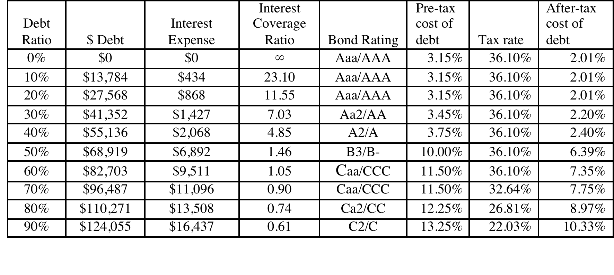
Bond Ratings, Cost of Debt and Debt Ratios
Notes:
This is the completed schedule of interest coverage ratios, ratings and costs of debt at different debt ratios ranging up to 90%.
It is significant that EBITDA not change as the debt ratio goes up. The reason is that the new debt is not used to make the firm larger by taking new projects, but to buy back equity. (This isolates the effect of the financing decision on the value of the firm)
We are being simplistic in assuming that the interest coverage ratio solely determines the ratings. We could use more than one ratio, create a consolidated score (like the Altman Z score) and make the rating a function of this score.
Note that the effective tax rate decreases after the 80% debt ratio. That is because we have insufficient income to cover the entire interest expense beyond that point. (EBIT < Interest Expenses) We therefore lose some of the tax advantage of borrowing.

Slide 50
Stated versus Effective Tax Rates
You need taxable income for interest to provide a tax savings. Note that the EBIT at Disney is $10,032 million. As long as interest expenses are less than $10,032 million, interest expenses remain fully tax-deductible and earn the 36.1% tax benefit. At an 60% debt ratio, the interest expenses are $9,511 million and the tax benefit is therefore 36.1% of this amount.
At a 70% debt ratio, however, the interest expenses balloon to $11,096 million, which is greater than the EBIT of $10,032 million. We consider the tax benefit on the interest expenses up to this amount:
  Maximum Tax Benefit = EBIT * Marginal Tax Rate = $10,032 million * 0.361 = $ 3,622 million
  Adjusted Marginal Tax Rate = Maximum Tax Benefit/Interest Expenses = $3,622/$11,096 = 32.64%
Notes:
We are being conservative. The interest that is not tax deductible can be carried forward and will probably earn some tax benefit in future periods.
Given that this is a permanent change in capital structure, however, it seems to be more conservative to just look at the interest expenses that provide a tax benefit in the current period.

Slide 51
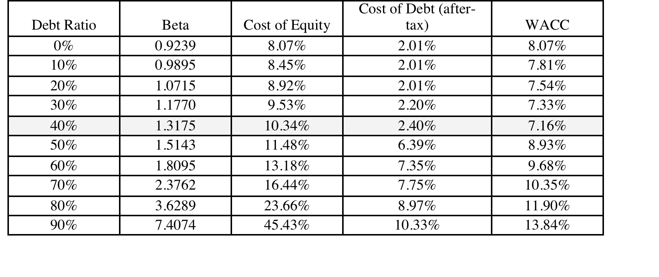
Disney’s cost of capital schedule…
Notes:
Summarizes the cost of equity and debt from prior pages, as well as the cost of capital at different debt ratios.
If the objective is to minimize cost of capital, it occurs at 30 and 40%... We did try for a more precise answer by working in 1% increments and arrived at an optimal of 43% with a cost of capital of 7.28%. (We moved in 1% increments from 30% top 50%)
This will maximize firm value, if operating cashflow (EBITDA) is unaffected by changes in leverage and the consequent changes in ratings. (In other words, we are assuming no indirect bankruptcy costs… If we did, the optimal might be affected, especially if it is at low rating).

Slide 52
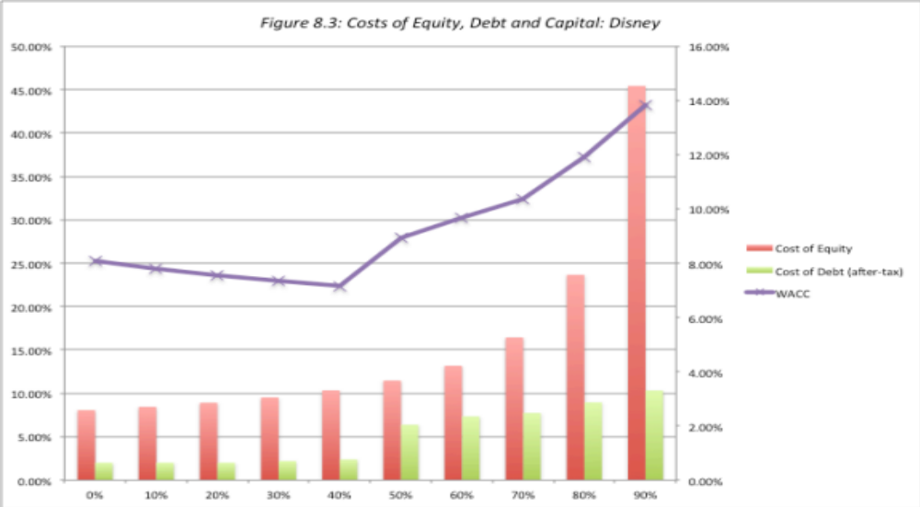
Disney: Cost of Capital Chart
Notes:
The cost of capital is minimized at 40% but notes that the cost of capital does not rise smoothly. Note that surge in cost of capital just beyond 40%. This is not unusual and represents a tipping point, where you go from being comfortable with your debt to pushing the limit…. Interest coverage ratios decrease, pushing up the cost of debt, pushing up interest expenses, pushing down interest coverage ratios, thus creating a spiral.
For those who may still be fixated on the assuming that we made that debt has a zero beta, when computing levered betas, we re-estimated the optimal allowing debt to have a beta (We backed into a beta for debt by taking the default spread at debt rating, assuming that 25% of that spread was due to market risk and estimating an imputed beta)

Slide 53
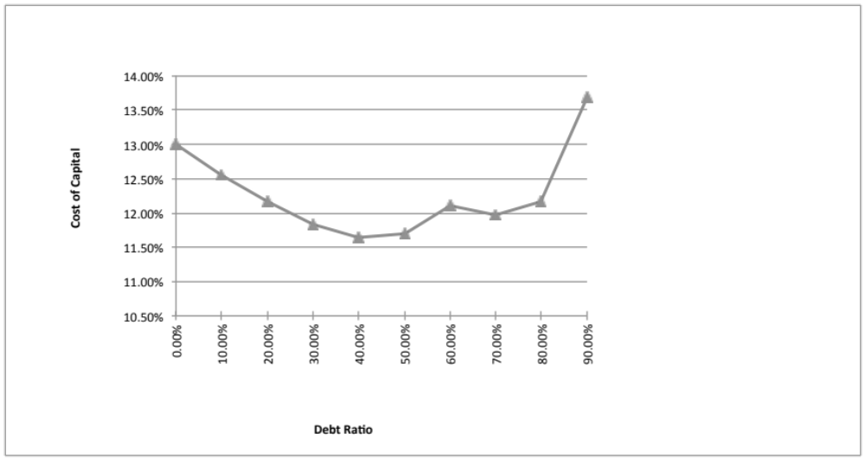
Disney: Cost of Capital Chart: 1997
Note the kink in the cost of capital graph at 60% debt. What is causing it?
Notes:
Note the kink in the cost of capital curve at 70%. This occurs largely because the cost of debt in this calculation is discontinuous. It changes only when the rating changes. In reality, the cost of debt, even within a ratings class, will vary depending upon where in the class the firm falls (low AA rated versus high AA rated).
We can make the cost of debt a continuous function of default risk or interest coverage ratios.

Slide 54
The cost of capital approach suggests that Disney should do the following…
Disney currently has $15.96 billion in debt. The optimal dollar debt (at 40%) is roughly $55.1 billion. Disney has excess debt capacity of 39.14 billion.
To move to its optimal and gain the increase in value, Disney should borrow $ 39.14 billion and buy back stock.
Given the magnitude of this decision, you should expect to answer three questions:
  Why should we do it?
  What if something goes wrong?
  What if we don’t want (or cannot ) buy back stock and want to make investments with the additional debt capacity?
Notes:
The cost of capital approach holds investments constant and changes the financial mix to see the effect on the cost of capital. Consequently, the recommendation that flows out of it is a recapitalization: borrow money and buy back stock to increase the debt ratio or issue stock and repay debt to lower the debt ratio.

Slide 55
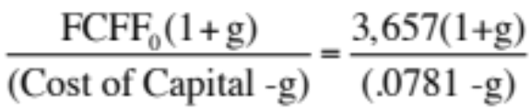
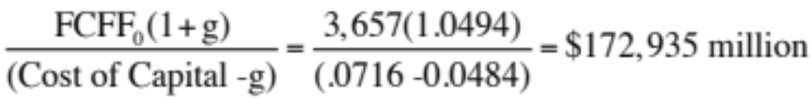
Why should we do it?
Effect on Firm Value – Full Valuation
Step 1: Estimate the cash flows to Disney as a firm
  EBIT (1 – Tax Rate) = 10,032 (1 – 0.361) = $6,410
  + Depreciation and amortization = $2,485
  – Capital expenditures = $5,239
  – Change in noncash working capital $0
  Free cash flow to the firm = $3,657
Step 2: Back out the implied growth rate in the current market value
  Current enterprise value = $121,878 + 15,961 - 3,931 = 133,908
  Value of firm = $ 133,908 =
  Growth rate = (Firm Value * Cost of Capital – CF to Firm)/(Firm Value + CF to Firm)
  = (133,908* 0.0781 – 3,657)/(133,908+ 3,657) = 0.0494 or 4.94%
Step 3: Revalue the firm with the new cost of capital
  Firm value =
  Increase in firm value = $172,935 - $133,908 = $39,027 million
Notes:
We are assuming that the firm is correctly valued now, not because of any belief in market efficiency but to isolate the effect of changing the cost of capital. In other words, whatever the market’s expectations are now (realistic or unrealistic), those expectations stay unchanged as we move from the old to the new capital structure.
This approach will tend to break down with growth or money losing companies because the valuation models you will need for those are far more complicated.

Slide 56
Effect on Value: Incremental approach
In this approach, we start with the current market value and isolate the effect of changing the capital structure on the cash flow and the resulting value.
  Enterprise Value before the change = $133,908 million
  Cost of financing Disney at existing debt ratio = $ 133,908 * 0.0781 = $10,458 million
  Cost of financing Disney at optimal debt ratio = $ 133,908 * 0.0716 = $ 9,592 million
  Annual savings in cost of financing = $10,458 million – $9,592 million = $866 million
  Enterprise value after recapitalization
  = Existing enterprise value + PV of Savings = $133,908 + $19,623 = $153,531 million
Notes:
The reduction in the cost of capital translates into annual savings. Most of these savings are implicit, being savings in the cost of equity. Thus, the firm’s accounting earnings will not reflect these savings directly.
These savings can be converted into a present value by discounting back at the new cost of capital.
It is more realistic to assume growth in firm value. A simple way to estimate what the current growth attributed to the firm by the market is to estimate it using the firm value today, the free cash flow to the firm and the current cost of capital.
Note that the simple valuation formula used above assumes stable growth forever. For high growth firms, this formula will yield an implied growth rate that is too high (It will be very close to the cost of capital). In those cases, it is better to put a cap on the growth rate of around the risk free rate.
In this case, maximizing firm value also maximizes stock price, because we assume that
Debt is refinanced at current market rates, thus protecting bondholders
Markets are rational and efficient.

Slide 57
From firm value to value per share: The Rational Investor Solution
Because the increase in value accrues entirely to stockholders, we can estimate the increase in value per share by dividing by the total number of shares outstanding (1,800 million).
  Increase in Value per Share = $19,623/1800 = $ 10.90
  New Stock Price = $67.71 + $10.90= $78.61
Implicit in this computation is the assumption that the increase in firm value will be spread evenly across both the stockholders who sell their stock back to the firm and those who do not and that is why we term this the “rational” solution, since it leaves investors indifferent between selling back their shares and holding on to them.
Notes:
If investors are rational, the price on the buyback should be such that investors are indifferent between selling back their shares and holding on to them. At $78.61, that will happen.

Slide 58
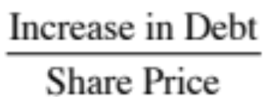
The more general solution, given a buyback price
Start with the buyback price and compute the number of shares outstanding after the buyback:
  Increase in Debt = Debt at optimal – Current Debt
  # Shares after buyback = # Shares before –
Then compute the equity value after the recapitalization, starting with the enterprise value at the optimal, adding back cash and subtracting out the debt at the optimal:
  Equity value after buyback = Optimal Enterprise value + Cash – Debt
Divide the equity value after the buyback by the post-buyback number of shares.
  Value per share after buyback = Equity value after buyback/ Number of shares after buyback
Notes:
In the more general scenario, you are looking at the division of spoils between those who sell their shares back and those who stay on as stockholders.

Slide 59
Let’s try a price: What if can buy shares back at the old price ($67.71)?
Start with the buyback price and compute the number of shares outstanding after the buyback
  Debt issued = $ 55,136 - $15,961 = $39,175 million
  # Shares after buyback = 1800 - $39,175/$67.71 = 1221.43 m
Then compute the equity value after the recapitalization, starting with the enterprise value at the optimal, adding back cash and subtracting out the debt at the optimal:
  Optimal Enterprise Value = $153,531
  Equity value after buyback = $153,531 + $3,931– $55,136 = $102,326
Divide the equity value after the buyback by the post-buyback number of shares.
  Value per share after buyback = $102,326/1221.43 = $83.78
Notes:
This is the best case scenario for those who stay on as stockholders, since they claim the entire surplus.

Slide 60
Back to the rational price ($78.61): Here is the proof
Start with the buyback price and compute the number of shares outstanding after the buyback
  # Shares after buyback = 1800 - $39,175/$78.61 = 1301.65 m
Then compute the equity value after the recapitalization, starting with the enterprise value at the optimal, adding back cash and subtracting out the debt at the optimal:
  Optimal Enterprise Value = $153,531
  Equity value after buyback = $153,531 + $3,931– $55,136 = $102,326
Divide the equity value after the buyback by the post-buyback number of shares.
  Value per share after buyback = $102,326/1301.65 = $78.61
Notes:
Proof that the $78.61 leaves everyone equally well off.
Try different prices and see how the increase in value is apportioned between the groups.
In fact, try estimating the buyback price at which the entire value increase goes to those who sell their shares back.

Slide 61
2. What if something goes wrong?
The Downside Risk
Sensitivity to Assumptions
  A. “What if” analysis
  The optimal debt ratio is a function of our inputs on operating income, tax rates and macro variables. We could focus on one or two key variables – operating income is an obvious choice – and look at history for guidance on volatility in that number and ask what if questions.
  B. “Economic Scenario” Approach
  We can develop possible scenarios, based upon macro variables, and examine the optimal debt ratio under each one. For instance, we could look at the optimal debt ratio for a cyclical firm under a boom economy, a regular economy and an economy in recession.
Constraint on Bond Ratings/ Book Debt Ratios
  Alternatively, we can put constraints on the optimal debt ratio to reduce exposure to downside risk. Thus, we could require the firm to have a minimum rating, at the optimal debt ratio or to have a book debt ratio that is less than a “specified” value.
Notes:
This analysis is based upon the firm continuing as a going concern. To the extent that more debt can put this survival at risk, it is important to do “what-if” analyses or build in survival constraints into the analysis.

Slide 62
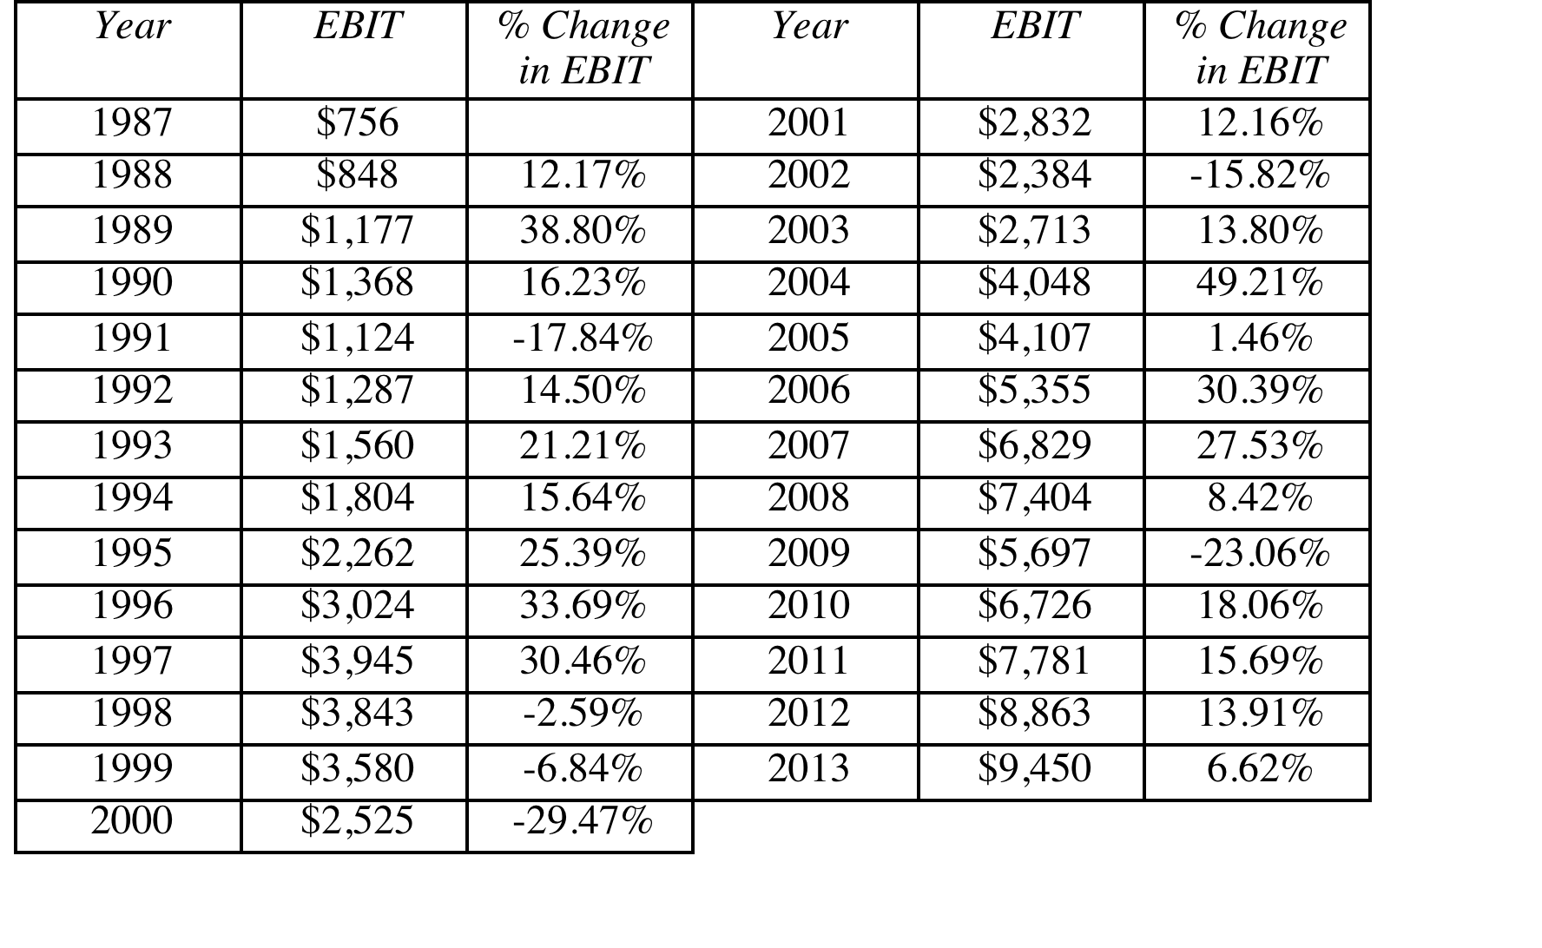
Disney’s Operating Income: History
Recession Decline in Operating Income
2009 Drop of 23.06%
2002 Drop of 15.82%
1991 Drop of 22.00%
1981-82 Increased by 12%
Worst Year Drop of 29.47%
Standard deviation in % change in EBIT = 19.17%
Notes:
These are percentage changes in operating income at Disney.

Slide 63
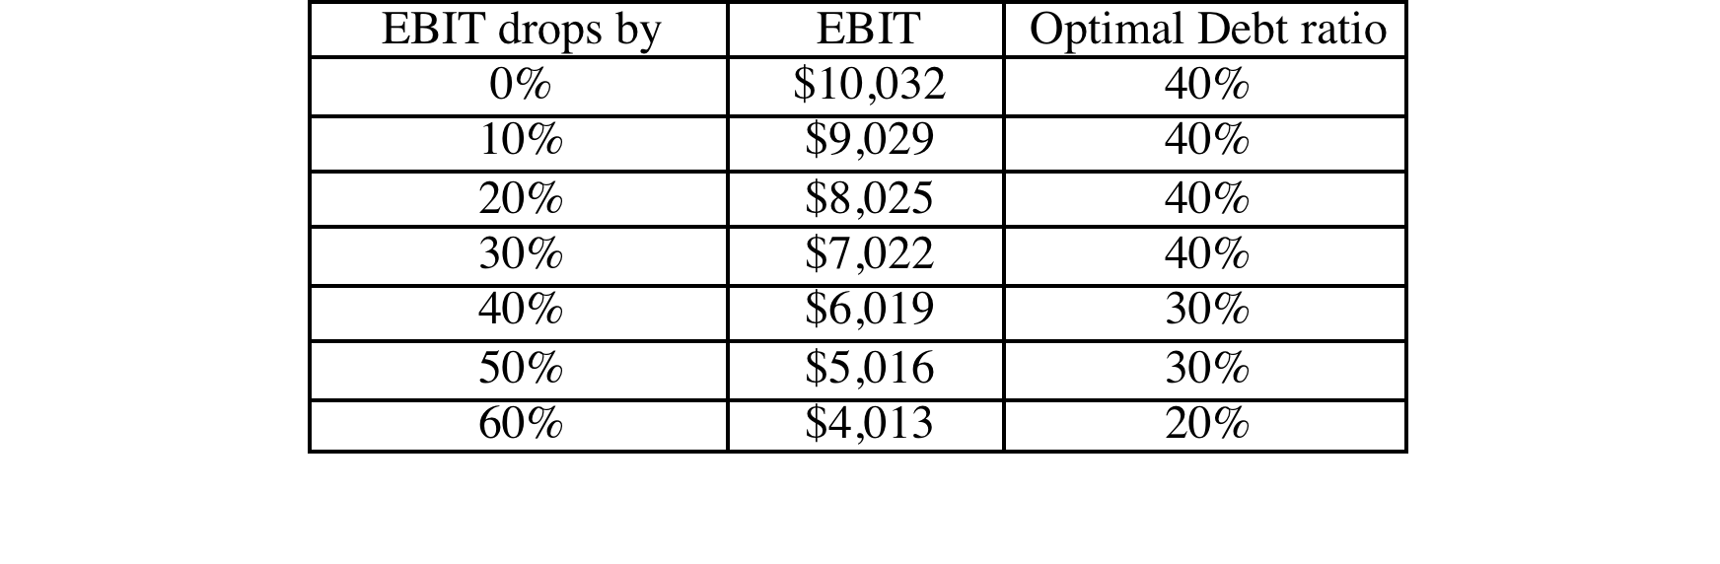
Disney: Safety Buffers?
Notes:
Disney’s optimal debt ratio is robust and survives up to a 30% drop in EBIT, which is worse than their worst year in the last three decades.

Slide 64
Constraints on Ratings
Management often specifies a 'desired rating' below which they do not want to fall.
The rating constraint is driven by three factors
  it is one way of protecting against downside risk in operating income (so do not do both)
  a drop in ratings might affect operating income
  there is an ego factor associated with high ratings
Caveat: Every rating constraint has a cost.
  The cost of a rating constraint is the difference between the unconstrained value and the value of the firm with the constraint.
  Managers need to be made aware of the costs of the constraints they impose.
Notes:
Rating constraints are one way of buffering your analysis against the assumption that operating income will not change as leverage changes. If the operating income will suffer when ratings fall below a certain point (say BBB or investment grade), it makes sense to build in that constraint into the analysis.
When managers brag about their high ratings, the questions that should come up are whether the high rating is paying off in terms of higher operating income, and if not, how much stockholders are paying for managers’ bragging rights.

Slide 65
Ratings Constraints for Disney
At its optimal debt ratio of 40%, Disney has an estimated rating of A.
If managers insisted on a AA rating, the optimal debt ratio for Disney is then 30% and the cost of the ratings constraint is fairly small:
  Cost of AA Rating Constraint = Value at 40% Debt – Value at 30% Debt = $153,531 m – $147,835 m = $ 5,696 million
If managers insisted on a AAA rating, the optimal debt ratio would drop to 20% and the cost of the ratings constraint would rise:
  Cost of AAA rating constraint = Value at 40% Debt – Value at 20% Debt = $153,531 m – $141,406 m = $ 12,125 million
Notes:
This may be overstated, since it is based upon the assumption that operating income is unaffected by the change in ratings. To the degree that Disney’s operating income will drop if its rating drops below BBB, this will overstate the cost of the constraint.
This process can be modified to allow for other constraints. For instance, some firms do not want their book value debt ratios to rise above a certain level (say, industry averages). In other cases, existing bond covenants may restrict a financial ratio from exceeding a specified number.

Slide 66
3. What if you do not buy back stock..
The optimal debt ratio is ultimately a function of the underlying riskiness of the business in which you operate and your tax rate.
Will the optimal be different if you invested in projects instead of buying back stock?
  No. As long as the projects financed are in the same business mix that the company has always been in and your tax rate does not change significantly.
  Yes, if the projects are in entirely different types of businesses or if the tax rate is significantly different.
Notes:
The analysis is built on the assumption that debt is used to buy back stock. Many firms would rather use the debt to take projects, or might be barred from buying back stock (as is the case in markets like Germany)
If we assume that projects in the same line of business have the same cash flow generating capacity as the current firm (EBITDA/Firm Value), the optimal debt ratio will remain unchanged, but the optimal dollar debt will be a much higher number. (This analysis is impervious to changes in scale. If you double all the numbers, the optimal debt ratio will remain unchanged)
If the business you are expanding into has more risk and more negative cashflows, your optimal will decrease.

Slide 67
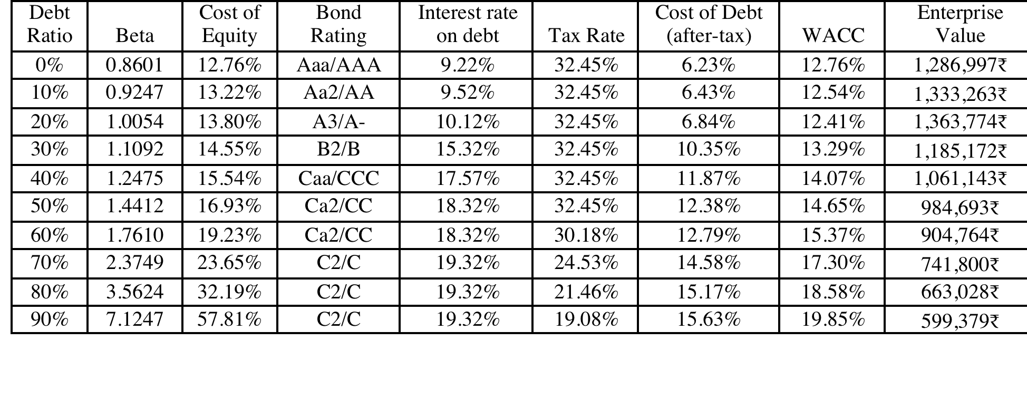
Extension to a family group company: Tata Motor’s Optimal Capital Structure
Tata Motors looks like it is over levered (29% actual versus 20% optimal), perhaps because it is drawing on the debt capacity of other companies in the Tata Group.
Notes:
While Tata Motors looks over levered, it is possible that the company is borrowing money on the basis of the Tata Group’s financial strength…. Thus, to assess whether there is too much or too little debt, we should be looking at the overall group’s optimal and actual debt ratio.

Slide 68
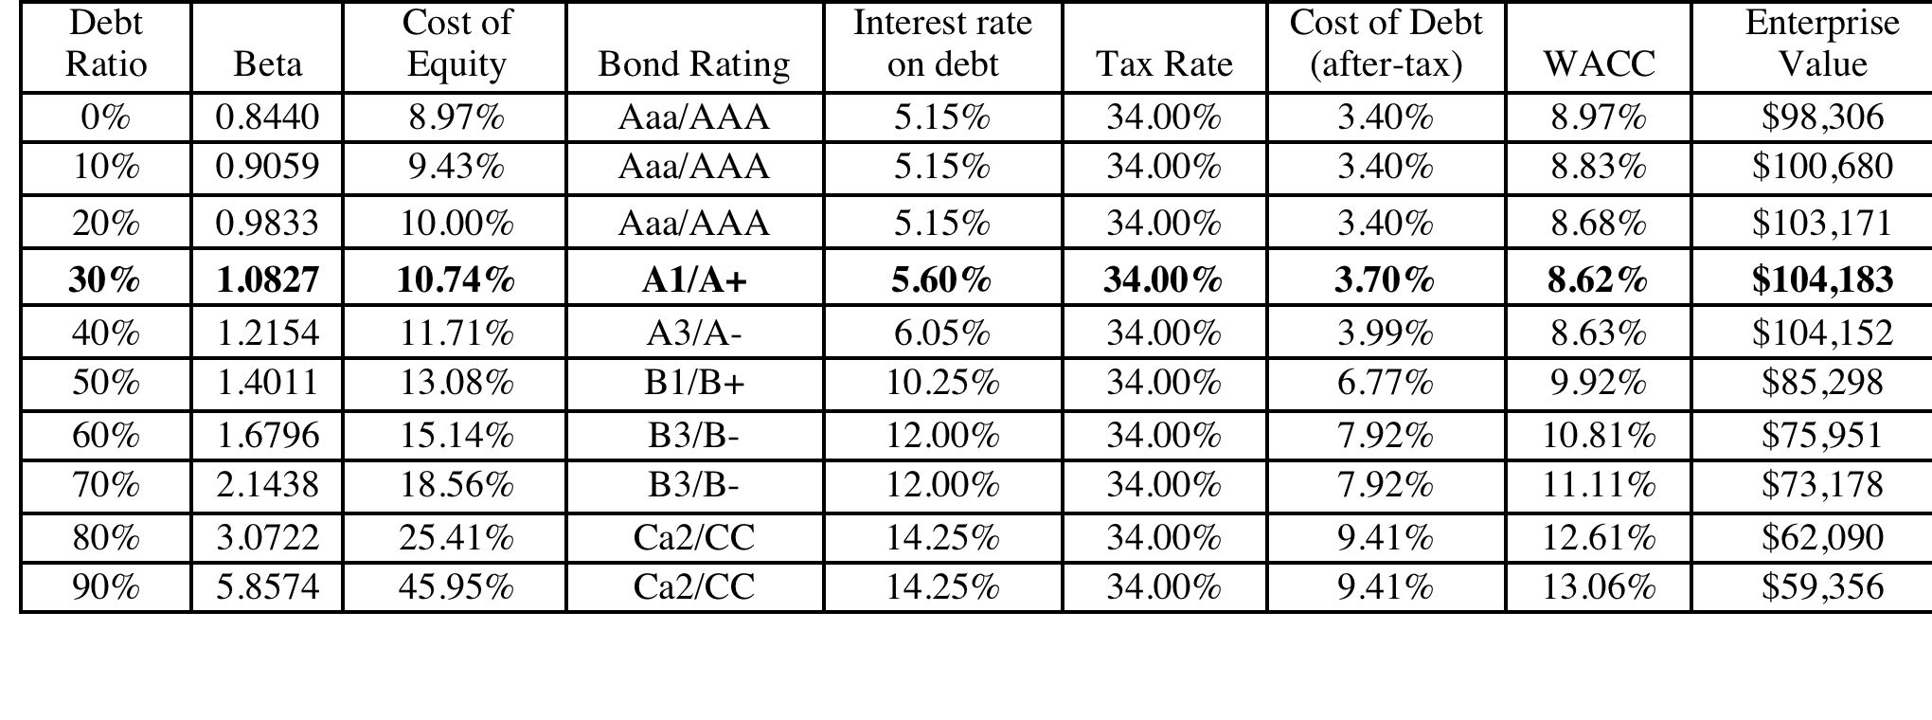
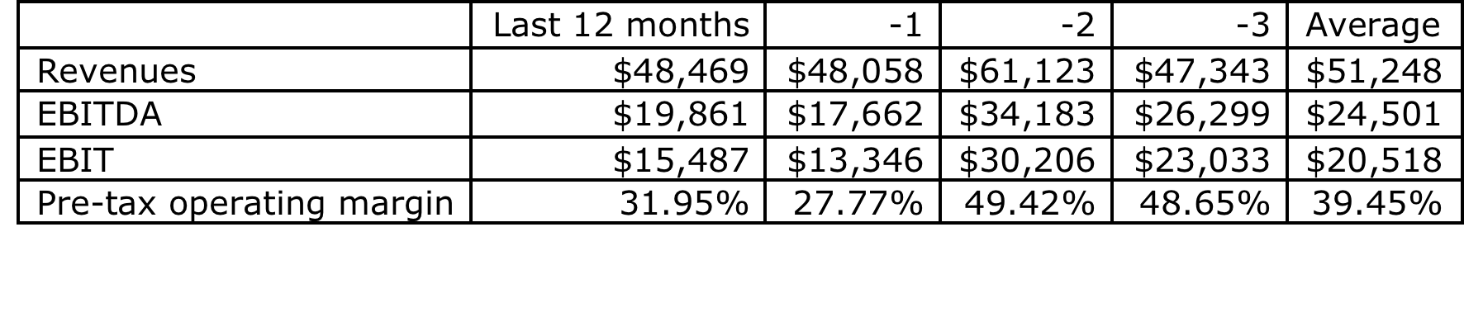
Extension to a firm with volatile earnings:
Vale’s Optimal Debt Ratio
Replacing Vale’s current operating income with the average over the last three years pushes up the optimal to 50%.
Notes:
Vale looks over levered at its current operating income, but since it is a mining company and its normalized income is higher, I think it is less worrisome.

Slide 69
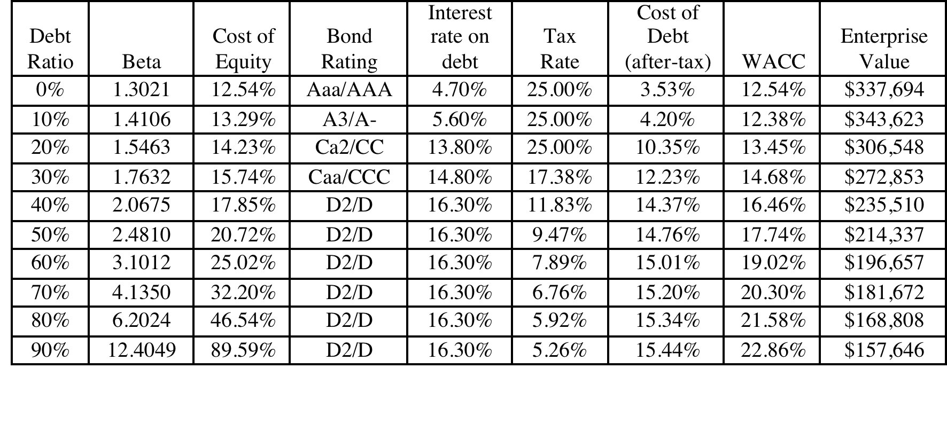
Optimal Debt Ratio for a young, growth firm: Baidu
The optimal debt ratio for Baidu is between 0 and 10%, close to its current debt ratio of 5.23%, and much lower than the optimal debt ratios computed for Disney, Vale and Tata Motors.
Notes:
May be a high flyer in terms of market cap, but cannot afford much debt, since its operating income is low, relative to its market value.

Slide 70
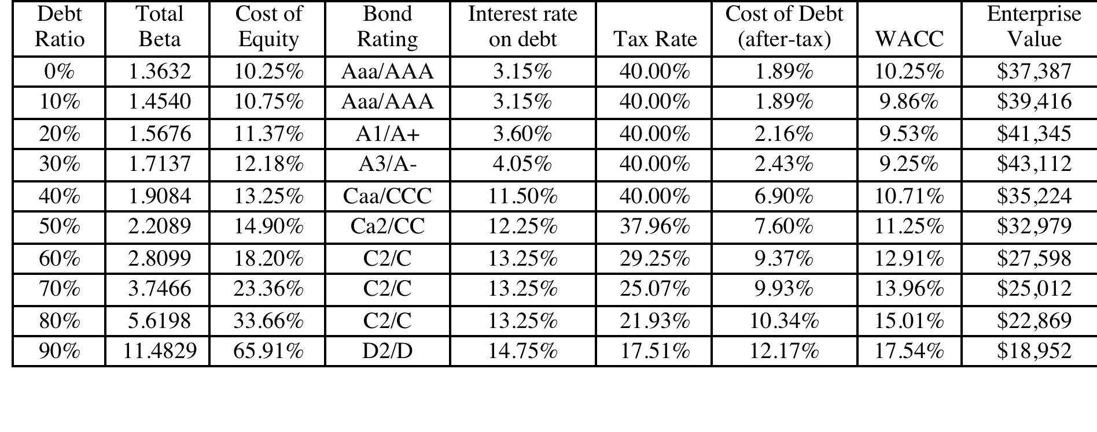
Extension to a private business
Optimal Debt Ratio for Bookscape
Debt value of leases = $12,136 million (only debt)
Estimated market value of equity = Net Income * Average PE for Publicly Traded Book Retailers = 1.575 * 20 = $31.5 million
Debt ratio = 12,136/(12,136+31,500) = 27.81%
The firm value is maximized (and the cost of capital is minimized) at a debt ratio of 30%. At its existing debt ratio of 27.81%, Bookscape is at its optimal.
Notes:
The optimal debt ratio for the private firm is 30% but the cost of capital is flat between 10% and 30%. The firm value is maximized at that point.
To the extent that private business owners view default risk more seriously than stockholders in a publicly traded firm, they will probably be more cautious about moving to the optimal.
We can extend the argument to closely held publicly traded firms. We would expect these firms to have lower debt ratios than publicly traded firms with diverse stockholdings.

Slide 71
Limitations of the Cost of Capital approach
It is static: The most critical number in the entire analysis is the operating income. If that changes, the optimal debt ratio will change.
It ignores indirect bankruptcy costs: The operating income is assumed to stay fixed as the debt ratio and the rating changes.
Beta and Ratings: It is based upon rigid assumptions of how market risk and default risk get borne as the firm borrows more money and the resulting costs.
Notes:
While the traditional cost of capital approach is a powerful tool, it has its limitations. In particular, the fact that it leaves the operating income fixed as ratings and debt ratios change implies that we are ignoring indirect bankruptcy costs and thus over estimating optimal debt ratios.

Slide 72
II. Enhanced Cost of Capital Approach
Distress cost affected operating income: In the enhanced cost of capital approach, the indirect costs of bankruptcy are built into the expected operating income. As the rating of the firm declines, the operating income is adjusted to reflect the loss in operating income that will occur when customers, suppliers and investors react.
Dynamic analysis: Rather than look at a single number for operating income, you can draw from a distribution of operating income (thus allowing for different outcomes).
Notes:
The most significant innovation is that the operating income is a function of the ratings. As he firm borrows more and its rating drops, its operating income will drop to reflect the indirect bankruptcy costs.

Slide 73
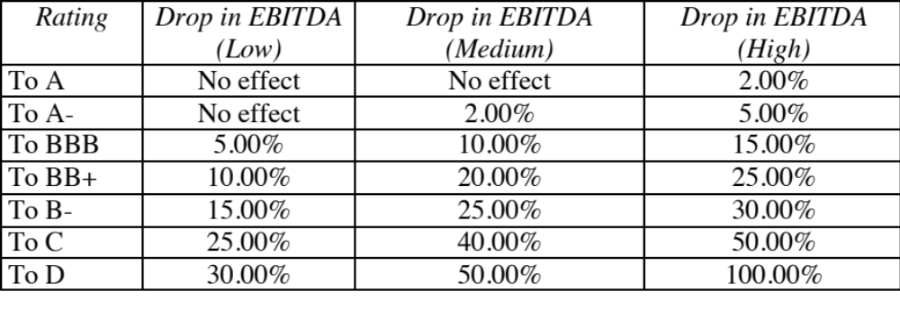
Estimating the Distress Effect- Disney
Notes:
To estimate these values, we looked at firms that had been downgraded and looked the change in operating income in the next year. There is a lot of estimation noise in these values…. And a lot of variation across firms.

Slide 74
The Optimal Debt Ratio with Indirect Bankruptcy Costs
Debt Ratio | Beta | Cost of Equity | Bond Rating | Interest rate on debt | Tax Rate | Cost of Debt (after-tax) | WACC | Enterprise Value
0% | 0.9239 | 8.07% | Aaa/AAA | 3.15% | 36.10% | 2.01% | 8.07% | $122,633
10% | 0.9895 | 8.45% | Aaa/AAA | 3.15% | 36.10% | 2.01% | 7.81% | $134,020
20% | 1.0715 | 8.92% | Aaa/AAA | 3.15% | 36.10% | 2.01% | 7.54% | $147,739
30% | 1.1769 | 9.53% | Aa2/AA | 3.45% | 36.10% | 2.20% | 7.33% | $160,625
40% | 1.3175 | 10.34% | A2/A | 3.75% | 36.10% | 2.40% | 7.16% | $172,933
50% | 1.5573 | 11.72% | C2/C | 11.50% | 31.44% | 7.88% | 9.80% | $35,782
60% | 1.9946 | 14.24% | Caa/CCC | 13.25% | 22.74% | 10.24% | 11.84% | $25,219
70% | 2.6594 | 18.07% | Caa/CCC | 13.25% | 19.49% | 10.67% | 12.89% | $21,886
80% | 3.9892 | 25.73% | Caa/CCC | 13.25% | 17.05% | 10.99% | 13.94% | $19,331
90% | 7.9783 | 48.72% | Caa/CCC | 13.25% | 15.16% | 11.24% | 14.99% | $17,311
The optimal debt ratio stays at 40% but the cliff becomes much steeper.
Notes:
When both operating income and cost of capital change, the optimal debt ratio may no longer be at the point where cost of capital is minimized. Firm value may be maximized at a different point, with higher operating income and a a higher cost of capital.

Slide 75
Extending this approach to analyzing Financial Service Firms
Interest coverage ratio spreads, which are critical in determining the bond ratings, have to be estimated separately for financial service firms; applying manufacturing company spreads will result in absurdly low ratings for even the safest banks and very low optimal debt ratios.
It is difficult to estimate the debt on a financial service company’s balance sheet. Given the mix of deposits, repurchase agreements, short-term financing, and other liabilities that may appear on a financial service firm’s balance sheet, one solution is to focus only on long-term debt, defined tightly, and to use interest coverage ratios defined using only long-term interest expenses.
Financial service firms are regulated and have to meet capital ratios that are defined in terms of book value. If, in the process of moving to an optimal market value debt ratio, these firms violate the book capital ratios, they could put themselves in jeopardy.
Notes:
Financial service firms often do not consider debt to be a source of capital, as much as they consider it to be raw material that they use to produce their products.
Thus, most banks borrow, using the regulatory capital ratios as constraints, rather than to minimize cost of capital.

Slide 76
Capital Structure for a bank:
A Regulatory Capital Approach
Consider a bank with $ 100 million in loans outstanding and a book value of equity of $ 6 million. Furthermore, assume that the regulatory requirement is that equity capital be maintained at 5% of loans outstanding. Finally, assume that this bank wants to increase its loan base by $ 50 million to $ 150 million and to augment its equity capital ratio to 7% of loans outstanding.
  Loans outstanding after Expansion = $ 150 million
  Equity after expansion = 7% of $150 = $10.5 million
  Existing Equity = $ 6.0 million
  New Equity needed = $ 4.5 million
Your need for “external” equity as a bank/financial service company will depend upon
  Your growth rate: Higher growth -> More external equity
  Existing capitalization vs Target capitalization: Under capitalized -> More external equity
  Current earnings: Less earnings -> More external equity
  Current dividends: More dividends -> More external equity
Notes:
As regulatory capital ratios increase, banks will have to raise more equity to grow.
Conservative banks will raise more equity than aggressive banks.
Assessing the financing mix for a bank or financial service firm boils down to equity. In effect, the firm can have too little or too much book equity, and that judgment is made based upon capital ratios (actual versus required). Unlike non-financial service firms, where debt can be reduced or increased to change the ratio, financial service firms generally have much less flexibility.
So, what can cause book equity to vary across time? Retained earnings obviously. Profits will increase book equity and losses will reduce them. Any dividends paid reduce book equity. For banks, loan losses can reduce book equity dramatically. In other words, a bank can go from being comfortably over funded to significantly under funded overnight.
The one issue in this approach is that it is framed by regulatory defintiions.of equity. Thus, preferred stock is usually counted as equity. After the crisis of 2008, there was a debate about whether wartrants should be counted in book equity.

Slide 77
Deutsche Bank’s Financial Mix
 | Current | 1 | 2 | 3 | 4 | 5
Asset Base | 439,851 € | 453,047 € | 466,638 € | 480,637 € | 495,056 € | 509,908 €
Capital ratio | 15.13% | 15.71% | 16.28% | 16.85% | 17.43% | 18.00%
Tier 1 Capital | 66,561 € | 71,156 € | 75,967 € | 81,002 € | 86,271 € | 91,783 €
Change in regulatory capital |  | 4,595 € | 4,811 € | 5,035 € | 5,269 € | 5,512 €
Book Equity | 76,829 € | 81,424 € | 86,235 € | 91,270 € | 96,539 € | 102,051 €
ROE | -1.08% | 0.74% | 2.55% | 4.37% | 6.18% | 8.00%
Net Income | -716 € | 602 € | 2,203 € | 3,988 € | 5,971 € | 8,164 €
- Investment in Regulatory Capital |  | 4,595 € | 4,811 € | 5,035 € | 5,269 € | 5,512 €
FCFE |  | -3,993 € | -2,608 € | -1,047 € | 702 € | 2,652 €
The cumulative FCFE over the next 5 years is -4,294 million Euros. Clearly, it does not make the sense to pay dividends or buy back stock.
Notes:
Assessing the financing mix for a bank or financial service firm boils down to equity. In effect, the firm can have too little or too much book equity, and that judgment is made based upon capital ratios (actual versus required). Unlike non-financial service firms, where debt can be reduced or increased to change the ratio, financial service firms generally have much less flexibility.
So, what can cause book equity to vary across time? Retained earnings obviously. Profits will increase book equity and losses will reduce them. Any dividends paid reduce book equity. For banks, loan losses can reduce book equity dramatically. In other words, a bank can go from being comfortably over funded to significantly under funded overnight.
The one issue in this approach is that it is framed by regulatory defintiions.of equity. Thus, preferred stock is usually counted as equity. After the crisis of 2008, there was a debate about whether wartrants should be counted in book equity.
\

Slide 78
Financing Strategies for a financial institution
The Regulatory minimum strategy: In this strategy, financial service firms try to stay with the bare minimum equity capital, as required by the regulatory ratios. In the most aggressive versions of this strategy, firms exploit loopholes in the regulatory framework to invest in those businesses where regulatory capital ratios are set too low (relative to the risk of these businesses).
The Self-regulatory strategy: The objective for a bank raising equity is not to meet regulatory capital ratios but to ensure that losses from the business can be covered by the existing equity. In effect, financial service firms can assess how much equity they need to hold by evaluating the riskiness of their businesses and the potential for losses.
Combination strategy: In this strategy, the regulatory capital ratios operate as a floor for established businesses, with the firm adding buffers for safety where needed..
Notes:
The Regulatory minimum strategy is likely to yield the highest profits and ROE during good times but is most likely to expose the firm to problems in bad times. To the extent that governments bail firms out when trouble strikes, firms are going to move towards this strategy because they do not see a downside.
The self regulatory strategy is the only option for firms that have no regulatory overlay or downside protection from an external entity but want to ensure their own survival. For hundreds of years, banks self regulated with mixed results. This is a more resource intensive approach, since you have to examine the risk in your business carefully and make your assessments of possible downside risk.
Combination strategy: In this strategy, you start with regulatory minimum but add to it, based upon how much risk you want to run of facing downside risk. Thus, conservative banks will keep higher capital ratios than required, which will lead to lower ROE.

Slide 79
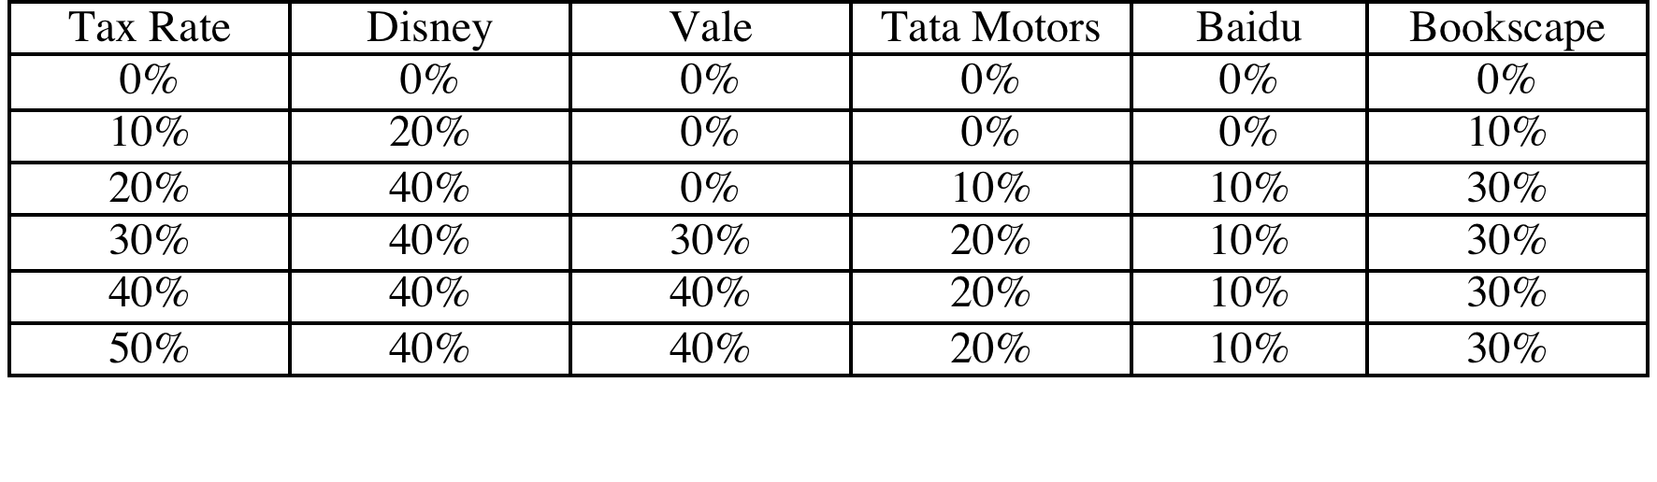
Determinants of the Optimal Debt Ratio:
1. The marginal tax rate
The primary benefit of debt is a tax benefit. The higher the marginal tax rate, the greater the benefit to borrowing:
Notes:
Note that with zero taxes, the optimal debt ratio goes to zero. Intuitively, if the costs of borrowing (higher bankruptcy cost, agency costs) and the primary benefit disappears, there will always by a net cost to borrowing.
If debt is cheaper than equity on a pre-tax basis (and it generally is), why do we not gain by borrowing?
Because the additional debt makes both debt and equity more expensive. (Ratings drop and betas increase…)

Slide 80
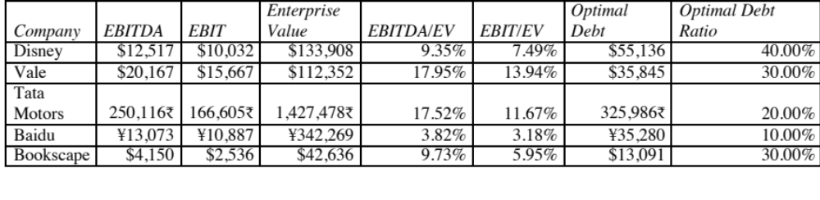
2. Pre-tax Cash flow Return
Higher cash flows, as a percent of value, give you a higher debt capacity, though less so in emerging markets with substantial country risk.
Notes:
This is the answer to the puzzle of why growth firms, even extremely profitable ones like Apple and Google, tend to have low optimal debt ratios. While they may generate huge dollar profits, their market values are

Slide 81
3. Operating Risk
Firms that face more risk or uncertainty in their operations (and more variable operating income as a consequence) will have lower optimal debt ratios than firms that have more predictable operations.
Operating risk enters the cost of capital approach in two places:
  Unlevered beta: Firms that face more operating risk will tend to have higher unlevered betas. As they borrow, debt will magnify this already large risk and push up costs of equity much more steeply.
  Bond ratings: For any given level of operating income, firms that face more risk in operations will have lower ratings. The ratings are based upon normalized income.
Notes:
A risky firm can be very profitable in a good year. However, it should be cautious about borrowing on the basis of that income, since earnings can drop quickly.

Slide 82
4. The only macro determinant:
Equity vs Debt Risk Premiums
Notes:
The cost of equity is determined by the equity risk premium and the cost of debt by the default spread. When ERP rise (fall) relative to default spreads, firms will borrow more (less).
This graph has the implied equity risk premium and the default spread on a Baa rated bond going back to 1960. While they generally move together, there have been periods of disconnect between the two.
In the late 1990s, equity risk premiums dropped relative to default spreads: Firms should have shifted to equity from debt and optimal debt ratios should have decreased.
Between 2004 and 2007, default spreads dropped while equity risk premiums remained unchanged. It was a golden age for leveraged transactions.
In 2008, risk premia climbed across the board but default spreads increased at a far faster pace than equity risk premium. On a relative basis, debt became more expensive relative to equity.
We would expect optimal debt ratios to decrease across the board as a consequence. . (Between 2004 and 2007, default spreads fell while equity risk premiums stagnated… ushering in the age of leveraged recaps and buyouts)

Slide 83
6 Application Test: Your firm’s optimal financing mix
Using the optimal capital structure spreadsheet provided:
  Estimate the optimal debt ratio for your firm
  Estimate the new cost of capital at the optimal
  Estimate the effect of the change in the cost of capital on firm value
  Estimate the effect on the stock price
In terms of the mechanics, what would you need to do to get to the optimal immediately?
Notes:
The best way to see how capital structure is determined by fundamentals is to try it for a real firm and see how the optimal changes as you change the inputs.

Slide 84
III. The APV Approach to Optimal Capital Structure
In the adjusted present value approach, the value of the firm is written as the sum of the value of the firm without debt (the unlevered firm) and the effect of debt on firm value
  Firm Value = Unlevered Firm Value + (Tax Benefits of Debt - Expected Bankruptcy Cost from the Debt)
The optimal dollar debt level is the one that maximizes firm value
Notes:
This is an alternative approach with the same objective of maximizing firm value. It assesses the costs and benefits of debt in dollar value terms rather than through the cost of capital.

Slide 85
Implementing the APV Approach
Step 1: Estimate the unlevered firm value. This can be done in one of two ways:
  Estimating the unlevered beta, a cost of equity based upon the unlevered beta and valuing the firm using this cost of equity (which will also be the cost of capital, with an unlevered firm)
  Alternatively, Unlevered Firm Value = Current Market Value of Firm - Tax Benefits of Debt (Current) + Expected Bankruptcy cost from Debt
Step 2: Estimate the tax benefits at different levels of debt. The simplest assumption to make is that the savings are perpetual, in which case
  Tax benefits = Dollar Debt * Tax Rate
Step 3: Estimate a probability of bankruptcy at each debt level, and multiply by the cost of bankruptcy (including both direct and indirect costs) to estimate the expected bankruptcy cost.
Notes:
In practice, analysts often do the first two steps but skip the third because the inputs are so difficult to get. The result is that the value of the firm always go up as you borrow money, since you count in the tax benefits but you don’t consider the bankrutpcy costs.

Slide 86
Estimating Expected Bankruptcy Cost
Probability of Bankruptcy
  Estimate the synthetic rating that the firm will have at each level of debt
  Estimate the probability that the firm will go bankrupt over time, at that level of debt (Use studies that have estimated the empirical probabilities of this occurring over time - Altman does an update every year)
Cost of Bankruptcy
  The direct bankruptcy cost is the easier component. It is generally between 5-10% of firm value, based upon empirical studies
  The indirect bankruptcy cost is much tougher. It should be higher for sectors where operating income is affected significantly by default risk (like airlines) and lower for sectors where it is not (like groceries)
Notes:
The two key inputs you need to estimate the expected bankruptcy cost. The first one is easier to get than the second. There have been attempts to measure the magnitude of indirect bankruptcy costs and they conclude that
indirect bankruptcy costs can be as high as 20-30% of firm value
Indirect bankrtupcy costs as a percent of firm value are different for different firms. In general, they tend to be higher for firms that produce longer life assets than for assets that have shorter lives and for firms where reputation matters more…

Slide 87
Ratings and Default Probabilities: Results from Altman study of bonds
Rating Likelihood of Default
AAA 0.07%
AA 0.51%
A+ 0.60%
A 0.66%
A- 2.50%
BBB 7.54%
BB 16.63%
B+ 25.00%
B 36.80%
B- 45.00%
CCC 59.01%
CC 70.00%
C 85.00%
D 100.00%
Altman estimated these probabilities by looking at bonds in each ratings class ten years prior and then examining the proportion of these bonds that defaulted over the ten years.
Notes:
This table is updated every year by Ed Altman at the Stern School of Business. It is the probability that a bond is each of these ratings classes will default and is based upon actual default rates over 10 years of bonds in each ratings class. This is from the 2008 update.

Slide 88
Disney: Estimating Unlevered Firm Value
Current Value of firm = $121,878+ $15,961 = $ 137,839
- Tax Benefit on Current Debt = $15,961 * 0.361 = $ 5,762
+ Expected Bankruptcy Cost = 0.66% * (0.25 * 137,839) = $ 227
Unlevered Value of Firm = = $ 132,304
  Cost of Bankruptcy for Disney = 25% of firm value
  Probability of Bankruptcy = 0.66%, based on firm’s current rating of A
  Tax Rate = 36.1%
Notes:
To implement APV, you have to first estimate the unlevered firm value.We are using a short-cut to derive the tax benefit from current debt and the indirect bankruptcy cost is an assumption (we went right for the mid-point of the 10-40% range for all companies.

Slide 89
Disney: APV at Debt Ratios
Debt Ratio | $ Debt | Tax Rate | Unlevered Firm Value | Tax Benefits | Bond Rating | Probability of Default | Expected Bankruptcy Cost | Value of Levered Firm
0% | $0 | 36.10% | $132,304 | $0 | AAA | 0.07% | $23 | $132,281
10% | $13,784 | 36.10% | $132,304 | $4,976 | Aaa/AAA | 0.07% | $24 | $137,256
20% | $27,568 | 36.10% | $132,304 | $9,952 | Aaa/AAA | 0.07% | $25 | $142,231
30% | $41,352 | 36.10% | $132,304 | $14,928 | Aa2/AA | 0.51% | $188 | $147,045
40% | $55,136 | 36.10% | $132,304 | $19,904 | A2/A | 0.66% | $251 | $151,957
50% | $68,919 | 36.10% | $132,304 | $24,880 | B3/B- | 45.00% | $17,683 | $139,501
60% | $82,703 | 36.10% | $132,304 | $29,856 | C2/C | 59.01% | $23,923 | $138,238
70% | $96,487 | 32.64% | $132,304 | $31,491 | C2/C | 59.01% | $24,164 | $139,631
80% | $110,271 | 26.81% | $132,304 | $29,563 | Ca2/CC | 70.00% | $28,327 | $133,540
90% | $124,055 | 22.03% | $132,304 | $27,332 | Caa/CCC | 85.00% | $33,923 | $125,713
The optimal debt ratio is 40%, which is the point at which firm value is maximized.
Notes:
Disney’s optimal debt ratio is 50%, which is slightly higher than the optimal debt ratio from the cost of capital approach.

Slide 90
IV. Relative Analysis
The “safest” place for any firm to be is close to the industry average
Subjective adjustments can be made to these averages to arrive at the right debt ratio.
  Higher tax rates -> Higher debt ratios (Tax benefits)
  Lower insider ownership -> Higher debt ratios (Greater discipline)
  More stable income -> Higher debt ratios (Lower bankruptcy costs)
  More intangible assets -> Lower debt ratios (More agency problems)
Notes:
Most firms pick their debt ratios by looking at industry averages. By staying close to the average, managers get cover in case they make mistakes - everyone else has made the same mistake.
Managers also try to stay close to the industry average, because ratings agencies and equity research analysts look at these averages.

Slide 91
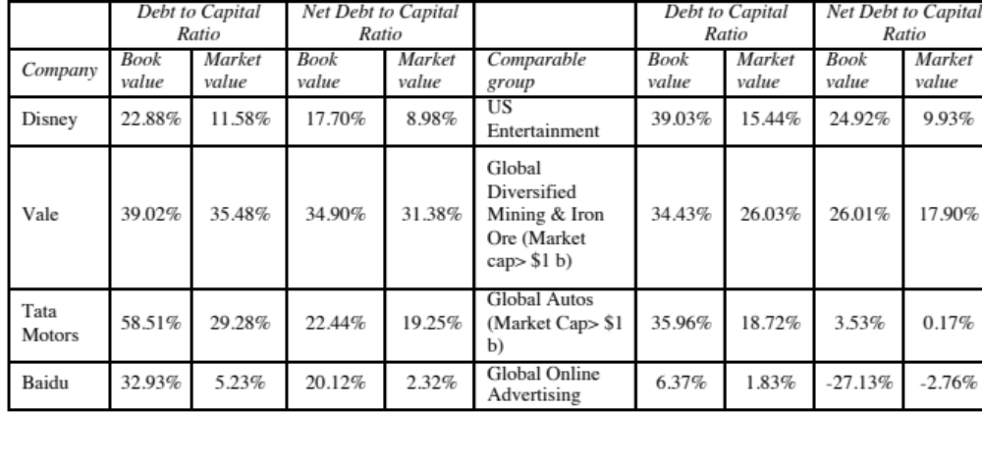
Comparing to industry averages
Notes:
Based on this comparison, Disney is operating at a debt ratio lower than those of other firms in the industry in both market and book value terms, whereas Vale and Tata Motors have debt ratios much higher than the averages for their sector.
The underlying assumptions in this comparison are that firms within the same industry are comparable and that, on average, these firms are operating at or close to their optimal. Both assumptions can be questioned, however. Firms within the same industry can have different product mixes, different amounts of operating risk, different tax rates, and different project returns. In fact, most do. For instance, Disney is considered part of the entertainment industry, but its mix of businesses is very different from that of Lion’s Gate, which is primarily a movie company, or Liberty Media, which is primarily a cable broadcasting company. Furthermore, Disney’s size and risk characteristics are very different from that of Westwood One, which is also considered part of the same industry group. The other problem is that, as we noted in Chapter 4, both Disney and Vale are multi-business companies and picking a sector to compare these firms is difficult to do.

Slide 92
Getting past simple averages
Step 1: Run a regression of debt ratios on the variables that you believe determine debt ratios in the sector. For example,
  Debt Ratio = a + b (Tax rate) + c (Earnings Variability) + d (EBITDA/Firm Value)
Check this regression for statistical significance (t statistics) and predictive ability (R squared)
Step 2: Estimate the values of the proxies for the firm under consideration. Plugging into the cross sectional regression, we can obtain an estimate of predicted debt ratio.
Step 3: Compare the actual debt ratio to the predicted debt ratio.
Notes:
This is one way to control for differences across firms. The variables in the regression should be proxies for the factors that drive the debt trade-off
Tax Benefit -> Tax Rate
Bankruptcy Risk -> Earnings Variability
Agency Costs -> EBITDA/Firm Value

Slide 93
Applying the Regression Methodology: Global Auto Firms
Using a sample of 56 global auto firms, we arrived at the following regression:
Debt to capital = 0.09 + 0.63 (Effective Tax Rate) + 1.01 (EBITDA/ Enterprise Value) - 0.93 (Cap Ex/ Enterprise Value)
The R squared of the regression is 21%. This regression can be used to arrive at a predicted value for Tata Motors of:
Predicted Debt Ratio = 0.09 + 0.63 (0.252) +1.01 (0.1167) - 0.93 (0.1949) = .1854 or 18.54%
Based upon the capital structure of other firms in the automobile industry, Tata Motors should have a market value debt ratio of 18.54%. It is over levered at its existing debt ratio of 29.28%.
Notes:
This assumes a linear relationship between the independent variables and the debt ratio. The variables can be transformed if the relationship is non-linear.
I plugged in the values for Tata Motors into the regression. This suggest that TMT is underlevered, relative to comparable firms, after controlling for differences across these firms. Note that the low R-squared will also result in large prediction errors.

Slide 94
Extending to the entire market
Using 2014 data for US listed firms, we looked at the determinants of the market debt to capital ratio. The regression provides the following results –
DFR = 0.27 - 0.24 ETR -0.10 g– 0.065 INST -0.338 CVOI+ 0.59 E/V
(15.79) (9.00) (2.71) (3.55) (3.10) (6.85)
  DFR = Debt / ( Debt + Market Value of Equity)
  ETR = Effective tax rate in most recent twelve months
  INST = % of Shares held by institutions
  CVOI = Std dev in OI in last 10 years/ Average OI in last 10 years
  E/V = EBITDA/ (Market Value of Equity + Debt- Cash)
  The regression has an R-squared of 8%.
Notes:
This looks at the entire market and uses the following variables (from Value Line CD-ROM)
Tax Rate as proxy for tax benefits
Closely held shares for disciplinary power of debt
EBITDA/Value for capacity to generate cash flows
Intangible assets “ Agency costs
Growth in EPS for Expected growth possibilities and need for flexibility
Low R-squared is typical of these large cross sectional regressions.

Slide 95
Applying the Regression
Disney had the following values for these inputs in 2014. Estimate the optimal debt ratio using the debt regression.
  Effective Tax Rate (ETR) = 31.02%
  Expected Revenue Growth = 6.45%
  Institutional Holding % (INST) = 70.2%
  Coeff of Variation in OI (CVOI) = 0.0296
  EBITDA/Value of firm (E/V) = 9.35%
Optimal Debt Ratio
= 0.27 - 0.24 (.3102) -0.10 (.0645)– 0.065 (.702) -0.338 (.0296)+ 0.59 (.0935)
= 0.1886 or 18.86%
What does this optimal debt ratio tell you?
Why might it be different from the optimal calculated using the weighted average cost of capital?
Notes:
Based upon the debt ratios of other firms in the market and Disney’s financial characteristics, we would expect Disney to have a debt ratio of 19%. Since its actual debt ratio is 12%, Disney is under levered.
It may be different from the optimal because it is based upon the assumption that firms, on average, get their debt ratios right. If most firms are under levered, for instance, you will get a lower predicted value from the regression than for a cost of capital approach.

Slide 96
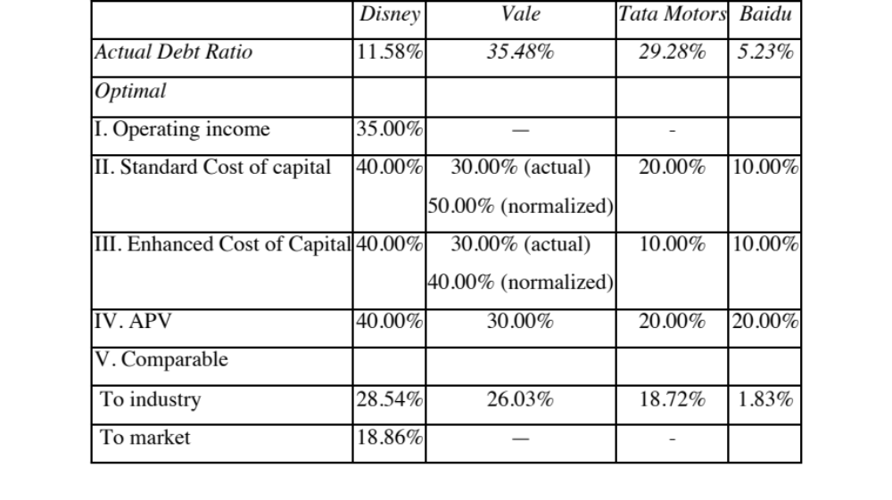
Summarizing the optimal debt ratios…
Notes:
Disney is under levered, no matter how you slice it. Vale is close to fairly levered, if you assume that income will bounce back. Tata Motors is over levered and Baidu is very mildly under levered.

Slide 97
Getting to the Optimal:
Timing and Financing Choices
You can take it slow.. Or perhaps not…
Notes:
There is no one path to get from the actual to the optimal. It will vary from firm to firm, and even for the same firm, across time.

Slide 98
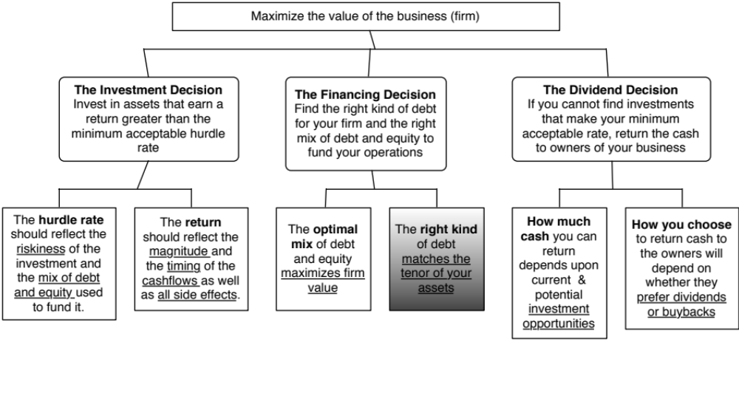
Big Picture…
Notes:
Completes the financing principle part of the analysis…

Slide 99
Now that we have an optimal.. And an actual.. What next?
At the end of the analysis of financing mix (using whatever tool or tools you choose to use), you can come to one of three conclusions:
  The firm has the right financing mix
  It has too little debt (it is under levered)
  It has too much debt (it is over levered)
The next step in the process is
  Deciding how much quickly or gradually the firm should move to its optimal
  Assuming that it does, the right kind of financing to use in making this adjustment
Notes:
When a firm is under or over levered, the natural reaction of the analyst looking at the numbers is that the firm should fix the problem instantaneously. However, there is a cost to abrupt shifts in capital structures:
You could be wrong in your assessment of the optimal: In other words, you may have misestimated the optimal, in which case the firm may have to back track, if it has followed your recommendations. That is expensive to do (and sometimes fatal).
Macro variables may shift: If there is a shift in the macro environment (interest rates and risk premiums could change), your recommendations can be wrong in hindisight
Adjustment costs: Changes in capital structure can change the way a company is managed and decision makers may not be ready to make the shift. Managers at highly levered firms have to make decisions differently (and perhaps focus on different decision rules) than managers at lightly levered firms. Increasing the debt ratio for a firm overnight can create adjustment problems for these managers.

Slide 100
A Framework for Getting to the Optimal
Is the actual debt ratio greater than or lesser than the optimal debt ratio?
Actual > Optimal
Actual < Optimal
Overlevered
Underlevered
Is the firm under bankruptcy threat?
Is the firm a takeover target?
Yes
No
Yes
No
Reduce Debt quickly
Does the firm have good
Increase leverage
Does the firm have good
1. Equity for Debt swap
projects?
quickly
projects?
2. Sell Assets; use cash
ROE > Cost of Equity
1. Debt/Equity swaps
ROE > Cost of Equity
to pay off debt
ROC > Cost of Capital
2. Borrow money&
ROC > Cost of Capital
3. Renegotiate with lenders
buy shares.
Yes
No
Yes
No
Take good projects with
1. Pay off debt with retained
Take good projects with
new equity or with retained
earnings.
debt.
earnings.
2. Reduce or eliminate dividends.
Do your stockholders like
3. Issue new equity and pay off
dividends?
debt.
Yes
No
Pay Dividends
Buy back stock
Notes:
Studies that have looked at the likelihood of a firm being taken over (in a hostile takeover) have concluded that
Small firms are more likely to be taken over than larger firms
Closely held firms are less likely to be taken over than widely held firms
Firms with anti-takeover restrictions in the corporate charter (or from the state) are less likely to be taken over than firms without these restrictions
Firms which have done well for their stockholders (positive Jensen’s alpha, Positive EVA) are less likely to be taken over than firms which have done badly.
Whether a firm is under bankruptcy threat can be assessed by looking at its rating. If its rating is BB or less, you can argue that the bankruptcy threat is real.
Looking at historical ROE or ROC, relative to the cost of equity and capital, does assume that the future will look like the past.

Slide 101
Disney: Applying the Framework
Is the actual debt ratio greater than or lesser than the optimal debt ratio?
Actual > Optimal
Actual < Optimal
Overlevered
Actual (11.58%) < Optimal (40%)
Is the firm under bankruptcy threat?
Is the firm a takeover target?
Yes
No
Yes
No. Large mkt cap & positive Jensen’s α
Reduce Debt quickly
Does the firm have good
Increase leverage
Does the firm have good
1. Equity for Debt swap
projects?
quickly
projects?
2. Sell Assets; use cash
ROE > Cost of Equity
1. Debt/Equity swaps
ROE > Cost of Equity
to pay off debt
ROC > Cost of Capital
2. Borrow money&
ROC > Cost of Capital
3. Renegotiate with lenders
buy shares.
Yes
No
Yes. ROC > Cost of capital
No
Take good projects with
1. Pay off debt with retained
Take good projects
new equity or with retained
earnings.
With debt.
earnings.
2. Reduce or eliminate dividends.
Do your stockholders like
3. Issue new equity and pay off
dividends?
debt.
Yes
No
Pay Dividends
Buy back stock
Notes:
This is the analysis for Disney in 2009.
I am assuming that future projects will be more successful than current projects..
Over time, our assessments have changed:
In 2003, we would have pushed for higher dividends (since Disney was earning terrible returns on capital and we did not trust management)
In 2000, Disney would have been a takeover target (because its market cap had dropped and its performance was awful on both accounting and stock price returns)
In 1997, Disney would not have been a takeover target (high market cap, good performance) and its excess debt capacity would have been directed to good investments.

Slide 102
6 Application Test: Getting to the Optimal
Based upon your analysis of both the firm’s capital structure and investment record, what path would you map out for the firm?
Immediate change in leverage
Gradual change in leverage
No change in leverage
Would you recommend that the firm change its financing mix by
Paying off debt/Buying back equity
Take projects with equity/debt
Notes:
Map out your firm’s path to the optimal debt ratio depending upon
Urgency: If your is a likely target for an acquisition or bankruptcy, go for an immediate change. If not, go for a gradual change.
If your stock price performance has been poor (Jensen’s alpha < 0) and your project choice has yielded negative excess returns (EVA <0) , go for recapitalization (paying off debt or buying back equity). If you have good projects, go for good investments.

Slide 103
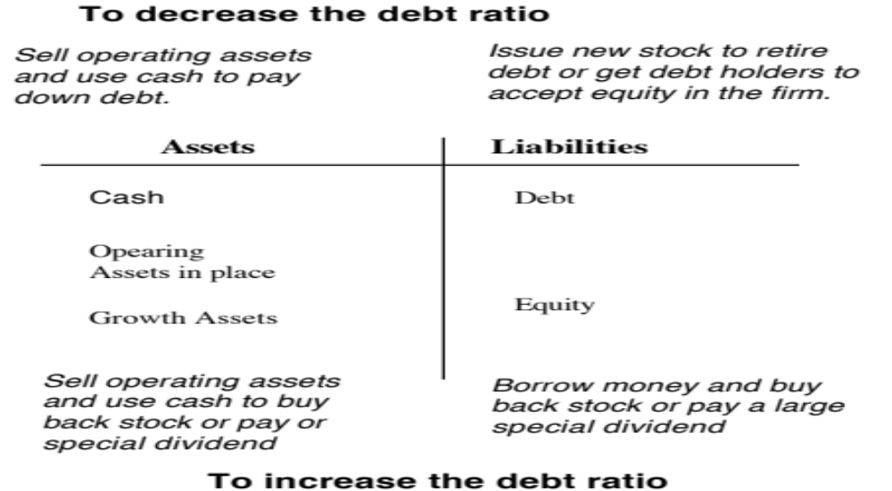
The Mechanics of Changing Debt Ratio quickly…
Notes:
To change the debt ratio, we can use either a pure recapitalization (where the assets remain unchanged but the liability side changes) or a mixed strategy where both sides of the balance sheet change. Which one you adopt will depend upon the market you are in (when capital markets are open and liquid, it is easier to do recapitalizations), the nature of your assets (liquid assets are easier to sell) and the magnitude of the change (bigger changes are more likely to require mixed strategies).

Slide 104
The mechanics of changing debt ratios over time… gradually…
To change debt ratios over time, you use the same mix of tools that you used to change debt ratios gradually:
  Dividends and stock buybacks: Dividends and stock buybacks will reduce the value of equity.
  Debt repayments: will reduce the value of debt.
The complication of changing debt ratios over time is that firm value is itself a moving target.
  If equity is fairly valued today, the equity value should change over time to reflect the expected price appreciation:
  Expected Price appreciation = Cost of equity – Dividend Yield
  Debt will also change over time, in conjunction as firm value changes.
Notes:
When debt ratios are changed over time, the biggest complication is that the firm value itself will change over time as a function of new investments made and expected growth in both equity and debt values. Put another way, trying to get to 40% of the firm value 5 years from now is more complicated than getting to 40% of firm value today… since firm value 5 years from now will be different from firm value today.

Slide 105
Designing Debt: The Fundamental Principle
The objective in designing debt is to make the cash flows on debt match up as closely as possible with the cash flows that the firm makes on its assets.
By doing so, we reduce our risk of default, increase debt capacity and increase firm value.
Notes:
Your objective is issue securities that bring you all of the tax benefits of debt while providing you with the flexibility of equity. It is not the reduction in risk but the increase in debt capacity that generates the value. A firm that does not use this debt capacity will not gain from matching debt to assets in the first place.

Slide 106
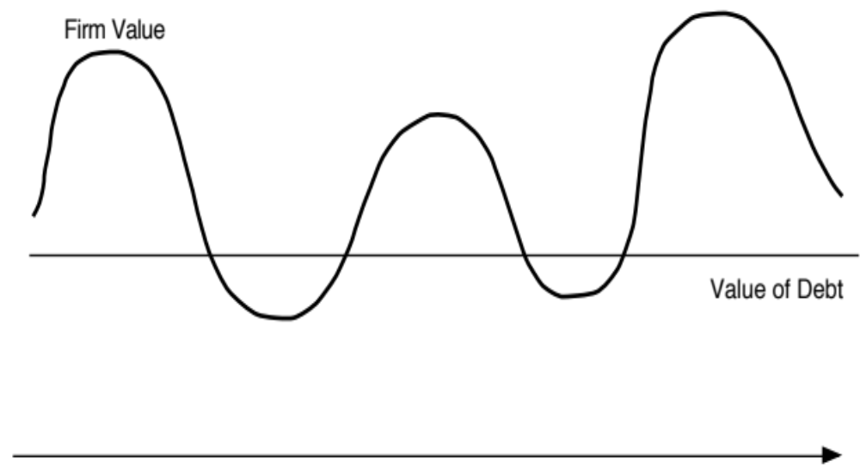
Firm with mismatched debt
Notes:
Note that the firm goes bankrupt in the two periods, when the firm value falls below the value of the debt.

Slide 107

Firm with matched Debt
Notes:
The same firm never goes bankrupt, even though it has borrowed a lot more.

Slide 108
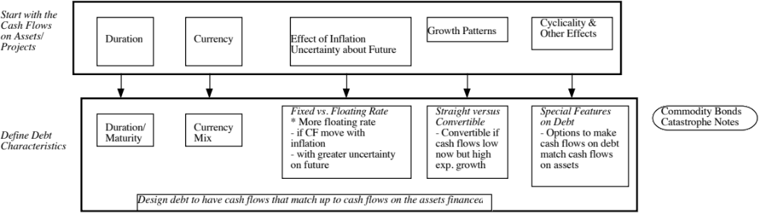
Design the perfect financing instrument
The perfect financing instrument will
  Have all of the tax advantages of debt
  While preserving the flexibility offered by equity
Notes:
There is ample scope for creativity in trying to design the perfect bond. The idea is to design debt that looks and acts like equity, in terms of the cash flows.
Consider each aspect;
Duration: Companies with long term projects (Boeing) should use long term debt. Companies with short term projects (Dell) should use short term debt.
Currency: Companies that get a high proportion of their revenues from non-domestic operations should use more foreign currency debt (especially if the currency mix is stable.
Inflation: Companies with pricing power can pass inflation through into their cash flows. These companies should be much better candidates for floating rate debt (because interest expenses on the debt will rise and fall with inflation).
Growth pattern: Mature companies with level , steady cash flows should be much better candidates for straight debt, whereas growth companies are much better candidates for convertible debt.

Slide 109

Ensuring that you have not crossed the line drawn by the tax code
All of this design work is lost, however, if the security that you have designed does not deliver the tax benefits.
In addition, there may be a trade off between mismatching debt and getting greater tax benefits.
Notes:
Note though that all is lost if the tax authorities do not allow you to subtract interest expenses for tax purposes.
It is also possible that you could increase your tax benefits by deviating from your perfect bond and issuing bonds in the wrong currency or the wrong maturity.

Slide 110
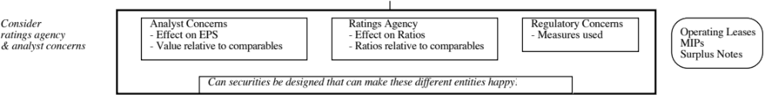
While keeping equity research analysts, ratings agencies and regulators applauding
Ratings agencies want companies to issue equity, since it makes them safer.
Equity research analysts want them not to issue equity because it dilutes earnings per share.
Regulatory authorities want to ensure that you meet their requirements in terms of capital ratios (usually book value).
Financing that leaves all three groups happy is nirvana.
Notes:
This is a tough balancing act to pull off. You have to issue a security that looks like equity to the ratings agency, debt to the equity research analysts and equity again to your regulatory authorities (if you are a financial service firm).
While it may seem impossible, trust preferred and several other very profitable innovations (at least to investment bankers) have succeeded in doing this.

Slide 111
Debt or Equity: The Strange Case of Trust Preferred
Trust preferred stock has
  A fixed dividend payment, specified at the time of the issue
  That is tax deductible
  And failing to make the payment can give these shareholders voting rights
When trust preferred was first created, ratings agencies treated it as equity. As they have become more savvy, ratings agencies have started giving firms only partial equity credit for trust preferred.
Notes:
Ratings agencies have learnt over time, but slowly. As they have learnt, investment banks have come up with new securities that have the same objective.

Slide 112
Debt, Equity and Quasi Equity
Assuming that trust preferred stock gets treated as equity by ratings agencies, which of the following firms is the most appropriate firm to be issuing it?
  A firm that is under levered, but has a rating constraint that would be violated if it moved to its optimal
  A firm that is over levered that is unable to issue debt because of the rating agency concerns.
Notes:
I would expect under levered firms to gain, and over levered firms to lose by doing this. The latter might fool the ratings agencies but they lose because of the expected default cost that they create for themselves.

Slide 113
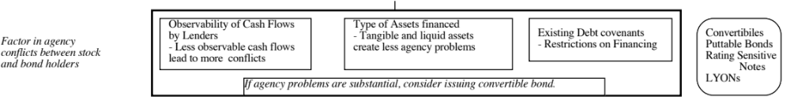
Soothe bondholder fears
There are some firms that face skepticism from bondholders when they go out to raise debt, because
  Of their past history of defaults or other actions
  They are small firms without any borrowing history
Bondholders tend to demand much higher interest rates from these firms to reflect these concerns.
Notes:
While adding these conditions to debt may make it less attractive to the firm, it may be only way they can borrow.

Slide 114
And do not lock in market mistakes that work against you
Ratings agencies can sometimes under rate a firm, and markets can under price a firm’s stock or bonds. If this occurs, firms should not lock in these mistakes by issuing securities for the long term. In particular,
  Issuing equity or equity based products (including convertibles), when equity is under priced transfers wealth from existing stockholders to the new stockholders
  Issuing long term debt when a firm is under rated locks in rates at levels that are far too high, given the firm’s default risk.
What is the solution
  If you need to use equity?
  If you need to use debt?
Notes:
When you feel that your equity or debt is under valued, you do not want to lock in the under valuation. You should use short-term solutions (bridge financing) until they feel more comfortable with the valuations. Bridge financing includes short term debt and short term warrants.

Slide 115
Designing Debt: Bringing it all together
Start with the
Cyclicality &
Cash Flows
Duration
Currency
Effect of Inflation
Growth Patterns
Other Effects
on Assets/
Uncertainty about Future
Projects
Fixed vs. Floating Rate
Straight versus
Special Features
Commodity Bonds
Define Debt
Duration/
Currency
* More floating rate
Convertible
on Debt
Catastrophe Notes
Characteristics
Maturity
Mix
- if CF move with
- Convertible if
- Options to make
inflation
cash flows low
cash flows on debt
- with greater uncertainty
now but high
match cash flows
on future
exp. growth
on assets
Design debt to have cash flows that match up to cash flows on the assets financed
Overlay tax
Deductibility of cash flows
Differences in tax rates
Zero Coupons
preferences
for tax purposes
across different locales
If tax advantages are large enough, you might override results of previous step
Consider
Analyst Concerns
Ratings Agency
Regulatory Concerns
ratings agency
- Effect on EPS
- Effect on Ratios
- Measures used
Operating Leases
& analyst concerns
- Value relative to comparables
- Ratios relative to comparables
MIPs
Surplus Notes
Can securities be designed that can make these different entities happy?
Observability of Cash Flows
Type of Assets financed
Existing Debt covenants
Convertibiles
Factor in agency
by Lenders
- Tangible and liquid assets
- Restrictions on Financing
Puttable Bonds
conflicts between stock
- Less observable cash flows
create less agency problems
Rating Sensitive
and bond holders
lead to more conflicts
Notes
If agency problems are substantial, consider issuing convertible bonds
LYONs
Consider Information
Uncertainty about Future Cashflows
Credibility & Quality of the Firm
Asymmetries
- When there is more uncertainty, it
- Firms with credibility problems
may be better to use short term debt
will issue more short term debt
Notes:
This provides the basic framework for designing the right kind of debt.
You begin by trying to match up financing type to asset type (in terms of duration, currency, growth patterns and special features). By doing so, you reduce your risk of bankruptcy, increase your capacity to borrow and consequently the tax benefits of debt.
Then, you modify the “perfect debt”
For tax factors, to ensure that you get the maximum tax benefit
To meet the needs and objectives of equity research analysts and ratings agencies
To fix any agency conflicts that might prevent lenders from lending
To prevent an undeservedly low rating from pushing up the cost of debt above what it should be. (If you are under rated, you should probably use short term debt until you feel your rating is justified)

Slide 116
Approaches for evaluating Asset Cash Flows
I. Intuitive Approach
  Are the projects typically long term or short term? What is the cash flow pattern on projects?
  How much growth potential does the firm have relative to current projects?
  How cyclical are the cash flows? What specific factors determine the cash flows on projects?
II. Project Cash Flow Approach
  Estimate expected cash flows on a typical project for the firm
  Do scenario analyses on these cash flows, based upon different macro economic scenarios
III. Historical Data
  Operating Cash Flows
  Firm Value
Notes:
These are the three basic approaches to assessing the cash flow characteristics of your asset base. The last two approaches provide more quantitative answers but may not work for companies which have a short history or have changed their asset mixes over time.

Slide 117
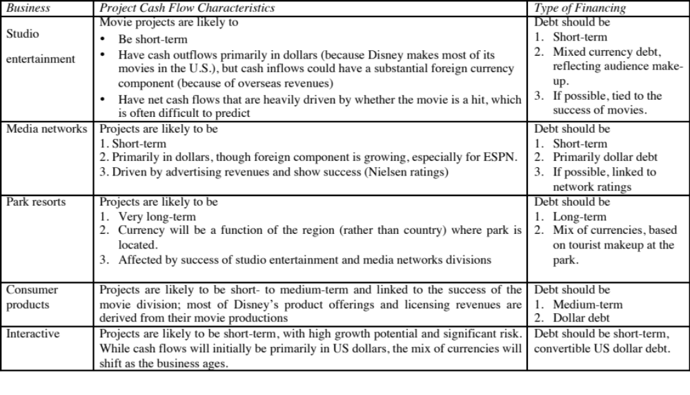
I. Intuitive Approach - Disney
Notes:
There is plenty of room to be creative in this approach.
Look at firms which operate in each of these businesses and see what financing they use. That might be useful in designing the right kind of debt.

Slide 118
6 Application Test: Choosing your Financing Type
Based upon the business that your firm is in, and the typical investments that it makes, what kind of financing would you expect your firm to use in terms of
  Duration (long term or short term)
  Currency
  Fixed or Floating rate
  Straight or Convertible
Notes:
Based upon what a typical investment looks like, assess the right type of debt for your firm….

Slide 119
II. Project Specific Financing
With project specific financing, you match the financing choices to the project being funded. The benefit is that the the debt is truly customized to the project.
Project specific financing makes the most sense when you have a few large, independent projects to be financed. It becomes both impractical and costly when firms have portfolios of projects with interdependent cashflows.
Notes:
If you have large, stand alone projects, you can try to match the debt specifically to the project’s characteristics. If you take lots of smaller projects, you will often find it less costly to finance a portfolio of projects rather than each project individually.

Slide 120
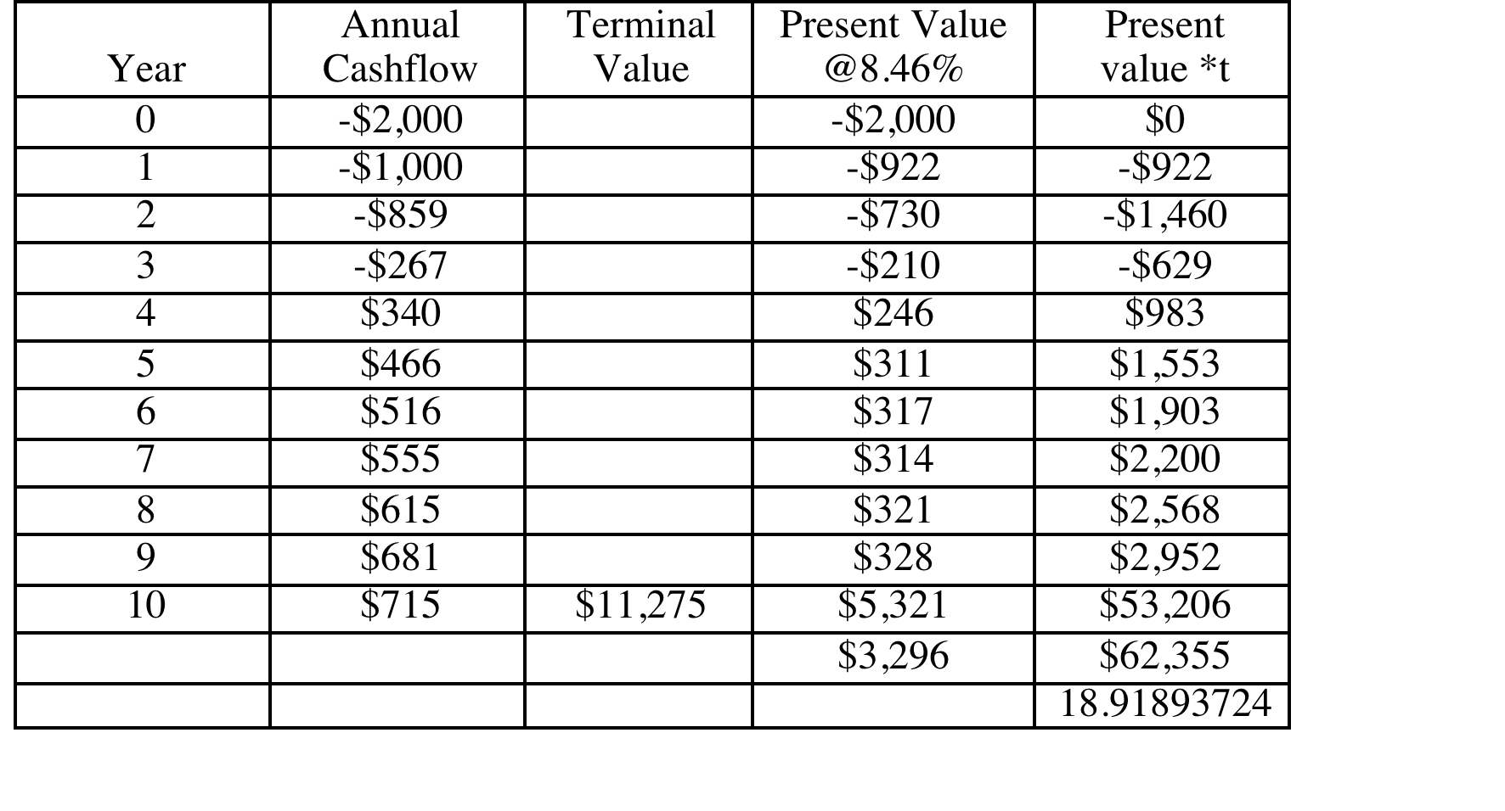
Duration of Disney Theme Park
Duration of the Project = 62,355/3296 = 18.92 years
Notes:
We have used the projected cash flows on the Disney theme park to estimate the duration of the theme park.
This understates the duration,
Since cash flows are likely to drop if interest rates go up
Since we have arbitrarily estimated a terminal value at the end of year 10.

Slide 121
The perfect theme park debt…
The perfect debt for this theme park would have a duration of roughly 19 years and be in a mix of Latin American currencies (since it is located in Brazil), reflecting where the visitors to the park are coming from.
If possible, you would tie the interest payments on the debt to the number of visitors at the park.
Notes:
It is entirely possible that the park will pull visitors from a wider global area (say Australia and New Zealand), in which case we should alter the currency mix.

Slide 122
III. Firm-wide financing
Rather than look at individual projects, you could consider the firm to be a portfolio of projects. The firm’s past history should then provide clues as to what type of debt makes the most sense.
Operating Cash Flows
    The question of how sensitive a firm’s asset cash flows are to a variety of factors, such as interest rates, inflation, currency rates and the economy, can be directly tested by regressing changes in the operating income against changes in these variables.
    This analysis is useful in determining the coupon/interest payment structure of the debt.
Firm Value
    The firm value is clearly a function of the level of operating income, but it also incorporates other factors such as expected growth & cost of capital.
    The firm value analysis is useful in determining the overall structure of the debt, particularly maturity.
Notes:
Each measures a different aspect of the firm.
The operating cash flows measure the year-to-year capacity of the firm to generate cash flows.
Firm value reflects current operating income, as well as the expected growth and the cost of capital.

Slide 123
Disney: Historical Data
Date | Operating Income | Enterprise Value (V) | % Chg in OI | % Chg in V
2013 | 9450 | $126,815 | 6.62% | 21.09%
2012 | 8863 | $104,729 | 13.91% | 56.85%
2011 | 7781 | $66,769 | 15.69% | -9.19%
2010 | 6726 | $73,524 | 18.06% | 22.84%
2009 | 5697 | $59,855 | -23.06% | -18.11%
2008 | $7,404 | $73,091 | 8.42% | -6.27%
2007 | $6,829 | $77,980 | 27.53% | 2.98%
2006 | $5,355 | $75,720 | 30.39% | 27.80%
2005 | $4,107 | $59,248 | 1.46% | 2.55%
2004 | $4,048 | $57,776 | 49.21% | 9.53%
2003 | $2,713 | $52,747 | 13.80% | 20.45%
2002 | $2,384 | $43,791 | -15.82% | -9.01%
2001 | $2,832 | $48,128 | 12.16% | -45.53%
2000 | $2,525 | $88,355 | -22.64% | 35.67%
1999 | $3,264 | $65,125 | -15.07% | -5.91%
1998 | $3,843 | $69,213 | -2.59% | 6.20%
1997 | $3,945 | $65,173 | 30.46% | 18.25%
1996 | $3,024 | $55,116 | 33.69% | 77.65%
1995 | $2,262 | $31,025 | 25.39% | 39.75%
1994 | $1,804 | $22,200 | 15.64% | 9.04%
1993 | $1,560 | $20,360 | 21.21% | 6.88%
1992 | $1,287 | $19,049 | 28.19% | 23.89%
1991 | $1,004 | $15,376 | -21.99% | 26.50%
1990 | $1,287 | $12,155 | 16.05% | -23.64%
1989 | $1,109 | $15,918 | 40.56% | 101.93%
1988 | $789 | $7,883 | 11.60% | -23.91%
1987 | $707 | $10,360 | 53.03% | 83.69%
1986 | $462 | $5,640 | 25.20% | 61.23%
1985 | $369 | $3,498 | 157.99% | 24.37%
Notes:
Disney has changed changed considerably over time in terms of its business mix. It has increasingly moved into the broadcasting business and its animated movies are only a small portion of its overall movie offerings.
The firm value is the market value of equity plus the book value of debt outstanding in each year. ( I would have preferred to use market value of debt, but book value seems like a reasonable proxy)
In doing this table, we reverted back to reported EBIT, rather than using the adjusted EBIT that we have been working with so far.

Slide 124
The Macroeconomic Data
Date | Change in T.Bond rate | % Chg in GDP | % Change in CPI | % Change in US $
2013 | 1.07% | 1.83% | 1.18% | 4.89%
2012 | -0.11% | 2.20% | -1.03% | 2.75%
2011 | -1.37% | 1.81% | 1.48% | -4.59%
2010 | -0.53% | 2.39% | 1.97% | -3.64%
2009 | 1.29% | -3.07% | -3.98% | 5.79%
2008 | -1.44% | -1.18% | -4.26% | 10.88%
2007 | -0.65% | 2.93% | 2.19% | -11.30%
2006 | 0.30% | 3.40% | -1.84% | -2.28%
2005 | 0.16% | 3.68% | 0.66% | 3.98%
2004 | 0.13% | 3.72% | 1.34% | -3.92%
2003 | 0.05% | 4.32% | -0.65% | -14.59%
2002 | -0.97% | 2.80% | 1.44% | -11.17%
2001 | -0.18% | -0.04% | -2.50% | 7.45%
2000 | -0.98% | 2.24% | 0.96% | 7.73%
1999 | 1.56% | 4.70% | 1.04% | 1.68%
1998 | -1.03% | 4.51% | 0.11% | -4.08%
1997 | -0.63% | 4.33% | -1.43% | 9.40%
1996 | 0.80% | 4.43% | 0.31% | 4.14%
1995 | -2.09% | 2.01% | -0.08% | -0.71%
1994 | 1.92% | 4.12% | 0.27% | -5.37%
1993 | -0.83% | 2.50% | -0.72% | 0.56%
1992 | -0.02% | 4.15% | 0.64% | 6.89%
1991 | -1.26% | 1.09% | -2.89% | 0.69%
1990 | 0.12% | 0.65% | 0.43% | -8.00%
1989 | -1.11% | 2.66% | 0.51% | 2.04%
1988 | 0.26% | 3.66% | 0.60% | 1.05%
1987 | 1.53% | 4.49% | 2.54% | -12.01%
1986 | -1.61% | 2.83% | -2.33% | -15.26%
1985 | -2.27% | 4.19% | 3.89% | -13.51%
Notes:
This would apply to any firm that we would analyze over this time period.

Slide 125
I. Sensitivity to Interest Rate Changes
How sensitive is the firm’s value and operating income to changes in the level of interest rates?
The answer to this question is important because it
  it provides a measure of the duration of the firm’s projects
  it provides insight into whether the firm should be using fixed or floating rate debt.
Notes:
How much has firm value changed for a given change in interest rates?

Slide 126
Firm Value versus Interest Rate Changes
Regressing changes in firm value against changes in interest rates over this period yields the following regression –
  Change in Firm Value = 0.1790 – 2.3251 (Change in Interest Rates)
  (2.74) (0.39)
  T statistics are in brackets.
The coefficient on the regression (-2.33) measures how much the value of Disney as a firm changes for a unit change in interest rates.
Notes:
These regressions tend to be noisy, even for firms with substantial historical data.
Industry-average coefficients might provide more reliable estimates (just as sector betas are often better than firm-specific betas)

Slide 127
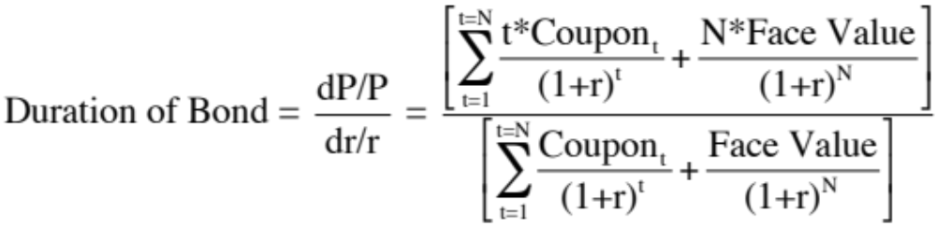
Why the coefficient on the regression is duration..
The duration of a straight bond or loan issued by a company can be written in terms of the coupons (interest payments) on the bond (loan) and the face value of the bond to be –
The duration of a bond measures how much the price of the bond changes for a unit change in interest rates.
Holding other factors constant, the duration of a bond will increase with the maturity of the bond, and decrease with the coupon rate on the bond.
Notes:
This is a traditional Macaulay duration. It is a measure of the percentage change in the bond price for a 1% change in interest rates.
Equivalently, it can be viewed as the maturity of a zero-coupon bond with the same sensitivity to interest rate changes.
Note, in the regression on the previous page, the coefficient on the change in interest rates, measures the percentage change in firm value for a 1% change in interest rates. Thus, the regression coefficient also measures duration.

Slide 128
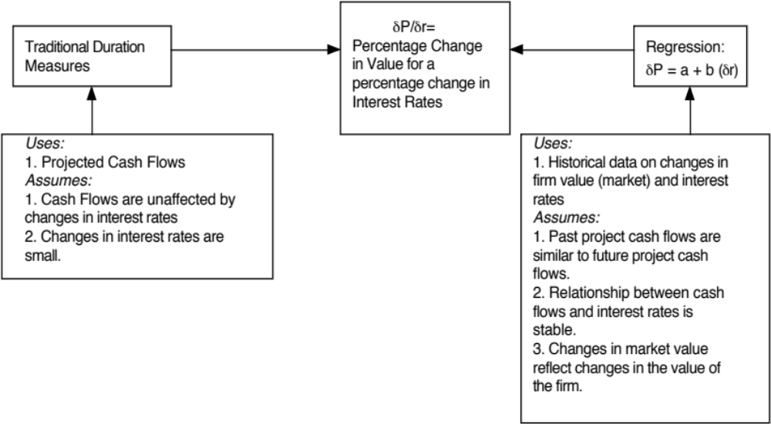
Duration: Comparing Approaches
Notes:
It is very difficult to estimate Macaulay Duration on a project-by-project basis for all the projects that a firm has.
It is much easier to run the regression, but the results are likely to be noisy and affected by whether the firm’s business mix has changed over time.
This leaves us with
The intuitive analysis that preceded this section
Industry average duration numbers, which can be used for any firm in that industy

Slide 129
Operating Income versus Interest Rates
Regressing changes in operating cash flow against changes in interest rates over this period yields the following regression –
Change in Operating Income = 0.1698 – 7.9339 (Change in Interest Rates) (2.69ª) (1.40)
  Conclusion: Disney’s operating income has been affected a lot more than its firm value has by changes in interest rates.
Notes:
This measures the effect of interest rates on operating income. Firm value will be affected more because discount rates tend to also go up when interest rates increase.

Slide 130
II. Sensitivity to Changes in GDP/ GNP
How sensitive is the firm’s value and operating income to changes in the GNP/GDP?
The answer to this question is important because
  it provides insight into whether the firm’s cash flows are cyclical and
  whether the cash flows on the firm’s debt should be designed to protect against cyclical factors.
If the cash flows and firm value are sensitive to movements in the economy, the firm will either have to issue less debt overall, or add special features to the debt to tie cash flows on the debt to the firm’s cash flows.
Notes:
Is the firm a cyclical firm? Cyclical firms should have operating income that moves with the economy. Value might not, since markets can look past cycles. In this case, the operating income regression may be the more valuable one.

Slide 131
Regression Results
Regressing changes in firm value against changes in the GDP over this period yields the following regression –
Change in Firm Value = 0.0067 + 6.7000 (GDP Growth)
(0.06) (2.03ª)
Conclusion: Disney is sensitive to economic growth
Regressing changes in operating cash flow against changes in GDP over this period yields the following regression –
Change in Operating Income = 0.0142 + 6.6443 ( GDP Growth)
(0.13) (2.05ª)
Conclusion: Disney’s operating income is sensitive to economic growth as well.
Notes:
Disney has increasingly become a cyclical firm. (In previous iterations in 1997 and 2003, it was insensitive to economic growth…) This may reflect its increasing dependence on broadcasting (where advertising is cyclical) and grown up movies.

Slide 132
III. Sensitivity to Currency Changes
How sensitive is the firm’s value and operating income to changes in exchange rates?
The answer to this question is important, because
  it provides a measure of how sensitive cash flows and firm value are to changes in the currency
  it provides guidance on whether the firm should issue debt in another currency that it may be exposed to.
If cash flows and firm value are sensitive to changes in the dollar, the firm should
  figure out which currency its cash flows are in;
  and issued some debt in that currency
Notes:
Again, we are assuming that the historical exposure of earnings and firm value to currencies is a good measure of future exposure.

Slide 133
Regression Results
Regressing changes in firm value against changes in the dollar over this period yields the following regression –
Change in Firm Value = 0.1774– 0.5705 (Change in Dollar)
(2.76) (0.67)
Conclusion: Disney’s value is sensitive to exchange rate changes, decreasing as the dollar strengthens. However, the effect is statistically insignificant.
Regressing changes in operating cash flow against changes in the dollar over this period yields the following regression –
Change in Operating Income = 0.1680 – 1.6773 (Change in Dollar)
(2.82ª) (2.13ª )
Conclusion: Disney’s operating income is more strongly impacted by the dollar than its value is. A stronger dollar seems to hurt operating income.
Notes:
The negative effect of the stronger dollar on operating income might reflect the revenues that Disney gets from tourists at its theme parks. These tourists are less likely to visit the theme parks when the dollar is stronger.
While firm value also goes down, the effect is less significant.

Slide 134
IV. Sensitivity to Inflation
How sensitive is the firm’s value and operating income to changes in the inflation rate?
The answer to this question is important, because
  it provides a measure of whether cash flows are positively or negatively impacted by inflation.
  it then helps in the design of debt; whether the debt should be fixed or floating rate debt.
If cash flows move with inflation, increasing (decreasing) as inflation increases (decreases), the debt should have a larger floating rate component.
Notes:
On floating rate debt, interest expenses tend to increase as market interest rates increase. We are assuming that year-to-year changes in interest rates are driven primarily by changes in inflation.

Slide 135
Regression Results
Regressing changes in firm value against changes in inflation over this period yields the following regression –
Change in Firm Value = 0.1855 + 2.9966 (Change in Inflation Rate)
(2.96) (0.90)
  Conclusion: Disney’s firm value does seem to increase with inflation, but not by much (statistical significance is low)
Regressing changes in operating cash flow against changes in inflation over this period yields the following regression –
Change in Operating Income = 0.1919 + 8.1867 (Change in Inflation Rate)
(3.43ª) (2.76ª )
Conclusion: Disney’s operating income increases in periods when inflation increases, suggesting that Disney does have pricing power.
Notes:
Operating income tends to move with inflation, but firm value does not as much. (This is not surprising, if cashflow effects and discount rate effects cancel out)
I would weigh the operating income regression more in determining whether to use floating rate or fixed rate debt, since the cash flows each year go towards paying the coupons.

Slide 136
Summarizing…
Looking at the four macroeconomic regressions, we would conclude that
  Disney’s assets collectively have a duration of about 2.33 years
  Disney is increasingly affected by economic cycles
  Disney is hurt by a stronger dollar
  Disney’s operating income tends to move with inflation
All of the regression coefficients have substantial standard errors associated with them. One way to reduce the error (a la bottom up betas) is to use sector-wide averages for each of the coefficients.
Notes:
Summarizes the results of the regressions… Caveat: The regressions have low R-squareds and any or all of these estimates could be wrong by a large amount.

Slide 137
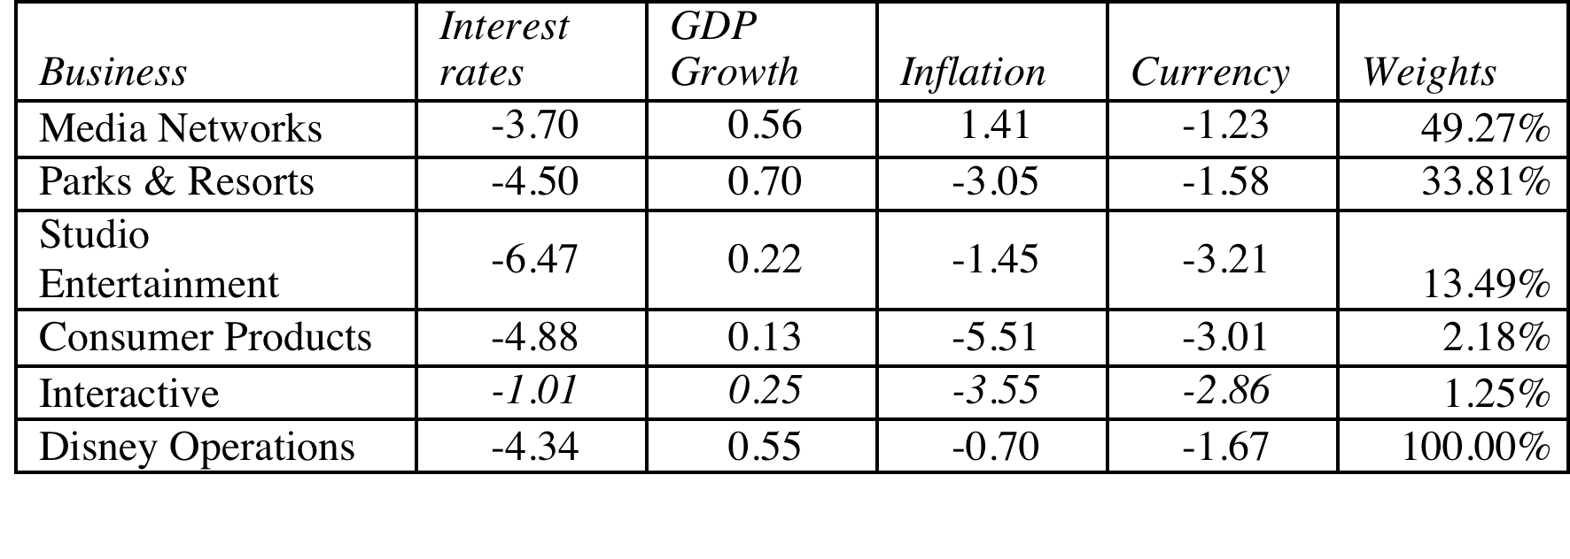
Bottom-up Estimates
These weights reflect the estimated values of the businesses
Notes:
Since the standard errors on the regression estimates are so high, this alternative may yield more precise estimates of the each of the coefficients. To obtain these bottom up values, we ran the regressions for each firm in the sector and averaged out the coefficients.

Slide 138
Recommendations for Disney
The debt issued should be long term and should have duration of about 4.3 years.
A significant portion of the debt should be floating rate debt, reflecting Disney’s capacity to pass inflation through to its customers and the fact that operating income tends to increase as interest rates go up.
Given Disney’s sensitivity to a stronger dollar, a portion of the debt should be in foreign currencies. The specific currency used and the magnitude of the foreign currency debt should reflect where Disney makes its revenues. Based upon 2013 numbers at least, this would indicate that about 18% of its debt should be in foreign currencies (and perhaps more, since even their US dollar income can be affected by currency movements).
Notes:
Converts the numbers into tangible recommendations…

Slide 139
Analyzing Disney’s Current Debt
Disney has $14.3 billion in interest-bearing debt with a face-value weighted average maturity of 7.92 years. Allowing for the fact that the maturity of debt is higher than the duration, this would indicate that Disney’s debt may be a little longer than would be optimal, but not by much.
Of the debt, about 5.49% of the debt is in non-US dollar currencies (Indian rupees and Hong Kong dollars), but the rest is in US dollars and the company has no Euro debt. Based on our analysis, we would suggest that Disney increase its proportion of Euro debt to about 12% and tie the choice of currency on future debt issues to its expansion plans.
Disney has no convertible debt and about 5.67% of its debt is floating rate debt, which looks low, given the company’s pricing power. While the mix of debt in 2013 may be reflective of a desire to lock in low long-term interest rates on debt, as rates rise, the company should consider expanding its use of foreign currency debt.
Notes:
There may be good reasons for the mismatch but for most firms, the existing debt structure is more a result of history and inertia. Disney’s business mix has changed significantly over the last decade - more broadcasting, less theme park - and it is not surprising that the debt structure has not kept pace.
In some cases, market frictions and limitations may contribute to the mismatch. In fact, many emerging market companies were unable to borrow long term until recently because banks would not lend long term in those markets.

Slide 140
Adjusting Debt at Disney
It can swap some of its existing fixed rate, dollar debt for floating rate, foreign currency debt. Given Disney’s standing in financial markets and its large market capitalization, this should not be difficult to do.
If Disney is planning new debt issues, either to get to a higher debt ratio or to fund new investments, it can use primarily floating rate, foreign currency debt to fund these new investments. Although it may be mismatching the funding on these investments, its debt matching will become better at the company level.
Notes:
Disney’s large size and access to capital markets give it lots of options. Smaller firms and emerging market firms will have fewer options. In the extreme scenario, it may take more time to adjust the debt.

Slide 141
Debt Design for Bookscape & Vale
Bookscape: Given Bookscape’s dependence on revenues at its New York bookstore, we would design the debt to be
  Recommendation: Long-term, dollar denominated, fixed rate debt
  Actual: Long term operating lease on the store
Vale: Vale’s mines are spread around the world, and it generates a large portion of its revenues in China (37%). Its mines typically have very long lives and require large up-front investments, and the costs are usually in the local currencies but its revenues are in US dollars.
  Recommendation: Long term, dollar-denominated debt (with hedging of local currency risk exposure) and if possible, tied to commodity prices.
  Actual: The existing debt at Vale is primarily US dollar debt (65.48%), with an average maturity of 14.70 years. All of the debt, as far as we can assess, is fixed rate and there is no commodity-linked debt.
Notes:
We don’t even try to assess Deutsche’s right debt because its assets are constantly changing and debt plays a different role in a bank… it is more raw material than source of capital.

Slide 142
And for Tata Motors and Baidu
Tata Motors: As an manufacturing firm, with big chunks of its of its revenues coming from India and China (about 24% apiece) and the rest spread across developed markets.
  Recommendation: Medium to long term, fixed rate debt in a mix of currencies reflecting operations.
  Actual: The existing debt at Tata Motors is a mix of Indian rupee debt (about 71%) and Euro debt (about 29%), with an average maturity of 5.33 years and it is almost entirely fixed rate debt.
Baidu: Baidu has relatively little debt at the moment, reflecting its status as a young, technology company.
  Recommendation: Convertible, Chinese Yuan debt.
  Actual: About 82% of Baidu’s debt is in US dollars and Euros currently, with an average maturity of 5.80 years. A small portion is floating rate debt, but very little of the debt is convertible.

Slide 143
Returning Cash to the Owners: Dividend Policy
“Companies don’t have cash. They hold cash for their stockholders.”

Slide 144
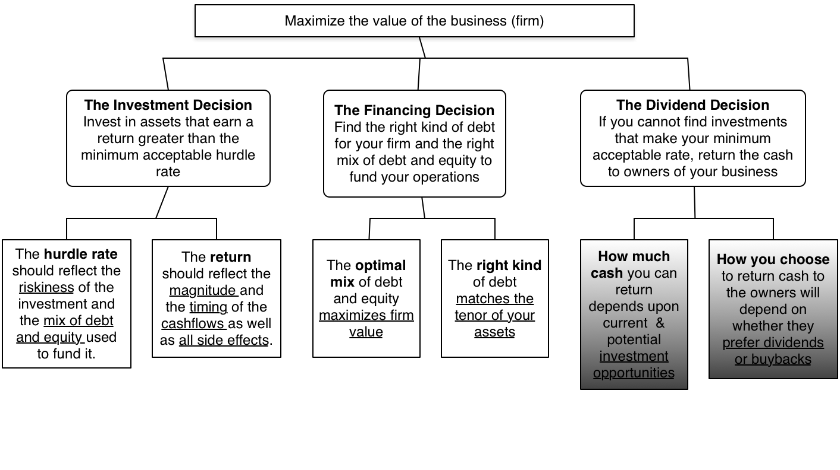
First Principles
Notes:
Third and final principle of corporate finance.

Slide 145
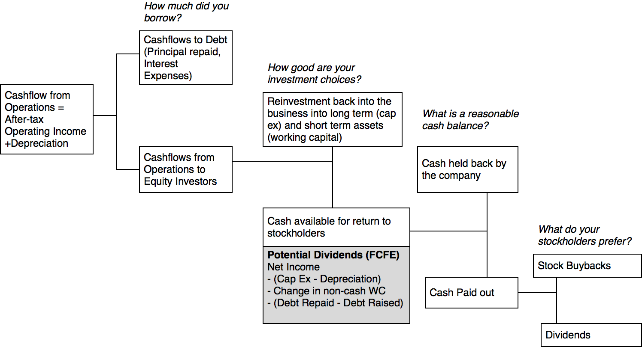
Steps to the Dividend Decision… if equity is treated as a residual claim
Notes:
Dividend policy is affected by investment and financing decisions…. And dividend decisions may affect investment and financing decisions. In other words, analyzing dividends has to be part and parcel of analyzing the whole company.

Slide 146
The Roots of Dividend Dysfunction
In practice, dividend policy is dysfunctional and does not follow the logical process of starting with your investment opportunities and working your way down to residual cash.
The two dominant factors driving dividend policy around the world are:
  Inertia: Companies seem to hate to let of their past, when it comes to dividend policy.
  Me-too-ism: Companies want to behave like their peer group.

Slide 147
I. Dividends are sticky
Notes:
Most companies in most years pay out what they did last year as dividends. Among firms that change dividends, increases are more common than decreases.

Slide 148
The last quarter of 2008 put stickiness to the test.. Number of S&P 500 companies that…
Quarter | Dividend Increase | Dividend initiated | Dividend decrease | Dividend suspensions
Q1 2007 | 102 | 1 | 1 | 1
Q2 2007 | 63 | 1 | 1 | 5
Q3 2007 | 59 | 2 | 2 | 0
Q4 2007 | 63 | 7 | 4 | 2
Q1 2008 | 93 | 3 | 7 | 4
Q2 2008 | 65 | 0 | 9 | 0
Q3 2008 | 45 | 2 | 6 | 8
Q4 2008 | 32 | 0 | 17 | 10
Notes:
If there was a quarter than should have shaken up the policy of leaving dividends unchanged, it should have been the last quarter of 2008, when markets collapsed globally and there were fears of a credit crisis. In the face of this mountain of bad news, more companies still increased dividends than suspended or cut them.

Slide 149
II. Dividends tend to follow earnings
Notes:
Dividends tend to follow earnings. They don’t lead them and they are not contemporaneous. In other words, don’t expect a company to pay out more in dividends if their earnings go up… If earnings go up two years in a row, maybe.. Three years in a row and the odds increase.

Slide 150
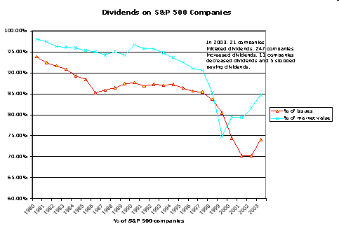
III. Are affected by tax laws…
In 2003
In the last quarter of 2012
As the possibility of tax rates reverting back to pre-2003 levels rose, 233 companies paid out $31 billion in dividends.
Of these companies, 101 had insider holdings in excess of 20% of the outstanding stock.
Notes:
In 2003, for the first time in decades, the tax rate on dividends was cut to 15% to match the tax rate on capital gains. How firms responded in terms of dividend policy is a good test of the tax effect.
More firms initiated dividends in 2003 and more dividends were paid, but the effect was muted. Stock buybacks still overwhelmed dividends.
The lesson: Taxes may affect dividend policy but they are not the key determinant.
In the last quarter of 2012, with the fiscal cliff looming, companies paid out huge amounts in special dividends.

Slide 151
IV. More and more US firms are buying back stock, rather than pay dividends...
Notes:
This trend accelerated through the 1990s. It can be partially explained by
An increase in the volatility of earnings at all companies, making dividends much more difficult to maintain
An increasing proportion of investors who invested primarily for capital gains
Managers being compensated with options like stock buybacks more than dividends since the latter leads to lower stock prices.

Slide 152
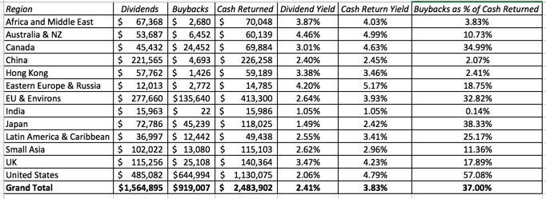
And its going global..
The 2015 Numbers
Notes:
In 2015, 57% of the cash that US companies returned to stockholders came from buybacks, putting them in front. But Japanese, Canadian and European companies are starting to catch up, Latin America is also moving up and Asia (other than Japan) has been slow.

Slide 153
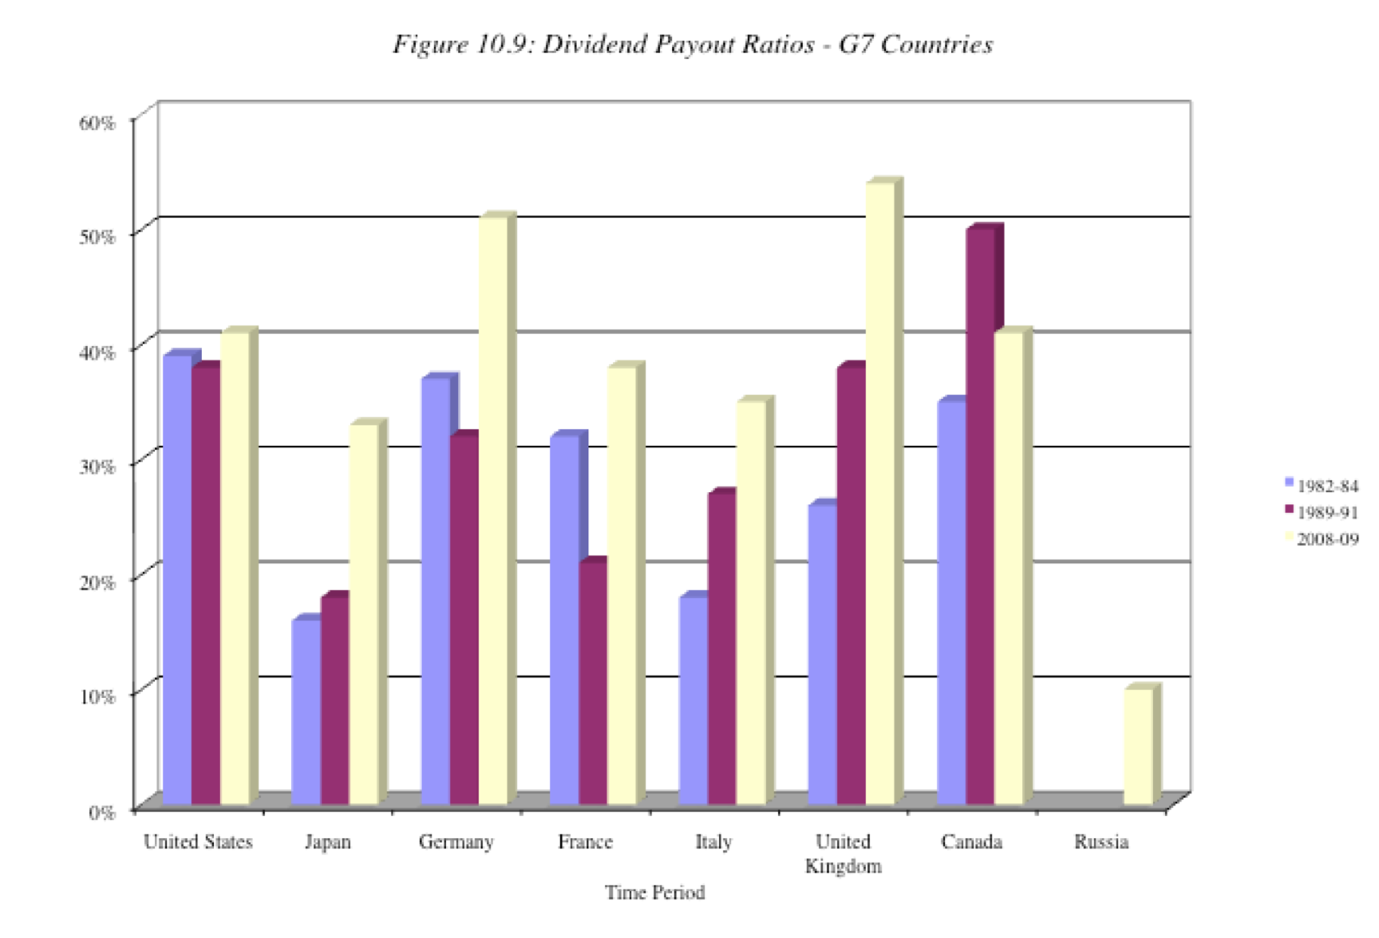
V. And there are differences across countries…
Notes:
Dividend policy vary across countries.
1. Differences in Stage of Growth: Just as higher-growth companies tend to pay out less of their earnings in dividends countries with higher growth pay out less in dividends. For instance, Japan had much higher expected growth in 1982–84 than the other G-7 countries and paid out a much smaller percentage of its earnings as dividends. As Japan’s growth declined, its payout ratio has risen.
2. Differences in Tax Treatment: Unlike the United States, where dividends are doubly taxed, some countries provide at least partial protection against the double taxation of dividends. For instance, Germany taxes corporate retained earnings at a higher rate than corporate dividends and the United Kingdom allows investors to offset corporate taxes against taxes due on dividends, thus reducing the effective tax rate on dividends.
3. Differences in Corporate Control: When there is a separation between ownership and management, as there is in many large publicly traded firms, and where stockholders have little control over managers, the dividends paid by firms will be lower. Managers, left to their own devices, have an incentive to accumulate cash. Russia, with its abysmal corporate governance system, has a dividend payout ratio of less than 10% in 2009.
4. Stock buyback restrictions: Especially in earlier perods, non_US companies faced restrictions on stock buybacks.
Not surprisingly, the dividend payout ratios of companies in most emerging markets are much lower than the dividend payout ratios in the G-7 countries. The higher growth and relative power of incumbent management in these countries contribute to keeping these payout ratios low.

Slide 154
Measures of Dividend Policy
Dividend Payout = Dividends/ Net Income
  Measures the percentage of earnings that the company pays in dividends
  If the net income is negative, the payout ratio cannot be computed.
Dividend Yield = Dividends per share/ Stock price
  Measures the return that an investor can make from dividends alone
  Becomes part of the expected return on the investment.
Notes:
These are the two most common measures of dividend. They both focus on traditional dividends, and could be modified to include stock buybacks.

Slide 155

Dividend Payout Ratio: January 2016

Slide 156
Dividend Yields: January 2016
Notes:
Here again, there is a trend. Over the last two decades, the dividend yield for U.S. firms has decreased across the board.
In 2009, the dividend yields shot up, not because dividends increased but stock prices decreased. In 2010, they were back down again, as stock prices rebounded.
Bottom line: Volatility in dividend yields is caused more by changes in the denominator (stock prices) than in the numerator (dividends)

Slide 157

Notes:
One way of assessing dividend policy is to look at where a firm stands in the life cycle. As firms grow and mature, their capacity to generate excess cash flows and pay dividends should increase….

Slide 158
Dividend Yields and Payout Ratios: Growth Classes
Notes:
Some backing for the life cycle story.
These are US firms, categorized based upon expected growth in earnings. As earnings growth increases, both dividend yields and payout ratios decrease.

Slide 159

Dividend Policy: Disney, Vale, Tata Motors, Baidu and Deutsche Bank
Notes:
Other than Baidu, all of the companies paid dividends. While the payout ratio was low for Disney and Tata Motors, it is more than 100% for Vale (perhaps reflecting expectations that the company’s earnings will bounce back) and Deutsche (for the same reason). The low dividend yield for all of the companies, other than Vale, indicate that as investors it is price appreciation that will determine whether you earn a reasonable return on these companies, not dividends.

Slide 160
Three Schools Of Thought On Dividends
If there are no tax disadvantages associated with dividends & companies can issue stock, at no issuance cost, to raise equity, whenever needed
  Dividends do not matter, and dividend policy does not affect value.
If dividends create a tax disadvantage for investors (relative to capital gains)
  Dividends are bad, and increasing dividends will reduce value
If dividends create a tax advantage for investors (relative to capital gains) and/or stockholders like dividends
  Dividends are good, and increasing dividends will increase value
Notes:
Note that the schools span the spectrum. Firms which increase, decrease or do nothing on dividends can all find something in one of these schools to justify their actions.
There is truth in each of these schools of thought. The key to sensible dividend analysis is extracting that which makes sense from each school and bringing them all together in a composite analysis.

Slide 161
The balanced viewpoint
If a company has excess cash, and few good investment opportunities (NPV>0), returning money to stockholders (dividends or stock repurchases) is good.
If a company does not have excess cash, and/or has several good investment opportunities (NPV>0), returning money to stockholders (dividends or stock repurchases) is bad.
Notes:
These propositions are really not about dividends, but about returning cash to the owners of the business. Firms which want to return money to stockholders can buy back stock or pay dividends.

Slide 162
The Dividends don’t matter school
The Miller Modigliani Hypothesis
The Miller-Modigliani Hypothesis: Dividends do not affect value
Basis:
  If a firm's investment policies (and hence cash flows) don't change, the value of the firm cannot change as it changes dividends.
  If a firm pays more in dividends, it will have to issue new equity to fund the same projects. By doing so, it will reduce expected price appreciation on the stock but it will be offset by a higher dividend yield.
  If we ignore personal taxes, investors have to be indifferent to receiving either dividends or capital gains.
Underlying Assumptions:
  (a) There are no tax differences to investors between dividends and capital gains.
  (b) If companies pay too much in cash, they can issue new stock, with no flotation costs or signaling consequences, to replace this cash.
  (c) If companies pay too little in dividends, they do not use the excess cash for bad projects or acquisitions.
Notes:
This summarizes the MM argument for why dividend policy is irrelevant.
Generally, firms that pay too much in dividends lose value because they cannot take value-creating projects that they should. In the MM world, this cost is eliminated by assuming that these firms can raise the capital (with no transactions costs and no frictions) to take these projects.
Investors who receive dividends often face a much larger tax bill than investors who get capital gains. This is eliminated by assuming that there are no tax disadvantages associated with dividends.
Intuitively, the MM proposition argues that your total returns on a stock will be unaffected by dividend policy.

Slide 163
II. The Dividends are “bad” school: And the evidence to back them up…
Notes:
This has generally been true in the United States, but is not always the case in other markets. For instance, in the UK, where investors are allowed to offset the corporate tax paid on dividends against their taxes, dividends may have a tax advantage for some investors over capital gains.
There are several markets where capital gains are not taxed at all and some where neither dividends nor capital gains are taxed.

Slide 164
What do investors in your stock think about dividends? Clues on the ex-dividend day!
Assume that you are the owner of a stock that is approaching an ex-dividend day and you know that dollar dividend with certainty. In addition, assume that you have owned the stock for several years.
P = Price at which you bought the stock a “while” back
P_{b}= Price before the stock goes ex-dividend
P_{a}=Price after the stock goes ex-dividend
D = Dividends declared on stock
t_{o}, t_{cg} = Taxes paid on ordinary income and capital gains respectively
Initial buy
At $P
P_{b}
P_{a}
Ex-dividend day
Dividend = $ D
Notes:
One of the toughest questions to answer is whether stockholders in your firms specifically pay higher taxes on dividends or capital gains. You may be able to look at how the stock price behaves on the ex-dividend day to get an answer.

Slide 165

Cashflows from Selling around Ex-Dividend Day
The cash flows from selling before ex-dividend day are:
  P_{b} - (P_{b} - P) t_{cg}
The cash flows from selling after ex-dividend day are:
  P_{a} - (P_{a} - P) t_{cg} + D(1-t_{o})
Since the average investor should be indifferent between selling before the ex-dividend day and selling after the ex-dividend day -
  P_{b} - (P_{b} - P) t_{cg} = P_{a} - (P_{a} - P) t_{cg} + D(1-t_{o})
Some basic algebra leads us to the following:
Notes:
For this market to be stable, the cash flow from selling before has to be equal to the cash flow from selling after for most of the investors in this firm (or for the median investor).
If, for instance, the cash flow from selling before was greater than the cash flow from selling after for the median investor, the market would collapse, with every one selling before the ex-dividend day.
If the cash flow from selling after was greater for the median investor, every one would hold through the ex-dividend day and sell after.
Differences in tax status will mean, however, that there are profit opportunities for investors whose tax status is very different from that of the median investor.

Slide 166
Intuitive Implications
The relationship between the price change on the ex-dividend day and the dollar dividend will be determined by the difference between the tax rate on dividends and the tax rate on capital gains for the typical investor in the stock.
Tax Rates | Ex-dividend day behavior
If dividends and capital gains are taxed equally | Price change = Dividend
If dividends are taxed at a higher rate than capital gains | Price change < Dividend
If dividends are taxed at a lower rate than capital gains | Price change > Dividend
Notes:
This equality has to hold, in equilibrium, for the median investor in the firm to be indifferent between selling before and selling after.
By looking at price behavior on ex-dividend days, we should be able to get a snap shot of what differential tax rate investors in this stock, on average, face on dividends as opposed to capital gains.
If the price drop is much smaller than the dividend, the median investor, it can be argued, faces a tax rate on dividends that is higher than the tax rate on capital gains.
If it is equal, the median investor faces the same tax rate on both (or does not pay taxes at all)
If the price drop is greater than the dividend, the median investor pays more taxes on capital gains than he or she does on dividends.

Slide 167
The empirical evidence…
1966-1969
Ordinary tax rate = 70%
Capital gains rate = 28%
1981-1985
Ordinary tax rate = 50%
Capital gains rate = 20%
1986-1990
Ordinary tax rate = 28%
Capital gains rate = 28%
Price change as % of Dividend = 78%
Price change as % of Dividend = 85%
Price change as % of Dividend = 90%
Notes:
As the difference in marginal tax rates has narrowed from what it used be prior to 1981, the trend in the ex-dividend day measure has been towards one. This may also reflect the greater role played by pension funds (which are tax exempt) in the process.
Note, thought, that even in the 1986-90 time period, when dividends and capital gains were taxed at the same rate, the ratio did not converge on one. This indicates that the timing option (you choose when to take capital gains and you have none on dividends) will make dividends less attractive than capital gains even when the tax rates are the same

Slide 168
Dividend Arbitrage
Assume that you are a tax exempt investor, and that you know that the price drop on the ex-dividend day is only 90% of the dividend. How would you exploit this differential?
  Invest in the stock for the long term
  Sell short the day before the ex-dividend day, buy on the ex-dividend day
  Buy just before the ex-dividend day, and sell after.
  ______________________________________________
Notes:
I would buy just before the ex-dividend day and sell after. I will profit as long as the transactions costs are less than the difference between the dividend and the price drop.

Slide 169
Example of dividend capture strategy with tax factors
XYZ company is selling for $50 at close of trading May 3. On May 4, XYZ goes ex-dividend; the dividend amount is $1. The price drop (from past examination of the data) is only 90% of the dividend amount.
The transactions needed by a tax-exempt U.S. pension fund for the arbitrage are as follows:
  1. Buy 1 million shares of XYZ stock cum-dividend at $50/share.
  2. Wait till stock goes ex-dividend; Sell stock for $49.10/share (50 - 1* 0.90)
  3. Collect dividend on stock.
Net profit = - 50 million + 49.10 million + 1 million = $0.10 million
Notes:
Note that this is before transactions costs and is exposed to the risk that the market might be down sharply on the day of the transaction.
To reduce these effects, successful dividend capture requires that it be done in large quantities (to reduce the transactions costs) and across a large number of stocks and ex-dividend days (to reduce the market risk)
There is the story of a pension fund manager in Oregon, who after reading about dividend capture, decided to try it out on one stock in a big way. The day happened to be October 19, 1987. Needless to say, he lost his job.

Slide 170
Two bad reasons for paying dividends
1. The bird in the hand fallacy
Argument: Dividends now are more certain than capital gains later. Hence dividends are more valuable than capital gains. Stocks that pay dividends will therefore be more highly valued than stocks that do not.
Counter: The appropriate comparison should be between dividends today and price appreciation today. The stock price drops on the ex-dividend day.
Notes:
When dividends are compared to the stock price drop that occurs on the ex-dividend day, this fallacy is exposed. At that point in time, the investor has a choice between receiving the dividends or cashing out on the stock (and getting the higher price).

Slide 171
2. We have excess cash this year…
Argument: The firm has excess cash on its hands this year, no investment projects this year and wants to give the money back to stockholders.
Counter: So why not just repurchase stock? If this is a one-time phenomenon, the firm has to consider future financing needs. The cost of raising new financing in future years, especially by issuing new equity, can be staggering.
Notes:
Excess cash might be a temporary phenomenon. To initiate dividends with the cash will create the expectation that the firm will continue to pay those dividends, which might be unsustainable.
Stock buybacks provide more flexibility in terms of future actions. An alternative is issue a special dividend.

Slide 172
The Cost of Raising Capital
Notes:
If a small firm has excess cash and is uncertain about its future investment needs, it is prudent to hold the cash rather than return it to its stockholders.
Larger firms with more access to capital markets should be more inclined to use the cash to buy back stock.

Slide 173
Three “good” reasons for paying dividends…
Clientele Effect: The investors in your company like dividends.
The Signalling Story: Dividends can be signals to the market that you believe that you have good cash flow prospects in the future.
The Wealth Appropriation Story: Dividends are one way of transferring wealth from lenders to equity investors (this is good for equity investors but bad for lenders)
Notes:
Given how many firms pay dividends, there must be good reasons for companies to start paying dividends, continue paying dividends or increase dividends.

Slide 174

1. The Clientele Effect
The “strange case” of Citizen’s Utility
Class A shares pay cash dividend
Class B shares offer the same amount as a stock dividend & can be converted to class A shares
Notes:
To add: Class B shares can be converted into class A shares at any time. In effect, investors are being offered dividends or an equivalent capital gain.
Since the tax rate on dividends vastly exceeded the tax rate on capital gains over this period, you would expect the capital gains shares to trade at a premium.
When the ratio is greater than one, class A shares trade at a premium on class B shares. Over this period, class A shares consistently traded at a premium over class B shares, ranging from 5-15%.

Slide 175
Evidence from Canadian firms
Company | Premium for cash dividend shares
Consolidated Bathurst | + 19.30%
Donfasco | + 13.30%
Dome Petroleum | + 0.30%
Imperial Oil | +12.10%
Newfoundland Light & Power | + 1.80%
Royal Trustco | + 17.30%
Stelco | + 2.70%
TransAlta | +1.10%
Average across companies | + 7.54%
Notes:
The same phenomenon seems to apply to these Canadian utilities, with cash dividend and capital gain shares, that were studied in a paper a few years ago.
Here again, our conclusions should be restricted to stockholders holding this stock. For whatever reason, they prefer dividends to capital gains.
What type of stockholders do you think hold these companies?
Young or Old
Rich or Poor
Mutual Funds or Pension funds
Older, poorer investors and pension funds are big investors in high dividend paying stocks.

Slide 176
A clientele based explanation
Basis: Investors may form clienteles based upon their tax brackets. Investors in high tax brackets may invest in stocks which do not pay dividends and those in low tax brackets may invest in dividend paying stocks.
Evidence: A study of 914 investors' portfolios was carried out to see if their portfolio positions were affected by their tax brackets. The study found that
  (a) Older investors were more likely to hold high dividend stocks and
  (b) Poorer investors tended to hold high dividend stocks
Notes:
Investors buy stock in companies which have dividend policies that they like. This self-selection process creates dividend clienteles that each firm caters to. As long as there are sufficient investors in each clientele, having a high dividend or no dividend, by itself, should not affect value.
If an imbalance occurs between supply and demand in any clientele, there can be an effect on stock prices.

Slide 177
Results from Regression: Clientele Effect
D
i
v
i
d
e
n
d
Y
i
e
l
d
=
a
+
b

+
c
A
g
e
+
d
I
n
c
o
m
e
+
e
D
i
f
f
e
r
e
n
t
i
a
l
T
a
x
R
a
t
e
+
t
t
t
t
t

t
V
a
r
i
a
b
l
e
C
o
e
f
f
i
c
i
e
n
t
I
m
p
l
i
e
s
C
o
n
s
t
a
n
t
4
.
2
2
%
B
e
t
a
C
o
e
f
f
i
c
i
e
n
t
-
2
.
1
4
5
H
i
g
h
e
r
b
e
t
a
s
t
o
c
k
s
p
a
y
l
o
w
e
r
d
i
v
i
d
e
n
d
s
.
A
g
e
/
1
0
0
3
.
1
3
1
F
i
r
m
s
w
i
t
h
o
l
d
e
r
i
n
v
e
s
t
o
r
s
p
a
y
h
i
g
h
e
r
d
i
v
i
d
e
n
d
s
.
I
n
c
o
m
e
/
1
0
0
0
-
3
.
7
2
6
F
i
r
m
s
w
i
t
h
w
e
a
l
t
h
i
e
r
i
n
v
e
s
t
o
r
s
p
a
y
l
o
w
e
r
d
i
v
i
d
e
n
d
s
.
D
i
f
f
e
r
e
n
t
i
a
l
T
a
x
R
a
t
e
-
2
.
8
4
9
I
f
o
r
d
i
n
a
r
y
i
n
c
o
m
e
i
s
t
a
x
e
d
a
t
a
h
i
g
h
e
r
r
a
t
e
t
h
a
n
c
a
p
i
t
a
l
g
a
i
n
s
,
t
h
e
f
i
r
m
p
a
y
s
l
e
s
s
d
i
v
i
d
e
n
d
s
.
Notes:
This is evidence of investors picking stocks based upon their tax status. Low income, older investors tend to buy safer stocks with higher dividends, and this behavior is accentuated when the difference in tax rates between dividends and capital gains increases.
Implication: The clientele effect has weakened in recent years, as the tax rates on dividends and capital gains have converged.

Slide 178
Dividend Policy and Clientele
Assume that you run a phone company, and that you have historically paid large dividends. You are now planning to enter the telecommunications and media markets. Which of the following paths are you most likely to follow?
Courageously announce to your stockholders that you plan to cut dividends and invest in the new markets.
Continue to pay the dividends that you used to, and defer investment in the new markets.
Continue to pay the dividends that you used to, make the investments in the new markets, and issue new stock to cover the shortfall
Other
Notes:
Given that the dividend clientele that I have attracted is unlikely to be swayed by my arguments about my investment needs, I would try to spin off my media division and allow it to set a dividend policy very different from mine. In the spin off, investors who would prefer the capital gains will hold on to the media division shares and those who want the dividends will continue to hold the phone company shares.
Many phone companies have separately traded stocks for their wireless arms - one reason may be that the wireless business requires more risk, more growth and more reinvestment. and can afford to pay out less in dividends.

Slide 179

2. Dividends send a signal”
Increases in dividends are good news..
Notes:
A firm which announces an increase in dividends is sending a signal that it expects future cash flows to be strong enough to sustain this dividend. This allows it to set itself apart from other firms, which might say they have great prospects but do not have the confidence in them to raise dividends.
Given how reluctant firms are to cut dividends, the act of cutting dividends is viewed by the market as a signal that the firm is in far worse trouble than they thought. (Note how much larger the stock price drop on a dividend decrease is than the stock price increase on a dividend increase.)

Slide 180
But higher or new dividends may signal bad news (not good)
Notes:
e flip side. A firm that increases or initiates dividends might be signaling that it is running out of investment opportunities. Note that earnings growth peaks around the period when dividends are initiated.

Slide 181
Both dividend increases and decreases are becoming less informative…
Notes:
Over time, as companies have increasingly turned to using stock buybacks to return cash to stockholders, both dividend increases and decreases have become less informative… Investors care less (though they still care) than they used to about both…

Slide 182
















3. Dividend increases may be good for stocks… but bad for bonds..
EXCESS RETURNS ON STOCKS AND BONDS AROUND DIVIDEND CHANGES
0.5
Stock price rises
0
t:-
-12
-9
-6
-3
0
3
6
9
12
15
-0.5
15
CAR (Div Up)
CAR
-1
CAR (Div down)
-1.5
Bond price drops
-2
Day (0: Announcement date)
Notes:
Bondholders view dividend increases as bad news. It makes the bonds much riskier. To the extent that the dividend increase was unanticipated and was not built into interest rate, this transfers wealth from bondholders to stockholders.

Slide 183

What managers believe about dividends…
Notes:
This survey was from 1985. In an updated and comprehensive survey of dividend policy published in 2004, Brav, Graham, Harvey, and Michaely conclude that management’s focus is not on the level of dividends but on changes in these dividends. Indicating a shift from views in prior studies, many managers in this survey saw little gain from increasing dividends, even in response to higher earnings and preferred stock buybacks instead. In fact, many managers in companies that paid dividends regret the level of dividends paid by their firms, indicating that they would have set the dividend at a much lower level if they had the choice. In contrast to the survey quoted in the last paragraph, managers also rejected the idea that dividends operate as useful financial signals. From the survey, the authors conclude that the rules of the game for dividends are the following: do not cut dividends, have a dividend policy similar to your peer group, preserve a good credit rating, maintain flexibility, and do not take actions that reduce earnings per share. A. Brav, J. R. Graham, C. R. Harvey, and R. Michaely, 2004, “Payout Policy in the 21st Century,” Working Paper, Duke University, Durham, NC.

Slide 184
Assessing Dividend Policy:
Or how much cash is too much?
It is my cash and I want it now…

Slide 185

The Big Picture…

Slide 186
Assessing Dividend Policy
Approach 1: The Cash/Trust Nexus
  Assess how much cash a firm has available to pay in dividends, relative what it returns to stockholders. Evaluate whether you can trust the managers of the company as custodians of your cash.
Approach 2: Peer Group Analysis
  Pick a dividend policy for your company that makes it comparable to other firms in its peer group.
Notes:
Two very different approaches to assessing dividend policy. The first is more comprehensive but the second is simpler.

Slide 187
I. The Cash/Trust Assessment
Step 1: How much did the the company actually pay out during the period in question?
Step 2: How much could the company have paid out during the period under question?
Step 3: How much do I trust the management of this company with excess cash?
  How well did they make investments during the period in question?
  How well has my stock performed during the period in question?
Notes:
By paid out to stockholders in this phase of the analysis, we mean both dividends and stock buybacks.

Slide 188
How much has the company returned to stockholders?
As firms increasing use stock buybacks, we have to measure cash returned to stockholders as not only dividends but also buybacks.
For instance, for the five companies we are analyzing the cash returned looked as follows.
 | Disney |  | Vale |  | Tata Motors |  | Baidu |  | Deutsche Bank
Year | Dividends | Buybacks | Dividends | Buybacks | Dividends | Buybacks | Dividends | Buybacks | Dividends | Buybacks
2008 | $648 | $648 | $2,993 | $741 | 7,595₹ | 0₹ | ¥0 | ¥0 | 2,274 € | 0 €
2009 | $653 | $2,669 | $2,771 | $9 | 3,496₹ | 0₹ | ¥0 | ¥0 | 309 € | 0 €
2010 | $756 | $4,993 | $3,037 | $1,930 | 10,195₹ | 0₹ | ¥0 | ¥0 | 465 € | 0 €
2011 | $1,076 | $3,015 | $9,062 | $3,051 | 15,031₹ | 0₹ | ¥0 | ¥0 | 691 € | 0 €
2012 | $1,324 | $4,087 | $6,006 | $0 | 15,088₹ | 970₹ | ¥0 | ¥0 | 689 € | 0 €
2008-12 | $4,457 | $15,412 | $23,869 | $5,731 | 51,405₹ | 970₹ | ¥0 | ¥0 | ¥4,428 | ¥0
Notes:
Four of the companies paid dividends over the five-year period, but there are interesting differences between the companies. Disney, and Tata Motors increased dividends in each of the five years, but Vale had more volatile dividends over the period, with dividends dropping significantly in the most recent year. This reflects the convention of focusing on absolute dividends in the United States and India, but the practice of maintaining payout ratios in Brazil. Deutsche Bank had a precipitous drop in dividends since 2008, reflecting the effects of the market crisis and the desire to maintain regulatory capital ratios.
Looking at stock buybacks, Disney has been the most active player buying stock in all five years, with buybacks exceeding $15 billion over the period. Vale also had some stock buybacks but they were negligible in Tata Motors and Deutsche Bank.

Slide 189
A Measure of How Much a Company Could have Afforded to Pay out: FCFE
The Free Cashflow to Equity (FCFE) is a measure of how much cash is left in the business after non-equity claimholders (debt and preferred stock) have been paid, and after any reinvestment needed to sustain the firm’s assets and future growth.
  Net Income
  + Depreciation & Amortization
  = Cash flows from Operations to Equity Investors
  - Preferred Dividends
  - Capital Expenditures
  - Working Capital Needs
  = FCFE before net debt cash flow (Owner’s Earnings)
  + New Debt Issues
  - Debt Repayments
  = FCFE after net debt cash flow
Notes:
This cashflow is
Free: because it cashflow left over after debt payments and investment needs have been met
To Equity Investors: because it is after payments to all non-equity claimholders
In coming up with the numbers, we define
Capital expenditures as including all capital investments. We do not distinguish between discretionary and non-discretionary cap ex. Once we assume growth in earnings, all cap ex is non-discretionary.
Working capital needs refers to the increase in non-cash working capital.

Slide 190
Estimating FCFE when Leverage is Stable
The cash flow from debt (debt issue, netted out against repayment) can be a volatile number, creating big increases or decreases in FCFE, depending upon the period examined.
To provide a more balanced measure, you can estimate a FCFE, assuming a stable debt ratio had been used to fund reinvestment over the period.
  Net Income
  - (1- Debt Ratio) (Capital Expenditures - Depreciation)
  - (1- Debt Ratio) Working Capital Needs
  = Free Cash flow to Equity
  Debt Ratio = Debt/Capital Ratio (either an actual or a target)
Notes:
When leverage is stable,
All principal repayments will come from new debt issues (since repaying them with equity will lower the debt ratio)
New external financing needs [Cap Ex - Depreciation + Change in non-cash working capital] have to be financed using the desired debt ratio
Adding the two together:
New Debt Issues = Principal Repayments + δ ( Cap Ex - Depreciation + Change in Non-cash Working Capital)
Substituting back into the FCFE equation on the previous page in the case where there is no preferred dividend, we arrive at this formula. If there are preferred dividends, they will be subtracted out to get to the FCFE.

Slide 191
Disney’s FCFE and Cash Returned: 2008 – 2012
 | 2012 | 2011 | 2010 | 2009 | 2008 | Aggregate
Net Income | $6,136 | $5,682 | $4,807 | $3,963 | $3,307 | $23,895
- (Cap. Exp - Depr) | $604 | $1,797 | $1,718 | $397 | $122 | $4,638
- ∂ Working Capital | ($133) | $940 | $950 | $308 | ($109) | $1,956
Free CF to Equity (pre-debt) | $5,665 | $2,945 | $2,139 | $3,258 | $3,294 | $17,301
+ Net Debt Issued | $1,881 | $4,246 | $2,743 | $1,190 | ($235) | $9,825
= Free CF to Equity (actual debt) | $7,546 | $7,191 | $4,882 | $4,448 | $3,059 | $27,126
Free CF to Equity (target debt ratio) | $5,720 | $3,262 | $2,448 | $3,340 | $3,296 | $18,065
Dividends | $1,324 | $1,076 | $756 | $653 | $648 | $4,457
Dividends + Buybacks | $5,411 | $4,091 | $5,749 | $3,322 | $1,296 | $19,869
Disney returned about $1.5 billion more than the $18.1 billion it had available as FCFE with a normalized debt ratio of 11.58% (its current debt ratio).
Notes:
The depreciation numbers also include amortization and the capital expenditures include cash acquisitions. Increases in noncash working capital, shown as positive numbers, represent a drain on the cash, whereas decreases in noncash working capital, shown as negative numbers, represent positive cash flows. In 2008, for example, noncash working capital decreased by $109 million, increasing the cash available for stockholders in that year by the same amount. Finally, the net cash flow from debt is the cash generated by the issuance of new debt, netted out against the cash outflow from the repayment of old debt. Again, using 2008 as an example, Disney repaid $235 more in old debt than it raised in new debt, and this represents a negative cash flow in that year. We have computed three measures of FCFE, one before the net debt cash flow, one after the actual net debt cash flow and one computed assuming that they had stuck with a target debt ratio of 40%. Using 2008 as an illustration, we compute each as follows:
FCFE_{Before Debt CF}= Net Income + Depreciation – Capital Expenditures – Change in Noncash Working Capital = 3307 -122 –(-109) = 3294
FCFE_{After Debt CF}= FCFE_{Before Debt CF} + Net Debt CF = 3296 - 235 = 3059
FCFE target debt ratio = 3307 – (122-109) (1-.40) =3296

Slide 192
How companies get big cash balances: Microsoft in 1996…
Consider the following inputs for Microsoft in 1996.
  Net Income = $2,176 Million
  Capital Expenditures = $494 Million
  Depreciation = $ 480 Million
  Change in Non-Cash Working Capital = $ 35 Million
  Debt = None
FCFE = Net Income - (Cap ex - Depr) – Change in non-cash WC – Debt CF
  = $ 2,176 - (494 - 480) - $ 35 - 0 = $ 2,127 Million
By this estimation, Microsoft could have paid $ 2,127 Million in dividends/stock buybacks in 1996. They paid no dividends and bought back no stock. Where will the $2,127 million show up in Microsoft’s balance sheet?
Notes:
Note that Microsoft has almost no net cap ex. That is because their biggest reinvestment expenditure is R&D, which is expensed to arrive at net income. This cash if not paid out will result in an increase in the cash balance for Microsoft of $2,127 million just in 1996. Each year that Microsoft did this, its cash balance increased further.

Slide 193
FCFE for a Bank?
We redefine reinvestment as investment in regulatory capital.
FCFE_{Bank}= Net Income – Increase in Regulatory Capital (Book Equity)
Consider a bank with $ 10 billion in loans outstanding and book equity of $ 750 million. If it maintains its capital ratio of 7.5%, intends to grow its loan base by 10% (to $11 and expects to generate $ 150 million in net income:
FCFE = $150 million – (11,000-10,000)* (.075) = $75 million
Deutsche Bank: FCFE estimates (November 2013)
 | Current | 1 | 2 | 3 | 4 | 5
Risk Adjusted Assets (grows 3% each year) | 439,851 € | 453,047 € | 466,638 € | 480,637 € | 495,056 € | 509,908 €
Tier 1 as % of Risk Adj assets | 15.13% | 15.71% | 16.28% | 16.85% | 17.43% | 18.00%
Tier 1 Capital | 66,561 € | 71,156 € | 75,967 € | 81,002 € | 86,271 € | 91,783 €
Change in regulatory capital |  | 4,595 € | 4,811 € | 5,035 € | 5,269 € | 5,512 €
Book Equity | 76,829 € | 81,424 € | 86,235 € | 91,270 € | 96,539 € | 102,051 €
ROE (increases to 8%) | -1.08% | 0.74% | 2.55% | 4.37% | 6.18% | 8.00%
Net Income | -716 € | 602 € | 2,203 € | 3,988 € | 5,971 € | 8,164 €
- Investment in Regulatory Capital |  | 4,595 € | 4,811 € | 5,035 € | 5,269 € | 5,512 €
FCFE |  | -3,993 € | -2,608 € | -1,047 € | 702 € | 2,652 €
Notes:
We draw on the regulatory capital measure to estimate FCFE. Since it is difficult to estimate traditional cap ex and working capital for a bank, we look at additions to regulatory capital as the primary capital expenditure. Thus, conservative banks or banks that want to increase their capital ratio will tend to pay less dividends, as will growing banks.
See how much dividend you could pay, if you were willing to maintain a 6% capital ratio ($90 million) or if your growth were only 5% ($112.5 million).
For Deutsche Bank, we are assuming the following:
We begin with the current values for the asset base and regulatory capital at the end of 2012
2. We assume that the expected growth in the asset base will be 3% a year for the next 5 years and 2% thereafter.
3. We assume a target Tier 1 regulatory capital ratio of 16% in year 5..
4. We assume that the return on equity from the current value of -1.08% to 8% in year 5 and beyond.

Slide 194
Dividends versus FCFE: Across the globe
Notes:
Many firms in 2013 seemed to be paying out more than they could afford to in dividends.

Slide 195

Cash Buildup and Investor Blowback: Chrysler in 1994
Notes:
This shows the accumulation of a large cash balance at Chrysler. Starting with a zero cash balance in 1985, I added back the difference between FCFE and dividends each year to the cash balance. In the last few years, that difference has led to an accumulation in cash.
This large cash balance, of course, was what triggered the attempt by Kirk Kirkorian to take over Chrysler. While he failed, he did put sufficient pressure on Chrysler to force them to increase dividends and buy back stock.
Note that while Chrysler has argued that it needs a large cash balance as a buffer against the next recession, it used up only $ 0.5 billion during the 1990-91 recession.

Slide 196
6 Application Test: Estimating your firm’s FCFE
In General, If cash flow statement used
  Net Income Net Income
  + Depreciation & Amortization + Depreciation & Amortization
  - Capital Expenditures + Capital Expenditures
  - Change in Non-Cash Working Capital + Changes in Non-cash WC
  - Preferred Dividend + Preferred Dividend
  - Principal Repaid + Increase in LT Borrowing
  + New Debt Issued + Decrease in LT Borrowing
  + Change in ST Borrowing
  = FCFE = FCFE
Compare to
  Dividends (Common) Common Dividend
  + Stock Buybacks Stock Buybacks
Notes:
Estimate the firm’s FCFE and compare to how much it returned to stockholders.

Slide 197
A Practical Framework for Analyzing Dividend Policy
How much did the firm pay out? How much could it have afforded to pay out?
What it could have paid out
What it actually paid out
Net Income
Dividends
- (Cap Ex - Depr’n) (1-DR)
+ Equity Repurchase
- Chg Working Capital (1-DR)
= FCFE
Firm pays out too little
Firm pays out too much
FCFE > Dividends
FCFE < Dividends
Do you trust managers in the company with
What investment opportunities does the
your cash?
firm have?
Look at past project choice:
Look at past project choice:
Compare
ROE to Cost of Equity
Compare
ROE to Cost of Equity
ROC to WACC
ROC to WACC
Firm has history of
Firm has history
Firm has good
Firm has poor
good project choice
of poor project
projects
projects
and good projects in
choice
the future
Give managers the
Force managers to
Firm should
Firm should deal
flexibility to keep
justify holding cash
cut dividends
with its investment
cash and set
or return cash to
and reinvest
problem first and
dividends
stockholders
more
then cut dividends
Notes:
Most firms return less in cash than they have available to return. Whether they will find themselves under pressure (like Chrysler) or relatively untouched (like Microsoft) will depend upon how much stockholders trust the managers of the firm to use the cash wisely.
Stockholders will tend to be less aggressive about demanding that the cash be returned to them for firms
With a good investment track record
In a sector with high returns
Where managers have substantial equity stakes in the firm
They will tend to be most aggressive when these conditions do not hold.

Slide 198

A Dividend Matrix
Notes:
The freedom that a company will have with dividend policy is directly proportional to its history in delivering high returns both on projects and to its stockholders.

Slide 199
More on Microsoft
Microsoft had accumulated a cash balance of $ 43 billion by 2002 by paying out no dividends while generating huge FCFE. At the end of 2003, there was no evidence that Microsoft was being penalized for holding such a large cash balance or that stockholders were becoming restive about the cash balance. There was no hue and cry demanding more dividends or stock buybacks. Why?
In 2004, Microsoft announced a huge special dividend of $ 33 billion and made clear that it would try to return more cash to stockholders in the future. What do you think changed?
Notes:
During that period, Microsoft also generated extraordinary returns on the projects its took (ROE > cost of equity by more than 10%) and good returns for its stockholders (Jensen’s alpha > 10%)…. Stockholders felt comfortable leaving their cash in the company. (The fact that Bill Gates and Steve Ballmer had substantial investments in the company was probably a contributing factor)
While the most obvious answer that comes to mind is the change in the dividend tax rate, there was a strong contributing factor. Microsoft’s return on equity has been dropping in recent years and many of Microsoft’s recent investments (in entertainment and software) have not paid off… The stock has not done much over the last two years. Microsoft may be anticipating stockholder pressure and being proactive.
Pstscript: Microsoft announced a $40 billion stock buyback in 2006

Slide 200
Case 1: Disney in 2003
FCFE versus Dividends
  Between 1994 & 2003, Disney generated $969 million in FCFE each year.
  Between 1994 & 2003, Disney paid out $639 million in dividends and stock buybacks each year.
Cash Balance
  Disney had a cash balance in excess of $ 4 billion at the end of 2003.
Performance measures
  Between 1994 and 2003, Disney has generated a return on equity, on it’s projects, about 2% less than the cost of equity, on average each year.
  Between 1994 and 2003, Disney’s stock has delivered about 3% less than the cost of equity, on average each year.
  The underperformance has been primarily post 1996 (after the Capital Cities acquisition).
Notes:
In

Slide 201
Can you trust Disney’s management?
Given Disney’s track record between 1994 and 2003, if you were a Disney stockholder, would you be comfortable with Disney’s dividend policy?
Yes
No
Does the fact that the company is run by Michael Eisner, the CEO for the last 10 years and the initiator of the Cap Cities acquisition have an effect on your decision.
Yes
No
Notes:
The fact that Disney has underperformed the market both in terms of stock price performance and return on equity suggests that stockholders are unlikely to have much patience with Disney accumulating cash (afraid of what they will do with the cash).
That conclusion is reinforced by the fact that the managers responsible for the damage are still at the helm of the firm.

Slide 202
The Bottom Line on Disney Dividends in 2003
Disney could have afforded to pay more in dividends during the period of the analysis.
It chose not to, and used the cash for acquisitions (Capital Cities/ABC) and ill fated expansion plans (Go.com).
While the company may have flexibility to set its dividend policy a decade ago, its actions over that decade have frittered away this flexibility.
Bottom line: Large cash balances would not be tolerated in this company. Expect to face relentless pressure to pay out more dividends.
Notes:
Disney’s acquisition of ABC is a huge gamble. By taking cash that has accumulated over time, and using this cash (in conjunction with new debt and equity issues) to finance a large acquisition, Disney has essentially puts its chips on the acquisition working out.
If it does not, stockholders will probably remember the acquisition and be much less likely to let Disney’s managers accumulate cash again. (This is what happened in the aftermath of large failures like AT&T’s acquisition of NCR and Kodak’s acquisition of Sterling Drugs)

Slide 203
Following up: Disney in 2009
Between 2004 and 2008, Disney made significant changes:
  It replaced its CEO, Michael Eisner, with a new CEO, Bob Iger, who at least on the surface seemed to be more receptive to stockholder concerns.
  Its stock price performance improved (positive Jensen’s alpha)
  Its project choice improved (ROC moved from being well below cost of capital to above)
The firm also shifted from cash returned < FCFE to cash returned > FCFE and avoided making large acquisitions.
If you were a stockholder in 2009 and Iger made a plea to retain cash in Disney to pursue investment opportunities, would you be more receptive?
  Yes
  No
Notes:
I would trust Disney’s management more in 2008 than I did in 2003. I would probably agree that they should retain more cash, especially in light of last year’s liquidity crisis, but it would not be a blank check. I would watch their new investments (say the acquisition of Marvel to see if they are continue to be deserving of my trust.

Slide 204
Final twist: Disney in 2013
Disney did return to holding cash between 2008 and 2013, with dividends and buybacks amounting to $2.6 billion less than the FCFE (with a target debt ratio) over this period.
Disney continues to earn a return on capital well in excess of the cost of capital and its stock has doubled over the last two years.
Now, assume that Bob Iger asks you for permission to withhold even more cash to cover future investment needs. Are you likely to go along?
Yes
No
Notes:
Disney continues to do well. That is the good news and will buy them some flexibility.
But Iger needs to mend fences and improve corporate governance.

Slide 205
Case 2: Vale – Dividends versus FCFE
 | Aggregate | Average
Net Income | $57,404 | $5,740
Dividends | $36,766 | $3,677
Dividend Payout Ratio | $1 | $1
Stock Buybacks | $6,032 | $603
Dividends + Buybacks | $42,798 | $4,280
Cash Payout Ratio | $1
Free CF to Equity (pre-debt) | ($1,903) | ($190)
Free CF to Equity (actual debt) | $1,036 | $104
Free CF to Equity (target debt ratio) | $19,138 | $1,914
Cash payout as % of pre-debt FCFE | FCFE negative
Cash payout as % of actual FCFE | 4131.08%
Cash payout as % of target FCFE | 223.63%
Notes:
Vale was clearly paying too much in dividends.

Slide 206
Vale: Its your call..
Vale’s managers have asked you for permission to cut dividends (to more manageable levels). Are you likely to go along?
  Yes
  No
The reasons for Vale’s dividend problem lie in it’s equity structure. Like most Brazilian companies, Vale has two classes of shares - common shares with voting rights and preferred shares without voting rights. However, Vale has committed to paying out 35% of its earnings as dividends to the preferred stockholders. If they fail to meet this threshold, the preferred shares get voting rights. If you own the preferred shares, would your answer to the question above change?
  Yes
  No
Notes:
Vale can make a reasonable case that they should be cutting dividends and reinvesting more back into the business… Whether their investors will accept this reasoning is a different issue. After all, preferred stockholders have not had voting rights and have received large dividends to compensate for the lack of control. At the minimum, I would demand voting rights in exchange for giving up dividends.
The broader lesson: Many emerging market companies have created multiple classes of shares, with different voting rights. The lower voting right shares are often compensated with a higher dividend. Sooner or later, these firms will be confronted by the conflict between their desire to maintain voting control and the need to have a sustainable dividend policy.

Slide 207
Mandated Dividend Payouts
Assume now that the government decides to mandate a minimum dividend payout for all companies. Given our discussion of FCFE, what types of companies will be hurt the most by such a mandate?
Large companies making huge profits
Small companies losing money
High growth companies that are losing money
High growth companies that are making money
What if the government mandates a cap on the dividend payout ratio (and a requirement that all companies reinvest a portion of their profits)?
Notes:
It will most hurt high growth companies that are making money, and thus will be mandated to pay out dividends, even though their FCFE is negative. Note that while earnings are positive, the net cap ex needed to sustain growth might make the FCFE a negative number.

Slide 208
Case 3: BP: Summary of Dividend Policy: 1982-1991
Summary of calculations
Average
Standard Deviation
Maximum
Minimum
Free CF to Equity
$571.10
$1,382.29
$3,764.00
($612.50)
Dividends
$1,496.30
$448.77
$2,112.00
$831.00
Dividends+Repurchases
$1,496.30
$448.77
$2,112.00
$831.00
Dividend Payout Ratio
84.77%
Cash Paid as % of FCFE
262.00%
ROE - Required return
-1.67%
11.49%
20.90%
-21.59%
Notes:
BP clearly paid out more than it could have afforded to during this period. It financed the shortfall (in each year except 1987, when it issued stock) by borrowing money.

Slide 209

BP: Just Desserts!
Notes:
While it is pretty clear the BP should cut dividends, the stock price response was not positive when it did. This reflects the fact that investor clienteles cannot be changed overnight. In BP’s case, its history of high dividends had attracted investors who liked the high dividends. When they cut the dividends, these investors sold and a new clientele moved in, but not immediately. (It took a few months)
In hindsight, by cutting dividends, BP became a much healthier firm, with higher returns and lower leverage, after the dividend cut.

Slide 210

Managing changes in dividend policy
Notes:
There are several lessons for a firm that plans to change its dividend policy. First, no matter how good the rationale may be to cut dividends, it should expect markets to react negatively to the initial announcement for two reasons. The first reason is the well-founded skepticism with which markets greet any statement by the firm about dividend cuts. A second is that large dividend changes typically make the existing investor clientele unhappy. Although other stockholders may be happy with the new dividend policy, the transition will take time, during which stock prices fall. Second, if a firm has good reasons for cutting dividends, such as an increase in project availability, it will gain at least partial protection by providing information to markets about these projects.

Slide 211
Case 4: The Limited: Summary of Dividend Policy: 1983-1992
Summary of calculations
Average
Standard Deviation
Maximum
Minimum
Free CF to Equity
($34.20)
$109.74
$96.89
($242.17)
Dividends
$40.87
$32.79
$101.36
$5.97
Dividends+Repurchases
$40.87
$32.79
$101.36
$5.97
Dividend Payout Ratio
18.59%
Cash Paid as % of FCFE
-119.52%
ROE - Required return
1.69%
19.07%
29.26%
-19.84%
Notes:
A firm with negative FCFE should not pay dividends, especially when its projects earn excess returns.

Slide 212
Growth Firms and Dividends
High growth firms are sometimes advised to initiate dividends because its increases the potential stockholder base for the company (since there are some investors - like pension funds - that cannot buy stocks that do not pay dividends) and, by extension, the stock price. Do you agree with this argument?
Yes
No
Why?
Notes:
No. For every investor that these firms gain because they pay dividends, they lose more investors who will not buy the stock any more because the firm pays dividends.
Besides, firms which cannot afford to pay dividends should not be attracting a clientele that wants and likes dividends.

Slide 213
5. Tata Motors
 | Aggregate | Average
Net Income | $421,338.00 | $42,133.80
Dividends | $74,214.00 | $7,421.40
Dividend Payout Ratio | 17.61% | 15.09%
Stock Buybacks | $970.00 | $97.00
Dividends + Buybacks | $75,184.00 | $7,518.40
Cash Payout Ratio | 17.84%
Free CF to Equity (pre-debt) | ($106,871.00) | ($10,687.10)
Free CF to Equity (actual debt) | $825,262.00 | $82,526.20
Free CF to Equity (target debt ratio) | $47,796.36 | $4,779.64
Cash payout as % of pre-debt FCFE | FCFE negative
Cash payout as % of actual FCFE | 9.11%
Cash payout as % of target FCFE | 157.30%
Negative FCFE, largely because of acquisitions.
Notes:
Tata Motors is paying out too much, relative to its actual FCFE and the only reason that it is able to pay dividends is because of its access to debt. Looks like the Tata Group is subsidizing dividend payments to Tata Motors stockholders.

Slide 214

Summing up…
Notes:
Summarizes the discussion from the last few pages… with a few examples as of 2013
Baidu is accumulating cash but is likely to be cut some slack both because of its growth status and because it has done well for its investors….
Deutsche Bank is paying too much in dividends, but its poor investment choices leave investors in a bad position.
Disney, Vale and Tata Motors all return too much cash but the damage that this is creating likely varies across the companies. Disney has excess debt capacity and can afford to pay out more than it can afford to and make up the difference by issuing debt. Vale is fairly levered and may be digging a hole for itself. Tata Motors is over levered and its dividend policy will only make things worse.

Slide 215
6 Application Test: Assessing your firm’s dividend policy
Compare your firm’s dividends to its FCFE, looking at the last 5 years of information.
Based upon your earlier analysis of your firm’s project choices, would you encourage the firm to return more cash or less cash to its owners?
If you would encourage it to return more cash, what form should it take (dividends versus stock buybacks)?
Notes:
Customize a solution for your firm’s dividend policy… but think about your earlier analysis of its capital structure as well.

Slide 216
II. The Peer Group Approach
In the peer group approach, you compare your company to similar companies (usually in the same market and sector) to assess whether and if yes, how much to pay in dividends.
 | Dividend Yield |  | Dividend Payout
Company | 2013 | Average 2008-12 | 2013 | Average 2008-12 | Comparable Group | Dividend Yield | Dividend Payout
Disney | 1.09% | 1.17% | 21.58% | 17.11% | US Entertainment | 0.96% | 22.51%
Vale | 6.56% | 4.01% | 113.45% | 37.69% | Global Diversified Mining & Iron Ore (Market cap> $1 b) | 3.07% | 316.32%
Tata Motors | 1.31% | 1.82% | 16.09% | 15.53% | Global Autos (Market Cap> $1 b) | 2.13% | 27.00%
Baidu | 0.00% | 0.00% | 0.00% | 0.00% | Global Online Advertising | 0.09% | 8.66%
Deutsche Bank | 1.96% | 3.14% | 362.63% | 37.39% | European Banks | 1.96% | 79.32%
Notes:
All of the companies looks surprisingly similar to their peer groups. (Actually, not so surprising).

Slide 217

A closer look at Disney’s peer group
Notes:
Of the seventeen companies in this group, only seven paid dividends and six firms bought back stock. Rather than compare to the average or median for the entire sector, which is skewed by the non-dividend payers, we compared Disney to three of the other largest market-cap companies (Twenty-First Century Fox, Time Warner and Viacom) and there are similarities. Not only do they all pay dividends, with yields ranging from 0.52% to 1.68%, but they all returned more cash than they had available to pay out (as FCFE).

Slide 218

Going beyond averages… Looking at the market
Regressing dividend yield and payout against expected growth across all US companies in January 2014 yields:
  PYT = Dividend Payout Ratio = Dividends/Net Income
  YLD = Dividend Yield = Dividends/Current Price
  BETA = Beta (Regression or Bottom up) for company
  EGR = Expected growth rate in earnings over next 5 years (analyst estimates)
  DCAP = Total Debt / (Total Debt + Market Value of equity)
Notes:
T statistics are in brackets. While the R-squared is unimpressive, the t statistics are all significant. Thus, we will use the regression with the recognition that predicted values will be noisy.
Higher growth companies tend to pay lower dividends. These simple regressions allow us to adjust payout ratios and yields for differences across entertainment companies. Based upon this analysis, it looks like Disney is paying out too much in dividends.

Slide 219
Using the market regression on Disney
To illustrate the applicability of the market regression in analyzing the dividend policy of Disney, we estimate the values of the independent variables in the regressions for the firm.
  Beta for Disney (bottom up) = 1.00
  Disney’s expected growth in earnings per share = 14.73% (analyst estimate)
  Disney’s market debt to capital ratio = 11.58%
Substituting into the regression equations for the dividend payout ratio and dividend yield, we estimate a predicted payout ratio:
  Predicted Payout = .649 – 0.296 (1.00)-.800 (.1473) + .300 (.1158) = .2695
  Predicted Yield = 0.0324 – .0154 (1.00)-.038 (.1473) + .023 (.1158) = .0140
Based on this analysis, Disney with its dividend yield of 1.09% and a payout ratio of approximately 21.58% is paying too little in dividends. This analysis, however, fails to factor in the huge stock buybacks made by Disney over the last few years.
Notes:
Two things to note:
The low R-squared on the regressions will create large prediction ranges. Disney may very well be paying out the right amount in dividends (at least for the payout ratio) when we consider this.
We are assuming linear relationships between each of the independent variables and the dividend measures.

Slide 220
Valuation
Cynic: A person who knows the price of everything but the value of nothing..
Oscar Wilde
Notes:
If corporate finance is all about maximizing value, you do have to know how to estimate value.

Slide 221

First Principles
Notes:
Back, full circle to the objective.

Slide 222
Three approaches to valuation
Intrinsic valuation: The value of an asset is a function of its fundamentals – cash flows, growth and risk. In general, discounted cash flow models are used to estimate intrinsic value.
Relative valuation: The value of an asset is estimated based upon what investors are paying for similar assets. In general, this takes the form of value or price multiples and comparing firms within the same business.
Contingent claim valuation: When the cash flows on an asset are contingent on an external event, the value can be estimated using option pricing models.
Notes:
While there are hundreds of valuation models in practice, they will all fall into one of these three categories. There are some who argue that liquidation value is a fourth approach, but we estimate the values of assets in liquidation using either discounted cash flow or relative valuation models.
Intrinsic value and relative value will converge in efficient markets, but can diverge in inefficient markets. One way to frame how companies approach corporate finance is in terms of whether they focus on maximizing intrinsic value or relative value.

Slide 223

One tool for estimating intrinsic value: Discounted Cash Flow Valuation
Notes:
In discounted cash flow, the value of any asset is the present value of the expected cash flows on the assets. The discount rate becomes the vehicle for considering risks and the cash flow is an expectation across all possible outcomes.
Note: There is a misconception that computing the expected cash flow across multiple scenarios is somehow risk adjusting the cash flow. It is not.

Slide 224

Equity Valuation
The value of equity is obtained by discounting expected cashflows to equity, i.e., the residual cashflows after meeting all expenses, tax obligations and interest and principal payments, at the cost of equity, i.e., the rate of return required by equity investors in the firm.
  where,
  CF to Equity _{t} = Expected Cashflow to Equity in period t
  ke = Cost of Equity
The dividend discount model is a specialized case of equity valuation, and the value of a stock is the present value of expected future dividends.
Notes:
The value of equity is the present value of cash flows to the equity investors discounted back at the rate of return that those equity investors need to make to break even (the cost of equity).
In the strictest sense of the word, the only cash flow stockholders in a publicly traded firm get from their investment is dividends, and the dividend discount model is the simplest and most direct version of an equity valuation model.

Slide 225

Firm Valuation
The value of the firm is obtained by discounting expected cashflows to the firm, i.e., the residual cashflows after meeting all operating expenses and taxes, but prior to debt payments, at the weighted average cost of capital, which is the cost of the different components of financing used by the firm, weighted by their market value proportions.
  where,
  CF to Firm _{t} = Expected Cashflow to Firm in period t
  WACC = Weighted Average Cost of Capital
Notes:
A firm includes not just the equity, but all claim holders. The cash flow to the firm is the collective cash flow that all claim holders make from the firm, and it is discounted at the weighted average of their different costs.

Slide 226
Choosing a Cash Flow to Discount
When you cannot estimate the free cash flows to equity or the firm, the only cash flow that you can discount is dividends. For financial service firms, it is difficult to estimate free cash flows. For Deutsche Bank, we will be discounting dividends.
If a firm’s debt ratio is not expected to change over time, the free cash flows to equity can be discounted to yield the value of equity. For Tata Motors, we will discount free cash flows to equity.
If a firm’s debt ratio might change over time, free cash flows to equity become cumbersome to estimate. Here, we would discount free cash flows to the firm. For Vale and Disney, we will discount the free cash flow to the firm.
Notes:
As a general rule, we should use a free cash flow (rather than a dividend) to discount, if we can estimate the free cash flow. It is difficult to estimate cap ex and working capital for a financial service firm.
When leverage is changing, we need to forecast debt repayments and new debt issues to estimate the free cash flow to equity. The free cash flow to the firm can be estimated much more directly.

Slide 227

The Ingredients that determine value.
Notes:
Sets up the basic inputs:
1. Discount rates
2. Cash flows
3. Expected Growth
4. Length of the period that they can sustain a growth rate higher than the growth rate of the economy.
How we estimate each of these numbers depends on whether we are taking an equity perspective or a firm perspective.
The answer to the fourth question matters because we cannot estimate cash flows forever and a publicly traded company, at least in theory, can last forever. If cash flows grow at the same rate forever, we can short circuit the cash flow estimation and compute the present value of all cash flows beyond that point in time with one equation (CF/ (r-g)).

Slide 228

I. Estimating Cash Flows
Notes:
Shows the different cash flows that can be used in valuation.
In equity valuation,
The simplest and most direct measure of cash flow is dividends paid (Implicitly we are assuming that companies pay out their residual cash flows as dividends)
A slightly modified approach is to add stock buybacks to dividends. Since buybacks tend to be lumpy, you may need to average buybacks over time.
FCFE: You estimate the residual cash flow, after every conceivable need has been met. Again, there can be volatility in the reinvestment numbers that may need to be normalized.
In firm valuation, you are computing the cash flow to all claim holders in the firm. In effect, you are computing the cash flow before debt payments. That is why we start with operating income (EBIT) and act like we pay taxes on the EBIT. In effect, we ignore any tax benefits from interest expenses, since those will be captured in the cost of capital (through the use of an after-tax cost of debt)
Cap Ex includes acquisitions and the effect of R&D. (R&D is capitalized)

Slide 229
Dividends and Modified Dividends for Deutsche Bank
In 2007, Deutsche Bank paid out dividends of 2,146 million Euros on net income of 6,510 million Euros. In early 2008, we valued Deutsche Bank using the dividends it paid in 2007. In my 2008 valuation I am assuming the dividends are not only reasonable but sustainable.
In November 2013, Deutsche Bank’s dividend policy was in flux. Not only did it report losses but it was on a pathway to increase its regulatory capital ratio. Rather than focus on the dividends (which were small), we estimated the potential dividends (by estimating the free cash flows to equity after investments in regulatory capital)
 | Current | 2014 | 2015 | 2016 | 2017 | 2018 | Steady state
Asset Base | 439,851 € | 453,047 € | 466,638 € | 480,637 € | 495,056 € | 509,908 € | 517,556 €
Capital ratio | 15.13% | 15.71% | 16.28% | 16.85% | 17.43% | 18.00% | 18.00%
Tier 1 Capital | 66,561 € | 71,156 € | 75,967 € | 81,002 € | 86,271 € | 91,783 € | 93,160 €
Change in regulatory capital |  | 4,595 € | 4,811 € | 5,035 € | 5,269 € | 5,512 € | 1,377 €
Book Equity | 76,829 € | 81,424 € | 86,235 € | 91,270 € | 96,539 € | 102,051 € | 103,605 €
ROE | -1.08% | 0.74% | 2.55% | 4.37% | 6.18% | 8.00% | 8.00%
Net Income | -716 € | 602 € | 2,203 € | 3,988 € | 5,971 € | 8,164 € | 8,287 €
- Investment in Regulatory Capital |  | 4,595 € | 4,811 € | 5,035 € | 5,269 € | 5,512 € | 1,554 €
FCFE |  | -3,993 € | -2,608 € | -1,047 € | 702 € | 2,652 € | 6,733 €
Notes:
Dividends may be the most tangible and observable of all cash flows, but we are implicitly assuming that firms are paying out what they can afford to in dividends. While this may be reasonable for mature firms in stable economies, the assumption can break down (even for these firms). Deutsche Bank is a classic example.
In early 2008, most analysts would have considered Deutsche Bank (with its large size, diversified asset base and long history) to be in steady state and valued it by taking the dividends it paid in 2007 and building on those dividends. The banking crisis of 2008 should have led to a reassessment of that assumption.

Slide 230
Estimating FCFE (past) : Tata Motors
Year | Net Income | Cap Ex | Depreciation | Change in WC | Change in Debt | Equity Reinvestment | Equity Reinvestment Rate
2008-09 | -25,053₹ | 99,708₹ | 25,072₹ | 13,441₹ | 25,789₹ | 62,288₹ | -248.63%
2009-10 | 29,151₹ | 84,754₹ | 39,602₹ | -26,009₹ | 5,605₹ | 13,538₹ | 46.44%
2010-11 | 92,736₹ | 81,240₹ | 46,510₹ | 50,484₹ | 24,951₹ | 60,263₹ | 64.98%
2011-12 | 135,165₹ | 138,756₹ | 56,209₹ | 22,801₹ | 30,846₹ | 74,502₹ | 55.12%
2012-13 | 98,926₹ | 187,570₹ | 75,648₹ | 680₹ | 32,970₹ | 79,632₹ | 80.50%
Aggregate | 330,925₹ | 592,028₹ | 243,041₹ | 61,397₹ | 120,160₹ | 290,224₹ | 87.70%
Notes:
Like most firms, Tata Motors has volatile capital expenditures and its usage of debt varies widely over time. In making our projections, we will also look at averages over time.

Slide 231
Estimating FCFF: Disney
In the fiscal year ended September 2013, Disney reported the following:
  Operating income (adjusted for leases) = $10,032 million
  Effective tax rate = 31.02%
  Capital Expenditures (including acquisitions) = $5,239 million
  Depreciation & Amortization = $2,192 million
  Change in non-cash working capital = $103 million
The free cash flow to the firm can be computed as follows:
  After-tax Operating Income = 10,032 (1 -.3102) = $6,920
  - Net Cap Expenditures = $5,239 - $2,192 = $3,629
  Change in Working Capital = =$103
  = Free Cashflow to Firm (FCFF) = = $3,188
The reinvestment and reinvestment rate are as follows:
  Reinvestment = $3,629 + $103 = $3,732 million
  Reinvestment Rate = $3,732/ $6,920 = 53.93%
Notes:
We include acquisitions made during 2013 in capital expenditures, but this is a volatile item. We also used the numbers that we obtained after adjusting for leases (as financial expenses rather than operating expenses).

Slide 232
II. Discount Rates
Critical ingredient in discounted cashflow valuation. Errors in estimating the discount rate or mismatching cashflows and discount rates can lead to serious errors in valuation.
At an intuitive level, the discount rate used should be consistent with both the riskiness and the type of cashflow being discounted.
The cost of equity is the rate at which we discount cash flows to equity (dividends or free cash flows to equity). The cost of capital is the rate at which we discount free cash flows to the firm.
Notes:
Recaps what we stated when we talked about investment analysis.

Slide 233
Cost of Equity: Deutsche Bank
2008 versus 2013
In early 2008, we estimated a beta of 1.162 for Deutsche Bank, which used in conjunction with the Euro risk-free rate of 4% (in January 2008) and an equity risk premium of 4.50%, yielded a cost of equity of 9.23%.
  Cost of Equity _{Jan 2008} = Riskfree Rate _{Jan 2008} + Beta* Mature Market Risk Premium
  = 4.00% + 1.162 (4.5%) = 9.23%
In November 2013, the Euro riskfree rate had dropped to 1.75% and the Deutsche’s equity risk premium had risen to 6.12%:
  Cost of equity _{Nov ’13} = Riskfree Rate _{Nov ‘13} + Beta (ERP)
  = 1.75% + 1.1516 (6.12%) = 8.80%
Notes:
The cost of equity can change over time, even if the beta for a firm does not change. In this case, the increase in the equity risk premium is pushing up the cost of equity. Even if the dividends were not expected to change, the value of equity in Deutsche will go down.

Slide 234
Cost of Equity: Tata Motors
We will be valuing Tata Motors in rupee terms. That is a choice. Any company can be valued in any currency.
Earlier, we estimated a levered beta for equity of 1.1007 for Tata Motor’s operating assets . Since we will be discounting FCFE with the income from cash included in the cash, we recomputed a beta for Tata Motors as a company (with cash):
  Levered Beta_{Company}= 1.1007 (1428/1630)+ 0 (202/1630) = 0.964
With a nominal rupee risk-free rate of 6.57 percent and an equity risk premium of 7.19% for Tata Motors, we arrive at a cost of equity of 13.50%.
  Cost of Equity = 6.57% + 0.964 (7.19%) = 13.50%
Notes:
Currency is a choice. While it is usually easiest to get financial information in the local currency, there may be times when you choose to value a company in a different currency. Thus, if getting a riskfree rate in the local currency is difficult to do, you may decide to value a company in dollars or Euros.
Since we are discounting FCFE with the income from cash included in the cash flows, we adjust the beta (zero) for Tata Motor’s cash balance (202 billion Rs). If we had planned to discount the FCFE from just the operating assets, we would have used the equity beta of just the operating assets in this valuation.

Slide 235

Current Cost of Capital: Disney
The beta for Disney’s stock in November 2013 was 1.0013. The T. bond rate at that time was 2.75%. Using an estimated equity risk premium of 5.76%, we estimated the cost of equity for Disney to be 8.52%:
Cost of Equity = 2.75% + 1.0013(5.76%) = 8.52%
Disney’s bond rating in May 2009 was A, and based on this rating, the estimated pretax cost of debt for Disney is 3.75%. Using a marginal tax rate of 36.1, the after-tax cost of debt for Disney is 2.40%.
After-Tax Cost of Debt = 3.75% (1 – 0.361) = 2.40%
The cost of capital was calculated using these costs and the weights based on market values of equity (121,878) and debt (15.961):
Cost of capital =
Notes:
The one point we do know for Disney…
This reproduces the current cost of capital computation for Disney, using market value weights for both debt and equity, the cost of equity (based upon the bottom-up beta) and the cost of debt (based upon the bond rating)

Slide 236
But costs of equity and capital can and should change over time…
Year | Beta | Cost of Equity | After-tax Cost of Debt | Debt Ratio | Cost of capital
1 | 1.0013 | 8.52% | 2.40% | 11.50% | 7.81%
2 | 1.0013 | 8.52% | 2.40% | 11.50% | 7.81%
3 | 1.0013 | 8.52% | 2.40% | 11.50% | 7.81%
4 | 1.0013 | 8.52% | 2.40% | 11.50% | 7.81%
5 | 1.0013 | 8.52% | 2.40% | 11.50% | 7.81%
6 | 1.0010 | 8.52% | 2.40% | 13.20% | 7.71%
7 | 1.0008 | 8.51% | 2.40% | 14.90% | 7.60%
8 | 1.0005 | 8.51% | 2.40% | 16.60% | 7.50%
9 | 1.0003 | 8.51% | 2.40% | 18.30% | 7.39%
10 | 1.0000 | 8.51% | 2.40% | 20.00% | 7.29%
Notes:
In the case of Disney, the debt ratio is the number that changes the most. If Disney’s beta & cost of debt had been much higher or lower than that of a mature firm, those would have changed as well.
For evolving firms, with rapidly changing growth rates, the beta, the cost of debt and the debt ratio can all change over time as the firm matures.

Slide 237

III. Expected Growth
Notes:
Note that the approaches are similar, with the only difference being in how we define how much the firm reinvests and how well it reinvests.

Slide 238




Estimating growth in EPS: Deutsche Bank in January 2008
In 2007, Deutsche Bank reported net income of 6.51 billion Euros on a book value of equity of 33.475 billion Euros at the start of the year (end of 2006), and paid out 2.146 billion Euros as dividends.
Return on Equity =
Retention Ratio =
If Deutsche Bank maintains the return on equity (ROE) and retention ratio that it delivered in 2007 for the long run:
Expected Growth Rate _{Existing Fundamentals} = 0.6703 * 0.1945 = 13.04%
If we replace the net income in 2007 with average net income of $3,954 million, from 2003 to 2007:
Normalized Return on Equity =
Normalized Retention Ratio =
Expected Growth Rate _{Normalized Fundamentals} = 0.4572 * 0.1181 = 5.40%
Notes:
When forecasting future growth, we want estimates of the future retention ratio and future return on equity. While the current year’s numbers may be a good place to start, we should have no qualms about replacing those numbers with normalized values.

Slide 239
Estimating growth in Net Income: Tata Motors
Year | Net Income | Cap Ex | Depreciation | Change in WC | Change in Debt | Equity Reinvestment | Equity Reinvestment Rate
2008-09 | -25,053₹ | 99,708₹ | 25,072₹ | 13,441₹ | 25,789₹ | 62,288₹ | -248.63%
2009-10 | 29,151₹ | 84,754₹ | 39,602₹ | -26,009₹ | 5,605₹ | 13,538₹ | 46.44%
2010-11 | 92,736₹ | 81,240₹ | 46,510₹ | 50,484₹ | 24,951₹ | 60,263₹ | 64.98%
2011-12 | 135,165₹ | 138,756₹ | 56,209₹ | 22,801₹ | 30,846₹ | 74,502₹ | 55.12%
2012-13 | 98,926₹ | 187,570₹ | 75,648₹ | 680₹ | 32,970₹ | 79,632₹ | 80.50%
Aggregate | 330,925₹ | 592,028₹ | 243,041₹ | 61,397₹ | 120,160₹ | 290,224₹ | 87.70%
Year | Net Income | BV of Equity at start of the year | ROE
2008-09 | -25,053₹ | 91,658₹ | -27.33%
2009-10 | 29,151₹ | 63,437₹ | 45.95%
2010-11 | 92,736₹ | 84,200₹ | 110.14%
2011-12 | 135,165₹ | 194,181₹ | 69.61%
2012-13 | 98,926₹ | 330,056₹ | 29.97%
Aggregate | 330,925₹ | 763,532₹ | 43.34%
 | 2013 value | Average values: 2008-2013
Reinvestment rate | 80.50% | 87.70%
ROE | 29.97% | 43.34%
Expected growth | 24.13% | 38.01%
Notes:
We looked at both 2013 numbers and the aggregate values from 2008 to 2013. The acquisition of Landrover Jaguar has created accounting distortions in the return on equity in the years immediately after the acquisition.

Slide 240
ROE and Leverage
A high ROE, other things remaining equal, should yield a higher expected growth rate in equity earnings.
The ROE for a firm is a function of both the quality of its investments and how much debt it uses in funding these investments. In particular
ROE = ROC + D/E (ROC - i (1-t))
where,
ROC = (EBIT (1 - tax rate)) / (Book Value of Capital)
BV of Capital = BV of Debt + BV of Equity - Cash
D/E = Debt/ Equity ratio
i = Interest rate on debt
t = Tax rate on ordinary income.
Notes:
Leverage will have a positive effect on expected growth as long as the projects taken with the leverage earn more than the after-tax cost of debt.
Again, while we need to use book values if our objective is to explain past growth, looking forward, we need to make the best estimates we can for each of these inputs.

Slide 241
Decomposing ROE
Assume that you are analyzing a company with a 15% return on capital, an after-tax cost of debt of 5% and a book debt to equity ratio of 100%. Estimate the ROE for this company.
Now assume that another company in the same sector has the same ROE as the company that you have just analyzed but no debt. Will these two firms have the same growth rates in earnings per share if they have the same dividend payout ratio?
Will they have the same equity value?
Notes:
The return on equity for the first firm = 15% + 1 (15% -5%)= 25%
The two firms, if they have the same ROE and retention ratio, will have the same earnings per share growth rate.
However, the first firm will have a higher cost of equity, since it has the higher debt ratio, and thus a lower equity value.

Slide 242

Estimating Growth in EBIT: Disney
We started with the reinvestment rate that we computed from the 2013 financial statements:
Reinvestment rate =
  We computed the reinvestment rate in prior years to ensure that the 2013 values were not unusual or outliers.
We compute the return on capital, using operating income in 2013 and capital invested at the start of the year:
Return on Capital₂₀₁₃ =
  Disney’s return on capital has improved gradually over the last decade and has levelled off in the last two years.
If Disney maintains its 2013 reinvestment rate and return on capital for the next five years, its growth rate will be 6.80 percent.
  Expected Growth Rate from Existing Fundamentals = 53.93% * 12.61% = 6.8%
Notes:
The book value of debt is augmented by the present value of operating lease commitments. We checked both numbers (ROC and reinvestment rate) against prior years, to make sure that they looked reasonable. If not, we would have used average values over time.

Slide 243
When everything is in flux: Changing growth and margins
The elegant connection between reinvestment and growth in operating income breaks down, when you have a company in transition, where margins are changing over time.
If that is the case, you have to estimate cash flows in three steps:
  Forecast revenue growth and revenues in future years, taking into account market potential and competition.
  Forecast a “target” margin in the future and a pathway from current margins to the target.
  Estimate reinvestment from revenues, using a sales to capital ratio (measuring the dollars of revenues you get from each dollar of investment).

Slide 244
Here is an example: Baidu’s Expected FCFF
Year | Revenue growth | Revenues | Operating Margin | EBIT | Tax rate | EBIT (1-t) | Chg in Revenues | Sales/Capital | Reinvestment | FCFF
Base year |  | $28,756 | 48.72% | $14,009 | 16.31% | $11,724 |  | 2.64
1 | 25.00% | $35,945 | 47.35% | $17,019 | 16.31% | $14,243 | $7,189 | 2.64 | $2,722 | $11,521
2 | 25.00% | $44,931 | 45.97% | $20,657 | 16.31% | $17,288 | $8,986 | 2.64 | $3,403 | $13,885
3 | 25.00% | $56,164 | 44.60% | $25,051 | 16.31% | $20,965 | $11,233 | 2.64 | $4,253 | $16,712
4 | 25.00% | $70,205 | 43.23% | $30,350 | 16.31% | $25,400 | $14,041 | 2.64 | $5,316 | $20,084
5 | 25.00% | $87,756 | 41.86% | $36,734 | 16.31% | $30,743 | $17,551 | 2.64 | $6,646 | $24,097
6 | 20.70% | $105,922 | 40.49% | $42,885 | 18.05% | $35,145 | $18,166 | 2.64 | $6,878 | $28,267
7 | 16.40% | $123,293 | 39.12% | $48,227 | 19.79% | $38,685 | $17,371 | 2.64 | $6,577 | $32,107
8 | 12.10% | $138,212 | 37.74% | $52,166 | 21.52% | $40,938 | $14,918 | 2.64 | $5,649 | $35,289
9 | 7.80% | $148,992 | 36.37% | $54,191 | 23.26% | $41,585 | $10,781 | 2.64 | $4,082 | $37,503
10 | 3.50% | $154,207 | 35.00% | $53,972 | 25.00% | $40,479 | $5,215 | 2.64 | $1,974 | $38,505

Slide 245

IV. Getting Closure in Valuation
Since we cannot estimate cash flows forever, we estimate cash flows for a “growth period” and then estimate a terminal value, to capture the value at the end of the period:
When a firm’s cash flows grow at a “constant” rate forever, the present value of those cash flows can be written as:
  Value = Expected Cash Flow Next Period / (r - g)
  where,
  r = Discount rate (Cost of Equity or Cost of Capital)
  g = Expected growth rate forever.
This “constant” growth rate is called a stable growth rate and cannot be higher than the growth rate of the economy in which the firm operates.
Notes:
Firms have infinite lives. Since we cannot estimate cash flows forever, we assume a constant growth rate forever as a way of closing off the valuation.
A very commonly used variant is to use a multiple of the terminal year’s earnings. This brings an element of relative valuation into the analysis. In a pure DCF model, the terminal value has to be estimated with a stable growth rate.

Slide 246
Getting to stable growth…
A key assumption in all discounted cash flow models is the period of high growth, and the pattern of growth during that period. In general, we can make one of three assumptions:
  there is no high growth, in which case the firm is already in stable growth
  there will be high growth for a period, at the end of which the growth rate will drop to the stable growth rate (2-stage)
  there will be high growth for a period, at the end of which the growth rate will decline gradually to a stable growth rate(3-stage)
The assumption of how long high growth will continue will depend upon several factors including:
  the size of the firm (larger firm -> shorter high growth periods)
  current growth rate (if high -> longer high growth period)
  barriers to entry and differential advantages (if high -> longer growth period)
Notes:
This is the shakiest area of valuation. The high growth period should be a function of a firm’s capacity to earn excess returns and erect and maintain barriers to entry. This is where corporate strategy meets corporate valuation.

Slide 247

Choosing a Growth Period: Examples
Notes:
I would not be inclined to use growth periods longer than 10 years. While there are firms like IBM, Microsoft and Coca Cola which have been able to sustain growth for much longer periods, they are more the exception than the rule. Most firms are able to maintain high growth for shorter periods.
I am going to use firm valuation for Disney, because I expect leverage to change, and firm valuation is simpler when that occurs
For Tata Motors, I will use FCFE, since I do not expect leverage to change, and do the analysis in real terms, to avoid having to deal with expected inflation in BR
For Deutsche Bank, where it is difficult to estimate free cash flows, I will use dividends and make the assumptions that dividends over time will be equal to FCFE.

Slide 248


Slide 249
Estimating Stable Period Inputs after a high growth period: Disney
Respect the cap: The growth rate forever is assumed to be 2.5. This is set lower than the riskfree rate (2.75%).
Stable period excess returns: The return on capital for Disney will drop from its high growth period level of 12.61% to a stable growth return of 10%. This is still higher than the cost of capital of 7.29% but the competitive advantages that Disney has are unlikely to dissipate completely by the end of the 10th year.
Reinvest to grow: Based on the expected growth rate in perpetuity (2.5%) and expected return on capital forever after year 10 of 10%, we compute s a stable period reinvestment rate of 25%:
Reinvestment Rate = Growth Rate / Return on Capital = 2.5% /10% = 25%
Adjust risk and cost of capital: The beta for the stock will drop to one, reflecting Disney’s status as a mature company.
  Cost of Equity = Riskfree Rate + Beta * Risk Premium = 2.75% + 5.76% = 8.51%
  The debt ratio for Disney will rise to 20%. Since we assume that the cost of debt remains unchanged at 3.75%, this will result in a cost of capital of 7.29%
  Cost of capital = 8.51% (.80) + 3.75% (1-.361) (.20) = 7.29%
Notes:
As Disney moves into stable growth, it should exhibit the characteristics of stable growth firms. If you want to be conservative in your estimates, you could set the return on capital = cost of capital in stable growth.
The riskfree rate is a useful proxy for the nominal growth rate in the economy.
Riskfree rate = Expected inflation + Expected real interest rate
Nominal growth rate in economy = Expected inflation + Expected real growth rate
In the long term, expected real growth rate should converge on the expected real interest rate

Slide 250
V. From firm value to equity value per share
Approach used | To get to equity value per share
Discount dividends per share at the cost of equity | Present value is value of equity per share
Discount aggregate FCFE at the cost of equity | Present value is value of aggregate equity. Subtract the value of equity options given to managers and divide by number of shares.
Discount aggregate FCFF at the cost of capital | PV = Value of operating assets + Cash & Near Cash investments + Value of minority cross holdings Debt outstanding = Value of equity Value of equity options =Value of equity in common stock / Number of shares
Notes:
The present value of the cash flows yields different output, depending upon the model used. If the ultimate mission is to compute the value of equity per share, getting there can take quite a trek, especially if you use a firm valuation model.
In effect, you have add the values of any assets whose earnings are not part of operating income (cash and minority cross holdings), subtract out the market value of non equity claims (debt foremost but also leases) and then net out the value of equity in options granted to managers and others to get to the value of equity in common stock. Since we have already considered the effect of options outstanding, this value can then be divided by the primary (not diluted) number of shares to get to value per share.

Slide 251

Valuing Deutsche Bank in early 2008
To value Deutsche Bank, we started with the normalized income over the previous five years (3,954 million Euros) and the dividends in 2008 (2,146 million Euros). We assumed that the payout ratio and ROE, based on these numbers will continue for the next 5 years:
  Payout ratio = 2,146/3954 = 54.28%
  Expected growth rate = (1-.5428) * .1181 = 0.054 or 5.4%
  Cost of equity = 9.23%
Notes:
In early 2008, we were operating under the belief that Deutsche Bank, as a mature, regulated bank, was paying out what it could afford in dividends. Thus, we used the conventional dividend discount model, with a high growth period of 5 years.

Slide 252



Deutsche Bank in stable growth
At the end of year 5, the firm is in stable growth. We assume that the cost of equity drops to 8.5% (as the beta moves to 1) and that the return on equity also drops to 8.5 (to equal the cost of equity).
  Stable Period Payout Ratio = 1 – g/ROE = 1 – 0.03/0.085 = 0.6471 or 64.71%
  Expected Dividends in Year 6 = Expected Net Income₅ *(1+g_{Stable})* Stable Payout Ratio = €5,143 (1.03) * 0.6471 = €3,427 million
  Terminal Value =
  PV of Terminal Value =
Value of equity = €9,653+ €40,079 = €49,732 million Euros
Value of equity per share=
Stock was trading at 89 Euros per share at the time of the analysis.
Notes:
Note that the dividends in year 6 have to be recomputed with the new payout ratio and that the present value of the terminal value is computed using the current cost of equity (even though the terminal value itself is computed using a new cost of equity. The rationale: You have to live through the first 5 years to get to the terminal value. The risk and discount rate that applies is the rate over those 5 years.

Slide 253
Valuing Deutsche Bank in 2013
 | Current | 1 | 2 | 3 | 4 | 5 | Steady state
Risk Adjusted Assets (grows 3% a year for next 5 years) | 439,851 € | 453,047 € | 466,638 € | 480,637 € | 495,056 € | 509,908 € | 517,556 €
Tier 1 Capital ratio (increases from 15.13% to 18.00% over next 5 years | 15.13% | 15.71% | 16.28% | 16.85% | 17.43% | 18.00% | 18.00%
Tier 1 Capital (Risk Adjusted Assets * Tier 1 Capital Ratio) | 66,561 € | 71,156 € | 75,967 € | 81,002 € | 86,271 € | 91,783 € | 93,160 €
Change in regulatory capital (Tier 1) |  | 4,595 € | 4,811 € | 5,035 € | 5,269 € | 5,512 € | 1,377 €
Book Equity | 76,829 € | 81,424 € | 86,235 € | 91,270 € | 96,539 € | 102,051 € | 103,605 €
ROE (expected to improve from -1.08% to 8.00% in year 5) | -1.08% | 0.74% | 2.55% | 4.37% | 6.18% | 8.00% | 8.00%
Net Income (Book Equity * ROE) | -716 € | 602 € | 2,203 € | 3,988 € | 5,971 € | 8,164 € | 8,287 €
- Investment in Regulatory Capital |  | 4,595 € | 4,811 € | 5,035 € | 5,269 € | 5,512 € | 1,554 €
FCFE |  | -3,993 € | -2,608 € | -1,047 € | 702 € | 2,652 € | 6,733 €
Terminal value of equity |  |  |  |  |  | 103,582.19 €
Present value |  | -3,669.80 € | -2,202.88 € | -812.94 € | 500.72 € | 69,671.28 €
Cost of equity | 8.80% | 8.80% | 8.80% | 8.80% | 8.80% | 8.80% | 8.00%
Value of equity today = | 63,486.39 €
Number of shares outstanding = | 1019.50
Value per share = | 62.27 €
Stock price in November 2013 = | 35.46 €

Slide 254
Valuing Tata Motors with a FCFE model in November 2013: The high growth period
We use the expected growth rate of 24.13%, estimated based upon the 2013 values for ROE (29.97%) and equity reinvestment rate (80.5%):
  Expected growth rate = 29.97% * 80.5% = 24.13%
The cost of equity for Tata Motors is 13.50%:
  Cost of equity = = 6.57% + 0.964 (7.19%) = 13.50%
The expected FCFE for the high growth period
 | Current | 1 | 2 | 3 | 4 | 5
Expected growth rate |  | 24.13% | 24.13% | 24.13% | 24.13% | 24.13%
Net Income | 98,926₹ | 122,794₹ | 152,420₹ | 189,194₹ | 234,841₹ | 291,500₹
Equity Reinvestment Rate | 80.50% | 80.50% | 80.50% | 80.50% | 80.50% | 80.50%
Equity Reinvestment | 79,632₹ | 98,845₹ | 122,693₹ | 152,295₹ | 189,039₹ | 234,648₹
FCFE | 19,294₹ | 23,949₹ | 29,727₹ | 36,899₹ | 45,802₹ | 56,852₹
PV of FCFE@13.5% |  | 21,100₹ | 23,075₹ | 25,235₹ | 27,597₹ | 30,180₹
Sum of PV of FCFE = 127,187₹
Notes:
In November 2013, we chose to value Tata Motors using a FCFE model. Implicitly we are assuming that Tata Motors is comfortable with its existing debt ratio.

Slide 255
Stable growth and value….
After year five, we will assume that the beta will increase to 1 and that the equity risk premium will decline to 6.98% percent (as the company becomes more global). The resulting cost of equity is 13.55 percent.
Cost of Equity in Stable Growth = 6.57% + 1(6.98%) = 13.55%
We will assume that the growth in net income will drop to 6% and that the return on equity will drop to 13.55% (which is also the cost of equity).
  Equity Reinvestment Rate _{Stable Growth} = 6%/13.55% = 44.28%
  FCFE in Year 6 = ₹291,500(1.06)(1 – 0.4428) = ₹ 136,822million
  Terminal Value of Equity = ₹136,822/(0.1355 – 0.06) = ₹ 2,280,372 million
To value equity in the firm today
  Value of equity = PV of FCFE during high growth + PV of terminal value = ₹127,187 + 2,280,372/1.1355⁵ = ₹742,008 million
  Dividing by 2694.08 million shares yields a value of equity per share of ₹275.42, about 40% lower than the stock price of ₹427.85 per share.
Notes:
Note that the change in beta and ERP has a negligible effect on the cost of equity for Tata Motors, but that is exception, not the rule.

Slide 256


Slide 257

Disney: Inputs to Valuation
Notes:
The transition period is used as a phase where the inputs from the high growth period can be adjusted towards stable growth levels (which reflect industry or market averages).
Note that we estimate reinvestment needs using the expected growth rate and the return on capital.
We are making the assumption that Disney will continue to earn excess returns even in stable growth. (The return on capital is moved towards the cost of capital, but it is still higher than the cost of capital). If that assumption seems over optimistic, the return on capital in stable growth can be set equal to the cost of capital.
The leverage is pushed up to 20%, which is well below the optimal that we computed earlier, because current management seems intent on paying down debt.

Slide 258

Notes:
Brings it all together. Stock looks slightly over valued… or maybe the valuation is wrong…
Note that the non operating investment is the value of their minority holdings in other companies and that the minority interest reflects the value of others’ holdings in companies that Disney owns a majority stake in (and has consolidated). Both were taken at book value. Optimally, we would like to get both in market value terms.
The equity options is the value of management options, valued using an option pricing model, and adjusted for taxes.

Slide 259

Notes:
Shows the link between our valuation and the earlier corporate financial analysis.

Slide 260

Ways of changing value…
Notes:
To change value, you have to take actions that affect one of four inputs:
Cash flows from existing assets
Expected growth
Cost of capital
Length of the growth period

Slide 261

Notes:
Note that with two changes, a higher return on capital on new investments over the high growth phase (from 12.61% to 14%, with a slight drop in reinvestment) and moving to the optimal debt ratio of 40%, we can raise the value per share from $62.56 to $74.91. The difference of $11.35 can be viewed as the value of control. In general, the better managed a firm is, the lower will be the value of control.

Slide 262

First Principles
Notes:
As we begin, so we end.

