Slide 1
Option pricing: Basics
Aswath Damodaran
Notes:
A hot concept in corporate finance and valuation right now..

Slide 2
The ingredients that make an “option”
An option provides the holder with the right to buy or sell a specified quantity of an underlying asset at a fixed price (called a strike price or an exercise price) at or before the expiration date of the option.
There has to be a clearly defined underlying asset whose value changes over time in unpredictable ways.
The payoffs on this asset (real option) have to be contingent on an specified event occurring within a finite period.
Notes:
You are looking for all three to exist before you attach the option moniker on an asset:
There has to be an underlying asset
The payoff has to be contingent on an event happening
There has to be a finite life.

Slide 3
A Call Option
A call option gives you the right to buy an underlying asset at a fixed price (called a strike or an exercise price).
That right may extend over the life of the option (American option) or may apply only at the end of the period (European option).

Slide 4
Payoff Diagram on a Call
Net Payoff
on Call
Strike
Price
Price of underlying asset
Notes:
Any asset with a cash flow payoff that resembles this has call option characteristics.
The key is that losses are limited and profits are not.

Slide 5
A Put Option
A put option gives you the right to buy an underlying asset at a fixed price (called a strike or an exercise price).
That right may extend over the life of the option (American option) or may apply only at the end of the period (European option).

Slide 6
Payoff Diagram on Put Option
Net Payoff
On Put
Strike
Price
Price of underlying asset
Notes:
Any asset with a cash flow payoff that resembles this has put option characteristics.

Slide 7
Determinants of option value
Variables Relating to Underlying Asset
  Value of Underlying Asset; as this value increases, the right to buy at a fixed price (calls) will become more valuable and the right to sell at a fixed price (puts) will become less valuable.
  Variance in that value; as the variance increases, both calls and puts will become more valuable because all options have limited downside and depend upon price volatility for upside.
  Expected dividends on the asset, which are likely to reduce the price appreciation component of the asset, reducing the value of calls and increasing the value of puts.
Variables Relating to Option
  Strike Price of Options; the right to buy (sell) at a fixed price becomes more (less) valuable at a lower price.
  Life of the Option; both calls and puts benefit from a longer life.
Level of Interest Rates; as rates increase, the right to buy (sell) at a fixed price in the future becomes more (less) valuable.
Notes:
These six variables are constants in all option pricing models. The one variable that is key is risk. Unlike every other asset, options gain value as the underlying asset becomes riskier, because the downside is limited (see limited losses in cash flow diagram).

Slide 8
The essence of option pricing models: The Replicating portfolio & Arbitrage
Replicating portfolio: Option pricing models are built on the presumption that you can create a combination of the underlying assets and a risk free investment (lending or borrowing) that has exactly the same cash flows as the option being valued. For this to occur,
  The underlying asset is traded - this yield not only observable prices and volatility as inputs to option pricing models but allows for the possibility of creating replicating portfolios
  An active marketplace exists for the option itself.
  You can borrow and lend money at the risk free rate.
Arbitrage: If the replicating portfolio has the same cash flows as the option, they have to be valued (priced) the same.
Notes:
The key insight that Black and Scholes had in the early 1970s (and which every option pricing model has used since) is that you can value options by just valuing a portfolio composed of the underlying asset and the riskfree asset that has exactly the same cash flows as the option. All option pricing models try to pinpoint this replicating portfolio and then use the arbitrage argument to justify why its value = option value.
To do replication, though, you have to be able to trade the underlying asset, trade the option and borrow/lend at the riskfree rate.

Slide 9
Creating a replicating portfolio
The objective in creating a replicating portfolio is to use a combination of riskfree borrowing/lending and the underlying asset to create the same cashflows as the option being valued.
  Call = Borrowing + Buying D of the Underlying Stock
  Put = Selling Short D on Underlying Asset + Lending
  The number of shares bought or sold is called the option delta.
The principles of arbitrage then apply, and the value of the option has to be equal to the value of the replicating portfolio.
Notes:
The mechanics of creating a replicating portfolio…

Slide 10
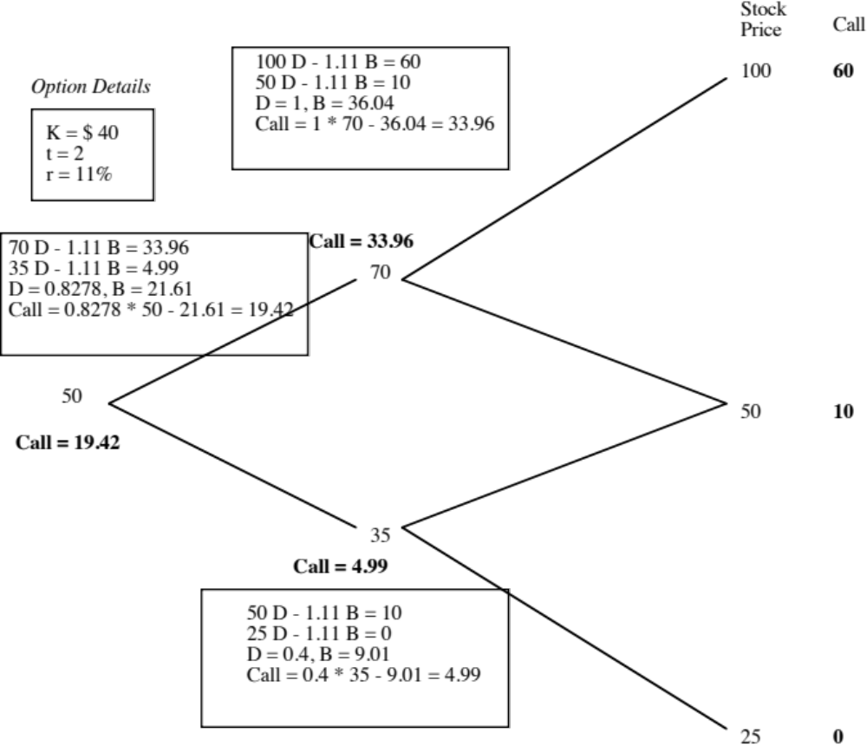
The Binomial Option Pricing Model
Notes:
Binomial models allow you to see arbitrage play out at each step in the process.
Here are the keys:
Start with the end node and work backwards (since the end node is the only time at which you know the cash flows on the option with certainty)
At each stage, compute the combination of the underlying asset and the riskless asset (lending/borrowing) you will need to get the same cash flows as the option
Estimate how much it will cost you to create this combination and make that the value of the option at that stage
Go to the prior stage and repeat the process.

Slide 11
The Limiting Distributions….
As the time interval is shortened, the limiting distribution, as t -> 0, can take one of two forms.
  If as t -> 0, price changes become smaller, the limiting distribution is the normal distribution, and the price process is a continuous one.
  If as t->0, price changes remain large, the limiting distribution is the poisson distribution, i.e., a distribution that allows for price jumps.
The Black-Scholes model applies when the limiting distribution is the normal distribution and explicitly assumes that the price process is continuous and that there are no jumps in asset prices.
Notes:
For most real-world options, the only chance you have of using a binomial is by making the time intervals really, really small (a minute or even a second). The catch is that your binomial will have thousands and thousands of branches…
The limiting distributions as time approaches zero are simple: if price changes also become small as the time interval becomes small, you end up with the normal distribution and the Black Scholes. If not, things are messier..

Slide 12
Black and Scholes to the rescue
The version of the model presented by Black and Scholes was designed to value European options, which were dividend-protected.
The value of a call option in the Black-Scholes model can be written as a function of the following variables:
  S = Current value of the underlying asset
  K = Strike price of the option
  t = Life to expiration of the option
  r = Riskless interest rate corresponding to the life of the option
  σ² = Variance in the ln(value) of the underlying asset
Notes:
Fischer Black and Myron Scholes won the Nobel prize for this model to value options…
Notice the absence of dividends in the original BS… It was designed to value dividend protected options (if the stock paid a dividend, the exercise price would be lowered by the dividend as well to match the stock price drop.) It was also designed to value options that could be exercised only at expiration (European options rather than American options)

Slide 13
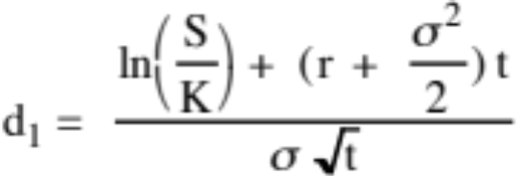
The Black Scholes Model
Value of call = S N (d1) - K e^{-rt} N(d2)
where
      d2 = d1 - σ √t
The replicating portfolio is embedded in the Black-Scholes model. To replicate this call, you would need to
  Buy N(d1) shares of stock; N(d1) is called the option delta
  Borrow K e^{-rt} N(d2)
Notes:
Note:
The entry of the normal distribution in the form of cumulative normal distribution variable (N(d1) and N(d2)
The replacement of the standard discount factor (1/(1+r)^n) with the continuous time version (e-rt)
The standard deviation input to capture the uncertainty about future value
The replicating portfolio is embedded in the equation. Almost every measure in option trading/pricing is built around this replicating portfolio.

Slide 14
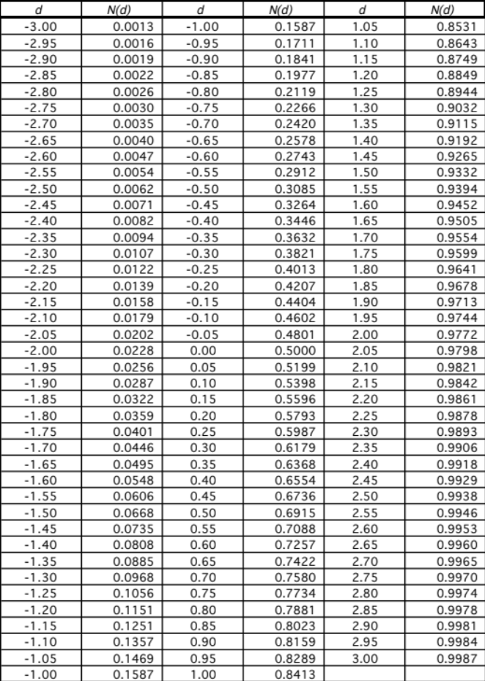
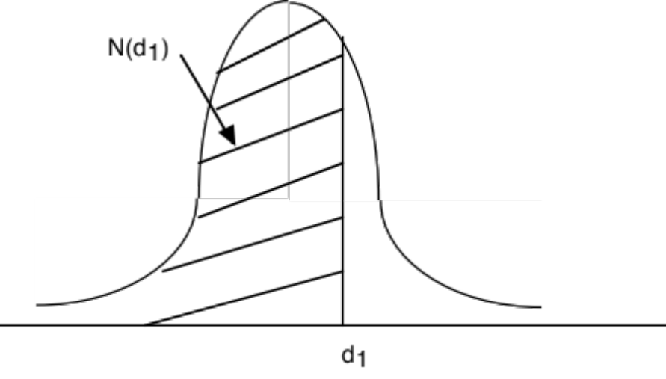
The Normal Distribution
Notes:
A standardized cumulative normal distribution yields values between 0 and 1… It looks and acts like a probability…
In face, N(d2) is the risk neutral probability that your option will end up in the money (S>K) over its lifetime.

Slide 15
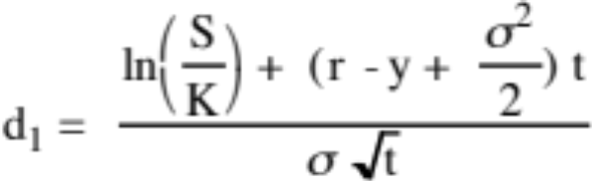
Adjusting for Dividends
If the dividend yield (y = dividends/ Current value of the asset) of the underlying asset is expected to remain unchanged during the life of the option, the Black-Scholes model can be modified to take dividends into account.
Call value = S e^{-yt} N(d1) - K e^{-rt} N(d2)
  where,
  d2 = d1 - σ √t
The value of a put can also be derived from put-call parity (an arbitrage condition):
Put value = K e^{-rt} (1-N(d2)) - S e^{-yt} (1-N(d1))
Notes:
An adapted version of the Black Scholes, assuming that the dividend yield stays constant over the life of the option.
The carrying cost for the replicating portfolio is reduced by the dividend yield. (You pay the riskfree rate on your borrowing but the shares you buy will pay a dividend that offsets some of the interest expense)
The current stock price is reduced to reflect the effect of the dividend payments over the life of the option (It is discounted at the dividend yield…)

Slide 16
Choice of Option Pricing Models
Some practitioners who use option pricing models to value options argue for the binomial model over the Black-Scholes and justify this choice by noting that
  Early exercise is the rule rather than the exception with real options
  Underlying asset values are generally discontinous.
In practice, deriving the end nodes in a binomial tree is difficult to do. You can use the variance of an asset to create a synthetic binomial tree but the value that you then get will be very similar to the Black Scholes model value.
Notes:
Most real options are exercised early… True.. But it is also true that getting the inputs to a binomial model is cumbersome. So, it may still make sense to get at least a lower bound on value by using the Black Scholes.

