Slide 1
Project Workbook
The Indonesia 2015 Edition
“Talk is cheap. Time for action”

Slide 2
Your data…
Data Packet
  Page 1: HDS (Bloomberg) – Top 17 stockholders
  Page 2: Beta (Bloomberg) – 2 year weekly return beta
  Pages 3-7: DES (Bloomberg) – 5 page description of your company
  Page 8: FA - Summary financial information for your company
  Page 9: CRPR – Bond Rating or Bloomberg Default Risk Assessement
  Page 10 : DDIS: Debt due table (with maturities)
Checklist before you start
  What country is your company incorporated in?
  What currency are the financial statements in? (Not necessarily in the local currency)
  What currency is your market capitalization and stock price stated in? (May not match the currency of the financial statements)
  What was the most recent fiscal year? (For most of your companies, it will be a year ending December… but some may have other year ends)

Slide 3

Source for data: Will vary across markets. 13F is SEC filing for US mutual/pension funds
Percent of outstanding shares in company

Slide 4

Corporate Governance: Assessing where the power lies and potential conflicts of interest

Slide 5
The Indonesian Sample
Company | Biggest Holder | Holding | Other comments
Krakatau Steel | Republic of Indonesia | 80.00%
Bumi Resources | Long Haul Holdings | 23.15% | 5 FII on list
Lippo Karawacki | Pacific Asia Holdings | 17.88% | Blackrock, Vanguard etc.
Gudang Garam | Sutyaduta Investama | 69.29% | Blackrock
Perushann Gas | Republic of Indonesia | 56.97% | Blackrock again
Semen Indonesia | Republic of Indonesia | 51.01% | Blackrock, Vanguard
United Tractors | PT Astra | 59.50% | Blackrock and other FII
Media Nusantra | Global Mediacom | 65.32% | Blackrock and FII
Indosat | Coredoo Asia | 65.00% | 4 FII

Slide 6
Local Currency Government Bond Rates – July 2015
Currency | Govt Bond Rate (6/30/15) | Currency | Govt Bond Rate (6/30/15)
Australian $ | 3.07% | Malyasian Ringgit | 4.03%
Brazilian Reai | 12.58% | Mexican Peso | 6.12%
British Pound | 2.18% | Nigerian Naira | 14.15%
Bulgarian Lev | 3.15% | Norwegian Krone | 1.92%
Canadian $ | 1.86% | NZ $ | 3.38%
Chilean Peso | 4.63% | Pakistani Rupee | 10.05%
Chinese Yuan | 3.62% | Peruvian Sol | 6.38%
Colombian Peso | 7.22% | Phillipine Peso | 4.38%
Croatian Kuna | 3.26% | Polish Zloty | 3.24%
Czech Koruna | 0.92% | Romanian Leu | 4.00%
Danish Krone | 1.15% | Russian Ruble | 11.14%
Euro | 0.92% | Singapore $ | 2.72%
HK $ | 1.85% | South African Rand | 8.30%
Hungarian Forint | 3.93% | Swedish Krona | 1.03%
Iceland Krona | 7.10% | Swiss Franc | 0.16%
Indonesian Rupee | 7.85% | Taiwanese $ | 1.51%
Indonesian Rupiah | 8.31% | Thai Baht | 2.97%
Israeli Shekel | 2.39% | Turkish Lira | 9.14%
Japanese Yen | 0.45% | US $ | 2.47%
Kenyan Shilling | 13.02% | Venezuelan Bolivar | 12.25%
Korean Won | 2.48% | Vietnamese Dong | 6.79%
Notes:
These numbers are usually tough to get. I get these from a website that lists them for free (for the moment):
http://www.tradingeconomics.com/bonds-list-by-country
These are local currency bond rates and some are more liquid (and credible) than others.

Slide 7
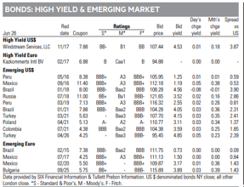
Approach 1: Default spread from Government Bonds
The Brazil Default Spread
Brazil 2021 Bond: 4.05%
US 2021 T.Bond: 1.75%
Spread: 2.30%
The Indonesia Default Spread
Indonesia does not have dollar or Euro denominated bonds outstanding.

Slide 8
Approach 2: CDS Spreads – July 2015
Country | Moody's rating | CDS Spread | CDS Spread adj for US | Country | Moody's rating | CDS Spread | CDS Spread adj for US | Country | Moody's rating | CDS Spread | CDS Spread adj for US
Abu Dhabi | Aa2 | 0.97% | 0.56% | India | Baa3 | 2.37% | 1.96% | Portugal | Ba1 | 2.71% | 2.30%
Australia | Aaa | 0.61% | 0.20% | Indonesia | Baa3 | 2.60% | 2.19% | Qatar | Aa2 | 1.01% | 0.60%
Austria | Aaa | 0.57% | 0.16% | Ireland | Baa1 | 1.13% | 0.72% | Romania | Baa3 | 1.73% | 1.32%
Bahrain | Baa3 | 3.21% | 2.80% | Israel | A1 | 1.06% | 0.65% | Russia | BA1 | 3.59% | 3.18%
Belgium | Aa3 | 0.85% | 0.44% | Italy | Baa2 | 2.03% | 1.62% | Saudi Arabia | Aa3 | 0.93% | 0.52%
Brazil | Baa2 | 3.32% | 2.91% | Japan | A1 | 0.84% | 0.43% | Slovakia | A2 | 0.99% | 0.58%
Bulgaria | Baa2 | 2.26% | 1.85% | Kazakhstan | Baa2 | 2.88% | 2.47% | Slovenia | Baa3 | 1.78% | 1.37%
Chile | Aa3 | 1.04% | 0.63% | Korea | Aa3 | 0.84% | 0.43% | South Africa | Baa2 | 2.73% | 2.32%
China | Aa3 | 1.52% | 1.11% | Latvia | A3 | 1.43% | 1.02% | Spain | Baa2 | 1.73% | 1.32%
Colombia | Baa2 | 2.32% | 1.91% | Lebanon | B2 | 4.03% | 3.62% | Sweden | Aaa | 0.36% | 0.00%
Costa Rica | Ba1 | 3.78% | 3.37% | Lithuania | A3 | 1.39% | 0.98% | Switzerland | Aaa | 0.31% | 0.00%
Croatia | Ba1 | 3.25% | 2.84% | Malaysia | A3 | 2.01% | 1.60% | Thailand | Baa1 | 1.64% | 1.23%
Cyprus | B3 | 5.15% | 4.74% | Mexico | A3 | 1.93% | 1.52% | Tunisia | Ba3 | 3.33% | 2.92%
Czech Republic | A1 | 0.94% | 0.53% | Morocco | Ba1 | 2.29% | 1.88% | Turkey | Baa3 | 2.81% | 2.40%
Denmark | Aaa | 0.44% | 0.03% | Netherlands | Aaa | 0.41% | 0.00% | United Kingdom | Aa1 | 0.41% | 0.00%
Egypt | B3 | 3.70% | 3.29% | New Zealand | Aaa | 0.65% | 0.24% | United States of America | Aaa | 0.41% | 0.00%
Estonia | A1 | 0.88% | 0.47% | Norway | Aaa | 0.31% | 0.00% | Vietnam | B1 | 2.90% | 2.49%
Finland | Aaa | 0.53% | 0.12% | Pakistan | B3 | 4.95% | 4.54%
France | Aa1 | 0.76% | 0.35% | Panama | Baa2 | 1.98% | 1.57%
Germany | Aaa | 0.41% | 0.00% | Peru | A3 | 2.01% | 1.60%
Hong Kong | Aa1 | 0.70% | 0.29% | Philippines | Baa2 | 1.55% | 1.14%
Hungary | Ba1 | 2.16% | 1.75% | Poland | A2 | 1.30% | 0.89%
Notes:
There are about 60 countries with CDS spreads. Think of these as annual insurance costs against default in percentage terms for the 10-year bond.
To insure yourself against Brazil default risk in January 2013 would have cost you about 1.42% a year.
The one catch with the CDS market is that there is counter party risk, i.e., you can buy insurance but there is the chance that the person you bought it from might default and there are quirks in the market that lead to CDS spreads to exist even for nominally default free entities (Switzerland, for example)
One way to counter this is to subtract out the CDS spread for markets like Switzerland, Germany and the US (if you think of these as default free) from every CDS spread.
In January 2013, the average CDS spreads across these markets was about 0.50%.
Netting that out against Brazil’s CDS spread yields = 1.42% - 0.50% = 0.92%

Slide 9
Approach 3: Typical Default Spreads: July 2015
Sovereign Rating | Default Spread over riskfree
Aaa | 0.00%
Aa1 | 0.40%
Aa2 | 0.50%
Aa3 | 0.60%
A1 | 0.70%
A2 | 0.85%
A3 | 1.20%
Baa1 | 1.60%
Baa2 | 1.90%
Baa3 | 2.20%
Ba1 | 2.50%
Ba2 | 3.00%
Ba3 | 3.60%
B1 | 4.50%
B2 | 5.50%
B3 | 6.50%
Caa1 | 7.50%
Caa2 | 9.00%
Caa3 | 10.00%
Brazil
Rating = Baa2
Spread = 1.9%
Indonesia
Rating = Baa3
Spread = 2.2%
Notes:
This table was developed using both sovereign bonds and CDS spreads. Within each ratings class, I found as many estimates of the spread as I could and averaged out across these estimates.
Using Brazil as an example, the rating for Brazil in June 2012 was Baa2. The default spread for Brazil in June 2012 would have worked out to 1.75%
Using all three approaches for Brazil in June 2012 yields the following:
$ denominated bond spread = 1.43%
Adjusted CDS spread = 1.58%
Rating-based spread = 1.75%
You can pick one of the three or use an average of the three.

Slide 10
Getting to a risk free rate in a currency: Examples
The Brazilian government bond rate in nominal reais in July 2015 was 12.58%.
  Approach 1: Government Bond spread
    The 2021 Brazil bond, denominated in US dollars, has a spread of 2.30% over the US treasury bond rate.
    Riskfree rate in $R = 12.58% - 2.30% = 10.28%
  Approach 2: The CDS Spread
    CDS spread for Brazil, adjusted for the US CDS, on July 1, 2015 was 2.91%.
    Riskfree rate in $R = 12.58% - 2.91% = 9.67%
  Approach 3: The Rating based spread
    Brazil has a Baa2 local currency rating, with a default spread of 1.90%.
    Riskfree rate in $R = 12.58% - 1.90% = 10.68%
The Indonesian government bond rate in rupiah in July 2015 was 8.31%
  Approach 2: The CDS Spread
    CDS spread for India, adjusted for the US CDS, on July 1, 2015 was 2.19%.
    Riskfree rate in Rupiah = 8.31% - 2.19% = 6.12%
  Approach 3: The Rating based spread
    Indonesia has a Baa3 local currency rating, with a default spread of 2.20%.
    Riskfree rate in Rupiah = 8.31% - 2.20% = 6.11%

Slide 11
Risk free Rates: By Currency – July 2015
Governments with no default risk |  | Governments with default risk
Currency | Risk free Rate | Currency | Risk free Rate
Australian $ | 3.07% | Brazilian Reai | 10.68%
Canadian $ | 1.86% | British Pound | 1.78%
Danish Krone | 1.15% | Bulgarian Lev | 1.25%
Euro | 0.92% | Chilean Peso | 4.03%
Norwegian Krone | 1.92% | Chinese Yuan | 3.02%
NZ $ | 3.38% | Colombian Peso | 5.32%
Singapore $ | 2.72% | Croatian Kuna | 0.76%
Swedish Krona | 1.03% | Czech Koruna | 0.22%
Swiss Franc | 0.16% | HK $ | 1.45%
US $ | 2.47% | Hungarian Forint | 1.43%
 |  | Iceland Krona | 4.90%
 |  | Indonesian Rupee | 5.65%
 |  | Indonesian Rupiah | 6.11%
 |  | Israeli Shekel | 1.69%
 |  | Japanese Yen | -0.25%
 |  | Kenyan Shilling | 8.52%
 |  | Korean Won | 1.88%
 |  | Malyasian Ringgit | 2.83%
 |  | Mexican Peso | 4.92%
 |  | Nigerian Naira | 10.55%
 |  | Pakistani Rupee | 2.55%
 |  | Peruvian Sol | 5.18%
 |  | Phillipine Peso | 2.48%
 |  | Polish Zloty | 2.39%
 |  | Romanian Leu | 1.80%
 |  | Russian Ruble | 9.24%
 |  | South African Rand | 6.40%
 |  | Taiwanese $ | 0.91%
 |  | Thai Baht | 1.37%
 |  | Turkish Lira | 6.94%
 |  | Venezuelan Bolivar | 4.75%
 |  | Vietnamese Dong | 2.29%

Slide 12
Risk free Rate: Desperation Time?
It is entirely possible that you may be unable to find a government bond issued in the local currency (that is traded) or that you do not trust the government bond rate as a fair market interest rate. There are two ways you can get to a risk free rate, in this case.
Build up approach: The risk free rate in any currency can be written as the sum of two variables:
  Risk free rate = Expected Inflation in currency + Expected real interest rate
    The expected real interest rate can be computed in one of two ways: from the US TIPs rate or set equal to real growth in the economy. Thus, if the expected inflation rate in a country is expected to be 15% and the TIPs rate is 1%, the risk free rate is 16%.
US $ rate & Differential Inflation: Alternatively, you can scale up the US $ risk free rate by the differential inflation between the US $ and the currency in question:
  Risk free rate_{Currency}=
  Thus, if the US $ risk free rate is 3.04%, the inflation rate in the foreign currency is 15% and the inflation rate in US $ is 2%, the foreign currency risk free rate is as follows:
  Risk free rate =

Slide 13

ERP : July 2015
Andorra | 8.21% | 2.40% | Guernsey | 6.41% | 0.60% | Netherlands | 5.81% | 0.00%
Austria | 5.81% | 0.00% | Iceland | 9.11% | 3.30% | Norway | 5.81% | 0.00%
Belgium | 6.71% | 0.90% | Ireland | 8.21% | 2.40% | Portugal | 9.56% | 3.75%
Cyprus | 15.56% | 9.75% | Isle of Man | 6.41% | 0.60% | Spain | 8.66% | 2.85%
Denmark | 5.81% | 0.00% | Italy | 8.66% | 2.85% | Sweden | 5.81% | 0.00%
Finland | 5.81% | 0.00% | Jersey | 6.41% | 0.60% | Switzerland | 5.81% | 0.00%
France | 6.41% | 0.60% | Liechtenstein | 5.81% | 0.00% | Turkey | 9.11% | 3.30%
Germany | 5.81% | 0.00% | Luxembourg | 5.81% | 0.00% | UK | 6.41% | 0.60%
Greece | 19.31% | 13.50% | Malta | 7.61% | 1.80% | W. Europe | 6.97% | 1.16%
Albania | 12.56% | 6.75% | Lithuania | 7.61% | 1.80%
Armenia | 11.21% | 5.40% | Macedonia | 11.21% | 5.40%
Azerbaijan | 9.11% | 3.30% | Moldova | 15.56% | 9.75%
Belarus | 17.06% | 11.25% | Montenegro | 11.21% | 5.40%
Bosnia | 15.56% | 9.75% | Poland | 7.09% | 1.28%
Bulgaria | 8.66% | 2.85% | Romania | 9.11% | 3.30%
Croatia | 9.56% | 3.75% | Russia | 9.56% | 3.75%
Czech Republic | 6.86% | 1.05% | Serbia | 12.56% | 6.75%
Estonia | 6.86% | 1.05% | Slovakia | 7.09% | 1.28%
Georgia | 11.21% | 5.40% | Slovenia | 9.11% | 3.30%
Hungary | 9.56% | 3.75% | Ukraine | 23.81% | 18.0%
Kazakhstan | 8.66% | 2.85% | E. Europe | 9.71% | 3.90%
Latvia | 7.61% | 1.80%
Canada | 5.81% | 0.00%
United States | 5.81% | 0.00%
North America | 5.81% | 0.00%
Country | ERP | CRP
Angola | 10.31% | 4.50%
Botswana | 7.09% | 1.28%
Burkina Faso | 15.56% | 9.75%
Cameroon | 14.06% | 8.25%
Cape Verde | 14.06% | 8.25%
Congo (DR) | 15.56% | 9.75%
Congo (Republic of) | 11.21% | 5.40%
C™te d'Ivoire | 12.56% | 6.75%
Egypt | 15.56% | 9.75%
Ethiopia | 12.56% | 6.75%
Gabon | 11.21% | 5.40%
Ghana | 15.56% | 9.75%
Kenya | 12.56% | 6.75%
Morocco | 9.56% | 3.75%
Mozambique | 12.56% | 6.75%
Namibia | 9.11% | 3.30%
Nigeria | 11.21% | 5.40%
Rwanda | 14.06% | 8.25%
Senegal | 12.56% | 6.75%
South Africa | 8.66% | 2.85%
Tunisia | 11.21% | 5.40%
Uganda | 12.56% | 6.75%
Zambia | 12.56% | 6.75%
Africa | 11.61% | 5.80%
Argentina | 17.06% | 11.25%
Belize | 19.31% | 13.50%
Bolivia | 11.21% | 5.40%
Brazil | 8.66% | 2.85%
Chile | 6.71% | 0.90%
Colombia | 8.66% | 2.85%
Costa Rica | 9.56% | 3.75%
Ecuador | 15.56% | 9.75%
El Salvador | 11.21% | 5.40%
Guatemala | 9.56% | 3.75%
Honduras | 15.56% | 9.75%
Mexico | 7.61% | 1.80%
Nicaragua | 15.56% | 9.75%
Panama | 8.66% | 2.85%
Paraguay | 9.56% | 3.75%
Peru | 7.61% | 1.80%
Suriname | 11.21% | 5.40%
Uruguay | 8.66% | 2.85%
Venezuela | 20.81% | 15.00%
Latin America | 10.29% | 4.48%
Bangladesh | 11.21% | 5.40% | Mauritius | 8.21% | 2.40%
Cambodia | 14.06% | 8.25% | Mongolia | 14.06% | 8.25%
China | 6.71% | 0.90% | Pakistan | 15.56% | 9.75%
Fiji | 12.56% | 6.75% | Papua NG | 12.56% | 6.75%
Hong Kong | 6.41% | 0.60% | Philippines | 8.66% | 2.85%
India | 9.11% | 3.30% | Singapore | 5.81% | 0.00%
Indonesia | 9.11% | 3.30% | Sri Lanka | 12.56% | 6.75%
Japan | 6.86% | 1.05% | Taiwan | 6.71% | 0.90%
Korea | 6.71% | 0.90% | Thailand | 8.21% | 2.40%
Macao | 6.56% | 0.75% | Vietnam | 12.56% | 6.75%
Malaysia | 7.61% | 1.80% | Asia | 7.31% | 1.50%
Abu Dhabi | 6.56% | 0.75%
Bahrain | 9.11% | 3.30%
Israel | 6.86% | 1.05%
Jordan | 12.56% | 6.75%
Kuwait | 6.56% | 0.75%
Lebanon | 14.06% | 8.25%
Oman | 6.86% | 1.05%
Qatar | 6.56% | 0.75%
Ras Al Khaimah | 7.09% | 1.28%
Saudi Arabia | 6.71% | 0.90%
Sharjah | 7.61% | 1.80%
UAE | 6.56% | 0.75%
Middle East | 6.91% | 1.10%
Australia | 5.81% | 0.00%
Cook Islands | 12.56% | 6.75%
New Zealand | 5.81% | 0.00%
Australia & NZ | 5.81% | 0.00%
Black #: Total ERP
Red #: Country risk premium
AVG: GDP weighted average
Notes:
Updated country risk premiums.

Slide 14
Company | Exposure | Revenues | Proportion | ERP | Weighted ERP
Krakatau | Indonesia | 1889 | 100.00% | 9.11% | 9.11%
Bumi Resources | Indonesia | 2800 | 39.47% | 9.11% | 7.9%
 | Rest of Asia | 3547 | 50.00% | 7.23%
 | Europe | 704 | 9.92% | 6.97%
 | United States | 43 | 0.61% | 5.81%
Lippo Karawacki | Indonesia | 12028 | 100.00% | 9.11% | 9.11%
Gudang Garam | Indonesia | 62273 | 95.53% | 9.11% | 9.03%
 | Rest of the World | 2912 | 4.47% | 7.24%
Perushaan Gas | Indonesia | 3408 | 100.00% | 9.11% | 9.11%
Semen Indonesia | Indonesia | 25610 | 94.90% | 9.11% | 9.01%
 | Rest of Asia | 1351 | 5.01% | 7.23%
 | Europe | 25 | 0.09% | 6.97%
United Tractor | Indonesia | 51012 | 100.00% | 9.11% | 9.11%
Media Nusantra | Indonesia | 24405 | 100% | 9.11% | 9.11%
Indosat | Indonesia | 24085 | 100% | 9.11% | 9.11%

Slide 15

If annualized riskfree rate during period was 1.5%,
Jensen’s alpha = 0.057% - (1.5%/52)*(1-0.422) = 0.0403%
Based on weekly returns
Regression beta is 0.422
Adj Beta = (2/3)(0.422) + (1/3) (1) = 0.614
Intercept in %
0.057%
R squared (decimals) = 21.5%
Std error of beta = 0.08
67% confidence:
0.34 (=0.42-0.08) to
0.50 (=0.42+0.08)
95% confidence:
0.26 (=0.42-2*0.08) to
0.58 (=0.42+2*0.08)
Using a 6% ERP for mature markets and a current riskfree rate of 1.87%,
Expected Return = Riskfree rate + Raw Beta (ERP)
= 1.87% + 0.422 (6%) = 4.40%

Slide 16
Indonesian Companies: Beta Regression
Company | Intercept | Beta | R-squared | Rf (1-Beta) | Jensen's alpha (monthy) | Jensen's alpha (annual) | Std Error of Beta | Beta (low) | Beta (high)
Krakatau Steel | -0.22% | 0.99 | 21.10% | 0.00% | -0.22% | -10.87% | 0.19 | 0.61 | 1.37
Bumi Resources | -1.68% | 1.19 | 9.30% | -0.02% | -1.66% | -58.16% | 0.37 | 0.45 | 1.93
Lippo Karawacki | -0.22% | 2.00 | 46.90% | -0.10% | -0.12% | -6.24% | 0.21 | 1.58 | 2.42
Gudang Garam | -0.08% | 0.95 | 24.30% | 0.00% | -0.08% | -4.32% | 0.17 | 0.61 | 1.29
Perushann Gas | -0.22% | 1.00 | 35.80% | 0.00% | -0.22% | -10.82% | 0.13 | 0.74 | 1.26
Semen Indonesia | -0.25% | 1.30 | 44.00% | -0.03% | -0.22% | -10.87% | 0.15 | 1 | 1.6
United Tractors | 0.26% | 0.81 | 19.30% | 0.02% | 0.24% | 13.38% | 0.17 | 0.47 | 1.15
Media Nusantra | -0.41% | 1.29 | 32.30% | -0.03% | -0.38% | -18.05% | 0.19 | 0.91 | 1.67
Indosat | -0.27% | 0.71 | 15.20% | 0.03% | -0.30% | -14.37% | 0.17 | 0.37 | 1.05

Slide 17

The best R-squared ever?

Slide 18

What sector is your firm in?
Bloomberg sector category
Read the description and make your own judgment

Slide 19
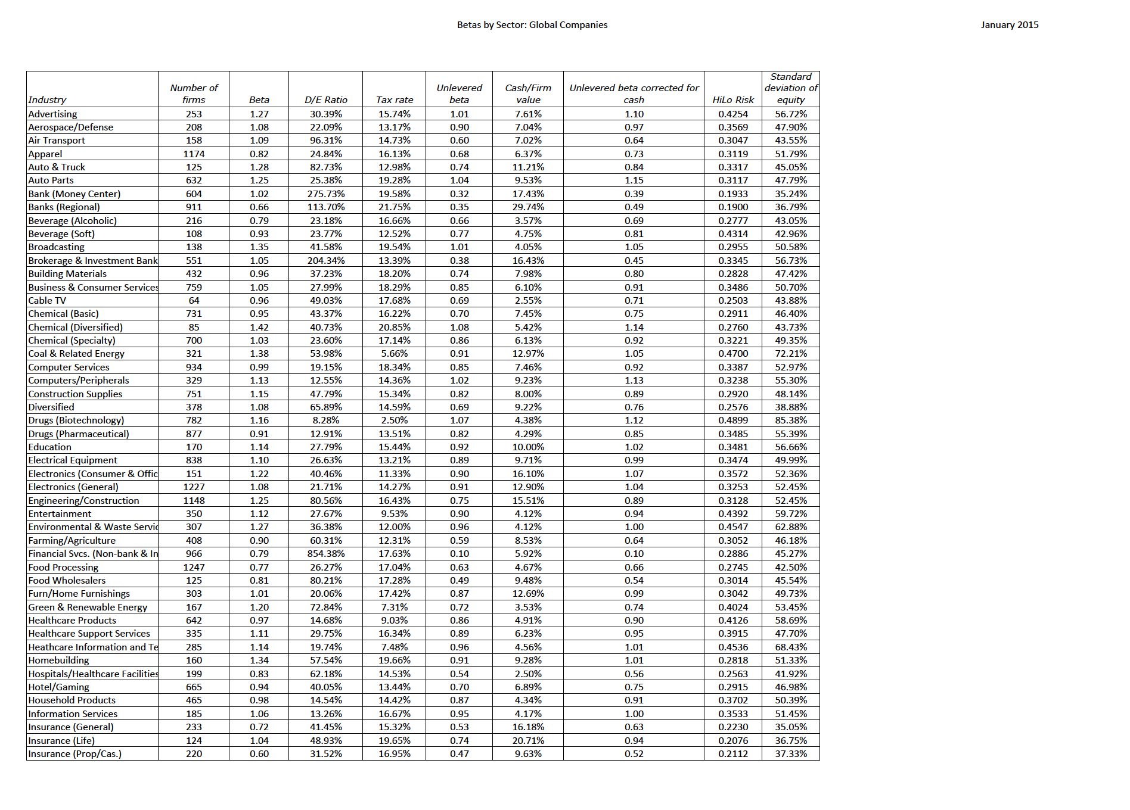

Slide 20
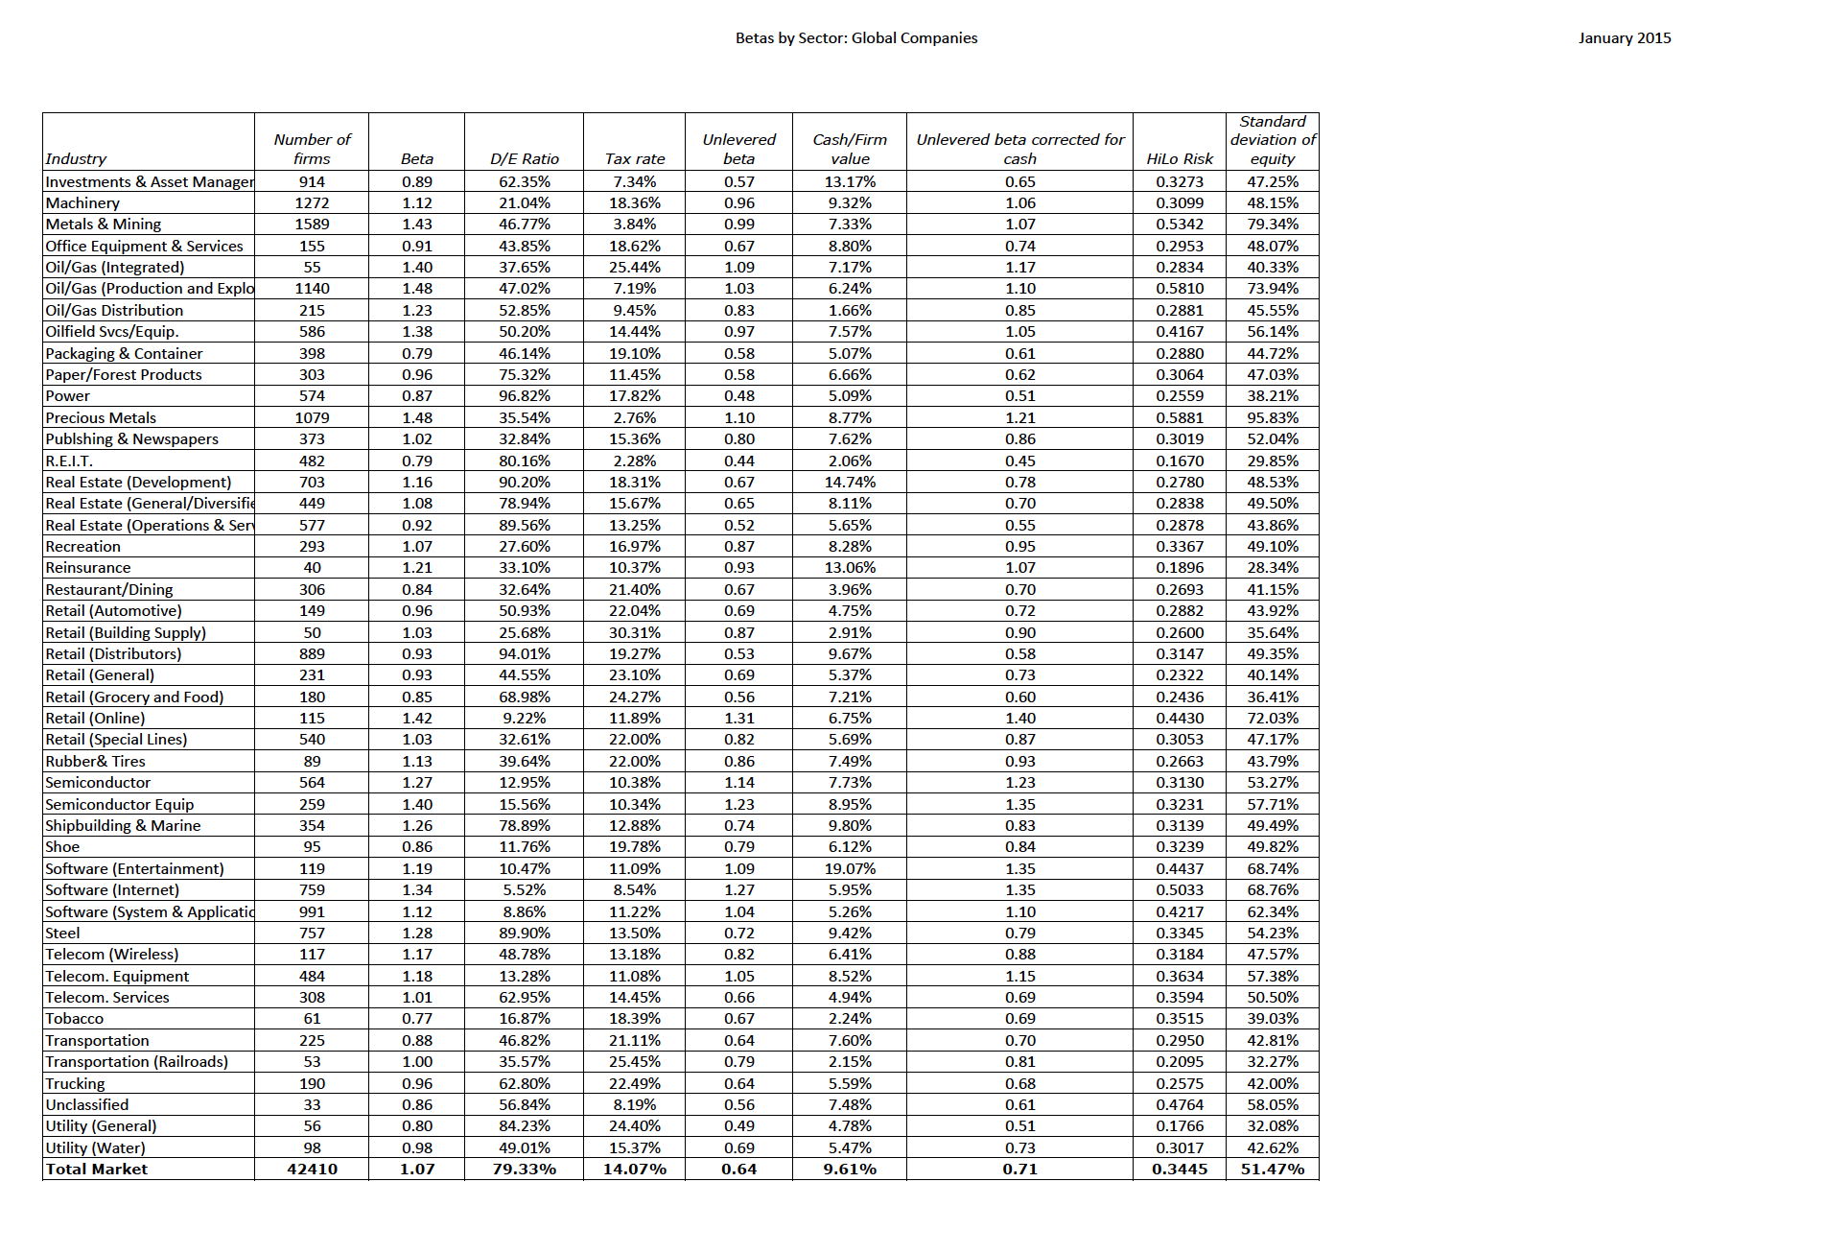

Slide 21
Indonesian Companies: Bottom up Betas
Marginal tax rate = | 25%
Company | Business | Unlevered Beta | Total Debt | Market Cap | D/E Ratio | Levered Beta
Krakatau Steel | Steel | 0.7189 | IDR 1,529 | IDR 408 | 374.75% | 2.74
Bumi Resources | Coal & Related Energy | 0.9147 | IDR 4,228 | IDR 216 | 1957.41% | 14.34
Lippo Karawacki | Real Estate (General/Diversified) | 0.6464 | IDR 10,787 | IDR 30,001 | 35.96% | 0.82
Gudang Garam | Tobacco | 0.6725 | IDR 15,170 | IDR 90,624 | 16.74% | 0.76
Perushann Gas | Oil/Gas Distribution | 0.8332 | IDR 2,145 | IDR 7,881 | 27.22% | 1.00
Semen Indonesia | Construction Supplies | 0.8219 | IDR 3,970 | IDR 79,779 | 4.98% | 0.85
United Tractors | Machinery | 0.9581 | IDR 2,620 | IDR 75,271 | 3.48% | 0.98
Media Nusantra | Entertainment | 0.8967 | IDR 3,376 | IDR 29,409 | 11.48% | 0.97
Indosat | Telecom. Services | 0.6581 | IDR 27,279 | IDR 20,323 | 134.23% | 1.32

Slide 22

Interest coverage ratios
Interest coverage ratio = Operating profit/ Interest expense
= 17,741/1,441 = 12.10

Slide 23
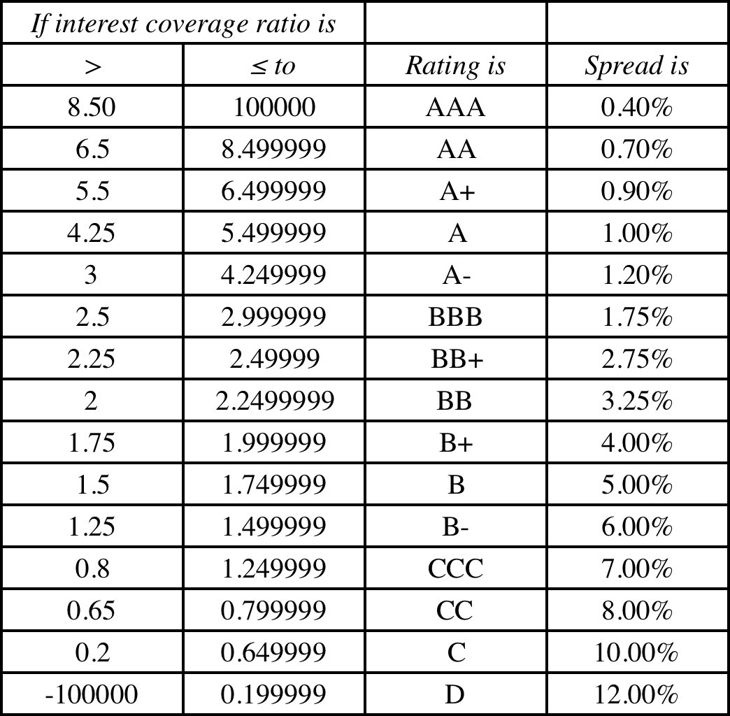
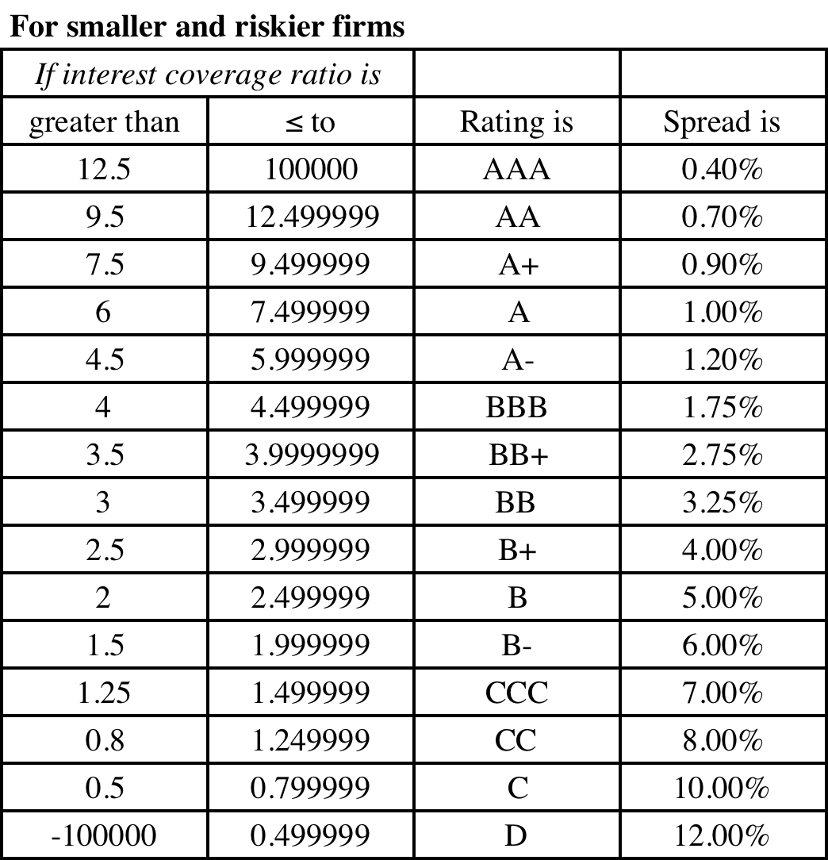
Synthetic Ratings and Default Spreads
Market cap > $ 5 billion
Market cap < $ 5 billion

Slide 24
Indonesian Companies: Cost of Debt
Indonesian Rupiah Risk free rate |  | 6.11%
Default Spread for Indonesia = |  | 2.20%
Marginal tax rate = |  | 25.00%
Company | EBIT | Interest Expense | Interest coverage ratio | Bond Rating | Pre-tax cost of debt | After-tax cost of debt
Krakatau Steel | -IDR 115.00 | IDR 67.00 | -1.72 | D | 20.31% | 15.23%
Bumi Resources | IDR 87.00 | IDR 723.00 | 0.12 | D | 20.31% | 15.23%
Lippo Karawacki | IDR 3,295.00 | IDR 1,356.00 | 2.43 | B | 13.31% | 9.98%
Gudang Garam | IDR 8,506.00 | IDR 1,488.00 | 5.72 | A- | 9.51% | 7.13%
Perushann Gas | IDR 721.00 | IDR 90.00 | 8.01 | A+ | 9.21% | 6.91%
Semen Indonesia | IDR 6,878.00 | IDR 843.00 | 8.16 | A+ | 9.21% | 6.91%
United Tractors | IDR 8,595.00 | IDR 92.00 | 93.42 | AAA | 8.71% | 6.53%
Media Nusantra | IDR 2,611.00 | IDR 82.00 | 31.84 | AAA | 8.71% | 6.53%
Indosat | IDR 348.00 | IDR 2,398.00 | 0.15 | D | 20.31% | 15.23%

Slide 25

Market value of equity = 66,452.45 M
BV of debt = Total Debt = $28,360 M
With a pre-tax cost of debt of 3%
MV of debt =
1,441 (PV of annuity, 3 years, 3%)
+ 28,360/ (1.03)³ = $ 30,029 M
PV of operating leases at 3%
767/1.03 +519/1.03² +382/1.03³ +300/1.03⁴ +202/1.03⁵ +259.5/1.03⁶ +259.5/1.03⁷ = 2,187

Slide 26
Indonesian Companies: Cost of Capital
Company | Levered Beta | ERP | Cost of Equity | After-tax cost of debt | Debt/Capital | Cost of Capital (Rupiah)
Krakatau Steel | 2.74 | 9.11% | 31.07% | 15.23% | 78.94% | 18.57%
Bumi Resources | 14.34 | 7.94% | 119.95% | 15.23% | 95.14% | 20.32%
Lippo Karawacki | 0.82 | 9.11% | 13.59% | 9.98% | 26.45% | 12.63%
Gudang Garam | 0.76 | 9.03% | 12.94% | 7.13% | 14.34% | 12.11%
Perushann Gas | 1.00 | 9.11% | 15.25% | 6.91% | 21.39% | 13.47%
Semen Indonesia | 0.85 | 9.01% | 13.80% | 6.91% | 4.74% | 13.47%
United Tractors | 0.98 | 9.11% | 15.07% | 6.53% | 3.36% | 14.78%
Media Nusantra | 0.97 | 9.11% | 14.98% | 6.53% | 10.30% | 14.11%
Indosat | 1.32 | 9.11% | 18.14% | 15.23% | 57.31% | 16.47%

Slide 27
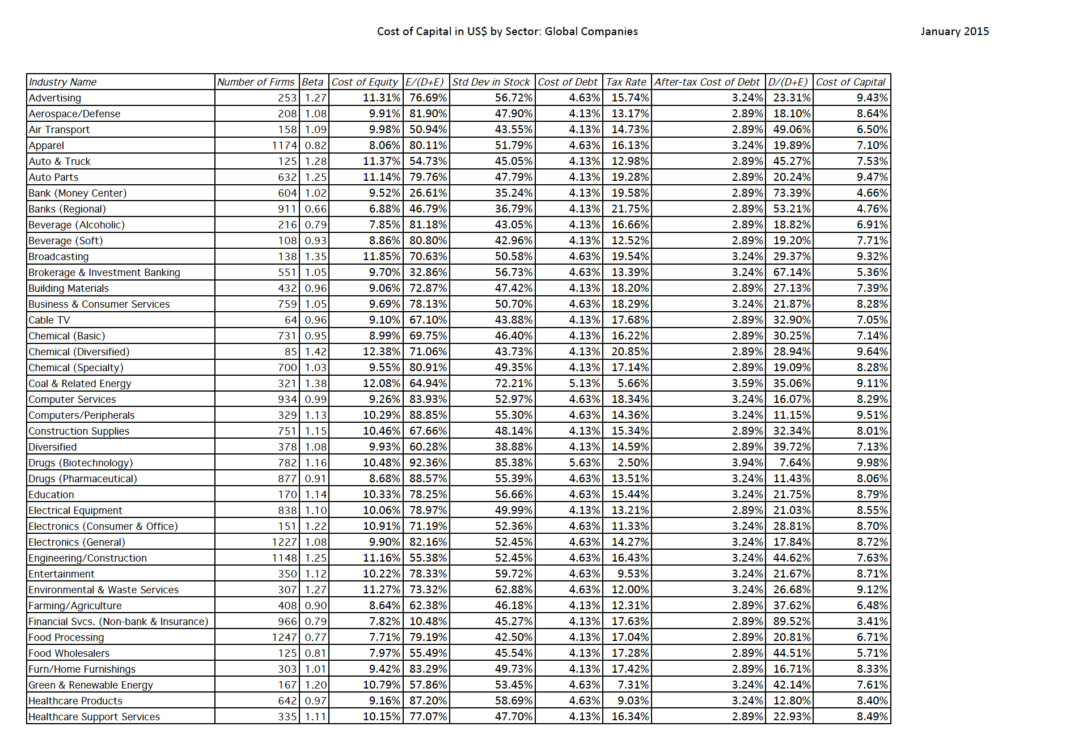

Slide 28
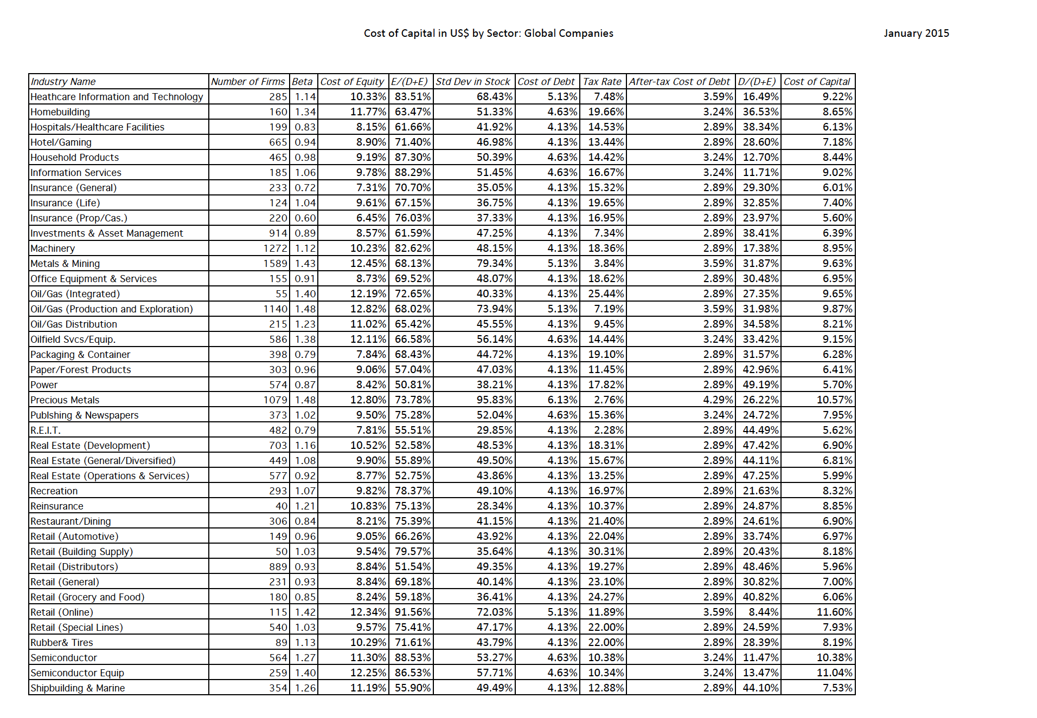

Slide 29
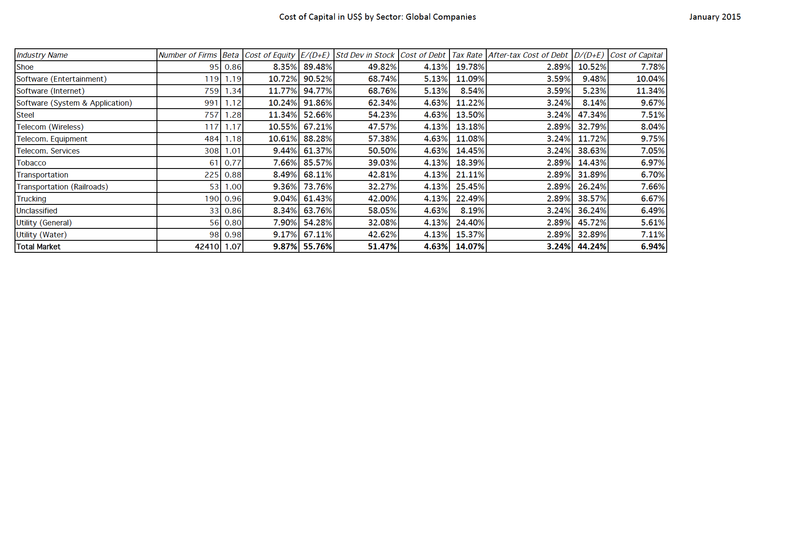

Slide 30
Pre-tax Return on capital
= Operating Income/
(BV of Debt last year + BV of Equity last year –Cash last year)
= 17741/(22,623+ 55,734-6,361) = 24.64%
After-tax Return on capital =
Pre-tax Return on capital (1- tax rate)
= 24.64% (1-.4603) = .1330 or 13.30%
Tax rate used: Effective tax rate (from this page)

Slide 31
Indonesian companies: ROIC & Return Spreads
Company | EBIT | Effective Tax Rate | Total Debt | Book Equity | Cash | Invested Capital | ROIC | Cost of Capital
Krakatau Steel | -IDR 115 | 0.00% | IDR 1,006 | IDR 835 | IDR 193 | IDR 1,648 | -6.98% | 18.57%
Bumi Resources | IDR 87 | 25.00% | IDR 4,252 | -IDR 321 | IDR 21 | IDR 3,910 | 1.67% | 20.32%
Lippo Karawacki | IDR 3,295 | 6.34% | IDR 9,997 | IDR 17,646 | IDR 11,640 | IDR 16,003 | 19.28% | 12.63%
Gudang Garam | IDR 8,506 | 25.01% | IDR 18,147 | IDR 33,229 | IDR 1,588 | IDR 49,788 | 12.81% | 12.11%
Perushann Gas | IDR 721 | 27.11% | IDR 1,892 | IDR 2,963 | IDR 1,309 | IDR 3,546 | 14.82% | 13.47%
Semen Indonesia | IDR 6,878 | 20.45% | IDR 4,083 | IDR 21,804 | IDR 4,175 | IDR 21,712 | 25.20% | 13.47%
United Tractors | IDR 8,595 | 26.10% | IDR 2,597 | IDR 36,576 | IDR 10,610 | IDR 28,563 | 22.24% | 14.78%
Media Nusantra | IDR 2,611 | 30.56% | IDR 3,182 | IDR 9,393 | IDR 1,132 | IDR 11,443 | 15.84% | 14.11%
Indosat | IDR 348 | 0.00% | IDR 27,872 | IDR 14,210 | IDR 3,480 | IDR 38,602 | 0.90% | 16.47%

Slide 32
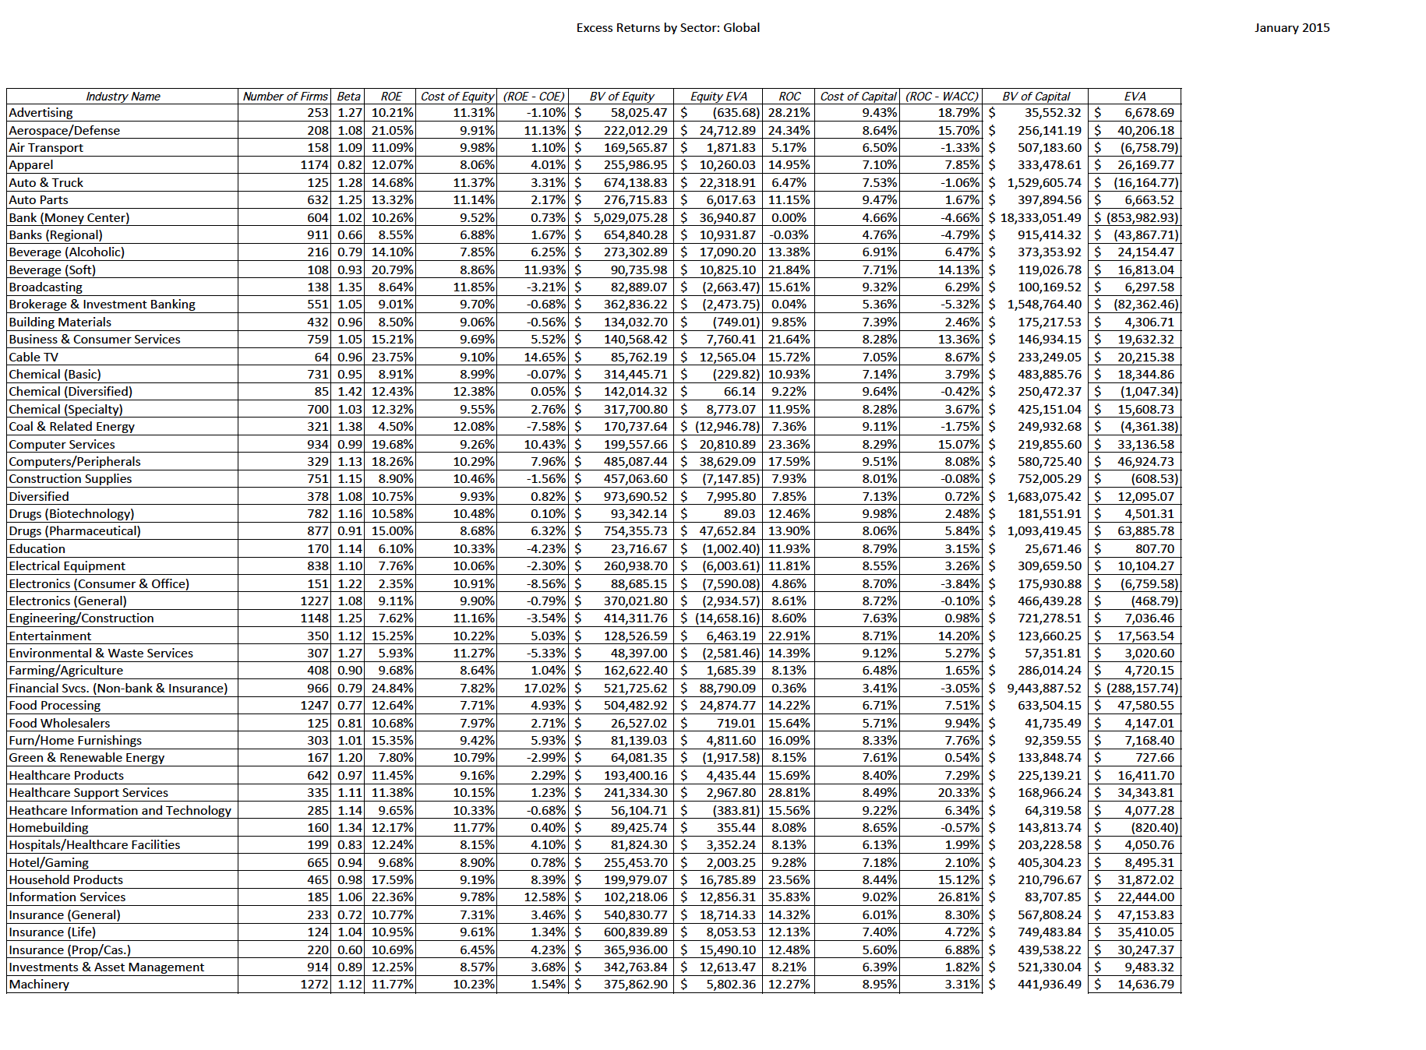

Slide 33
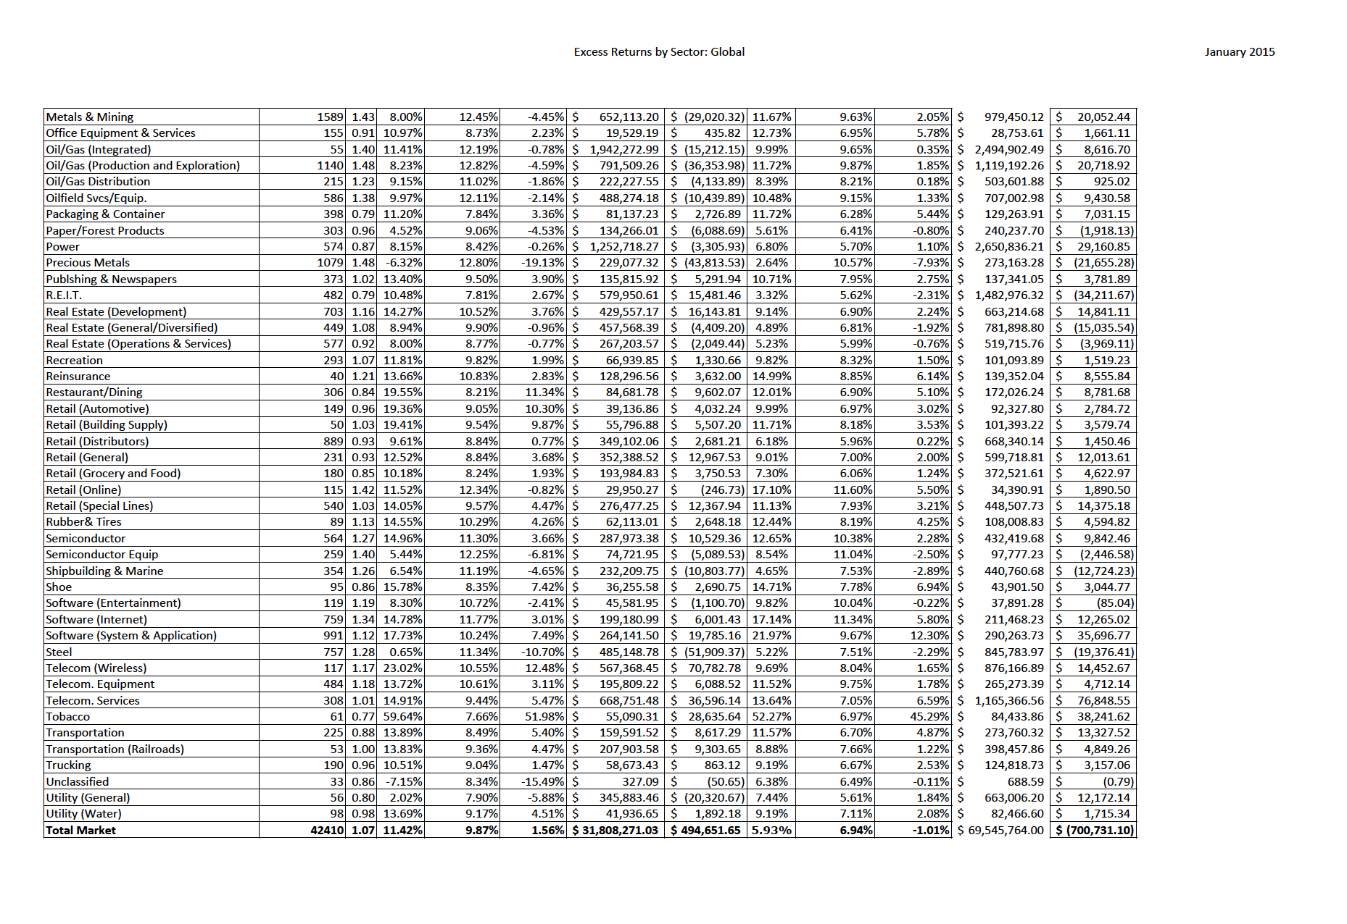

Slide 34
Return Spreads Globally in January 2015

Slide 35
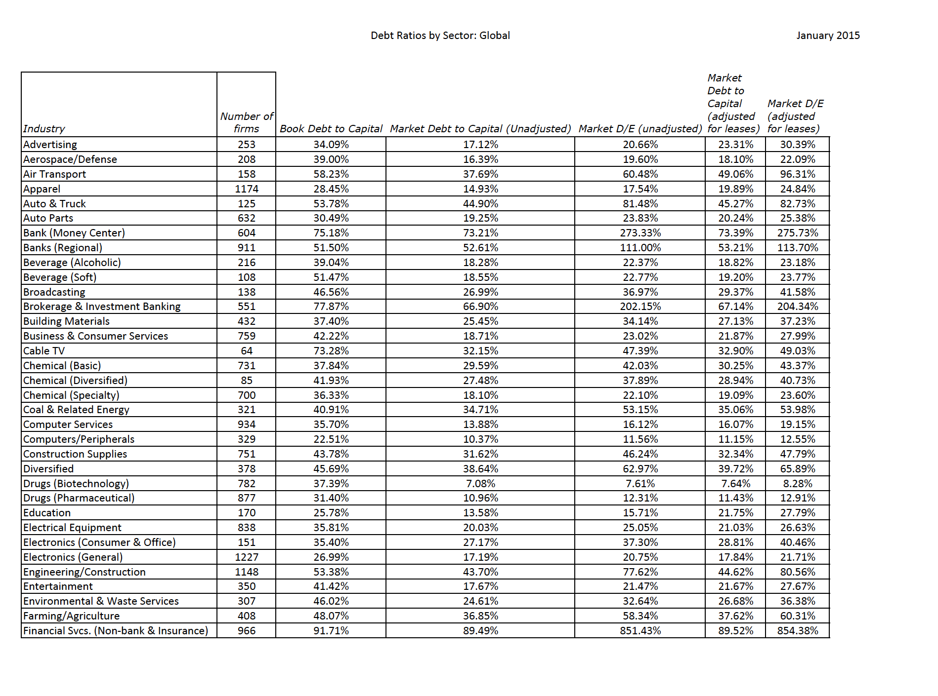

Slide 36
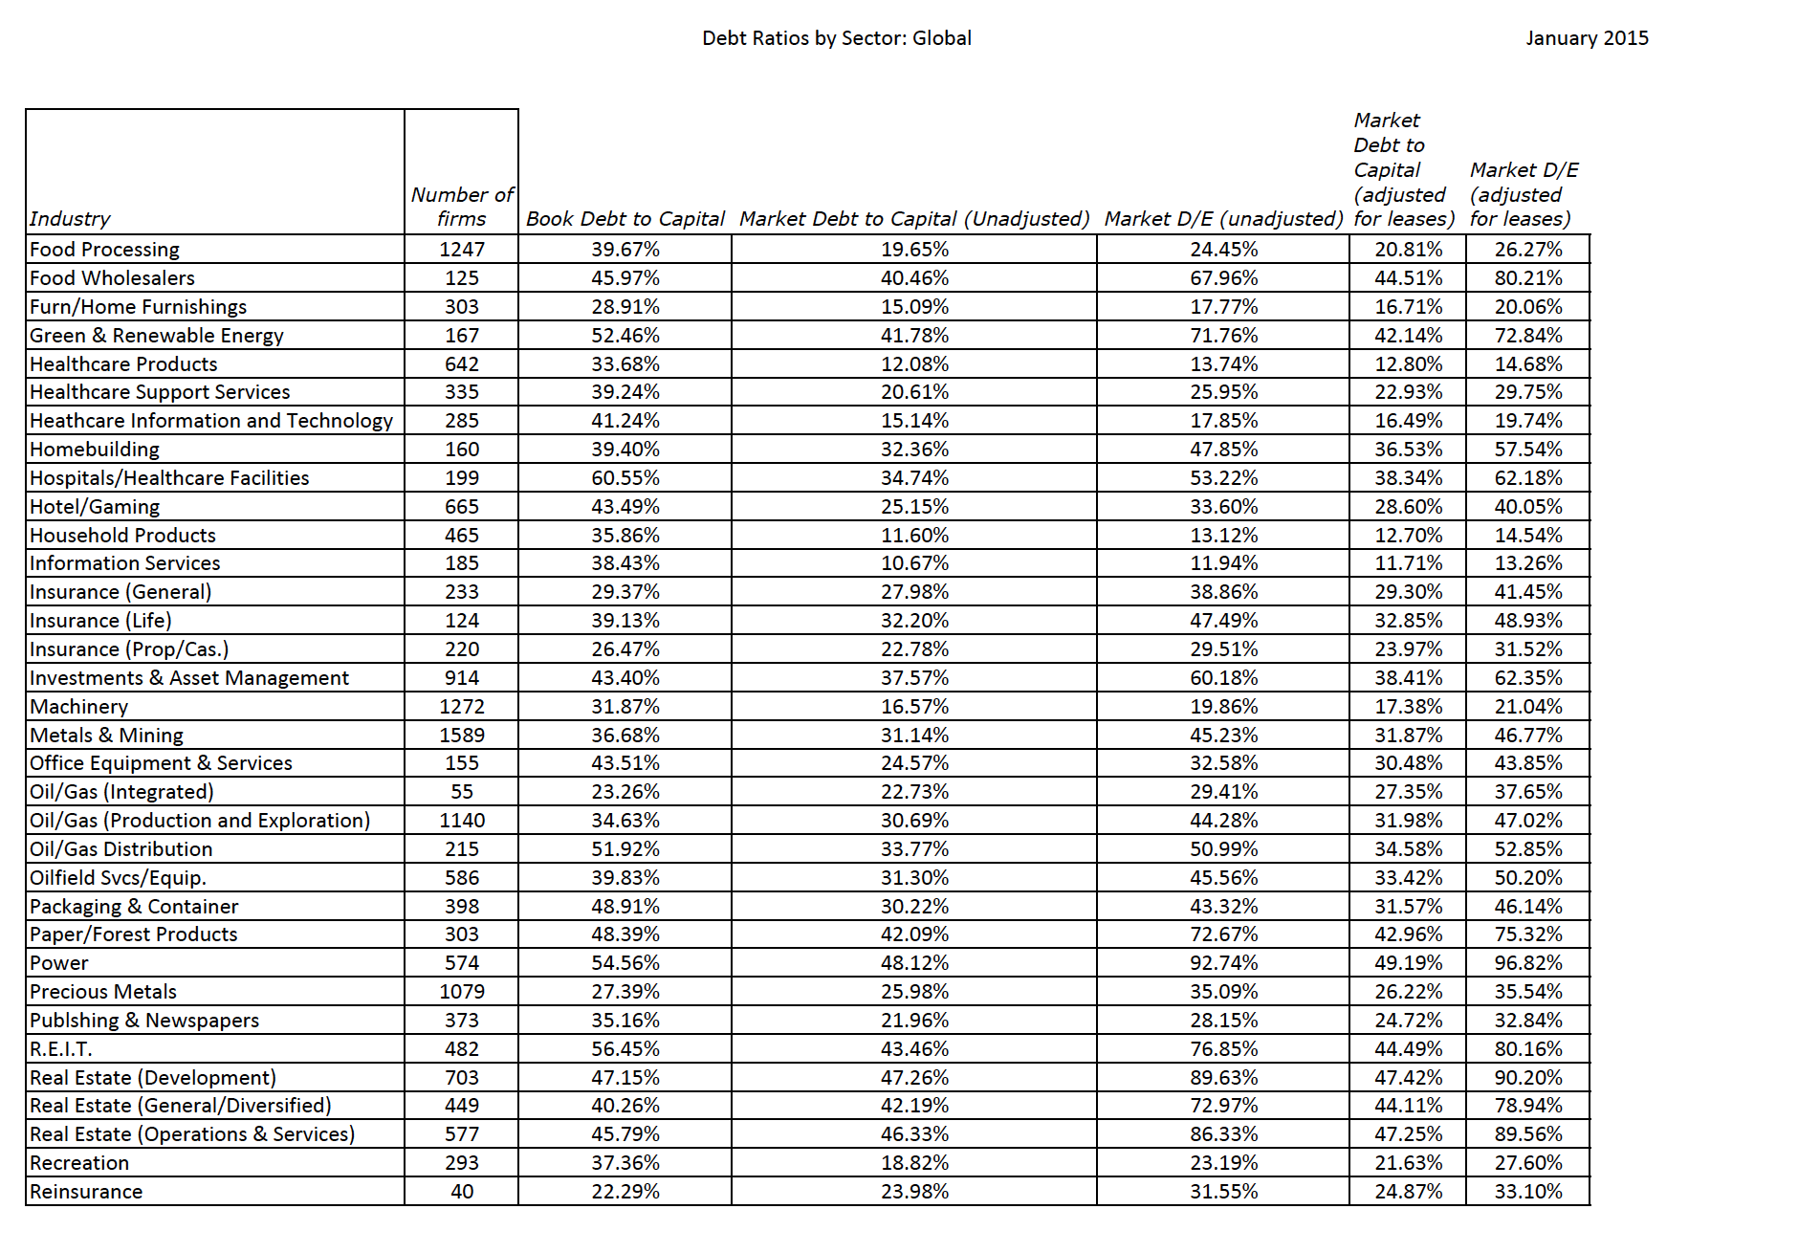

Slide 37
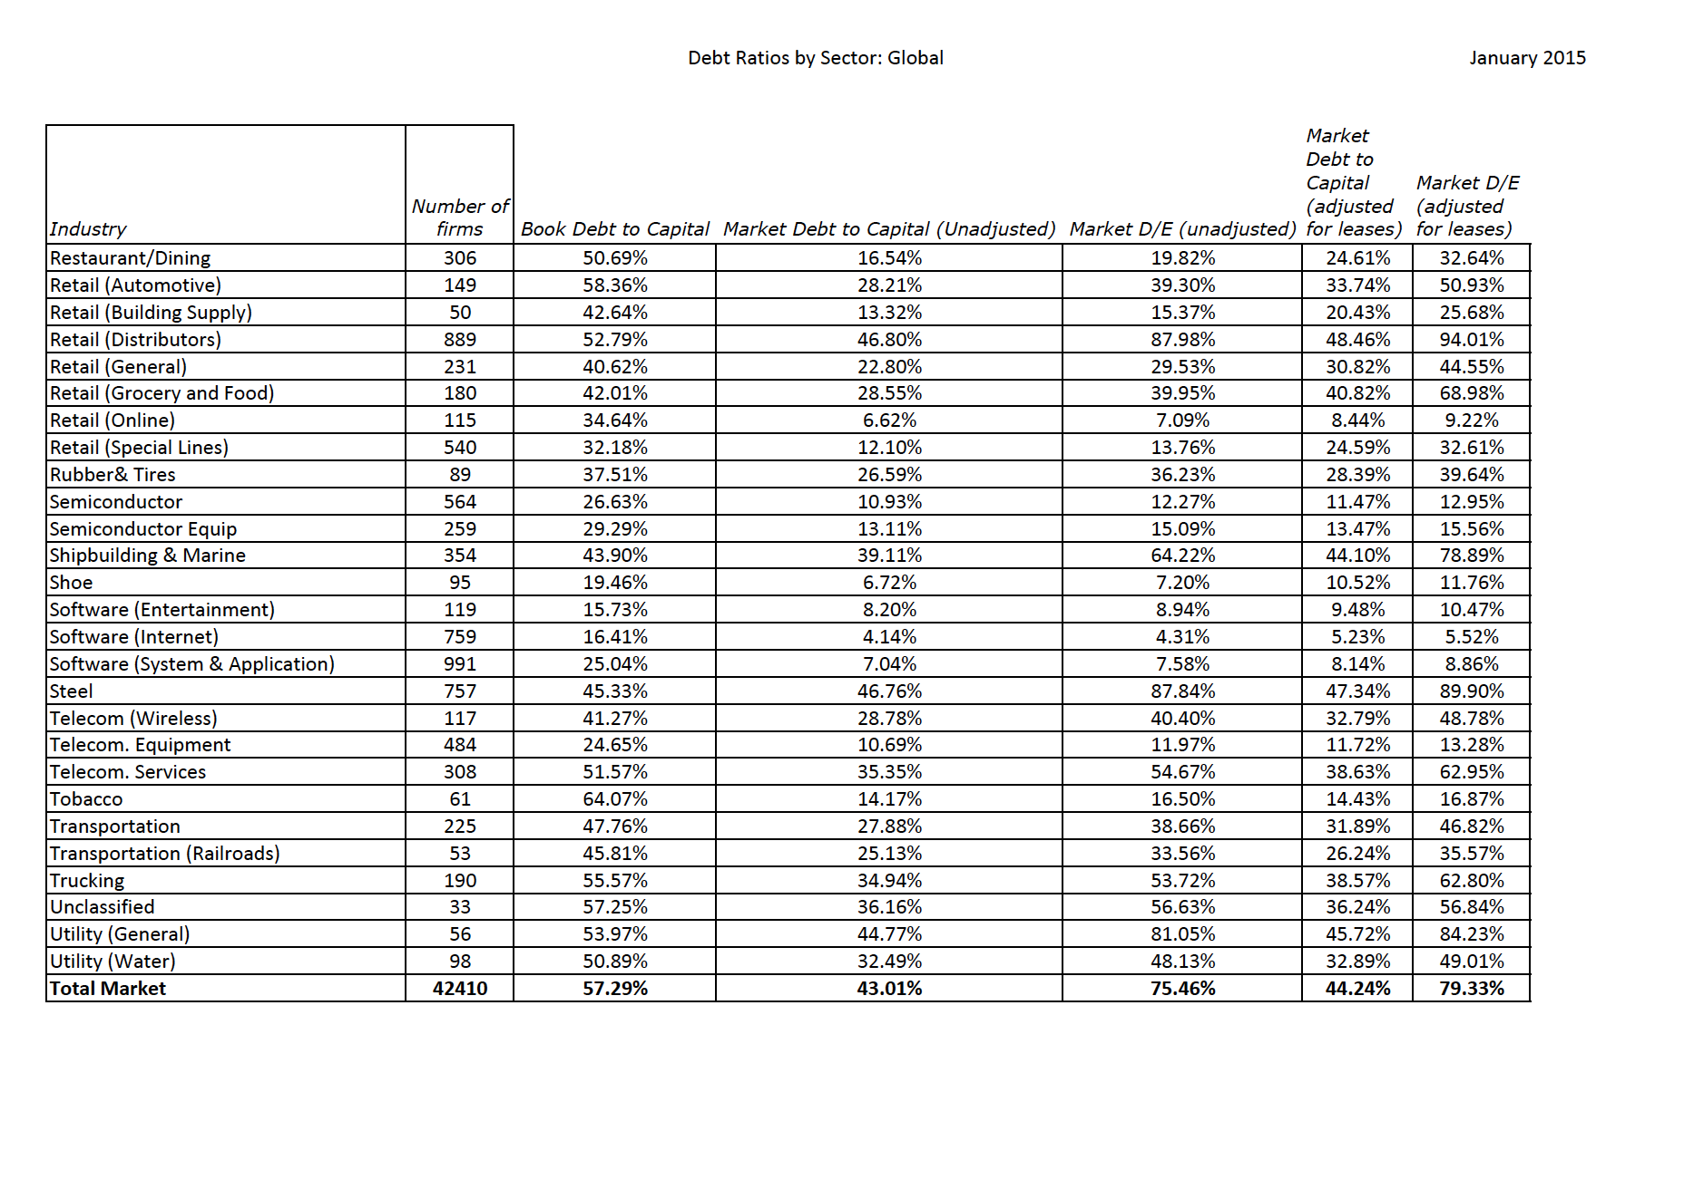

Slide 38
Indonesian Companies: Optimal Debt Ratios
Company | EBITDA/EV | Market Debt to Capital | Optimal Debt Ratio | Change in Value
Krakatau Steel | -2.75% | 78.94% | 0.00% | 55.19%
Bumi Resources | 13.14% | 95.14% | 0.00% | 61.57%
Lippo Karawacki | 10.20% | 26.45% | 10.00% | 10.28%
Gudang Garam | 9.68% | 14.34% | 10.00% | -0.01%
Perushann Gas | 11.24% | 21.39% | 20.00% | -0.14%
Semen Indonesia | 10.31% | 4.74% | 10.00% | 0.44%
United Tractors | 19.17% | 3.36% | 20.00% | 1.70%
Media Nusantra | 8.87% | 10.30% | 20.00% | 0.91%
Indosat | 19.61% | 57.31% | 0.00% | 75.18%

Slide 39
Indonesian Companies: Debt Ratios
Company | EBITDA | Debt/EBITDA | Market Debt to Capital | Industry for comparison | Industry Average Debt to Capital (Market)
Krakatau Steel | IDR 48.00 | -31.85 | 78.94% | Steel | 47.34%
Bumi Resources | IDR 581.00 | 7.28 | 95.14% | Coal & Related Energy | 35.06%
Lippo Karawacki | IDR 2,974.00 | 3.63 | 26.45% | Real Estate (General/Diversified) | 44.11%
Gudang Garam | IDR 10,088.00 | 1.50 | 14.34% | Tobacco | 14.43%
Perushann Gas | IDR 980.00 | 2.19 | 21.39% | Oil/Gas Distribution | 34.58%
Semen Indonesia | IDR 8,204.00 | 0.48 | 4.74% | Construction Supplies | 32.34%
United Tractors | IDR 12,900.00 | 0.20 | 3.36% | Machinery | 17.38%
Media Nusantra | IDR 2,809.00 | 1.20 | 10.30% | Entertainment | 21.67%
Indosat | IDR 8,654.00 | 3.15 | 57.31% | Telecom. Services | 38.63%

Slide 40

Dividend yield and payout

Slide 41
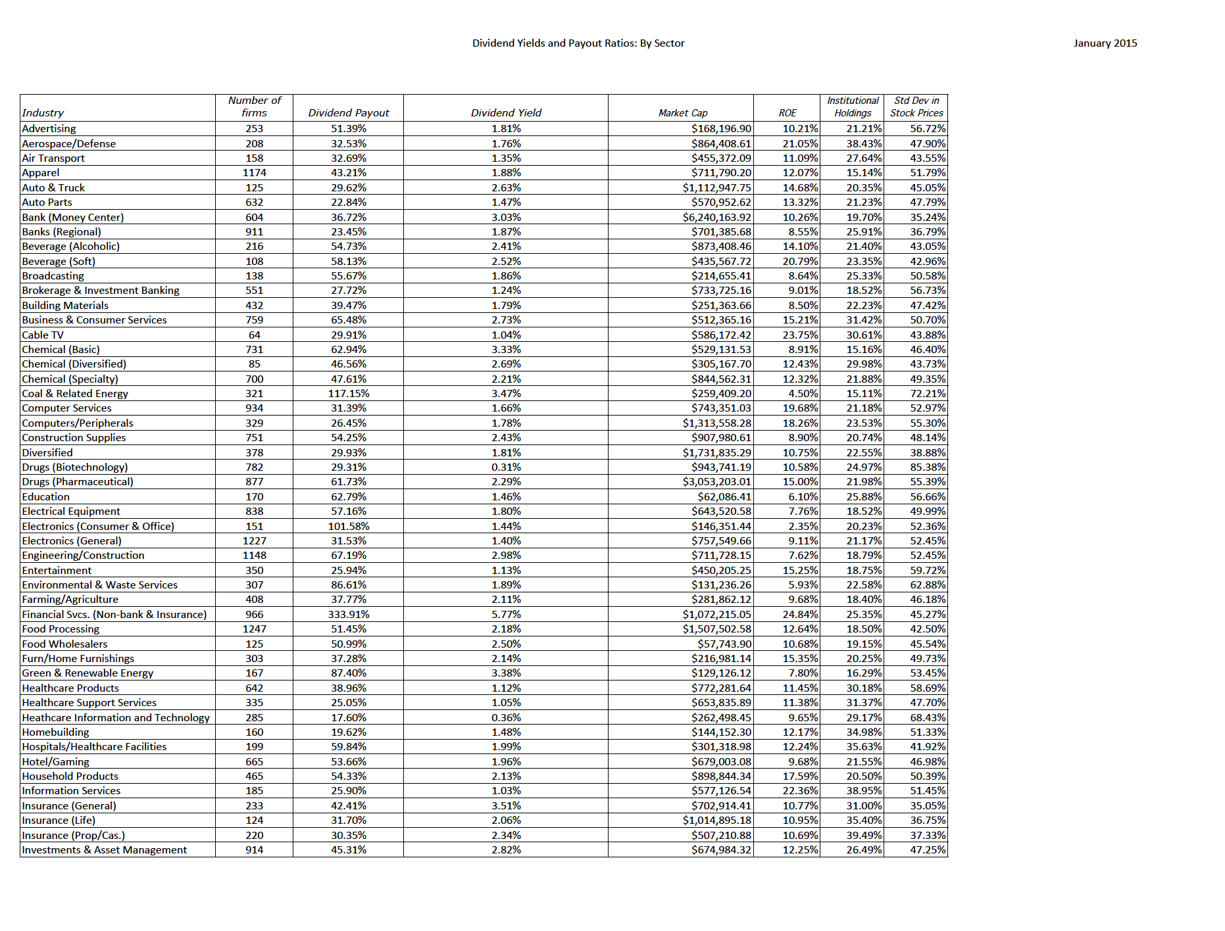

Slide 42
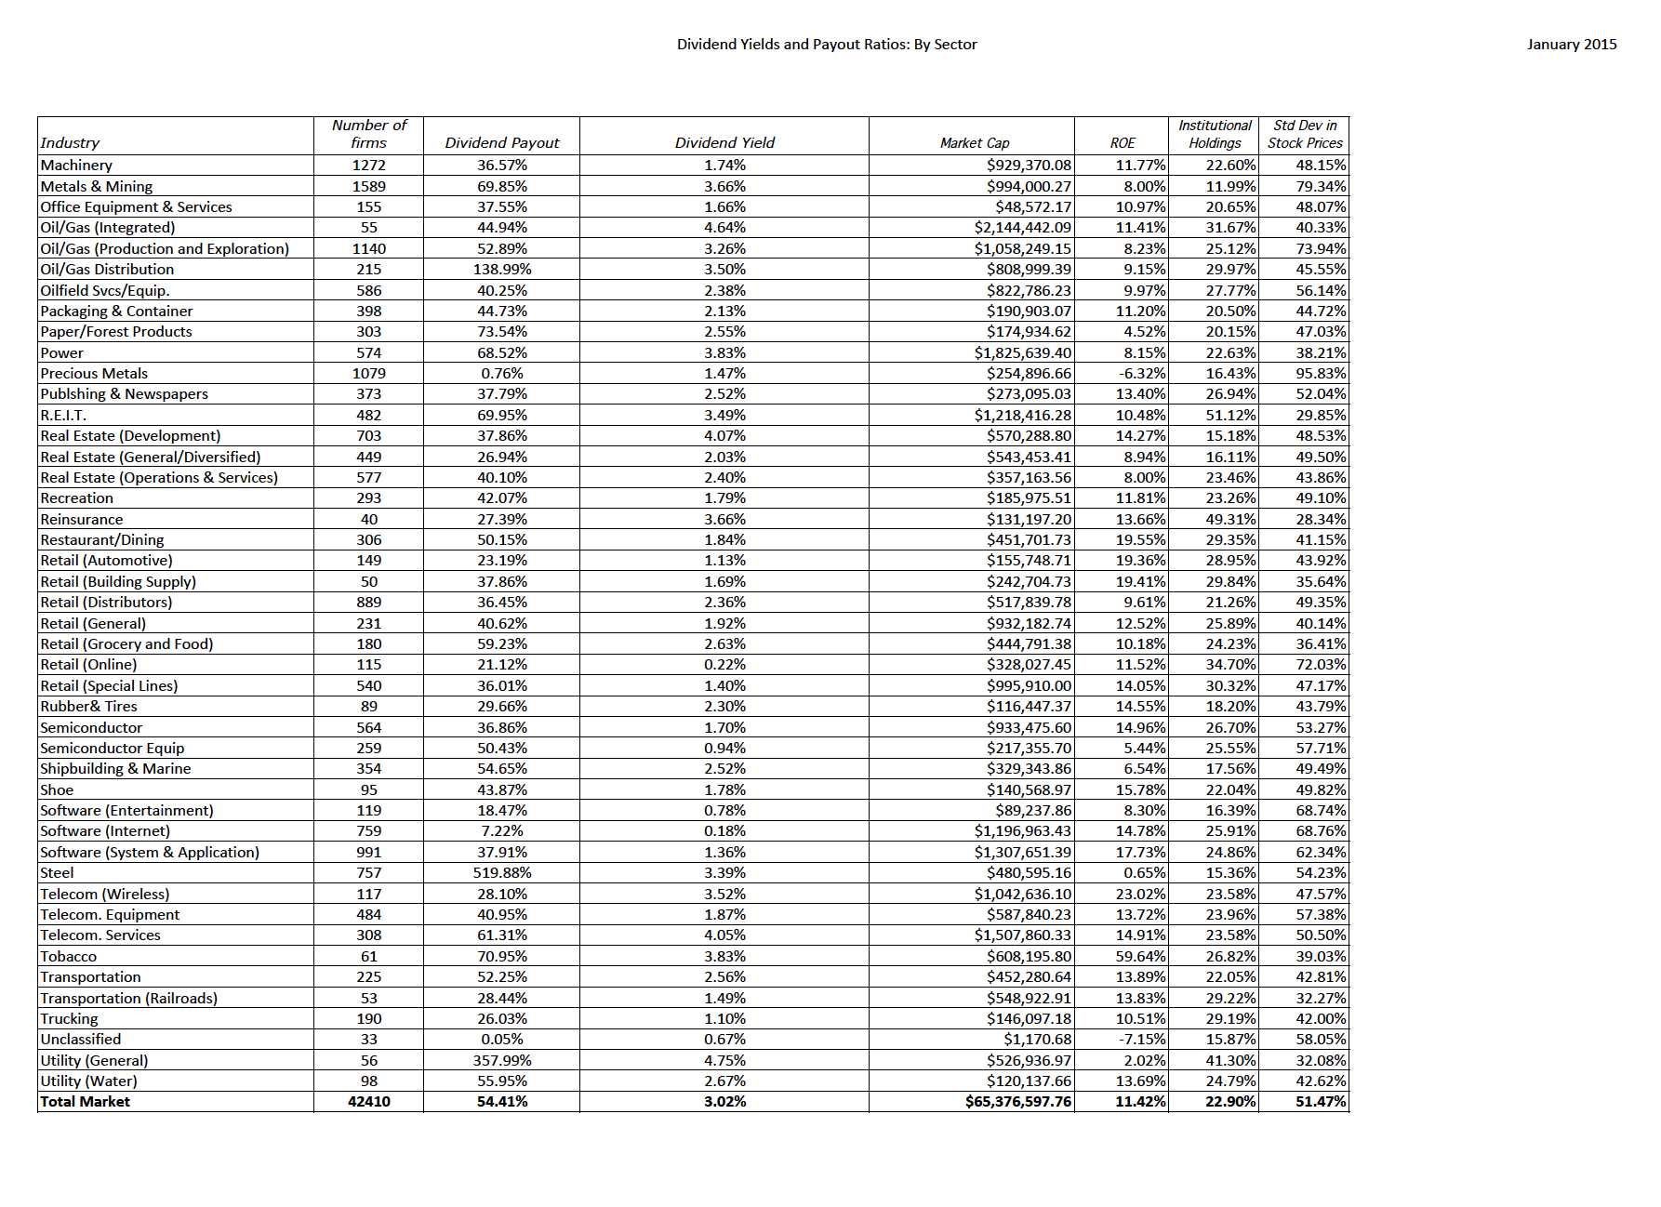

Slide 43
Indonesian Companies: Dividend Statistics
Company | Dividends | Net Income | Market Cap | Dividend Yield | Dividend Payout | Industry | Industry Dividend Yield | Industry Dividend Payout
Krakatau Steel | IDR 0 | -IDR 146 | IDR 408 | 0.00% | NA | Steel | 3.39% | 519.88%
Bumi Resources | IDR 0 | -IDR 218 | IDR 216 | 0.00% | NA | Coal & Related Energy | 3.47% | 117.15%
Lippo Karawacki | IDR 320 | IDR 2,653 | IDR 30,001 | 1.07% | 12.06% | Real Estate (General/Diversified) | 2.03% | 26.94%
Gudang Garam | IDR 1,539 | IDR 5,233 | IDR 90,624 | 1.70% | 29.41% | Tobacco | 3.83% | 70.95%
Perushann Gas | IDR 454 | IDR 655 | IDR 7,881 | 5.76% | 69.31% | Oil/Gas Distribution | 3.50% | 138.99%
Semen Indonesia | IDR 2,427 | IDR 5,453 | IDR 79,779 | 3.04% | 44.51% | Construction Supplies | 2.43% | 54.25%
United Tractors | IDR 1,995 | IDR 5,430 | IDR 75,271 | 2.65% | 36.74% | Machinery | 1.74% | 36.57%
Media Nusantra | IDR 263 | IDR 1,658 | IDR 29,409 | 0.89% | 15.86% | Entertainment | 1.13% | 25.94%
Indosat | IDR 0 | -IDR 3,243 | IDR 20,323 | 0.00% | NA | Telecom. Services | 4.05% | 61.31%

Slide 44
Net Income 12,345
+ Deprecn & Amortzn + 7,742
+ Chg in non-cash WC + 1,748
+ Cap Ex - 14,642
+ Inc (Dec) in ST Debt + 0
+ Increase in LT Debt + 5,794
- Decrease in LT Debt - 0
= FCFE = 9,491 M
Dividends Paid - 3,531
Decrease capital stock -11,623
Dividends + Buybacks -15,154
Operating Income 17,741
- Taxes = 17741*.4603 = - 8,166
+ Deprecn & Amortzn + 7,742
+ Chg in non-cash WC + 1,748
+ Cap Ex - 14,642
= FCFF = 4,423 M
EBITDA – Operating Income = Depreciation & Amortization
25,443 – 17,741 = 7,742 M

Slide 45
Post-class Analysis
Now that you have the numbers for your company, you should be in a position to make an assessment of where your company stands right now, what it does well, what it does badly and what you would change about it.
Here are some key questions to address:
  I. Stockholder Analysis: Who has the power and what are the potential conflicts of interest?
  II. Risk and Return: How risky is your firm and what are its hurdle rates?
  III. Investments: How good are existing investments and what is the potential for the future?
  IV. Capital Structure Choices: What are the current financing choices?
  V. Optimal Financing: What is the optimal mix of debt and equity for the firm?
  VI. Financing Changes: Should firm move to optimal and what type of debt should it use?
  VII. Dividend Policy: How much and how does the firm return cash to stockholders?
  VIII. Dividend Assessment: Should the firm return more or less cash to stockholders?
  IX: Valuation (optional): What value would you attach to the firm and its equity?

