Slide 1
Project Workbook (March 2017)
“Talk is cheap. Time for action”

Slide 2
Your data…
Data Packet
  Page 1: HDS (Bloomberg) – Top 17 stockholders
  Page 2: Beta (Bloomberg) – 2 year weekly return beta
  Pages 3-7: DES (Bloomberg) – 5 page description of your company (For some of you, it may be only 4 pages)
  Page 8: CRPR – Bond Rating or Bloomberg Default Risk Assessment
  Page 9 : DDIS: Debt due table (with maturities)
  Page 10: FA (Multi-year financial summary)
Checklist before you start
  What country is your company incorporated in?
  What currency are the financial statements in? (Not necessarily in the local currency)
  What currency is your market capitalization and stock price stated in? (May not match the currency of the financial statements)
  What was the most recent fiscal year? (For most of your companies, it will be a year ending December… but some may have other year ends)

Slide 3

Source for data: Will vary across markets. 13F is SEC filing for US mutual/pension funds
Percent of outstanding shares in company

Slide 4

Corporate Governance: Assessing where the power lies and potential conflicts of interest

Slide 5
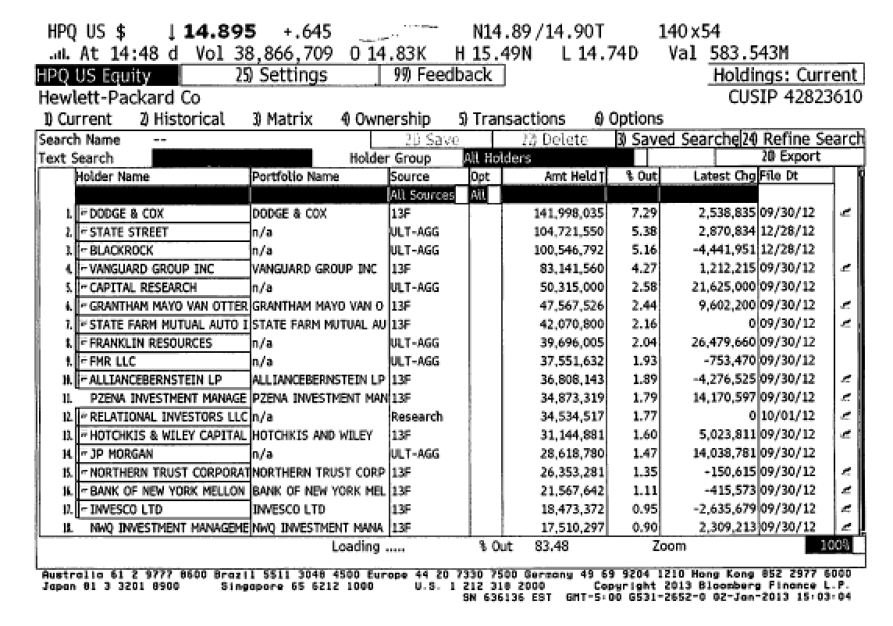
1. Institutional Default

Slide 6
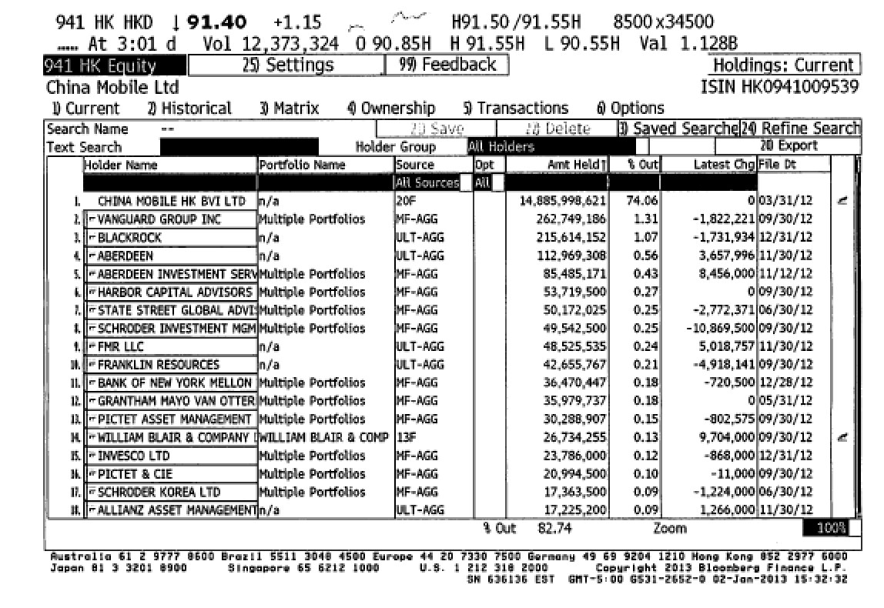
2. Self Holdings?

Slide 7
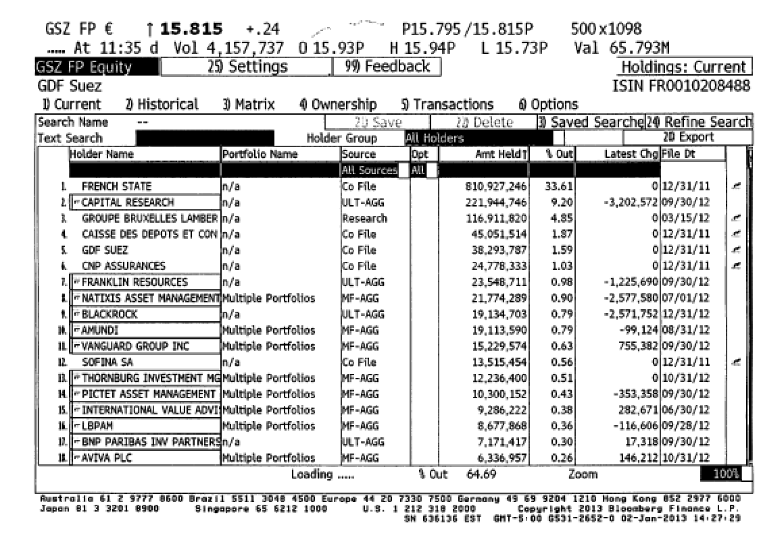
3. The Government Influence?

Slide 8
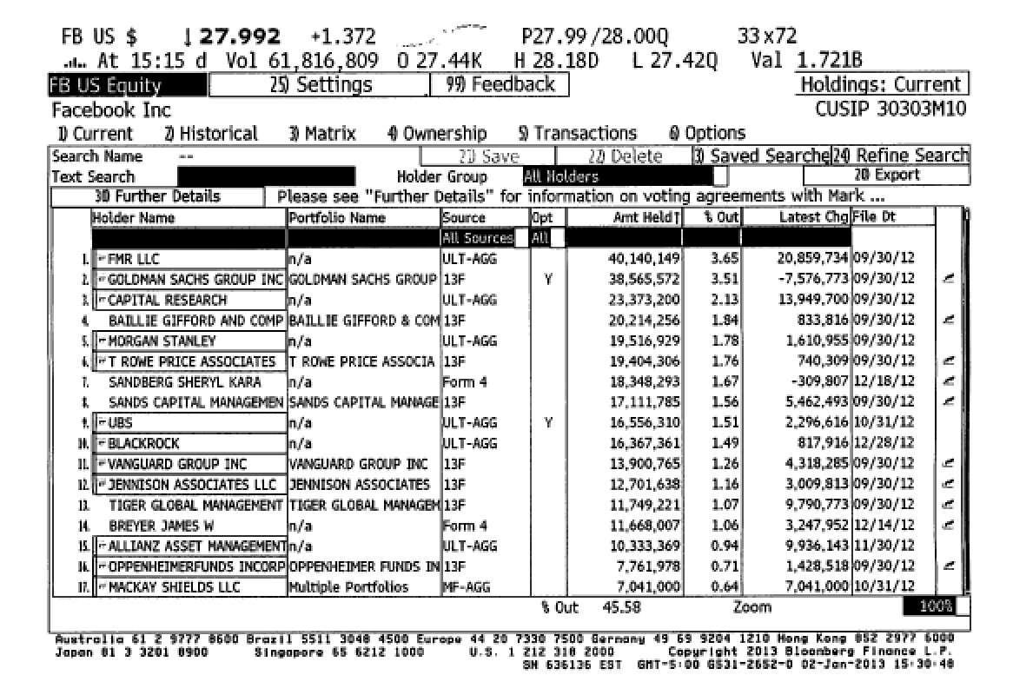
4. Different voting rights?

Slide 9
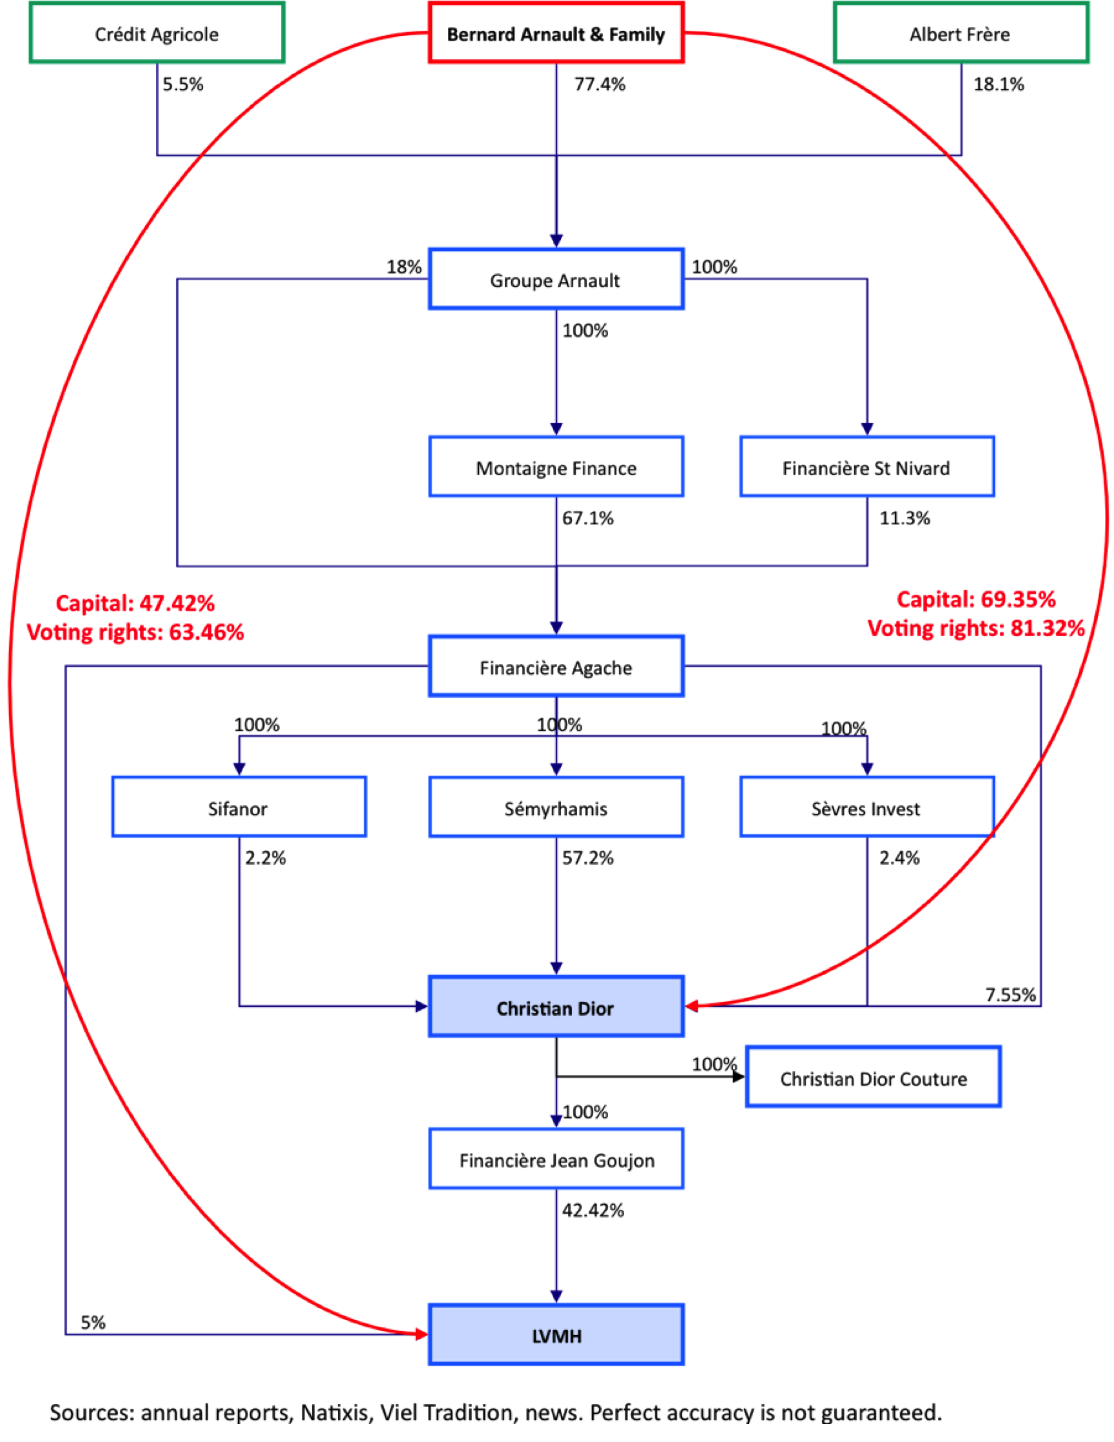
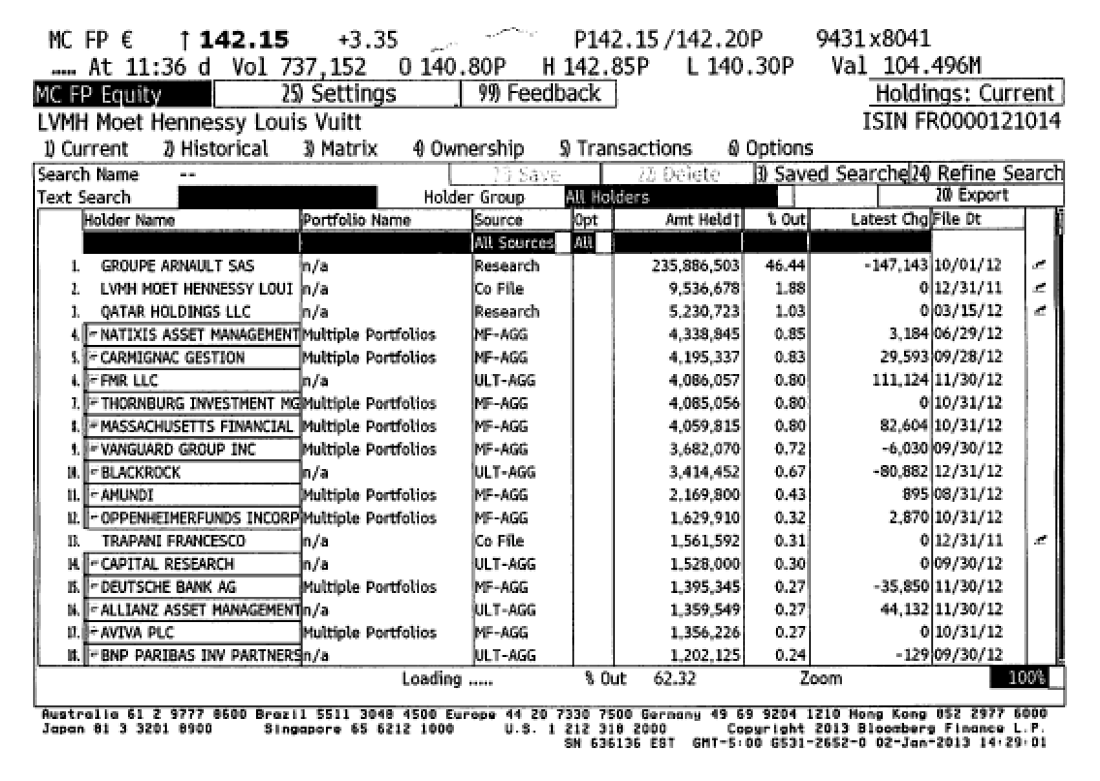
5. Family Group Companies

Slide 10
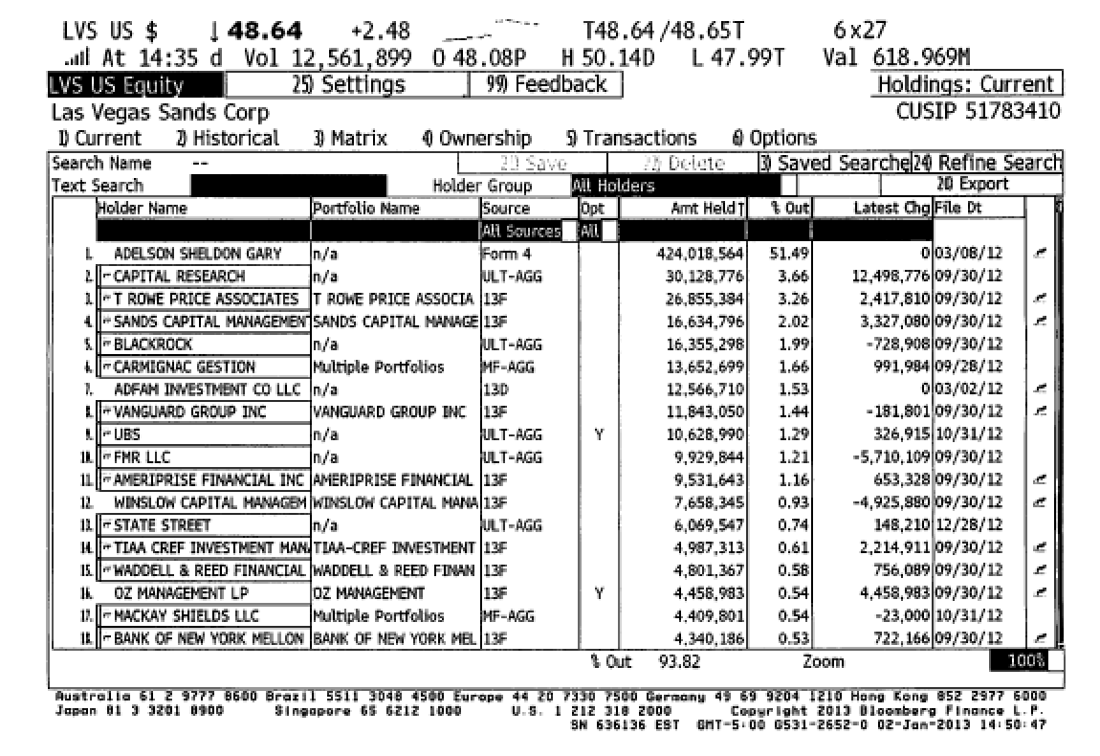
6. Founders hang on…

Slide 11
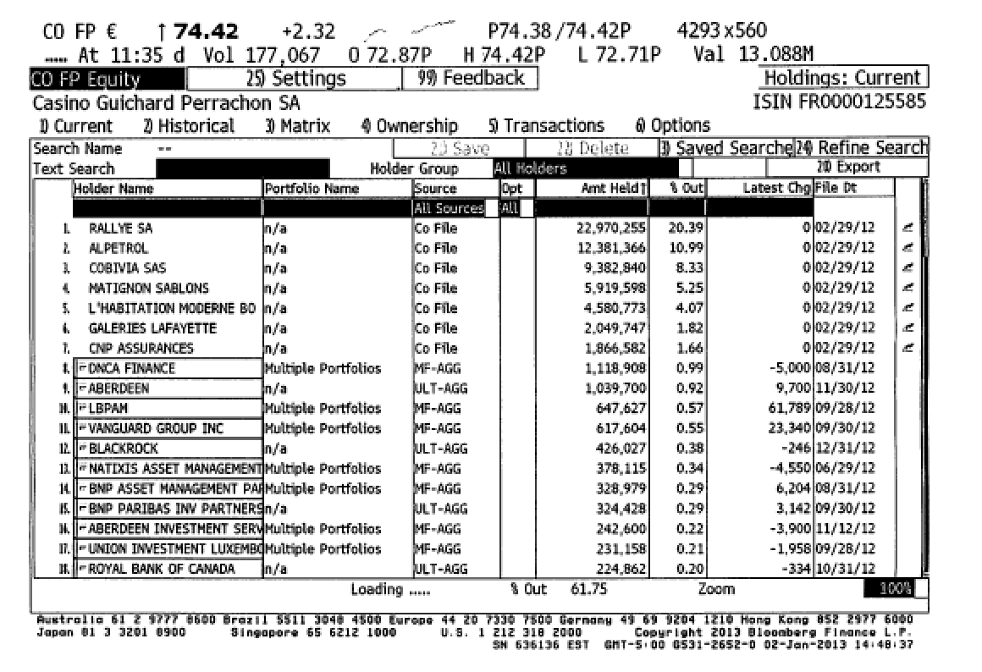
7. Corporate Cross Holdings

Slide 12
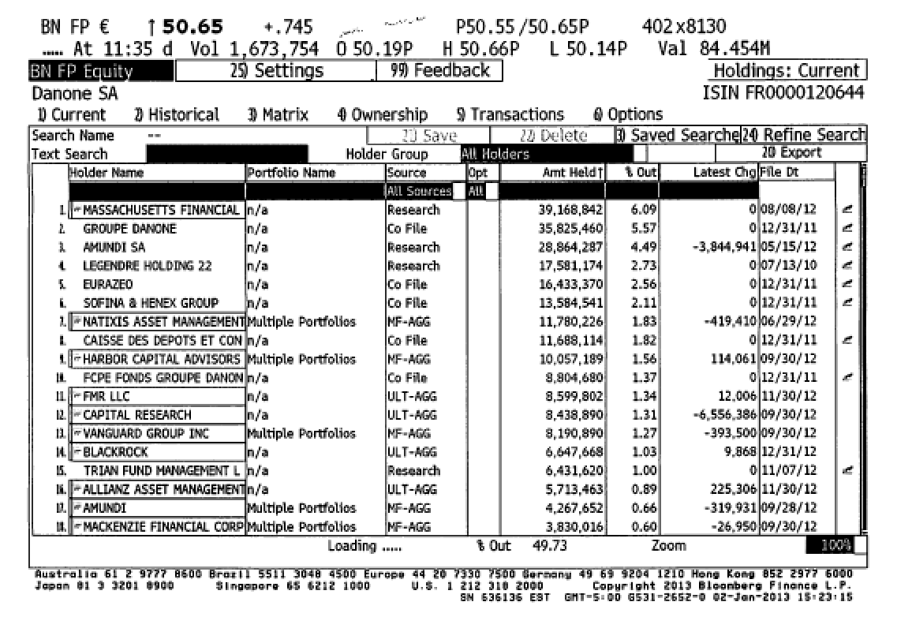
8. Activist investors

Slide 13
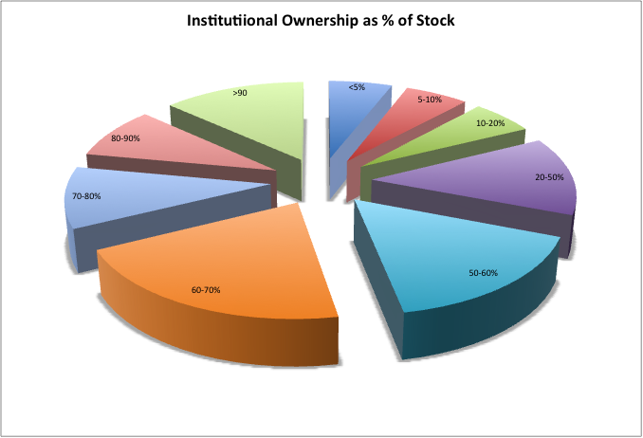
The marginal investor in your firm is….

Slide 14
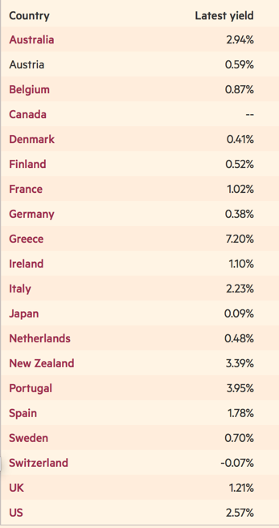
Risk free rate: Major Currency Government Bonds – March 9, 2017

Slide 15
Local Currency Government Bond Rates – January 1, 2017
Currency | Govt Bond Rate 12/31/16 | Currency | Govt Bond Rate 12/31/16
Australian $ | 2.76% | Malyasian Ringgit | 4.24%
Brazilian Reai | 11.37% | Mexican Peso | 7.63%
British Pound | 1.35% | Nigerian Naira | 15.97%
Bulgarian Lev | 2.04% | Norwegian Krone | 1.61%
Canadian $ | 1.70% | NZ $ | 3.25%
Chilean Peso | 4.12% | Pakistani Rupee | 8.03%
Chinese Yuan | 3.25% | Peruvian Sol | 6.43%
Colombian Peso | 6.76% | Phillipine Peso | 4.75%
Croatian Kuna | 3.13% | Polish Zloty | 3.67%
Czech Koruna | 0.49% | Romanian Leu | 3.44%
Danish Krone | 0.42% | Russian Ruble | 8.38%
Euro | 0.29% | Singapore $ | 2.45%
HK $ | 1.69% | South African Rand | 8.80%
Hungarian Forint | 3.41% | Swedish Krona | 0.62%
Iceland Krona | 5.06% | Swiss Franc | -0.19%
Indian Rupee | 6.40% | Taiwanese $ | 1.17%
Indonesian Rupiah | 7.60% | Thai Baht | 2.70%
Israeli Shekel | 2.06% | Turkish Lira | 11.00%
Japanese Yen | 0.06% | US $ | 2.45%
Kenyan Shilling | 14.02% | Venezuelan Bolivar | 20.43%
Korean Won | 2.08% | Vietnamese Dong | 6.10%
Notes:
These numbers are usually tough to get. I get these from a website that lists them for free (for the moment):
http://www.tradingeconomics.com/bonds-list-by-country
These are local currency bond rates and some are more liquid (and credible) than others.

Slide 16
Approach 1: Default spread from Government Bonds
Country | $ 10-year Bond Rate | US T.Bond Rate | Default Spread
Philippines | 3.91% | 2.45% | 1.46%
Chile | 3.12% | 2.45% | 0.67%
Peru | 6.11% | 2.45% | 3.66%
Mexico | 3.96% | 2.45% | 1.51%
Colombia | 4.18% | 2.45% | 1.73%
Indonesia | 4.67% | 2.45% | 2.22%
Turkey | 5.81% | 2.45% | 3.36%
Brazil | 5.59% | 2.45% | 3.14%
Ukraine | 9.07% | 2.45% | 6.62%
Venezuela | 22.40% | 2.45% | 19.95%

Slide 17
Approach 2: CDS Spreads – January 1, 2017
Country | CDS Spread | CDS Spread adj for US | Country | CDS Spread | CDS Spread adj for US | Country | CDS Spread | CDS Spread adj for US
Abu Dhabi | 0.97% | 0.59% | Hungary | 1.67% | 1.29% | Peru | 1.73% | 1.35%
Argentina | 5.14% | 4.76% | Iceland | 1.10% | 0.72% | Philippines | 1.61% | 1.23%
Australia | 0.49% | 0.11% | India | 1.76% | 1.38% | Poland | 1.17% | 0.79%
Austria | 0.52% | 0.14% | Indonesia | 2.25% | 1.87% | Portugal | 3.42% | 3.04%
Bahrain | 3.17% | 2.79% | Ireland | 1.02% | 0.64% | Qatar | 1.17% | 0.79%
Belgium | 0.60% | 0.22% | Israel | 1.12% | 0.74% | Romania | 1.51% | 1.13%
Brazil | 3.59% | 3.21% | Italy | 2.22% | 1.84% | Russia | 2.46% | 2.08%
Bulgaria | 1.87% | 1.49% | Japan | 0.62% | 0.24% | Saudi Arabia | 1.45% | 1.07%
Chile | 1.29% | 0.91% | Kazakhstan | 2.13% | 1.75% | Slovakia | 0.85% | 0.47%
China | 1.65% | 1.27% | Korea | 0.67% | 0.29% | Slovenia | 1.52% | 1.14%
Colombia | 2.42% | 2.04% | Latvia | 1.02% | 0.64% | South Africa | 2.87% | 2.49%
Costa Rica | 3.40% | 3.02% | Lebanon | 5.57% | 5.19% | Spain | 1.25% | 0.87%
Croatia | 2.60% | 2.22% | Lithuania | 0.94% | 0.56% | Sweden | 0.40% | 0.02%
Cyprus | 2.67% | 2.29% | Malaysia | 1.94% | 1.56% | Switzerland | 0.50% | 0.12%
Czech Republic | 0.74% | 0.36% | Mexico | 2.20% | 1.82% | Thailand | 1.28% | 0.90%
Denmark | 0.41% | 0.03% | Morocco | 2.11% | 1.73% | Tunisia | 5.00% | 4.62%
Egypt | 4.76% | 4.38% | Netherlands | 0.51% | 0.13% | Turkey | 3.44% | 3.06%
Estonia | 0.81% | 0.43% | New Zealand | 0.50% | 0.12% | Ukraine | 7.64% | 7.26%
Finland | 0.45% | 0.07% | Nigeria | 5.76% | 5.38% | United Kingdom | 0.61% | 0.23%
France | 0.70% | 0.32% | Norway | 0.34% | 0.00% | United States | 0.38% | 0.00%
Germany | 0.44% | 0.06% | Pakistan | 4.18% | 3.80% | Venezuela | 30.82% | 30.44%
Hong Kong | 0.58% | 0.20% | Panama | 1.94% | 1.56% | Vietnam | 2.61% | 2.23%
Notes:
There are about 60 countries with CDS spreads. Think of these as annual insurance costs against default in percentage terms for the 10-year bond.
To insure yourself against Brazil default risk in January 2013 would have cost you about 1.42% a year.
The one catch with the CDS market is that there is counter party risk, i.e., you can buy insurance but there is the chance that the person you bought it from might default and there are quirks in the market that lead to CDS spreads to exist even for nominally default free entities (Switzerland, for example)
One way to counter this is to subtract out the CDS spread for markets like Switzerland, Germany and the US (if you think of these as default free) from every CDS spread.
In January 2013, the average CDS spreads across these markets was about 0.50%.
Netting that out against Brazil’s CDS spread yields = 1.42% - 0.50% = 0.92%

Slide 18
Approach 3: Typical Default Spreads: July 1, 2016
S&P Sovereign Rating | Moody's Sovereign Rating | Default Spread
AAA | Aaa | 0.00%
AA+ | Aa1 | 0.46%
AA | Aa2 | 0.57%
AA- | Aa3 | 0.70%
A+ | A1 | 0.81%
A | A2 | 0.98%
A- | A3 | 1.39%
BBB+ | Baa1 | 1.84%
BBB | Baa2 | 2.20%
BBB- | Baa3 | 2.54%
BB+ | Ba1 | 2.89%
BB | Ba2 | 3.47%
BB | Ba3 | 4.16%
B+ | B1 | 5.20%
B | B2 | 6.36%
B- | B3 | 7.51%
CCC+ | Caa1 | 8.66%
CCC | Caa2 | 10.40%
CCC- | Caa3 | 11.55%
CC+ | Ca1 | 13.86%
CC | Ca2 | 15.25%
CC- | Ca3 | 16.50%
C+ | C1 | 18.00%
C | C2 | 20.00%
C- | C3 | 25.00%
Notes:
This table was developed using both sovereign bonds and CDS spreads. Within each ratings class, I found as many estimates of the spread as I could and averaged out across these estimates.
Using Brazil as an example, the rating for Brazil in June 2012 was Baa2. The default spread for Brazil in June 2012 would have worked out to 1.75%
Using all three approaches for Brazil in June 2012 yields the following:
$ denominated bond spread = 1.43%
Adjusted CDS spread = 1.58%
Rating-based spread = 1.75%
You can pick one of the three or use an average of the three.

Slide 19
Getting to a risk free rate in a currency: Example
The Brazilian government bond rate in nominal reais on January 1, 2017 was 11.37%. To get to a riskfree rate in nominal reais, we can use one of three approaches.
  Approach 1: Government Bond spread
    The 2018 Brazil bond, denominated in US dollars, has a spread of 3.14% over the US treasury bond rate.
    Riskfree rate in $R = 11.37% - 3.14% = 8.23%
  Approach 2: The CDS Spread
    The CDS spread for Brazil, adjusted for the US CDS spread was 3.21%.
    Riskfree rate in $R = 11.37% - 3.21% = 8.16%
  Approach 3: The Rating based spread
    Brazil has a Ba2 local currency rating from Moody’s. The default spread for that rating is 3.47%
    Riskfree rate in $R = 11.37% - 3.47% = 7.90%
Notes:
The risk free rate will be different, depending on which measure of default spread you use. Just pick one and stay with it all the way through (including when compute equity risk premiums). You should be okay.

Slide 20
Risk free Rates: By Currency – January 1, 2017
Currency | Risk free Rate | Currency | Risk free Rate | Currency | Risk free Rate
Australian $ | 2.76% | Iceland Krona | 3.67% | Phillipine Peso | 2.55%
Brazilian Reai | 7.90% | Indian Rupee | 3.86% | Polish Zloty | 2.69%
British Pound | 0.89% | Indonesian Rupiah | 5.06% | Romanian Leu | 0.90%
Bulgarian Lev | -0.16% | Israeli Shekel | 1.25% | Russian Ruble | 5.49%
Canadian $ | 1.70% | Japanese Yen | -0.75% | Singapore $ | 2.45%
Chilean Peso | 3.42% | Kenyan Shilling | 8.82% | South African Rand | 6.60%
Chinese Yuan | 2.55% | Korean Won | 1.51% | Swedish Krona | 0.62%
Colombian Peso | 4.56% | Malyasian Ringgit | 2.85% | Swiss Franc | -0.19%
Croatian Kuna | -0.34% | Mexican Peso | 6.24% | Taiwanese $ | 0.47%
Czech Koruna | -0.32% | Nigerian Naira | 10.77% | Thai Baht | 0.86%
Danish Krone | 0.42% | Norwegian Krone | 1.61% | Turkish Lira | 8.11%
Euro | 0.29% | NZ $ | 3.25% | US $ | 2.45%
HK $ | 1.23% | Pakistani Rupee | 0.52% | Venezuelan Bolivar | 8.88%
Hungarian Forint | 0.87% | Peruvian Sol | 5.04% | Vietnamese Dong | 0.90%

Slide 21
Risk free Rate: Desperation Time?
It is entirely possible that you may be unable to find a government bond issued in the local currency (that is traded) or that you do not trust the government bond rate as a fair market interest rate. There are two ways you can get to a risk free rate, in this case.
Build up approach: The risk free rate in any currency can be written as the sum of two variables:
  Risk free rate = Expected Inflation in currency + Expected real interest rate
    The expected real interest rate can be computed in one of two ways: from the US TIPs rate or set equal to real growth in the economy. Thus, if the expected inflation rate in a country is expected to be 15% and the TIPs rate is 1%, the risk free rate is 16%.
US $ rate & Differential Inflation: Alternatively, you can scale up the US $ risk free rate by the differential inflation between the US $ and the currency in question:
  Risk free rate_{Currency}=
  Thus, if the US $ risk free rate is 2.27%, the inflation rate in the foreign currency is 15% and the inflation rate in US $ is 1.5%, the foreign currency risk free rate is as follows:
  Risk free rate =

Slide 22
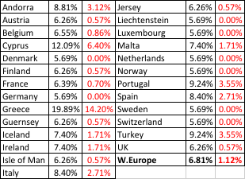
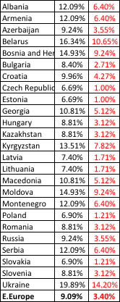
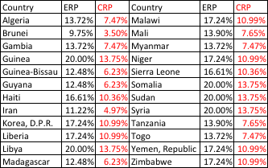

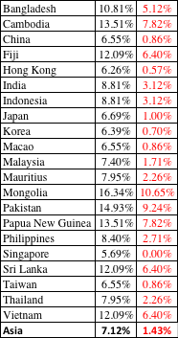

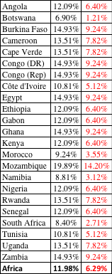
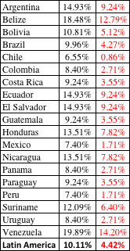
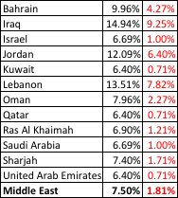

ERP : Jan 2017
Black #: Total ERP
Red #: Country risk premium
AVG: GDP weighted average
Notes:
Updated country risk premiums. No intellectual fire power here but it is transparent (based upon default spreads). It is only as good as the sovereign rating that is available for a country.

Slide 23

If annualized riskfree rate during period was 1.5%,
Jensen’s alpha = 0.057% - (1.5%/52)*(1-0.422) = 0.0403%
Based on weekly returns
Regression beta is 0.422
Adj Beta = (2/3)(0.422) + (1/3) (1) = 0.614
Intercept in %
0.057%
R squared (decimals) = 21.5%
Std error of beta = 0.08
67% confidence:
0.34 (=0.42-0.08) to
0.50 (=0.42+0.08)
95% confidence:
0.26 (=0.42-2*0.08) to
0.58 (=0.42+2*0.08)
Using a 6% ERP for mature markets and a current riskfree rate of 1.87%,
Expected Return = Riskfree rate + Raw Beta (ERP)
= 1.87% + 0.422 (6%) = 4.40%

Slide 24

The best R-squared ever?

Slide 25

What sector is your firm in?
Bloomberg sector category
Read the description and make your own judgment

Slide 26
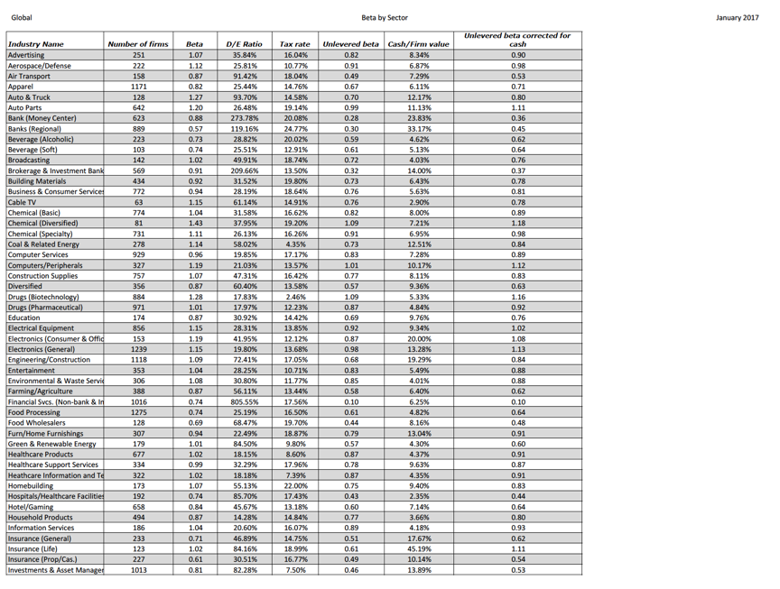

Slide 27
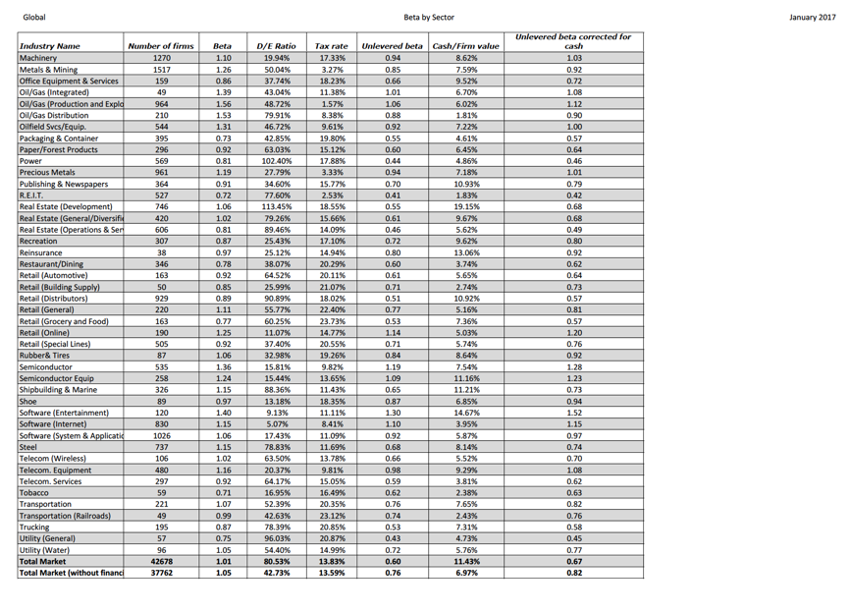

Slide 28

Interest coverage ratios
Interest coverage ratio = Operating profit/ Interest expense
= 17,741/1,441 = 12.10

Slide 29
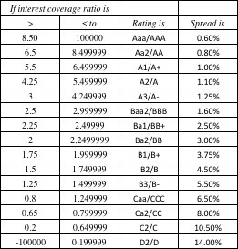
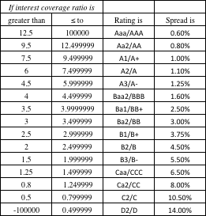
Synthetic Ratings and Default Spreads
Market cap > $ 5 billion
Market cap < $ 5 billion

Slide 30
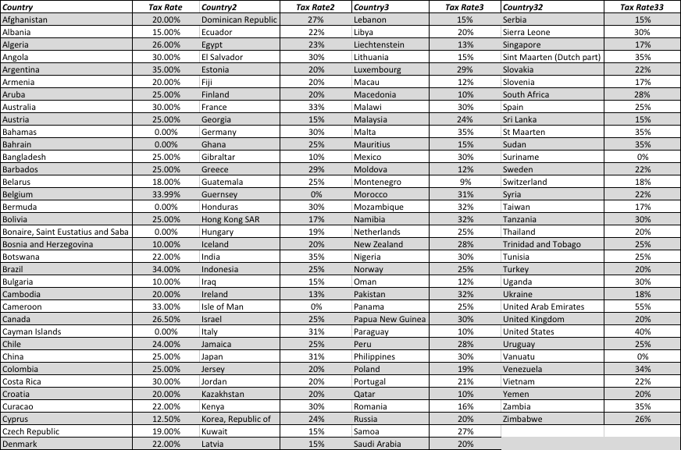
Marginal Corporate Tax Rate- By Country (2017)

Slide 31

Market value of equity = 66,452.45 M
BV of debt = Total Debt = $28,360 M
With a pre-tax cost of debt of 3%
MV of debt =
1,441 (PV of annuity, 3 years, 3%)
+ 28,360/ (1.03)³ = $ 30,029 M
PV of operating leases at 3%
767/1.03 +519/1.03² +382/1.03³ +300/1.03⁴ +202/1.03⁵ +259.5/1.03⁶ +259.5/1.03⁷ = 2,187

Slide 32
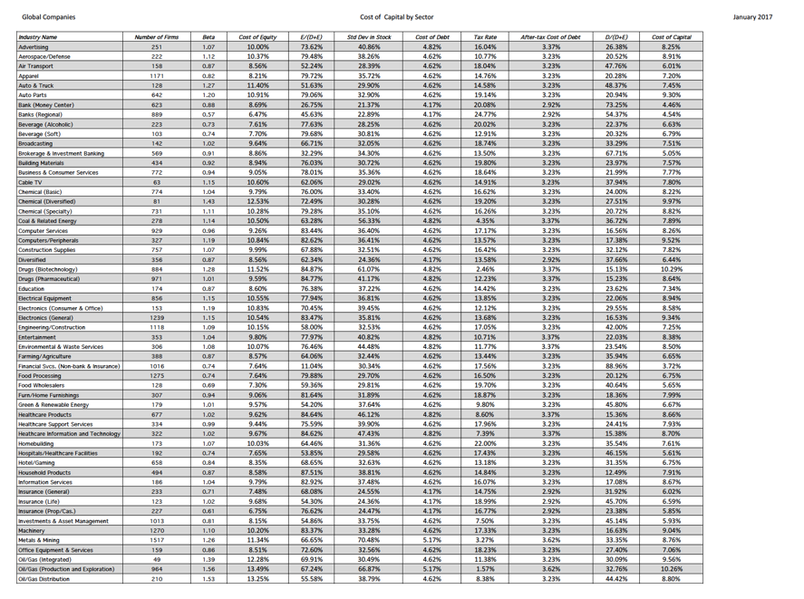

Slide 33
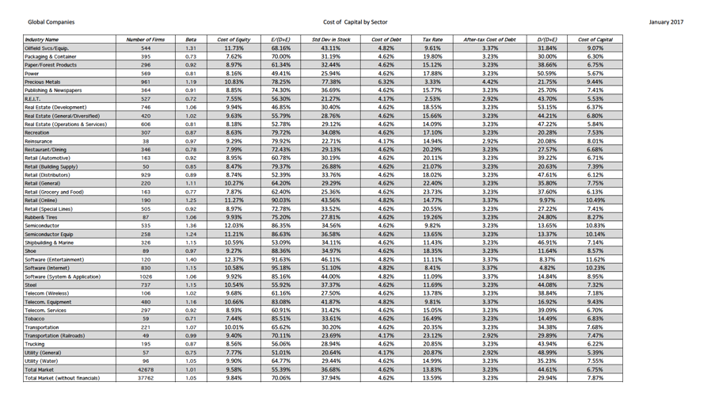

Slide 34
Pre-tax Return on capital
= Operating Income/
(BV of Debt last year + BV of Equity last year –Cash last year)
= 17741/(22,623+ 55,734-6,361) = 24.64%
After-tax Return on capital =
Pre-tax Return on capital (1- tax rate)
= 24.64% (1-.4603) = .1330 or 13.30%
Tax rate used: Effective tax rate (from this page)

Slide 35
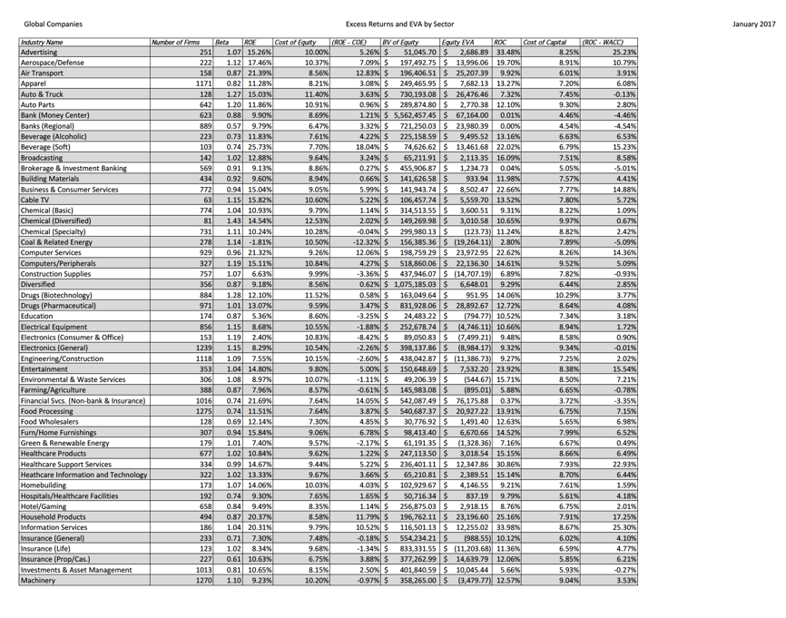

Slide 36
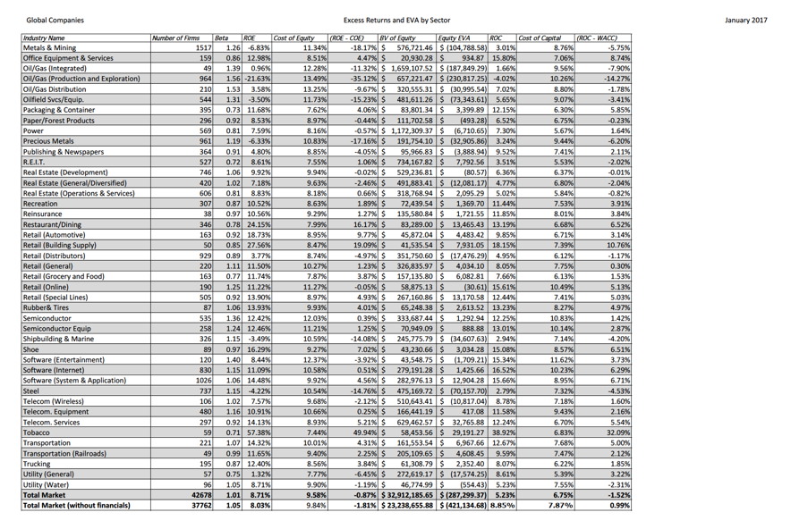

Slide 37
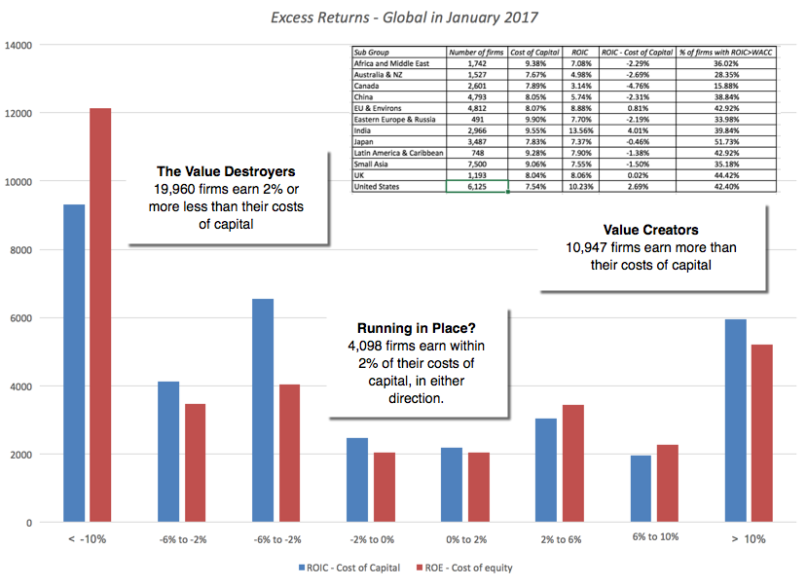
Return Spreads Globally….

Slide 38
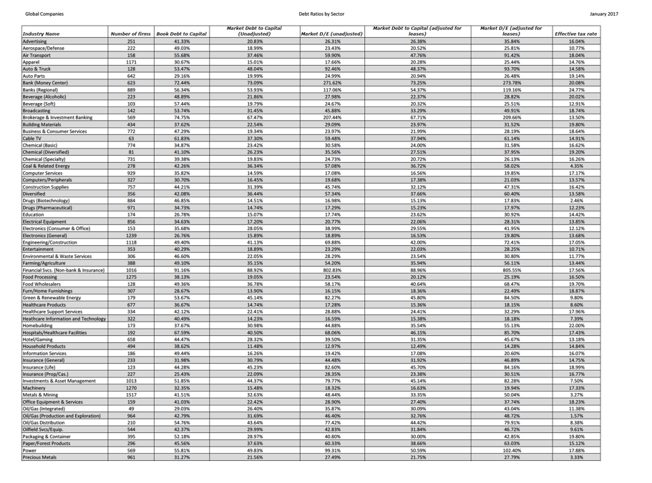

Slide 39
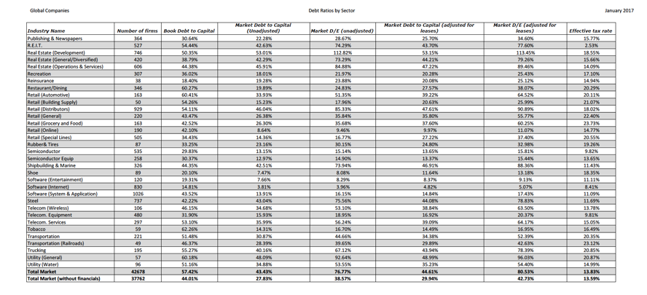

Slide 40

Dividend yield and payout

Slide 41
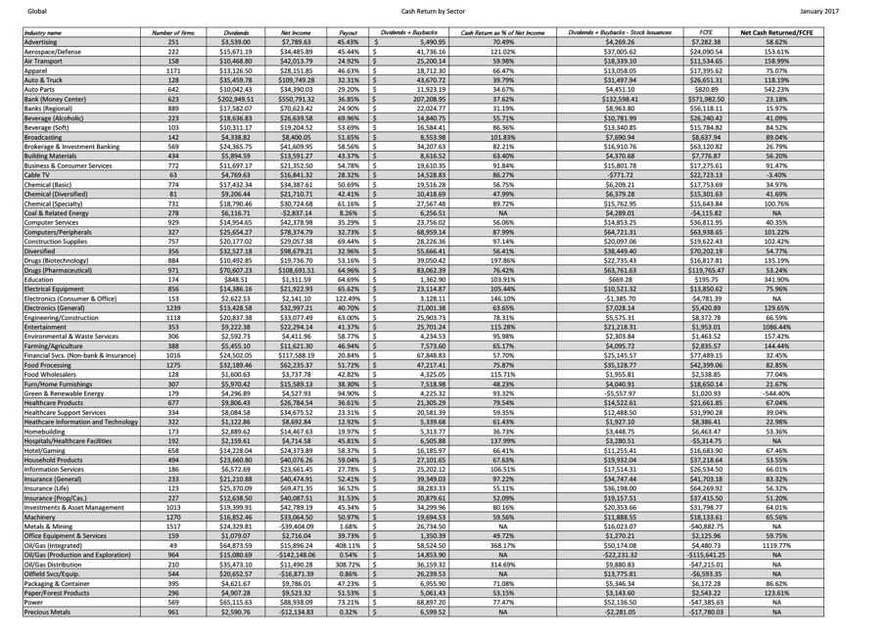

Slide 42
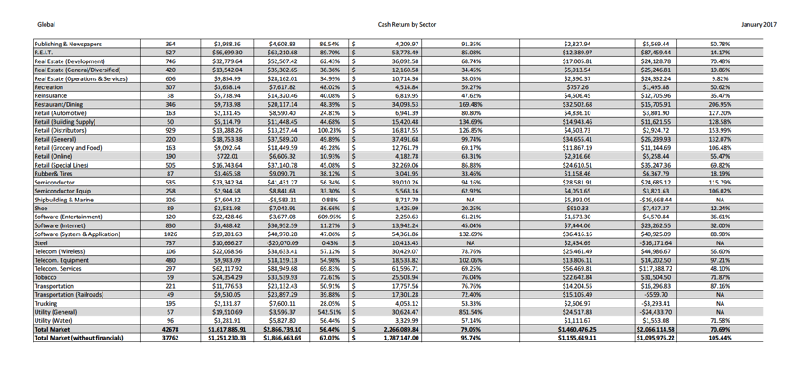

Slide 43
Net Income 12,345
+ Deprecn & Amortzn + 7,742
+ Chg in non-cash WC + 1,748
+ Cap Ex - 14,642
+ Inc (Dec) in ST Debt + 0
+ Increase in LT Debt + 5,794
- Decrease in LT Debt - 0
= FCFE = 9,491 M
Dividends Paid - 3,531
Decrease capital stock -11,623
Dividends + Buybacks -15,154
Operating Income 17,741
- Taxes = 17741*.4603 = - 8,166
+ Deprecn & Amortzn + 7,742
+ Chg in non-cash WC + 1,748
+ Cap Ex - 14,642
= FCFF = 4,423 M
EBITDA – Operating Income = Depreciation & Amortization
25,443 – 17,741 = 7,742 M

Slide 44
Post-class Analysis
Now that you have the numbers for your company, you should be in a position to make an assessment of where your company stands right now, what it does well, what it does badly and what you would change about it.
Your final project will therefore contain eight parts and an optional one, if you are so inclined:
  I. Stockholder Analysis: Who has the power and what are the potential conflicts of interest?
  II. Risk and Return: How risky is your firm and what are its hurdle rates?
  III. Investments: How good are existing investments and what is the potential for the future?
  IV. Capital Structure Choices: What are the current financing choices?
  V. Optimal Financing: What is the optimal mix of debt and equity for the firm?
  VI. Financing Changes: Should firm move to optimal and what type of debt should it use?
  VII. Dividend Policy: How much and how does the firm return cash to stockholders?
  VIII. Dividend Assessment: Should the firm return more or less cash to stockholders?
  IX: Valuation (optional): What value would you attach to the firm and its equity?

