Slide 1
Investment Philosophies: Introduction
Session 1
Investment Philosophies

Slide 2
What is an investment philosophy?
What is it? An investment philosophy is a coherent way of thinking about markets, how they work (and sometimes do not) and the types of mistakes that you believe consistently underlie investor behavior.
Investment philosophy vs. Investment strategy: An investment strategy is much narrower. It is a way of putting into practice an investment philosophy.
In brief: An investment philosophy is a set of core beliefs that you can go back to in order to generate new strategies when old ones do not work.

Slide 3
AT THE HEART OF A PHILOSOPHY…
Underlying every investment philosophy is a view about human behavior. Academics and practitioners in finance who have long viewed the rational investor assumption with skepticism have developed a branch of finance called behavioral finance that draws on psychology, sociology, and finance to try to explain both why investors behave the way they do and the consequences for investment strategies
A closely related second ingredient of an investment philosophy is the view of market efficiency or inefficiency that you need for the philosophy to be a successful one. While all active investment philosophies assume that markets are inefficient, they differ in their views on what parts of the market the inefficiencies are most likely to show up in and how long they will last
Once you have an investment philosophy in place, you develop investment strategies that build on the core philosophy. The same investment philosophy can spawn multiple investment strategies.

Slide 4
Why do you need an investment philosophy?
If you do not have an investment philosophy, you will find yourself:
A magnet for scams: Lacking a rudder or a core set of beliefs, you will be easy prey for charlatans and pretenders, with each one claiming to have found the magic strategy that beats the market.
With high switching costs: Switching from strategy to strategy, you will have to change your portfolio, resulting in high transactions costs and you will pay more in taxes.
And a philosophy that is not right for you: In addition to having a portfolio that under performs the market, you are likely to find yourself with an ulcer or worse.

Slide 5
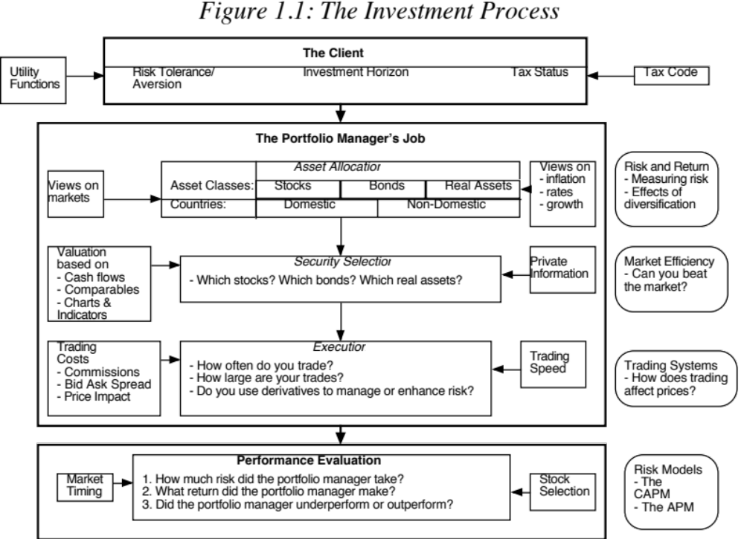

Slide 6
Categorizing Investment Philosophies
Investing versus Trading: When you invest, you estimate the value of an investment, buy if the price is less than the value and hope for converge. In trading, you buy at a low price and try to sell at a high price and care little about why.
Market Timing versus Asset Selection: With market timing, you bet on the movement of entire markets - financial as well as real assets. With asset selection, you focus on picking good investments within each market.
Activist versus Passive Investing: With passive investing, you take positions in companies and hope that the market corrects its mistakes. With activist investing, you play a role (or provide the catalyst) in correcting market mistakes.
Time Horizon: Some philosophies require that you invest for long time periods. Others are based upon short holding periods.

Slide 7
Contradictory vs complimentary philosophies
One of the most fascinating aspects of investment philosophy is the coexistence of investment philosophies based on contradictory views of the markets. Thus, you can have market timers who trade on price momentum (suggesting that investors are slow to learn from information) and market timers who are contrarians (which is based on the belief that markets overreact). Among security selectors who use fundamentals, you can have value investors who buy value stocks because they believe markets overprice growth and growth investors who buy growth stocks using exactly the opposite justification. The coexistence of these contradictory impulses for investing may strike some as irrational, but it is healthy and may be necessary to keep the market in balance.
In addition, you can have investors with contradictory philosophies coexisting in the market because of their different time horizons, views on risk, and tax statuses. For instance, tax-exempt investors may find stocks that pay large dividends a bargain, while taxable investors may reject these same stocks because dividends are taxed.
While investment philosophies can be categorized on the dimensions described above, it is worth emphasizing that investing is all about pragmatism, not purity.

Slide 8
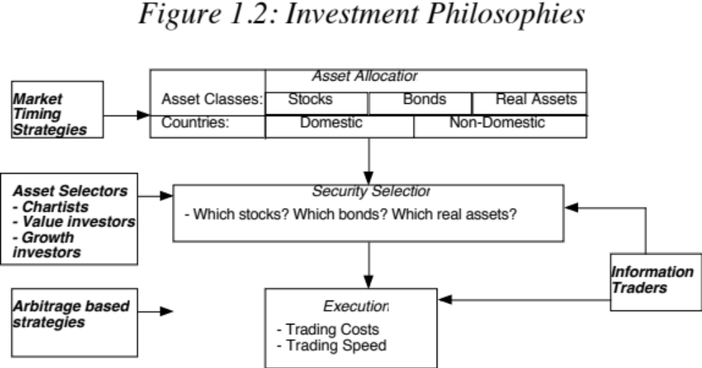
Investment Philosophies in Context

Slide 9
Developing an Investment Philosophy
Step 1: Acquire the tools of the trade
  Be able to assess risk and incorporate into investment decisions
  Understand financial statements
  Be aware of the frictions and the costs of trading
Step 2: Develop a point of view about how markets work and where they might break down
Step 3: Find the philosophy that provides the best fit for you, given your
  Risk aversion
  Investment amount
  Time Horizon
  Tax Status

Slide 10
I. Investor Risk Preferences
The trade off between risk and return
  Most, if not all, investors are risk averse
  To get them to take more risk, you have to offer higher expected returns
  Conversely, if investors want higher expected returns, they have to be willing to take more risk.
- Ways of evaluating risk
  Most investors do not know have a quantitative measure of how much risk that they want to take
  Traditional risk and return models tend to measure risk in terms of volatility or standard deviation

Slide 11
II. Portfolio size
Some strategies require larger amount of funds for success, whereas others work only on a smaller scale.
  For instance, it is very difficult to be an activist value investor if you have only $100,000 in your portfolio, since firms are unlikely to listen to your complaints.
  At the other extreme, a portfolio manager with $100 billion to invest may not be able to adopt a strategy that requires buying small, neglected companies.
  With such a large portfolio, the portfolio manager would very quickly end up becoming the dominant stockholder in each of the companies and affecting the price every time he or she trades.

Slide 12
III. Investor Time Horizon
An investor’s time horizon reflects
  Personal Characteristics: Some investors have the patience needed to hold investments for long time periods and others do not.
  Need for Cash. Investors with significant cash needs in the near term have shorter time horizons than those without such needs.
An investor’s time horizon will have an influence on both the kinds of assets that investor will hold in his or her portfolio and the weights of those assets.
Proposition 1: The longer the time horizon of an investor, the greater the proportion of the portfolio that should be in “risky” investments (such as equities).

Slide 13
IV Tax Status and Portfolio Composition
Investors can spend only after-tax returns. Hence taxes do affect portfolio composition.
  The portfolio that is right for an investor who pays no taxes might not be right for an investor who pays substantial taxes.
  Moreover, the portfolio that is right for an investor on one portion of his portfolio (say, his tax-exempt pension fund) might not be right for another portion of his portfolio (such as his taxable savings)
The effect of taxes on portfolio composition and returns is made more complicated by:
  The different treatment of current income (dividends, coupons) and capital gains
  The different tax rates on various portions of savings (pension versus non-pension)
  Changing tax rates across time

Slide 14
The Bottom Line
Every investor needs an investment philosophy, but to develop that philosophy takes time and introspection.
  You have to have beliefs about markets and how they work or do not work. You may be able to get some perspective from reading and looking at past studies, but for that perspective to stick, you may need to invest, make mistakes and learn from those mistakes.
  More importantly, it is only by investing that you will learn what you are comfortable with and what makes you uneasy and build that learning into your customized philosophy.
While there is no one best investment philosophy for all investors, there is one that is best for you, given your makeup as a person and investor.

