Slide 1
Price patterns, charts and technical analysis: Temporal Patterns
Good Januaries, Bad Mondays and other patterns…

Slide 2
Seasonal and Temporal Effects on Prices
Empirical studies indicate a variety of seasonal and temporal irregularities in stock prices. Among them are:
  The January Effect: Stocks, on average, tend to do much better in January than in any other month of the year.
  The Weekend Effect: Stocks, on average, seem to do much worse on Mondays than on any other day of the week.
  The Mid-day Swoon: Stocks, on average, tend to do much worse in the middle of the trading day than at the beginning and end of the day.
While these empirical irregularities provide for interesting conversation, it is not clear that any of them can be exploited to earn excess returns.

Slide 3
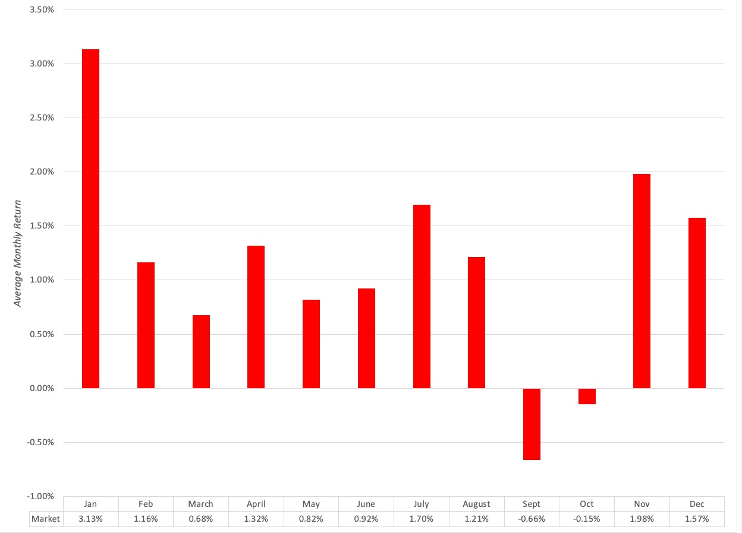
A. The January Effect

Slide 4
The January effect is strongest for small cap stocks

Slide 5
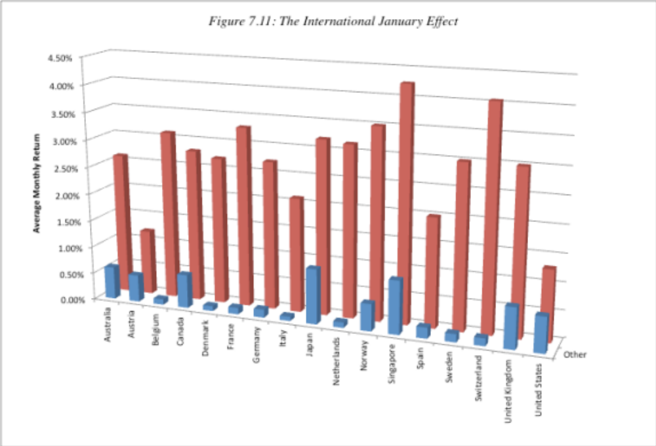
And it is strong across international markets

Slide 6
Potential explanations
There are three possible explanations for the January effect:
  Fund flows: It is possible that investors withdraw cash collectively from stocks in December and invest money back into stocks in January.
  Window dressing by institutions: Institutions may sell losing stocks in December and buy them back in January.
  Tax selling: Investors may sell in December for tax reasons and buy back in January.
The fact that the January effect is strongest for small cap stocks indicates that whatever the reason for it has to be stronger for smaller companies (which tend also to have less followed by analysts and therefore have more information coming from the companies).

Slide 7
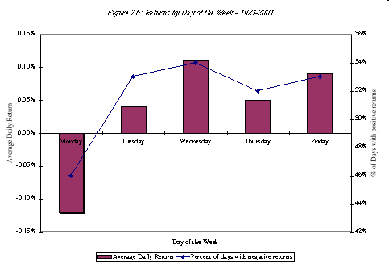
B. The Weekend Effect

Slide 8
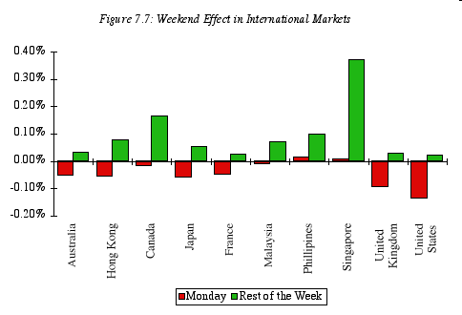
The Weekend Effect in International Markets

Slide 9
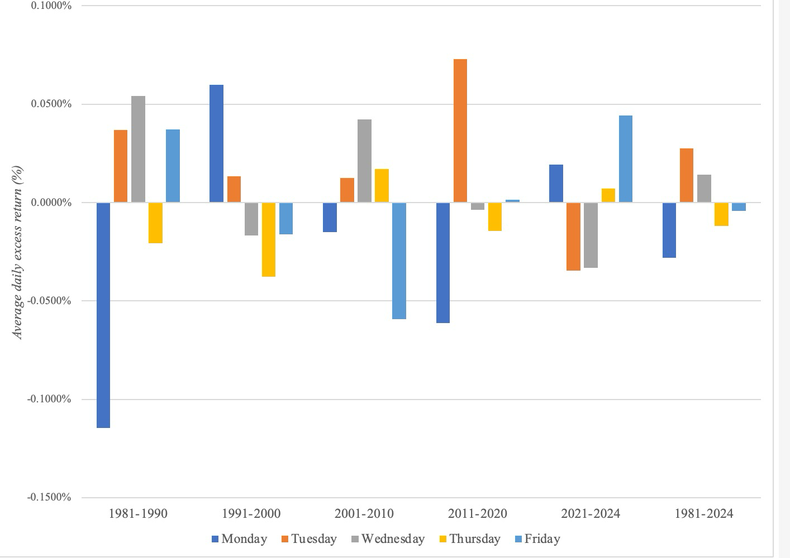
Has it held up?

Slide 10
The Weekend Effect: Explanations
The Monday effect is really a weekend effect since the bulk of the negative returns is manifested in the Friday close to Monday open returns. The returns from intraday returns on Monday are not the culprits in creating the negative returns.
  Monday effect is worse for small stocks than for larger stocks.
  Monday effect is no worse following three-day weekends than two-day weekends.
There are some who have argued that the weekend effect is the result of bad news being revealed after the close of trading on Friday and during the weekend.
There is evidence that the weekend effect gets weaker for stocks where short selling and/or put options is available, allowing traders to trade ahead of the Monday open, and that it has become weaker over time.

Slide 11
C. Intraday Price effects
As researchers get access to intraday prices, they are finding patterns in stock prices during the course of the day, with some claiming to find evidence of a mid-day market swoon and others finding evidence of price patterns at the start and end of trading days.
These patterns, even if they exist, are difficult to exploit for stand-alone profits but may allow investors to augment profits from other trading strategies.

Slide 12
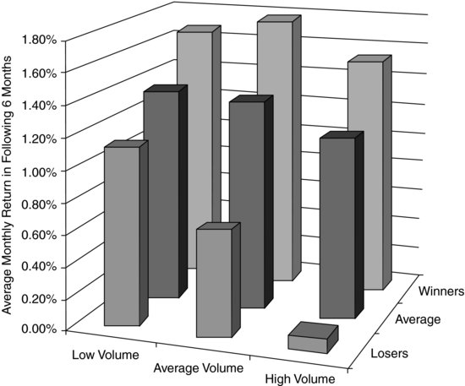
Volume and price momentum

Slide 13
Temporal Evidence and Investing
There are time patterns in stock prices: While much time and effort has been spent chronicling the presence of temporal effects on stock prices, the bottom line is that there is little evidence that investors have been able to exploit these effects to make money.
But making money on these patterns seems to be difficult: In fact, attempts to exploit the factors seems to reduce their potency, suggesting that temporal effects have less to do with market efficiency and more to do with market microstructure and information patterns.

