Slide 1
Technical analysis: Using price (and volume) as your investing basis!
Charting – Art or Science?

Slide 2
Foundations of Technical Analysis: What are the assumptions?
Price is determined solely by the interaction of supply & demand. Value is an abstraction that markets are not focused on, for the most part.
Supply and demand are governed by numerous factors, both rational and irrational. The market continually and automatically weighs all these factors.
Disregarding minor fluctuations in the market, stock prices tend to move in trends which persist for an appreciable length of time
Changes in trend are caused by shifts in demand and supply. These shifts no matter why they occur, can be detected sooner or later in the action of the market itself.

Slide 3
Technical Indicators
There are hundreds (perhaps thousands) of chart patterns and technical indicators that investors claim works at making them money.
Most of these patterns are in prices, but as volume data becomes available, there can be clues in volume as well.
Rather than try to deal with them individually, we will argue that all technical indicators are built on the presumption of investor irrationality on a global scale and that they can therefore be classified on that basis.

Slide 4
I. Investors overreact: The Contrarian Indicators
Basis: Research in experimental psychology suggests that people tend to overreact to unexpected and dramatic news events. In revising their beliefs, individuals tend to overweight recent information and underweight prior data.
Empirical evidence:
  Extreme movements in stock prices will be followed by subsequent price movements in the opposite direction.
  The more extreme the price adjustment, the greater will be the subsequent adjustment
Issues:
  Why, if this is true, is it that contrarian investors are so few in number or lacking in market power that the overreaction to new information is allowed to continue for so long?
  Is the market more efficient about incorporating some types of information than others?

Slide 5
Technical trading rules: Contrarian Opinion
Odd-lot trading: The odd-lot rule gives us an indication of what the man on the street thinks about the stock (As he gets more enthusiastic about a stock this ratio will increase).
Mutual Fund Cash positions: Historically, the argument goes, mutual fund cash positions have been greatest at the bottom of a bear market and lowest at the peak of a bull market. Hence investing against this statistic may be profitable.
Investment Advisory opinion: This is the ratio of advisory services that are bearish. When this ratio reaches the threshold (eg 60%) the contrarian starts buying.

Slide 6
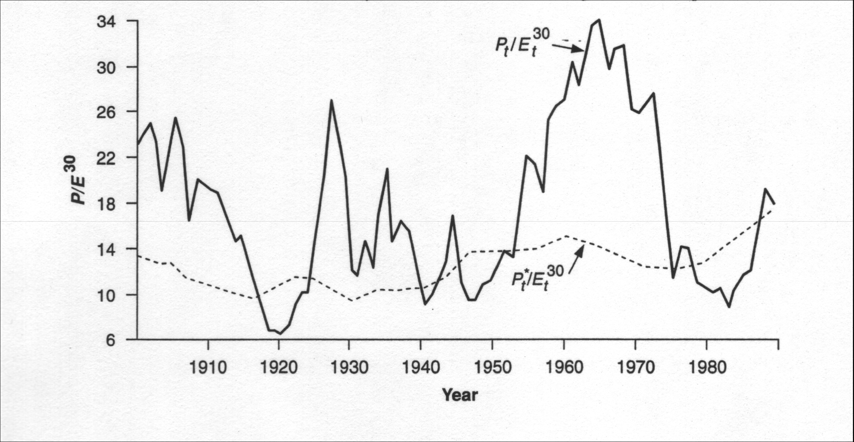
II. Investors have mood shifts: Detecting them in price patterns

Slide 7
Shift Indicators
Breadth of the market: This is a measure of the number of stocks in the market which have advanced relative to those that have declined. A market advance with less breadth is an indication of a demand shift (down).
Support & Resistance Lines: If either is broken, the market is poised for a major move.
Moving averages: A moving average line smooths out fluctuations and enables the chartist to see trends in the stock price. How that trend is interpreted then depends upon the chartist.
Volume shifts: Some technical analysts believe that there is information about future price changes in trading volume shifts.

Slide 8
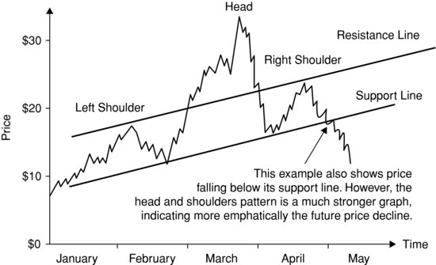
Price Feedback loops
There is an argument to be made that hitting support or resistance lines can have feedback effects, which can be positive or negative:
  The positive: It is possible that hitting the specified price level can add to the momentum on the stock, causing upward (downward) moving stocks to move up (down) even more.
  The negative: In an alternate story, hitting the specified price level can lead investors to reassess the company’s value, and correct over reach, pushing prices back down (up), if they have wandered way above (below) value.

Slide 9
III. Investors learn slowly: The Momentum Indicators
Basis: The argument here is that markets learn slowly. Thus, investors who are a little quicker than the market in assimilating and understanding information will earn excess returns. In addition, if markets learn slowly, there will be price drifts (i.e., prices will move up or down over extended periods) and technical analysis can detect these drifts and take advantage of them.
The Evidence: There is evidence, albeit mild, that prices do drift after significant news announcements. For instance, following up on price changes after large earnings surprises provides the following evidence.

Slide 10
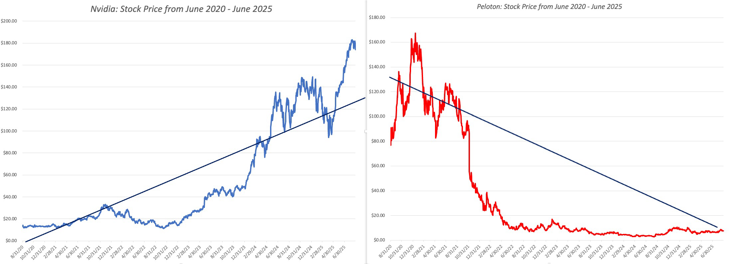
Momentum Indicators
Relative Strength: The relative strength of a stock is the ratio of its current price to its average over a longer period (eg. six months). The rule suggests buying stocks which have the highest relative strength (which will also be the stocks that have gone up the most in that period).
Trend Lines: You look past the day-to-day movements in stock prices at the underlying long-term trends. The simplest measure of trend is a trend line.

Slide 11
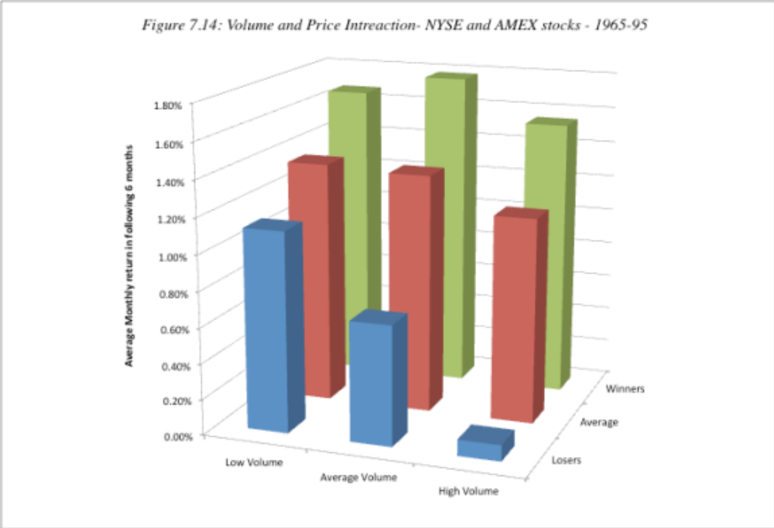
Trading Volume: The technical analyst’s secret weapon

Slide 12
IV. The Smart Investors are usually right: follow the smart money indicators
This approach is the flip side of the contrarian approach. Instead of assuming that investors, on average, are likely to be be wrong, you assume that they are right.
To make this assumption more palatable, you do not look at all investors but only at the smartest investors, who presumably know more than the rest of us.
The big question is of course how you identify these smart investors and learn about their trading behavior.

Slide 13
Smart Investor Indicators
Specialist short sales: The assumption is that specialists have more information about future price movements than other investors. Investors who use this indicator will often sell stocks when specialists do, and buy when they do.
Insider buying/selling: The ratio of insider buying to selling is often tracked for stocks with the idea that insiders who are buying must have positive information about a stock whereas insiders who are selling are likely to have negative information.

Slide 14
V. Markets are controlled by external forces: The Mystics
The Elliot Wave: Elliot's theory is that the market moves in waves of various sizes, from those encompassing only individual trades to those lasting centuries, perhaps longer. "By classifying these waves and counting the various classifications it is possible to determine the relative positions of the market at all times". "There can be no bull of bear markets of one, seven or nine waves, for example.
The Dow Theory:" The market is always considered as having three movements, all going at the same time. The first is the narrow movement (daily fluctuations) from day to day. The second is the short swing (secondary movements) running from two weeks to a month and the third is the main movement (primary trends) covering at least four years in its duration.

Slide 15
Determinants of Success at Technical Analysis
Behavioral basis: If you decide to use a charting pattern or technical indicator, you need to be aware of the investor behavior that gives rise to its success. You can modify or abandon the indicator if the underlying behavior changes.
Don’t trust, verify: It is important that you back-test your indicator to ensure that it delivers the returns that are promised. In running these tests, you should pay particular attention to the volatility in performance over time and how sensitive the returns are to holding periods.
Timely trading: The excess returns on many of the strategies that we described in this chapter seem to depend upon timely trading. To succeed at some of these strategies, you may need to monitor prices continuously, looking for the patterns that would trigger trading.
Goldilocks time horizons: Building on the theme of time horizons, success at charting can be very sensitive to how long you hold an investment.
Control trading costs: The strategies that come from technical indicators are generally short-term strategies that require frequent and timely trading. Not surprisingly, these strategies also generate large trading costs that can very quickly eat into any excess returns you may have.

