Slide 1
Investing for grown ups?
Value Investing
Value for your money!

Slide 2
Who is a value investor?
The simplistic definition: The lazy definition (used by services to classify investors into growth and value investors) is that anyone who invests in low PE stocks or low price to book stocks is a value investor.
The too broad definition: Another widely used definition of value investors suggests that they are investors interested in buying stocks for less that what they are worth. But that is too broad a definition since you could potentially categorize most active investors as value investors on this basis. After all, growth investors also want to buy stocks for less than what they are worth.

Slide 3
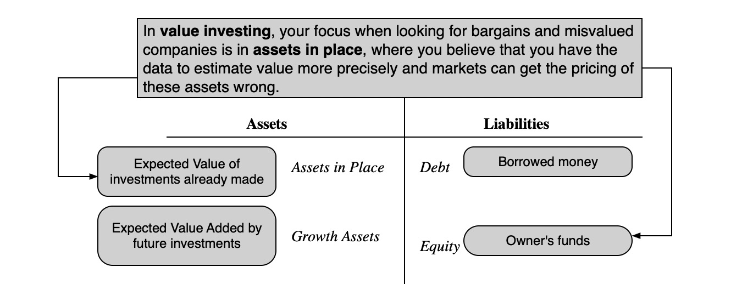
My definition..

Slide 4
The Different Faces of Value Investing
Passive Screeners: Following in the Ben Graham tradition, you screen for stocks that have characteristics that you believe identify under valued stocks. You are hoping to find market mistakes through the screens.
Contrarian Investors: These are investors who invest in companies that others have given up on, either because they have done badly in the past or because their future prospects look bleak. You are implicitly assuming that markets over react.
Activist Value Investors: These are investors who invest in poorly managed and poorly run firms but then try to change the way the companies are run. Y

Slide 5
The father of value investing:
Ben Graham’s Screens
PE of the stock has to be less than the inverse of the yield on AAA Corporate Bonds:
PE of the stock has to less than 40% of the average PE over the last 5 years.
Dividend Yield > Two-thirds of the AAA Corporate Bond Yield
Price < Two-thirds of Book Value
Price < Two-thirds of Net Current Assets
Debt-Equity Ratio (Book Value) has to be less than one.
Current Assets > Twice Current Liabilities
Debt < Twice Net Current Assets
Historical Growth in EPS (over last 10 years) > 7%
No more than two years of negative earnings over the previous ten years.

Slide 6
How well have Graham’s screens performed?
Graham’s best claim to fame comes from the success of the students who took his classes at Columbia University. Among them were Charlie Munger and Warren Buffett. However, none of them adhered to his screens strictly.
A study by Oppenheimer concluded that stocks that passed the Graham screens would have earned a return well in excess of the market. Mark Hulbert who evaluates investment newsletters concluded that newsletters that used screens similar to Grahas did much better than other newsletters.
However, an attempt by James Rea to run an actual mutual fund using the Graham screens failed to deliver the promised returns.

Slide 7
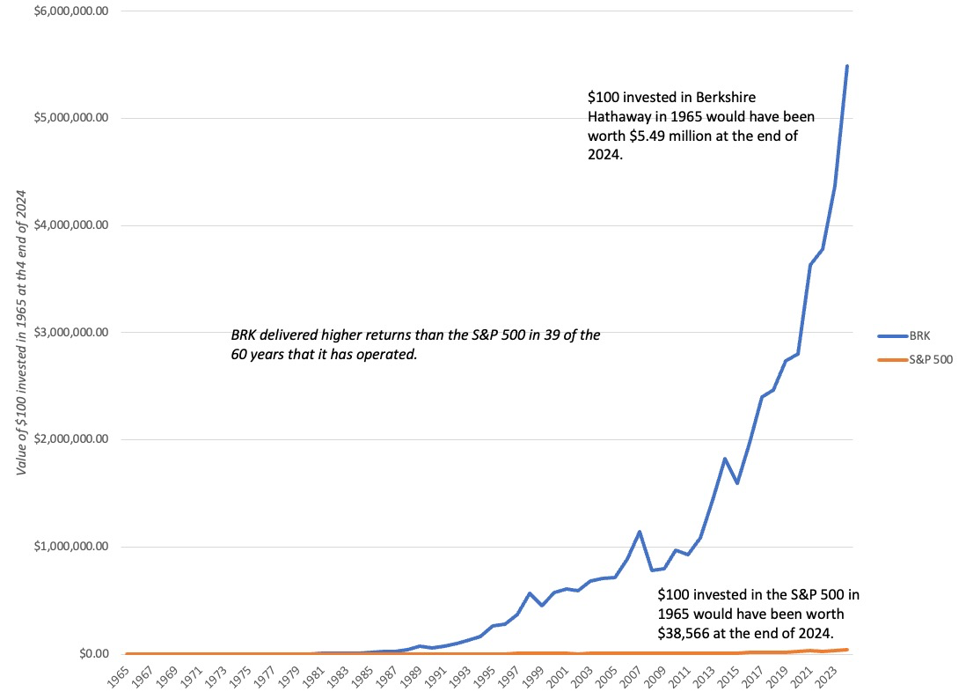
The Buffett Mystique: Investing in Berkshire Hathaway

Slide 8
Buffett’s Tenets
Business Tenets:
  • The business the company is in should be simple and understandable.
  • The firm should have a consistent operating history
  • The firm should be in a business with favorable long-term prospects.
Management Tenets:
  The managers of the company should be candid and honest.
  The managers of the company should be leaders and not followers.
Financial Tenets:
  The company should have a high return on equity. Buffett used a modified version of what he called owner earnings
    Owner Earnings = Net income + Depreciation & Amortization – Capital Expenditures
  The company should have high and stable profit margins.
Market Tenets:
  Use conservative estimates of earnings and the riskless rate as discount rate.
  In keeping with his view of Mr. Market as capricious and moody, even valuable companies can be bought at attractive prices.

Slide 9
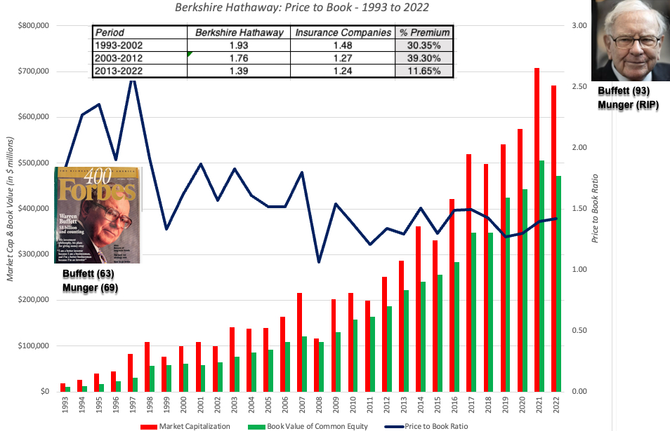
The Buffett Premium

Slide 10
So, what happened?
Imitators: His record of picking winners has attracted publicity and a crowd of imitators who follow his every move, buying everything be buys, making it difficult for him to accumulate large positions at attractive prices.
Scaling problems: At the same time the larger funds at his disposal imply that he is investing far more than he did two or three decades ago in each of the companies that he takes a position in, creating a larger price impact (and lower profits)
Macro game? The crises that have beset markets over the last few decades have been both a threat and an opportunity for Buffett. As markets have staggered through the crises, the biggest factors driving stock prices and investment success have become macroeconomic unknowns and not the company-specific factors that Buffett has historically viewed as his competitive edge (assessing a company’s profitability and cash flows).

Slide 11
Be like Buffett?
A different market: Markets have changed since Buffett started his first partnership. The investment world is much flatter, with data and models available to everyone.
Insider game: In recent years, Buffett has adopted a more activist investment style and has succeeded with it. To succeed with this style as an investor, though, you would need substantial resources and have the credibility that comes with investment success.
Patience: The third ingredient of Buffett’s success has been patience. He has often been willing to hold stocks that he believes to be under valued through disappointing years. In those same years, he has faced no pressure from impatient investors, since
    Berkshire Hathaway stockholders have such high regard for him and
    He invests insurance company money.

Slide 12
Chasing the dream
The Sage from Omaha: There is no one who is followed and imitated more than Warren Buffett. Investors not only show up in Omaha every year for the Berkshire Hathaway meetings, but every word that Buffett says is read and analyzed for hidden meaning.
The Followers: That said, it is not clear that even Buffett’s closest followers have been able to replicate even a fraction of his success. In fact, it is not just possible, but very likely, that index fund investors have outperformed the Omaha value investing contingent over the last two decades.

