Slide 1
Value Investing: The screening version
Low PE, Low PBV and High Dividends – The screening trifecta!

Slide 2
The Screeners
In passive value investing, you screen companies based upon either qualitative or quantitative factors to find “cheap” companies.
Qualitative screening: Investors look for “good” companies, with superior management and preferably with little or no risk and buy and hold these companies.
Quantitative screening: Tracing their lineage back to Ben Graham, the screeners try to find cheap stocks by screening stocks, using pricing multiples in conjunction with other screens

Slide 3
Qualitative screens
With qualitative screens, you are looking for qualities in a company or its management that do not show up in its financial statements.
At the company levels, those qualities can include
  Reputation for quality or service
  Loyal and well-trained work force
  Loyal customer base
  Cares about society and people
At the management level, those qualities can include
  Being honest and accountable
  Being creative
  Being capable

Slide 4
Quantitative Screens
In this approach, investors use pricing screens for cheapness to find their stocks. While there are many screens, they can be broadly classified into three groups:
  Book value screens: Buy stocks where the company trades at less than book value or at least a low multiple of the book value.
  Earnings Multiple screens: Buy assets where the asset trades at a low multiple of earnings.
  Cash Yield screens: Buy stocks with high yields. In its strictest form, the cash flow is just dividends. In more general form, it can be based upon augmented dividends (with buybacks) or even potential dividends.
In some cases, investors add other screens for fundamentals (growth, risk, cash flow) to ensure that there is no good reason for the cheapness.

Slide 5
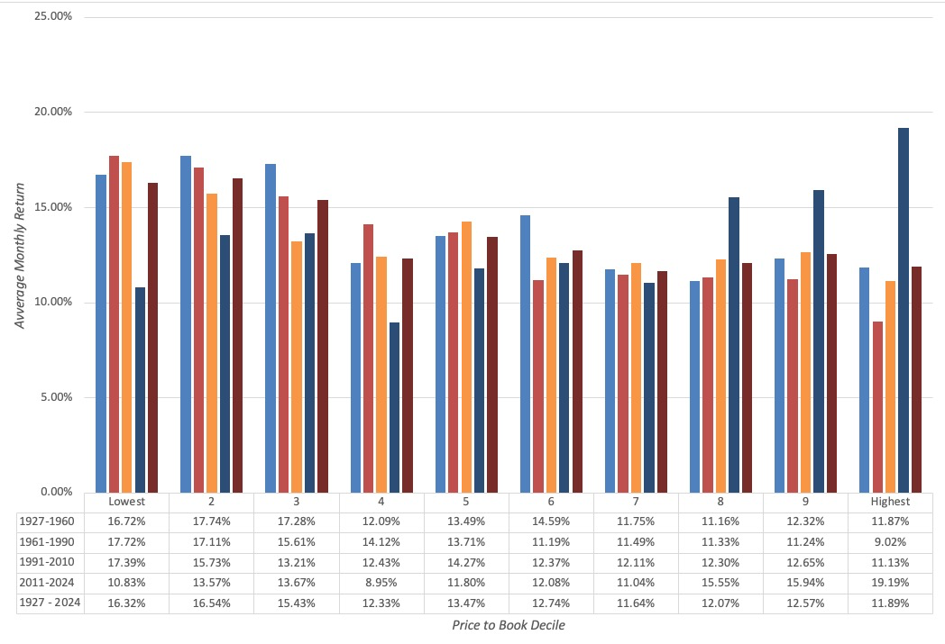
1. Price/Book Value Screens:
Low P/BV stocks are winners..

Slide 6
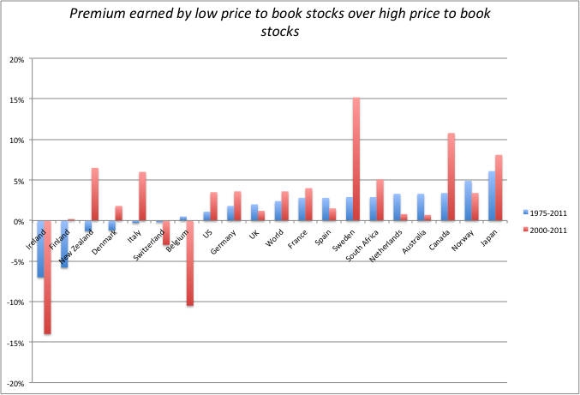
Evidence from International Markets

Slide 7
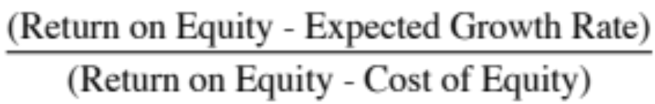
Caveat Emptor on P/BV ratios
A risk proxy: Fama and French point out that low price-book value ratios may operate as a measure of risk, since firms with prices well below book value are more likely to be in trouble and go out of business.
Low quality returns/growth: The price to book ratio for a stable growth firm can be written as a function of its ROE, growth rate and cost of equity:
  Companies that are expected to earn low returns on equity will trade at low price to book ratios.
  Conversely, companies that trade above book value are not necessarily over valued.

Slide 8
And a changing world has made book values less relevant
The basis for book-value-based investing is that book value measures capital invested in a company, albeit from an accounting standpoint and offers an alternative and more reasoned measure of value, perhaps in liquidation.
That may be a defensible argument with manufacturing or tangible asset-based companies, but it is getting increasingly difficult to sustain as the economy tilts towards service based or technology companies.
Inconsistencies in accounting can cause investments made by these companies to be either mis-measured or missed entirely, leading to book values that don’t truly measure capital invested in a business or its assets.

Slide 9
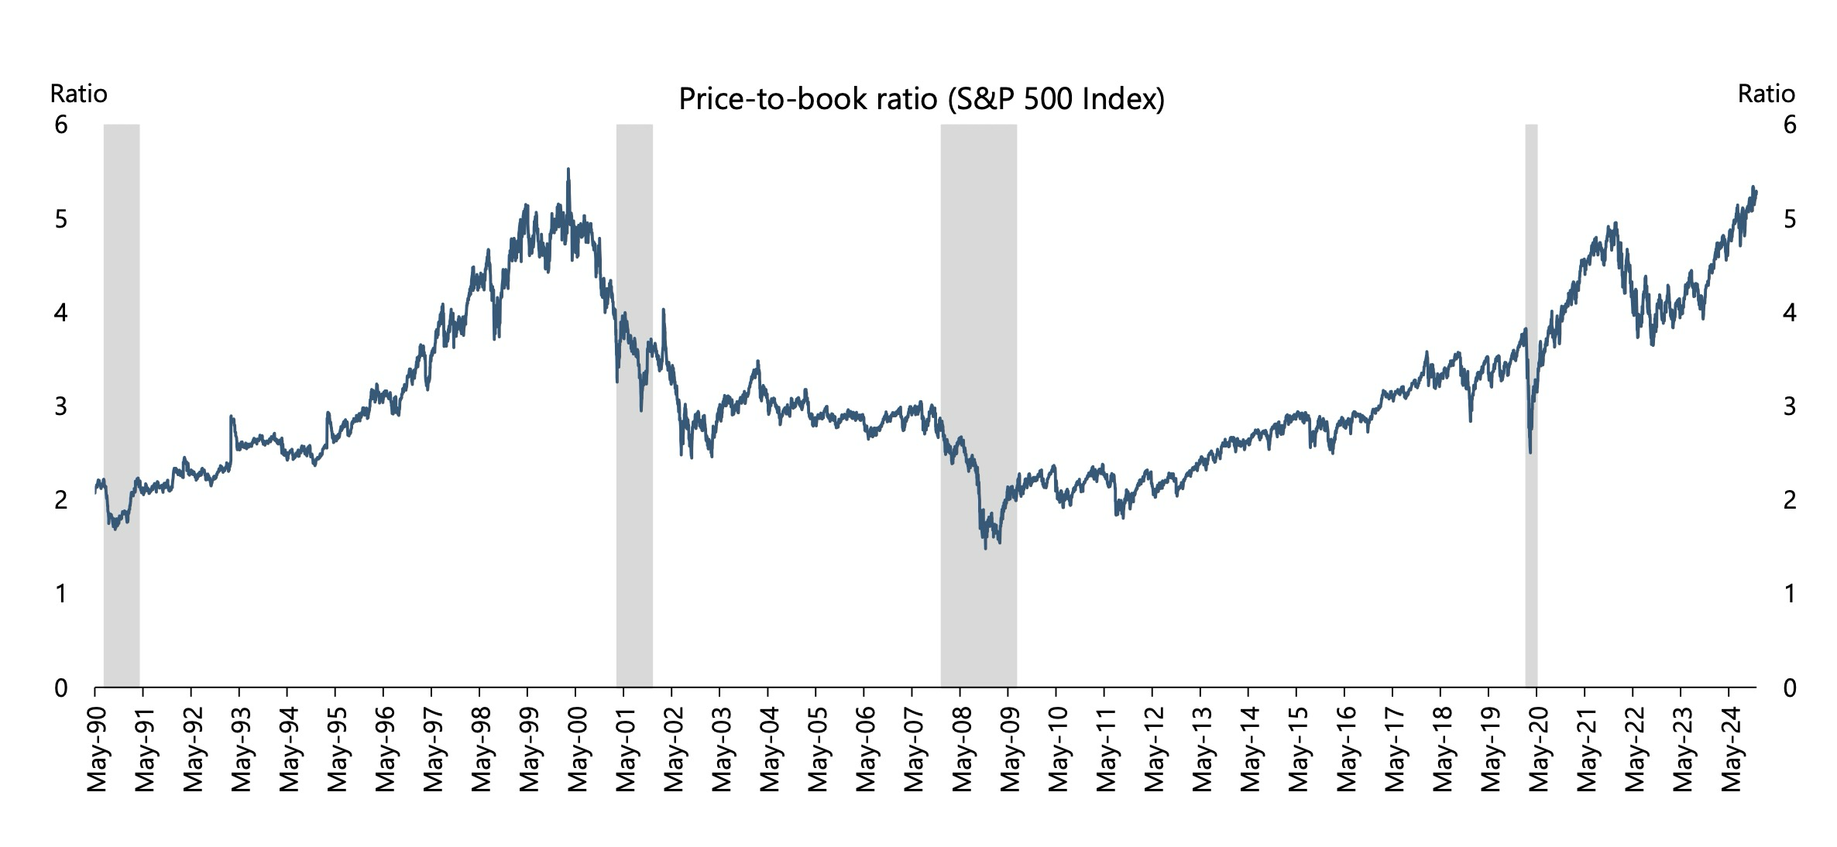
Price to Book over time: S&P 500

Slide 10
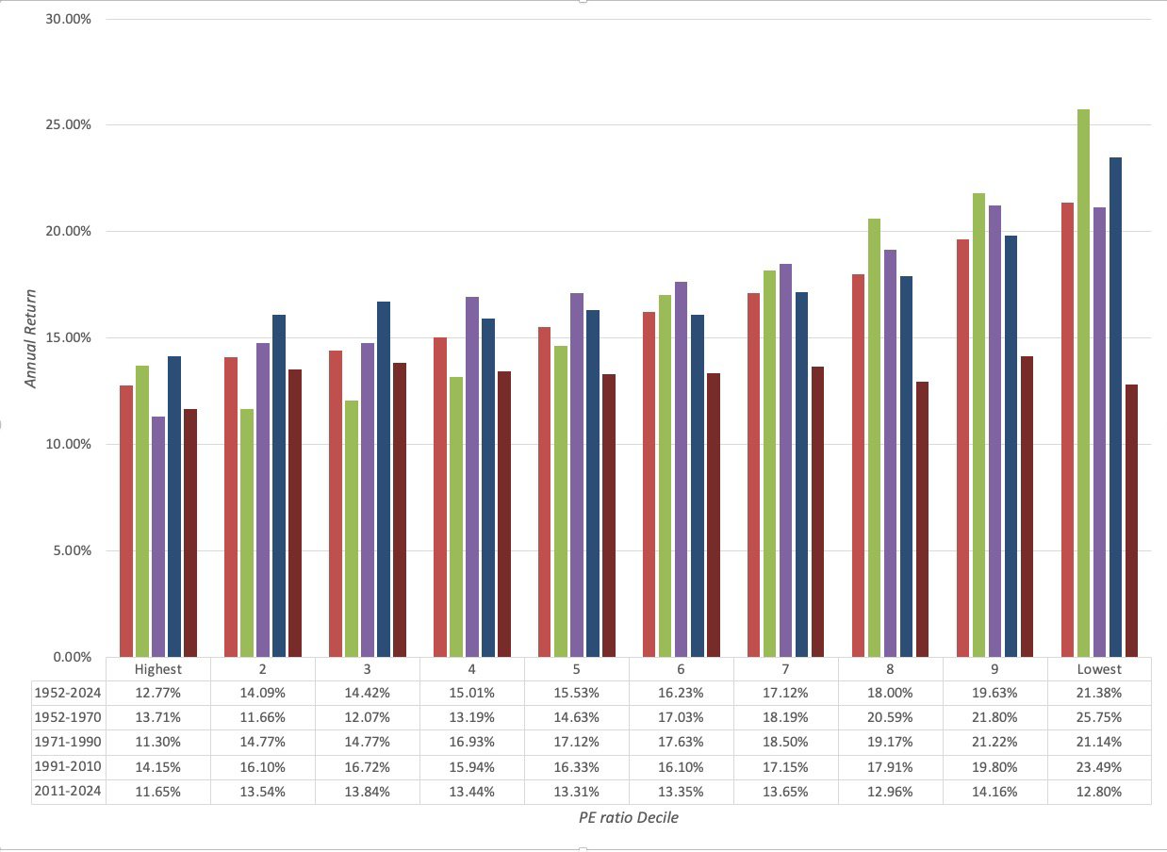
2. Price Earnings Ratio Screens:
The Low PE story has legs…

Slide 11
What can go wrong?
Companies with high-risk earnings: The excess returns earned by low price earnings ratio stocks can be explained using a variation of the argument used for small stocks, i.e., that the risk of low PE ratios stocks is understated by models. A related explanation, especially in the aftermath of the accounting scandals of recent years, is that accounting earnings is susceptible to manipulation.
Tax Costs: A second possible explanation is that low PE ratio stocks generally have large dividend yields, which would have created a larger tax burden for investors since dividends were taxed at higher rates during much of this period.
Low Growth: A third possibility is that the price earnings ratio is low because the market expects future growth in earnings to be low or even negative.

Slide 12
A variant on earnings multiples: EV/EBITDA
EV/EBITDA = (Market value of equity + Debt – Cash)/ EBITDA
  The proponents of this multiple argue that it is better than PE, because it is less impacted by financial leverage and focused on a cash flow measure, rather than earnings.
  In addition, you lose fewer firms, because EBITDA is less likely to be negative than net income.
There are two counter arguments:
  EBITDA is not a free cash flow, because you have to pay taxes and cover reinvestment needs.
  As with PE ratios, you have to be careful about checking for risk in EBITDA and low growth or low-quality growth (low return on capital)

Slide 13
And a caveat about changing times..
Just as book value measurements have been skewed by the shift in economies towards service and technology companies, earnings have also been affected.
If the largest capital expenditures of companies are treated as operating expenses (as is the case with R&D at technology companies), you will understate earnings at these companies and over state PE ratios.
A pure earnings multiple (PE or EV to EBITDA) approach may then find these companies to be expensive, even when they are not.

Slide 14
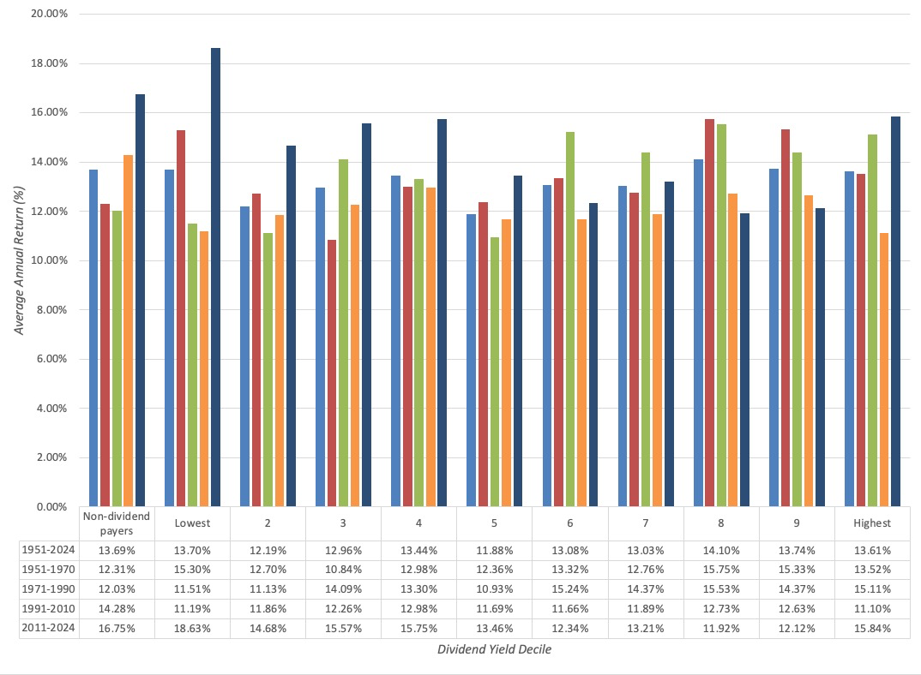
3. Dividend Yields

Slide 15
Dividend Screens: Specialized versions
Dogs of the Dow: In this version, investors focus on the largest dividend payers in the Dow 30, invest in that tightly concentrated group.
Dividend Aristocrats: Companies that not only pay large dividends but have a long history of doing so.
In all of these models, investors are putting their faith in dividends, arguing that
  Dividends are the only tangible returns that you get from investing in stocks, since price appreciation is either just on paper or reliant on other investors paying.
  Dividends are more predictable than price appreciation, because companies are reluctant to cut them.

Slide 16
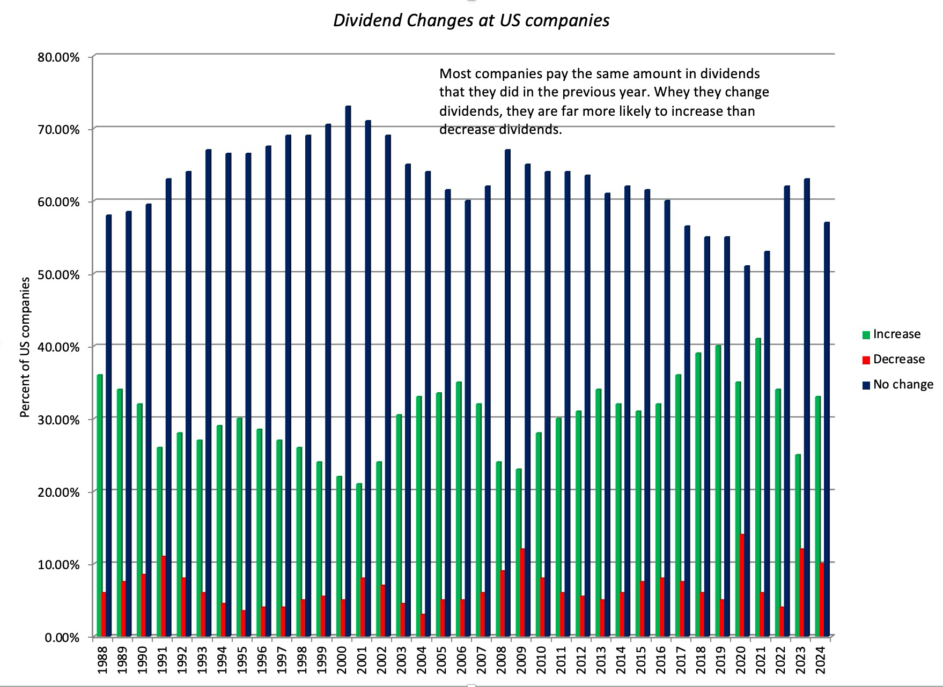
How sticky are dividends?

Slide 17
What to watch out for..
Unsustainable dividends: When you buy a stock with a high dividend yield, you are hoping that the dividends will not be cut or come under threat. While this may be a reasonable assumption across the entire market, it is also true that companies that are paying too much in dividends will be unable to sustain those dividends.
Low growth: One of the costs of returning more in dividends is that there is less to reinvest, leading to low growth.
Taxes: Investors who receive dividends have no choice on tax timing and may have to pay higher taxes on dividends.

Slide 18
And a brutal new reality… Companies are shifting away from dividends..

Slide 19
The Screener’s weakest link: Value Traps
A value trap is a company that looks cheap but rather than bounce back to what you perceive as a fair price either continues to remain cheap or becomes even cheaper.
A company becomes a value trap when forces within or without the firm cause the fundamentals to shift permanently, making assumptions that things will revert back to a norm (in terms of profits and pricing) into a pipe dream.
In a world where disruption is the norm, rather than the exception, established companies in industries that are being disrupted rapidly can look cheap, but they will become cheaper over time.

Slide 20
The Value Investors’ Protective Armour
Accounting checks: Rather than trust the current earnings, value investors often focus on three variants:
  Normalized earnings, i.e., average earnings over a period of time.
  Adjusted earnings, where investors correct for what they see as shortcomings in conventional accounting earnings.
  Owner’s earnings, where depreciation, amortization and other non-cash charges are added back and capital expenditures to maintain existing assets is subtracted out.
The Moat: The “moat” is a measure of a company’s competitive advantages; the stronger and more sustainable a company’s competitive advantages, the more difficult it becomes for others to breach the moat and the safer becomes the earnings stream.
Margin of safety: The margin of safety (MOS) is the buffer that value investors build into their investment decision to protect themselves against risk. Thus, a MOS of 20% would imply that an investor would buy a stock only if its price is more than 20% below the estimated value (estimated using a multiple or a discounted cash flow model).

Slide 21
A Screening template
Screen for cheapness: You use a pricing multiple (PE, PBV, EV/EBITDA) to find cheap stocks.
Screen for low risk: You try to remove those stocks that look cheap but are risky, using your preferred proxy for risk. This proxy can be a price-based one (standard deviation, beta), an accounting measure (debt ratio) or a sector screen (no tech stocks…)
Screen for high growth: You also want to get companies that have, in not high growth, some growth in them. So, you may put in a minimum growth requirement.
Screen for high quality growth: Finally, you also want to remove companies that reinvest badly (earning low returns on investments).

Slide 22
Determinants of Success at Passive Screening
Have a long time horizon: All the studies quoted above look at returns over long time horizons. In fact, low price-book value stocks have underperformed high price-book value stocks over shorter time periods.
Choose your screens wisely: Too many screens can undercut the search for excess returns since the screens may end up eliminating just those stocks that create the positive excess returns.
Trust mean reversion: Hope that the market/companies have not changed fundamentally.
Be diversified: The excess returns from these strategies often come from a few holdings in large portfolio. Holding a small portfolio may expose you to extraordinary risk and not deliver the same excess returns.
Watch out for taxes and transactions costs: Some of the screens may end up creating a portfolio of low-priced stocks, which, in turn, create larger transactions costs.

