Slide 1
Value Investing: Activist Investing
Private Equity – The Good, The Bad and the Ugly!

Slide 2
Classes of Activist Investors
Lone wolves: These are individual investors, with substantial resources and a willingness to challenge incumbent managers.
Institutional investors: While most institutional investors prefer to vote with their feet (selling stock in companies that are poorly managed), a few have been willing to challenge managers at these companies and push for change.
Activist hedge & private equity funds: . A subset of private equity funds have made their reputations (and wealth) at least in part by investing in (and sometimes buying outright) publicly traded companies that they feel are managed less than optimally, changing the way they managed and cashing out in the market place. A key difference between these funds and the other two classes of activist investors is that rather than challenge incumbent managers as incompetent, they often team up with them in taking public companies into the private domain, at least temporarily.

Slide 3
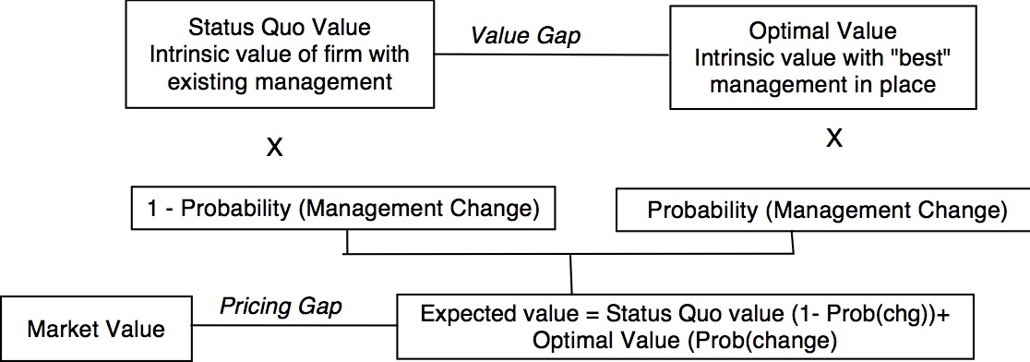
Activist Value Investing
Passive investors buy companies with a pricing gap and hope (and pray) that the pricing gap closes.
Activist investors buy companies with a value and/or pricing gap and provide the catalysts for closing the gaps.

Slide 4
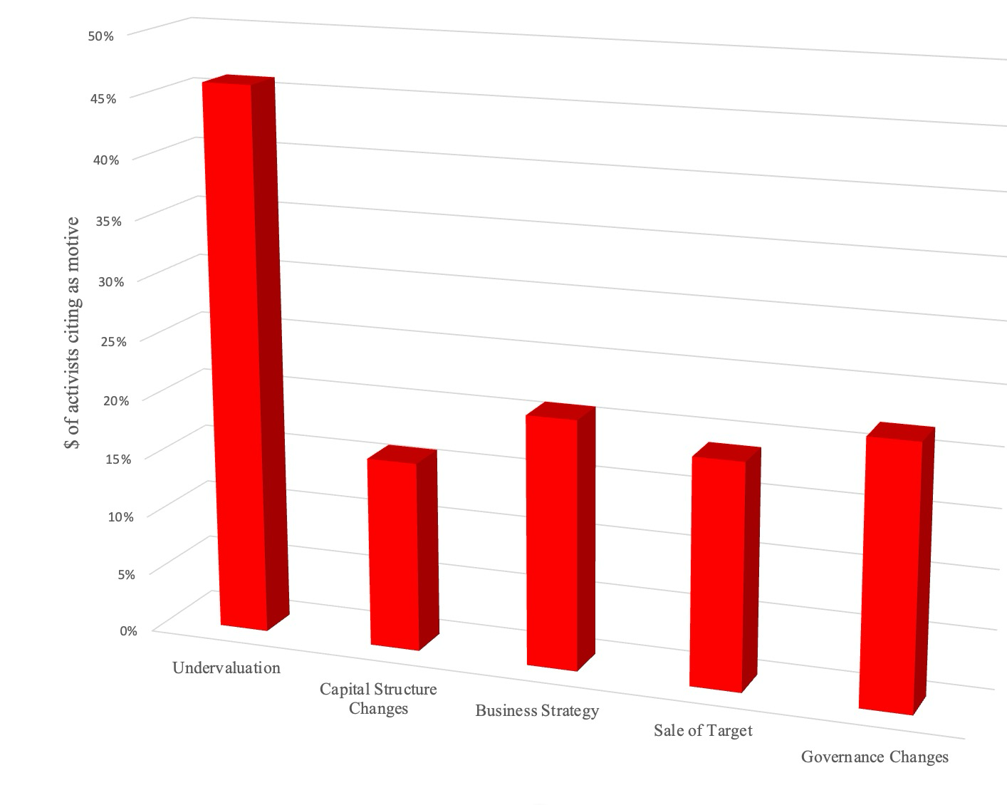
And what are their Motives?
You have to be able to buy the target company at the right price.

Slide 5
Who do they target?
Free cash flows: Given that many buyouts are funded with debt, it should come as no surprise that one of the common characteristics across target firms in buyouts is large positive free cash flows from operations that can be used to service and pay down debt.
Cheap: While the objective in a buyout may be fixing up a poorly run firm and flipping it back to the market, at a much higher price, private equity firms improve their odds of high returns, if they can acquire target firms at low prices. Target firms in leveraged buyouts trade at lower pricing multiples, with enterprise value to EBITDA among the more widely used metrics..
Potential for operating improvement: One simple, and flawed, measure of the potential for operating improvement is a comparison of the operating margins or returns on invested capital of the targeted firm to that of its peer group, and here too, the evidence is supportive of the notion that companies that lag their peer group in profitability and investment returns are more likely to be targeted in buyouts.

Slide 6
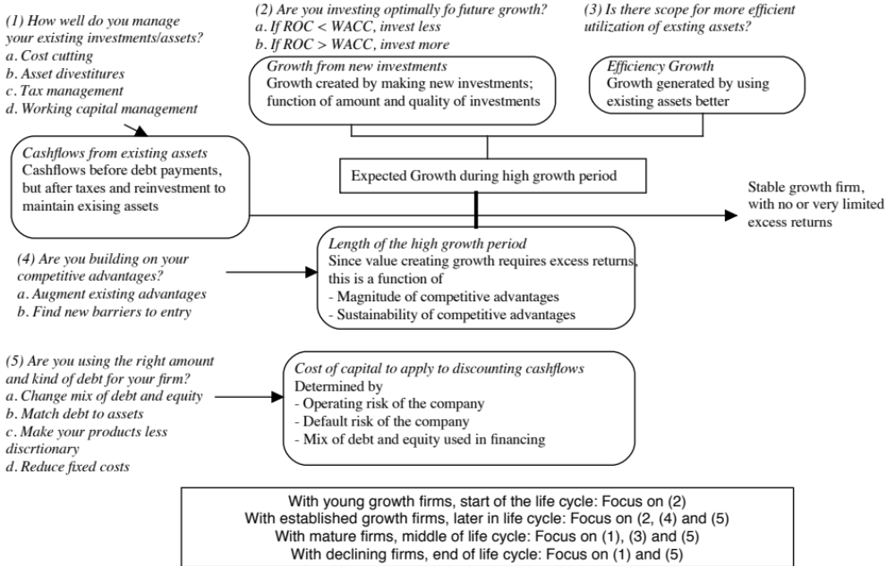
And what do they try to do at these firms?

Slide 7
On the “governance” part… they push for changes
Board of directors: The board of directors at target firms is picked by the equity investors in the buyout deal and therefore is more active in overseeing management.
  Boards of the targeted firms tend to become smaller and meet more frequently after buyouts.
  More of the directors are picked for their expertise in the target firm’s business
Top management: While some of the managers in the target firm are part of the buyout team, there is also a greater push on accountability and compensation:
  The likelihood of CEO turnover jumps at firms that have been, increasing 5.5% after the targeting. One study found that two-thirds of CEO of buyout companies were replaced within four years of buyout.
  CEO compensation decreases in the targeted firms in the years after the activism, with pay tied more closely to performance.

Slide 8
On asset deployment…less in invested back into existing businesses…
The firms that are targeted by PE investors tend to be investing less in their businesses than their peer group even before the PE and there is a decline in that reinvestment after the PE.
When growth firms are targeted by PE groups, there is no perceptible decrease in R&D and other investments after the buyout.

Slide 9
And there are divestitures…
There is an increase in divestitures, especially in non-core businesses, for firms with business sprawl.
There is little evidence of wanton stripping of assets for cash, i.e., the divestitures are generally not overboard are driven by the need to service debt, at least in the aggregate.
At the same time, many targeted firms find new businesses to invest in and change their asset mix.

Slide 10
With effects on profitability…
Target firms come into buyouts with declining profitability in the two years prior but see improvements in the two years after, and more so in highly levered firms.

Slide 11
On the financial front… they do borrow money to finance the deal..
 | Excess CF LBOs |  | Cash Shortfall LBOs |  | All Firms
Year | Mean | Median | Mean | Median | Mean | Median
Year -2 | 45.30% | 40.00% | 48.80% | 41.70% | 47.50% | 41.00%
Year -1 | 41.30% | 40.80% | 46.80% | 44.10% | 44.70% | 43.20%
Year of LBO | 73.10% | 69.50% | 75.80% | 77.50% | 74.80% | 75.40%
Year +1 | 74.80% | 69.60% | 76.70% | 78.70% | 76.00% | 77.60%
Year +2 | 80.00% | 76.00% | 84.50% | 77.60% | 82.70% | 77.50%
PE investors use more debt in funding transactions than other public companies.
Default risk increase as debt increases as % of value and cash flows
Existing bondholders/lenders may be adversely affected, if they did not protect themselves.

Slide 12
And on dividend policy, they do take cash out of firms..
Special dividends: While there are some who fear that PE investors pay themselves large dividends right after they take over target firms, special dividends remain rare. A study of 788 private equity targets, tracked from 1993 to 2009 found only 42 instances of special dividends paid to PE investors.
Asset strips: While there are undoubtedly some PE houses that turn target companies into ATMs, selling assets and drawing cash out of them, they are not the norm.

Slide 13
Their success rate is modest…
Activist Demand | # Campaigns | % of Sample | % Success Rate
Strategic and Operating Changes
Sale of Company to 3rd party | 159 | 31.55% | 32.08%
Operating restructuring | 69 | 13.69% | 34.78%
Convert to private (from public) | 52 | 10.52% | 40.38%
Capital Structure and Dividend Policy
More dividends & buybacks | 78 | 15.48% | 16.67%
Increase debt load | 22 | 4.37% | 31.82%
M&A
Back out of announced merger | 63 | 12.50% | 28.57%
Corporate Governance
Remove CEO, Separate CEO from Board Chair | 27 | 5.36% | 18.52%
Reduce executive compensation | 20 | 3.97% | 15.00%
Increase disclosure | 14 | 2.78% | 35.71%

Slide 14
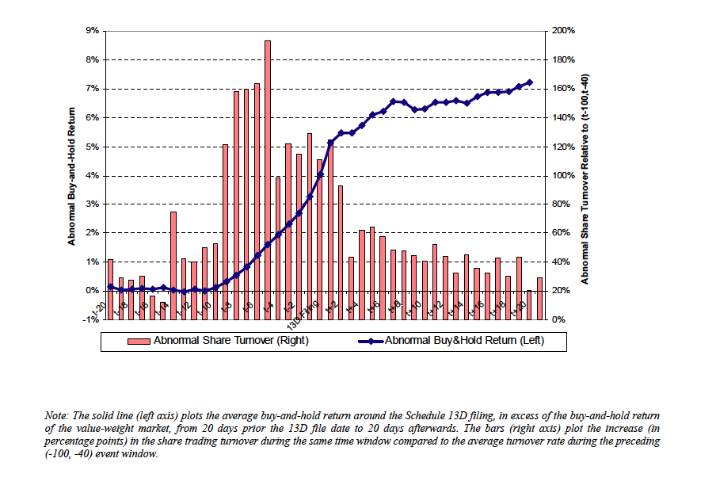
Do activists make money? When the transaction is announced…

Slide 15
Ways for Private equity to generate profits from the transaction
Management fees: When the PE investor runs the company as a private business, the company will pay management fees for the services rendered by the PE investor.
Make equity stake more valuable before exit: By finding market mistakes, making operating fixed or through financial engineering, try to reap the difference in value at exit (by taking company back public or by selling in a private transaction).
The big winners almost always require the second component to be significant, but fees can sometimes flip the assessment of even bad or neutral investments.

Slide 16
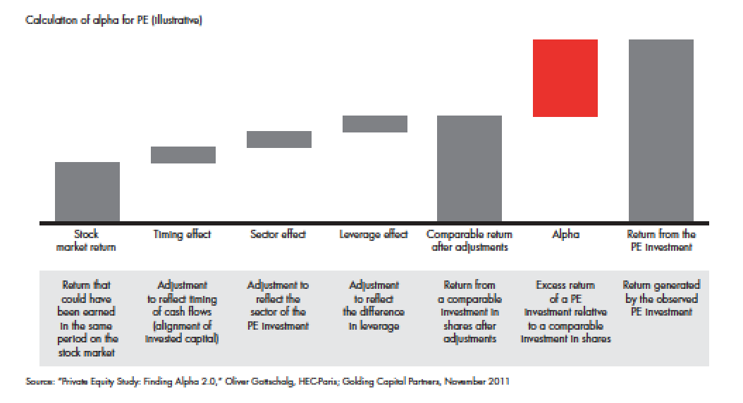
Breaking down the returns to PE investors

Slide 17
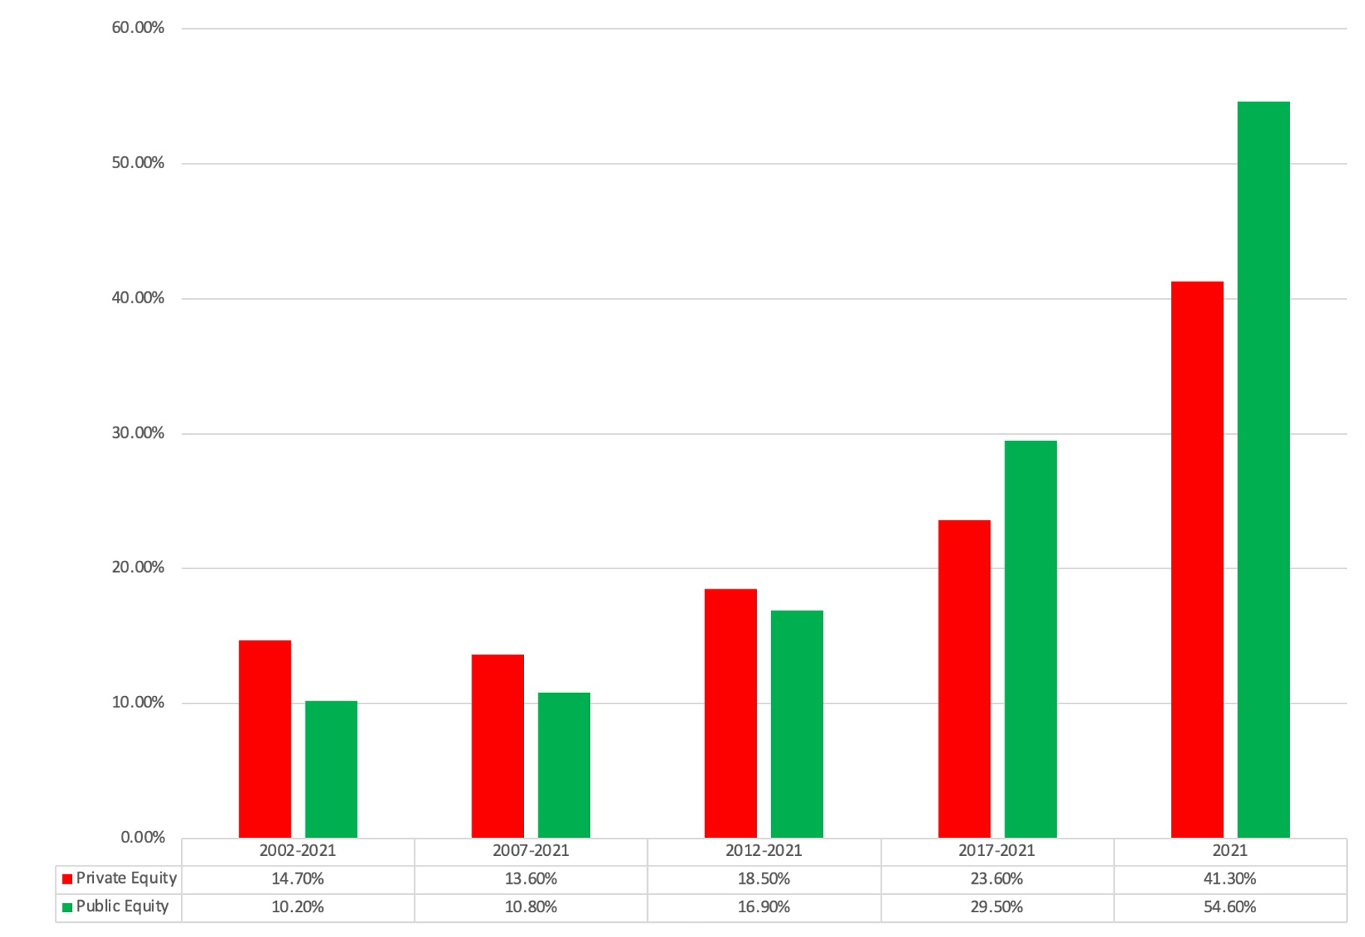
The returns to PE investors are declining..

Slide 18
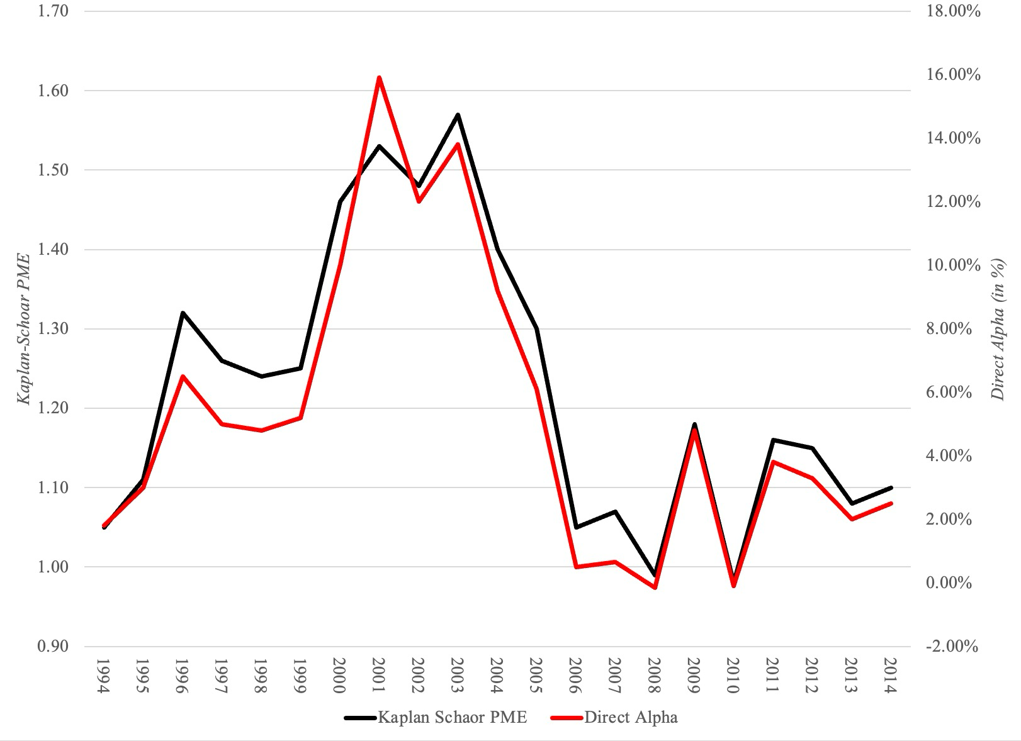
As are excess returns over time..

Slide 19
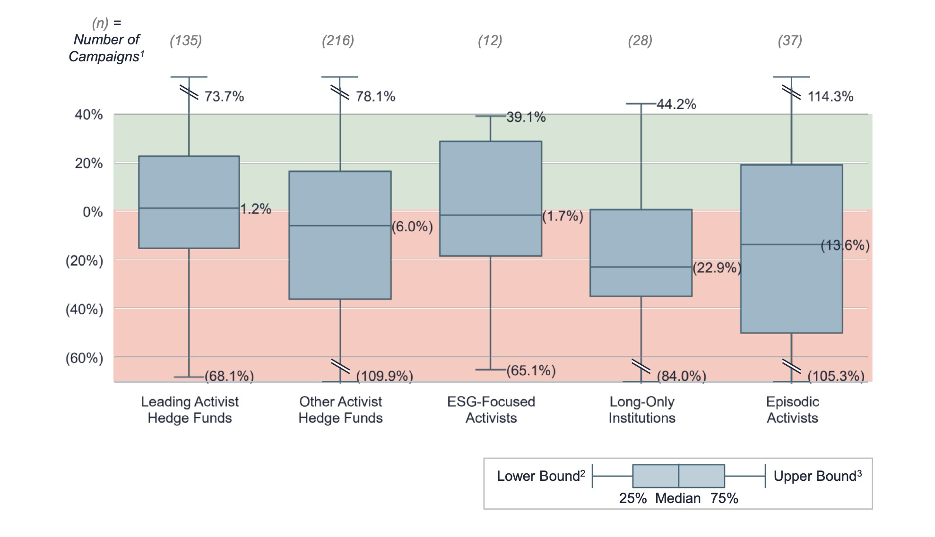
With wide variations across PE investors..

Slide 20
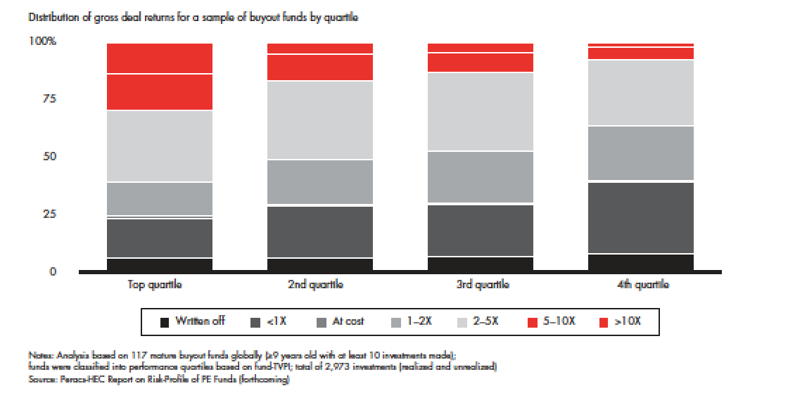
And even the best PE investors lose sometimes... But make up with big winners

Slide 21
Determinants of Success at Activist Investing
Have lots of capital: Since this strategy requires that you be able to put pressure on incumbent management, you have to be able to take significant stakes in the companies.
Know your company well: Since this strategy is going to lead a smaller portfolio, you need to know much more about your companies than you would need to in a screening model.
Understand corporate finance: You have to know enough corporate finance to understand not only that the company is doing badly (which will be reflected in the stock price) but what it is doing badly.
Be persistent: Incumbent managers are unlikely to roll over and play dead just because you say so. They will fight (and fight dirty) to win. You have to be prepared to counter.
Do your homework: You have to form coalitions with other investors and to organize to create the change you are pushing for.

