Slide 1
Value Investing: Where is the beef?
Aswath Damodaran

Slide 2
Value Investing: The Lost Decade

Slide 3
Value Investing glory days…
While the story told about value investing is one of uninterrupted success, even in its glory days, value investing had bad years, where growth investing beat value investing.
Even over this period where value investing looks like it beat growth investing, it is not clear that “active” value investing has added much value to the process.
The conventional value screens (PE, PBV, Dividend Yield) worked well in the twentieth century, but their effectiveness has faded over time. In the last fifteen years, none of them have worked, leaving value investing in the lurch.
Updating the data, it is clear that value investing is being put to a test. While its defenders argue that it is transitional, two decades is a long transition.

Slide 4
Value vs Growth, by year

Slide 5
And active value investing does not seem to have a payoff
Investing in low PE or low PBV stocks would not be considered true value investing, by most of its adherents.
  In fact, most value investors would argue that the while you may start with these stocks, the real payoff to value investing comes in from the additional analysis that they do, whether it be in bringing in other quantitative screens (following up on Ben Graham) and qualitative ones (good management, moats).
  If we call this active value investing, the true test of value investing then becomes whether following value investing precepts and practices and picking stocks generates returns that exceed the returns on a value index fund, created by investing in low price to book or low PE stocks, in proportion to their market value

Slide 6
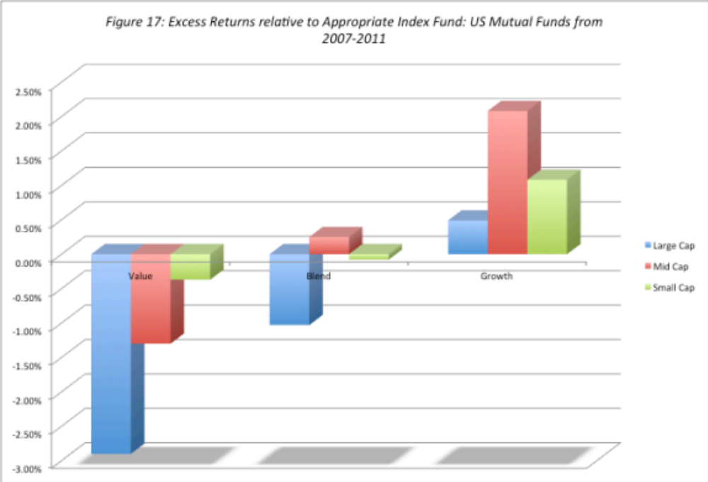
The payoff to institutional “active” value investing is weak..
If value investing is the “best way to invest”, how do we explain the fact that active growth investors beat a passive growth index fund far more frequently and by far more than active value investors do, relative to a passive value fund?

Slide 7
And only slightly stronger for active individual investors
Average underperformance: In a study of individual brokerage accounts between 1991-96, the average individual investor under performed the S&P 500 by about 1% and that the degree of under performance increased with trading activity.
Heavily skewed: The top-performing quartile in the study referenced above outperformed the market by about 6%. Another study of 16,668 individual trader accounts at a large discount brokerage house finds that the top 10 percent of traders in this group outperform the bottom 10 percent by about 8 percent per year over a long period.
Home bias and concentration? Studies of individual investors find that they generate relatively high returns when they invest in companies close to their homes compared to the stocks of distant companies, and that investors with more concentrated portfolios outperform those with more diversified portfolios.
Less (trading) is more (return): While none of these studies of individual investors classify the superior investors by investment philosophy, the collective finding that these investors tend not to trade much and have concentrated portfolios can be viewed as evidence (albeit weak) that they are more likely to be value investors.

Slide 8
Some activists do well, but activism is often a zero-sum game…
Overall returns: Activist mutual funds seem to have had the lowest payoff to their activism, with little change accruing to the corporate governance, performance or stock prices of targeted firms. Activist hedge funds, on the other hand, seem to earn substantial excess returns, ranging from 7-8% on an annualized basis at the low end to 20% or more at the high end. Individual activists seem to fall somewhere in the middle, earning higher returns than institutions but lower returns than hedge funds.
Volatility in returns: While the average excess returns earned by hedge funds and individual activists is positive, there is substantial volatility in these returns and the magnitude of the excess return is sensitive to the benchmark used and the risk adjustment process.
Skewed distributions: The average returns across activist investors obscures a key component, which is that the distribution is skewed with the most positive returns being delivered by the activist investors in the top quartile; the median activist investor may very well just break even, especially after accounting for the cost of activism.

Slide 9
Value investing in the 21st century
As the years of under performance have stretched on, there are fewer value investors who believe that this is a passing phase and that all is needed is patience.
  There are many value investors who still blame the Fed (and other central banks) for their underperformance.
  While I agree with them that central banks have sometimes over reached and skewed markets, I also think that this belief has become a convenient excuse for not looking at the very real problems at the heart of value investing.
However, and especially after the tech boom of the last decade, there are at least some value investors who are willing to consider the possibility that it is time to change the way we practice value investing.

Slide 10
Value Investing has lost its way!
It has become rigid: In the decades since Ben Graham published Security Analysis, value investing rules reflect value investing history and some are a throwback in time, and some just seem curmudgeonly.
It is ritualistic: The rituals of value investing are well established, from the annual trek to Omaha, to the claim that your investment education is incomplete unless you have read Ben Graham's Intelligent Investor and Security Analysis to an almost unquestioning belief that anything said by Warren Buffett or Charlie Munger has to be right.
And righteous: While investors of all stripes believe that their "investing ways" will yield payoffs, some value investors seem to feel entitled to high returns because they have followed all of the rules and rituals. In fact, they view investors who deviate from the script as shallow speculators but are convinced that they will fail in the "long term".

Slide 11
1. Be clearer about value vs price..
Value is a function of cash flows, growth and risk, and any intrinsic valuation model that does not explicitly forecast cash flows or adjust for risk is lacking core elements.
Price is determined by demand and supply, and moved by mood and momentum, and you price an asset by looking at how the market is pricing comparable or similar assets.
Many value investors seem to view discounted cash flow valuation as a speculative exercise and instead pin their analysis on comparing comparing on pricing multiples (PE, Price to book etc.).
Notes:
There are three levels at which this class will approach valuation.
At the most elevated level, it will talk about different approaches to valuation, there financial underpinnings and why they may give different answers to valuation. Rather than taking the dogmatic view that DCF valuation is the only approach that a rational person will choose, we will consider why we may prefer relative valuation in some scenarios at least.
At its second level, the class will emphasize how you are and what your task is can affect the value that you attach to an asset. The same firm can have different values to different people, depending upon the information and biases they bring to the process. Some people (managers, acquirers) may have more degrees of freedom when it comes to how a firm is managed and run.
At its most detailed level, all of the philosophical understanding of valuation in the world and deep thinking is of little use unless you can actually value a business (with number). This is where the rubber meets the road. There are many who have trouble at this stage because they are unwilling to make mistakes. Valutation is about using the information you have (not the information you wish you had) to make reasonable estimates of the future.

Slide 12
2. Avoiding uncertainty cannot be the end game…

Slide 13
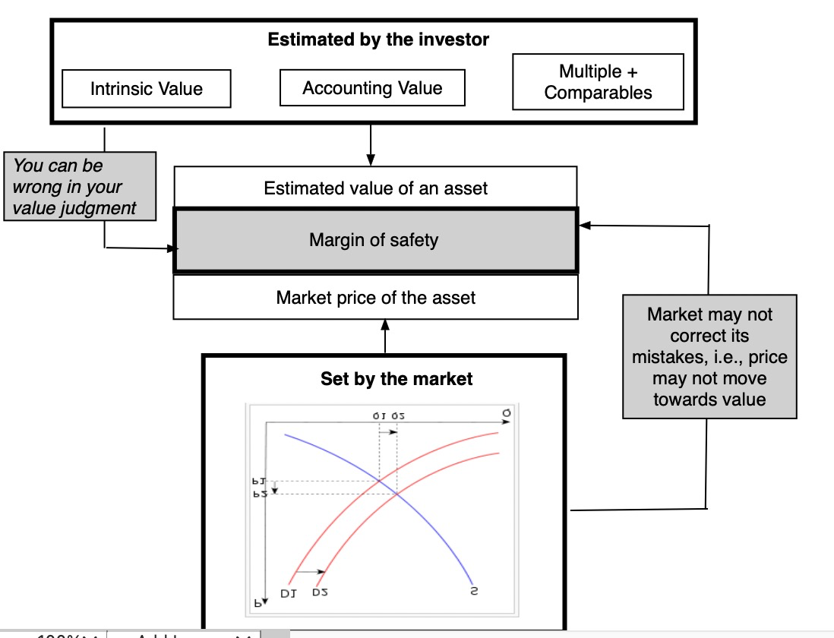
3. The Margin of Safety is not a substitute for risk assessment…

Slide 14
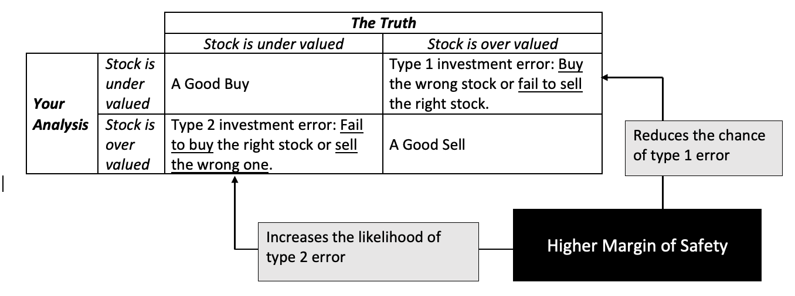
And increasing MOS creates a trade off…

Slide 15
4. Don’t take accounting at face value… Or look to accounting rules for salvation..
It is undeniable that value investing has an accounting focus, with earnings and book value playing a central role in investing strategies.
There is good reason to trust those numbers less now than in decades past, for a few reasons.
  One is that companies have become much more aggressive in playing accounting games, using pro forma income statements to skew the numbers in their favor.
  The second is that as the center of gravity in the economy has shifted away from manufacturing companies to technology and service companies, accounting has struggled to keep up. In fact, it is clear that the accounting treatment of R&D has resulted in the understatement of book values of technology and pharmaceutical companies.

Slide 16
5. You can pick stocks and be diversified… At the same time…
While not all value investors make this contention, a surprisingly large number seem to view concentrated portfolios as a hallmark of good value investing, arguing that spreading your bets across too many stocks will dilute your upside.
The choice of whether you want to pick good stocks or whether you want to be diversified is a false one, since there is no reason you cannot do both.
After all, you have thousands of publicly traded stocks to pick from, and all that diversification requires is that rather than put your money in the very best stock or the five best stocks, you should hold the best thirty or forty stocks.

Slide 17
Concentration vs Diversification

Slide 18
6. Don’t’ feel entitled to a reward for your virtue…
Investing is not a morality play, and there are no virtuous ways of making money. The distinction between investing and speculating is not only a fine one, but very much in the eyes of the beholder.
  To hold any investing philosophy as better than the rest is a sign of hubris and an invitation for markets to take you down.
  Keeping an open mind about other investment philosophies can not only keep you grounded but allow you to incorporate aspects of those philosophies into your own.
If you are a value investor, that is your choice, but it should not preclude you from treating other investors with respect and borrowing tools to enhance your returns.

Slide 19
The value investors’ final defense..
Some value investors will fall back on that old standby, which is that we should draw our cues from the most successful of the value investors, not the average.
Arguing that value investing works because Warren Buffett and Seth Klarman have beaten the market is a sign of weakness, not strength. After all, every investment philosophy (including technical analysis) has its winners and its losers.
A more telling test would be to take the subset of value investors, who come closest to purity, at least as defined by the oracles in value investing, and see if they collectively beat the market
  Have those investors who have read Graham and Dodd generated higher returns, relative to the market, than those who just listen to CNBC?
  Do the true believers who trek to Omaha for the Berkshire Hathaway annual meeting every year have superior track records to those who buy index funds?

Slide 20
Conclusion
Value investing comes in many stripes.
  There are screens such as price-book value, price earnings and price sales ratios that seem to yield excess returns over long periods. It is not clear whether these excess returns are truly abnormal returns, rewards for having a long time horizon or just the appropriate rewards for risk that we have not adequately measured.
  There are also “contrarian” value investors, who take positions in companies that have done badly in terms of stock prices and/or have acquired reputations as “bad” companies.
  There are activist investors who take positions in undervalued and/or badly managed companies and by virtue of their holdings are able to force changes that unlock this value.
In spite of the impeccable academic evidence in its favor, there is little backing for the general claim that being an active value investor generates excess returns (relative to investing a value index fund).

