Slide 1
Investing on Hope? Growth Investing & Small Cap Investing
Aswath Damodaran

Slide 2
Who is a growth investor?
The Conventional definition: An investor who buys high price earnings ratio stocks or high price to book ratio stocks.
The Generic definition: An investor who buys growth companies where the value of growth potential is being underestimated. In other words, both value and growth investors want to buy under valued stocks. The difference lies mostly in where they think they can find these bargains and what they view as their strengths.

Slide 3
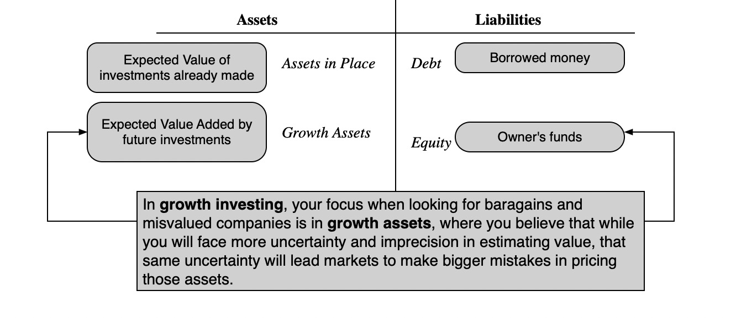
My definition…

Slide 4
The many faces of growth investing
The Small Cap investor: The simplest form of growth investing is to buy smaller companies in terms of market cap, expecting these companies to be both high growth companies and also expecting the market to under estimate the value of growth in these companies.
The IPO investor: Presumably, stocks that make initial public offerings tend to be smaller, higher growth companies.
The Passive Screener: Like the passive value screener, a growth screener can use screens - low PE ratios relative to expected growth, earnings momentum - to pick stocks.
The Activist Growth investor: These investors take positions in young growth companies (even before they go public) and play an active role not only in how these companies are managed but in how and when to take them public.

Slide 5
Small Cap Investing
One of the most widely used passive growth strategies is the strategy of investing in small-cap companies.
That said, not all small cap stocks are high growth stocks and there are variants of value investing which also are built around small cap stocks.
The key questions:
  Does investing in small cap stocks generate higher returns than investing in large cap stocks?
  If yes, are these higher returns compensation for taking higher risks in small cap stocks or excess returns? And can you generate these excess returns in practice?
  If they are excess returns, have there been changes over time to to these returns?

Slide 6
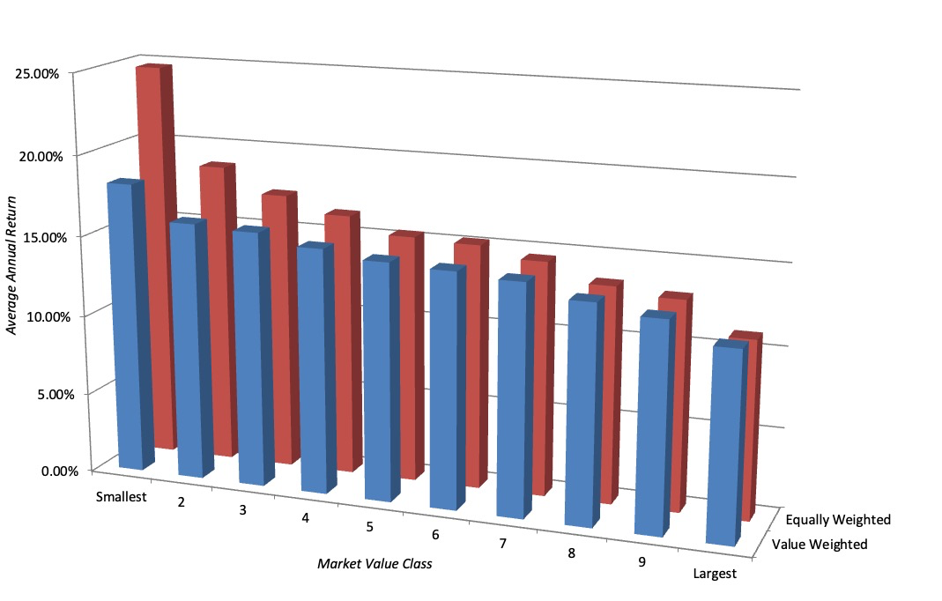
The Small Firm Effect: 1927 - Current

Slide 7
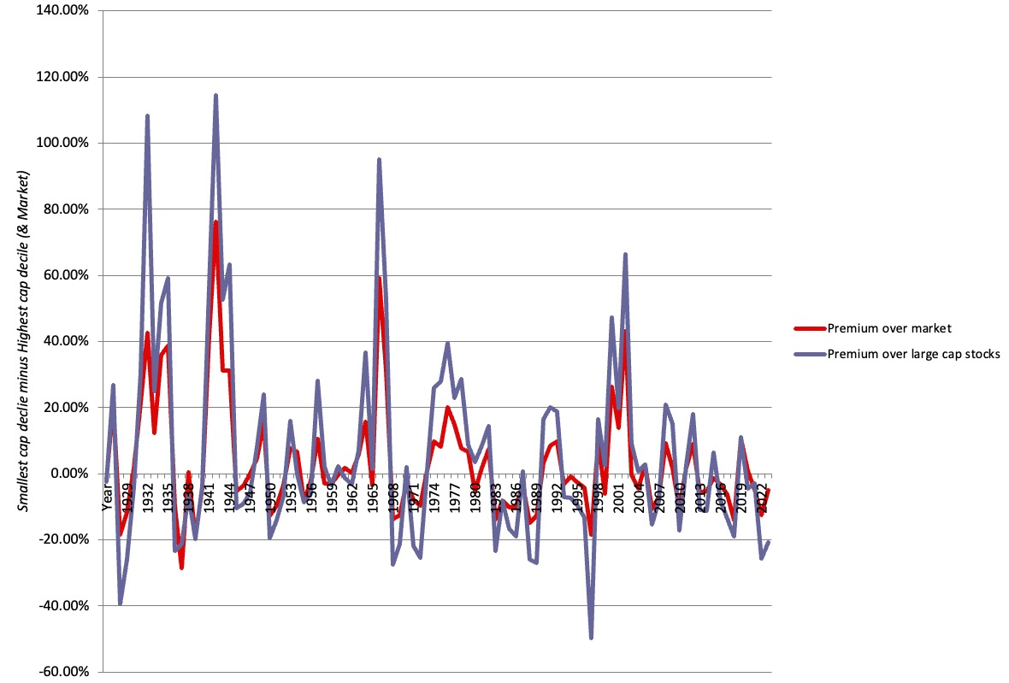
And over time..

Slide 8
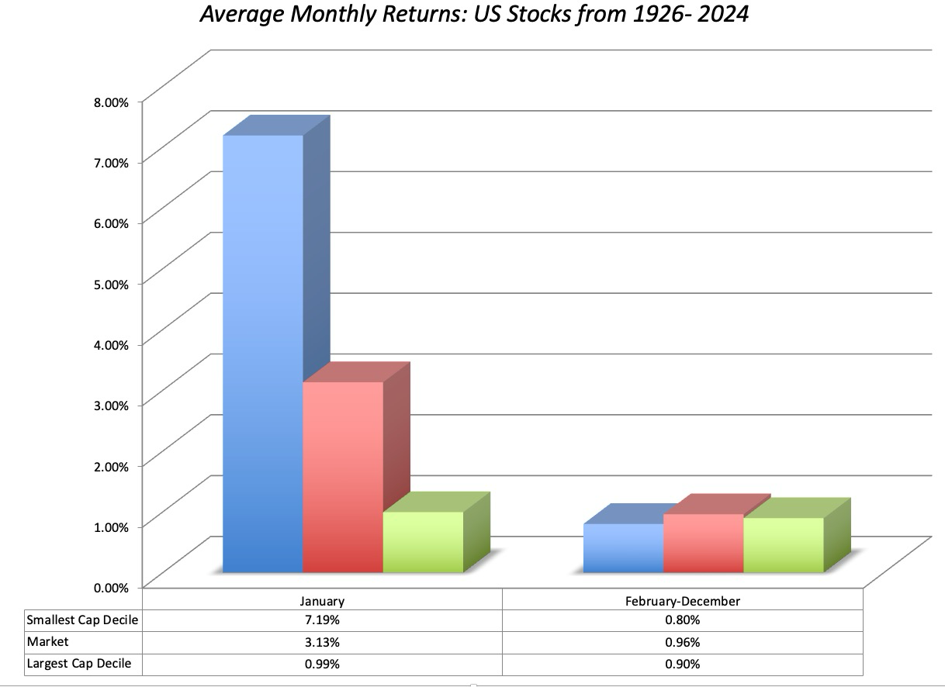
A January Effect?

Slide 9
Risk Models and the Size Effect
The capital asset pricing model may not be the right model for risk, and betas underestimate the true risk of small stocks. Thus, the small firm premium is really a measure of the failure of beta to capture risk. The additional risk associated with small stocks may come from several sources.
  First, the estimation risk associated with estimates of beta for small firms is much greater than the estimation risk associated with beta estimates for larger firms. The small firm premium may be a reward for this additional estimation risk.
  Second, there may be additional risk in investing in small stocks because far less information is available on these stocks. In fact, studies indicate that stocks that are neglected by analysts and institutional investors earn an excess return that parallels the small firm premium.

Slide 10
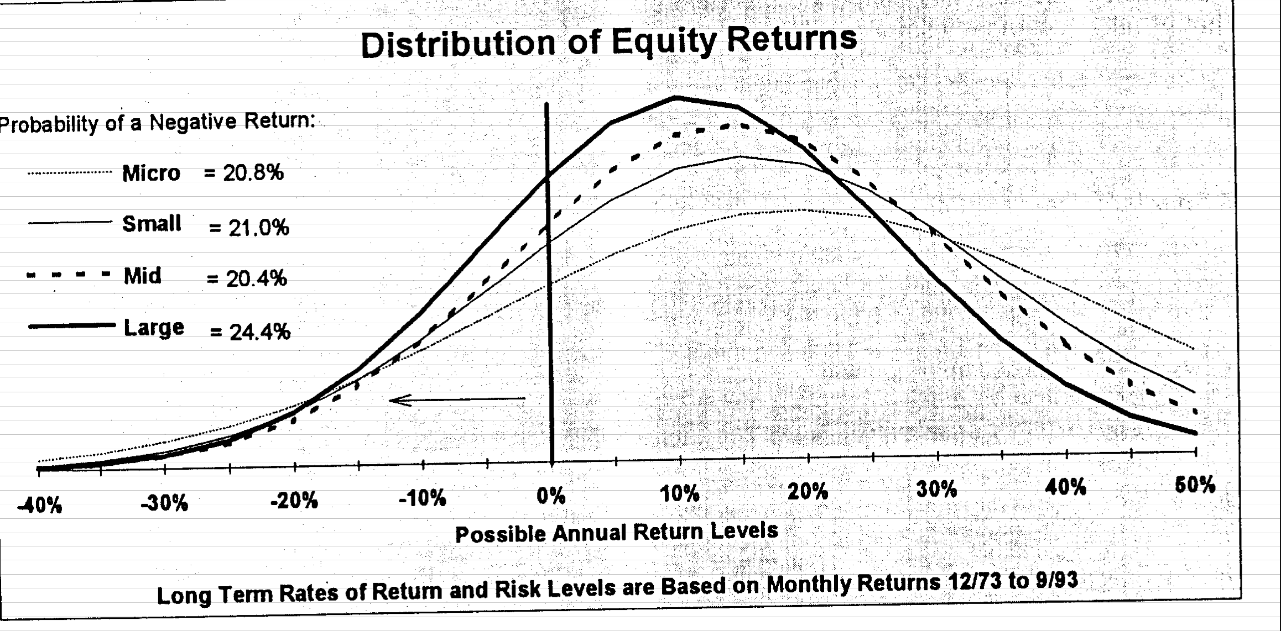
1. There may be more risk in individual small cap stocks, but not in portfolios
While it is undeniable that the stock returns for individual small cap stocks are much more volatile than large market cap stocks, a portfolio of small cap stocks has a distribution that is similar to the distribution for a large cap portfolio.

Slide 11
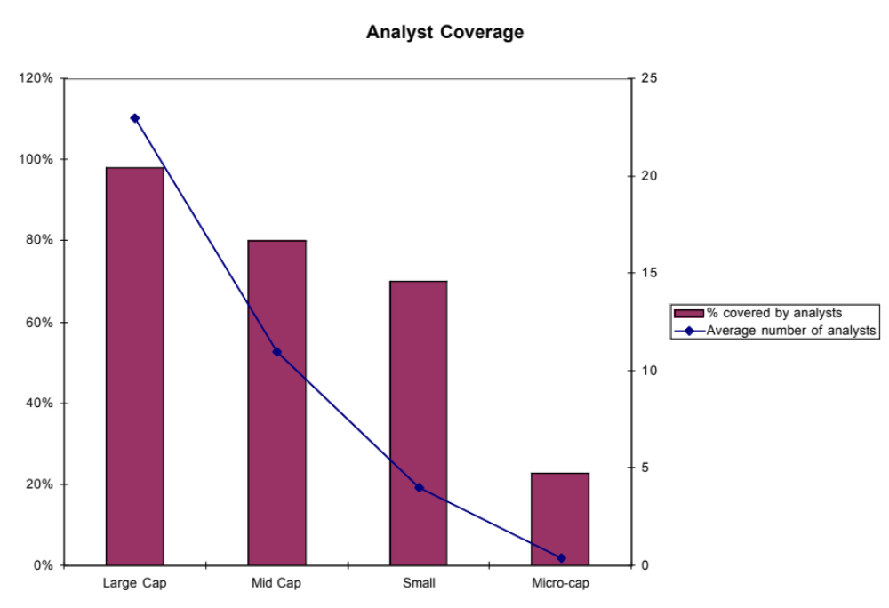
2. There is less analyst coverage of small firms

Slide 12
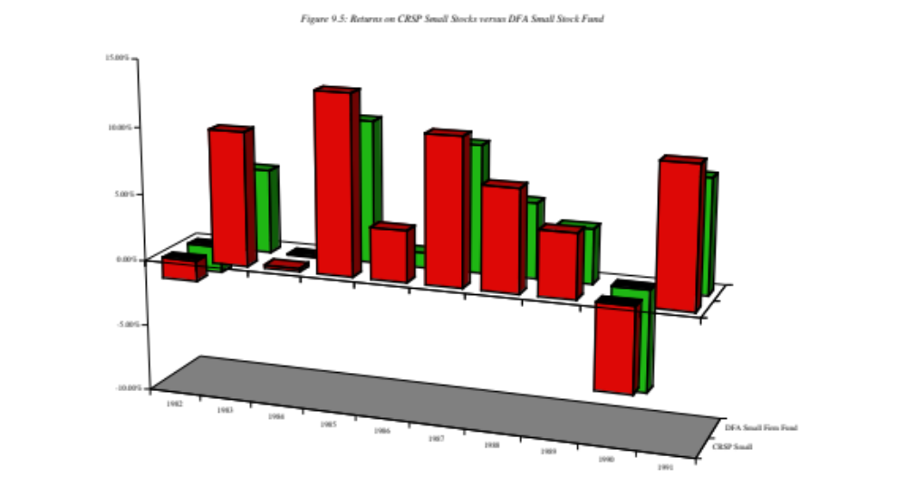
Difficulties in Replicating Small Firm Effect: DFA Small Cap versus Small Cap Index

Slide 13
Possible Explanations
The transactions costs of investing in small stocks is significantly higher than the transactions cots of investing in larger stocks, and the premiums are estimated prior to these costs.
  While this is generally true, the differential transactions costs are unlikely to explain the magnitude of the premium across time, and are likely to become even less critical for longer investment horizons.
It is difficult to replicate in practice: The funds that invest in small cap stocks seem to have a difficult time replicating the returns that you see on paper in studies.

Slide 14
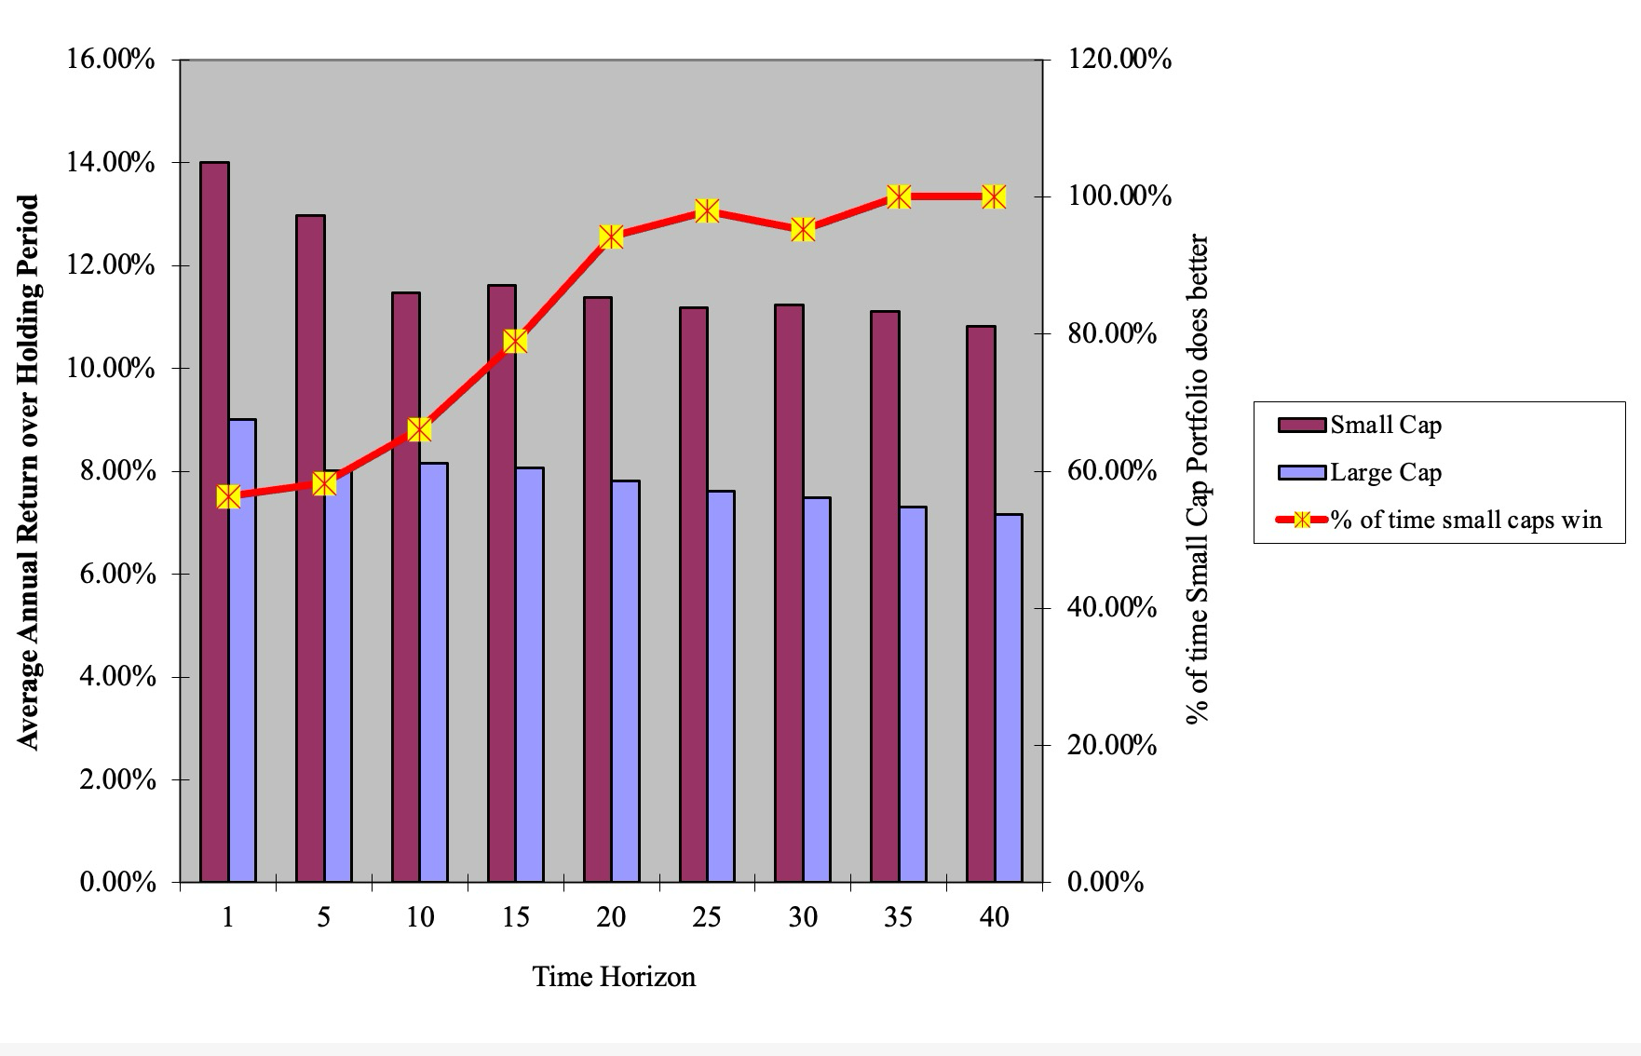
The importance of a long time horizon..

Slide 15
Determinants of Success at Small Cap Investing
The importance of discipline and diversification become even greater, if you are a small cap investor. Since small cap stocks tend to be concentrated in a few sectors, you will need a much larger portfolio to be diversified with small cap stocks. In addition, diversification should also reduce the impact of estimation risk and some information risk.
When investing in small cap stocks, the responsibility for due diligence will often fall on your shoulders as an investor, since there are often no analysts following the company. You may have to go beyond the financial statements and scour other sources (local newspapers, the firm’s customers and competitors) to find relevant information about the company.
Have a long time horizon. The small cap premium seems to hold over long time periods, but disappears for sub-periods that can be as long as five years.

Slide 16
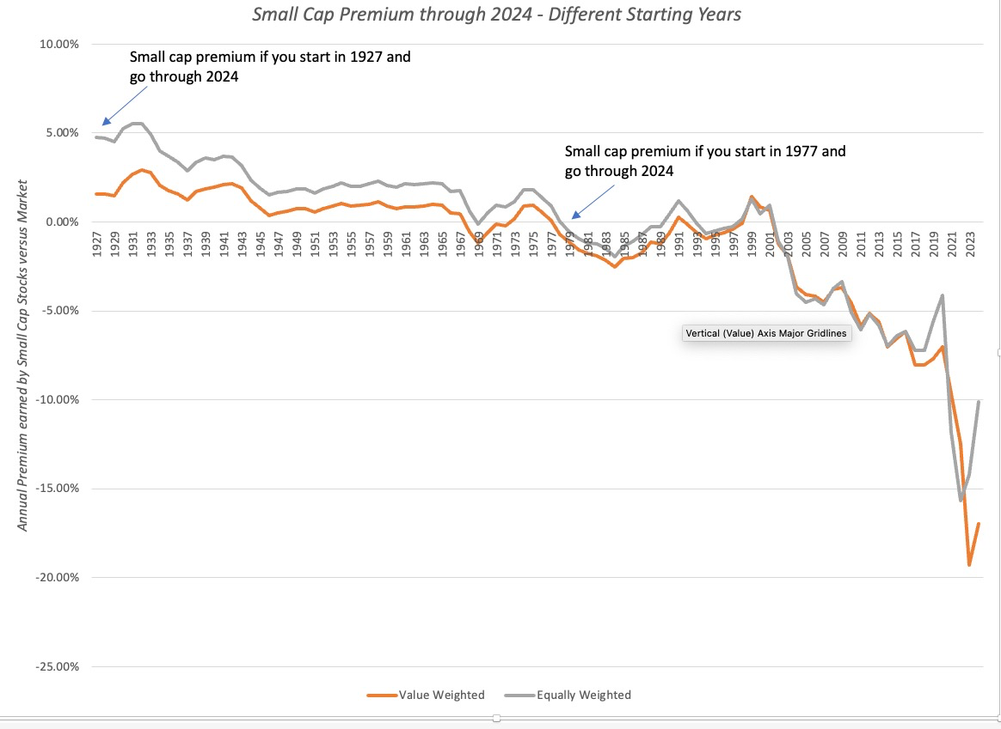
The fading of the small cap premium…

Slide 17
Has the small firm premium disappeared?
More volatile: The small stock has become much more volatile since 1981. Whether this is a long term shift in the small stock premium or just a temporary dip is still being debated.
A 70s effect? Jeremy Siegel notes in his book on the long term performance of stocks that the small stock premium can be almost entirely attributed to the performance of small stocks in the 1970s. Since this was a decade with high inflation, could the small stock premium have something to do with inflation?

Slide 18
Summing up…
A 20th century phenomenon? Small market cap stocks did earn a premium over larger cap stocks, after adjusting for risk, in the US in the 20th century.
Excess return or risk mismeasurement? It remains a debatable question as to whether that premium was an “excess return” or a reflection of a failure to adjust for risks and the illiquidity of small cap stocks.
Weaker or gone: Whatever the reason, the small cap effect has weakened in the last 40 years and perhaps even disappeared.
An ETF strategy: Even if none of the above convince you, a strategy of investing in small cap stocks is so easily replicable (in an index fund or ETF) that it does not even qualify as an active investing strategy.

