Slide 1
Get in on the ground floor: The IPO story
Buy newly minted companies?

Slide 2
The Initial Public Offering: Institutional setting
When a private firm decides to go public, the process is usually managed by a syndicate of investment banks, with a lead bank, and supporting banks. The larger the offering, the more banks there will be…
Most IPOs are backed by an investment banking underwriting guarantee, where the investment banker guarantees the offering price in return for an underwriting fee.
To make an IPO in the United States, a company has to file a prospectus with the SEC specifying not only the financials of the company but also how it plans to use the proceeds from the offering (to hold in the company or as cash to the founders).

Slide 3
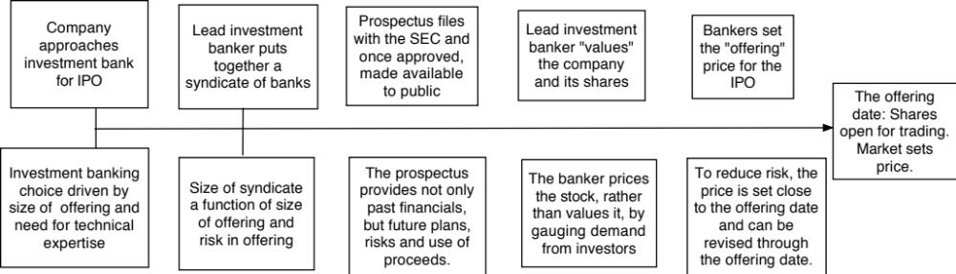
IPO institutional timing and details

Slide 4
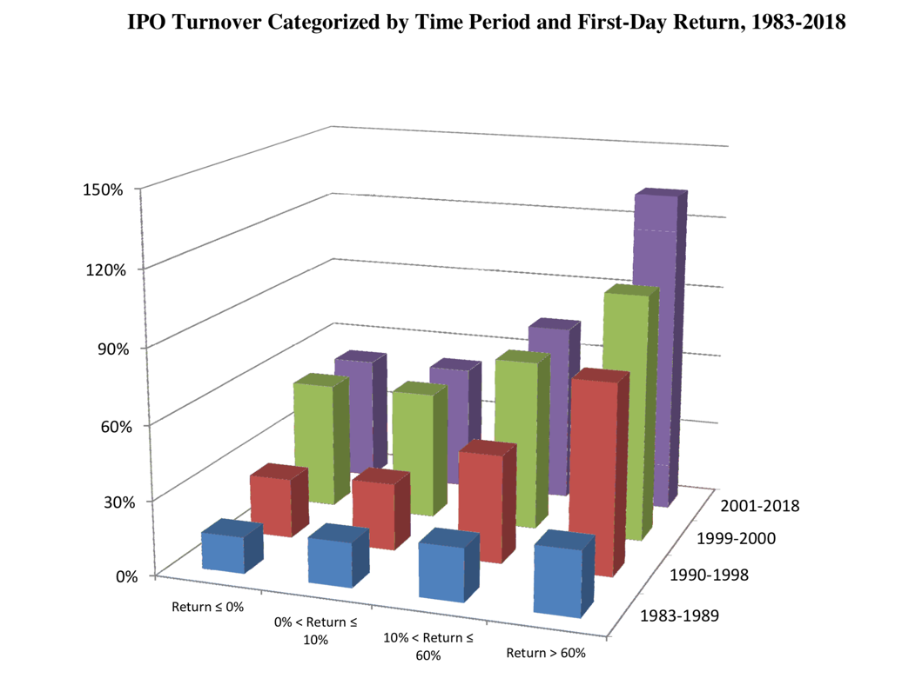
The returns on the IPO offering date

Slide 5
More on IPO pricing…
The average initial return is 15.8% across a sample of 13,308 initial public offerings. However, about 15% of all initial public offerings are over priced.
Initial public offerings where the offering price is revised upwards prior to the offering are more likely to be under priced than initial public offerings where the offering price is revised downwards.
Offering price | Number of IPOs | Average initial return | % of offerings underpriced
Revised down | 708 | 3.54% | 53%
Revised up | 642 | 30.22% | 95%

Slide 6
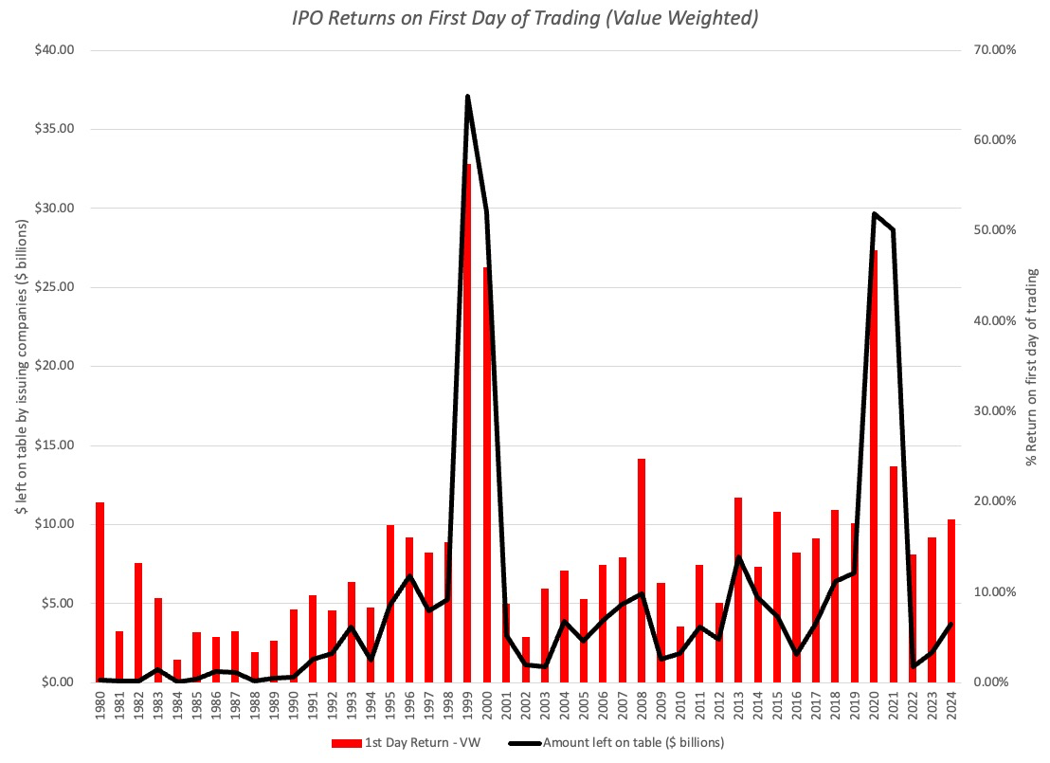
IPO underpricing over time…

Slide 7
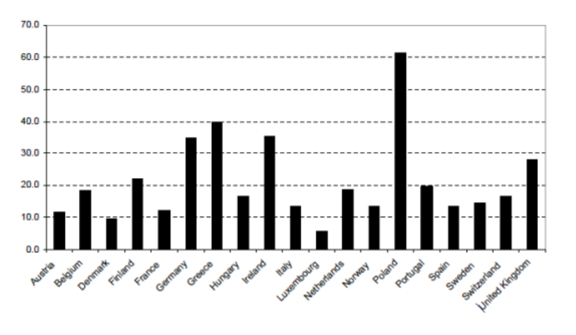
IPO underpricing in Europe..

Slide 8
A blanket IPO strategy…
The under pricing of IPOs, on average, seems to offer an investment opportunity to investors. Why not try to invest in every IPO that comes along?
There are three problems with that strategy:
  Selection bias: You will not get your full allotment of every IPO that you apply for.
  Feast or famine: If your entire investment strategy is built around investing in IPOs, you will go through periods where you will nothing to invest in.
  Timing is everything: While the initial return to IPOs is good, at least on average, those returns may not persist in the post IPO period.

Slide 9
1. Selection bias
Even if you apply to get shares in every IPO that is offered, you will not get all the shares you requested in all of the IPOs.
  If the IPO is overpriced, you will get your full allotment.
  If your IPO is underpriced, you will get only a fraction of your request.
If investment banks play favorites, and assign more of the allotment of the ”best” IPOs to preferred clients, and less to outsiders, your problems get worse.
Your end portfolio will therefore be over weighted in overpriced IPOs and under weighted in underpriced IPOs.
The returns on this portfolio will be nowhere as attractive as the returns on the paper portfolios that average returns across all IPOs.

Slide 10
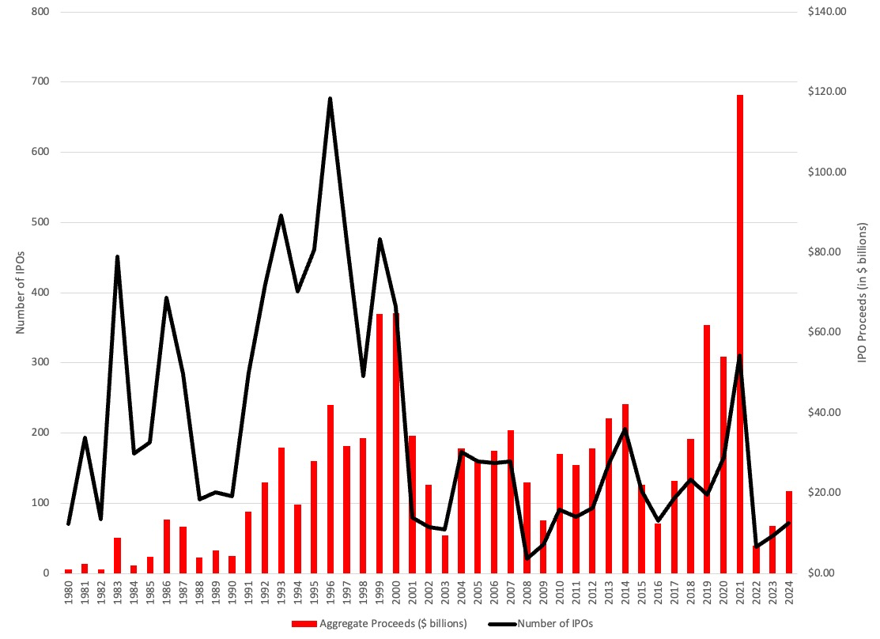
2. The IPO Cycle

Slide 11
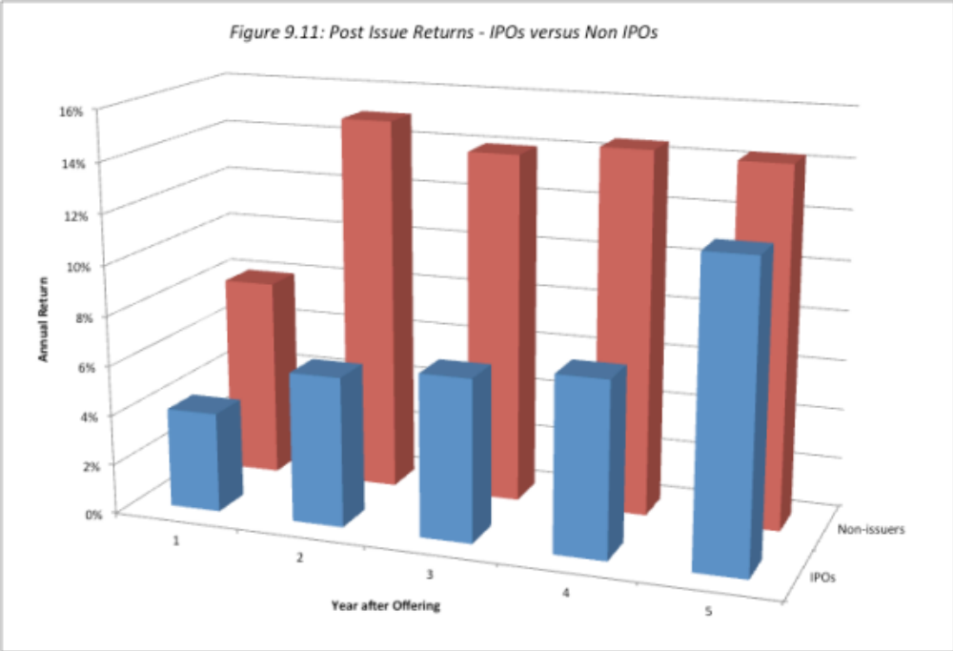
3. What happens after the IPO?

Slide 12
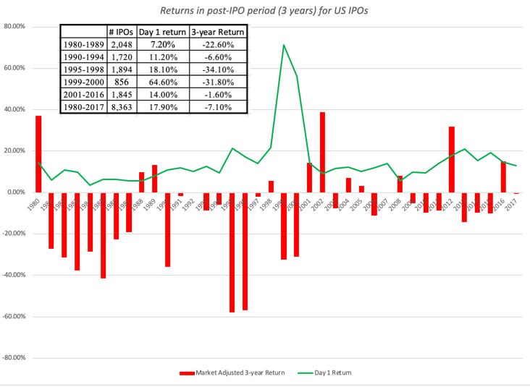
Updated and by year

Slide 13
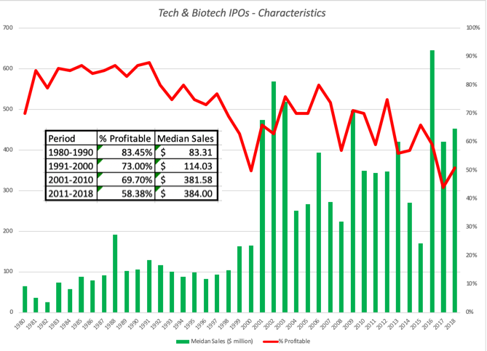
A Game Changer? More money losing companies going public… Tech & Biotech

Slide 14
Determinants of Success at IPO investing
Select the “right’ IPOs: Have the valuation skills to value companies with limited information and considerable uncertainty about the future, so as to be able to identify the companies that are under or over priced.
Play the allotment game: Ask for more shares than you want in companies which you view as severely under priced and fewer or no shares in firms that are overpriced or that are priced closer to fair value.
All in the timing: Since this is a pricing game, often involving getting the shares at the offering price and flipping the shares on the offering date, you will have to gauge the market mood and demand for each offering, in addition to assessing its value. In other words, a shift in market mood can leave you with a large allotment of over-priced shares in an initial public offering.

