Slide 1
Growth Investing: Against the tide of history
Against the odds!

Slide 2
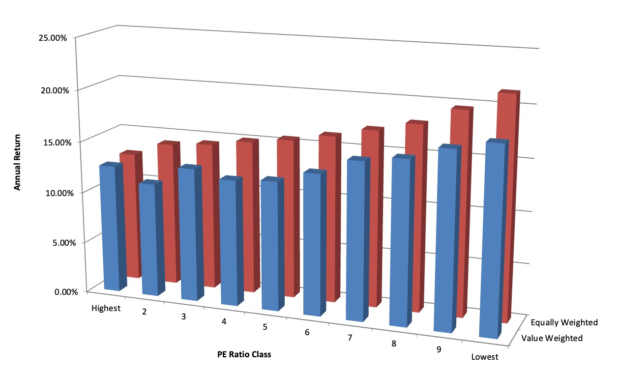
In passive investing, history has picked a winner…

Slide 3
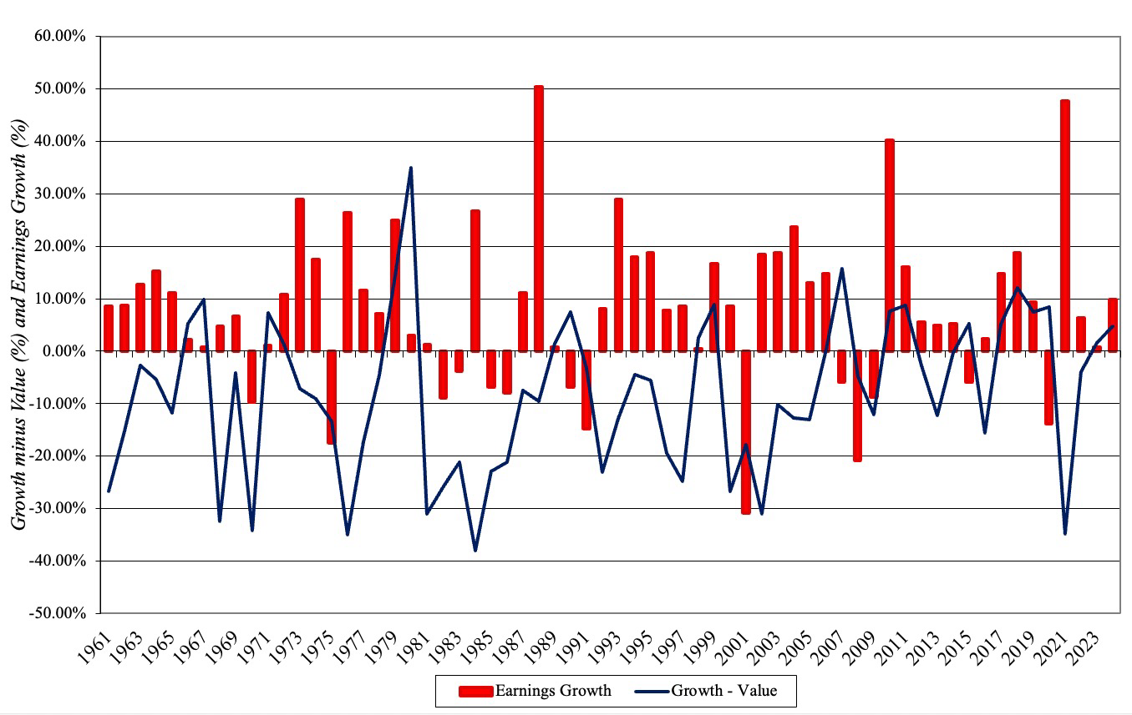
But there are periods when growth outperfoms value ..

Slide 4
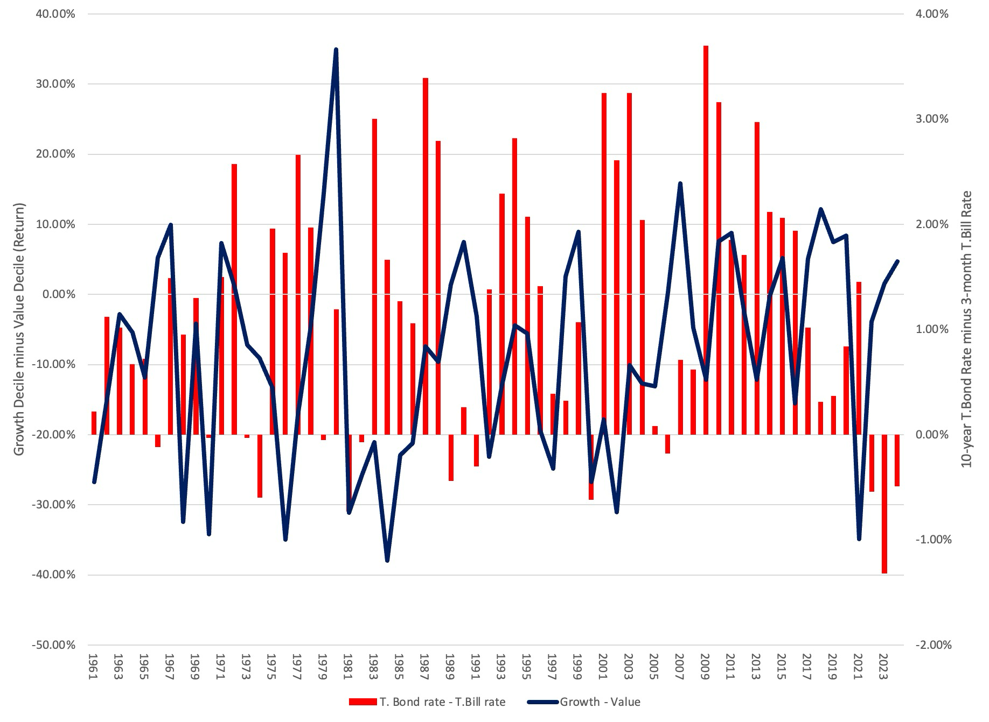
Especially when the yield curve is flat or downward sloping..

Slide 5
And may be waning..
PE Ratio | 1952-2018 | 1969-2018 | 1999-2018
Lowest PE | 17.96% | 15.08% | 11.66%
2 | 17.21% | 14.30% | 10.91%
3 | 16.05% | 13.90% | 10.36%
4 | 14.73% | 13.85% | 8.98%
5 | 13.99% | 12.25% | 7.82%
6 | 12.27% | 11.57% | 8.34%
7 | 11.70% | 11.34% | 7.35%
8 | 12.03% | 12.04% | 9.02%
9 | 10.23% | 10.21% | 7.44%
Highest PE | 11.82% | 10.98% | 9.98%
Lowest vs Highest | 6.14% | 4.10% | 1.68%

Slide 6
Active growth investing seems to beat active value investing…
When measured against their respective indices, active growth investors seem to beat growth indices more often than active value investors beat value indices.
In his paper on mutual funds in 1995, Malkiel provides evidence on this phenomenon. He notes that between 1981 and 1995, the average actively managed value fund outperformed the average actively managed growth fund by only 16 basis points a year, while the value index outperformed a growth index by 47 basis points a year.
He attributes the 31 basis point difference to the contribution of active growth managers, relative to value managers.

Slide 7
Reconciling the contradiction…
Selection bias: The companies that are scrutinized by growth investors, for the most part, tend to be smaller and less followed than companies followed by value investors. Hence, there is a greater chance of finding mispricing.
Valuation difficulty: Value companies are generally easier to value than growth companies. Thus, an investor who can bring valuation skills to the table can take more away from that table, with growth stocks than with value stocks.
Sector/Company specific knowledge: High growth firms are often in nascent sectors, where having a knowledge of the sector (biotechnology, social media etc.) can provide an advantage to investors.

Slide 8
The pitfalls in growth investing
The Scaling factor: As companies grow, they get bigger, but as they get bigger, it gets more difficult to keep growing. If you underestimate scaling problems, you will have trouble with your growth investments.
Paying too much for growth: Growth, by itself, can be good, bad or neutral for value. It depends on how much the company pays (in investments) to get that growth.
Playing the momentum game: Since most investors in growth stocks have given upon on trying the value those stocks, because of the uncertainty inherent in them, the momentum game is likely to dominate how these stocks get priced. That, in turn, may cause the pricing gap to increase over time, rather than decrease.

Slide 9
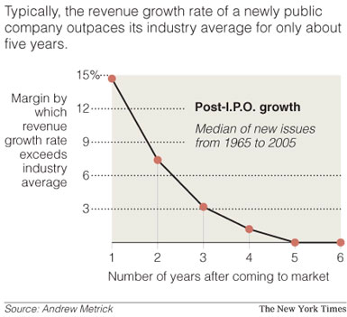
1. Scaling up is hard to do…

Slide 10
2. The value of growth
To generate growth, firms have to reinvest money (in capital expenditures, R&D, acquisitions and working capital). That reinvestment reduces the cash flows.
The effect of growth then becomes a net effect, which weighs off the benefits of having higher earnings in the future (from the growth) against lower cash flows today.
As a shorthand, the value of growth can be written as a function of the “excess returns” the firm earns on its new investments, with excess returns being the difference between the return on the investment (ROE or ROIC) and the cost of the financing (cost of equity or capital).

Slide 11
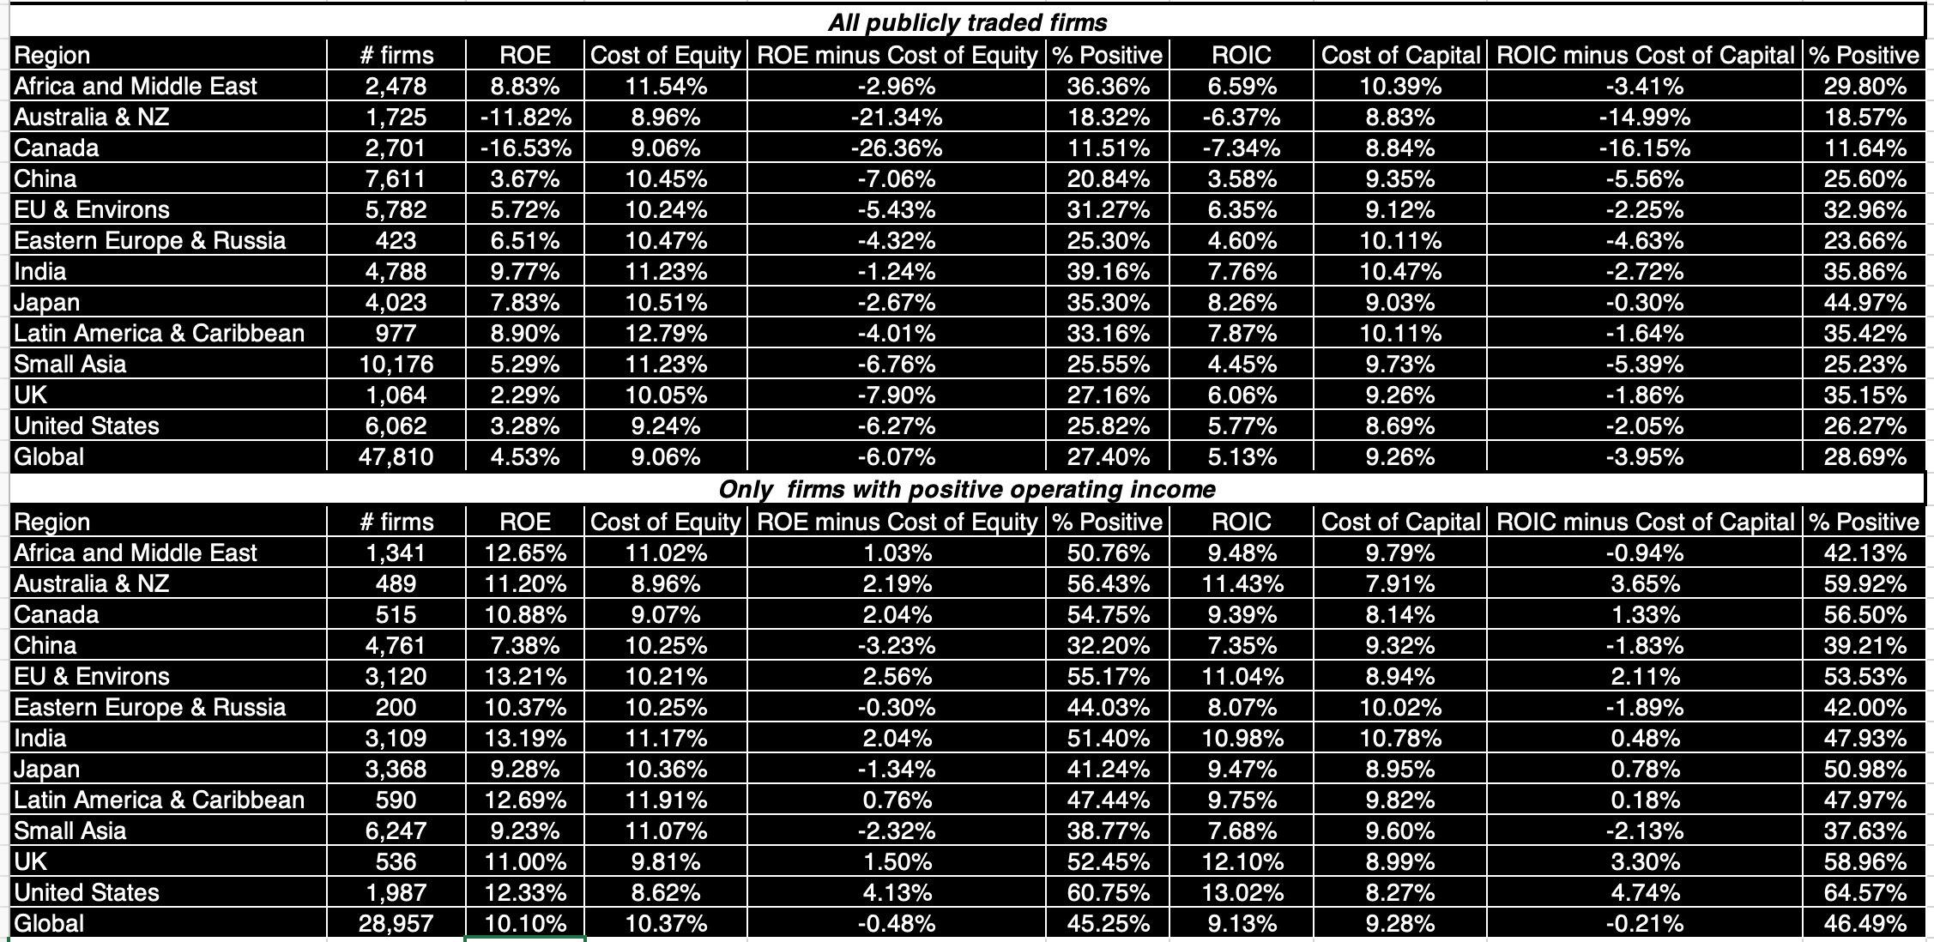
Is Growth good?

Slide 12
And is it sustainable?
 |  | Type of competitive advantage (moat)
 |  | Brand Name | Switching Costs | Network Benefits | Cost Advantages | Legal Protection
Moat Width | Wide | Top brand | Infinite | Global | Permanent | Full
 | Narrow | Name brand | High | Local | Temporary | Partial
 | No Moat | Generic | None | None | None | None
Place in story |  | Margins | Customer Retention | Market Share | Profit margins | Pricing Power

Slide 13
3. The Pricing Game
A momentum game? It is often easier to make money on growth stocks playing the momentum game than trying to value growth and get it at a bargain.
Delusional thinking? While there is nothing wrong with playing the momentum game, there are many growth investors who delude themselves into believing that they are valuing growth companies.

Slide 14
The Bottom Line
A stigma? Fewer investors seem to want to call themselves growth investors than value investors and part of the reason seems to be the perception that growth investors not only don’t care about value, but that they are more speculators than investors.
Not true: Good growth investors care just as much about value as good value investors do, but believe that their advantages in assessing value are greater with growth assets than assets in place.
Better odds: To the extent that you will be able to generate excess returns only because you bring something different/unique to the table, the odds of doing so are greater with growth stocks, where uncertainty abounds, data is limited and estimation challenges are greater.

