Slide 1
Information Trading: Following the “insiders”
They must know more than we do…

Slide 2
The Insider Advantage
Insiders are managers, directors or major stockholders in firms. While they are constrained from trading ahead of information releases, they can still legally buy or sell stock in their companies.
Analysts operate at the nexus of private and public information. To the extent that they “know” something about the company that the rest of us do not, their recommendations should convey information to the market.
One way to examine whether private information can be used to earn excess returns is to look at whether insiders and analysts earn excess returns.

Slide 3
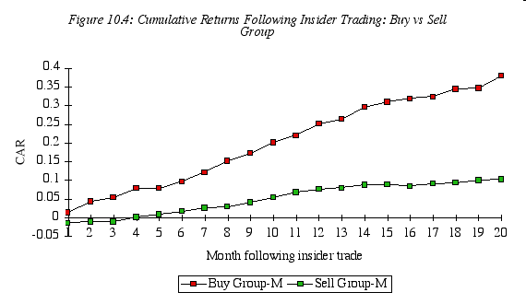
Insider Trading as a Leading Indicator of Stock prices..

Slide 4
More on insider trading…
Noisy signal? Studies since support this finding, but it is worth noting that insider buying is a noisy signal – about 4 in 10 stocks where insiders are buying turn out to be poor investments, and even on average, the excess returns earned are not very large.
Insider selling is a stronger signal than buying: In a study in 1998, Lakonishok and Lee take a closer look at the price movements around insider trading. They find that firms with substantial insider selling have stock returns of 14.4% over the subsequent 12 months, which is significantly lower than the 22.2% earned by firms with insider buying.
Stronger at smaller firms: However, they find that the link between insider trading and subsequent returns is greatest for small companies and that there is almost no relationship at larger firms.

Slide 5
Insider trading - updated
Insider trading laws tightened: The first is that the SEC has become more expansive in its definition of what constitutes insider information (to include any material non-public information, rather than just information releases from the firm) and more aggressive in its enforcement of insider trading laws.
Companies are more restricted in what they can share: The second is that companies, perhaps in response to the SEC’s hard line on insider trading, have adopted more stringent policies restricting insiders from trading on information.
Price effect of insider trading has decreased: Perhaps as a consequence, the price effect of insider trading has decreased over time and one study finds that the price effect of (legal) insider trading has almost disappeared since 2002, with the adoption of Regulation Fair Disclosure (FD), which restricted selective information disclosure by companies to a few investors or analysts, and Sarbanes-Oxley, which increased scrutiny of insider trading.

Slide 6
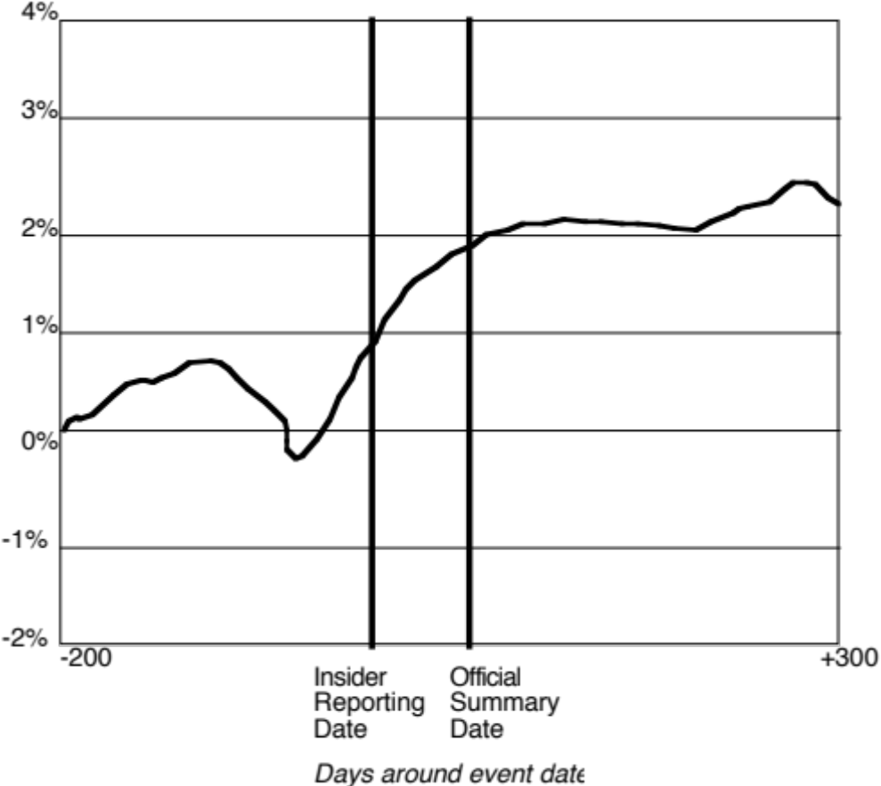
Can you follow insiders and make money?

Slide 7
Are some insiders more inside than others?
Not all insiders have equal access to information. Top managers and members of the board should be privy to much more important information and thus their trades should be more revealing. A study by Bettis, Vickrey and Vickery finds that investors who focus only on large trades made by top executives, rather than total insider trading may, in fact, be able to earn excess returns.
As investment alternatives to trading on common stock have multiplied, insiders have also become more sophisticated about using these alternatives. As an outside investor, you may be able to add more value by tracking these alternative investments.
Knowledge about insider trading is more useful in some companies than in others. Insider buying or selling is likely to contain less information (and thus be less useful to investors) in companies where information is plentiful (both because of disclosure by the company and analysts following the company) and easy to assess.

Slide 8
Illegal Insider Trading: Is it profitable?
It is pervasive: Almost all major news announcements made by firms are preceded by a price run-up (if it is good news) or a price drop (if it is bad news). While this may indicate a very prescient market, it is much more likely that someone with access to the privileged information. In fact, the other indicator of insider trading is the surge in trading volume in both the stock itself and derivatives prior to big news announcements.
Illegal insiders make money: When insiders are caught trading illegally, they almost invariably have made a killing on their investment. Clearly, some insiders made significant returns off their privileged positions.
Timing is key: In addition to having access to information, insiders are often in a position to time the release of relevant information to financial markets. One study find that insiders sell stock between 3 and 9 quarters before their firms report a break in consecutive earnings increases. They also find, for instance, that insider selling increases at growth firms prior to periods of declining earnings.

Slide 9
What if insider information is legal?
There are some markets where managers and insiders are allowed to legally disclose information to a subset of outside investors (analysts, big institutions).
In those markets, the investors who have access to insider information have an advantage over other investors who do not.
That should give them an advantage and excess returns, but there are two potential catches:
  The perception that the market is not fair will drive out the investors who do not access private information, causing liquidity to dry up.
  In this illiquid market, the very act of trading by those with access to insider information may drive out excess returns.

