Slide 1
Information Trading: Public Information – Earnings Reports
A game of expectations!

Slide 2
Trading on Public Information
There is substantial information that comes out about stocks publicly.
  Some of the information comes from the firm - earnings and dividend announcements, acquisitions and other news - and some comes from competitors.
  Prices generally react to this information.
Access to this information has widened, and information has become more timely, removing an advantage that institutional investors and professional traders used to have, leveling the playing field.

Slide 3
Earnings Announcements
Every quarter (in the U.S) and less frequently elsewhere, firms report their earnings for the most recent period.
When firms make earnings announcements, they convey information to financial markets about their current and future prospects. The magnitude of the information, and the size of the market reaction, should depend upon how much the earnings report exceeds or falls short of investor expectations.
In an efficient market, there should be an instantaneous reaction to the earnings report, if it contains surprising information, and prices should increase following positive surprises and down following negative surprises, with surprises measured relative to expectations.

Slide 4
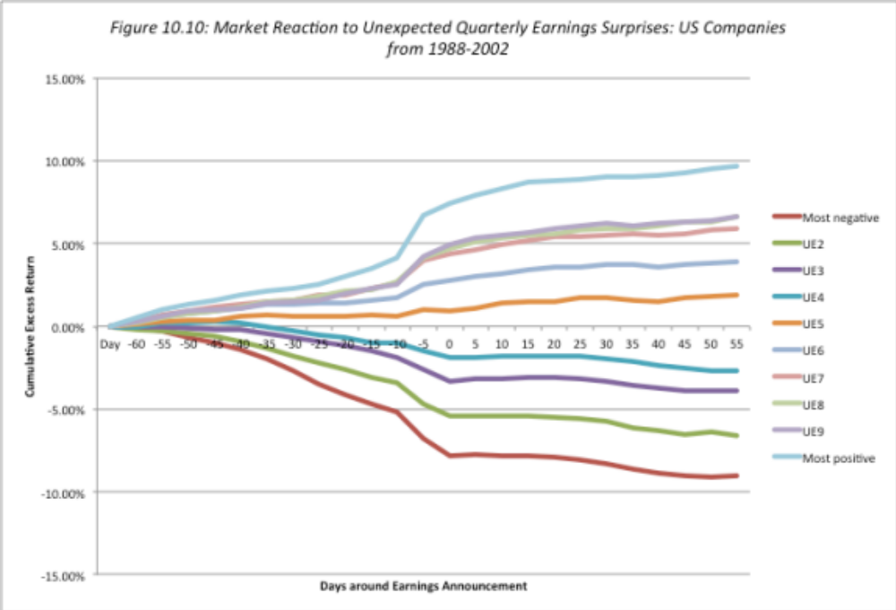
Market Reaction to Earnings Reports

Slide 5
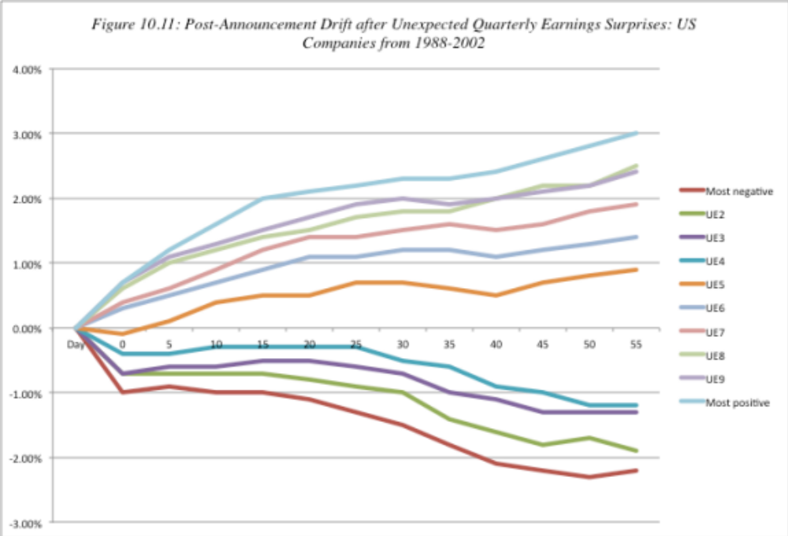
The post-announcement drift?

Slide 6
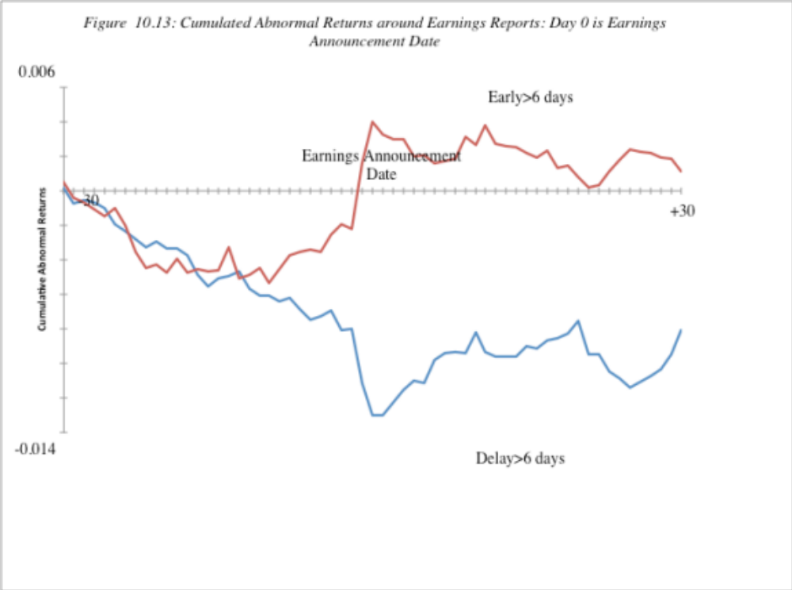
The Consequence of Delays…

Slide 7
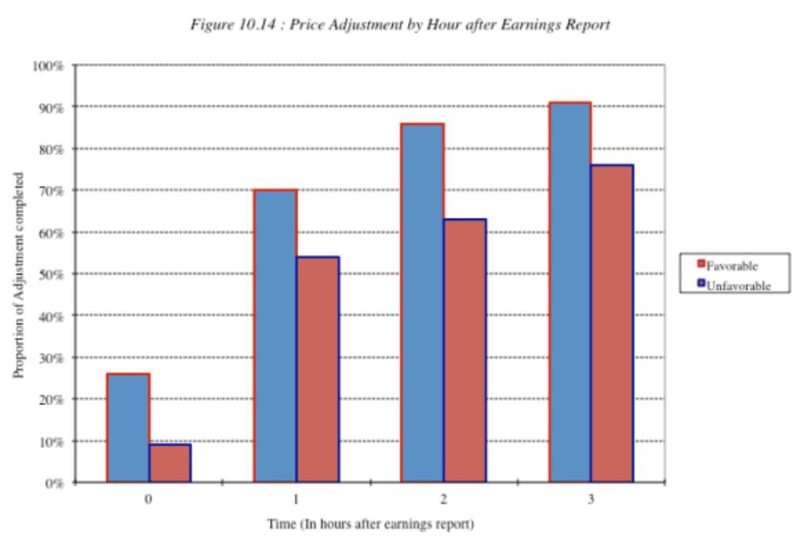
The Intraday reaction..

Slide 8
And earnings quality matters…
Quality varies across firms: As firms play the earnings game, the quality of earnings has also diverged across companies. A firm that beats earnings estimates because it has more efficient operating should be viewed more favorably than one that beats estimates because it changed the way it valued inventory.
Accrual versus cash earnings: Firm that reported high accruals – i.e. the difference between accounting earnings and cash flows and firms that report that high earnings without a matching increase in cashflow have poorer quality earnings see declining earnings and negative stock returns in subsequent years.

Slide 9
The guidance game
In the last two decades, companies have come under pressure to release guidance about future earnings, at the time that they release current earnings.
The guidance includes information about revenues and future earnings that is also measured against expectations, and unexpectedly positive or negative guidance can affect prices.
The process is also open to gaming, where companies use guidance to manage expectations, and thus are sometimes inclined to provide more pessimistic guidance than warranted.

Slide 10
Can you make money of earnings announcements?
Play the drift: One strategy is to buy stocks that report large positive earnings surprises, hoping to benefit from the drift. The evidence indicates that across all stocks, the potential for excess returns from buying after earnings announcements is very small.
But be selective: You can concentrate only on earnings announcements made by smaller, less liquid companies where the drift is more pronounced. In addition, you can try to direct your money towards companies with higher quality earnings surprises by avoiding firms with large accruals.
And see if you can get ahead of the game: Your biggest payoff is in investing in companies before large earnings surprises. You may be able to use a combination of quantitative techniques (time series models that forecast next quarter’s earnings based upon historical earnings) and trading volume (insiders do create blips in the volume) to try to detect these firms. Even if you are right only 55% of the time, you should be able to post high excess returns.

