Slide 1
Information Trading: Public Information – Other than Earnings
Breaking news!!!!!

Slide 2
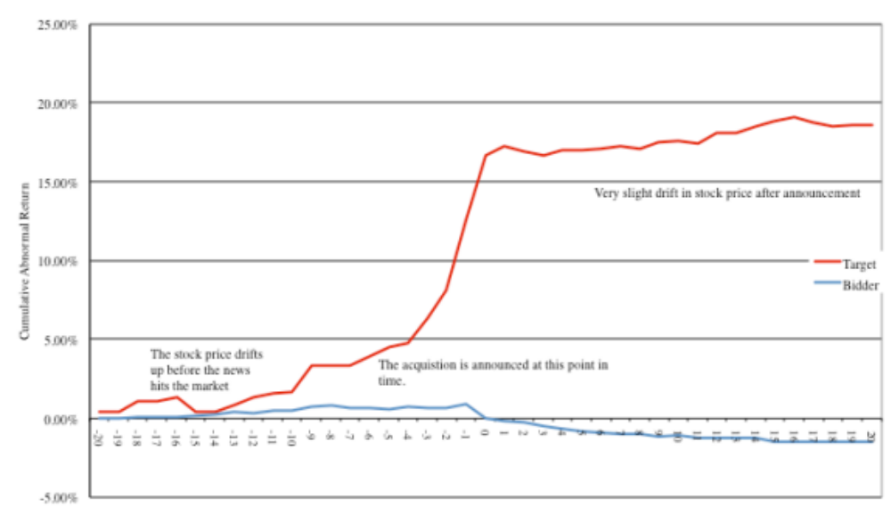
I. Acquisitions

Slide 3
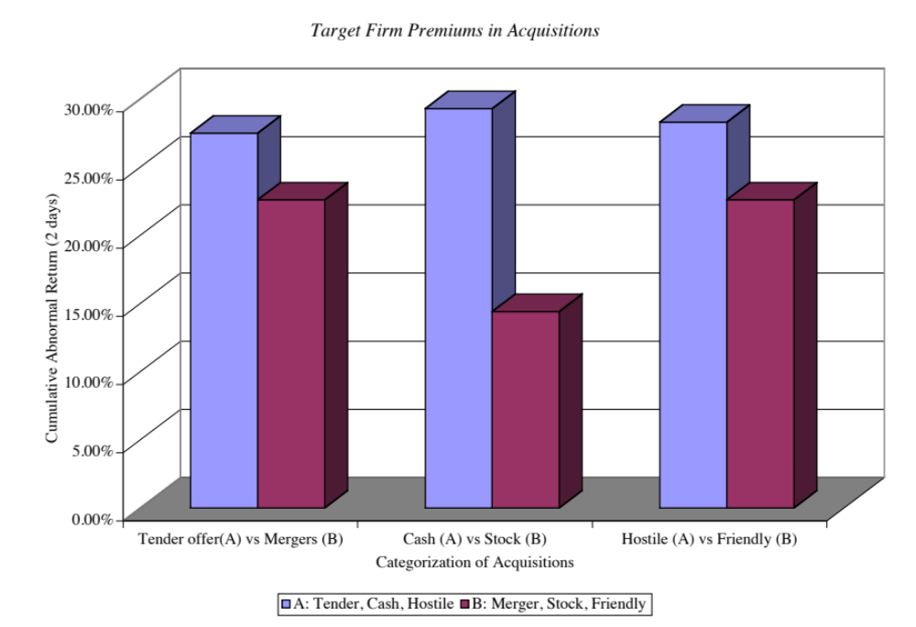
Across different types of acquisitions…

Slide 4
The Effect on Acquirers..
Mixed evidence on stock price effect: Jensen and Ruback report excess returns of 4% for bidding firm stockholders around tender offers and no excess returns around mergers. Jarrell, Brickley and Netter, in their examination of tender offers from 1962 to 1985, note a decline in excess returns to bidding firm stockholders from 4.4% in the 1960s to 2% in the 1970s to -1% in the 1980s.
Price drops for about half of all acquirers: Other studies indicate that approximately half of all bidding firms earn negative excess returns around the announcement of takeovers, suggesting that shareholders are skeptical about the perceived value of the takeover in a significant number of cases.

Slide 5
After the acquisition… Operating Evidence
Most acquisitions don’t pass basic financial tests: McKinsey and Co. examined 58 acquisition programs between 1972 and 1983 for evidence on two questions: (1) Did the return on the amount invested in the acquisitions exceed the cost of capital? (2) Did the acquisitions help the parent companies outperform the competition? They concluded that 28 of the 58 programs failed both tests, and six failed at least one test.
And earn negative excess returns: In a follow-up study of 115 mergers in the U.K. and the U.S. in the 1990s, McKinsey concluded that 60% of the transactions earned returns on capital less than the cost of capital, and that only 23% earned excess returns.
While delivering little or no synergy: In 1999, KPMG examined 700 of the most expensive deals between 1996 and 1998 and concluded that only 17% created value for the combined firm, 30% were value neutral and 53% destroyed value.

Slide 6
After the acquisition… Divestitures
Many get reversed: The most damaging piece of evidence on the outcome of acquisitions is the large number of acquisitions that are reversed within fairly short time periods. Mitchell and Lehn note that 20.2% of the acquisitions made between 1982 and 1986 were divested by 1988. In a study published in1992, Kaplan and Weisbach found that 44% of the mergers they studied were reversed, largely because the acquirer paid too much or because the operations of the two firms did not mesh.
Especially over longer time periods: Studies that have tracked acquisitions for longer time periods (ten years or more) have found the divestiture rate of acquisitions rises to almost 50%, suggesting that few firms enjoy the promised benefits from acquisitions do not occur. In another study,

Slide 7
Takeover based investment strategies
Invest in target firm prior to acquisition announcement: The first and most lucrative, if you can pull it off, is to find a way (legally) to invest in a target firm before the acquisition is announced.
Invest in either target or acquiring firm or both after acquisition is announced but before it is completed: The second is to wait until after the takeover is announced and then try to take advantage of the price drift between the announcement date and the day the deal is consummated. This is often called risk arbitrage.
Invest in “good” mergers and sell short on “bad” ones: The third is also a post-announcement strategy, but it is a long-term strategy where you invest in firms that you believe have the pieces in place to deliver the promised synergy or value creation.

Slide 8
Preannouncement Trading
Research indicates that the typical target firm in a hostile takeover has the following characteristics:
  It has under performed other stocks in its industry and the overall market, in terms of returns to its stockholders in the years preceding the takeover.
  It has been less profitable than firms in its industry in the years preceding the takeover.
  It has a much lower stock holding by insiders than do firms in its peer groups.
  It has a low price to book ratio & a low ratio of value to replacement cost.
There are two ways in which we can use the findings of these studies to identify potential target firms.
  Develop a set of screens that incorporate the variables mentioned above.
  The second and slightly more sophisticated variant is to estimate the probability of being taken over for every firm in the market using statistical techniques

Slide 9
Post-Announcement Trading
In this strategy, you buy companies after acquisitions or mergers are completed because you believe that they will be able to deliver what they promise at the time of the merger – higher earnings growth and synergy.
The likelihood of success seems to be greater
  In hostile acquisitions, where the management is replaced.
  In mergers of like businesses than in conglomerate mergers
  In cost-saving mergers than in growth-oriented mergers
  In mergers where plans for synergy are made before the merger
  In acquisitions of small, privately owned businesses by larger companies

Slide 10
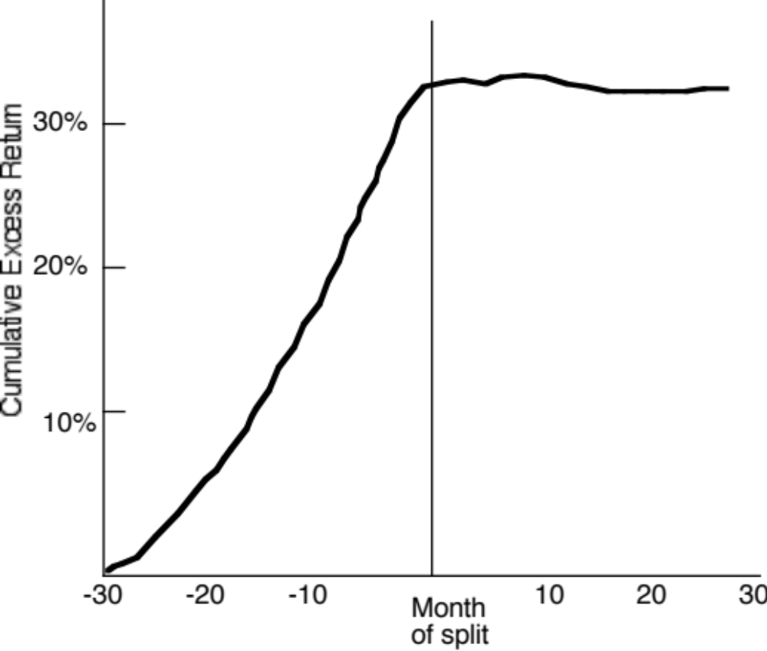
II. Stock Splits

Slide 11
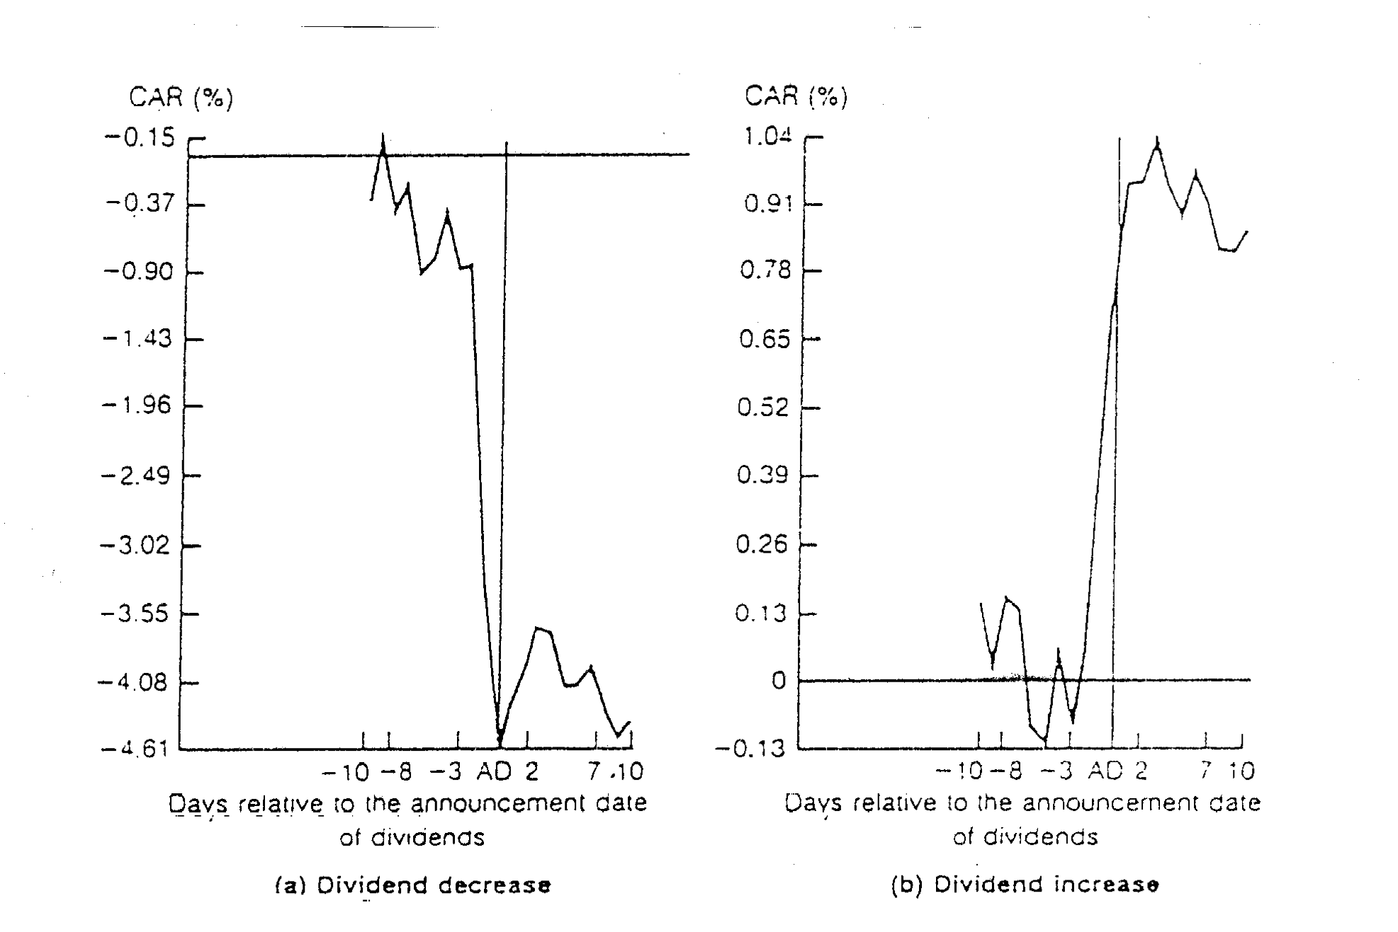
III. Dividend Changes

Slide 12
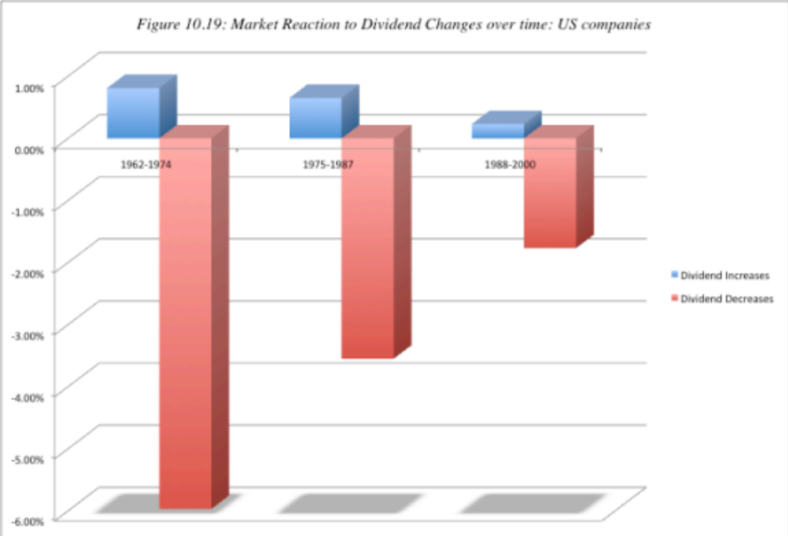
Have dividends become less informative?

Slide 13
Determinants of Success
Identify the information around which your strategy will be built: Since you have to trade on the announcement, it is critical that you determine in advance the information that will trigger a trade.
Invest in an information system that will deliver the information to you instantaneously: Many individual investors receive information with a time lag – 15 to 20 minutes after it reaches the trading floor and institutional investors.
Execute quickly: Getting an earnings report or an acquisition announcement in real time is of little use if it takes you 20 minutes to trade. Immediate execution of trades is essential to succeeding with this strategy.
Keep a tight lid on transactions costs: Speedy execution of trades usually goes with higher transactions costs, but these transactions costs can very easily wipe out any potential you may see for excess returns).
Know when to sell: Almost as critical as knowing when to buy is knowing when to sell, since the price effects of news releases may begin to fade or even reverse after a while.

