Slide 1
Too good to be true?
The Dream of Pure Arbitrage
Money machines?

Slide 2
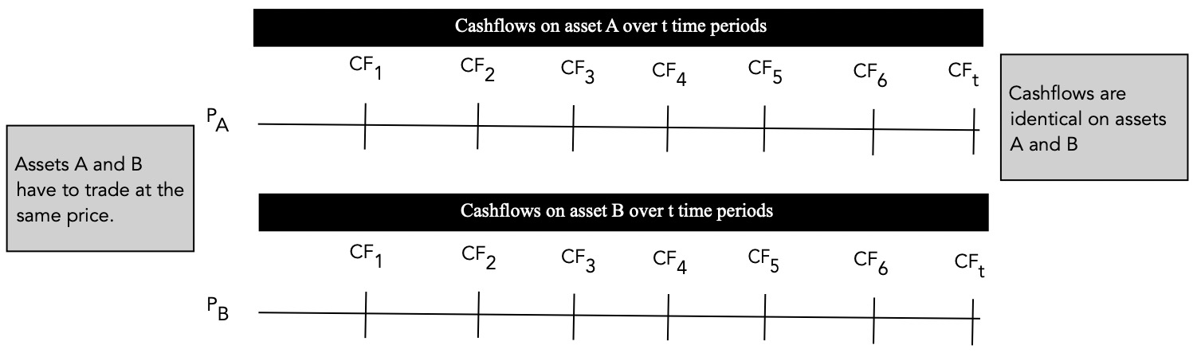
The Essence of arbitrage

Slide 3
Variants of Arbitrage
In pure arbitrage, you invest no money, take no risk and walk away with sure profits.
You can categorize arbitrage in the real world into three groups:
  Pure arbitrage, where, in fact, you risk nothing and earn more than the riskless rate.
  Near arbitrage, where you have assets that have identical or almost identical cash flows, trading at different prices, but there is no guarantee that the prices will converge and there exist significant constraints on the investors forcing convergence.
  Speculative arbitrage, which may not really be arbitrage in the first place. Here, investors take advantage of what they see as mispriced and similar (though not identical) assets, buying the cheaper one and selling the more expensive one.

Slide 4
Pure Arbitrage
For pure arbitrage, you have two assets with identical cashflows and different market prices makes pure arbitrage difficult to find in financial markets.
There are two reasons why pure arbitrage will be rare:
  Identical assets are not common in the real world, especially if you are an equity investor.
  Assuming two identical assets exist, you have to wonder why financial markets would allow pricing differences to persist.
If in addition, we add the constraint that there is a point in time where the market prices converge, it is not surprising that pure arbitrage is most likely to occur with derivative assets – options and futures and in fixed income markets, especially with default-free government bonds.

Slide 5
Futures Arbitrage
A futures contract is a contract to buy (and sell) a specified asset at a fixed price in a future time period.
The basic arbitrage relationship can be derived fairly easily for futures contracts on any asset, by estimating the cashflows on two strategies that deliver the same end result – the ownership of the asset at a fixed price in the future.
  In the first strategy, you buy the futures contract, wait until the end of the contract period and buy the underlying asset at the futures price.
  In the second strategy, you borrow the money and buy the underlying asset today and store it for the period of the futures contract.
In both strategies, you end up with the asset at the end of the period and are exposed to no price risk during the period – in the first, because you have locked in the futures price and in the second because you bought the asset at the start of the period.

Slide 6
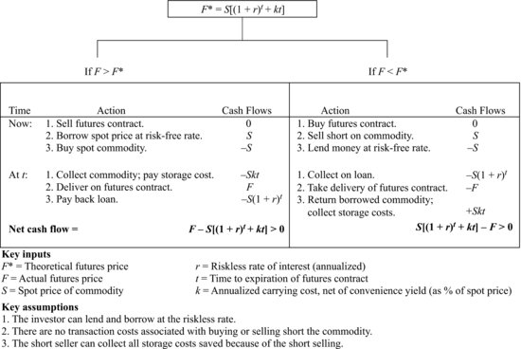
a. Storable Commodities

Slide 7
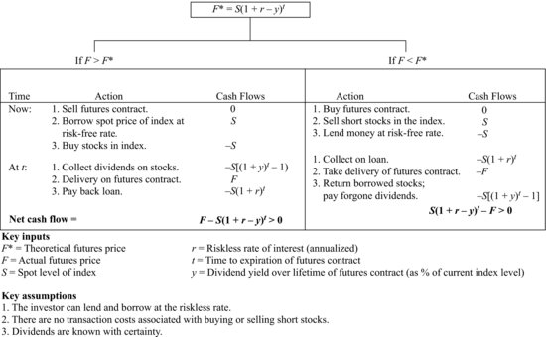
b. Stock Index Futures

Slide 8
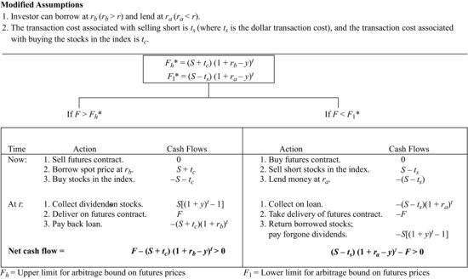
Stock Index futures with modified assumptions…

Slide 9
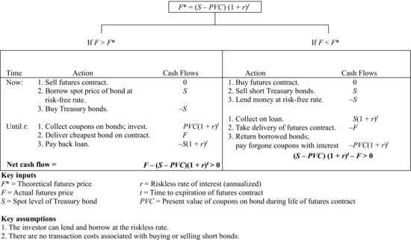
c. T. Bond Futures

Slide 10
d. Currency Futures
Forward Rate Mispricing | Actions to Take Today | Actions at Expiration of Futures Contract
If futures price > Spot price (1+ US $ rate – Swiss Franc rate) = $1.10 (1+.02-.01) = $1.1109 Example: If futures price = $1.12 | 1. Borrow the spot price ($1.10) in the U.S. domestic markets @ 2%. 2. Convert the $1.10 into a Swiss franc at spot price. 3. Invest the Swiss francs @ 1%. 4. Sell futures contract on Sfr for proceeds for Sfr investment @ $1.12 | 1. Collect 1.01 Sfr on Swiss franc investment. 2. Convert 1.01 Sfr into dollars at futures price of 1.12. 1.01 × 1.12 = 1.1312 3. Repay dollar borrowing with interest. 1.10 × 1.02 = $1.1220 Profit = $1,1312– $1.220 = $0.0090
If futures price < Spot price (1+ US $ rate – Swiss Franc rate) = $1.10 (1+.02-.01) = $1.1109 Example: If futures price = $1.105 | 1. Borrow a Swiss franc @ 1%. 2. Convert the Swiss franc into dollars at spot rate of $1.10. 3. Invest $1.10 in the U.S. market @ 2%. 4. Buy a futures contract on Sfr for proceeds on U.S. $ investment @ 1.105. | 1. Collect on dollar investment. $1.10 × 1.02 = $1.122 2. Convert $1.122 into Swiss francs at futures price of $1.105. $1.122/1.105 $/Sfr = 1.0154 Sfr 3. Repay Sfr borrowing with interest. 1×1.01 = 1.01 Sfr Profit = 1.0154 Sfr – 1.01 Sfr = 0.0054 Sfr
Notes:
1

Slide 11
Feasibility of Futures Arbitrage
In the commodity futures market, for instance, Garbade and Silber (1983) find little evidence of arbitrage opportunities and their findings are echoed in other studies. In the financial futures markets, there is evidence that indicates that arbitrage is indeed feasible but only to a sub-set of investors.
Note, though, that the returns are small even to these large investors and that arbitrage will not be a reliable source of profits, unless you can establish a competitive advantage on one of three dimensions.
  You can try to establish a transactions cost advantage over other investors, which will be difficult to do since you are competing with other large institutional investors.
  You may be able to develop an information advantage over other investors by having access to information earlier than others. Again, though much of the information is pricing information and is public.
  You may find a quirk in the data or pricing of a particular futures contract before others learn about it.

Slide 12
Options Arbitrage
Options represent rights rather than obligations – calls gives you the right to buy and puts gives you the right to sell. Consequently, a key feature of options is that the losses on an option position are limited to what you paid for the option, if you are a buyer.
Since there is usually an underlying asset that is traded, you can, as with futures contracts, construct positions that essentially are riskfree by combining options with the underlying asset.

Slide 13
1. Exercise Arbitrage
The easiest arbitrage opportunities in the option market exist when options violate simple pricing bounds. No option, for instance, should sell for less than its exercise value.
  With a call option: Value of call > Value of Underlying Asset – Strike Price
  With a put option: Value of put > Strike Price – Value of Underlying Asset
You can tighten these bounds for call options, if you are willing to create a portfolio of the underlying asset and the option and hold it through the option’s expiration. The bounds then become:
  With a call option: Value of call > Value of Underlying Asset – Present value of Strike Price
  With a put option: Value of put > Present value of Strike Price – Value of Underlying Asset

Slide 14
2. Pricing Arbitrage (Replication)
A portfolio composed of the underlying asset and the riskless asset could be constructed to have exactly the same cash flows as a call or put option. This portfolio is called the replicating portfolio.
Since the replicating portfolio and the traded option have the same cash flows, they would have to sell at the same price.
If they do not, you can buy the cheaper one and sell the more expensive one, effectively locking in the profits, with no risk involved.

Slide 15
3a. Arbitrage Across Options:
Put-Call Parity
You can create a riskless position by selling the call, buying the put and buying the underlying asset at the same time.
Since this position yields K with certainty, the cost of creating this position must be equal to the present value of K at the riskless rate (K e-rt).
S+P-C = K e-rt
C - P = S - K e-rt
Position | Payoffs at t if S*>K | Payoffs at t if S*<K
Sell call | -(S*-K) | 0
Buy put | 0 | K-S*
Buy stock | S* | S*
Total | K | K

Slide 16
3b. Mispricing across strike prices and maturities
Strike Prices: A call with a lower strike price should never sell for less than a call with a higher strike price, assuming that they both have the same maturity. If it did, you could buy the lower strike price call and sell the higher strike price call, and lock in a riskless profit.
Maturity: A call (put) with a shorter time to expiration should never sell for more than a call (put) with the same strike price with a long time to expiration. If it did, you would buy the call (put) with the shorter maturity and sell the call (put) with the longer maturity (i.e, create a calendar spread) and lock in a profit today.

Slide 17
Fixed Income Arbitrage
Fixed income securities lend themselves to arbitrage more easily than equity because they have finite lives and fixed cash flows. This is especially so, when you have default free bonds, where the fixed cash flows are also guaranteed.
For instance, you could replicate a 10-year treasury bond’s cash flows by buying zero-coupon treasuries with expirations matching those of the coupon payment dates on the treasury bond.
With corporate bonds, you have the extra component of default risk. Since no two firms are exactly identical when it comes to default risk, you may be exposed to some risk if you are using corporate bonds issued by different entities.

Slide 18
Does fixed income arbitrage pay?
Grinblatt and Longstaff, in an assessment of the treasury strips program – a program allowing investors to break up a treasury bond and sell its individual cash flows – note that there are potential arbitrage opportunities in these markets but find little evidence of trading driven by these opportunities.
A study by Balbas and Lopez of the Spanish bond market examined default free and option free bonds in the Spanish market between 1994 and 1998 and concluded that there were arbitrage opportunities especially surrounding innovations in financial markets.
The opportunities for arbitrage with fixed income securities are probably greatest when new types of bonds are introduced – mortgage backed securities in the early 1980s, inflation- indexed treasuries in the late 1990s and the treasury strips program in the late 1980s. As investors become more informed about these bonds and how they should be priced, arbitrage opportunities seem to subside.

Slide 19
Determinants of Success at Pure Arbitrage
The nature of pure arbitrage – two identical assets that are priced differently – makes it likely that it will be short lived. In other words, in a market where investors are on the look out for riskless profits, it is very likely that small pricing differences will be exploited quickly, and in the process, disappear. Consequently, the first two requirements for success at pure arbitrage are access to real-time prices and instantaneous execution.
It is also very likely that the pricing differences in pure arbitrage will be very small – often a few hundredths of a percent. To make pure arbitrage feasible, therefore, you can add two more conditions.
  The first is access to substantial debt at favorable interest rates, since it can magnify the small pricing differences. Note that many of the arbitrage positions require you to be able to borrow at the riskless rate.
  The second is economies of scale, with transactions amounting to millions of dollars rather than thousands.

