Slide 1
Close Enough? Near Arbitrage
Not quite riskless, but…

Slide 2
Near Arbitrage
In near arbitrage, you either have two assets that are very similar but not identical, which are priced differently, or identical assets that are mispriced, but with no guaranteed price convergence.
No matter how sophisticated your trading strategies may be in these scenarios, your positions will no longer be riskless.

Slide 3
1. Same Stock listed in Multiple Markets
If you can buy the same stock at one price in one market and simultaneously sell it at a higher price in another market, you can lock in a riskless profit.
There are two scenarios where this can happen:
  Dual or Multiple listed stocks, where the same security is listed and traded on two or more exchanges.
  Depository receipts, where foreign stocks are traded on the US exchanges.

Slide 4
a. Dual Listed Stocks
Many large companies trade on multiple markets on different continents.
Since there are time periods during the day when there is trading occurring on more than one market on the same stock, it is conceivable (though not likely) that you could buy the stock for one price in one market and sell the same stock at the same time for a different (and higher price) in another market.
The stock will trade in different currencies, and for this to be a riskless transaction, the trades have to at precisely the same time and you have to eliminate any exchange rate risk by converting the foreign currency proceeds into the domestic currency instantaneously.
Your trade profits will also have to cover the different bid-ask spreads in the two markets and transactions costs in each.

Slide 5
Evidence of Mispricing?
It exists on smaller and less liquid exchanges: Swaicki and Hric examine 84 Czech stocks that trade on the two Czech exchanges – the Prague Stock Exchange (PSE) and the Registration Places System (RMS)- and find that prices adjust slowly across the two markets, and that arbitrage opportunities exist (at least on paper) –the prices in the two markets differ by about 2%. These arbitrage opportunities seem to increase for less liquid stocks.
But it is tough to exploit: While the authors consider transactions cost, they do not consider the price impact that trading itself would have on these stocks and whether the arbitrage profits would survive the trading.

Slide 6
b. Depository Receipts
Depository receipts create a claim equivalent to the one you would have had if you had bought shares in the local market and should therefore trade at a price consistent with the local shares.
  What makes them different and potentially riskier than the stocks with dual listings is that ADRs are not always directly comparable to the common shares traded locally – one ADR on Telmex, the Mexican telecommunications company, is convertible into 20 Telmex shares.
  In addition, converting an ADR into local shares can be both costly and time consuming. In some cases, there can be differences in voting rights as well.
In spite of these constraints, you would expect the price of an ADR to closely track the price of the shares in the local market, albeit with a currency overlay, since ADRs are denominated in dollars.

Slide 7
Evidence on Pricing
Mispricing happens: A study conducted in 2000 that looks at the link between ADRs and local shares finds that about 60 to 70% of the variation in ADR prices can be attributed to movements in the underlying share prices and that ADRs overreact to the U.S. market and under react to exchange rates and the underlying stock.
Convergence may not happen: They also conclude that investors cannot take advantage of the pricing errors in ADRs because convergence does not occur quickly or in predictable ways.
Time horizon matters: With a longer time horizon and/or the capacity to convert ADRs into local shares, though, you should be able to take advantage of significant pricing differences.

Slide 8
2. Closed End Funds
Closed end mutual funds differ from other mutual funds in one very important respect. They have a fixed number of shares that trade in the market like other publicly traded companies, and the market price can be different from the net asset value.
If they trade at a price that is lower than the net asset value of the securities that they own, there should be potential for arbitrage.
In theory, you could buy closed end funds at their market prices and liquidate the stocks they own, claiming the difference.

Slide 9
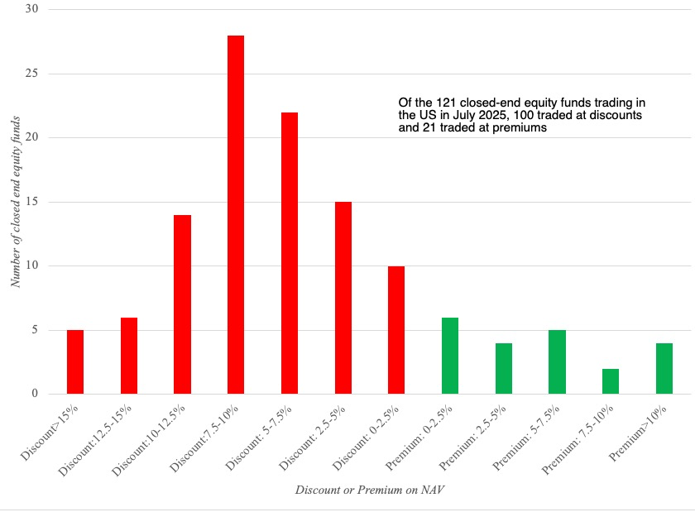
Discounts and Premiums on Closed End Funds

Slide 10
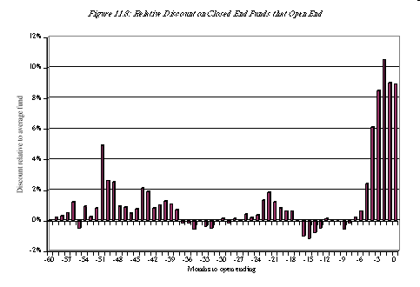
Closed end funds that open end…

Slide 11
What is the catch?
Governance/Control issues: In practice, taking over a closed-end fund while paying less than net asset value for its shares seems to be very difficult to do for several reasons- some related to corporate governance and some related to market liquidity.
Liquidity and taxes: The potential profit is also narrowed by the mispricing of illiquid assets in closed end fund portfolios (leading to an overstatement of the NAV) and tax liabilities from liquidating securities. There have been a few cases of closed end funds being liquidated, but they remain the exception.

Slide 12
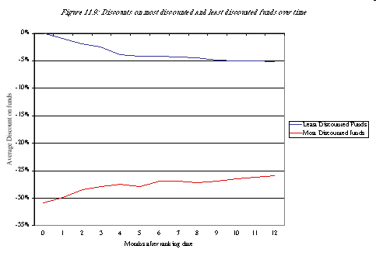
An Investment Strategy of buying discounted funds…

Slide 13
Holding company and conglomerate discounts
Since holding companies are often traded, and many of the subsidiaries are also listed, there are two estimates that you can arrive at for the market value of the holding company:
  The holding company’s listed value in the market can be viewed as the value that investors attach to the equity in the holding com, which with the debt owed and cash held by the holding company can be used to estimate an enterprise value for the holding company.
  Alternatively, you can obtain the market values of each of the holdings, assuming that they are all traded, to estimate a bottom-up enterprise value for the holding company.
While you may expect to arrive at roughly the same enterprise value from the two processes, it turns out that the former yields a much lower value than the latter, and this discount has been named the holding company discount.

Slide 14
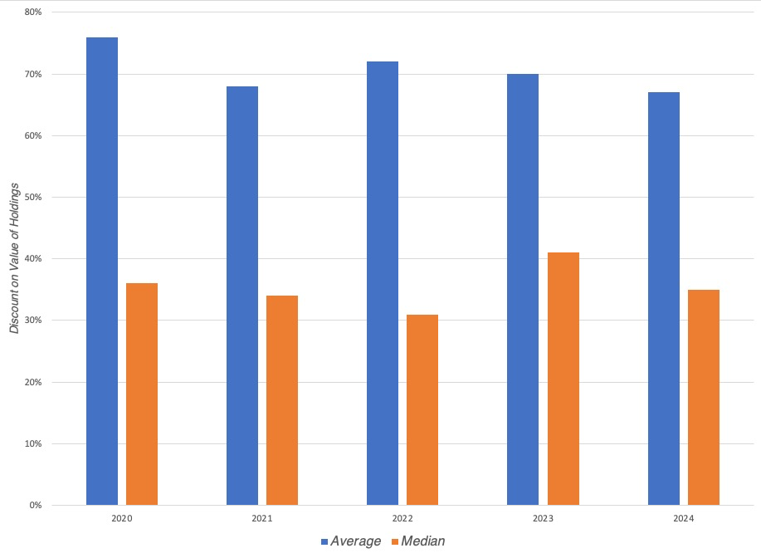
Indian holding company discounts..

Slide 15
Reasons for the discount
Market mistakes: When a holding company is composed of dozens of cross holdings, with connections and intra company business, it is possible that markets may be making mistakes in the aggregation.
Contaminated Parts: In some cases, a holding company may have a holding in a subsidiary with actual, perceived, or potential liabilities that are so large that they drag down the valuations of the holding company.
The efficiency story: Studies over the last three decades suggests that this optimism was misplaced and that conglomerates are often less efficient than competitors, earning lower returns and profit margins.
The simplicity story: Valuing multi-business companies is more difficult that valuing a focused business, and how to do a true sum of the parts valuation
The tax story: When tax codes are complex (and when are they not?), there may be times when a holding company pays more in taxes on the income generated by its subsidiaries than would have been paid without the holding company structure.
Corporate governance: To the extent that investors mistrust these managers/family group members to not put their interests over shareholder interests, you will see discounts at the holding company level

Slide 16
Unlock the holding company discount?
In the first, the holding company structure stays intact, but the discount decreases over time, either because of a market cycle, or because the reason keeping the discount large dissipates over time. Thus, if the discount is cause by mistrust of the managers running the holding company, a change in top management may be sufficient to reduce the mistrust and the discount. This is more likely to happen when the discount is caused by market perception or misunderstanding and not by operating or tax concerns.
In the second, the holding company unlocks the discount with an action, by divesting or spinning off its subsidiary holdings, and if that act alone does not remove the discount, by returning the cash from the divestitures to shareholders.
In the third, an activist investor takes effective control of the holding company and essentially unravels the holding structure and captures the discount as a profit.

Slide 17
And potential costs..
Illiquidity: To the extent that some or many of the subsidiaries owned by a holding company are not traded, or even if traded, not liquid, the very act of selling your holdings may result in a pricing markdown that will eat into your expected profits.
Taxes: When you liquidate holdings that you have held for long periods, it is likely that there will be tax consequences, taking the form of taxable profits and capital gains taxes.
Corporate governance barriers: Holding company structures are designed to preserve the power of families or managers, and to the extent that they prize power over profits, they will fight any attempts at breaking those structures, with compliant boards and corporate charter provisions that make it difficult for shareholders to create change.

Slide 18
3. Convertible Arbitrage
When companies have convertible bonds or convertible preferred stock outstanding in conjunction with common stock, warrants, preferred stock and conventional bonds, it is entirely possible that you could find one of these securities mispriced relative to the other, and be able to construct a near-riskless strategy by combining two or more of the securities in a portfolio.
In practice, there are several possible impediments.
  Many firms that issue convertible bonds do not have straight bonds outstanding, and you have to substitute in a straight bond issued by a company with similar default risk.
  Companies can force conversion of convertible bonds, which can wreak havoc on arbitrage positions.
  Convertible bonds have long maturities. Thus, there may be no convergence for long periods, and you have to be able to maintain the arbitrage position over these periods.
  Transactions costs and execution problems (associated with trading the different securities) may prevent arbitrage.

Slide 19
Determinants of Success at Near Arbitrage
You need capital: These strategies will not work for small investors or for very large investors. Small investors will be stymied both by transactions costs and execution problems. Very large investors will quickly drive discounts to parity and eliminate excess returns.
Convergence tactics: If you decide to adopt these strategies, you need to refine and focus your strategies on those opportunities where convergence is most likely.
Catalysts: It helps if you can provide the catalyst to make convergence happen.

