Slide 1
Understanding Risk II: The risk in bonds
Bonds are safe, right?

Slide 2
The risk in bonds
If you buy a conventional bond, you are promised fixed payments (coupons) in the future and the face value of the bond at maturity.
You face two risks while you hold the bond:
  Interest rate risk, where changes in market interest rates affect the value of your fixed payments.
  Default risk, where the entity that promised the fixed payments is unable to deliver.

Slide 3
1. Interest rate risk
The coupons and face value are fixed at the time of issue for bonds, but the value of these coupons can vary over time, even if they are guaranteed.
  If interest rates change after a bond has been issued, the value of these guaranteed cash flows will change.
  Thus, if interest rates go up (down), the present value of the cash flows (the price of the bond) will go down (up).

Slide 4
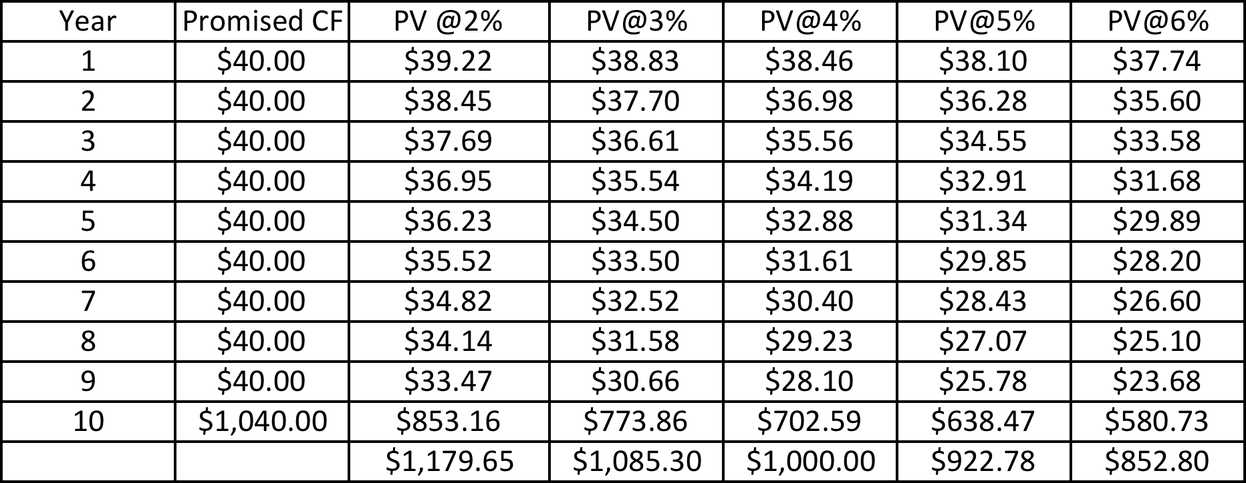
A simple example: The price of 4%, 10-year coupon bond

Slide 5
Measuring Interest rate risk
There are two factors that determine how exposed a bond is to interest rate risk.
  The level of coupons on the bond: Higher coupon bonds are less exposed to interest rate risk that lower coupon bonds.
  The maturity of the bond: Longer maturity bonds are more exposed to interest rate risk than shorter maturity bonds.
The “duration” of a bond is a composite measure of interest rate risk that incorporates both the magnitude of the coupons and the maturity of the bond. The higher the duration of a bond, the more sensitive it is to interest rate movements.

Slide 6
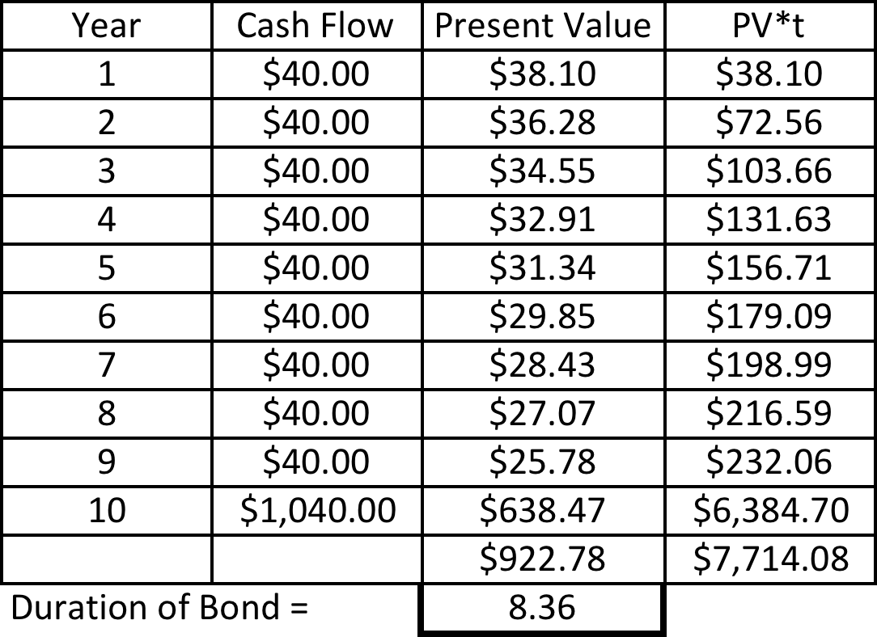
Duration: Example

Slide 7
2. Default Risk
When you buy a bond, you are promised a fixed payment (the interest rate on the bond) by the entity issuing the bond. If there is risk that the entity will default:
  The best-case scenario for you is that you receive that fixed payment.
  The worse case scenarios have a much wider range, with the worst-case scenario being that you do not receive any of your promised cash flows.
Since the potential for upside is limited and for downside is very large, we measure risk in bonds by looking at the downside or default risk.

Slide 8
Determinants of Default Risk
Capacity to generate cashflows from operations: The larger the cashflows that you generate from operations, the lower your default risk should be.
Volatility in these cashflows: The more predictable your cashflows are, the lower your default risk should be.
Other fixed Commitments: The larger your commitments (interest and principal payments), relative to your operating cashflows, the greater is your default risk.

Slide 9
Measuring Default Risk
Credit Risk Scores: For as long as institutions and individuals have been lending money, they have been using both qualitative and quantitative factors to measure the credit risk of borrowers.
Bond Ratings: Publicly traded companies that desire to access the bond market (where individual investors may lack the resources and the incentives to measure default risk on their own) have been rated by ratings agencies.
Credit Default Swaps: There is a subset of companies where you can buy insurance against default, and the price you pay is measured in annual terms, in the credit default swap (CDS) market.

Slide 10
And charging for default risk

Slide 11
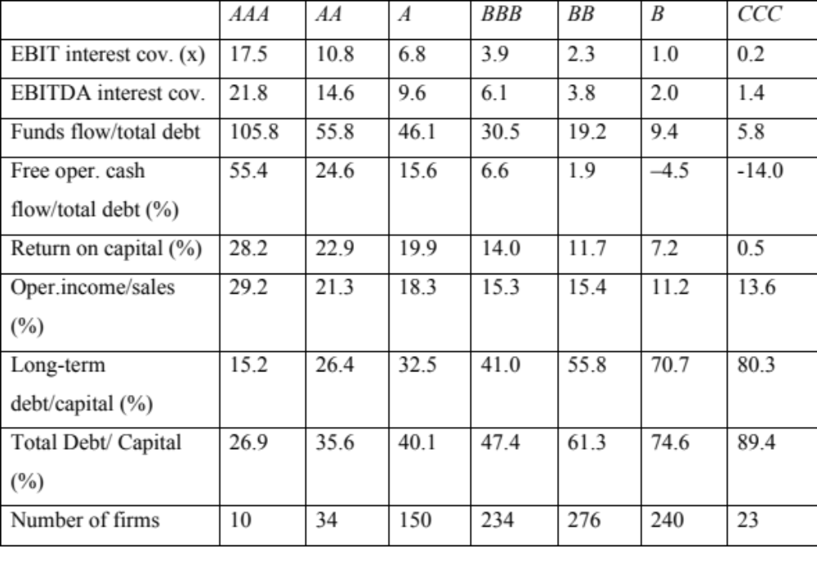
Ratings and Financial Ratios: What Ratings agencies look at..

Slide 12
Estimating Synthetic Ratings
The rating for a firm can be estimated using the financial characteristics of the firm. In its simplest form, the rating can be estimated from the interest coverage ratio
Interest Coverage Ratio = EBIT / Interest Expenses
For a firm, which has earnings before interest and taxes of $ 3,500 million and interest expenses of $ 700 million
Interest Coverage Ratio = 3,500/700= 5.00
  Based upon the relationship between interest coverage ratios and ratings, we would estimate a rating of A for the firm.
Notes:
This is simplistic. A more realistic approach would use more than the interest coverage ratio. In fact, we could construct a score based upon multiple ratios (such as a Z-score) and use that score to estimate ratings.

Slide 13
Synthetic Ratings and Default Spreads
Market cap > $ 5 billion
Market cap < $ 5 billion
Interest Coverage is
> | ≤ to | Rating is | Spread is
8.50 | 100000 | Aaa/AAA | 0.54%
6.5 | 8.499999 | Aa2/AA | 0.72%
5.5 | 6.499999 | A1/A+ | 0.90%
4.25 | 5.499999 | A2/A | 0.99%
3 | 4.249999 | A3/A- | 1.13%
2.5 | 2.999999 | Baa2/BBB | 1.27%
2.25 | 2.49999 | Ba1/BB+ | 1.98%
2 | 2.2499999 | Ba2/BB | 2.38%
1.75 | 1.999999 | B1/B+ | 2.98%
1.5 | 1.749999 | B2/B | 3.57%
1.25 | 1.499999 | B3/B- | 4.37%
0.8 | 1.249999 | Caa/CCC | 8.64%
0.65 | 0.799999 | Ca2/CC | 10.63%
0.2 | 0.649999 | C2/C | 13.95%
-100000 | 0.199999 | D2/D | 18.60%
Interest Coverage is
greater than | ≤ to | Rating is | Spread is
12.5 | 100000 | Aaa/AAA | 0.54%
9.5 | 12.499999 | Aa2/AA | 0.72%
7.5 | 9.499999 | A1/A+ | 0.90%
6 | 7.499999 | A2/A | 0.99%
4.5 | 5.999999 | A3/A- | 1.13%
4 | 4.499999 | Baa2/BBB | 1.27%
3.5 | 3.9999999 | Ba1/BB+ | 1.98%
3 | 3.499999 | Ba2/BB | 2.38%
2.5 | 2.999999 | B1/B+ | 2.98%
2 | 2.499999 | B2/B | 3.57%
1.5 | 1.999999 | B3/B- | 4.37%
1.25 | 1.499999 | Caa/CCC | 8.64%
0.8 | 1.249999 | Ca2/CC | 10.63%
0.5 | 0.799999 | C2/C | 13.95%
-100000 | 0.499999 | D2/D | 18.60%

Slide 14
Bonds: The Bottom Line
Proposition 1: While bonds are often described as safe investments, they can vary in safety widely, depending upon the way they are structured (maturity and coupon) and default risk.
Proposition 2: Your perceived risk in a bond can depend upon your time horizon as an investor. Thus, a bond with no default risk can still be risky to a short-term investor, when interest rates are volatile.

