Slide 1
Dreaming the impossible dream?
Market Timing
The Promise and the Peril of Market Forecasting!

Slide 2
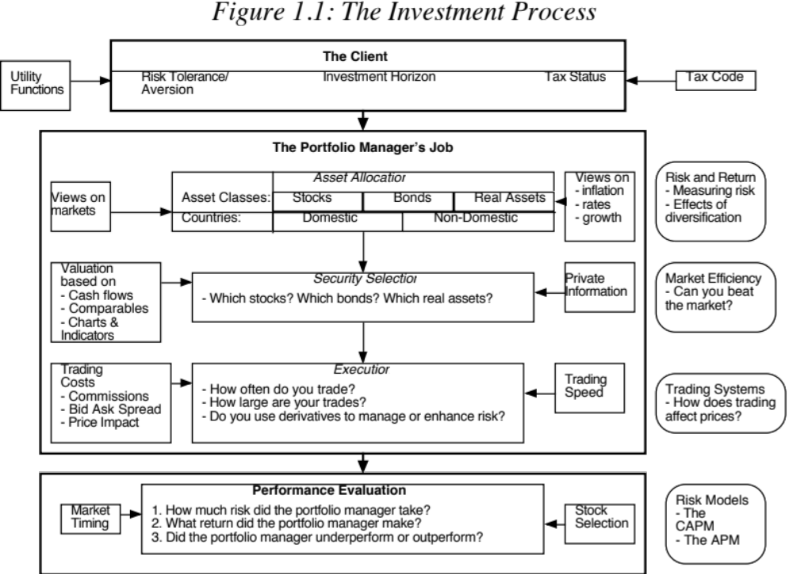

Slide 3
The essence of market timing: Asset allocation
With market timing, the focus shifts away from asset selection (which is at the heart of every other investment philosophy) to asset allocation.
Rather than allocate your portfolio across asset classes based upon your risk aversion and cash needs, you use your views about markets to determine what asset classes to hold.
In its broadest version, market timing is about timing stock, bond and real asset markets, and within each market, making further timing judgments about
  Geography
  Sector

Slide 4
The Payoff to Market Timing: It explains differences in returns
Asset allocation dominates stock picking: In a 1986 article, a group of researchers raised the shackles of many an active portfolio manager by estimating that as much as 93.6% of the variation in quarterly performance at professionally managed portfolios could be explained by the mix of stocks, bonds and cash at these portfolios.
And explains more of the returns: Ibbotson examined the relative importance of asset allocation and security selection of 94 balanced mutual funds and 58 pension funds, all of which had to make both asset allocation and security selection decisions. Using ten years of data through 1998, Ibbotson finds that about 40% of the differences in returns across funds can be explained by their asset allocation decisions and 60% by security selection.

Slide 5
The allure of market timing
Huge payoff: If you can time markets well, your payoff will be immense. The returns to being in markets, only in the good times, and out of markets, in bad times, vastly outweighs the return that you can make from picking individual assets.
Looks easy (in hindsight): Investors suffer from hindsight bias. Looking back, they are convinced that they had the capacity, if only they had exploited it, to time markets.
And there are indicators that work (again in hindsight): Looking back, you can always find indicators that provided advance notice of what was coming, and you will be tempted to use those indicators again.
Notes:
,

Slide 6
Stock Market Timing: The upside
Just avoid bad days: Returns on stocks seem to be concentrated on a few days of the market each year. Put simply, if you can avoid the ten worst days of the market each year, you can almost double your returns.
  In a study in 1992, Shilling examined the effect on your annual returns of being able to stay out of the market during bad months. He concluded that an investor who would have missed the 50 weakest months of the market between 1946 and 1991 would have seen his annual returns almost double from 11.2% to 19%.
  Other studies reinforce this finding. Skipping the worst days (weeks, years) can supercharge your returns.
Out of bubbles: And if you can stay out of the worst of bear markets, your portfolio returns get even better.

Slide 7
The Cost of Stock Market Timing
Out at the wrong time: In the process of switching from stocks to cash and back, you may miss the best days of the market. Just as staying out on the ten worst days of the market each year can double your returns, being out of the market on the ten best days can halve your returns.
Transactions Costs: These studies do not consider the additional transactions costs that inevitably flow from market timing strategies, since you will trade far more extensively with these strategies. At the limit, a stock/cash switching strategy will mean that you will have to liquidate your entire equity portfolio if you decide to switch into cash and start from scratch again the next time you want to be in stocks.
Taxes: A market timing strategy will also increase your potential tax liabilities. You will have to pay capital gains taxes when you sell your stocks, and over your lifetime as an investor, you will pay far more in taxes.

Slide 8
Timing other markets: Is it easier?
Bond market timing: There are some who argue that it should be easier to time bond markets since all you have to do is forecast the direction of interest rates and looking back over time, there seems to be strong mean reversion to a normal interest rate.
Real estate timing: Real estate also moves in long cycles of boom and bust, and timing it looks easier that timing the stock market.
Collectibles and other assets: Timing yields immense payoffs, and with crypto it is visible.
Again, hindsight is 20/20 and timing these markets can be stymied by
  Shifting fundamentals
  Unpredictable cycles
  Higher transactions costs

Slide 9
Market Timing Approaches
Non-financial indicators, which can range the spectrum from the absurd to the reasonable.
Technical indicators, such as price charts and trading volume.
Mean reversion indicators, where stocks and bonds are viewed as mispriced if they trade outside what is viewed as a normal range.
Macro economic variables, such as the level of interest rates or the state of the economy.
Intrinsic valuation, where you use fundamentals to determine whether stocks are cheap/expensive, interest rates should decline/increase and real assets are headed up/down.

