Slide 1
Market Timing Approaches: Mean Reversion and Macro Fundamentals
Interest rates and the Economy…

Slide 2
I. Mean Reversion Measures
These approaches are based upon the assumption that assets have a normal range that they trade at, and that any deviation from the normal range is an indication that assets are mispriced.
  With stocks, the normal range is defined in terms of PE ratios.
  With bonds, the normal range is defined in terms of interest rates and default spreads (for corporate bonds).

Slide 3
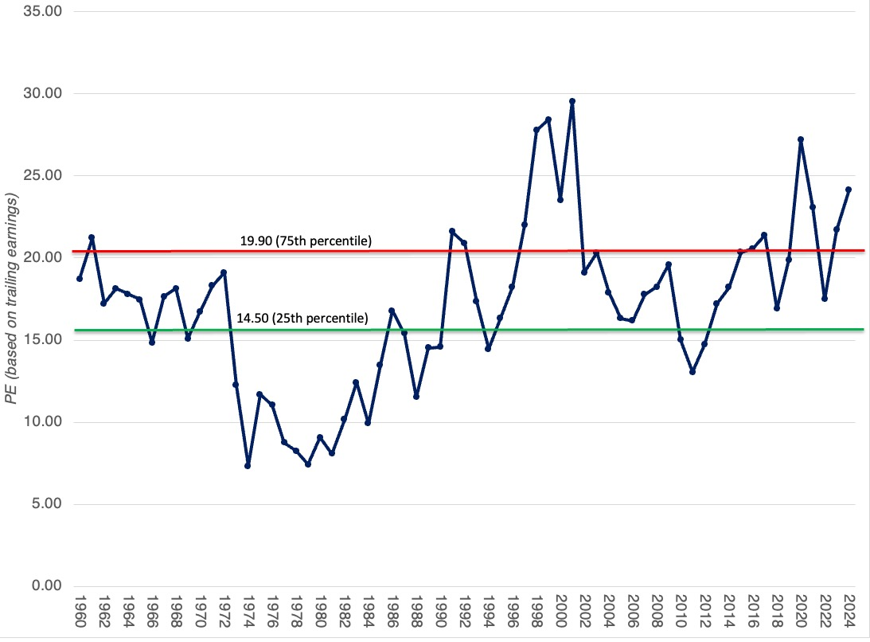
1a. A Normal Range of PE Ratios

Slide 4
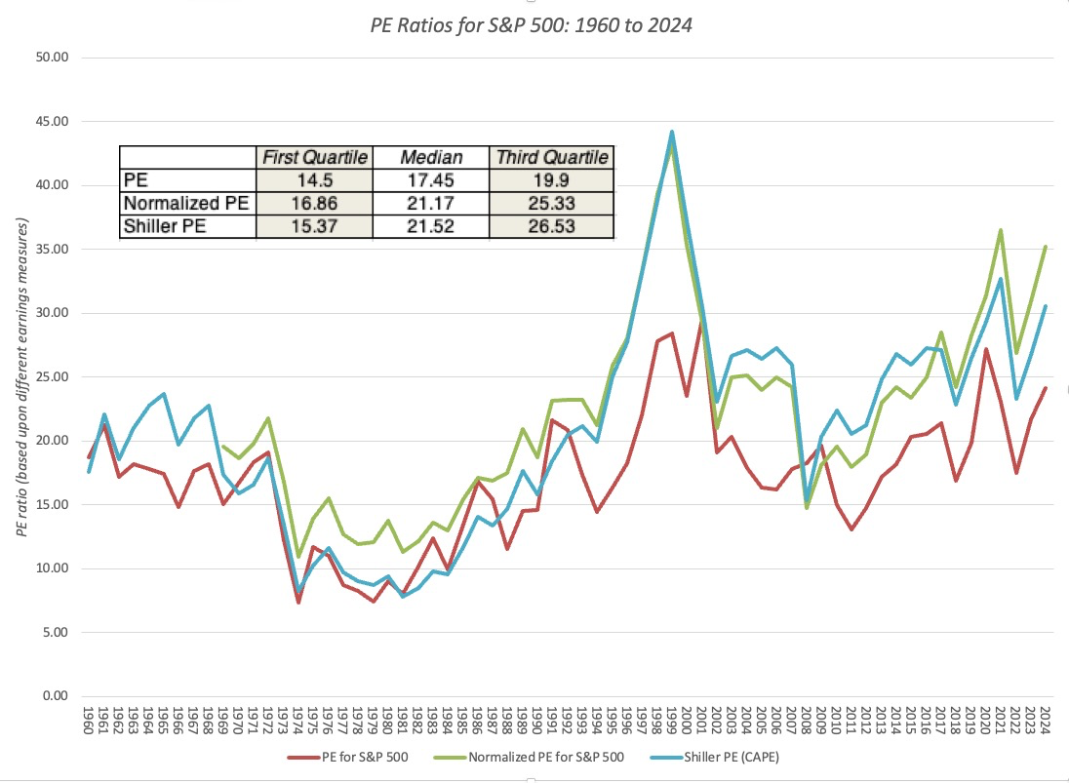
And Shiller PE ratios…

Slide 5
1B. A normal range for interest rates…

Slide 6
II. Fundamentals
The simplest way to use fundamentals is to focus on macroeconomic variables such as interest rates, inflation and GDP growth and devise investing rules based upon the levels or changes in macro economic variables.
Over time, a number of rules of thumb have been devised that relate stock returns to the level of interest rates or the strength of the economy. For instance, we are often told that it is best to buy stocks when
  Interest rates are dropping
  Interest rate are low
  When the yield curve is upward sloping
  GDP growth is strong

Slide 7
1. Treasury Bill Rates: Should you buy stocks when the T.Bill rate is low?
 |  | Stock returns in following year
Change in T.Bill Rate | Number of years | % of up years | Average Annual returns
Drop by more than 1% | 16 | 68.75% | 9.14%
Drop between 0 and 1% | 27 | 85.19% | 18.40%
Increase between 0 and 1% | 35 | 71.43% | 9.84%
Increase more than 1% | 18 | 61.11% | 6.25%

Slide 8
More on interest rates and stock prices…
A 1989 study by Breen, Glosten and Jagannathan evaluated a strategy of switching from stock to cash and vice versa, depending upon the level of the treasury bill rate and conclude that such a strategy would have added about 2% in excess returns to an actively managed portfolio.
In a 2002 study that does raise cautionary notes about this strategy, Abhyankar and Davies examine the correlation between treasury bill rates and stock market returns in sub-periods from 1929 to 2000.
  They find that almost all of the predictability of stock market returns comes from the 1950-1975 time period, and that short term rates have had almost no predictive power since 1975.
  They also conclude that short rates have more predictive power with the durable goods sector and with smaller companies than they do with the entire market.

Slide 9
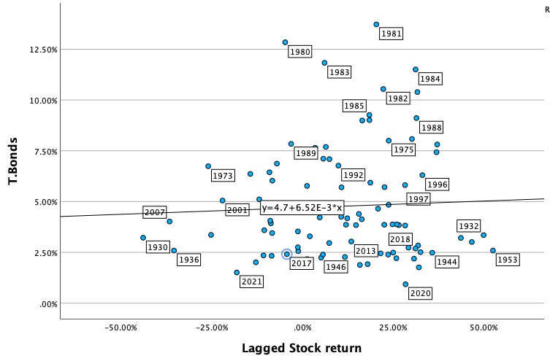
2. Level of T. Bond Rates
By itself, the level of the T.Bond rate at the start of the period seems to provide no indication of how stocks will do during the period.

Slide 10
when the earnings yield is high, relative to the T.Bond rate (The Fed Model)…
 |  | Stock Returns
Earnings yield - T.Bond Rate | Number of years | Average | Standard Deviation | Maximum | Minimum
> 2% | 21 | 13.85% | 13.74% | 32.15% | -11.81%
1 -2% | 12 | 0.08% | 20.30% | 26.38% | -38.49%
0-1% | 4 | 18.62% | 7.09% | 26.06% | 8.99%
-1-0% | 7 | 13.33% | 13.07% | 27.25% | -11.36%
-2-1% | 16 | 7.74% | 18.69% | 34.11% | -23.37%
< -2% | 5 | 3.04% | 8.40% | 12.40% | -10.14%

Slide 11
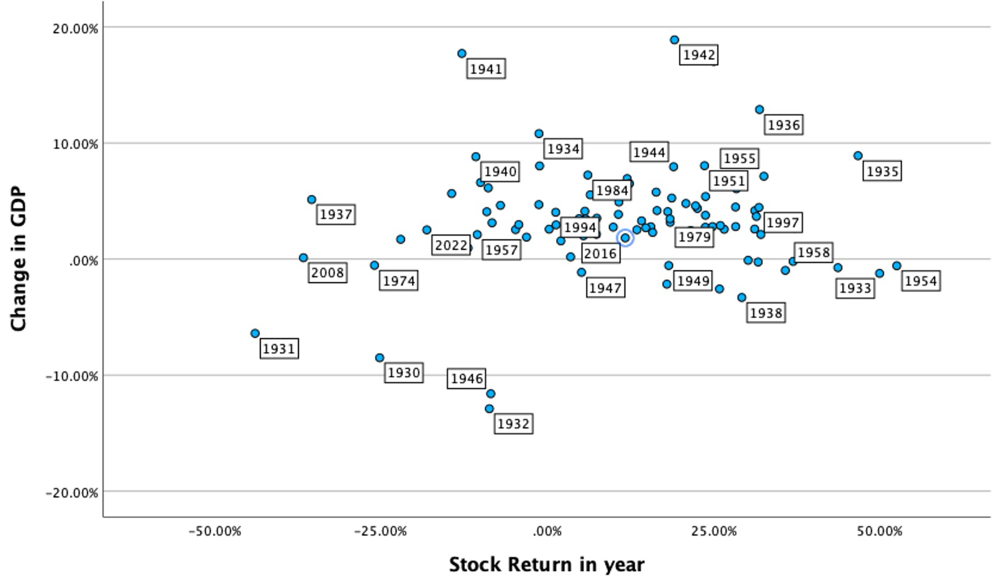
3. Business Cycles and GNP growth

Slide 12
Real GDP growth and Stock Returns
 |  |  | Stock Return in next year
GDP Growth Class | Number of years | Average of Stock Return in same year | Average | Std Deviation | Worst year | Best year
>5% | 23 | 10.04% | 10.84% | 21.37% | -35.34% | 46.74%
3.5%-5% | 24 | 13.32% | 14.23% | 16.02% | -11.85% | 52.56%
2-3.5% | 13 | 11.25% | 4.93% | 21.82% | -36.58% | 43.72%
0-2% | 5 | -13.98% | 15.35% | 21.77% | -21.97% | 30.23%
<0% | 17 | 15.78% | 10.23% | 21.99% | -43.84% | 49.98%
All years | 82 | 10.92% | 11.05% | 19.92% | -43.84% | 52.56%

Slide 13
Macro forecasting: The perils
The links are weak: While we assume that the links between macro variables and stock prices are strong, the relationship is a lot weaker than most of us realize. Put simply, the notion that stock prices go down when the economy does badly is not backed strongly in the data.
Forecasting macro variables is difficult: If you need to forecast macro variables (GDP growth, interest rates etc.) to get a forecast of the stock market, you have just replaced one problem with an even bigger one.
And watch out for structural changes: Mean reversion works as long as the underlying fundamentals do not change significantly. If they do, mean reversion will break down and you could wait for a long time for normalization and not see it.

