Slide 1
Market Timing Approaches:
Valuing/pricing the Market
Cash flows, growth and risk?

Slide 2
Valuation Approaches
Just as you can value individual stocks with intrinsic valuation (DCF) models and relative valuation (multiples) models, you can value the market.
If you have faith in your market valuations, you view markets as under valued (over valued) if they are priced at a level lower (higher) than predicted by your intrinsic or relative value models.

Slide 3
An intrinsic valuation of the market
Following the same thesis that the value of a business (stock) is the present value of the cash flows on that business (stock), you can value the entire market.
To value the market, you have to
  Estimate expected cash flows from buying the entire market in future years. If you are looking at an equity index, these cash flows have to be to equity investors.
  Assess a rate of return that you believe is a fair rate of return on stocks collectively, by adding a “fair” equity risk premium to a risk free rate.

Slide 4
IIntrinsic Value: Valuing the S&P 500 with a dividend discount model
On January 1, 2025, the S&P 500 was trading at 5881.63, and the dividends on the index amounted to 73.40 over the previous year (on earnings of 243.32 during the year).
On the same date, analysts were estimating an expected growth rate of 9.57% in earnings for the index for the following five years.
Assuming that dividends grow at the same rate as earnings, we obtain the following:
 | Last 12 months | 1 | 2 | 3 | 4 | 5
Expected Earnings | 243.32 | 266.62 | 292.14 | 320.12 | 350.77 | 384.35
Expected Dividends | 73.40 | $ 80.42 | $ 88.12 | $ 96.56 | $ 105.81 | $ 115.94

Slide 5
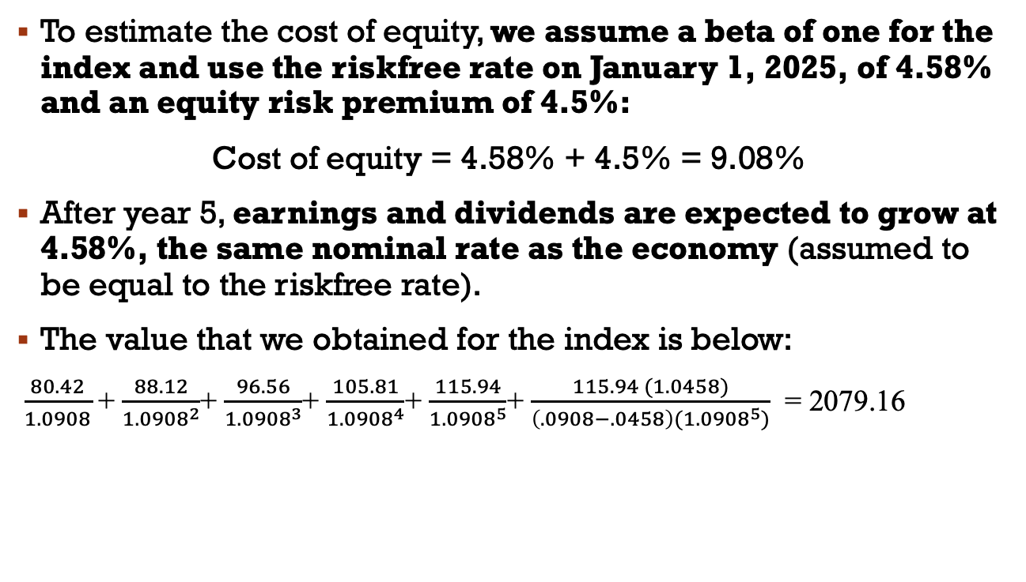
Completing the valuation
To estimate the cost of equity, we assume a beta of one for the index and use the riskfree rate on January 1, 2025, of 4.58% and an equity risk premium of 4.5%:
Cost of equity = 4.58% + 4.5% = 9.08%
After year 5, earnings and dividends are expected to grow at 4.58%, the same nominal rate as the economy (assumed to be equal to the riskfree rate).
The value that we obtained for the index is below:
$\frac{80.42}{1.0908}$ + $\frac{88.12}{{1.0908}^{2}}$+ $\frac{96.56}{{1.0908}^{3}}$+ $\frac{105.81}{{1.0908}^{4}}$+ $\frac{115.94}{{1.0908}^{5}}$+ $\frac{115.94 (1.0458)}{{\left(.0908−.0458\right)(1.0908}^{5})}$ = 2079.16

Slide 6
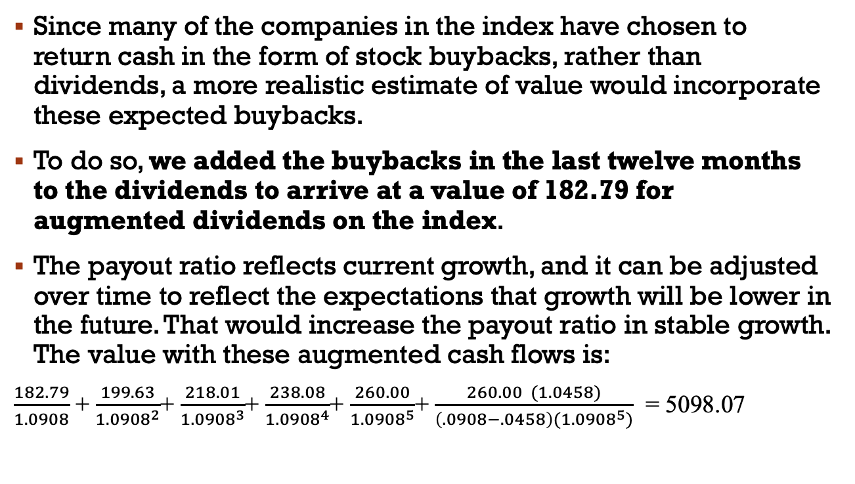
From dividends to augmented dividends…
Since many of the companies in the index have chosen to return cash in the form of stock buybacks, rather than dividends, a more realistic estimate of value would incorporate these expected buybacks.
To do so, we added the buybacks in the last twelve months to the dividends to arrive at a value of 182.79 for augmented dividends on the index.
The payout ratio reflects current growth, and it can be adjusted over time to reflect the expectations that growth will be lower in the future. That would increase the payout ratio in stable growth. The value with these augmented cash flows is:
$\frac{182.79}{1.0908}$ + $\frac{199.63}{{1.0908}^{2}}$+ $\frac{218.01}{{1.0908}^{3}}$+ $\frac{238.08}{{1.0908}^{4}}$+ $\frac{260.00}{{1.0908}^{5}}$+ $\frac{260.00 (1.0458)}{{\left(.0908−.0458\right)(1.0908}^{5})}$ = 5098.07

Slide 7
How well do intrinsic valuation models work?
Generally speaking, the odds of succeeding increase as the quality of your inputs improves and your time horizon lengthens. Eventually, markets seem to revert back to intrinsic value but eventually can be a long time coming.
There is, however, a significant cost associated with using intrinsic valuation models when they find equity markets to be overvalued. If you take the logical next step of not investing in stocks when they are overvalued, you will have to invest your funds in either other securities that you believe are fairly valued (such as short term government securities) or in other asset classes. In the process, you may end up out of the stock market for extended periods while the market is, in fact, going up.
The problem with intrinsic value models is their failure to capture permanent shifts in attitudes towards risk or investor characteristics. This is because so many of the inputs for these models come from looking at the past.

Slide 8
Relative Valuation (pricing) Models
In pricing models, you examine how markets are priced relative to other markets and to fundamentals.
While it shares some characteristics with intrinsic valuation models, this approach is less rigid, insofar as it does not require that you work within the structure of a discounted cashflow model.
Instead, you either make comparisons of markets over time (the S&P in 2019 versus the S&P in 1990) or different markets at the same point in time (U.S. stocks in 2019 versus European stocks in 2019).

Slide 9
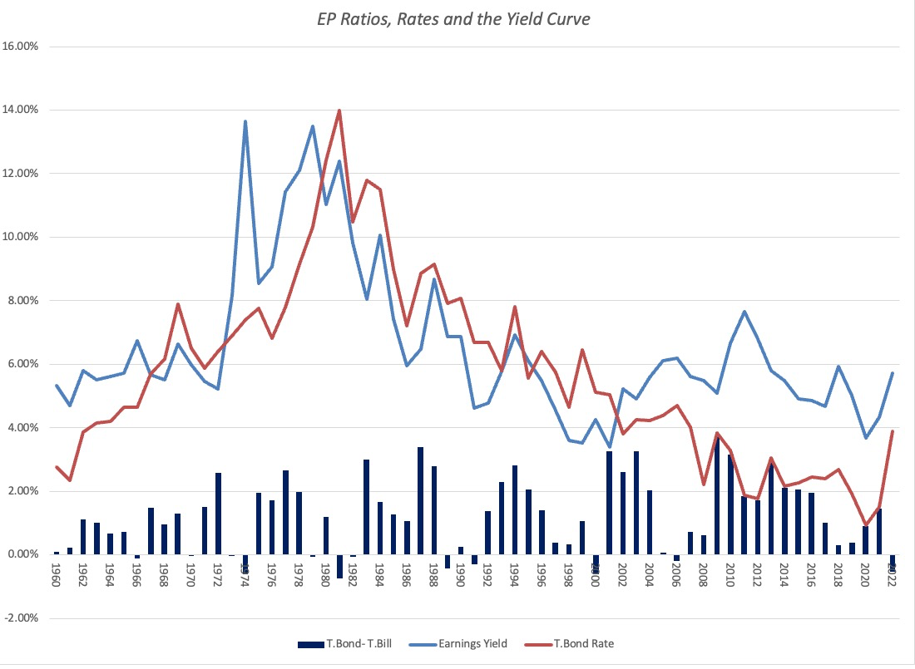
US Stocks: E/P Ratios , T.Bond Rates and Term Structure over time
Notes:
Graphs out the inverse of the PE ratios (the earnings to price ratio or the earnings yield), the 10-year treasury bond rate and the difference between the 10-year T.Bond rate and the 6-month T.Bill rate. Even without any statistical analysis, the earnings yield and interest rates are highly correlated.

Slide 10

Regression Results
In the following regression, using 1960-2024 data, we regress E/P ratios against the level of T.Bond rates and a term structure variable (T.Bond - T.Bill rate)
  EP Ratio = 0.0341 + 0.5618 T.Bond Rate - 0.1161 (T.Bond Rate - T.Bill Rate) (6.47) (7.45) (-0.08)
  R squared = 47.4%
In 2008, this is what the regression looked like:
  E/P = 2.56% + 0.7044 T.Bond Rate – 0.3289 (T.Bond Rate-T.Bill Rate) (4.71) (7.10) (1.46)
  R squared = 50.71%
  The R-squared has dropped and the differential with the T.Bill rate has lost significance. How would you read this result?
Correlation between E/P and interest rates
Notes:
The regression yields the following conclusions:
Every 1% increase in the treasury bond rate increases the earnings yield by 0.52% (an increase in the earnings yield lowers the PE ratio). The effect on the PE ratio will therefore depend upon whether the T.Bond rate is increasing from 4% to 5% (the effect will be much larger) or from 9% to 10%..
Every 1% increase in the difference between long term and short term rates decreases the earnings yield by 0.17% (and increases PE ratios). As the yield curve becomes more upward sloping, expectations of real economic growth generally increase. This variable may therefore be a proxy for economic growth. Higher growth translates into higher PE ratios.
The last five years, where low interest rates have co-existed with low PE ratios have changed the relationship. Perhaps, the market is less trusting of a Fed effect (that the Fed can change the real growth in the economy) than it used to be…

Slide 11
2. Comparisons across markets: Markets with the lowest PE in 2025
Country | Number of firms | Trailing PE)
Zambia | 15 | 4.31
Kenya | 50 | 4.43
Ghana | 23 | 5.34
Cyprus | 64 | 6.08
Pakistan | 424 | 6.24
Serbia | 17 | 6.69
Kazakhstan | 21 | 6.82
Isle of Man | 16 | 7.32
Sri Lanka | 262 | 7.49
Mauritius | 75 | 7.51
Tanzania | 15 | 7.52
Nigeria | 126 | 7.90
Macau | 16 | 8.30
Ivory Coast | 34 | 8.41
Tunisia | 76 | 8.68
Bermuda | 62 | 8.69
Malawi | 14 | 8.71
Colombia | 28 | 8.71
Chile | 122 | 8.84
Lithuania | 29 | 8.87

Slide 12
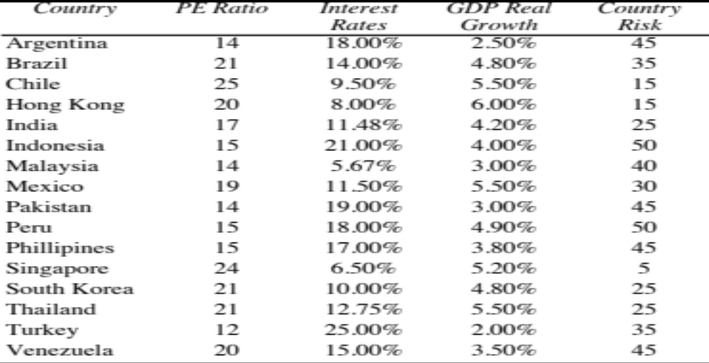
Example : Emerging Markets: June 2000
Notes:
We used the Economist’s measure of country risk because it is numerical rather than the ratings, which are not. There are significant differences in country risk, at least as measured by the Economist.
The estimates of GDP real growth were for the next year and were obtained from the OECD.

Slide 13
Regression Results
The markets that trade at low PE ratios also have high interest rates and high country risk.
To control for those differences, I regressed PE ratios on these variables–
  PE = 16.16 - 7.94 Interest Rates
  + 154.40 Growth in GDP
  - 0.1116 Country Risk
  R Squared = 73%
Notes:
The regression confirms our priors:
Higher interest rates translate into lower PE ratios.
Higher GDP growth results in higher PE ratios
Higher country risk results in lower PE ratios

Slide 14
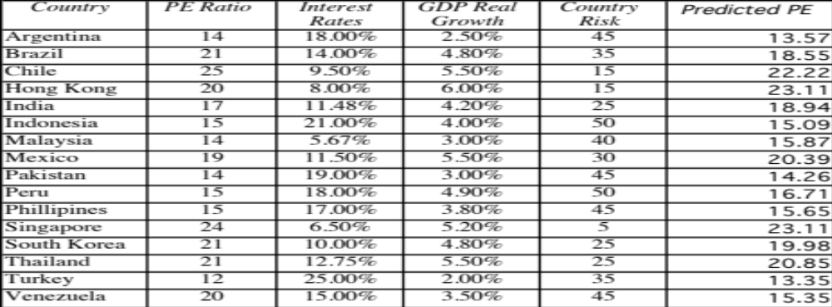
Predicted PE Ratios
Notes:
The predicted PE ratios are close to the actual PE ratios for most of the countries. Venezuela looks most overvalued…

Slide 15
Determinants of Success at using Fundamentals in Market Timing
This approach has two limitations:
  Since you are basing your analysis by looking at the past, you are assuming that there has not been a significant shift in the underlying relationship.
  Even if you assume that the past is prologue and that there will be reversion back to historic norms, you do not control this part of the process..
How can you improve your odds of success?
  You can try to incorporate into your analysis those variables that reflect the shifts that you believe have occurred in markets.
  You can have a longer time horizon, since you improve your odds on convergence.

