Slide 1
Market Timing: Does it work?
Back to the “impossible” in the impossible dream!

Slide 2
The Evidence on Market Timing – everyone does it!
Mutual fund managers constantly try to time markets by changing the amount of cash that they hold in the fund. If they are bullish, the cash balances decrease. If they are bearish, the cash balances increase.
Investment Newsletters often take bullish or bearish views about the market.
Market Strategists at investment banks make their forecasts for the overall market.

Slide 3
1. Mutual Fund Managers
While most mutual funds don’t claim to do market timing, they implicitly do so by holding more of the fund in cash (when they are bearish) or less in cash (when they are bullish).
Some mutual funds do try to time markets. They are called tactical asset allocation funds.

Slide 4
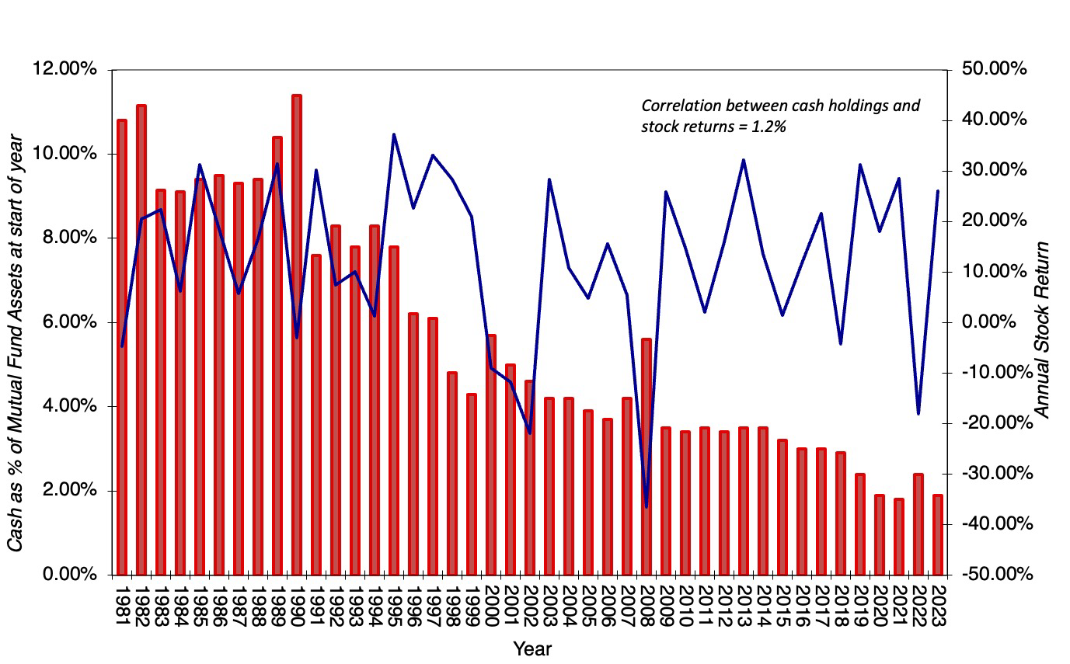
a. Mutual Fund Cash Positions

Slide 5
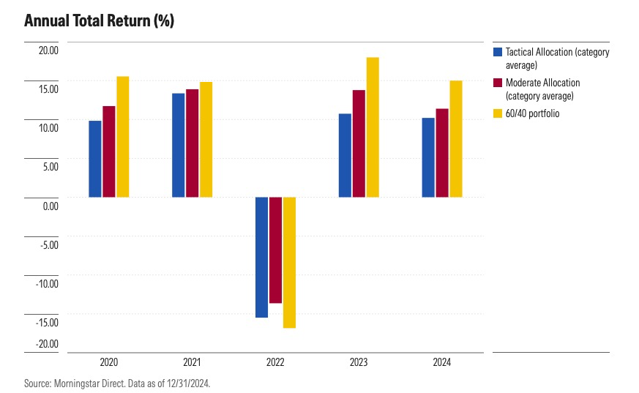
Tactical Allocation funds

Slide 6
2. Hedge Funds
An early paper looking at the ability of hedge funds to time markets in their focus groups (which may be commodities, currencies, fixed income or arbitrage) found some evidence (albeit not overwhelming) of market timing payoff in bond and currency markets but none in equity markets.
A more recent and comprehensive evaluation of just 221 market timing hedge funds found evidence that a few of these funds are able to time both market direction and volatility, and generate abnormal returns as a consequence.
There is also evidence that what separates successful hedge funds from those that fail is their capacity to adjust market exposure ahead of market liquidity changes, reducing exposure prior to periods of high illiquidity. The funds that do this best outperform funds that are don’t make the adjustment by 3.6-4.9% a year after adjusting for risk.

Slide 7
3. Investment Newsletters
Campbell and Harvey (1996) examined the market timing abilities of investment newsletters by examining the stock/cash mixes recommended in 237 newsletters from 1980 to 1992.
  If investment newsletters are good market timers, you should expect to see the proportion allocated to stocks increase prior to the stock market going up. When the returns earned on the mixes recommended in these newsletters is compared to a buy and hold strategy, 183 or the 237 newsletters (77%) delivered lower returns than the buy and hold strategy.
  One measure of the ineffectuality of the market timing recommendations of these investment newsletters lies in the fact that while equity weights increased 58% of the time before market upturns, they also increased by 53% before market downturns.
  There is some evidence of continuity in performance, but the evidence is much stronger for negative performance than for positive. In other words, investment newsletters that give bad advice on market timing are more likely to continue to give bad advice than are newsletters that gave good advice to continue giving good advice.

Slide 8
Some hope? Professional Market Timers
Professional market timers provide explicit timing recommendations only to their clients, who then adjust their portfolios accordingly - shifting money into stocks if they are bullish and out of stocks if they are bearish.
A study by Chance and Hemler (2001) looked at 30 professional market timers who were monitored by MoniResearch Corporation, a service monitors the performance of such advisors and found mild evidence of market timing ability.
It should be noted that the timing calls were both short term and frequent. One market timer had a total of 303 timing signals between 1989 and 1994, and there were, on average, about 15 signals per year across all 30 market timers. Notwithstanding the high transactions costs associated with following these timing signals, following their recommendations would have generated excess returns for investors.

Slide 9
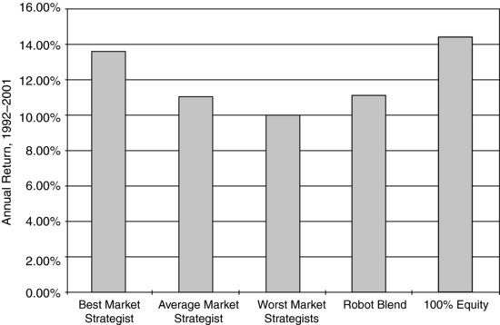
4. Market Strategists provide timing advice…

Slide 10
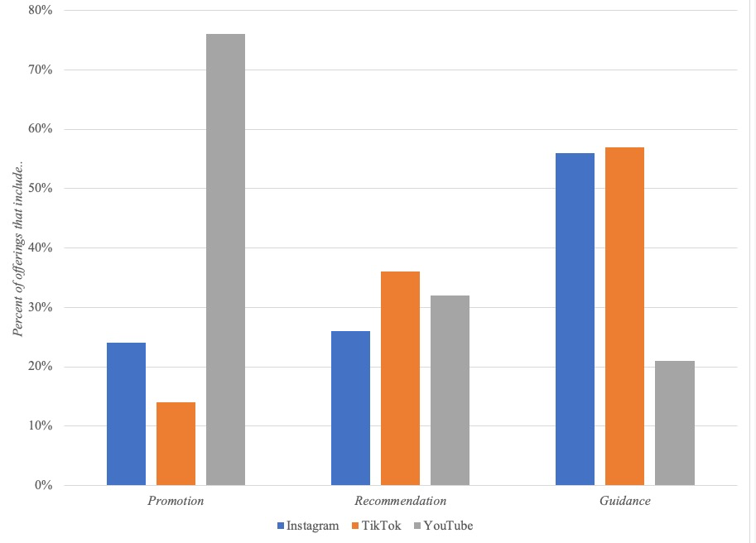
5. Finfluencers: What do they do?

Slide 11
But how good is the advice?
Most finfluencers have been in operation in a period where stocks have gone up strongly, and the test of market timing is often in periods of duress.
Many finfluencers have been drawn to meme stocks (in equity markets) or crypto, not only because they are volatile (and momentum plays), but also because you have someone to blame (hedge funds, shadow bankers etc.) if your recommendations do not work out.

Slide 12
Market timing Strategies
Adjust asset allocation: Adjust your mix of assets, allocating more than you normally would (given your time horizon and risk preferences) to markets that you believe are under valued and less than you normally would to markets that are overvalued.
Switch investment styles: Switch investment styles and strategies within a market (usually stocks) to reflect expected market performance.
Sector rotation: Shift your funds within the equity market from sector to sector, depending upon your expectations of future economic and market growth.
Market speculation: Speculate on market direction, using either borrowed money (leverage) or derivatives to magnify profits.

Slide 13
1. Asset Allocation Changes
The simplest way of incorporating market timing into investment strategies is to alter the mix of assets – stocks, cash, bonds and other assets – in your portfolio.
  In this strategy, you will shift part or all of your funds out of equity markets if you believe that they are over valued and can pay a significant price if the stock market goes up.
  If you adopt an all or nothing strategy, shifting 100% into equity if you believe that the market is under valued and 100% into cash if you believe that it is overvalued, you increase the cost of being wrong.

Slide 14
2. Style Switching
There are some investment strategies that do well in bull markets and others that do better in bear markets. If you can identify when markets are overvalued or undervalued, you could shift from one strategy to another or even from one investment philosophy to another just in time for a market shift.
  Growth and small cap investing do better when growth is low and when the yield curve is downward sloping.
Kao and Shumaker estimate the returns an investor would have made if she had switched with perfect foresight from 1979 to 1997 from value to growth stocks and back for both small cap and large cap stocks. The annual returns from a perfect foresight strategy each year would have been 20.86% for large cap stocks and 27.30% for small cap stocks. In contrast, the annual return across all stocks was only 10.33% over the period.

Slide 15
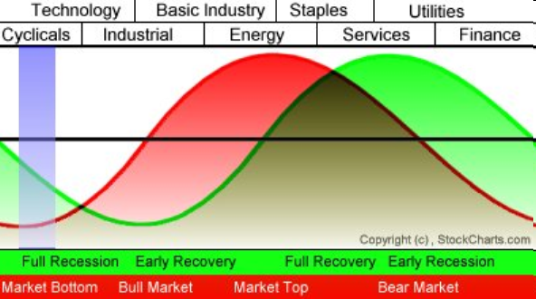
3. Sector Rotation

Slide 16
4. Speculation
The most direct way to take advantage of your market timing abilities is to buy assets in a market that you believe is under valued and sell assets in one that you believe is over valued.
It is a high risk, high return strategy. If you are successful, you will earn an immense amount of money. If you are wrong, you could lose it all.
If you use leverage (either by borrowing money or investing in options), it becomes even higher risk and return.

Slide 17
Connecting Market Timing to Security Selection
You can be both a market timer and security selector. The same beliefs about markets that led you to become a security selector may also lead you to become a market timer. In fact, there are many investors who combine asset allocation and security selection in a coherent investment strategy.
There are, however, two caveats to an investment philosophy that includes this combination.
  To the extent that you have differing skills as a market timer and as a security selector, you have to gauge where your differential advantage lies, since you have limited time and resources to direct towards your task of building a portfolio.
  You may find that your attempts at market timing are under cutting your asset selection and that your overall returns suffer as a consequence. If this is the case, you should abandon market timing and focus exclusively on security selection.

