Slide 1
The Case For Passive Investing: Active investor track records
When doing nothing beats doing something!

Slide 2
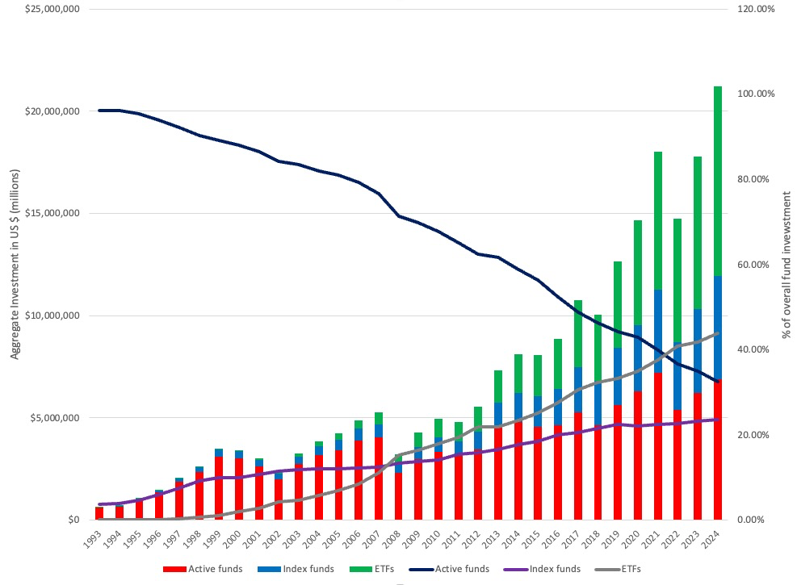
The rise of Passive investing…

Slide 3
The Case for passive investing
The case for passive investing is best made by active investors who try to beat the market and fail.
Looking at the evidence, the question of whether to index can be boiled down to answering two questions?
  Can individual investors who are active investors beat the market?
  Can professional money managers beat the market?

Slide 4
Individual Investors: The bad news first…
The average individual investor does not beat the market, after netting out trading costs. Between 1991 and 1996, for instance, the annual net (of transactions costs) return on an S&P 500 index fund was 17.8% whereas the average investor trading at the brokerage house had a net return of 16.4%.
The more individual investors trade, the lower their returns tend to be. In fact, the returns before transactions costs are accounted for are lower for more active traders than they are for less active traders. After transactions costs are accounted for, the returns to active trading get worse.
Pooling the talent and strengths of individual investors into investment clubs does not result in better returns. Barber and Odean examined the performance of 166 randomly selected investment clubs that used the discount brokerage house. Between 1991 and 1996, these investment clubs had a net annual return of 14.1%, underperforming the S&P 500 (17.8%) and individual investors (16.4%).

Slide 5
And some possible good news…
Stay with what you know: Building on that theme, other studies of individual investors find that they generate relatively high returns when they invest in companies close to their homes compared to the stocks of distant companies, and that investors with more concentrated portfolios outperform those with more diversified portfolios.
The winners win big: The study by Barber and Odean, quoted in the last page, found that the top performing quartile of individual investors does outperform the market by about 6% a month. A study of 16,668 individual trader accounts at a large discount brokerage house finds that the top 10% of traders in this group outperform the bottom 10% by about 8 percent per year over long period.

Slide 6
Professional Money Managers
Professional money managers operate as the experts in the field of investments. They are supposed to be better informed, smarter, have lower transactions costs and be better investors overall than smaller investors.
Studies of mutual funds do not seem to support the proposition that professional money managers earn excess returns.

Slide 7
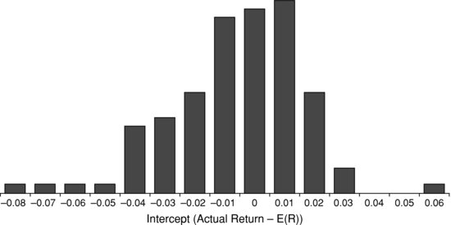
Jensen’s Results on mutual funds

Slide 8
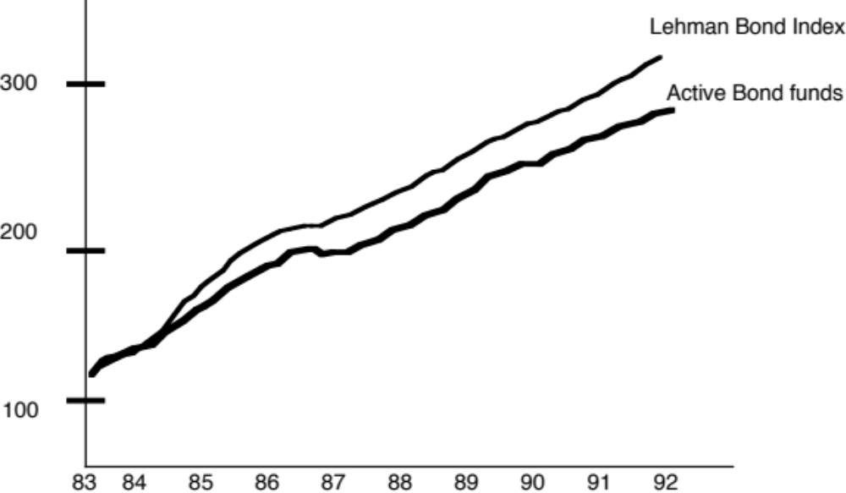
The same holds true for bond funds as well…

Slide 9
Measurement Issue 1: Sensitivity to Risk Measures
The Jensen study used the capital asset pricing model to estimate and correct for risk.
The limitations of the CAPM have opened up the question of how sensitive the conclusions at to different risk and return models.
The answer is not much, and the results remain intact no matter what model you use (or with no model at all).

Slide 10
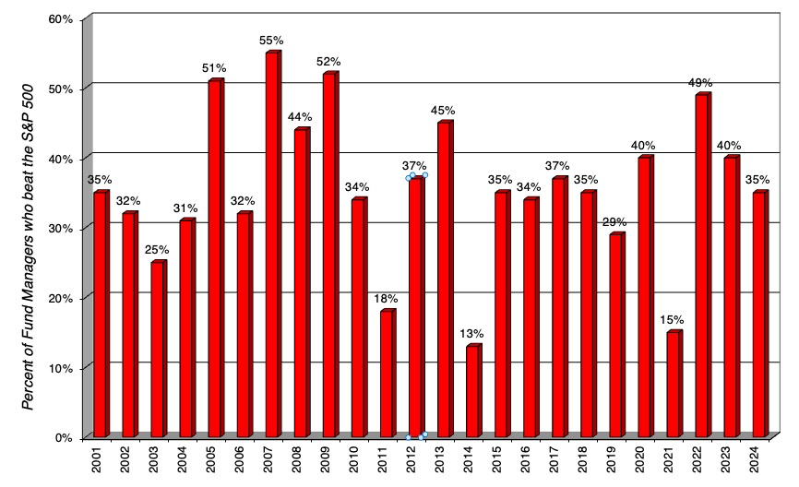
1. Relative to the Market

Slide 11
2. Other Risk Measures
CAPM based measures: The Sharpe ratio, which is computed by dividing the excess return on a portfolio by its standard deviation, the Treynor measure, which divides the excess return by the beta and the appraisal ratio which divides the alpha from the regression by the standard deviation can be considered close relatives of Jensen’s alpha. Studies using all three of these alternative measures conclude that mutual funds continue to under perform the market.
APM: In a study that examined the sensitivity of the conclusion to alternative risk and return models, Lehmann and Modest computed the abnormal return earned by mutual funds using the arbitrage pricing model for 130 mutual funds from 1969 to 1982. While the magnitude of the abnormal returns earned is sensitive to alternative specifications of the model, every specification of the model yields negative abnormal returns.

Slide 12
3. Expanded Proxy Models
Studies seem to indicate that risk and return model consistently underestimate the expected returns for stocks with low price to book ratios, low market capitalization and price momentum.
If you do not control for this finding, you may find that mutual fund managers who invest disproportionately in these classes of stocsk look like they beat the market.
In 1997, Carhart used a four-factor model, including beta, market capitalization, price to book ratios and price momentum as factors, and concluded that the average mutual fund still under performed the market by about 1.80% a year. In other words, you cannot blame empirical irregularities for the under performance of mutual funds.

Slide 13
Measurement Issue 2: Survivor Bias
One of the limitations of many studies of mutual funds is that they use only mutual funds that have data available for a sample period and are in existence at the end of the sample period. Since the funds that fail are likely to be the poorest performers, there is likely to be a bias introduced in the returns that we compute for funds.
Carhart examined all equity mutual funds (including failed funds) from January 1962 to December 1995.
  Over that period, approximately 3.6% of the funds in existence failed each year and they tend to be smaller and riskier than the average fund in the sample.
  In addition, and this is important for the survivor bias issue, about 80% of the non-surviving funds under perform other mutual funds in the 5 years preceding their failure.
  Ignoring them as many studies do when computing the average annual return from holding mutual funds results in annual returns being overstated by 0.17% with a one-year sample period to more than 1% with 20-year time horizons.

Slide 14
Performance by Sub-categories
Mutual funds adopt a variety of styles. Some are value funds while others are growth funds. Some buy small-cap stocks whereas others buy large-cap stocks.
Mutual funds also come in different sizes. Some funds have tens of billions to invest whereas others have only a few hundred million to invest.
Mutual funds can also be domestic and foreign, load and no-load…

Slide 15
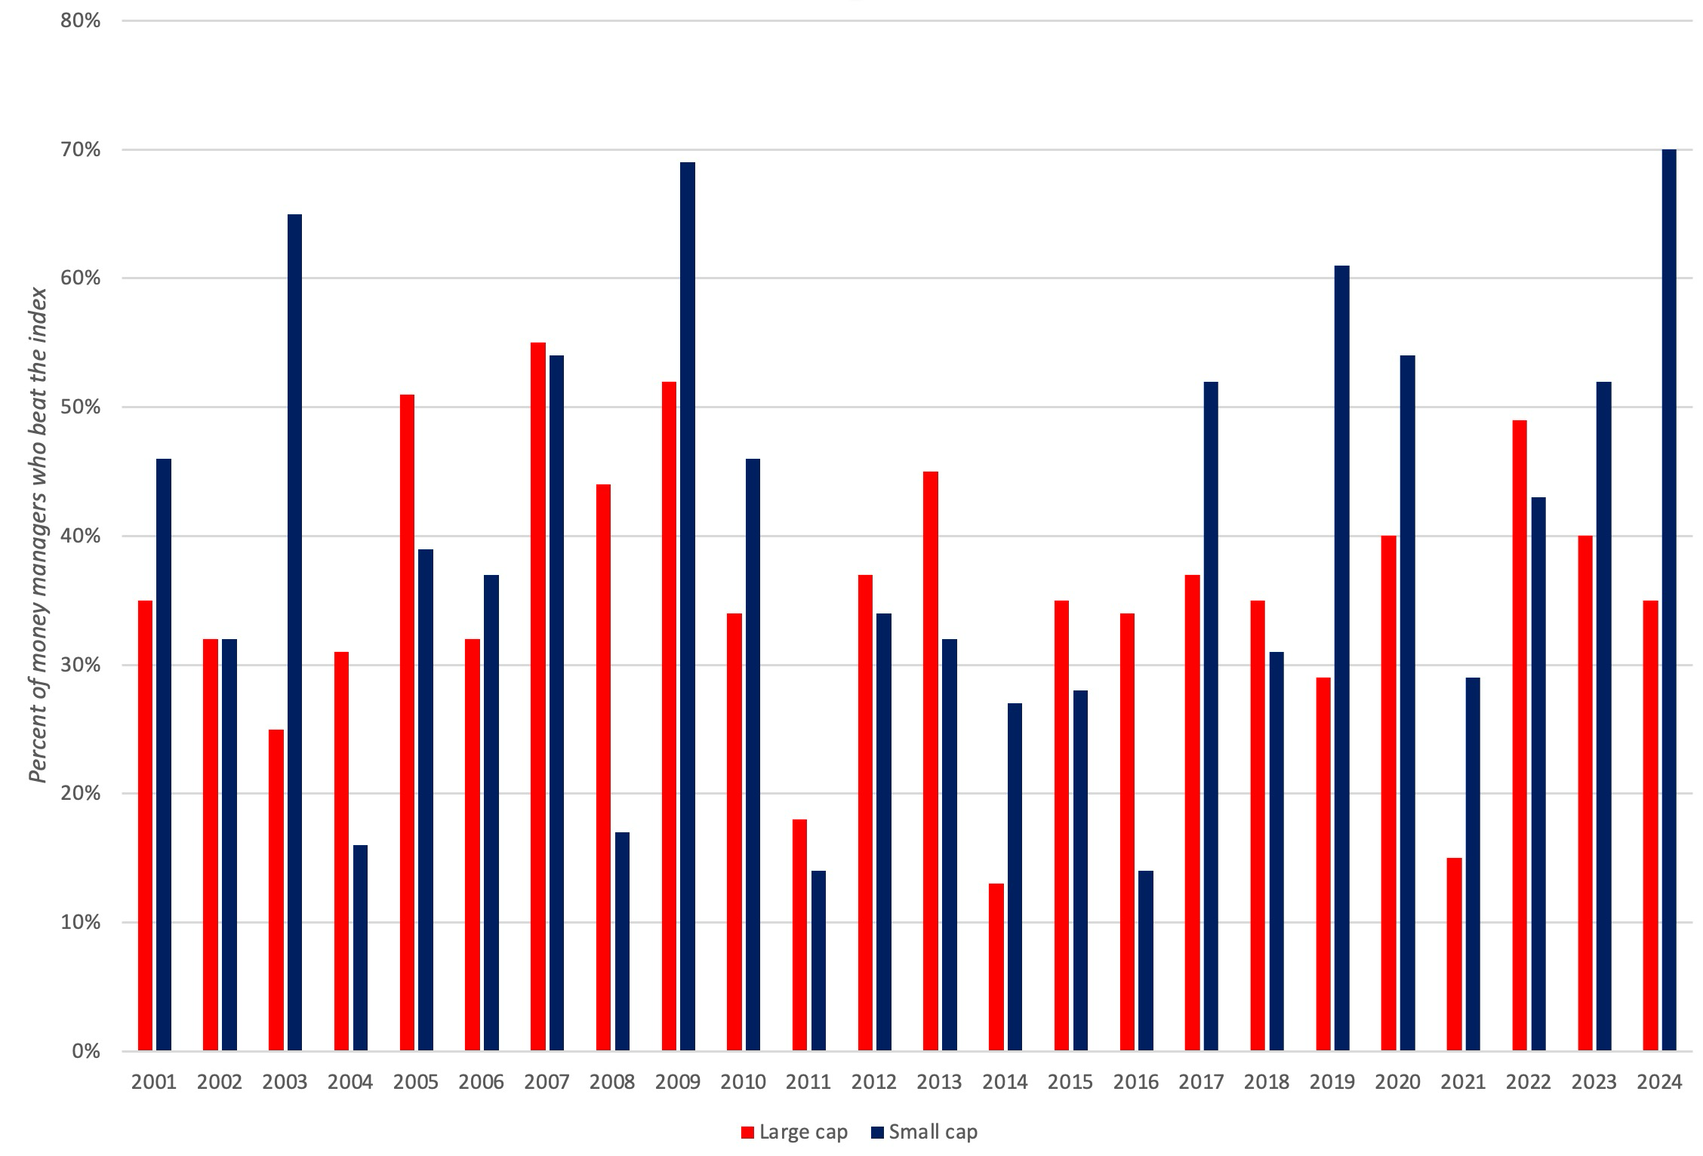
1. Categorized by market cap of companies that funds invest in…

Slide 16
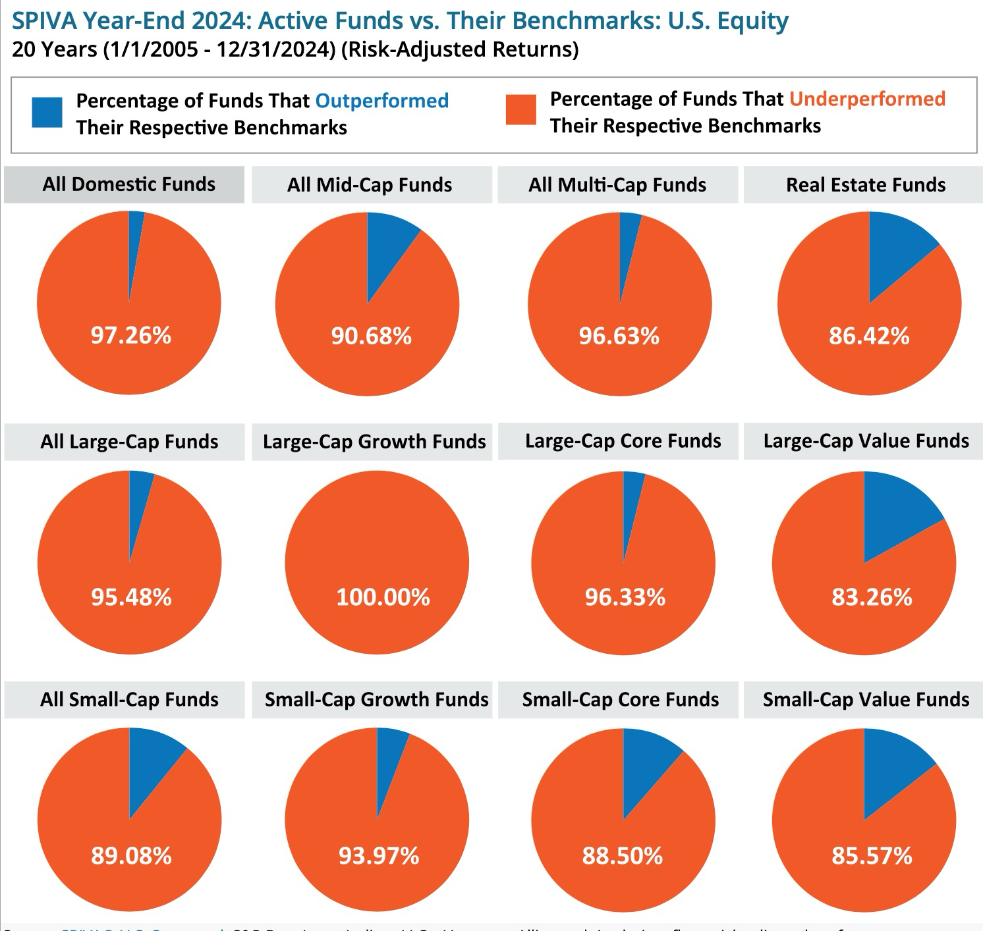
2. Categorized by Investment Style

Slide 17
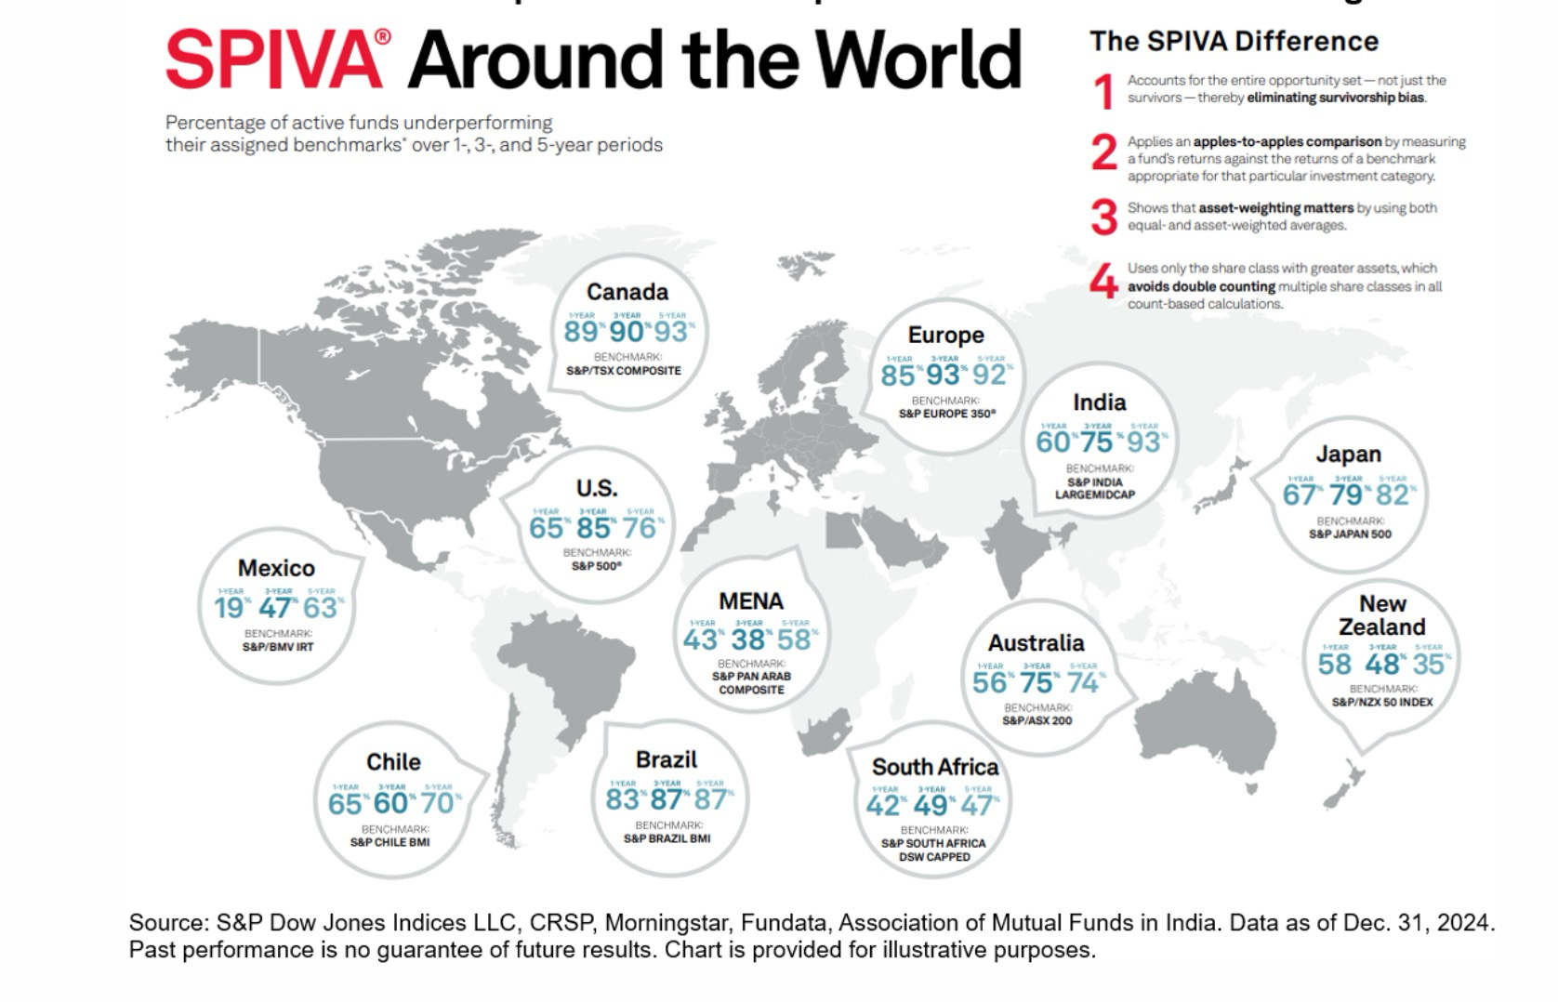
3. Emerging Market and International Funds

Slide 18
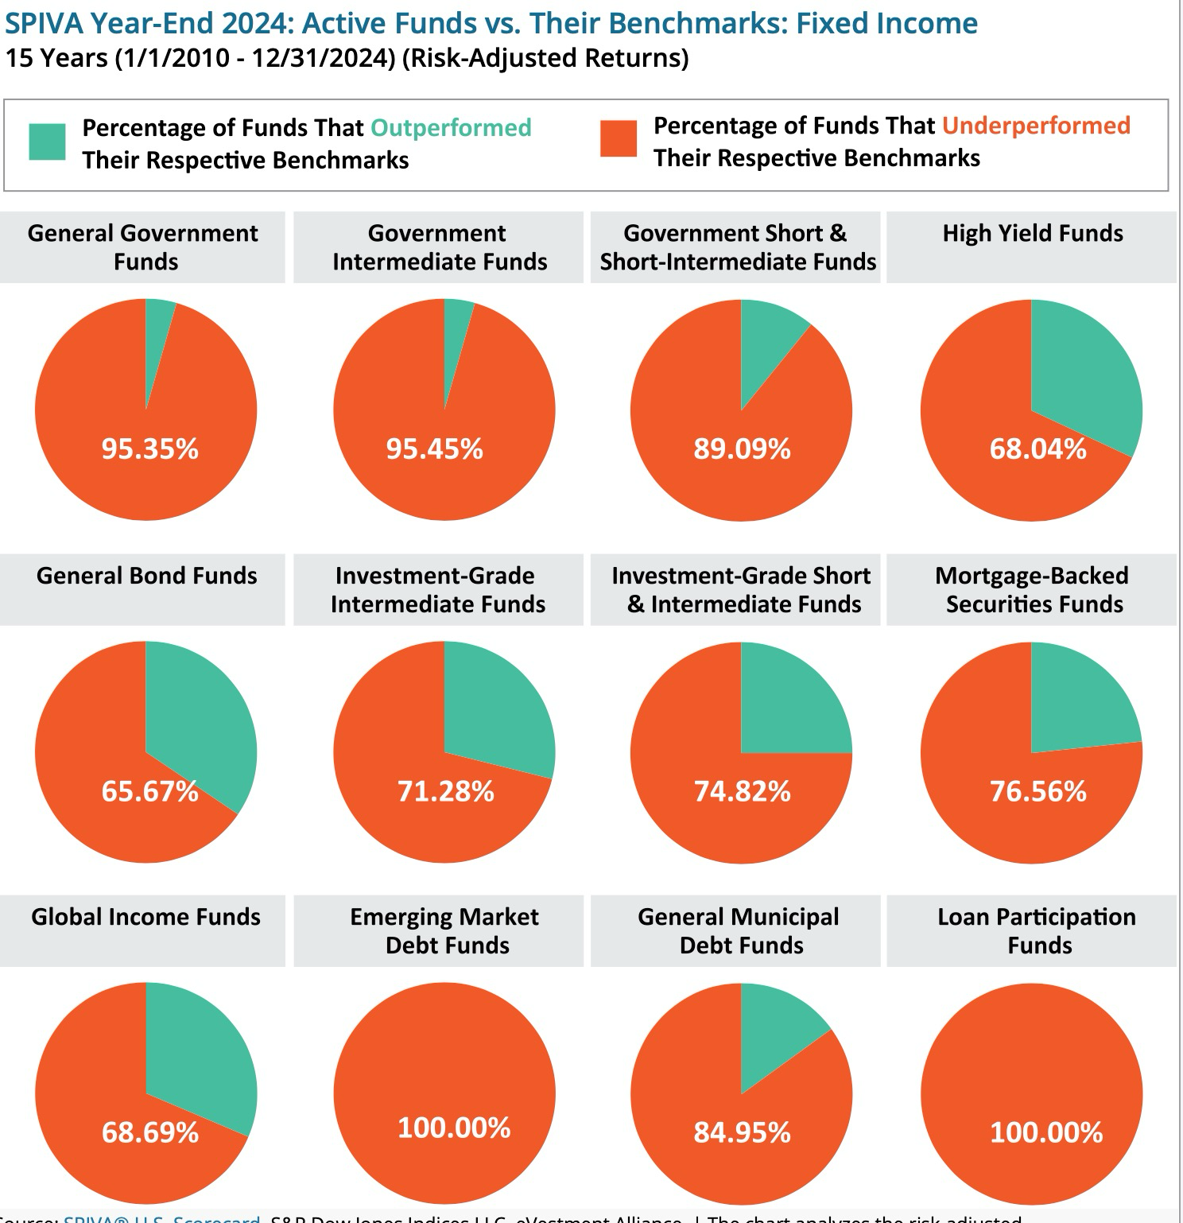
4. It’s not just stocks

Slide 19
The Bottom Line
Put simply, there is almost no good news in mutual fund performance, no matter how you slice the data.
Across all time periods, styles and groupings of funds, under performance is rampant.
The news is no better when you look at emerging or smaller markets, where at least in theory, professional money managers should have a bigger advantage.

