Slide 1
Passive Investing Choices
Giving up on active investing? That’s okay!

Slide 2
Choices on passive investing
Once you decide that active investing is not going to pay off for you, you have chosen the path of passive investing.
The choices on passive investing have grown over time and here are a few:
  Classic Index Funds
  Enhanced Index Funds
  Exchange traded funds

Slide 3
I. Index Funds
Fully indexed fund: An index fund attempts to replicate a market index. It is relatively simple to create, once the index to be replicated has been identified.
  Identify the index to be replicated. (Example: S & P 500)
  Estimate the weighting base (market cap, revenues, equal etc) in that index.
  Create a weighted portfolio of stocks in the index. This fund will replicate the index and is self correcting, if market cap weighted. It will need to be adjusted only if stocks enter or leave the index.
Sampled Index fund: Here, you sample an index because the index contains too many stocks like the Wilshire 5000 or it is too expensive to index the assets in a fund.

Slide 4
The growth of indexing
In the past three decades, index funds have significantly increased their share of the overall market not only for individual investors' savings but for pension and insurance money; the percentage of money invested in equity index funds, as a percentage of total money invested in equity mutual funds, increased from 3.7 percent in 1993 to 14.2 percent in 2010 and to 23.64% in 2024.
Along the way, ETFs have exploded in terms of gaining share of this market, rising from 0.07% in 1993 to 43.81% in 2024. Combining index funds and ETFs into the passive column, equity mutual funds that are active investors have seen their share drop from 96.24% of money invested in 1993 to 32.55% of money invested in 2024.

Slide 5
Alternatives to Indexing
Exchange Traded Funds such as SPDRs provide investors with a way of replicating the index at low cost, while preserving liquidity.
Index Futures and Options, effectively levered bets on indices.
Enhanced Index Funds that attempt to deliver the low costs of index funds with slightly higher returns.

Slide 6
II. Exchange Traded Funds…
With exchange traded funds, you get many of the benefits of being invested in an index, with the added allure of liquidity and more choices.
The costs of exchange traded funds are slightly higher than index funds over the long term, but the trade off may still work in their favor, especially for more obscure indices.

Slide 7
III. Enhanced Index Funds
In synthetic enhancement strategies, you build on the derivatives strategies that we described in the last section. Using the whole range of derivatives – futures, options and swaps- that may be available at any time on an index, you look for mispricing that you can use to replicate the index and generate additional returns.
In investment-based enhancement strategies, you adopt a more conventional active strategy using either stock selection or allocation to generate the excess returns.
In quantitative enhancement strategies, you use the mean-variance framework that is the foundation of modern portfolio theory to determine the optimal portfolio in terms of the trade-off between risk and return.

Slide 8
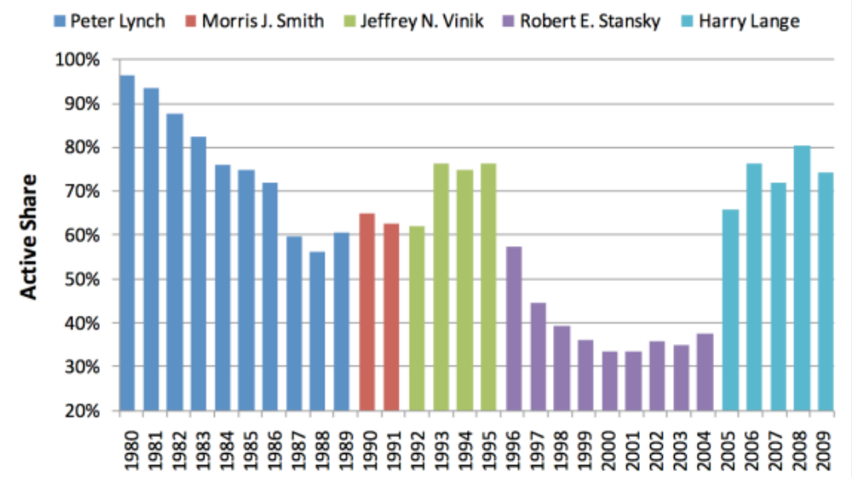
And many active funds are really enhanced index funds..

Slide 9
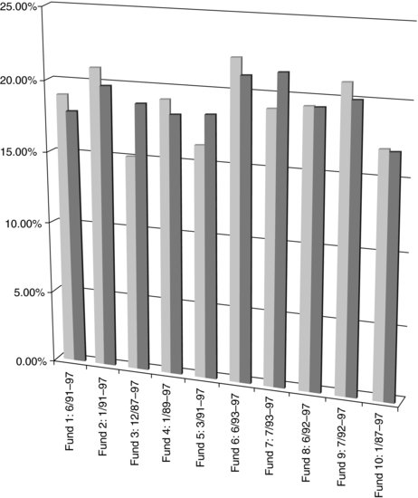
Enhanced Index Funds… The Returns Promise..
With enhanced index funds, you start with the premise of an index fund but try to tilt your holdings towards stock groupings that have historically outperformed the market.

Slide 10
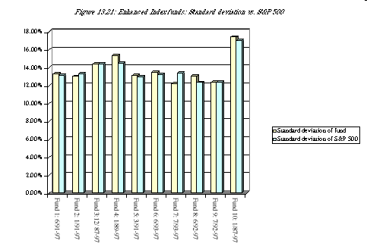
Enhanced Index Funds…The Risk

Slide 11
The Bottom Line
Passive investing works for most people: While many investors view investing in index funds/passive vehicles as a sign of weakness, it is the right choice for many investors since it delivers higher returns for less cost.
A little bit active? Even passive investors will be tempted to be a little bit active to get a higher return. While the track records of these funds can look good on paper, you face many of the same challenges that active investors do and the key to success is to keep activity low and costs even lower.

