Slide 1
Investing in alternatives
Gold, Bitcoin and Beanie Babies!

Slide 2
Alternatives to what?
It is true that most of the investment philosophies that we have talked about in this book are directed at those who invest in stocks and bonds with long-only strategies.
It is also true that in the process, we are ignoring vast swaths of the investment universe, from other asset classes (real estate, collectibles, cryptos) to investing and building private businesses to selling short and derivatives trading.
These ignored investment classes are what fall under the rubric of alternative investments, and while many of these choices have been with us for as long as we have had financial markets, they were accessible to only a small subset of investors for much of that period.
In terms of investment philosophies, there are significant numbers of investors who have made their money by owning and building their own businesses, trading gold or crypto, or even collecting artwork.

Slide 3
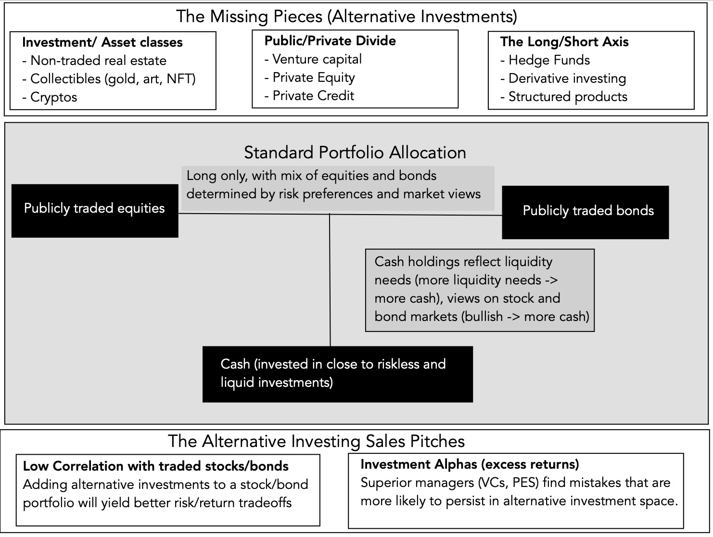
The alternative investment universe

Slide 4
1. Long/Short
In principle, there is little difference between being long on an investment and holding a short position, with the only real divergence being in the sequencing of cash flows. In practice, though, regulators and a subset of investors seem to view short selling more negatively.
Many institutional investors, including most mutual, pension, and endowment funds, are restricted from taking short positions on investments, with exceptions sometimes carved out for hedging. For close to a century, at least in the United States, hedge funds have been given the freedom to short assets, and while they do not always use that power to benefit, it is undeniable that having that power allows them to create return distributions that are different from those faced by long-only investors.
Finally, it is worth noting that the opening of derivatives markets in the last few decades has created new avenues for shorting assets.

Slide 5
2. Public/Private
For young private businesses, and especially those that aspire to become bigger and eventually go public, it is venture capital that fills the void, covering the spectrum from angel financing for idea businesses to growth capital for firms further along in their evolution.
For more established private businesses, some of which need capital to grow and some of which have owners who want to cash out, the capital has come from private equity investors.
On the debt front, the public debt and bank debt market is supplemented by private credit, where investors pool funds to lend to private businesses, with negotiated rates and terms, a process that has been around a while, but one that has also become formalized and a much larger source of funds.

Slide 6
3. Asset classes
Real estate: For much of the twentieth century, real estate remained outside the purview of public markets, with a segmented investor base and illiquid investments, requiring localized knowledge. That is starting to change.
Collectibles: The collectible asset class spans an array of investment, most of which generate little or no cash flows, but derive their pricing from scarcity and enduring demand.
  The first and perhaps the longest standing collectible is gold, a draw for investors during inflationary period or when they lose faith in fiat currencies and governments.
  The second is artwork, ranging from paintings from the masters to digital art (non-fungible tokens or NFTs), that presumably offers owners not just financial returns but emotional dividends.
  At the risk of raising the ire of crypto enthusiasts, we would argue that much of the crypto space (and especially bitcoin) also fall into this grouping, with a combination of scarcity and trading demand determining pricing.

Slide 7
The sales pitch for alternatives!
The strongest pitch for adding alternative investments to a portfolio dominated by publicly traded stocks and bonds comes from a basic building block for portfolio theory, which is that adding investments that have low correlation to the existing holdings in a portfolio can create better risk/return trade-offs for investors.
That pitch has been supplemented in the last two decades with arguments that alternative investments also offer a greater chance of finding market mistakes and inefficiencies, partly because they are more likely to persist in these markets, and partly because of superior management skills on the part of alternative investment managers, particularly hedge funds and private equity.

Slide 8
1. The correlation argument
 | Investment Grade Bonds | Cash | Commodities | Currencies | Hedge Funds | International Equity | Long/Short Equity | Managed Futures | REITs | S&P 500
Investment Grade Bonds | 1.00
Cash | 0.12 | 1.00
Commodities | −0.18 | −0.12 | 1.00
Currencies | −0.47 | −0.06 | −0.21 | 1.00
Hedge Funds | 0.14 | −0.02 | 0.6 | −0.25 | 1.00
International Equity | 0.41 | 0.00 | 0.45 | −0.57 | 0.73 | 1.00
Long/Short Equity | 0.3 | 0.06 | 0.46 | −0.4 | 0.86 | 0.84 | 1.00
Managed Futures | −0.16 | −0.04 | 0.04 | 0.25 | 0.34 | −0.12 | 0.05 | 1.00
REITs | 0.58 | −0.05 | 0.25 | −0.31 | 0.61 | 0.71 | 0.66 | 0.03 | 1.00
S&P 500 | 0.37 | 0 | 0.4 | −0.39 | 0.72 | 0.86 | 0.84 | −0.05 | 0.78 | 1.00

Slide 9
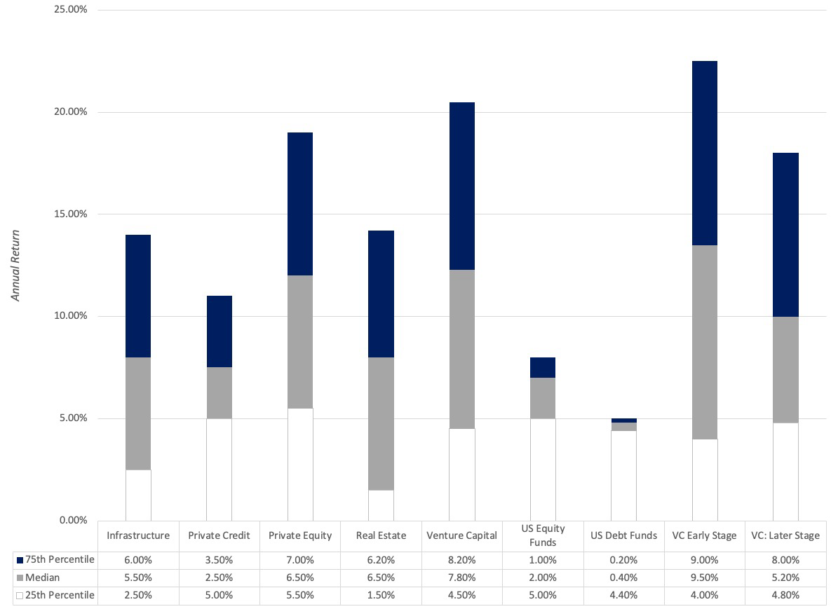
The alternative alphas

Slide 10
Price versus value: A revisit!
Type | To value | To price
Assets | Can be valued based upon expected cash flows, with higher cash flows and lower risk = higher value. | Can be priced against similar assets, after controlling for cash flows and risk
Commodity | Can be valued based upon utilitarian demand and supply, but with long lags in both. | Can be priced against its own history (normalized price over time)
Currency | Cannot be valued | Can be priced against other currencies, with greater acceptance and more stable purchasing power = higher price.
Collectible | Cannot be valued | Can be priced based upon scarcity and desirability

Slide 11
Alternatives: Price or value?
Real estate: Commercial real estate can be valued, since it generates cash flows (rental and least income) and even residential real estate has a value, if you impute cash flows based upon what you would pay as a rental to stay at the property. In practice, it is mostly priced.
Collectibles: Collectibles cover a wide swath of investments, and they can only be priced.
Trophy assets: We will complete the discussion by looking at trophy assets, investments that have cash flows (and thus can be valued), but where that cash flow effect has been drowned out by a demand for these assets that reflects almost a collectible status.

Slide 12
Real Estate: traded portion
 | United States | Global
REITs | $1,120,897 | $1,515,764
Real Estate (Development) | $6,734 | $512,953
Real Estate (General/Diversified) | $4,950 | $349,936
Real Estate (Operations and Services) | $107,958 | $605,711
Rest of the Market | $28,628,250 | $107,882,319
Real Estate as Percentage of Market | 4.15% | 2.69%
The non-traded: In 2023, for instance, it is estimated that the total value of real estate globally is about $400 trillion, with a third in residential and two thirds in commercial real estate.

Slide 13
Historical returns
Asset Class | Data Source | Period | Return Measure | Arithmetic Average (%) | Standard Deviation (%) | Geometric Average (%)
Stocks | S&P 500 | 1928–2023 | Dividend + Price Appreciation | 11.66 | 19.55 | 9.80
Treasury Bonds | FRED | 1928–2023 | Total return on 10-year bond | 4.86 | 7.95 | 4.57
Treasury Bills | FRED | 1928–2023 | 3-month T-bill rate | 3.34 | 3.01 | 3.30
Corporate Bonds (Baa) | FRED | 1928–2023 | Total return on | 6.95 | 7.71 | 6.68
Equity | FTSE | 1972–2023 | Dividend + Price Appreciation | 12.74 | 18.41 | 10.89
Mortgage REITs | FTSE | 1972–2023 | Dividend + Price Appreciation | 8.40 | 27.64 | 4.68
All REITS | FTSE | 1971–2023 | Dividend + Price Appreciation | 11.27 | 20.42 | 9.00
Commercial Real Estate | NCREIF | 1978–2023 | Total return, appraised values | 9.20 | 7.40 | NA
Residential Real Estate | Case & Shiller | 1928–2023 | Transaction prices | 4.42 | 6.24 | 4.23

Slide 14
NOTES ABOUT REAL ESTATE RETURNS
The first is that the price appreciation in real estate over time has been modest, with residential real estate delivering a compounded average return of 4.23 percent a year from 1928 to 2003, lower than the 4.57 percent that investors could have earned on a 10-year treasury bond. The returns are better on a total return basis, with income cash flows supplementing the price appreciation, with the NCREIF index of commercial real estate indicating annual returns of 9.20 percent between 1978 and 2023, with less than half of those returns coming from price appreciation.
The standard deviation in the appraised real estate indices (NCREIF and Case-Shiller) is low, but that is because these indices are based on either appraised values or infrequent transactions. Investors who use this as an indication that real estate is less risky than other asset classes will be making a serious mistake.

Slide 15
CO-MOVEMENT WITH OTHER INVESTMENT CLASSES
 | I&S | CREF | Home | C&S | Farm | S&P | T-bonds | T-bills | Inflation
I&S | 1.00
CREF | 0.79 | 1.00
Home | 0.52 | 0.12 | 1.00
C&S | 0.26 | 0.16 | 0.62 | 1.00
Farm | 0.06 | −0.06 | 0.51 | 0.49 | 1.00
S&P | 0.16 | 0.25 | −0.13 | −0.20 | −0.10 | 1.00
T-bonds | −0.04 | 0.01 | −0.22 | −0.54 | −0.44 | 0.11 | 1.00
T-bills | 0.53 | 0.42 | 0.13 | −0.56 | −0.32 | −0.07 | 0.48 | 1.00
Inflation | 0.7 | 0.35 | 0.77 | 0.56 | 0.49 | −0.02 | −0.17 | 0.25 | 1.00
I&S = Ibbotson & Siegal; CREF: CREF index; Home: Index of home prices; C&S: Case & Shiller; Farm: Index of farmland prices. Source: Ibbotson and Brinson (1996).

Slide 16
RETURNS BY DECADE: INVESTMENT CLASS
 |  |  | Real Return (Annual) (%)
Decade | Actual Inflation (%) | Unexpected Inflation (%) | Stocks | T-bills | T- bonds | Baa Corp Bonds | Gold | Real Estate
1930–1939 | −1.92 | 0.07 | 6.19 | 2.91 | 5.93 | 9.69 | NA | 0.87
1940–1949 | 5.51 | 3.08 | 4.14 | −5.03 | −2.99 | −0.32 | NA | 3.05
1950–1959 | 2.24 | −1.89 | 18.69 | −0.24 | −1.41 | 0.08 | NA | 0.85
1960–1969 | 2.53 | 0.84 | 6.07 | 1.45 | −0.02 | 0.70 | NA | −0.35
1970–1979 | 7.41 | 2.80 | 0.11 | −1.12 | −1.83 | −0.12 | 30.05 | 1.39
1980–1989 | 5.14 | −2.33 | 12.81 | 3.68 | 7.45 | 9.31 | −6.10 | 0.76
1990–1999 | 2.94 | −0.90 | 15.88 | 1.92 | 4.89 | 6.75 | −5.65 | −0.24
2000–2009 | 2.53 | −0.02 | −1.37 | 0.16 | 4.09 | 6.08 | 12.42 | 1.77
2010–2019 | 1.76 | −0.38 | 12.27 | −1.24 | 2.59 | 5.48 | 2.68 | 2.11

Slide 17
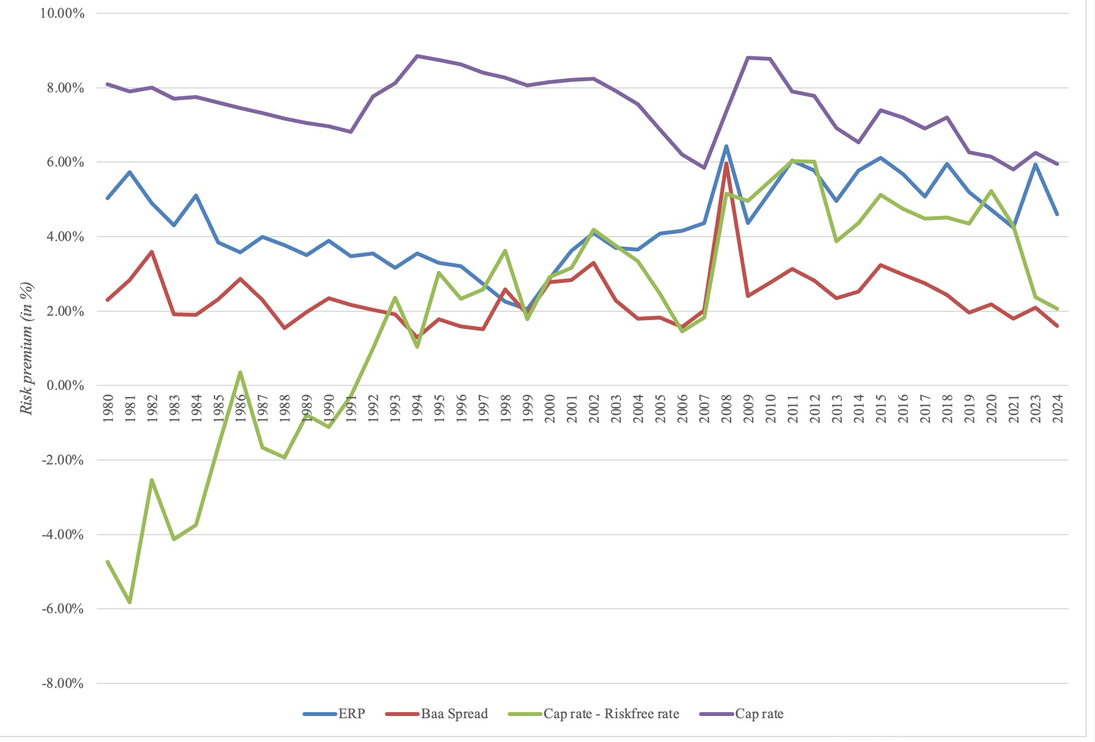
CHANGE COMING TO REAL ESTATE?

Slide 18
Real estate: Change is in the wind!
The 20th Century
The 21st Century
Largely untraded & illiquid
Held by individual investors & specialized real estate investors
With high leverage
Low to Moderate Returns
Low Risk
Negatively correlated with financial assets
Inflation protection
More liquid & traded
Institutional investors enter the fray
With continued high leverage
Higher Risk
Positively correlated with financial assets
Return & Inflation Protection -> ?

Slide 19
Real estate in your Portfolio?
As an add-on: Add real estate to a portfolio dominated by financial assets, hoping that it hedges against inflation risk and produces better risk/return tradeoff.
As center of portfolio: Make real estate the center of your portfolio, hoping to take advantage of localized knowledge (of location and regulations) to earn excess returns, relative to other investors.
As a trade: Take advantage of the swings in real estate prices over time, hoping that you have the capacity to detect shifts in mood and momentum, and using leverage to increase your payoff.

Slide 20
The bottom line
It is undeniable that financial assets get most of the attention, when we look at investments as investors, and we generally pay short shrift to investments that fall outside the standard paradigm.
That is starting to change as investors look at alternatives, drawn by two factors:
  Their “low” correlation with financial assets
  The potential for “alpha” in alternative investments
The largest alternative asset class is real estate, and while through much of history it has not been traded, things are starting to change.

