Slide 1
Collectibles and trophy assets
Session 39
Gold, Picassos and Sports Franchises!

Slide 2
Collectibles: definition and challenges!
Investments that do not produce cash derive their value from a combination of factors—a scarcity of supply relative to demand, consumption utility, and individual perceptions, and they are collectibles.
They can only be priced, but even that pricing can be difficult because:
  Finding comparable assets may be difficult to do for some non-cash-flow-producing assets. While there are indices compiled on various unconventional assets, there are substantial differences between the assets within each index.
  The markets for many of these assets are neither liquid nor public. Many transactions are private, and the reported prices are therefore unreliable.
  It is not clear how one controls for differences across assets that are comparable when these differences are not quantitative but relate to perception.

Slide 3
1. artwork
 | Art (%) |  | Stocks (%)
 | Average | Std Deviation | Average | Std Deviation
1875–2010 | 4.63 | 44.30 | 8.02 | 17.79
1910–2010 | 5.67 | 28.40 | 7.79 | 19.09
1960–2010 | 9.49 | 17.10 | 11.10 | 17.06
Correlations
 | Art | S&P 500 | T-bonds
Art | 1.00
S&P 500 | −0.02 | 1.00
T-bonds | −0.13 | 0.06 | 1.00

Slide 4
Challenges with artwork!
The first is that this is not a very liquid market with relatively few transactions. Thus, the most recent sale of a Picasso might have three years ago, and a great deal might have changed in the art market since then.
The second is that no two artworks, even by the same artist, are alike, and there are substantial differences (both in style and value) across different paintings.
The third problem is that there is the very real possibility of forgery and fraud, and much of it can be detected only by an expert eye.
Consequently, the pricing of art and collectibles remains the province of expert appraisers, who in addition to being expensive, are susceptible to market moods, and bubbles and busts are just as common in this market as they are in others.

Slide 5
Lessons for investors in artwork
The first is that while art and collectibles, as a class, may balance a portfolio, you must spend substantially more time acquiring specialized knowledge to be successful with these investments than you would with financial investments.
The second is that you should expect to have much higher transaction costs with investments in art and collectibles, especially at the high end of the market.
The third is that you should collect baseball cards or old master paintings because you enjoy them and not just as investments. The psychological returns that you receive will then compensate for the substandard financial returns that you may well earn.
Finally, the risk of being fooled by fakes and scams is much greater with artwork than with any other asset class, since even experts seem to have trouble distinguishing between the originals and copies.

Slide 6
2. gold
Gold has been valued as precious by civilizations going back millennia, with evidence of usage in the form of coins going back to the Lydian civilization, located in Turkey in 600 BC, with the Greeks and the Romans following.
Issuers (governments and kingdom) of fiat currencies tied them to gold to get skeptical populaces to hold them. In the nineteenth century, this linkage was formalized in the gold standards, where paper currency issuance was backed by holdings in gold, with paper money convertible into gold.
In the second half of the nineteenth century, the gold standard became the base for most major currencies, but two events in the early twentieth century put it to the test.
  The first was the First World War, governments in need of money to fund their armies found their hands tied by the constraints of gold, and many were forced to abandon convertibility.
  The United States stayed with the gold standard into the Great Depression, with some economists blaming the Fed’s actions trying to defend it for worsening the economic collapse.
After the Second World War, the United States emerged as the economic superpower, and with the Bretton-Woods agreement, the US dollar took the place of gold at the center of the global monetary system, with the dollar convertible to gold at a fixed price.

Slide 7
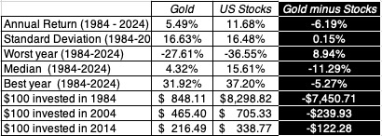
Historical returns

Slide 8
Assessing Gold
It is an inefficient currency, and while there are undoubtedly transactions where gold coins have been used as tender, difficulties associated with checking authenticity, security and breaking down into small units have limited its use through history.
It can be used as a commodity, as is the case when it is used to make jewelry or statues (or in tooth fillings), but even when used in this context, it is often held more for its value as a collectible than for aesthetic reasons.
It is as a collectible that gold has stood out, with governments, banks and individuals attaching value to it over time.

Slide 9
Is it a good collectible?
Scarcity: At the start of 2025, there were approximately 244,000 metric tons of gold in the world, held in a variety of forms (jewelry, gold bars & coins etc.).
  While gold production in 2024 amounted added 3,000 tons to this quantity, it is estimated that that there about 60,000 metric tons of gold that are still in reserves.
  That puts it in a sweet spot between elements like platinum that are too scarce (about 10,000 metric tons) to be widely held, and more difficult to extract, and elements that are too plentiful to hold their value.
Durability: For a collectible to hold its value, it has to be durable, and one of the reasons that gold acquired its collectible status is because it is so chemically stable, malleable and does not oxidize or corrode.
Desirability: There is something about gold that exerts a hold on human beings. From the Greek myth of Midas, the king whose touch turned everything to gold, to the legend of El Dorado, a city made of gold, that led the Spanish to cross the ocean to seek it out in South America, gold has driven narratives and altered history.

Slide 10
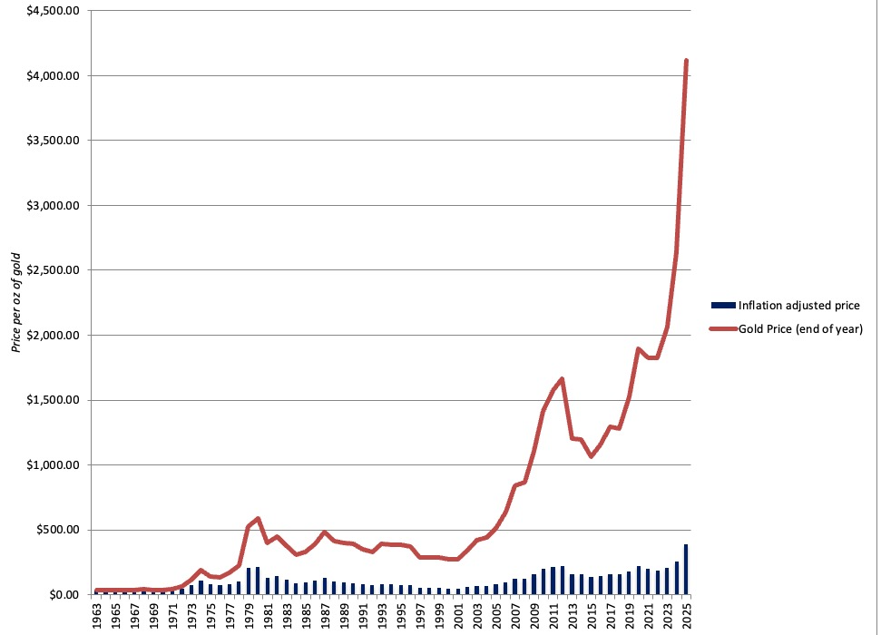
Gold Prices: From 1963 to 2025

Slide 11
Drivers of Gold Prices
There is an alternate route that can be used to estimate the "fundamental" value of a commodity by gauging the demand for the commodity (based on its uses) and the supply.
While that may work, at least in principle, for industrial commodities, it is tough to put into practice with precious metals in general, and gold because the demand is not driven primarily by practical uses.
While gold does not have an intrinsic value, there are at least three factors historically that have influenced the price of gold- inflation, fear of crises and real interest rates.

Slide 12
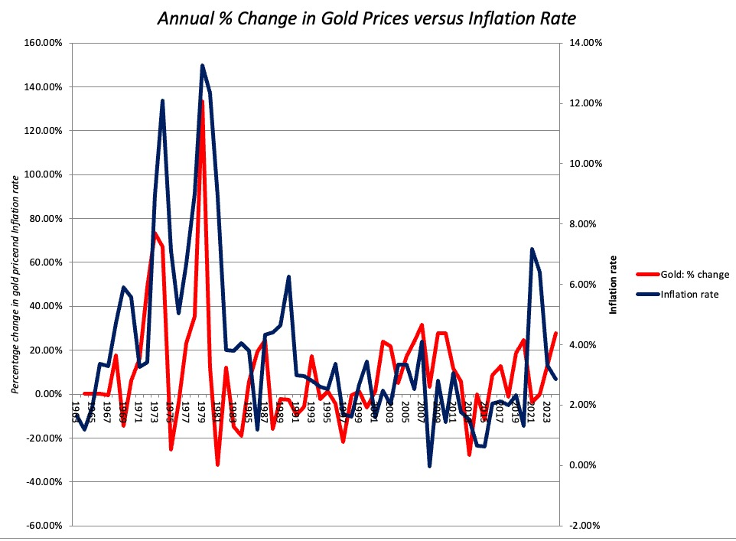
1. Inflation and Gold Prices
% Change in Gold price = -0.06 + 3.92 (Inflation rate) R squared = 18.8%

Slide 13
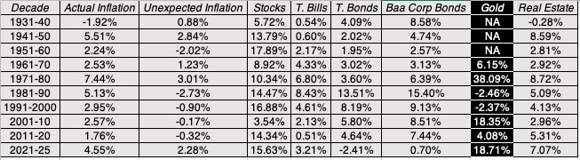
Investment Class Returns: By Decade

Slide 14
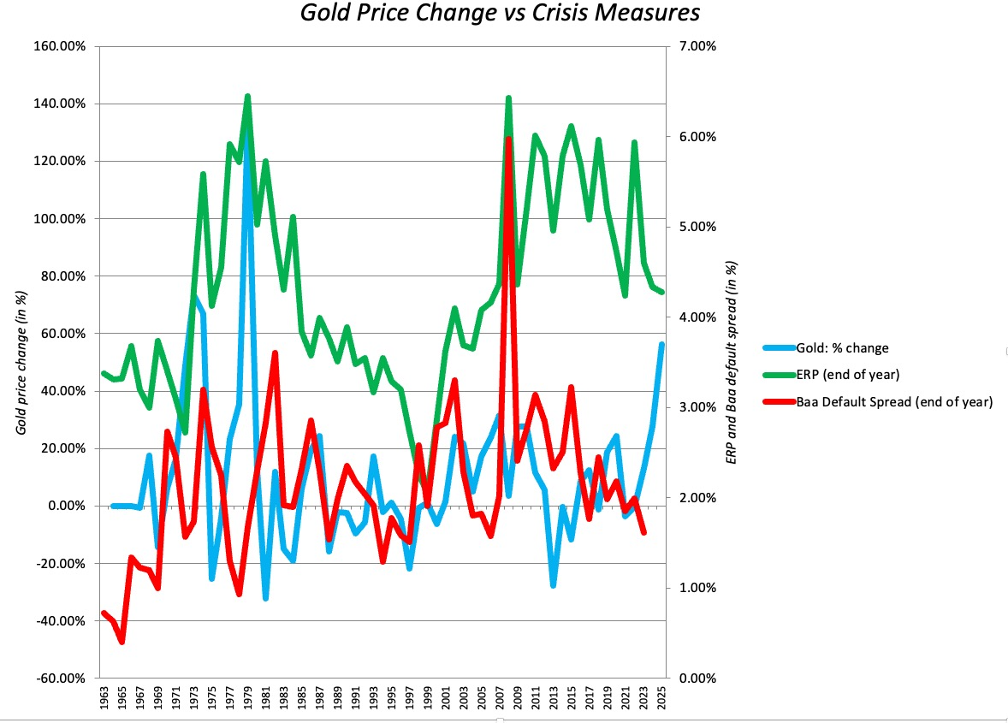
2. Risk and Crises
% Change in Gold Price = -0.13 + 5.21 (ERP) R squared = 5.02%
% Change in Gold Price = 0.13 -1.32 (Baa Rate - T.Bond Rate) R squared = 0.20%

Slide 15
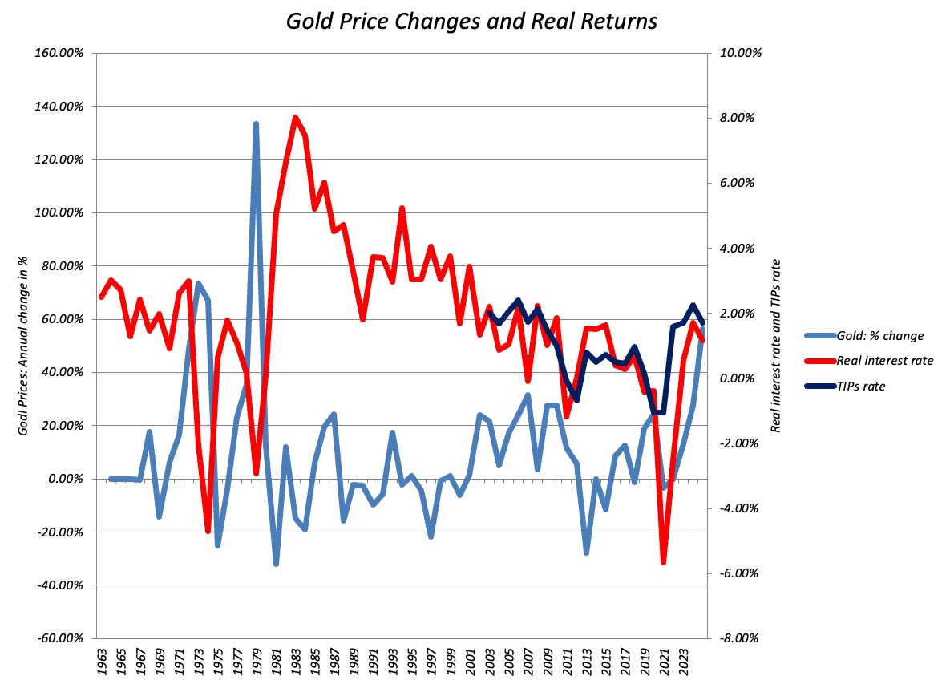
3. Gold and Real Rates
% Change in Gold price = 0.18 – 4.69 (T.Bond Rate - Inflation Rate)
(5.34) (4.20) R Squared = 21.9%

Slide 16
The Bottom Line
Gold is often touted as a hedge against inflation and crises, but the evidence from history is nuanced. With inflation, it is a better hedge against unexpected inflation than expected inflation, and even with unexpected inflation, only for increases that put inflation above normal bounds. In short, it is a hedge against hyper inflation but not just higher-than-usual inflation that falls within normal bounds..
With crises as well, the evidence is mixed, since gold prices are, for the most part, unaffected by movements in equity and bond risk measures that fall within historical bounds but increase during risk events that are uncommon and potentially catastrophic.
Investors who add gold to their portfolios because of the protection it offers should recognize it more akin to buying insurance against extreme events, and more useful if the bulk of their wealth is in financial assets.

Slide 17
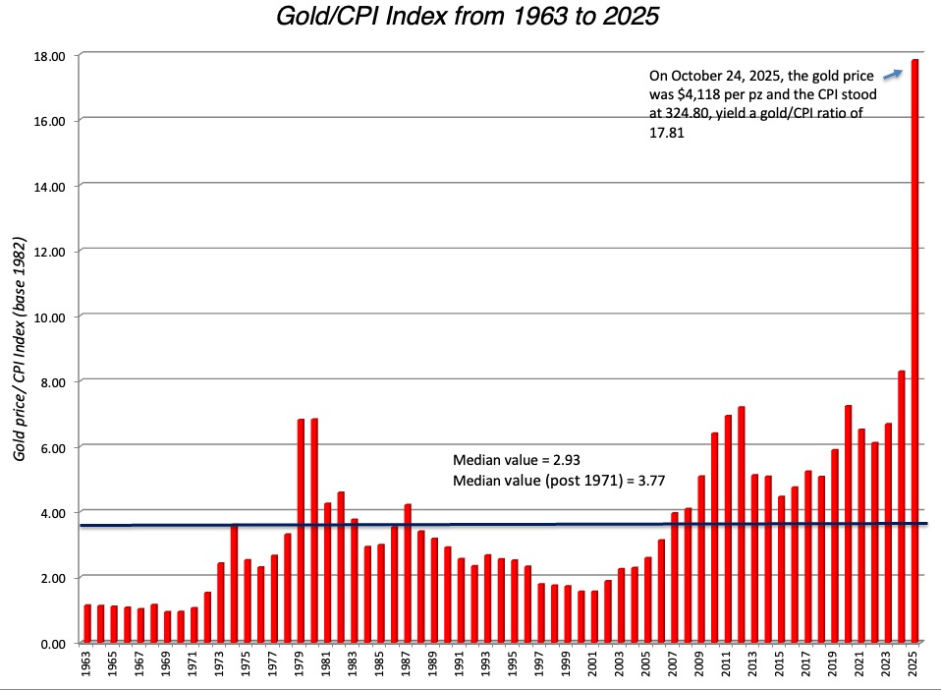
Is Gold overpriced in October 2025? An inflation test!

Slide 18
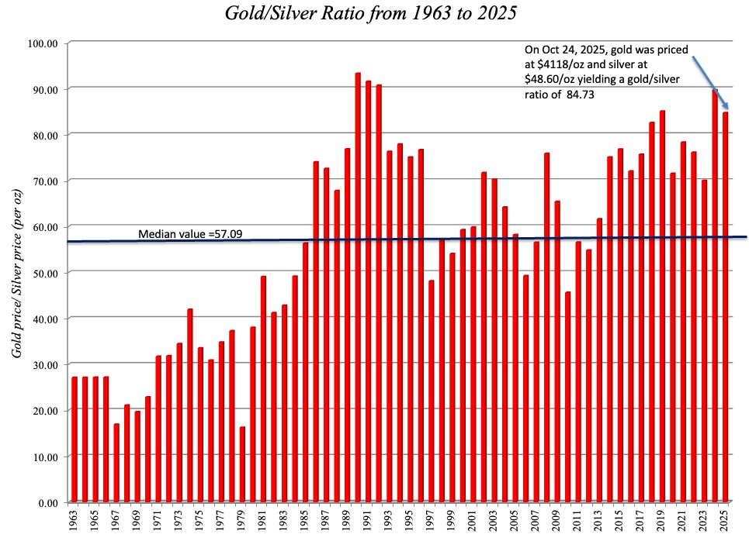
Against Silver in October 2025!

Slide 19
The Bottom Line
If you believe that history is your best guide for the future and that mean reversion will win out, it is undeniable that gold is overpriced against almost every metric it is usually priced against. In fact, you could argue that the rise of gold prices in the last decade is unprecedented since it has not been accompanied by raging inflation or by market crises (though there have been economic crises).
The counter is that using historical data as a guide, gold has been overpriced over the last decade, a period over which its price has increased almost four-fold, from $1060/oz at the end of 2015 to $4,118 on October 24, 2025.
When an investment stays overpriced for that long, it is legitimate to question whether the pricing metric is flawed, and whether there a structural shift has occurred that has shifted the distribution.

Slide 20
Structural Changes
More pathways to buying/holding gold: The rise of Gold exchange traded funds has reduced or removed both constraints allowing more investors entree into the gold market.
Mistrust of central banks: Investments in financial assets (stocks and bonds) are a reflection of the trust in central banks (and government) working to preserve the buying power of the currencies that they issue.
Slippage of the US dollar: The dollar have been under stress for the last decade or more, with the ratings downgrade for the US being only a manifestation of these stresses.
A New Global Order: While the first two factors have been in play for decades, this year has seen unusual turmoil, as tariff threats and economic wars threaten to unravel an economic world order that has governed markets and economies for much of the last century..

Slide 21
Gold’s Place in your Portfolio
Gold as a core investment: There are some investors who have built their portfolios, with gold as a central component, representing a significant portion of their wealth.
Gold as insurance: For investors with the bulk of their portfolios in financial assets (stocks and bonds), gold holdings can help insure their portfolios, at least partially, against inflation and market/economic crises.
Gold as a trade: In trading, the key to winning is timing, buying when prices are low and selling when they are high, and there are some who make their money on gold by timing its ups and downs well.
Gold as a signal: There are many investors who have no desire or or are averse to holding gold in their portfolios, but use gold prices as signals of either hyperinflation or economic catastrophes to structure their portfolios.

Slide 22
1. Core Investment
Trade off: As we saw in the table of historical returns earlier, investing in gold alone or primarily would have yielded much lower annual returns, with higher standard deviation, than investing in stocks.
The Draw: For investors who have a deep attachment to gold combined with a distrust of financial assets, governments and central banks, the net effect of holding a portfolio dominated by gold is that it improves their odds of passing the sleep test, i.e., you don't lose sleep wondering how your portfolio is doing.

Slide 23
2. Insurance
Trade off: Gold has been only a weak hedge against inflation and market crises that fall within normal bounds, but has done much better as a edge against hyperinflation and catastrophic market/economic risks. Adding gold to a financial asset dominated portfolio can provide insurance against the latter, but only if held in large enough quantity to make a difference.
The draw: All investors should be concerned about catastrophic risks, but it is undeniable that this concern varies across investors, with older and more risk averse investors more inclined to have that concern. It is also true that worries about catastrophes vary over time, increasing across investors in troubled times.

Slide 24
3. Trade
Trade off: Getting the timing right in trading is easier said that done. While the peaks and bottoms of gold prices are easy to pinpoint in hindsight, it is worth remembering that many investors who became rich riding the gold price boom from 1977-1979 lost it all in next five years.
The draw: Trading is a pricing game, and since price is determined more by mood and momentum, success in gold trading comes down to detecting momentum shifts before they occur, and trading on that basis. For some gold traders, this capacity may come from examining charts on gold prices and volume, and for others, it may be in reading the macroeconomic tealeaves, especially on inflation.

Slide 25
4. Signal
Trade off: The allure of gold as a signal of inflation and market crises comes from history, where gold prices have tended to rise during periods of high inflation and economic uncertainty. Much of the relationship, though, is contemporaneous, i.e,, gold prices rise in periods when inflation is high and risks surge, and there is only weak evidence of gold prices being a leading indicator of future changes.
The draw: If gold prices rising is a signal that inflation will be higher than expected in the future, you could alter your asset allocation, shifting money from stocks and long terms bonds to short term bills and commercial paper, or even your asset selection, moving money from companies that have little pricing power and significant operating risk to companies with substantial pricing power and predictable earnings streams.

Slide 26
III. Trophy assets
Emotional appeal overwhelms financial characteristics. The key to a trophy asset is that the core of its attraction, to potential buyers or investors, lies less in business models and cash flows and more in the emotional appeal it has to buyers. That appeal may be only to a subset of individuals, but these buyers want to own the asset more for the emotional dividends, not the cashflows.
It is unique. Trophy assets pack a punch because they are unique, insofar as they cannot be replicated by someone, even if that someone has substantial financial resources.
It is scarce. For trophy assets to command a pricing that is significantly higher than value, they must be scarce.
It is bought and held for nonfinancial reasons. If trophy assets are opened for bidding, the winning bidder will almost always be an individual or entity that is buying the asset more for its history or provenance, not its financial characteristics.

Slide 27
Sports franchises as trophy assets
When the Rooney family bought the Pittsburg Steelers, now a storied franchise in the most highly priced sports league (NFL) is 1932 for $2,500, it was very likely that they were buying it as a business, hoping to generate enough in ticket sales to cover their costs and earn a profit.
In fact, you can still view the Steelers as a business, and value them as such, but as we will argue in this section that number will bear little resemblance to the $4 billion pricing that Forbes attached to the team.
In fact, sports franchises across the world have already become or are increasingly on the pathway to becoming trophy assets.

Slide 28
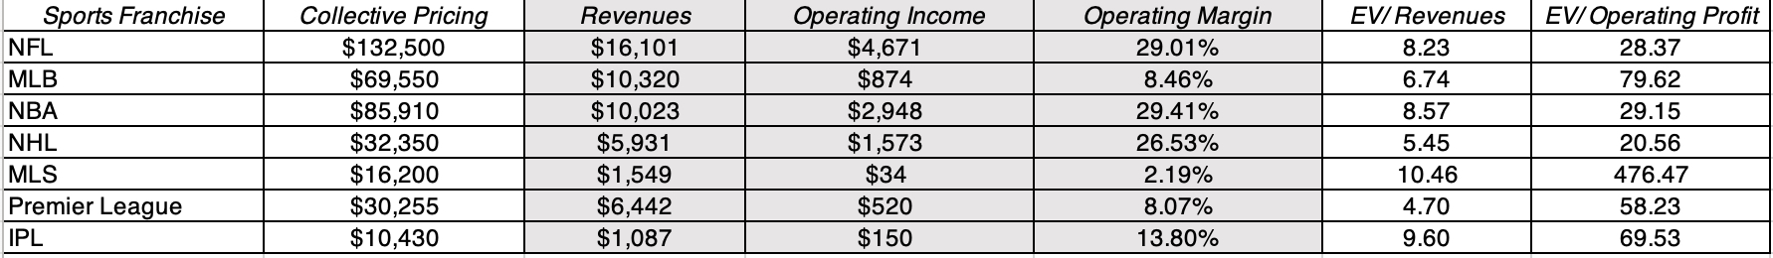
Prices disconnect from financials

Slide 29
Rich people’s toys?
Team | Owner | Wealth (Billions) | Year Bought | Business Background
Indiana Pacers | Herb Simon | $2.80 | 1983 | Real estate
Chicago Bulls | Jerry Reinsdorf | $1.50 | 1985 | Real estate
Portland Trailblazers | Paul Allen (family) | $20.30 | 1988 | Microsoft cofounder
Orlando Magic | Richard DeVos | $5.40 | 1991 | Amway co-founder
San Antoni Spurs | Peter Holt | $0.20 | 1993 | Tractor dealership
Minnesota Timberwolves | Glen Taylor | $2.50 | 1994 | Taylor Corporation owner
New York Knicks | James Dolan | $2.00 | 1994 | Cablevision (founder’s son)
Miami Heat | Mickey Arison | $5.90 | 1995 | Carnival Corp (founder’s son)
LA Lakers | Phillip Anschutz | $10.10 | 1998 | Oil, railroad, telecom, entertainment
Toronto Raptors | Larry Tanenbaum | $1.50 | 1998 | Construction and broadcasting
Denver Nuggets | Stanley Kroenke | $8.30 | 2000 | Real estate
Dallas Mavericks | Mark Cuban | $4.20 | 2000 | Company founder and venture capital
Boston Celtics | Wyc Grousbeck | $0.40 | 2002 | Venture capital
Cleveland Cavaliers | Dan Gilbert | $44.80 | 2005 | Quicken founder
Oklahoma City Thunder | Clay Bennett | $0.40 | 2006 | Media (inheritance)
Utah Jazz | Gail Miller | $1.90 | 2009 | Car dealerships
Charlotte Hornets | Michael Jordan | $1.60 | 2010 | Basketball player (and legend)
Washington Wizards | Theodore Leonsis | $1.40 | 2010 | Media and entertainment
Golden State Warriors | Joe Lacob | $1.20 | 2010 | Venture capital
Detroit Pistons | Tom Gores | $5.70 | 2011 | Private equity (Platinum Equity)
Philadelphia 76ers | Joshua Harris | $4.60 | 2011 | Private equity (Apollo Global)
Memphis Grizzliers | Robert Pera | $14.10 | 2012 | Ubiquiti founder
Sacramento Kings | Vivek Ranadive | $0.70 | 2013 | Software
LA Clippers | Steve Ballmer | $75.60 | 2014 | Microsoft CEO (and employee #30)
Milwaukee Bucks | Marc Lasry | $1.80 | 2014 | Private equity
Phoenix Suns | Robert Sarver | $0.40 | 2014 | Banking and real estate
Atlanta Hawks | Tony Ressler | $3.90 | 2015 | Private equity and venture capital
Houston Rockets | Tilman Fertitta | $4.10 | 2017 | Restaurant and hotel owner
New Orleans Pelicans | Gayle Benson | $3.30 | 2018 | Car dealerships and banks
Brooklyn Nets | Joseph Tsai | $14.20 | 2019 | Alibaba cofounder

Slide 30
Are they for you?
If you are making a play for a sports franchise in an established league with lucrative media contracts, you will need to be very wealthy to even enter the game, since teams are likely to be priced in hundreds of millions or even billions of dollars.
If you do decide to sell your investment, you should recognize that the sports franchise market is an illiquid one, not only because of the price tag but also because transactions may need franchise approval.
·There is an alternative, albeit risky, path to consider, if you do not have the wealth to play in the big leagues. You could invest in a professional team in an up-and-coming or lightly monetized sports (pickleball, track and field, pickleball) and hope that sport catches on.

Slide 31
The Bottom Line
Collectibles, as an investment class, come with lots of limitations. They have no cash flows, while you hold them, are often illiquid, and can be difficult to authenticate.
That said, they are also an investment class, where you can gain a differential advantage by researching and understanding investments better than the “typical” investor, and gain emotional dividends from holding them.
You can hold collectibles as a hedge on a “mostly financial asset” portfolio, make it the center of your portfolio or trade it.

