Slide 1
Understanding Risk III: The risk in stocks
The Risk in Equities…

Slide 2
The Risk in Equity
An equity investment in a business (private or public) entitles you to residual earnings and cash flows. In other words, you are not promised an interest rate but earn whatever is left over after you pay off other investors.
Investing in equity in a business therefore exposes you to more risk than lending money or buying bonds in that same business.
If you are investing in equity, you should demand a higher expected return to compensate you for that risk. That higher expected return can be, at its most general level, broken down into two parts:
  An equity risk premium that you would demand for investing in equities as an asset class, over and above something riskless.
  A relative risk measure for individual equities that will allow you to differentiate between safer and riskier businesses to invest in.

Slide 3
1. The Price of Equity Risk
Since equities are collectively more risky than bonds, you should expect them to earn a premium over bonds over long periods and you should price in that premium, when you value stocks.
That premium, over and above what you can earn on a risk free investment, is called the equity risk premium.
There are two ways in which investors measure this risk premium:
  Historical premiums look at what stocks have earned over very long time periods in the past, relative to risk free investments.
  Implied premiums back out the premium by looking at what people are paying today for stocks.

Slide 4
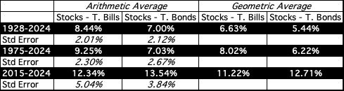
The ubiquitous historical risk premium
The historical premium is the premium that stocks have historically earned over riskless securities.
While the users of historical risk premiums act as if it is a fact (rather than an estimate), it is sensitive to
  How far back you go in history…
  Whether you use T.bill rates or T.Bond rates
  Whether you use geometric or arithmetic averages.
For instance, looking at the US:
Notes:
While everyone uses historical risk premiums, the actual premium in use can vary depending upon
How far back you go in time
Whether you T.Bills or T.Bonds
Whether you use arithmetic or geometric averages
This table was developed using data that is publicly accessible on the S&P 500, treasury bills and 10-year treasury bonds on the Federal Reserve of St. Louis web site.
Dataset: histretSP.xls
Note how much the historical risk premium varies in this table. In fact, any of these numbers, which range from very low or negative values to very high values could be called a historical risk premium.

Slide 5
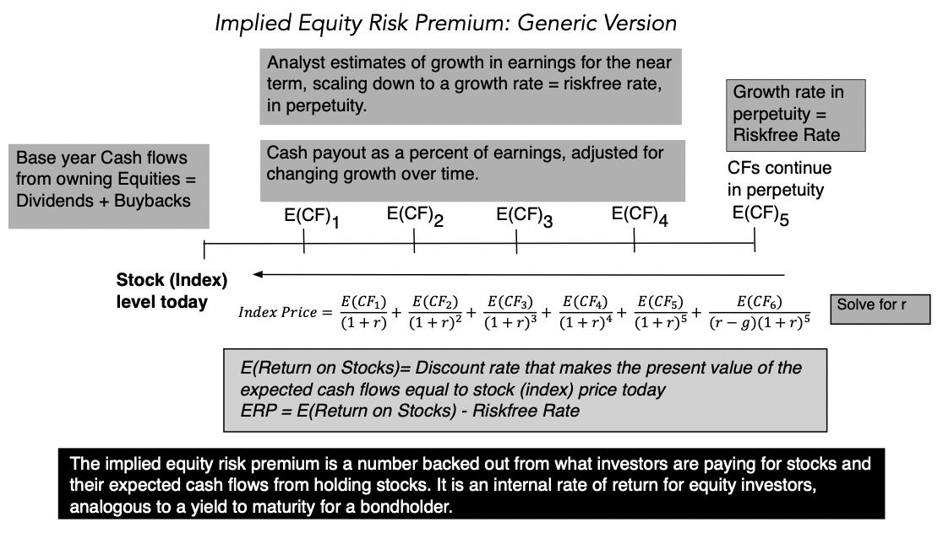
An Implied Equity Risk Premium
Notes:
The key lesson I would take away is that equity risk premiums are unstable and that globalization has made them more unstable. The other is that there seems to be mean reversion in the process – implied premiums, when abnormally high or low, move back towards a longer term average.

Slide 6
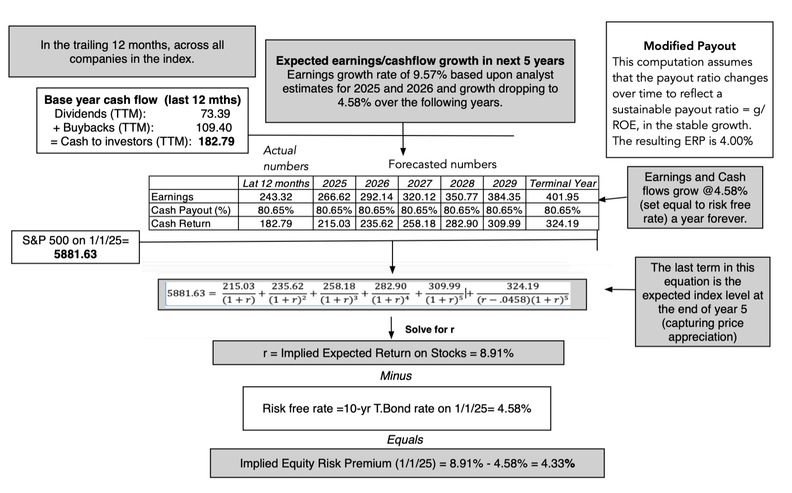
An Updated Estimate: ERP in 2025
Notes:
This is an updated equity risk premium. It is updated every month on my webpage at Damodaran.com. You can get a time series of monthly ERPs going back to 2008 there.

Slide 7
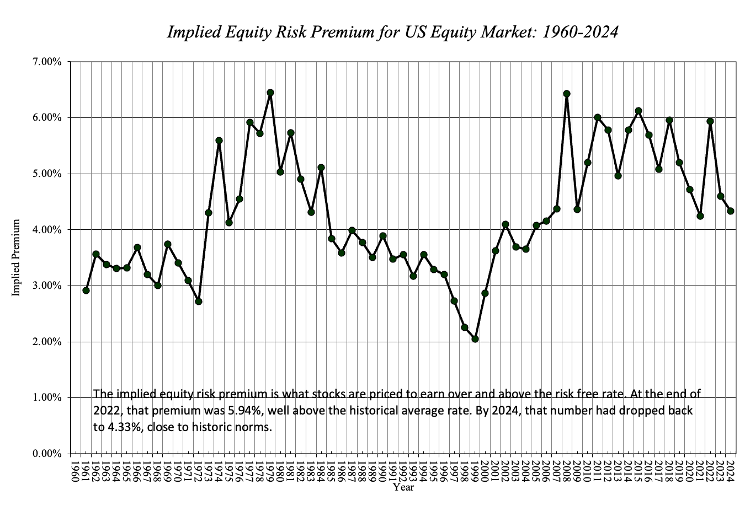
The Implied ERP over time…

Slide 8
II. Relative Risk
Once you have a price for equity risk in the aggregate, you still have to decide how risky an individual stock or group of stocks is, to determine what return you need to make on that stock.
Models that try to measure equity risk vary across investors. Broadly speaking, these risk and return models can be categorized as:
  Theory-based models that begin with an economic (and quantitative) definition of risk and derive risk measures based on that definition.
  Data-based models, where you look at what investments have earned over time, and posit that investments that have earned higher returns should be riskier.
  Alternative models that are based upon either intuitive or qualitative measures of risk.

Slide 9
I. Theory Based Models
Most theory-based models begin by defining risk in terms of variance in actual returns around expected returns.
  They usually measure risk through the eyes of the marginal investor in equity (rather than the average investor).
  The marginal investor is an investor who owns a large portion of the equity and trades frequently.

Slide 10
a. The Capital Asset Pricing Model
Building Blocks
We live in a mean variance world, trading expected returns (good) for standard deviation (bad).
There are no transactions costs. You can trade freely, without brokerage costs or bid-ask spreads.
There is no private information, i.e., we all share the same information set.
All the non-diversifiable risk in the market can be captured with one market risk factor.
Implications
There is no reason to stop diversifying. We all hold every traded asset in the market (market portfolio) and vary only in how much we put into it.
The risk of an asset becomes the risk it adds to the market portfolio.
That risk can be measured by how it moves with the market (its covariance) and can be measured standardized by dividing by the variance of the market:
  Beta = Covariance_{Asset, Market}/ σ_{Market}²
The expected return for an asset is a function of it’s beta:
Beta = Riskfree Rate + Beta (ERP)

Slide 11
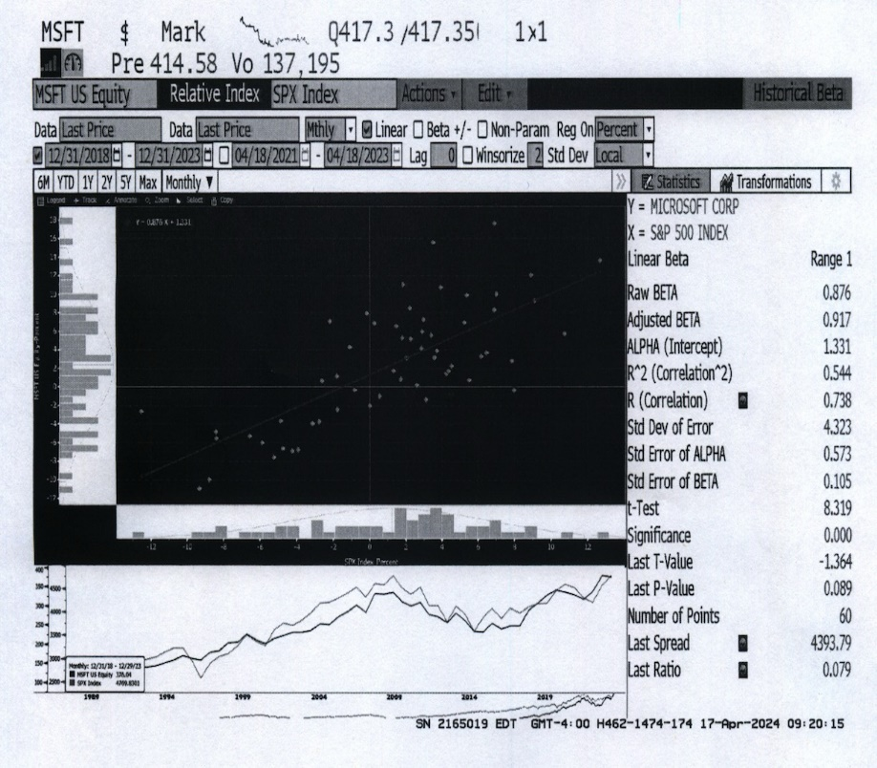
The beta for a company: The standard regression

Slide 12
Myths about beta
Beta is a measure of overall risk: It is not. It measures only exposure to macro or market risk. Thus, volatile investments can have low betas, if the bulk of their risk is specific to the investment.
Beta is a statistical measure: While betas might be estimated from regressions, they are determined by three fundamental decisions that a firm makes: the business it is in, its fixed cost structure and its financial leverage.
Beta is a fact: It is not. It is an estimate, and a single regression beta can have a very high standard error.
Beta measures investment quality: It does not. It measures investment risk. Thus, you can have a great investment with a low beta, an average beta or a high beta.

Slide 13
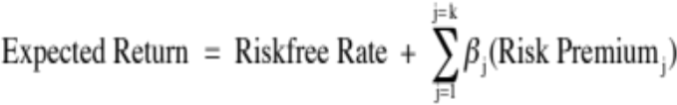
b. The Arbitrage Pricing Model
Building Blocks
We live in a mean variance world, trading expected returns (good) for standard deviation (bad).
There are no transactions costs. You can trade freely, without brokerage costs or bid-ask spreads.
There is no private information, i.e., we all share the same information set.
There are multiple market risk factors, with individual stock exposures varying against each one.
Implications
The risk of an asset comes from its exposure to different market risk factors.
Analyzing past stock returns (factor analysis) should tell us how many market risk factors there are in those returns and individual stock exposures against each one..
The expected return on an asset then can be written as a function of its betas against each market risk factor and the risk premiums associated with each:

Slide 14
C. Multi-factor models
Building Blocks
We live in a mean variance world, trading expected returns (good) for standard deviation (bad).
There are no transactions costs. You can trade freely, without brokerage costs or bid-ask spreads.
There is no private information, i.e., we all share the same information set.
There are multiple macroeconomic risk factors that are the source of market risk.
Implications
The risk of an asset comes from its exposure to macroeconomic risk factors.
Looking at past returns for individual stocks against macro economic variables should yield estimates of betas against each one.
The expected return on an asset then can be written as a function of its betas against each macroeconomic risk factor and the risk premiums associated with each:

Slide 15
II. Data-based models
In data-based models, you look at historical returns on individual investments or stocks.
You assume that if an investment earns higher returns historically, it must be because that investment is riskier. (In effect, you are assuming that markets are right in the long term).
You look for characteristics (factors) shared by companies that explain differences in returns.
You use these characteristics (factors) as risk factors in developing expected return models, again based upon historical data.

Slide 16
Fama-French and the factor zoo!
The Fama/French study of stocks in 1992 represented the opening for factor models. It found that while betas did not explain much of the variation in returns across stocks, two other factors did:
  The market capitalization of the company, with small companies earning higher returns than large companies.
  The price-to-book ratio, measured by dividing the market cap by the book value of equity, with lower price to book stocks earning higher returns.
  The Fama-French study yielded a regression, relating returns to market cap and price to book.
As data on stocks has become richer, the number of factors that claim to explain returns has mushroomed, leading to what some have called the factor zoo.

Slide 17
III. Alternative models of Equity Risk
There are many who find theory-based models of equity risk lacking because
  They look at both upside and downside volatility (it is only the latter that investors don’t like)
  They are based upon market prices rather than fundamentals
  They break risk down into diversifiable and non-diversifiable components, a break down that may have no relevance if you are only minimally diversified.
The alternative models for equity risk can broadly be classified as
  Models that are based upon accounting statements
  Proxy models (where something else stands in for risk)
  Market implied measures of risk
  Risk adjusted earnings/ cash flows

Slide 18
a. Accounting based risk measures
Accounting Ratio: You can use an accounting ratio as your measure of risk. Here are some choices:
  Debt risk: If you start with the presumption that companies that are more indebted are riskier than firms that are not, you can use the debt ratio (debt as a percent of overall capital or as a percent of equity) as your risk measure.
  Earnings risk: If you assume that companies with higher earnings are safer than companies with lower earnings, you can use an accounting measure of earnings (earnings as a percent of market capitalization or as a percent of book value of equity) as your risk measure.
Compute an accounting beta: Look at changes in accounting earnings at a firm, relative to accounting earnings for the entire market. Firms that have more stable earnings than the rest of the market or whose earnings movements have nothing to do with the rest of the market will have low accounting betas.

Slide 19
b. Proxy Models
Look at returns on individual stocks over long periods and search for characteristics shared by companies that earn high returns.
This approach was kicked off by Fama and French, who found that low price to book and small market cap stocks earned higher returns than the rest of the market.
In the years since, there have been additional three additional variables that seem to be correlated with returns:
  Earnings momentum: Companies that have reported stronger than expected earnings growth in the past earn higher returns than the rest of the market.
  Price momentum: Returns are higher for stocks that have outperformed markets in recent time periods and lower for stocks that have lagged.
  Liquidity: Stocks that are less liquid (lower trading volume, higher bid-ask spreads) earn higher returns than more liquid stocks.

Slide 20
c. Market Implied risk measures
If you can observe the price of a risky asset, and you can estimate the expected cash flows on that asset, you can back out the market’s implied “required return” for that asset.
With stocks, with we can used expected dividends or cash flows together with the stock price to get an expected return on the stock.
Here is a simple example. Assume that you have a stable dividend paying stock that is trading at $20/share, is expected to pay a dividend of $1/share next year and grow at 3% in perpetuity. You can back out the cost of equity for this company:
Value per share = 20 = 1/ (r - .03)
Implied expected return = r = .08 = 8%
This process becomes more complicated if you use cash flow based models and if there is growth, but the process remains the same.

Slide 21
d. Risk adjusted cash flows
Risk adjusting the cash flows requires more than taking the expected cash flow across all scenarios, good and bad. You have to convert these expected cash flows into certainty equivalent cash flows.
There are two practical approaches to computing certainty equivalent cash flows. .
  In the first, you consider only those cash flows from a business that are "safe" and that you can count on, when you do valuation. If you do so, and you are correct in your assessment, you don't have to risk adjust the cash flows.
  The second variant is an interesting twist on dividends and a throw back to Ben Graham. To the extent that companies are reluctant to cut dividends, once they initiate them, it can be argued that the dividends paid by a company reflects its view of how much of its earnings are certain.

Slide 22
Final thoughts about equity risk
Explicit versus implicit: There are plenty of analysts who steer away from discounted cash flow valuation and use relative valuation (multiples and comparable firms) because they are uncomfortable with measuring risk explicitly. The danger with implicit assumptions is that you can be lulled into a false sense of complacency, even as circumstances change.
Quantitative versus qualitative: Analysts who use conventional risk and return models are accused of being too number oriented and not looking at qualitative factors enough. Perhaps, but the true test of whether you can do valuation is whether you can take stories that you hear about companies and convert them into numbers for the future.
Simple versus complicated: Sometimes, less is more and you get your best assessments when you keep things simple.

