Slide 1
Alternative investing: The Bitcoin/Crypto question
Millennial Gold?
Notes:
Sets the agenda for the class. This is a class that will be focused on the big picture of corporate finance rather than details, theories or models on a piecemeal basis.

Slide 2
The origins of bitcoin
The origin story for Bitcoin matters since it helps us understand both its appeal and its structure. It was born in November 2008, two months into one of the worst financial crises of the last century, with banks and governments viewed as largely responsible for the mess.
Not surprisingly, Bitcoin was built on the presumption that you cannot trust these institutions, and its biggest innovation was the blockchain, designed as a way of crowd-checking transactions and preserving transaction integrity.
I have long described Bitcoin as a currency designed by the paranoid for the paranoid, and I have never meant that as a critique, since in the untrustworthy world that we live in, paranoia is a justifiable posture.

Slide 3
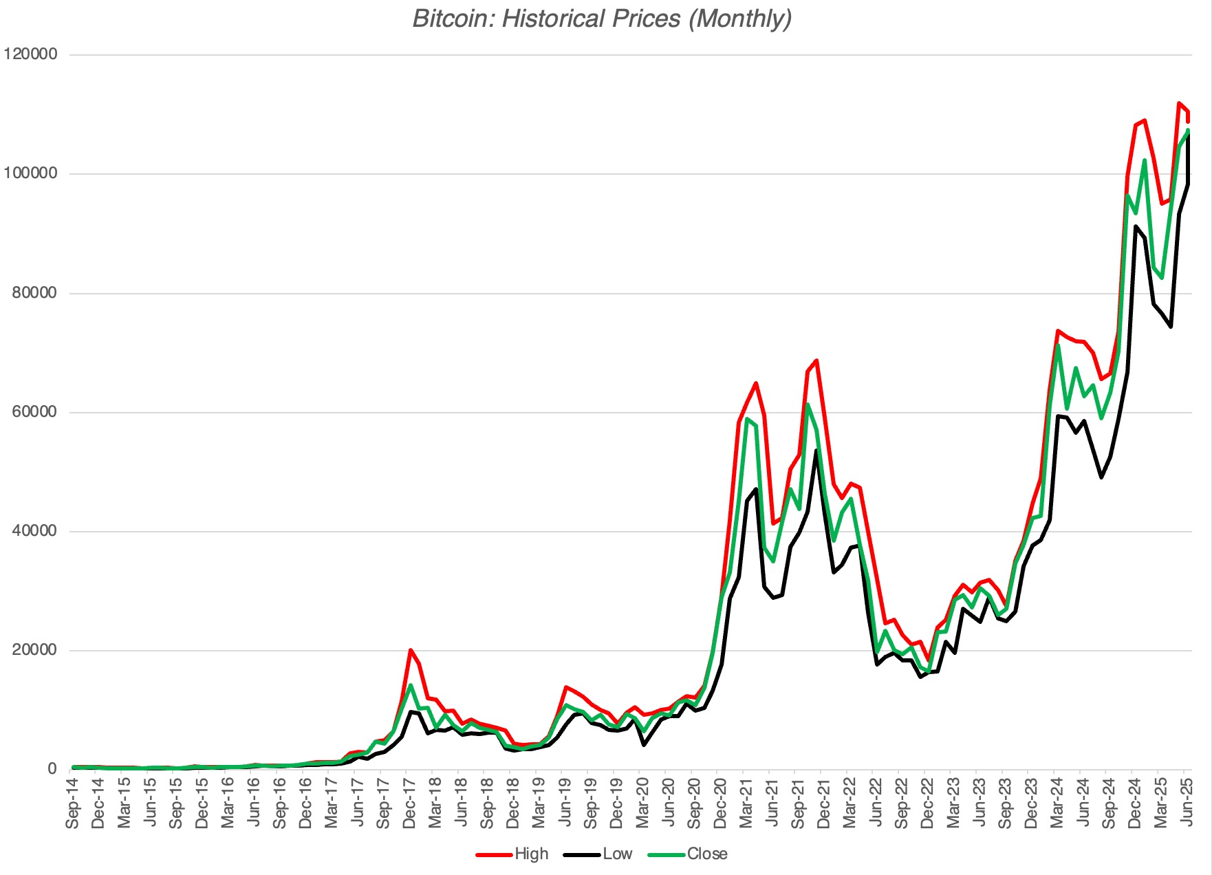
And its price magic!

Slide 4
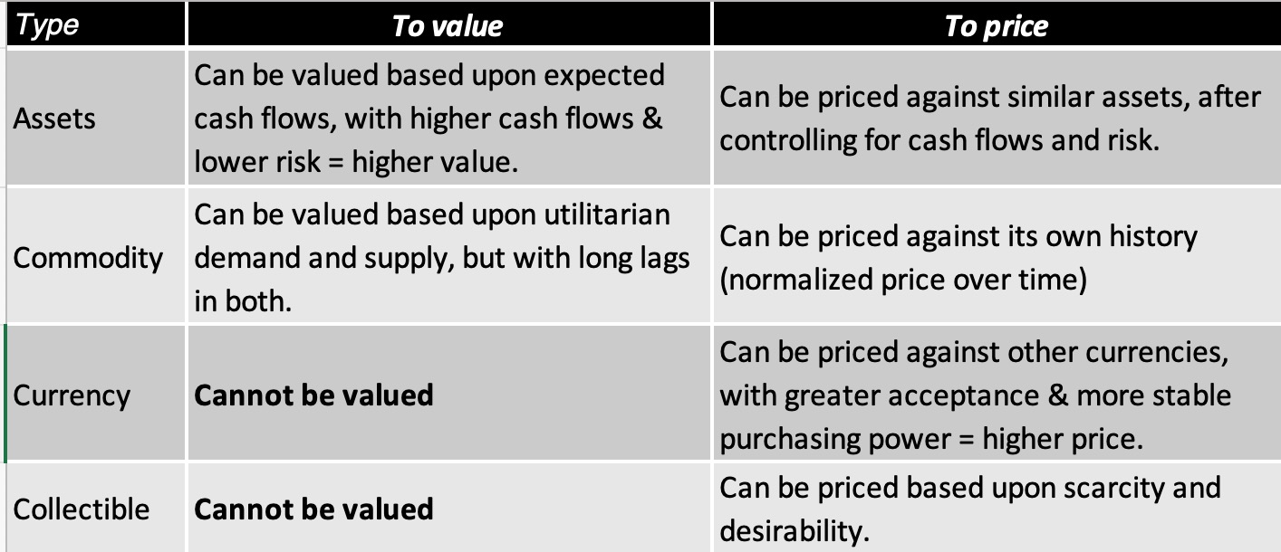
Bitcoin: what is it?

Slide 5
What is Bitcoin?
Bitcoin is not an asset, since it does not generate cash flows standing alone for those who hold it (until you sell it) and it is not a commodity, because it is not raw material that can be used in the production of something useful.
The choice then becomes whether it is a currency or a collectible, with some of its supporters tilting towards the former and some the latter.
Questions about pricing then boil down to whether you think bitcoin is a good currency or collectible.

Slide 6
Reality Checks with Bitcoin
You cannot value Bitcoin, you can only price it: Any one who claims to value Bitcoin either has a very different definition of value than I do or is just making up stuff as he or she goes along.
  If a currency, it will be judged based upon its use as a currency:. If it is accepted widely as a medium of exchange and is stable enough to be a store of value, it should command a high price.
  If it is a collectible, it will be judged on whether it is a good collectible: If it is a good collectible, it could compete with gold, especially among younger investors.
You don't invest in Bitcoin, you trade it: Since you cannot value Bitcoin, you don't have a critical ingredient that you need to be an investor. You can trade Bitcoin and become wealthy doing so, but it is because you are a good trader.

Slide 7
Bitcoin as currency
Almost two decades into its existence, Bitcoin has struggled on the currency front, and while there are pockets where it has gained acceptance, its design had made it inefficient, and its volatility has impeded its adoption as a medium of exchange.
While some of that may reflect institutional barriers to use (legal and regulatory) and the fact that it is a young currency, it is troubling that its use has not increased even as regulatory barriers have fallen, and more people know of its existence.
While some of the inefficiencies may decrease with usage, some are built into the design of the currency:
  Crowd-checking transactions will be more expensive than trust-based transactions
  No healthy currency has a finite limit on its units

Slide 8
Bitcoin as collectible
Bitcoin is scarce: The algorithm-imposed limits on Bitcoin effectively mean that it will be scarce and if it is scarce, it will have value.
  Counter: Bitcoin may have scarcity, but what if you opened the space up to other crypto currencies that resemble bitcoin’s design, i.e., create bitcoin alchemy.
Bitcoin is desirable: Advocates for bitcoin argue that the rising price of bitcoin is an illustration of its desirability.
  Counter: Bitcoin has been around only two decades. Will it be still desirable in two decades.
Notes:
to other crypto current ce

Slide 9
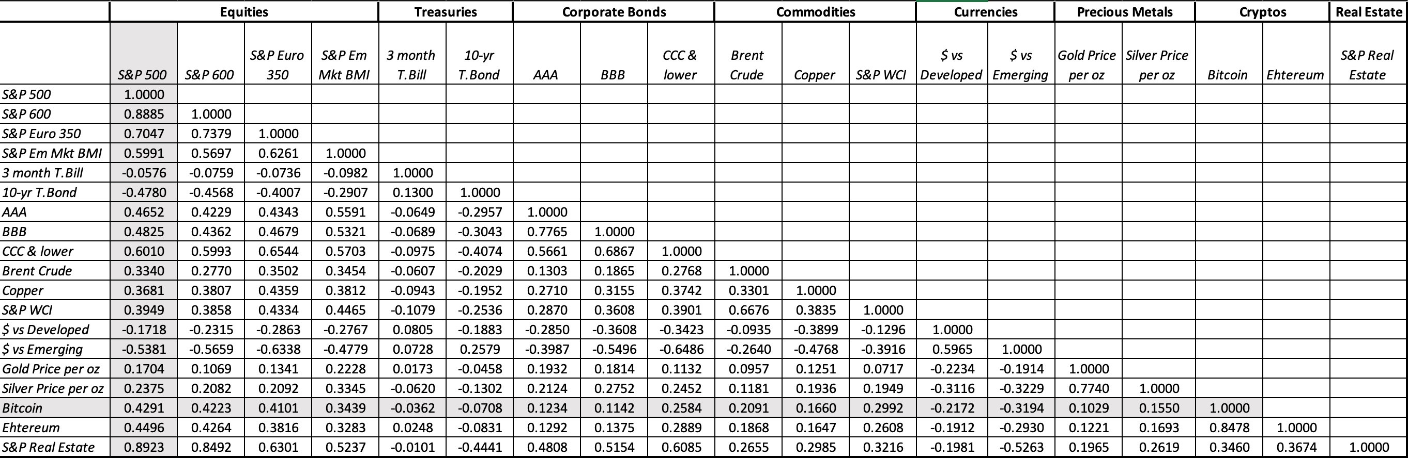
The collectible test!

Slide 10
Other cryptos…
Cryptos can range the spectrum from assets to commodities to collectibles to currencies, and no one size fits all.
  There are crypto tokens that can be asset-like insofar as they are expected to generate cash flows.
  To the extent that a crypto is an ingredient in a process that becomes in wide use, it can take on the characteristics of a commodity. Thus, if blockchains become commonplace in business, and a crypto (say ether) is a better lubricant, you can build a model of charging for its use and value as a commodity.

Slide 11
Bitcoin in your portfolio!
Bitcoin as add on: Like gold, bitcoin can be added to a portfolio of mostly financial assets, with the hope that it will be a hedge against catastrophe, but for this to work, it has to fundamentally change in behavior (and perhaps even investor base).
Bitcoin as a trade: The wild swings in price that have characterized bitcoin make for a trading dream, since if you can play mood and momentum well, you will be enriched.

