Slide 1
alternative investing: The Promise and (uncertain) payoff!
Where is the beef?
Notes:
Sets the agenda for the class. This is a class that will be focused on the big picture of corporate finance rather than details, theories or models on a piecemeal basis.

Slide 2
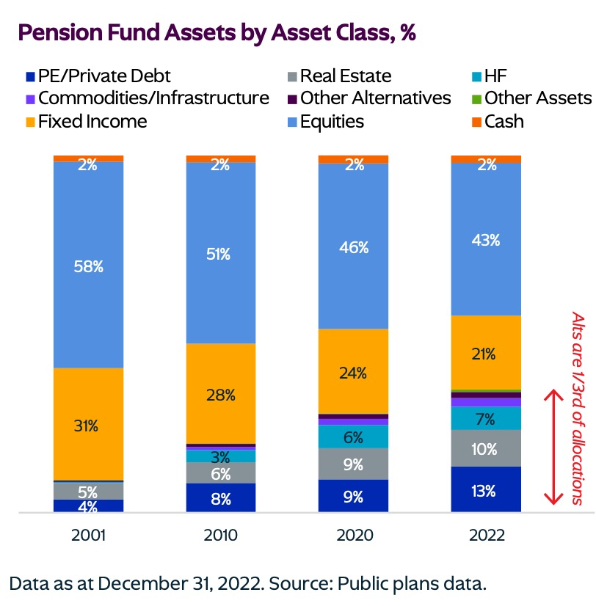
The rise of alternatives…

Slide 3
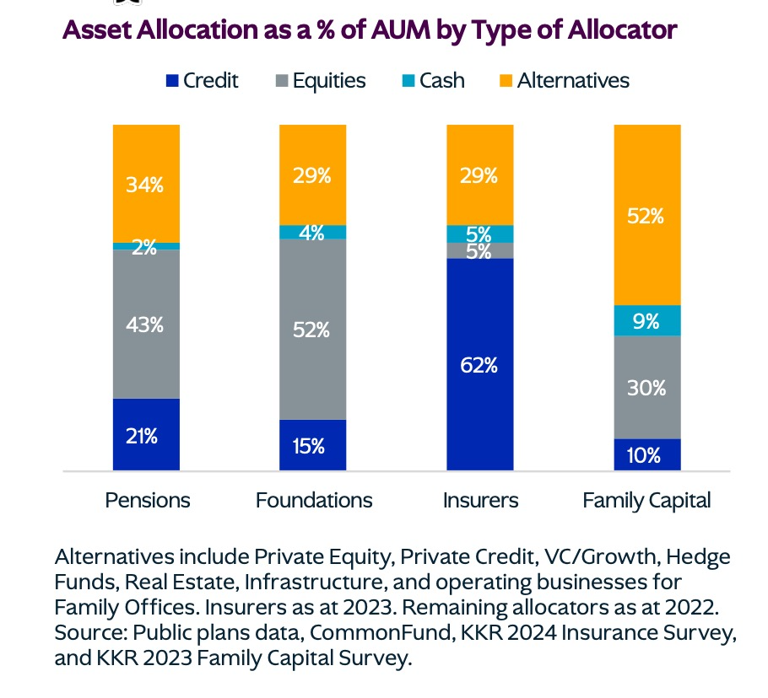
And by fund group…

Slide 4
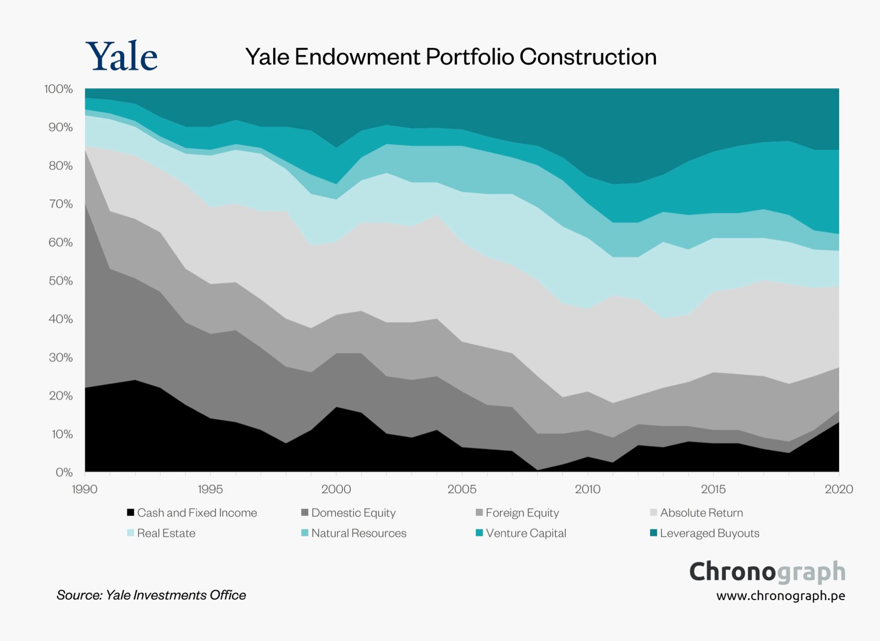
With early adopters celebrated… David Swensen at Yale!

Slide 5
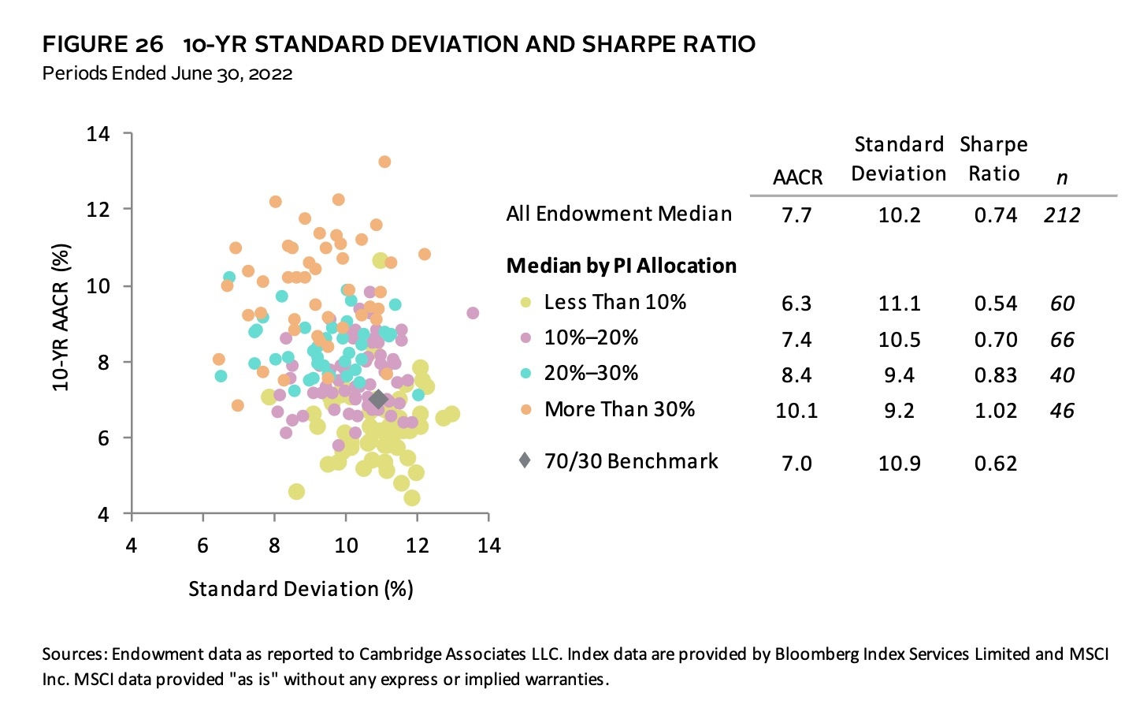
The payoff in practice? Endowment funds…

Slide 6
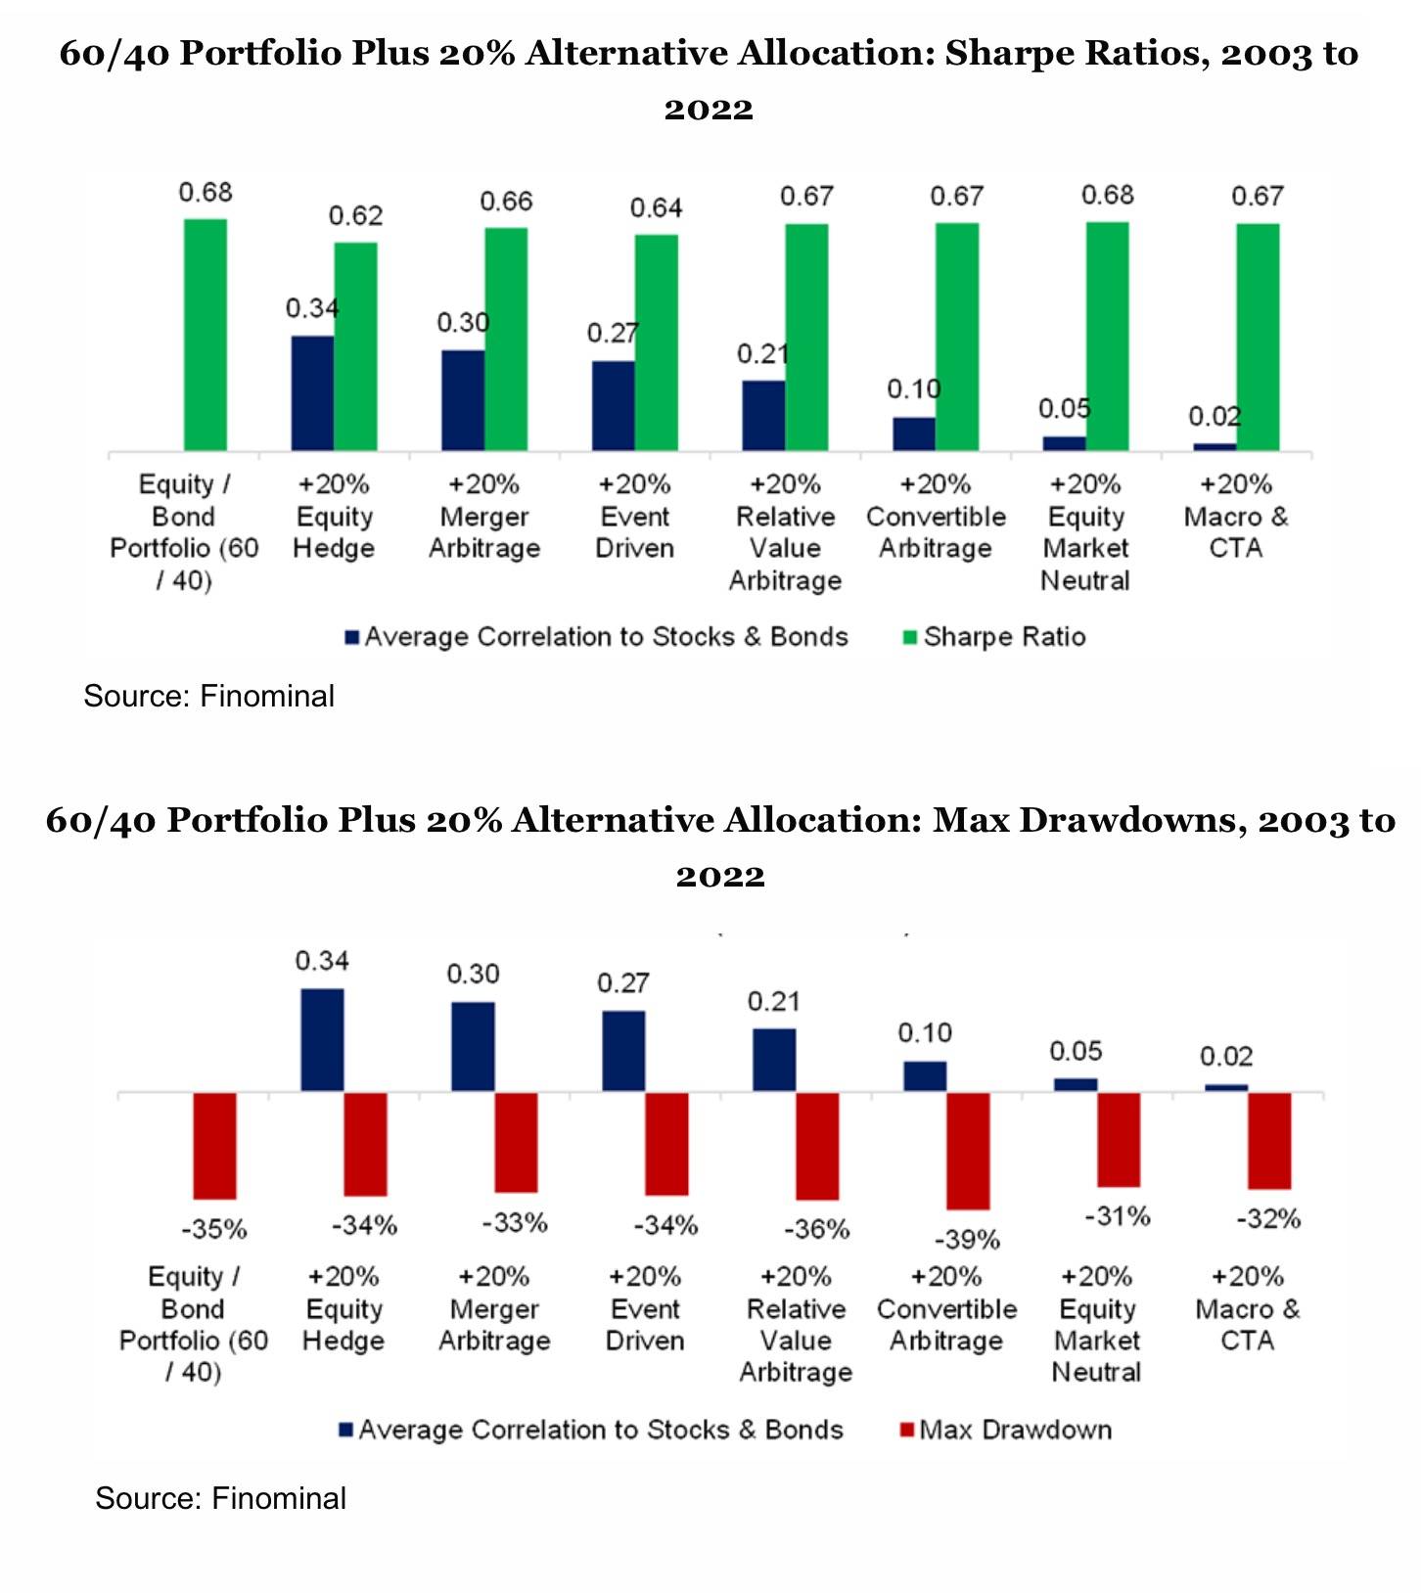
A closer look!

Slide 7
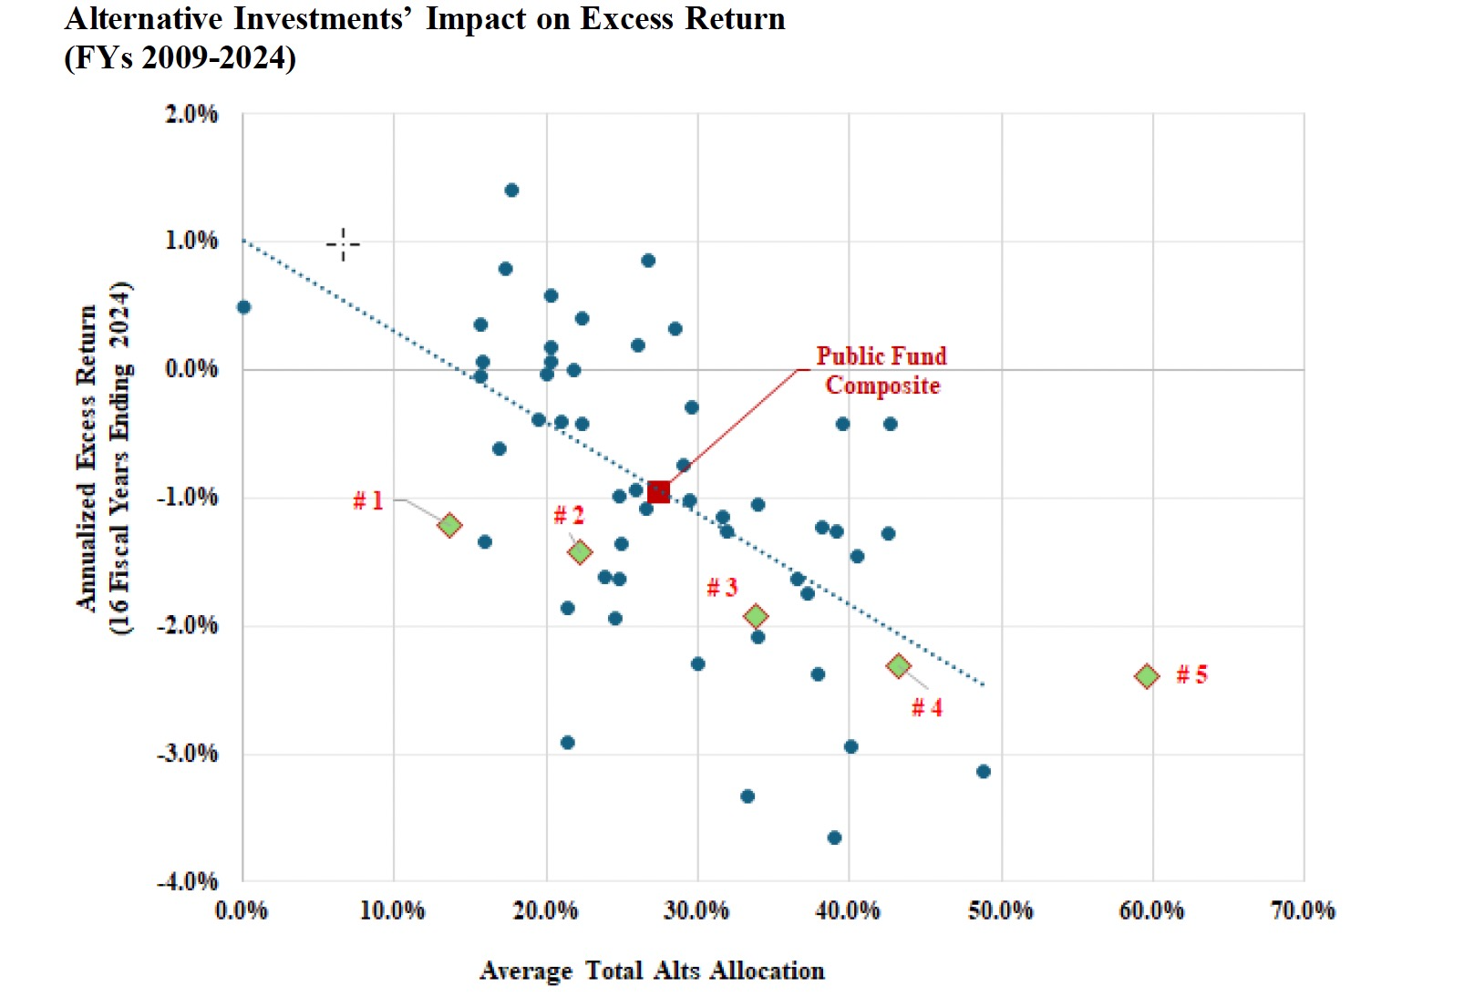
Alternative investing and alphas: The ennis critique

Slide 8
The Bottom line!
While alternative investing advocates will take issue with the Ennis findings, on empirical and statistical bases, even long-term beneficiaries from alternative investing seem to have become more skeptical about its benefits over time.
In a 2018 paper, Fragkiskos, Ryan and Markov noted that among Ivy League endowments, properly adjusting for risk causes any benefits in terms of Sharpe ratios, from adding alternative investments to the mix, to disappear.
In perhaps the most telling sign that the bloom is off the alternative investing rose, Yale's endowment announced its intent to sell of billions of dollars of private equity holdings in June 2025, after years of under performance on its holdings in that investment class.

Slide 9
1. (low) Correlations are understated or misleading
Pricing lags; Unlike publicly traded equities and bonds, where there is an observable market price from current transactions, most private assets are not liquid and the pricing is based upon appraisals. In theory, these appraisers are supposed to mark-to-market, but in practice, the pricing that they attach to private assets lag market changes.
Market crises: While correlations between investment classes are often based upon long periods, and across up and down markets, the truth is that investors care most about risk (and correlations) during crises, and many investment classes that exhibit low correlation during sideways or stable markets can have lose that feature and move in lock step with public markets during crisis.

Slide 10
2. Illiquidity and opacity
Even the strongest advocates for alternative investments accept that they are less liquid than public market investments but argue that for investors with long time horizons and clearly defined cash flow needs that illiquidity should not be a deal breaker.
  The problem with this argument is that much as investors like to believe that they control their time horizons and cash needs, they do not and find their need for liquidity rising during acute market crises or panics.
  The other problem with illiquidity is that it manifests in transactions costs, manifesting both in terms of bid-ask spreads and in price impact that drains from returns.
The other aspect of the private investment market that is mentioned but then glossed over is that they tend to be opaque in terms of governance structure and reporting. Again, that absence of transparency may be ignored in good times but could make bad times worse.
Notes:
,

Slide 11
3. Disappearing alphas…
When alternative investing first became accessible to institutional investors, the presumption was that market-beating opportunities abounded in private markets, and that hedge fund, private equity and venture capital managers brought superior abilities to the investment game.
That may have been true then, but that perception has faded for many reasons.
  First, as the number of funds and money under management in these investment vehicles has increased, the capacity to make easy money has also faded, and in my view, the average venture capital, private equity or hedge fund manager is now no better or worse than the average mutual fund manager.
  Second, the investment game has also become more difficult to win, as the investment world has become flatter, with many of the advantages that fund managers used to extract excess returns dissipating over time.
  Third, the entry of passive investment vehicles like exchange traded funds (ETFS) that can spot and replicate active investors who are beating the market has meant that excess returns, even if present, do not last for long.

Slide 12
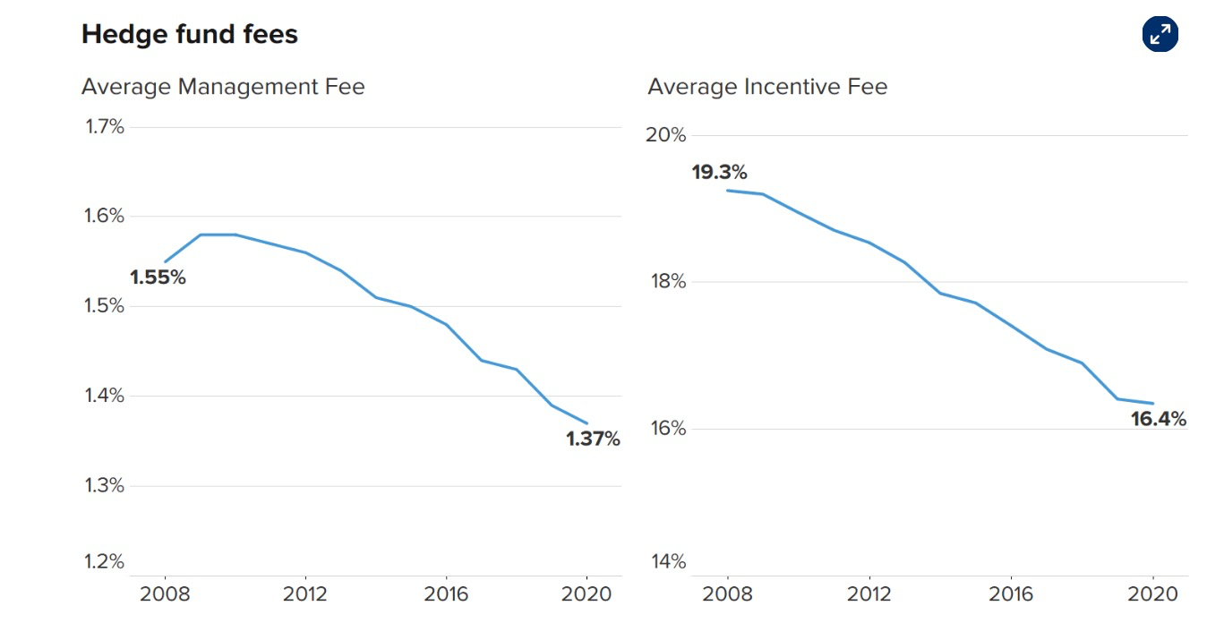
4. The cost effect
Most alternative investments have a management fee, set as a percent of assets under management, and a performance fee, where they get an additional fee, for outperforming a benchmark.
The classic 2 & 20 fee entitles the hedge fund or PE investor to collect 2% of funds under management every year, and 20% of returns over the benchmark. Both have been trending down:

Slide 13
An epitaph for alternative investing? Not necessarily…
Be picky about alternatives: Given that the alpha pitch has lost its heft, it is correlations that should guide investor choices on alternative investments.
Avoid high-cost and exotic vehicles: Investing is a tough enough game to win, without costs, and adding high-cost vehicles makes it even more difficult.
Be realistic about time horizon and liquidity needs: On this front, individual investors need to be honest with themselves about how susceptible they are to panic attacks and peer-group pressure, and institutional investors have to recognize that their time horizon is determined by their clients, and not by their own preferences.
Be wary of correlation matrices and historical alphas: If there is one takeaway from this post, I hope that it is that historical correlations, especially when you have non-traded investments at play, are untrustworthy and that alphas fade over time, and more so when the vehicles that delivered them are sold relentlessly.

